Slide 1
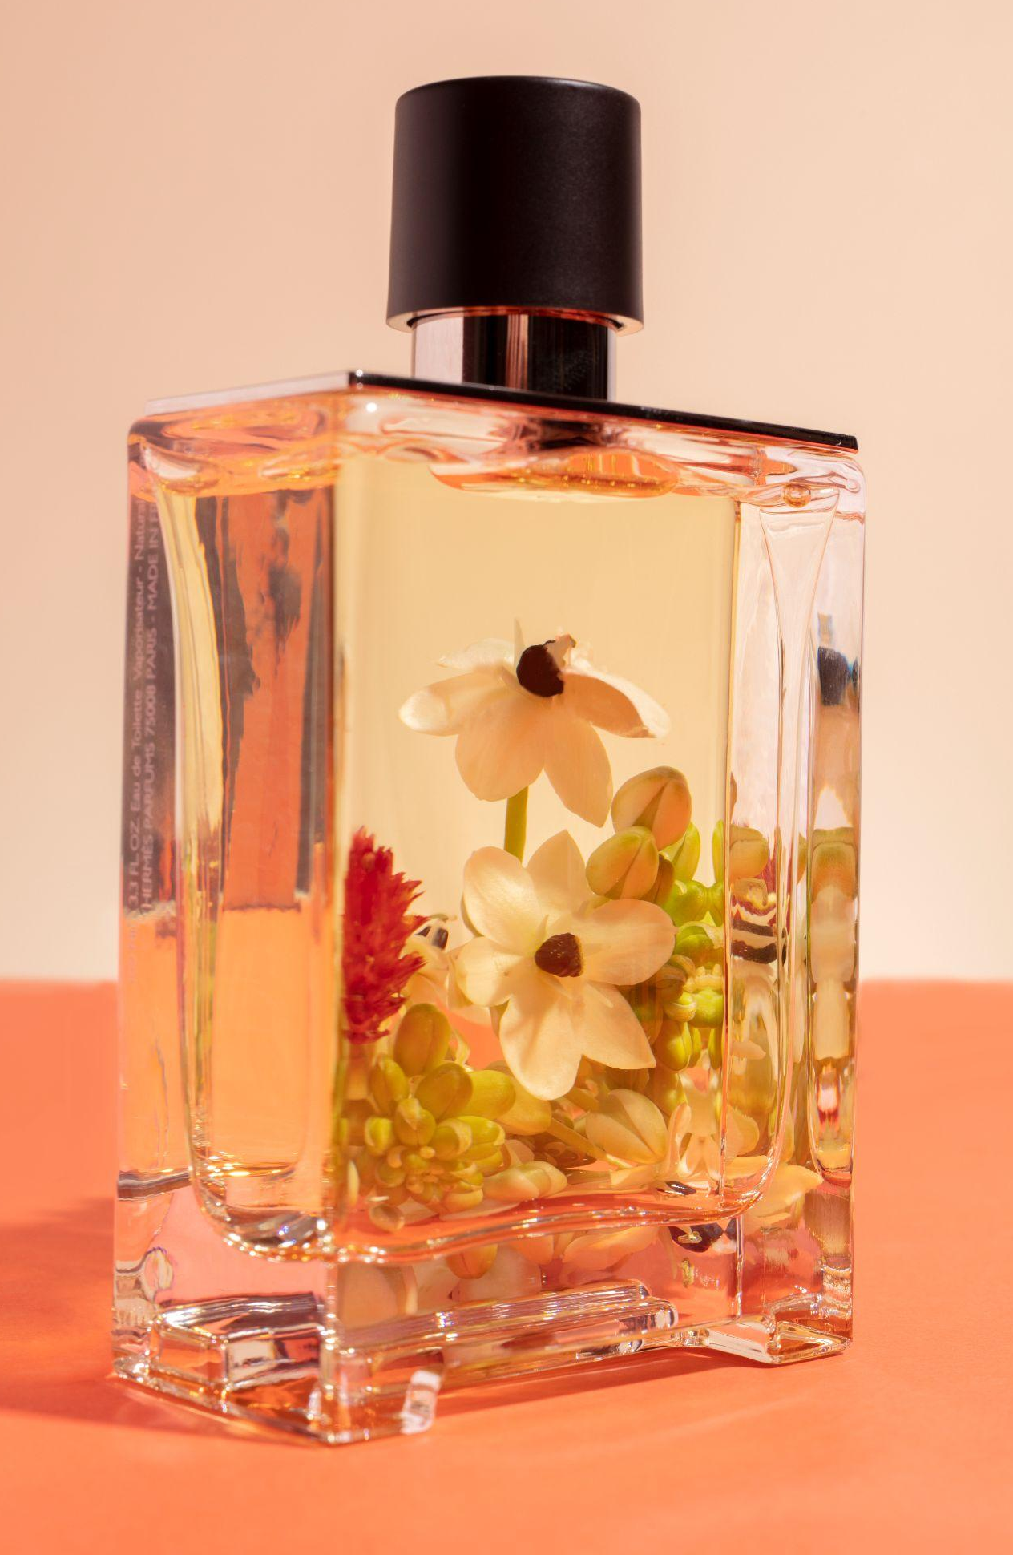
Fragrance Matcher
est. 1987
Taflan Cristina
Toth Cristina
Toth Naomi
Toth Rahela

Slide 2
Why?
Personalization.
Convenience.
Compatibility Testing & Learning.
Community Support.
Eco-Friendly.

Slide 3
Application
Django web framework
Kaggle dataset
Gensim = Generate + Similar
Word2Vec
word embeddings
flat neural network
dog
cat
animal
school
notebook
blackboard

Slide 4
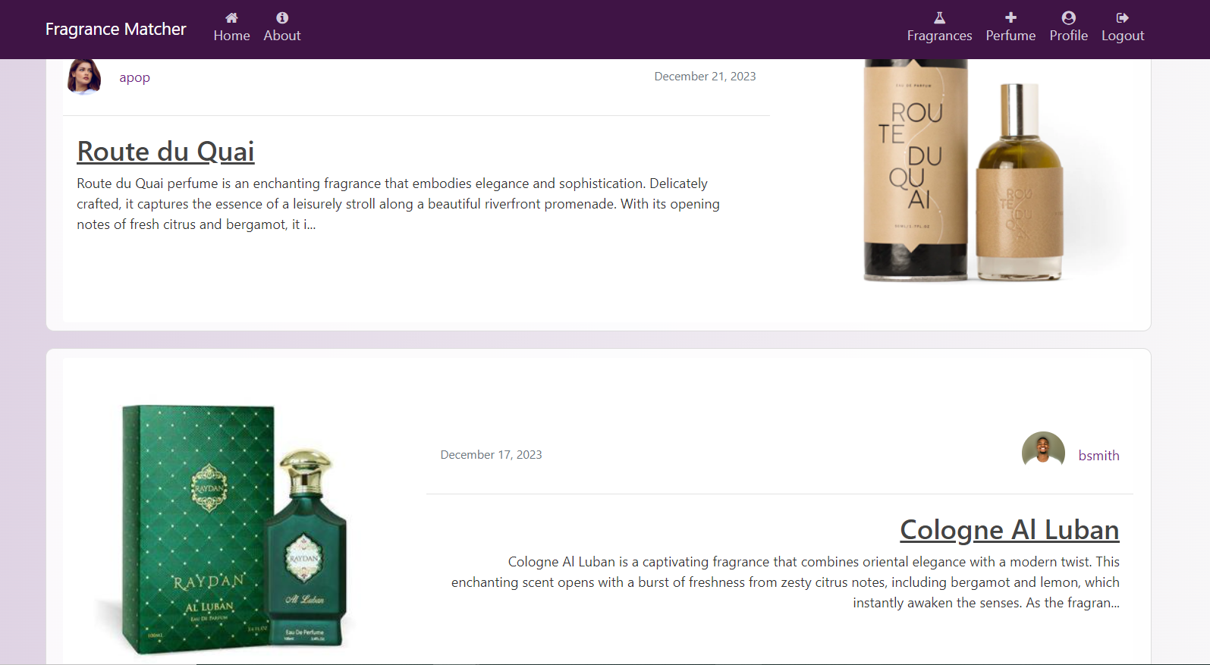
Our website
Try the Fragrance Matcher web application

Slide 5
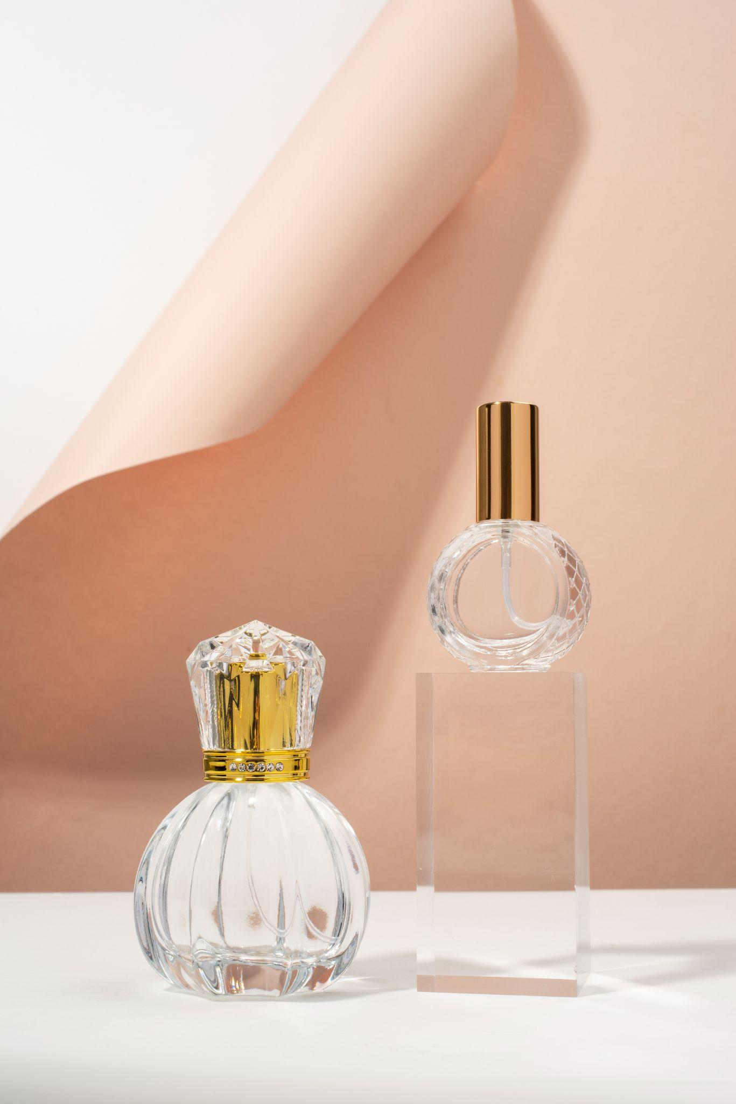
Thank you
Fragrance Matcher

