Slide 1
Controler 1
Controler 2
Ieșire
Audio
Ieșire
Video
Consola NES
CPU + APU
(RP2A03 / RP2A07)
PPU
(RP2C02 / RP2C07)
Cip de securitate
(3193A)
2K RAM
2K V-RAM
Cip de securitate
(3193A)
16K / 32k
PRG ROM
8K CHR ROM
or
8K CHR RAM
8K RAM
Mapper
(opțional)
(opțional)
Cartridge NES

Slide 2
RP2A03 / RP2A07
AD1 <-
1
40
-- +5V
AD2 <-
2
39
-> OUT0
RST ->
3
38
-> OUT1
A00 <-
4
37
-> OUT2
A01 <-
5
36
-> OE1
A02 <-
6
35
-> OE2
A03 <-
7
34
-> R/W
A04 <-
8
33
<- NMI
A05 <-
9
32
<- IRQ
A06 <-
10
31
-> M2
A07 <-
11
30
<- TST
A08 <-
12
29
<- CLK
A09 <-
13
28
<> D0
A10 <-
14
27
<> D1
A11 <-
15
26
<> D2
A12 <-
16
25
<> D3
A13 <-
17
24
<> D4
A14 <-
18
23
<> D5
A15 <-
19
22
<> D6
GND --
20
21
<> D7

Slide 3
RP2C02 / RP2C07
R/W ->
1
40
-- +5V
CPU D0 <>
2
39
-> ALE
CPU D1 <>
3
38
<> PPU AD0
CPU D2 <>
4
37
<> PPU AD1
CPU D3 <>
5
36
<> PPU AD2
CPU D4 <>
6
35
<> PPU AD3
CPU D5 <>
7
34
<> PPU AD4
CPU D6 <>
8
33
<> PPU AD5
CPU D7 <>
9
32
<> PPU AD6
CPU A2 ->
10
31
<> PPU AD7
CPU A1 ->
11
30
-> PPU A8
CPU A0 ->
12
29
-> PPU A9
CS ->
13
28
-> PPU A10
EXT0 <>
14
27
-> PPU A11
EXT1 <>
15
26
-> PPU A12
EXT2 <>
16
25
-> PPU A13
EXT3 <>
17
24
-> RD
CLK ->
18
23
-> WR
INT <-
19
22
<- RST
GND --
20
21
-> VOUT

Slide 4
00
01
02
03
04
05
06
07
08
09
0A
0B
0C
0D
0E
0F
10
11
12
13
14
15
16
17
18
19
1A
1B
1C
1D
1E
1F
20
21
22
23
24
25
26
27
28
29
2A
2B
2C
2D
2E
2F
30
31
32
33
34
35
36
37
38
39
3A
3B
3C
3D
3E
3F

Slide 5
(0,0)
(256,0)
(511,0)
$2000
$2400
(0,240)
(511,240)
$2800
$2C00
(0,479)
(256,479)
(511,479)

Slide 6
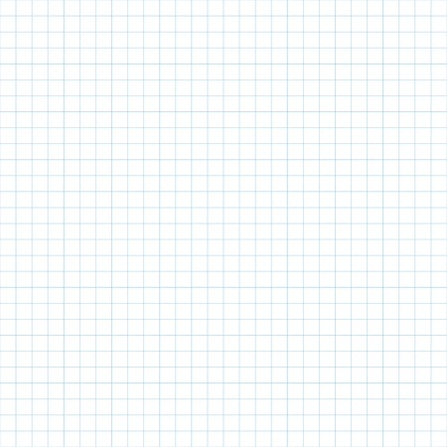
$2000
$2400
$2000
$2400
A
A
A
B
$2800
$2C00
$2800
$2C00
B
B
A
B

Slide 7
$2000
$2400
$2000
$2400
B
B
A
A
$2800
$2C00
$2800
$2C00
B
B
A
A

Slide 8
Sprite-uri cu prioritate mare
Fundal
Sprite-uri cu prioritate joasă
Culoare universală de fundal

Slide 9
Încărcare sprite-uri pentru următoarea linie
Încărcare blocuri de fundal
Așteptare
Așteptare
Afișare linie
linia 0
1 ciclu
256 cicli
64 cicli
16 cicli
4 cicli
Linii vizibile
linia 1
1 ciclu
256 cicli
64 cicli
16 cicli
4 cicli
.........................................................................................................
linia 239
1 ciclu
256 cicli
64 cicli
16 cicli
4 cicli
Generare NMI
linia 240
341 cicli
Vertical blank
.........................................................................................................
linia 261
341 cicli
Horizontal blank

Slide 10
sprite 5
sprite 6
sprite 3
sprite 7
sprite 0
sprite 2
sprite 4
sprite 1
Sprite priority mux
sprite
pixel
background
pixel
Pixel priority mux
universal
background
Transparency mux
pixel
output

Slide 12
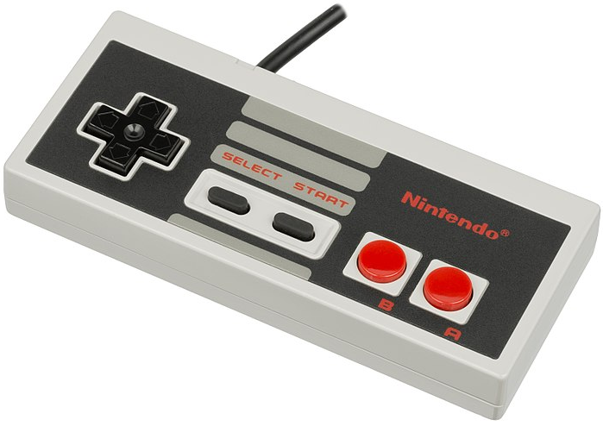

Slide 13
16K
block 0
16K
block 0
16K
block 1
$8000
16K
block 1
$8000
32K CPU
address space
32K CPU
address space
16K
block 2
16K
block 2
$FFFF
$FFFF
16K
block 3
16K
block 3

Slide 14
16byte header
16KB*n PRG memory (n ≥ 1)
8KB*m CHR memory (m ≥ 0)

Slide 15
.....................
.............

