Slide 1
ETHERNET PACKET INSPECTION
IDS solution
Sd. Sg. Maj. ANDREI Marius-Cristian

Slide 2



Intrusion Detection Systems
SNORT
What is an IDS?
Most popular IPS/IDS:
WinPatrol
Security Onion

Slide 3
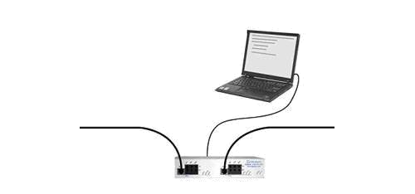
Overview
Target PC
Internet
Local Area Network
IDS System

Slide 4
Unauthorized Traffic Detection System as a Solution
Solution: EPI
+ Fast
+ Easy to use
- Requires hardware

Slide 5
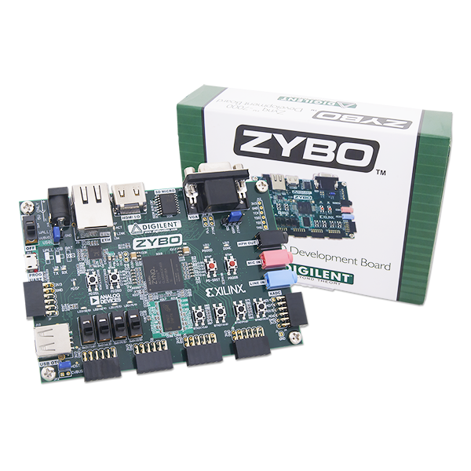

Hardware

Slide 6
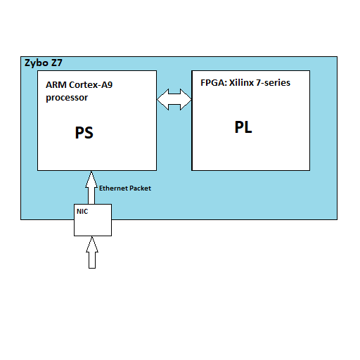
Hardware Design

Slide 7
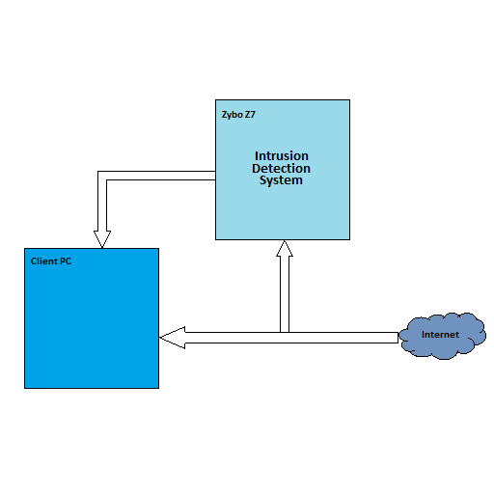
Hardware Design
having passed the simple sanity checks
PREROUTING

Slide 8
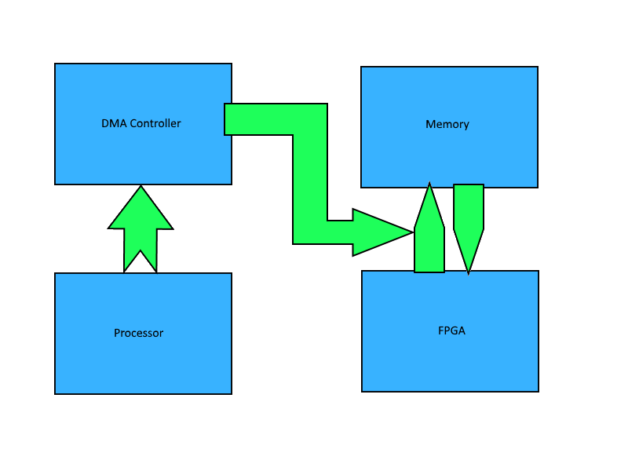
DMA Transfer

Slide 9
Tools
Xilinx Vivado
Design Suite
Linux Kernel
Xilinx
U-Boot
Xilinx

Slide 10
Code
FPGA
- 16 strings patterns
- 2048 bytes packets
- Returns Yes/No
Driver
Controls the FPGA –
Captures Eth Packets -
Uses DMA transfer -
App
- User Friendly
- Tests the Data Flow

Slide 11
Test
Sample Data
Automatic check

Slide 12
Implementation: FPGA
32 bits
FPGA
Returns:
1 – intrusion found
2 – intrusion not found

Slide 13
Implementation: Driver
Speed-Up Test
Packet Log FIFO

Slide 14
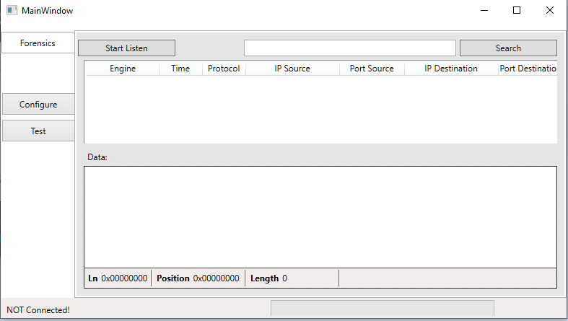
Implementation: interface

Slide 15
Implementation: Application
Interface functions to control the FPGA via Driver
3 types of tests
UART communication with Host Computer
Main purpose:
Reads the logs from driver and sends them to the Host Computer

Slide 16
Quality Assurance
Unit Tests
Integration Tests
System Test
FPGA = Test Bench
Driver = File Functions Calls
App = Self Test
Driver – VIO Core IP
App – Driver – App Loopback
Stress Test
Speed Test
User Experience Test

Slide 17

Speed-Up
Speed-Up:
3 → 6

Slide 18

Marketing
In 2016, a Freedonia research states: “World
demand for security equipment is forecast to increase 6.8 percent”
Size of the industry: $90.2 billion world
security equipment in 2016
Size of the industry: $126 billion
world security equipment in 2018
The higher the threat,
the higher the need for security

Slide 19
Questions?
?

Slide 20
DEMO

