Slide 1
All of this is great but I don’t have a Cluster
Notes:
Let’s try to work on a single machine first.

Slide 2
My data does not fit in RAM !
df = pd.read_csv("my_big_file.csv")

Slide 3
Pandas optimization
Pandas is quite memory inefficient
One issue is that at column type inference time, it casts them to the largest possible type
Pandas types
int8 / uint8 : consumes 1 byte of memory, range between -128/127 or 0/255
bool : consumes 1 byte, true or false
float16 / int16 / uint16: consumes 2 bytes of memory, range between -32768 and 32767 or 0/65535
float32 / int32 / uint32 : consumes 4 bytes of memory, range between -2147483648 and 2147483647
float64 / int64 / uint64: consumes 8 bytes of memory

Slide 4
Pandas optimization
Categorical columns
If you have some categorical columns in your dataset (with strings inside for instance) they are stored as objects
If the number of possible categories is limited you can force pandas to use a virtual mapping table where all unique values are mapped via an integer instead of a pointer. This is done using the category datatype.

Slide 5
Pandas optimization
So what can we do ?
You can:
Inspect a representative number of lines of your dataset
Downcast or convert into categorical the appropriate columns
Use this new schema to load your whole dataset

Slide 6
Pandas optimization
Don’t forget to only load the subset of columns you are going to use
df_optimized = pd.read_csv("my_big_file.csv", dtype=column_types, usecols=["float_col", "int_col", "cat_col"])

Slide 7
My data still does not fit in RAM !

Slide 8
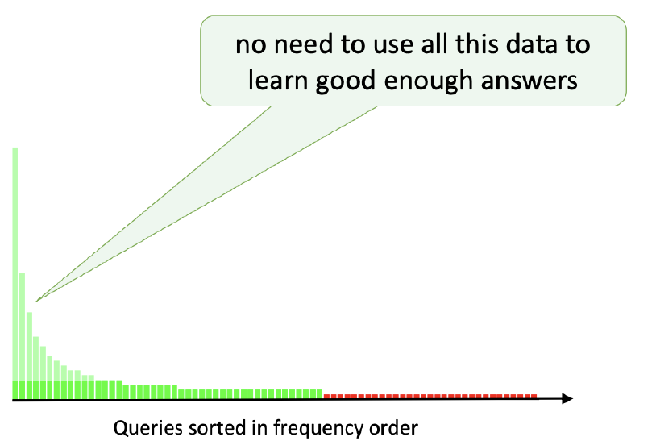
Sampling
Maybe we can rely on a smaller version of the dataset
Uniform Sampling
We can do better !

Slide 9
Sampling
Stratified Sampling
You can use a different sampling ratio for each group
Population
Strata
Random selection
Sample

Slide 10
Sampling
Grouping criterion
One group ➔ uniform sampling
One group per class to predict
(advertising, fraud detection, cheminformatics)
Or any other criterion (as long as individuals look the same)
➔ Notion of “consistent subset of a sample set”
In practice, make sure that you:
- don’t remove individuals from the ‘long tail’
- don’t degrade your loss
?
?

Slide 11
Sampling
Don’t forget to correct your loss
Sampling Ratio
Loss
Group | Sampling Ratio
A | 1 (unchanged)
B | 1/10
C | 1/30
Loss = Loss(X_a, y_a) + Loss(X_b, y_b) + Loss(X_c, y_c)
Loss = 1 * Loss(X_sampled_a, y_sampled_a)
+ 10 * Loss(X_sampled_b, y_sampled_b)
+ 30 * Loss(X_sampled_c, y_sampled_c)

Slide 12

Sampling
Emptying the drawers
Condensend nearest neighbours : stream through the examples, keep example if it cannot be correctly classified by the content of the added examples so far (using nearest neighbour methods)
Tomek links : remove element from pair of closest elements, with different label (remove element from majority class)
Scaling ???

Slide 13
My data still does not fit in RAM !

Slide 14

Out of Core algorithms
No need to fit whole dataset into RAM to build your model
Dataset $\left\{{\left(x_{i}, y_{i}\right)}_{i=1..N}\right\}$ grouped into batches $\{{\left(X_{b}, Y_{b}\right)}_{b=1..B}\}$
Differentiable predictor $f_{w}(X)$
Cost function $J(f(X),Y)$
Repeat until some stopping criterion is met:
For $b=1 to B$
$w ≔w −α ∇_{w}J\left(X_{b}, Y_{b}\right)$
update $α$

Slide 15


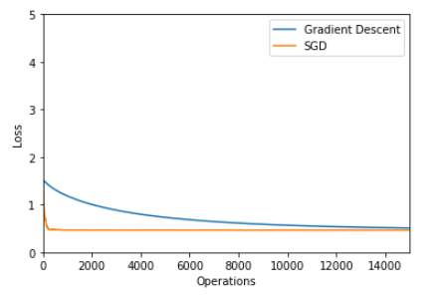
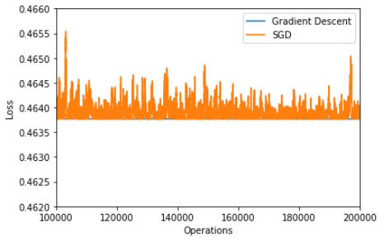
Out of Core algorithms
Toy example
Simple linear regression example:
Compromise memory/speed/optimization error
Operations, not iterations
(lines processed + vectorization)

Slide 16
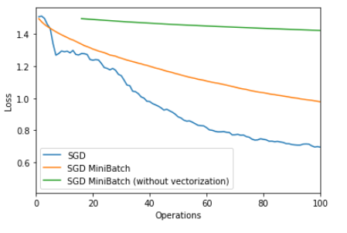
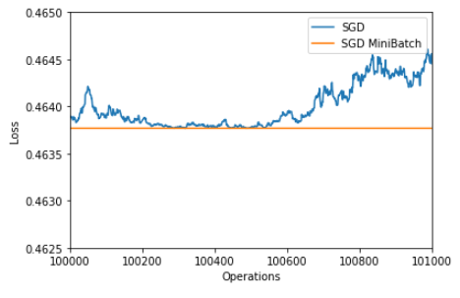
Out of Core algorithms
Mini batch, what’s the deal ?
Vectorization (SIMD, GPU) speed-up ? Yes
Smoother convergence ? Yes
Faster convergence (smoother gradient) ? Maybe

Slide 17

Out of Core algorithms
Scikitlearn
All algorithms with a partial fit method
sklearn.linear_model.SGDClassifier
sklearn.linear_model.SGDRegressor
…
SGD without mini batch
Learning rate updated at each row
By the way, don’t forget to normalize your data
Are we good to go ?

Slide 18

Shuffling
Why should I care about shuffling ?
What happens ?
People Height | Shoe Size
130cm | 35
130cm | 36
131cm | 35
…
Sorted by height
Training set
…
Validation set
Notes:
Ici on a de la chance ça fonctionne quand même

Slide 19
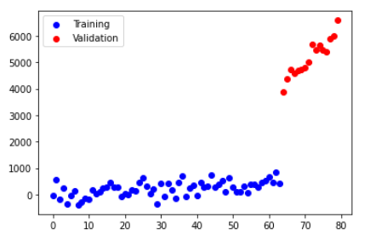
Shuffling
Why should I care about shuffling ?

Slide 20
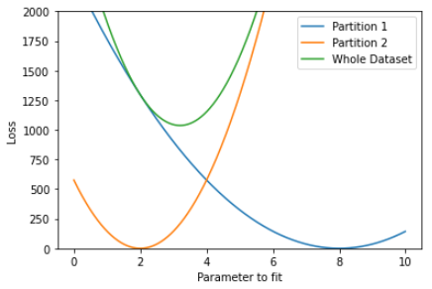
Shuffling
Batches should be representative of dataset
Otherwise, risk of overfitting:
on last batches of the training
In theory, you need to shuffle the dataset after each epoch.
In non-convex optimization, helps to hop from one local optimum to another.

Slide 21
Shuffling
How do you shuffle a file that does not fit in RAM ?
One solution
Pick numbers from a large set so that probability that any two lines have same random number is small.
Some versions of the UNIX utility sort already have this:
cat -n myfile.csv | sort --random-sort | cut -f 2
One or multiple files
Multiple files
One or multiple files
..
Row 1
Row 42
…
Row 123
…
Row n
random | …
261136629 | Row 1
2 | Row 42
..
988215456 | Row 123
535215832 | Row n
random | …
2 | Row 42
… | …
261136629 | Row 1
.. | …
535215832 | Row n
… | …
988215456 | Row 123
Add random
column
External sort
O(n)
O(n log(n) )

Slide 22
Shuffling
How do you shuffle a file that does not fit in RAM ?
Better solution : don’t sort because it’s too expensive
Pick amount of files so that each file can be processed in-memory
Need to know big file size
Unix : no simple one-liner for the first operation !
Multiple files
Shuffled files
One or multiple files
..
Row 1
Row 42
…
Row 123
…
Row n
Assign to
Random file
In-memory
shuffles
…
…
O(n)
O(n)

