Slide 1


Scaling Tricks
Notes:
All of this is great but I don’t have a Cluster

Slide 2
Learning a large scale model, Step 0
Large scale: costly and difficult to train.
First try to downsize the dataset and train on a single machine.
Gives you a better understanding of the task
Model learned might be good enough !
These tricks will still be interesting when going distributed

Slide 3
My data does not fit in RAM !
df = pd.read_csv("my_big_file.csv")

Slide 4
Pandas optimization
Pandas is quite memory inefficient
One issue is that at column type inference time, it casts them to the largest possible type
Pandas types
int8 / uint8 : consumes 1 byte of memory, range between -128/127 or 0/255
bool : consumes 1 byte, true or false
float16 / int16 / uint16: consumes 2 bytes of memory, range between -32768 and 32767 or 0/65535
float32 / int32 / uint32 : consumes 4 bytes of memory, range between -2147483648 and 2147483647
float64 / int64 / uint64: consumes 8 bytes of memory

Slide 5
Pandas optimization
Categorical columns
If you have some categorical columns in your dataset (with strings inside for instance) they are stored as objects
If the number of possible categories is limited you can force pandas to use a virtual mapping table where all unique values are mapped via an integer instead of a pointer. This is done using the category datatype.

Slide 6
Pandas optimization
So what can we do ?
You can:
Inspect a representative number of lines of your dataset
Downcast or convert into categorical the appropriate columns
Use this new schema to load your whole dataset

Slide 7
Pandas optimization
Don’t forget to only load the subset of columns you are going to use
df_optimized = pd.read_csv("my_big_file.csv", dtype=column_types, usecols=["float_col", "int_col", "cat_col"])

Slide 8
My data still does not fit in RAM !

Slide 9
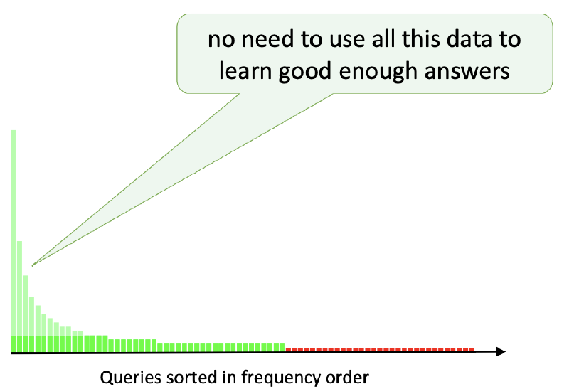
Sampling
Maybe we can rely on a smaller version of the dataset
Uniform Sampling
Maybe we can do better

Slide 10
Sampling
Stratified Sampling
You can use a different sampling ratio for each group
Population
Strata
Random selection
Sample

Slide 11
Sampling
Grouping criterion ?
Each individual of the group should look alike !
Should I go for clustering technique ?
Maybe, but it may be costful. In practice (advertising, fraud detection, cheminformatics) we can do simpler:
Use the Label
Use a given column of the dataset
Sometimes the criterion may be dictated by your infra
But ideally make sure that you:
- don’t remove individuals from the ‘long tail’
- don’t degrade your loss
?
?
Notes:
Criterion dictated by infra:
Chez Criteo dans notre système de recommendation, en reçois vraiment beaucoup de requêtes pour un type de client donné. Nous n’avons même pas envie de stocker tout cela, ça prendrait trop de taille sur le cluster. On ne log même pas les données, le sampling est réalisé au moment du logging.

Slide 12
Sampling
Don’t forget to correct your loss
Sampling Ratio
Loss
Group | Sampling Ratio
A | 1 (unchanged)
B | 1/10
C | 1/30
Loss = Loss(X_a, y_a) + Loss(X_b, y_b) + Loss(X_c, y_c)
Loss = 1 * Loss(X_sampled_a, y_sampled_a)
+ 10 * Loss(X_sampled_b, y_sampled_b)
+ 30 * Loss(X_sampled_c, y_sampled_c)

Slide 13

Sampling
Emptying the drawers
Condensend nearest neighbours : stream through the examples, keep example if it cannot be correctly classified by the content of the added examples so far (using nearest neighbour methods)
Tomek links : remove element from pair of closest elements, with different label (remove element from majority class)
Scaling ???

Slide 14
My data still does not fit in RAM !

Slide 15

Out of Core algorithms
No need to fit whole dataset into RAM to build your model
Dataset $\left\{{\left(x_{i}, y_{i}\right)}_{i=1..N}\right\}$ grouped into batches $\{{\left(X_{b}, Y_{b}\right)}_{b=1..B}\}$
Differentiable predictor $f_{w}(X)$
Cost function $J(f(X),Y)$
Repeat until some stopping criterion is met:
$$w ≔w −α ∇_{w}J\left(X_{b}, Y_{b}\right)$$
update $α$

Slide 16
Out of Core algorithms
Batch Gradient Descent
Use whole dataset at each step
Stochastic Gradient Descent
Use one data point at each step
Mini Batch Gradient Descent
Use a group of data points at each step
Epoch
Whole dataset has been read in one epoch

Slide 17


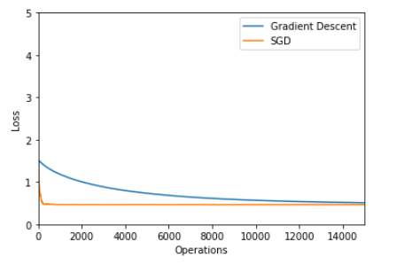
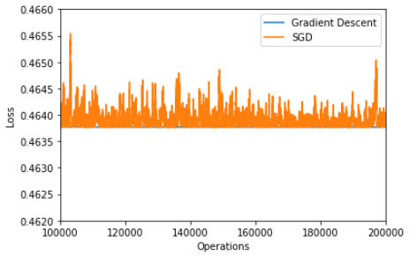
Out of Core algorithms
Toy example
Simple linear regression example:
Compromise memory/speed/optimization error

Slide 18
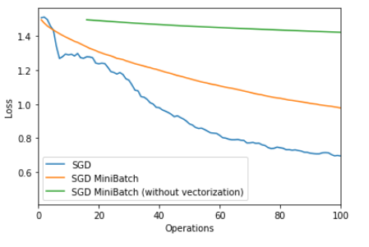
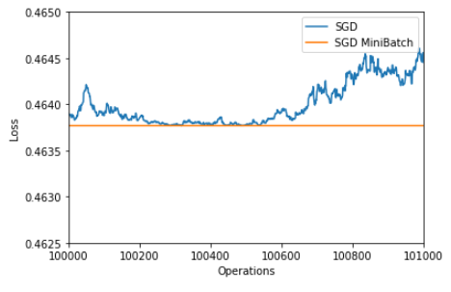
Out of Core algorithms
Mini batch, what’s the deal ?
Smoother convergence ? Yes
Vectorization (SIMD, GPU) speed-up ? Yes
Faster convergence (smoother gradient) ? Maybe
Operations, not iterations
(lines processed + vectorization)

Slide 19

Out of Core algorithms
Scikitlearn
All algorithms with a partial fit method
sklearn.linear_model.SGDClassifier
sklearn.linear_model.SGDRegressor
…
SGD without mini batch
Learning rate updated at each row
By the way, don’t forget to normalize your data
Are we good to go ?

Slide 20

Shuffling
Why should I care about shuffling ?
What happens ?
People Height | Shoe Size
130cm | 35
130cm | 36
131cm | 35
…
Sorted by height
Training set
…
Validation set
Notes:
Ici on a de la chance ça fonctionne quand même

Slide 21
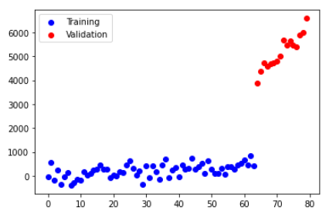
Shuffling
Why should I care about shuffling ?

Slide 22
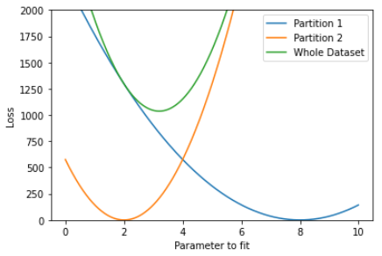
Shuffling
Batches should be representative of dataset
Otherwise, risk of overfitting:
on last batches of the training
In theory, you need to shuffle the dataset after each epoch.
In non-convex optimization, helps to hop from one local optimum to another.

Slide 23
Shuffling
How do you shuffle a file that does not fit in RAM ?
One solution
Pick numbers from a large set so that probability that any two lines have same random number is small.
Some versions of the UNIX utility sort already have this:
cat -n myfile.csv | sort --random-sort | cut -f 2
One or multiple files
Multiple files
One or multiple files
..
Row 1
Row 42
…
Row 123
…
Row n
random | …
261136629 | Row 1
2 | Row 42
..
988215456 | Row 123
535215832 | Row n
random | …
2 | Row 42
… | …
261136629 | Row 1
.. | …
535215832 | Row n
… | …
988215456 | Row 123
Add random
column
External sort
O(n)
O(n log(n) )

Slide 24
Shuffling
How do you shuffle a file that does not fit in RAM ?
Better solution : don’t sort because it’s too expensive
Pick amount of files so that each file can be processed in-memory
Need to know big file size
Unix : no simple one-liner for the first operation !
Multiple files
Shuffled files
One or multiple files
..
Row 1
Row 42
…
Row 123
…
Row n
Assign to
Random file
In-memory
shuffles
…
…
O(n)
O(n)

Slide 25
Conclusion
Model Performance limited by training cost/time, not number of samples.
More data will increase model breadth. What is your task ?
Some task require manual data annotation that will not scale. Sometimes some cheap ways to generate labels exist.
We need to decrease training costs/time:
Use sampling
Replace polynomial algorithms by linear algorithms
Out of core algorithms (some kind of divide and conquer strategy)
- Optimize RAM usage (avoids I/O)
- Parallelize computations, use dedicated hardware (not covered)
Notes:
Next week:
- Scaling tricks: Random projections, Hashing
- A few large-scale ML frameworks

