Slide 1
Large Scale Machine Learning
Part 2: Distributed Logistic Regression

Slide 2
Previously on Large Scale ML
Definition of Large Scale ML
Overview of Large Scale ML software and hardware paradigms
Large Scale ML on your machine

Slide 3
This episode
Distributed Logistic Regression
Synchronous Distributed Gradient Descent
Second order methods
Other distribution strategies
Parameter Server
AllReduce

Slide 4
Distributed Computing
Using multiple networked computation nodes (computers)
Nodes communicate and coordinate their actions by passing data on the network
Distributed ML
Designing algorithms that work efficiently on distributed systems

Slide 5
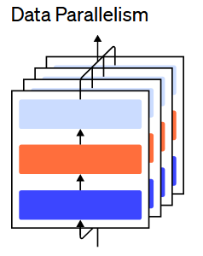
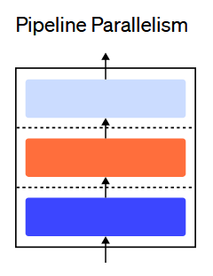
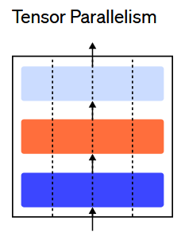
How to distribute ?

Slide 6
Logistic Regression
We are going to use logistic regression as a show case for some of the techniques shown
Most of what we are going to say applied to most parametric models that can be optimized with Gradient Descent
Logistic Regression is used everywhere
Most common classification algorithm, can be quite very flexible
Criteo trains thousands of LR models per day and uses them to do billions of predictions

Slide 7
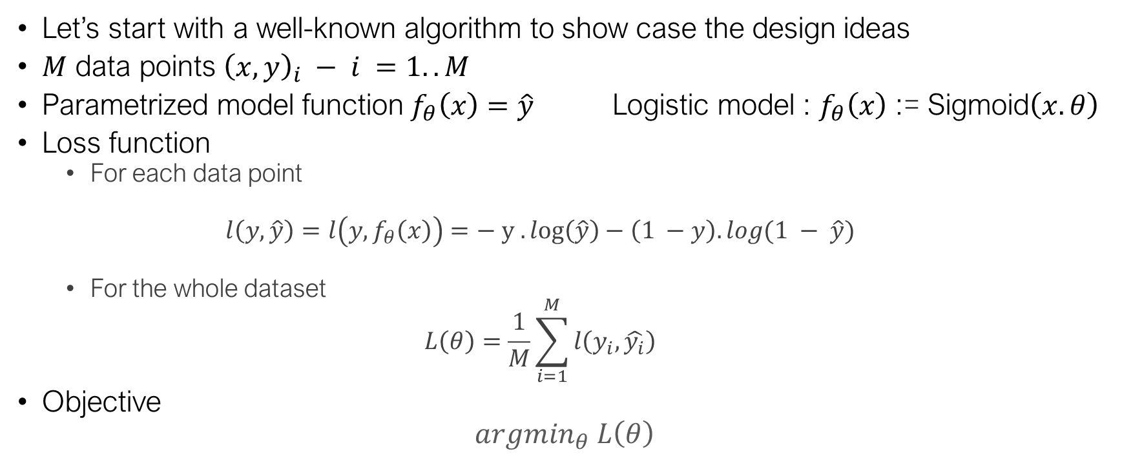
Logistic Regression
Let’s start with a well-known algorithm to show case the design ideas
$M$ data points ${\left(x, y\right)}_{i} − i =1..M$
Parametrized model function $f_{θ}\left(x\right)=\hat{y}$ Logistic model : $f_{θ}\left(x\right)$ := Sigmoid$\left(x.θ\right)$
Loss function
For each data point
$$l\left(y,\hat{y}\right)=l\left(y, f_{θ}\left(x\right)\right)=− y . log\left(\hat{y}\right)−\left(1 −y\right). log(1 − \hat{y})$$
For the whole dataset
$$L\left(θ\right)=\frac{1}{M}\sum_{i=1}^{M}{l\left(y_{i},\hat{y_{i}}\right)}$$
Objective
$${argmin}_{θ} L\left(θ\right)$$
Log Proba( Y_{i} = y_{i} | model _{θ}, x_{i} )

Slide 8

Gradient and stochastic gradient
Gradient descent
Repeat until convergence
$$θ_{t+1}⟵θ_{t} − α_{t}∇L\left(θ\right)$$
Stochastic gradient descent
Repeat until convergence
Sample random $i$ from $\{1..M\}$
$$θ_{t+1}⟵θ_{t} − α_{t}∇_{θ}l\left(y_{i} ,\hat{ y_{i}}\right)$$

Slide 9
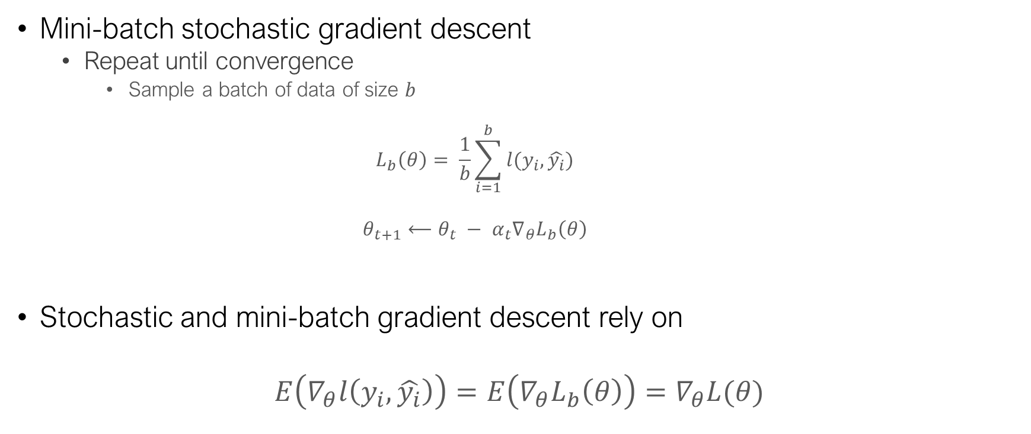
Gradient and stochastic gradient
Mini-batch stochastic gradient descent
Repeat until convergence
Sample a batch of data of size $b$
$$L_{b}\left(θ\right)= \frac{1}{b}\sum_{i=1}^{b}{l(y_{i}, \hat{y_{i}})}$$
$$θ_{t+1}⟵θ_{t} − α_{t}∇_{θ}L_{b}\left(θ\right)$$
Stochastic and mini-batch gradient descent rely on
$$E\left(∇_{θ}l\left(y_{i}, \hat{y_{i}}\right)\right)=E\left(∇_{θ}L_{b}\left(θ\right)\right)=∇_{θ}L(θ)$$

Slide 10

Distributed Gradient Descent 101
$W$ workers
Each worker
Reads a partition of data
Computes a local gradient
Sends the gradient over to be aggregated
Model is updated and re-pushed to the workers
Rince and repeat

Slide 11
Distributed Gradient Descent 101
In mini-batch SGD gradients will only be computed on a batch of data
Each worker will process a small batch of data
In Full Gradient Descent it will computed on the whole dataset
Assuming n workers, each worker will process 1/n of the dataset

Slide 12


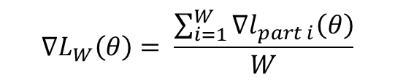



Distributed Gradient Descent 101
Σ
$$∇L_{W}\left(θ\right)= \frac{\sum_{i=1}^{W}{∇l_{part i}\left(θ\right)}}{W}$$
$$∇l_{part 1}(θ)$$
$$∇l_{part 2}(θ)$$
$$∇l_{part 3}(θ)$$
$$∇l_{part W}(θ)$$
…
Dataset Partition 1
Dataset Partition 2
Dataset Partition 3
Dataset Partition W

Slide 13
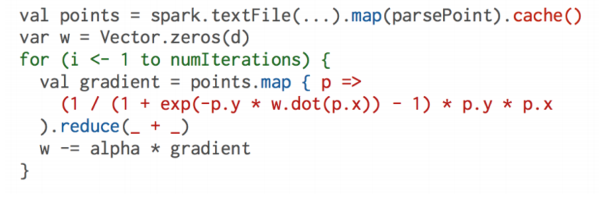
Distributed Gradient Descent 101
Easy to implement a simple version in Spark
Notes:
Model w is broadcasted to all workers at every iteration

Slide 14
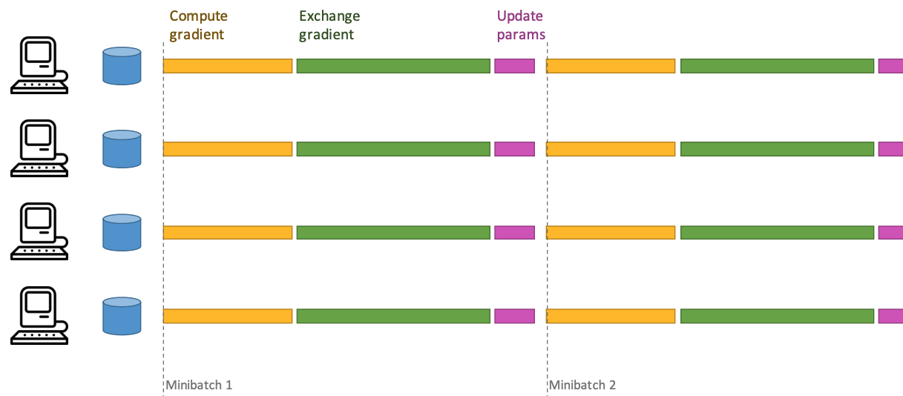
Synchronous Data Parallel SGD

Slide 15
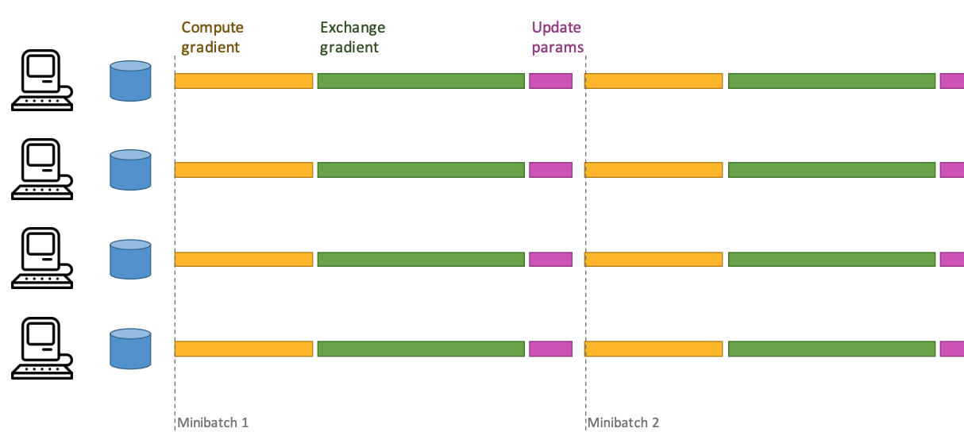
Synchronous Data Parallel SGD

Slide 16
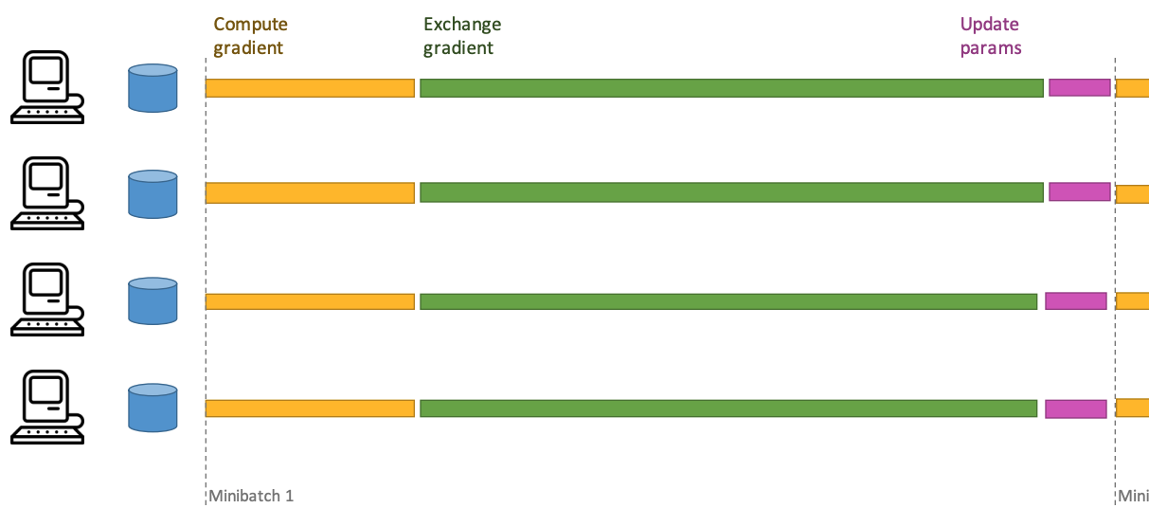
Synchronous Data Parallel SGD

Slide 17
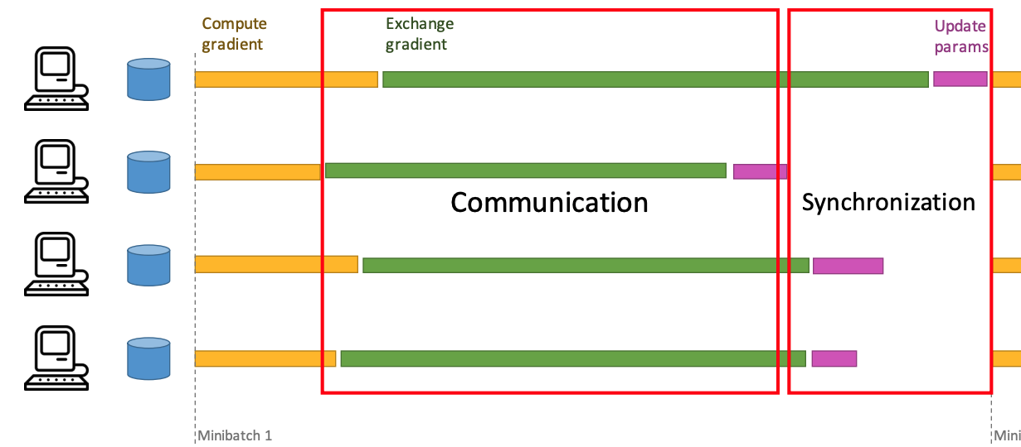
Synchronous Data Parallel SGD

Slide 18
Main Overheads
Objective: compute the gradient in parallel
Two main overheads
Communication: sending gradient updates to the driver / other workers
Synchronization: waiting for all the workers to execute the current iteration
This is what is preventing from getting the theoretical speed up
With n workers
Gradient computation: T / n
Comm and sync cost: does not decrease with n but increase !

Slide 19
Communication cost
Sparse model example
Total model weights M
But only f << M non zero features per row
For the log-loss defined earlier, gradient will be sparse and needs to be represented by a sparse vector
This is the key to efficiency
Gradient update is sparse + sparse operation

Slide 20

Why is the gradient sparse
$$∇_{θ}l\left(y, \hat{y}\right)= {− ∇}_{θ}\left[y .\log{f_{θ}(x)}+\left(1−y\right).\log{{(1 − f}_{θ}(x))}\right] \\ ∇_{θ}l\left(y, \hat{y}\right)=\left(y − \frac{1}{1+ e^{−x^{T}θ}}\right) x \\ ∇_{θ}l\left(y, \hat{y}\right) =κ x$$
Sparse feature vector = sparse gradient

Slide 21

Some bad news
What about regularization ?
L2 Regularization term $\frac{1}{2}λ θ^{T}θ$
$$∇_{θ}\frac{1}{2}λ θ^{T}θ=λθ$$
The update rule becomes
$θ⟵θ −α (κ x+λθ)$
It’s dense now ☹ no matter how sparse the feature vector is

Slide 22
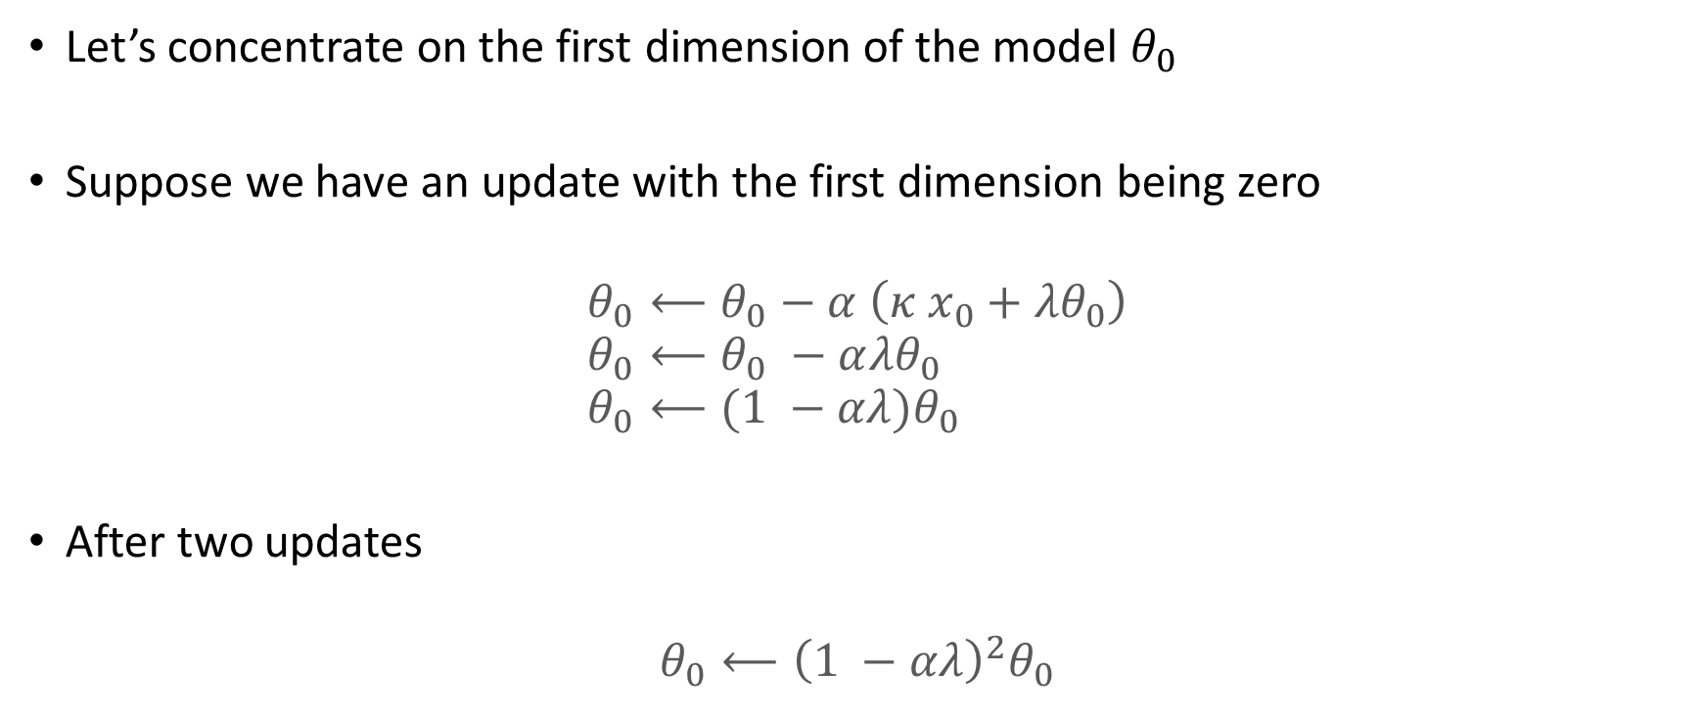
Regularized SGD with Sparse Updates
Let’s concentrate on the first dimension of the model $θ_{0}$
Suppose we have an update with the first dimension being zero
$$θ_{0}⟵θ_{0}−α \left(κ x_{0}+{λθ}_{0}\right) \\ θ_{0}⟵θ_{0} −α{λθ}_{0} \\ θ_{0}⟵{(1 −αλ)θ}_{0}$$
After two updates
$$θ_{0}⟵{{\left(1 −αλ\right)}^{2}θ}_{0}$$

Slide 23

Regularized SGD with Sparse Updates
We can then compress K computations
$$θ_{0}⟵{{\left(1 −αλ\right)}^{K}θ}_{0}$$
We remember how many steps we didn’t update a particular dimension
Catch up when needed

Slide 24
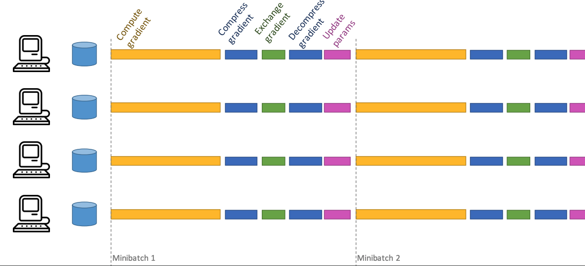
More general pattern for reducing communication cost

Slide 25
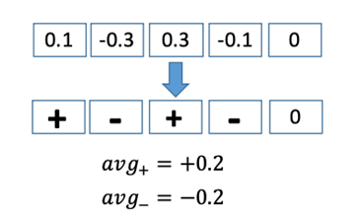
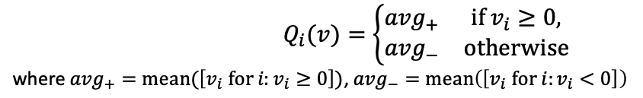

How can we compress a vector ?
Lossy compression
Quantization function
$v$ vector of real values

Slide 26
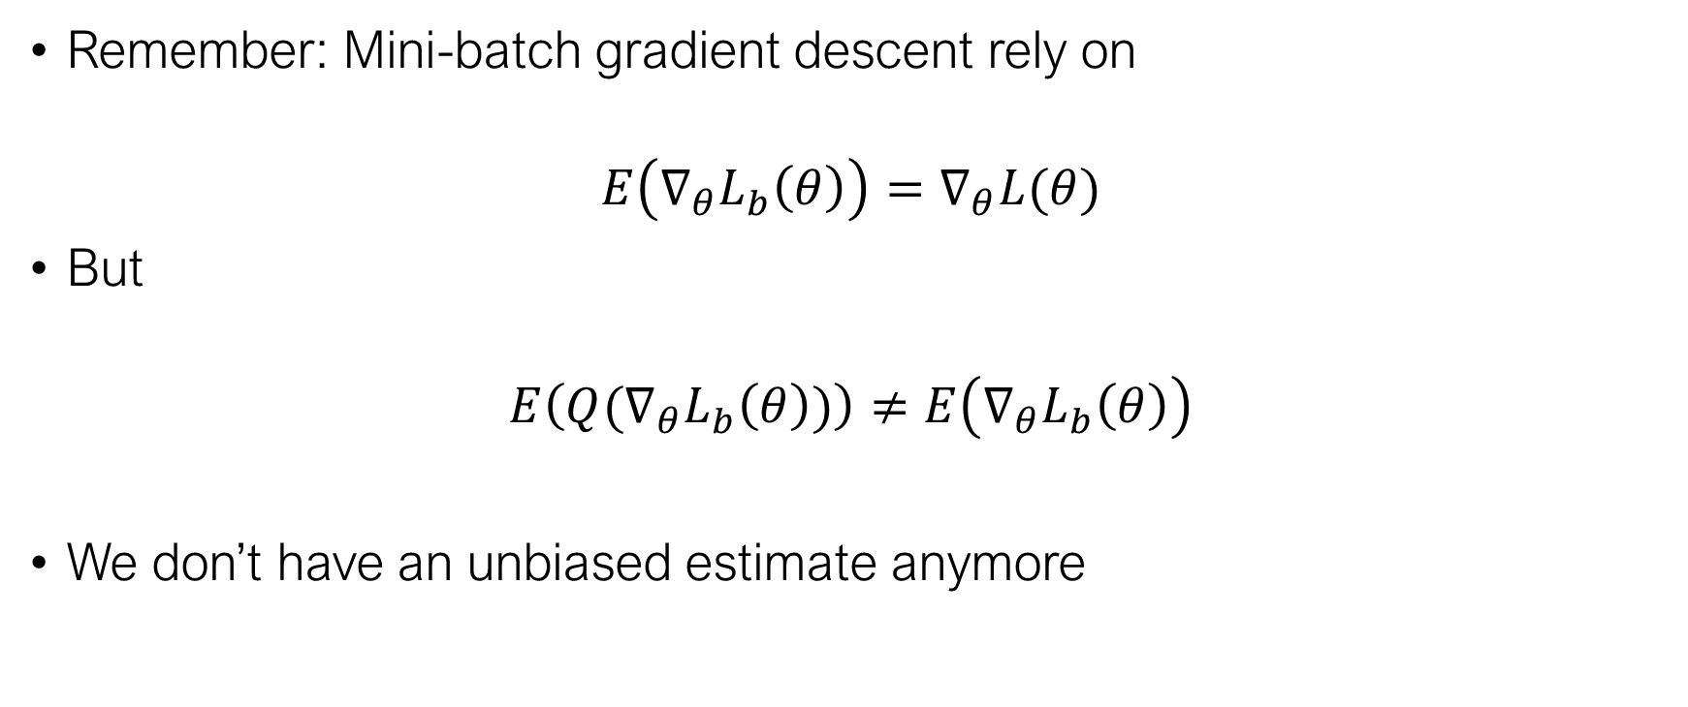
Why this shouldn’t work
Remember: Mini-batch gradient descent rely on
$$E\left(∇_{θ}L_{b}\left(θ\right)\right)=∇_{θ}L(θ)$$
But
$$E\left(Q(∇_{θ}L_{b}\left(θ\right))\right)≠E\left(∇_{θ}L_{b}\left(θ\right)\right)$$
We don’t have an unbiased estimate anymore

Slide 27
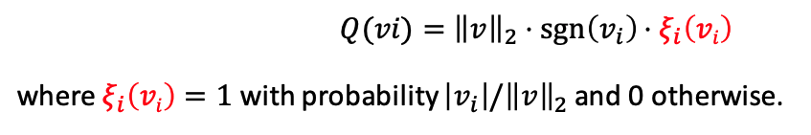
Nice trick: Stochastic Quantization
Quantization function
Now it’s unbiased

Slide 28
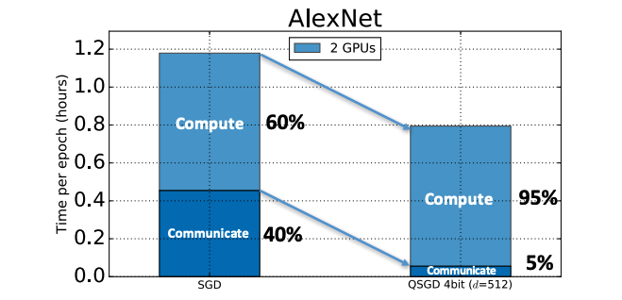
Nice trick: Stochastic Quantization

Slide 29
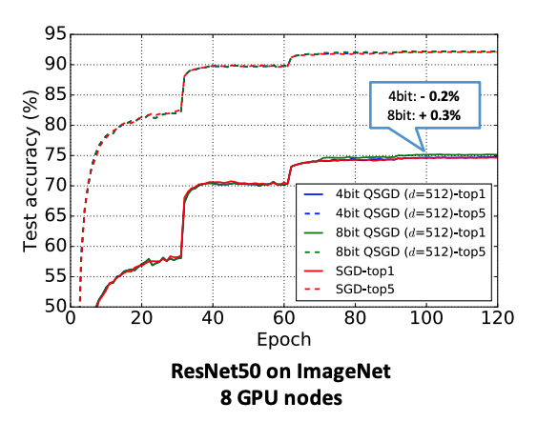
Nice trick: Stochastic Quantization

Slide 30
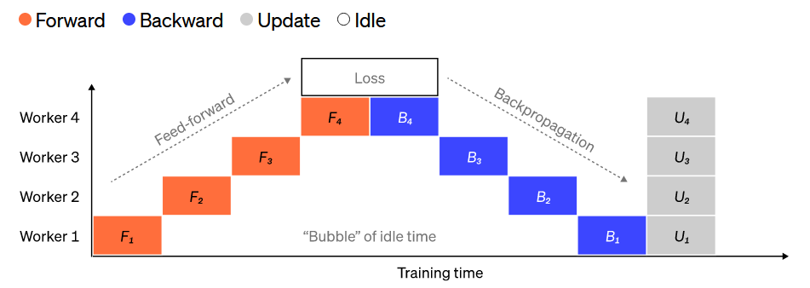
How about synchronization ?
We will talk about it a bit later but here is simple solution
Drop the gradients of slow workers by imposing a timeout to the computation
Other ‘Synchronization’ costs may arise when working with (deep) nets:
Source: Techniques for training
large neural networks (openai)

