Slide 1
Why Spark ?
Support iterative algorithms, like gradient descent
In memory processing
Built-in broadcast
Make it easier to explore data interactively
Developer friendly, no need to create tons of classes and jobs…
Repl mode
Scala/Python API similar to functional programming

Slide 2
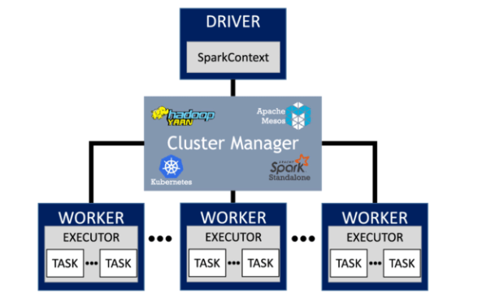
Main Components

Slide 3
How to run it
Repl : Spark-shell, notebooks ➔ exploratory mode
Spark-submit : runs a script ➔ scheduled job
Api for Java, Scala, Python.
Dependencies
Depends on Hadoop Libraries (HDFS and Yarn)
Requires a Java Runtime Environment (need Java in your system path)

Slide 4
RDD
Resilient Distributed Dataset
The base building block of your application
Lazy : doesn’t compute anything before it really needs to do so.
Immutable : a transformation doesn’t change the data set, it returns a new RDD.
Fault Tolerant : partition can be recomputed in case of failure
Conceptually, an RDD is a graph a function.
API is pretty much similar with Functional Programming. Forget the for-loop.
Inside the RDD:
Knows the partitions he is working-on, how data is partitionned
Knows how to iterate over each partition to yield records
Know RDD’s it depends-on

Slide 5
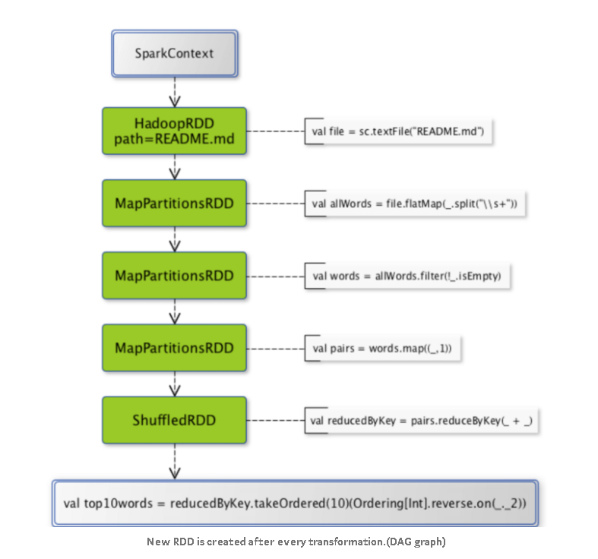
RDD as a Directed Acyclic Graph
MAP
REDUCE

Slide 6
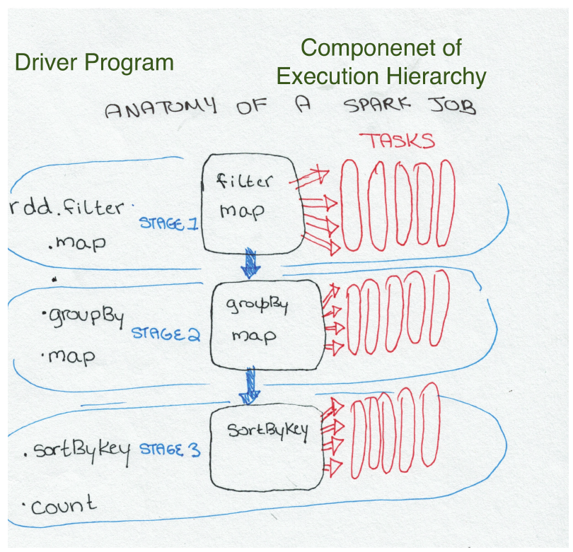
Jobs, Stages, Tasks
Source : high performance Spark

Slide 7
RDD API - Actions
Row
{"user":"John", "movie":"Blade Runner", "rating":5.0}
{"user":"Louise", "movie":"Dirty dancing", "rating":5.0}
{"user":“Sam", "movie":“Blade Runner", "rating":3.5}
count
3
Row
{"user":"John“}
{"user":"Louise“}
{"user":“Sam“}
take(2)
Row
{"user":"John“}
{"user":"Louise“}
Row
{"user":"John“}
….
{"user":“Sam“}
Row
{"user":"John“}
….
{"user":“Sam“}
collect()

Slide 8
RDD API
Row
{"user":"John", "movie":"Blade Runner", "rating":5.0}
{"user":"Louise", "movie":"Dirty dancing", "rating":5.0}
{"user":“Sam", "movie":“Blade Runner", "rating":3.5}
Row
Blade Runner
Dirty Dancing
Blade Runner
map(x ➔ x[‘movie’])
Row
{"user":"John", "movie":"Blade Runner", "rating":5.0}
{"user":"Louise", "movie":"Dirty dancing", "rating":5.0}
{"user":“Sam", "movie":“Blade Runner", "rating":3.5}
Row
("John“, …)
(“Louise“, …)
(“Sam“, …)
keyBy(x ➔ x[‘user’])
Row
("John", "Blade Runner")
("Louise“, "Dirty dancing")
(“Sam“, “Blade Runner")
Row
("John“, 12)
(“Louise“, 13)
(“Sam“, 12)
mapValues(x ➔ len(x[1]))

Slide 9
RDD API
Row
cyberpunk
scifi
action
music
danse
romance
Row
{"movie":"Blade Runner", “genres":”cyberpunk;scifi;action”}
{"movie":"Dirty dancing", “genres":”music;danse;romance”}
flatmap(x ➔ x[‘genres’].split(‘;’))
Row
{"user":"John", "movie":"Blade Runner", "rating":5.0}
{"user":"Louise", "movie":"Dirty dancing", "rating":5.0}
{"user":“Sam", "movie":“Blade Runner", "rating":3.5}
Row
{"user":"John", "movie":"Bl…
{"user":"Louise", "movie":"Dir…
filter(x ➔ x[‘rating’]>4.0)

Slide 10
RDD API - Aggregations
Row
5.0
5.0
3.5
Row
13.5
Reduce(x,y ➔ x+y)
Row
(“Blade Runner", 5.0)
("Dirty dancing", 5.0)
(“Blade Runner“, 3.5)
Row
(“Blade Runner", 8.5)
("Dirty dancing", 5.0)
reduceByKey(x,y ➔ x+y)

Slide 11
Other useful functions
Join (shuffle ? Lazy ?)
Sample
mappartitions
zippartitions

Slide 12
Links
https://spark.apache.org/docs/latest/api/scala/org/apache/spark/api/java/JavaPairRDD.html
https://0x0fff.com/hadoop-mapreduce-comprehensive-description/

