Slide 1
Big Scale ML Frameworks

Slide 2




Good ones
Open Source
Manifold contributors
Well documented
State of the art algorithms
Performance
Notes:
Spark maybe more expressive ; TF and Pytorch maybe more low-level : matrixes ;
Apache Mxnet : not endorsed by one big company ; deep learning framework of choice in AWS

Slide 3
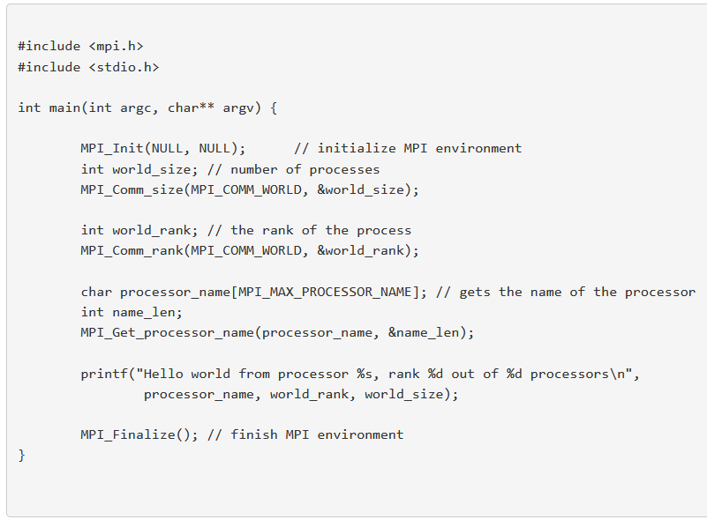
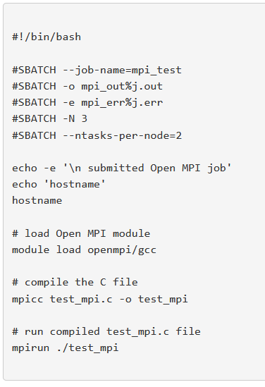
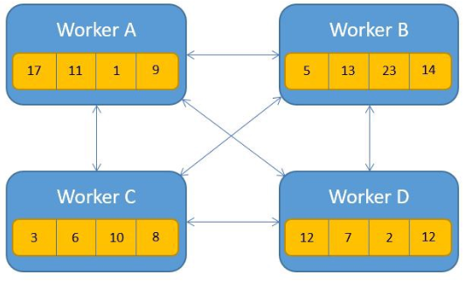
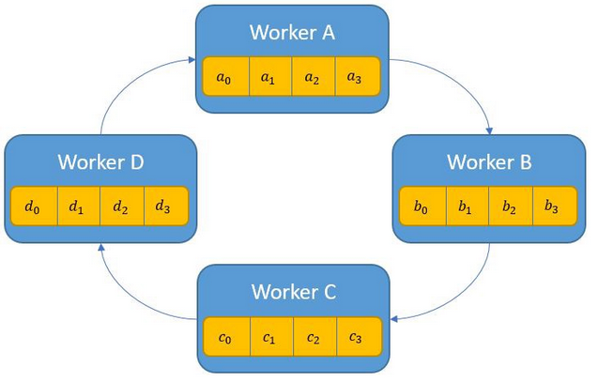
One word about MPI / OpenMPI

Slide 4
What about these ones ?
Microsoft CNTK – distributed deep learning framework ; open source but low amount of contributors
Caffe(2) – caffe2 has been integrated in PyTorch
MapReduce – we (Criteo) used to train some models on MapReduce some time ago ; implied mapreduce boilerplate ; sharing information between executors was a pain
Scikit-learn – out of core algorithms for single machine learning ; no distributed algorithms
h2O.ai – proposes automatic feature engineering as well as user interfaces, that can interface with Spark, TensorFlow, etc… Open source ; proposes a platform (with fee)
MOA – data stream mining ; only supports java ; does not seem prod-grade (no integration with kafka…)
Shogun – machine learning library ; no out-of-core algorithm ; not meant to be used in distributed environment
Baidu AllReduce / Horovod – nope – will talk about it in course 3;4
Theano – library to evaluate mathematical expressions on vectors
Breeze, BLAS, LAPACK – efficient linear algebra libraries

Slide 5
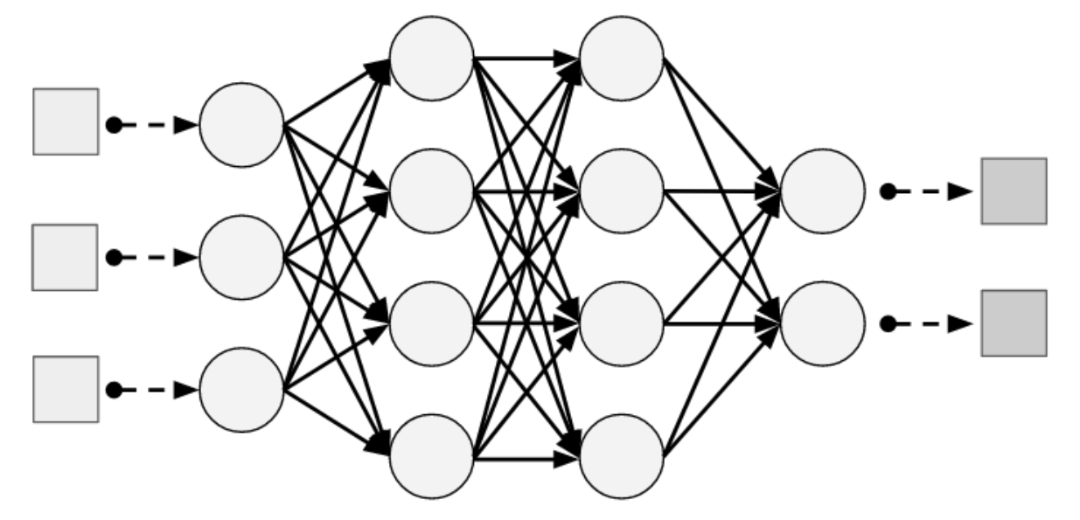
Tensorflow
Model is a graph of parameterized transformations
Joint of optimization of all parameters
Some features
Parallel, Distributed, Accelerator support
Languages (inference)
Serving
Tensorboard
…
Automatic differentiation (vs numeric differentiation)
➔ Need to use tensorflow functions, code is data !
Notes:
PyTorch : no specific functions, can use plain python ; can use varying data size e.g. for NLP

Slide 6

Tensorflow – use cases in production
https://blog.google/products/search/search-language-understanding-bert/
Notes:
PyTorch : no specific functions, can use plain python ; can use varying data size e.g. for NLP

Slide 7
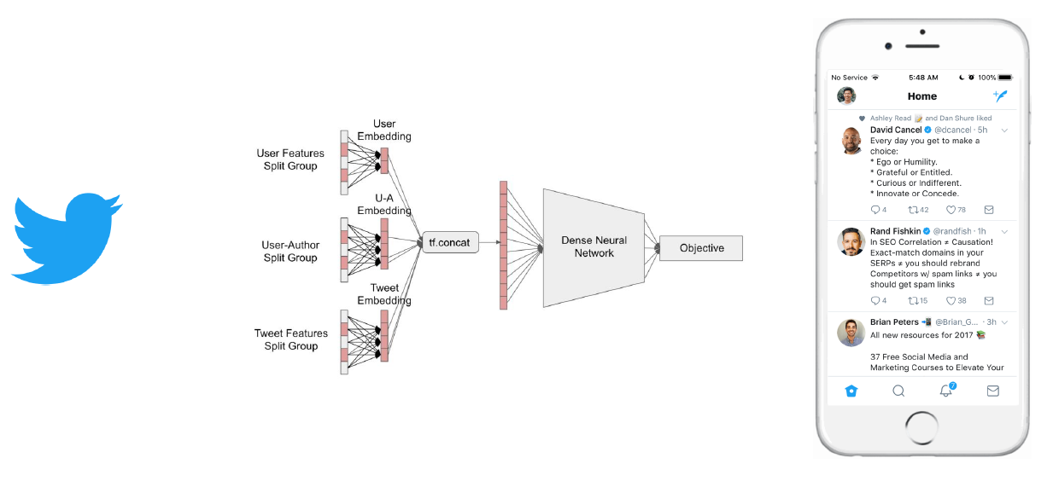
Tensorflow – use cases in production
https://blog.tensorflow.org/2019/03/ranking-tweets-with-tensorflow.html
Notes:
PyTorch : no specific functions, can use plain python ; can use varying data size e.g. for NLP

Slide 8
Spark MLLib
Version >= 3.0

Slide 9
Spark MLlib - Features
ML library built on top of Spark
Python / Scala / Java
Distributed
Features
ML algorithms : classification, regression, clustering, collaborative filtering…
Feature extraction and transformation
Pipelines (with persistence)

Slide 10

Spark MLlib – Concepts
Estimator
fit()
Extra columns
parameters
Transformer
predict()
Pipeline
Estimator
Estimator
…
Estimator
fit()
Transformer
Transformer
…
Transformer
predict()

Slide 11
Spark MLlib – ML algorithms
Classification and Regression
Clustering
Collaborative Filtering…
Vector !
from pyspark.ml.classification import LogisticRegression
estimator = LogisticRegression(maxIter=100, regParam=0.3, featuresCol="features", labelCol="label")
transformer = estimator.fit(df)
df_with_prediction = model.predict(df)
Regression : numeric
Classification : [0;…;K-1]

Slide 12
Spark MLlib – I want to … feed model with numeric column
VectorAssembler is your friend !
from pyspark.ml.feature import VectorAssembler
from pyspark.ml.classification import LogisticRegression
from pyspark.ml import Pipeline
stages=[]
stages += [VectorAssembler(inputCols=["int_age"], outputCol="vec_age")]
stages += [LogisticRegression(featuresCol="vec_age", labelCol="label")]
pipeline = Pipeline(stages=stages)

Slide 13
Spark MLlib – I want to … use categorical feature
StringIndexer
OneHotEncoder
string
vector
Other methods : learning with counts https://www.oreilly.com/library/view/strata-hadoop/9781491928004/video228193.html
int
from pyspark.ml.feature import OneHotEncoder, StringIndexer
from pyspark.ml.classification import LogisticRegression
stages = []
stages += [StringIndexer(inputCol="cat_class", outputCol="int_class")]
stages += [OneHotEncoder(inputCols=["int_class"], outputCols=["vec_class"])]
stages += [LogisticRegression(featuresCol="vec_class", labelCol="label")]
pipeline = Pipeline(stages=stages)

Slide 14
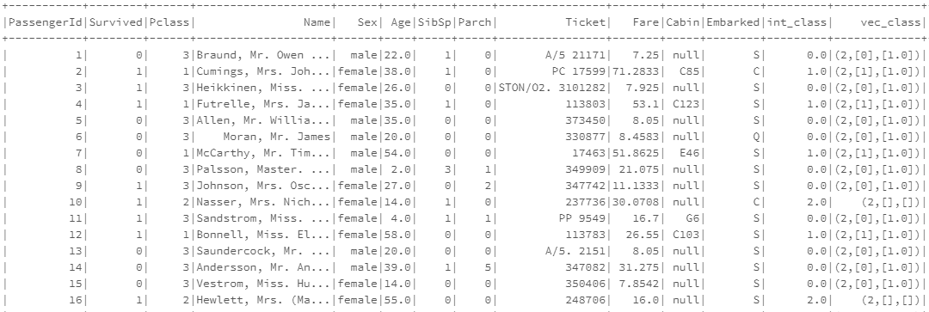
Spark MLlib – Wait my vector looks so weird now !
Sparse Vector representation !
???

Slide 15
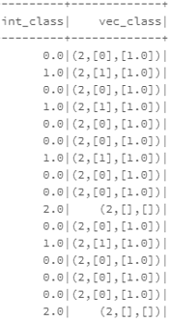
Spark MLlib – Sparse Vectors
(6, [2, 3], [10.0, 0.5])
[0.0, 0.0, 10.0, 0.5, 0.0, 0.0]
Array size
Indices where value!=0
Values
OneHotEncoder use case:
n different modalities leads to an array size of n-1
One modality is mapped to one dimension
Last modality is encoded as all-0 vector. Why ?

Slide 16
Spark MLlib – I want to … combine columns
Depends !
FeatureHasher transforms multiple primitive columns in sparse vector
VectorAssembler will concatenate multiple vectors into a single one

Slide 17
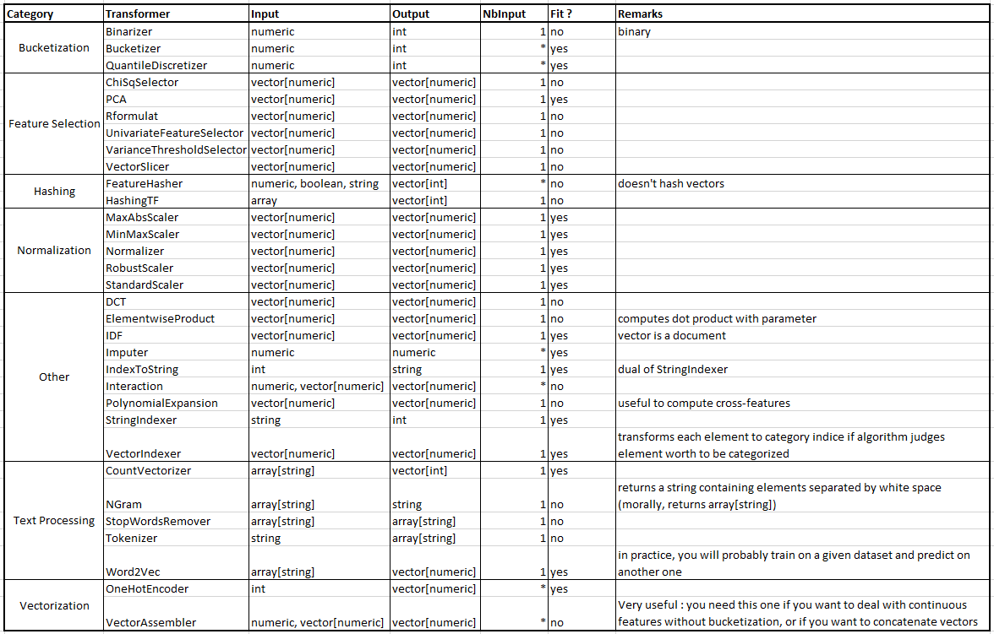
Spark MLlib – Transformations Catalog

Slide 18

Spark MLlib – Want to know more ?
Read the doc
https://spark.apache.org/docs/latest/ml-guide.html
Some examples deprecated though (old api : ml vs mllib)
Code is open source !
https://github.com/apache/spark

Slide 19
Conclusion
Many technologies, few chosen
MLlib benefits from a nice api, just like dataframe api
Don’t reinvent the wheel
Libraries built by real humans ; they have real bugs
Read the docs !

