Slide 1
Systems, paradigms and algorithms for Big Data TD 2

Slide 2
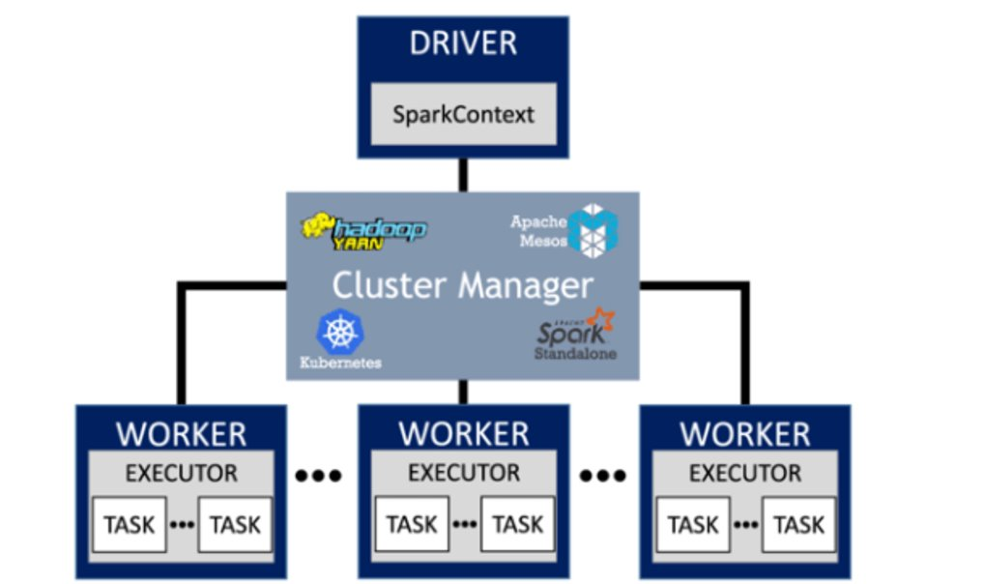
Reminder : tasks, stages and lazy operations
Narrow transformations: parallel tasks
map, mapValues, filter...
Shuffle operations: move data across workers
reduceByKey, join...
Actions: evaluate
count, take, collect
Stage: sequence of tasks between shuffles

Slide 3
Reminder : Shuffle
Spark.read(…).csv(/path/to/csv).keyBy(‘City’).mapValues(x ➔ x[‘consumption’]).reduceByKey(x,y➔ x+y)
Client-id | City | Yearly Energy Consumption (kWh)
Alice | Paris | 380
Bob | Toulouse | 200
.. | … | …
Jean | Paris | 390
Isabelle | Rouen | 350
Task 1.1
(partition 1)
Task 1.8
(partition 8)
…..
Partition 1
Task 2.1
(Paris, Rouen)
Task 2.1
(Toulouse, Marseille)
Partition 8
No shuffle if your dataset is already partitionned by the key you want to aggregate-on !

Slide 4
DataFrame vs RDD
Feature | DataFrame | RDD
Data Format | Structured, organized in columns | Anything, but schema to be passed to spark.
Compile-time safety | No | Yes
API | High Level, spark take care of optimizations for you | Low Level
Memory Management | Off-heap (because spark knows the schema it is working with) | Heap (implies serialization, garbage collection)

Slide 5
DataFrame Concepts
DataFrame
contains rows and columns
immutable
dag of operations
Column
there is more to it than a mere ‘column’
can be an expression of other columns (e.g. ‘a+b’)
can be an aggregation of a column : ‘avg(rating)’ (n rows ➔ 1 row)
can be an explosion of a column (1row ➔ k rows)
pyspark.sql.functions
GroupedData
similar to pandas
intermediary object when doing groupBy
one needs to call aggregation function on it to get back to a dataframe

Slide 6
RDD vs DataFrame - Actions
RDD
{"user":"John", "movie":"Blade Runner", "rating":5.0}
{"user":"Louise", "movie":"Dirty dancing", "rating":5.0}
{"user":"Sam", "movie":"Blade Runner", "rating":3.5}
count
3
df.count()
RDD
{"user":"John"}
{"user":"Louise"}
{"user":"Sam"}
take(2)
list
{"user":"John"}
{"user":"Louise"}
df.take(2)
df.show(2)
RDD
{"user":"John"}
….
{"user":"Sam"}
list
{"user":"John"}
….
{"user":"Sam"}
collect()
df.collect()
df.toPandas()

Slide 7
RDD vs Dataframe – Narrow transformations
RDD
{"user":"John", "movie":"Blade Runner", "rating":5.0}
{"user":"Louise", "movie":"Dirty dancing", "rating":5.0}
{"user":"Sam", "movie":"Blade Runner", "rating":3.5}
RDD
"Blade Runner"
"Dirty Dancing"
"Blade Runner"
map(lambda: x x['movie'])
df.select('movie')
Df.withColumn(…)
RDD of (K, V) pairs
("John", "Blade Runner")
("Louise", "Dirty dancing")
("Sam“, "Blade Runner")
RDD of (K, V) pairs
("John", 12)
("Louise", 13)
("Sam", 12)
mapValues(lambda x: len(x[1]))
RDD
{"user":"John", "movie":"Blade Runner", "rating":5.0}
{"user":"Louise", "movie":"Dirty dancing", "rating":5.0}
{"user":"Sam", "movie":"Blade Runner", "rating":3.5}
RDD
{"user":"John", "movie":"Bl…
{"user":"Louise", "movie":"Dir…
filter(lambda x: x['rating']>4.0)
df.filter('rating>3.5')

Slide 8
RDD vs DataFrame – Aggregations
RDD
{"user":"John", "movie":"Blade Runner", "rating":5.0}
{"user":"Louise", "movie":"Dirty dancing", "rating":5.0}
{"user":“Sam", "movie":“Blade Runner", "rating":3.5}
RDD of (K, V) pairs
("John“, …)
(“Louise“, …)
(“Sam“, …)
keyBy(lambda x: x['user'])
RDD
5.0
5.0
3.5
reduce(lambda x,y: x+y)
13.5
import pyspark.sql.functions as F
df.select(F.sum('rating'))
RDD
{"user":"John", "movie":"Blade Runner", "rating":5.0}
{"user":"Louise", "movie":"Dirty dancing", "rating":5.0}
{"user":"Sam", "movie":"Blade Runner", "rating":3.5}
RDD of (K, V) pairs
("Blade Runner", 8.5)
("Dirty dancing", 5.0)
reduceByKey(lambda x,y : x+y)
import pyspark.sql.functions as F
df.groupBy('user').agg (F.sum('rating'))
df.groupBy('user').agg ({'rating':'sum'})

Slide 9
RDD vs DataFrame - Explosion
RDD
"cyberpunk"
"scifi"
"action"
"music"
"danse"
"romance"
RDD
{"movie":"Blade Runner", "genres":"cyberpunk|scifi|action"}
{"movie":"Dirty dancing", "genres":"music|danse|romance"}
flatmap(lambda x: x['genres'].split(';'))
@udf("array<string>")
def get_genres(genres: str):
return genres.split('|’)
import pyspark.sql.functions as F
df.select(F.explode(get_genres(‘genres’)))

Slide 10
Scraping around...
Other operations
Join
Sort
Windowing (when you need context on previous/following records to process a record, e.g. compute moving average, get the rank of a record...)
SQL syntax
ratings_df.createOrReplaceTempView("Ratings")
df = sql('''select Ratings.id_movie, SUM(Ratings.rating) as s
from Ratings where Ratings.user_id=2 group by Ratings.id_movie''')

Slide 11
Appendix - Explaining Explain
Keyword | Meaning
FileScan | Data read
InMemoryRelation InMemoryTableScan | When caching has been done
Exchange | Shuffle
HashAggregate SortAggregate | When aggregating!
BatchEvalPython | User defined function
Project | Defining new column
AdaptativeSparkPlan | Spark may want to change the physical plan at runtime based on statistics collected.

Slide 12
Appendix - Explaining Explain - Partitionning
nb_records_by_key : dict<string, int> : amount of records in dataset, for each distinct key
n : total amount of records
Exchange RangePartitioning(k)
Divides dataset in k partitions
Each partition contains all records with same key
Each partition roughly contains n/k records
nb_records_by_key estimated with Reservoir Sampling algorithm
Exchange RoundRobinPartitioning
When called by repartition
First record goes to first partition
Second goes to second partition, etc...
Modulo amount of partitions

Slide 13

Appendix - Parquet
Columnar Storage
One doesn't need to read all lines completely if only one column needed.
Metadata
Associated to each column chunk
Min/Max values stored in metadata or even distinct values
One doesn't need necessarily needs to read a chunk when filtering on a given column
Sorting
Dataset sorted on ONE column
Filtering on this column particularly efficient

Slide 14
Appendix - Catalyst
A smart engine to optimize your operations
Physical plans
Broadcast hash join
Efficient if DF1 or DF2 is small enough
Query
Cost model
OR
How big is DF1 ?
How big is DF2 ?
Is one DF partitionned on the join key?
…
Selected physical plan
DF1
DF2
Shuffle hash join
Works with bigger dataframes but needs to maintain a hash table
.join(
)
OR
Sort merge join
Works with bigger dataframes but requires to sort the keys
OR
…

Slide 15
Appendix - Nice reads
Nice read about partitionning, shuffles, execution plans, lazyness : https://ggbaker.ca/data-science/content/spark-calc.html
RDD vs Dataframe : https://data-flair.training/blogs/apache-spark-rdd-vs-dataframe-vs-dataset
Execution plans : https://medium.com/datalex/sparks-logical-and-physical-plans-when-why-how-and-beyond-8cd1947b605a

