Slide 1
Systems, paradigms and algorithms for Big Data TD 1

Slide 2
Why Spark ?
Ease creation of complicated data analysis task
Support iterative algorithms, like gradient descent
Ease data exploration
Make it easier to explore data interactively
Developer friendly, no need to create tons of classes and jobs…
Repl mode
Scala/Python API similar to functional programming
Notes:
To create a map reduce job, lots of boilerplate going on : need to create class for mapper and reducer for each job, classes for data input / output…
In MapReduce, you get IO between each jobs. Here we can keep the data in memory, which eases a lots iterative algorithms, like learning tasks.
Scala REPL, lots of supported languages. Python notebooks.
Internally, spark is implemented in Java.

Slide 3
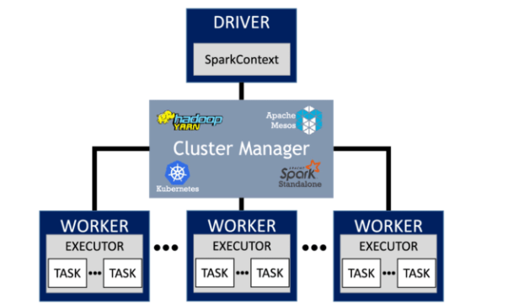
Main Components

Slide 4
How to run it
Repl : Spark-shell, notebooks ➔ exploratory mode
Spark-submit : runs a script ➔ scheduled job
Api for Java, Scala, Python.
Deploy Mode : client vs cluster
Dependencies
Depends on Hadoop Libraries (HDFS and Yarn)
Requires a Java Runtime Environment (need Java in your system path)
Notes:
Client mode : for small interactive jobs ; driver runs locally
Cluster mode : for bigger jobs ; driver runs in a container
Spark is developped in JAVA. Driver and executors are running in java process.

Slide 5
RDD
Resilient Distributed Dataset
The base building block of your application
Lazy : doesn’t compute anything before it really needs to do so.
Immutable : a transformation doesn’t change the data set, it returns a new RDD.
Fault Tolerant : partition can be recomputed in case of failure
Graph
Conceptually, an RDD is a node of a graph of functions.
API is pretty much similar with Functional Programming. Forget the for-loop.
Inside the RDD:
Knows the partitions he is working-on, how data is partitionned
Knows how to iterate over each partition to yield records
Know RDD’s it depends-on
Notes:
Fault Tolerance is also built-in in MapReduce.

Slide 6
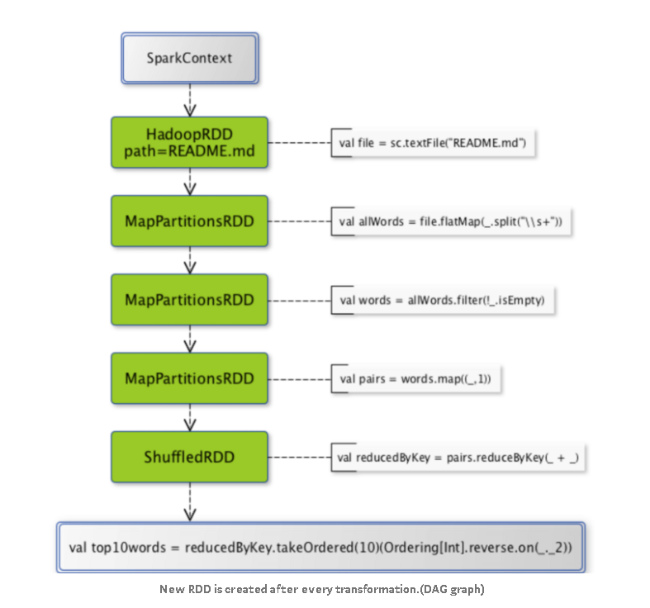
RDD as a Directed Acyclic Graph
MAP
REDUCE

Slide 7
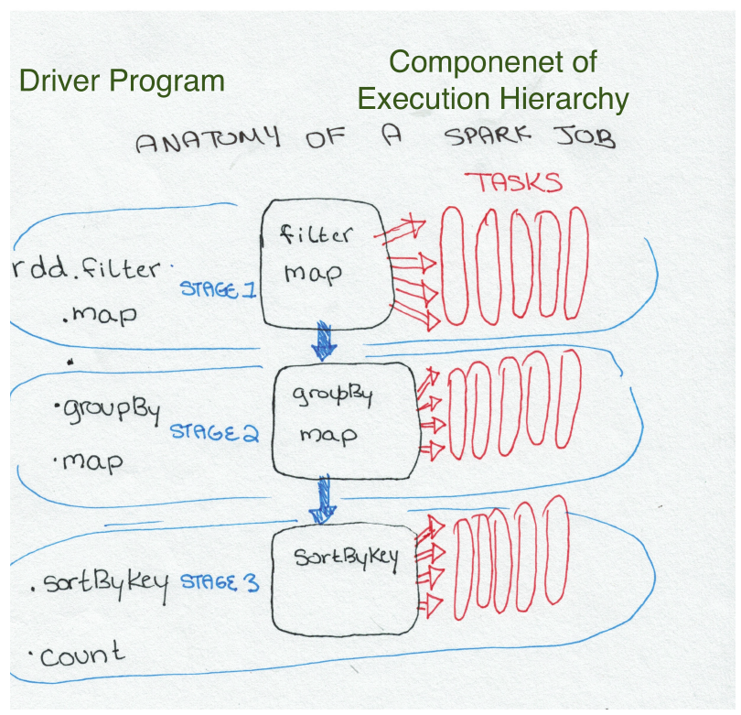
Jobs, Stages, Tasks
Source : high performance Spark

Slide 8
RDD API - Actions
RDD
{"user":"John", "movie":"Blade Runner", "rating":5.0}
{"user":"Louise", "movie":"Dirty dancing", "rating":5.0}
{"user":"Sam", "movie":"Blade Runner", "rating":3.5}
count()
3
RDD
{"user":"John"}
{"user":"Louise"}
{"user":"Sam"}
take(2)
list
{"user":"John"}
{"user":"Louise"}
RDD
{"user":"John"}
….
{"user":"Sam"}
list
{"user":"John"}
….
{"user":"Sam"}
collect()

Slide 9
RDD API - Transformations
RDD
{"user":"John", "movie":"Blade Runner", "rating":5.0}
{"user":"Louise", "movie":"Dirty dancing", "rating":5.0}
{"user":“Sam", "movie":“Blade Runner", "rating":3.5}
RDD
"Blade Runner"
"Dirty Dancing"
"Blade Runner"
map(lambda x:
x['movie'])
RDD
{"user":"John", "movie":"Blade Runner", "rating":5.0}
{"user":"Louise", "movie":"Dirty dancing", "rating":5.0}
{"user":"Sam", "movie":"Blade Runner", "rating":3.5}
RDD of (K, V) pairs
("John", …)
("Louise", …)
("Sam", …)
keyBy(lambda x:
x['user'])
RDD of (K, V) pairs
("John", "Blade Runner")
("Louise", "Dirty dancing")
("Sam", "Blade Runner")
RDD of (K, V) pairs
("John", 12)
("Louise", 13)
("Sam", 12)
mapValues(lambda x:
len(x[1]))

Slide 10
RDD API - Transformations
RDD
"cyberpunk"
"scifi"
"action"
music"
"danse"
"romance"
RDD
{"movie":"Blade Runner", "genres":"cyberpunk;scifi;action"}
{"movie":"Dirty dancing", "genres":"music;danse;romance"}
flatmap(lambda x:
x[‘genres’].split(';'))
RDD
{"user":"John", "movie":"Blade Runner", "rating":5.0}
{"user":"Louise", "movie":"Dirty dancing", "rating":5.0}
{"user":“Sam", "movie":“Blade Runner", "rating":3.5}
RDD
{"user":"John", "movie":"Bl…
{"user":"Louise", "movie":"Dir…
filter(lambda x:
x['rating']>4.0)

Slide 11
RDD API – Actions
RDD
5.0
5.0
3.5
reduce(lambda x, y: x+y)
13.5
RDD of (K, V) pairs
("Blade Runner", 5.0)
("Dirty dancing", 5.0)
("Blade Runner", 3.5)
RDD of (K, V) pairs
("Blade Runner", 8.5)
("Dirty dancing", 5.0)
reduceByKey(lambda x, y: x+y)

Slide 12
Other useful functions
Join (shuffle ? Lazy ?)
Sample
mappartitions
zippartitions

Slide 13
Links
https://spark.apache.org/docs/latest/api/scala/org/apache/spark/api/java/JavaPairRDD.html
https://0x0fff.com/hadoop-mapreduce-comprehensive-description/

