Slide 1
MICHIGAN DEVFEST HACKATHON 2026 · MANUFACTURING TRACK
ShiftProof
What the work instruction leaves out, reviewed for the next shift.
Josh · Daniel · Alex · Jason
Built on IBM Granite on watsonx.ai · ibm/granite-4-h-small
Notes:
0:00 to 0:05. Say the name and the one line: ShiftProof. What the work instruction leaves out, reviewed for the next shift. Then go straight to the problem.

Slide 2
The instruction says adjust the offset. The veteran says wait.
WORK INSTRUCTION WI-114 REV C · STEP 7
VETERAN NOTES · MARV K. (FICTIONAL)
If the pocket is out of tolerance, adjust the tool wear offset and rerun.
A 4 inch bracket that's maybe 40 degrees over shop temperature will read about two thousandths long.
Step 6 says to measure the pocket. It does not say when.
I've watched new guys measure it hot, see it over, chase the wear offset, and then every part after that comes out short once it cools.
FICTIONAL TRAINING FIXTURE
FICTIONAL TRAINING FIXTURE
An apprentice who follows the sheet to the letter can still make scrap.
Notes:
0:05 to 0:25, the problem. An apprentice's first bracket reads two thousandths over. Work instruction WI-114, Rev C, says: adjust the wear offset. The veteran's notes say: wait. A warm aluminum part reads long, and chasing the offset makes every part after it short. The instruction doesn't say that. That is the gap: machinists carry know-how the written instruction leaves out, and when they retire or move shifts it leaves with them.

Slide 3
Every retirement is a knowledge handoff, and most shops have no system for it
583,000
1 in 4
1 in 3
manufacturing workers in Michigan
US manufacturing workers are 55 or older (25.2%)
machine shop workers are 55 or older (31.6%)
Michigan LEO, Oct 2026 ¹
BLS CPS table 18b, 2025 ²
BLS CPS table 18b, 2025 ²
Machinists carry know-how the written work instruction leaves out: how to seat a part, when a measurement can be trusted, where to check twice. When a veteran retires or moves shifts, that knowledge leaves with them.
¹ Michigan Department of Labor and Economic Opportunity, Oct 2026. ² US Bureau of Labor Statistics, Current Population Survey table 18b, 2025. The age figures are national, not Michigan-specific.
Notes:
0:25 to 0:45, why we care. Michigan has about 583,000 manufacturing workers. Nationally a quarter of manufacturing workers are 55 or older, and in machine shops it is closer to a third. Say the age numbers are national, not Michigan-specific, if asked. Every one of those retirements is a knowledge handoff, and a 30-person shop has nobody to run a documentation program. The veteran should only have to talk.

Slide 4
The demo is three clicks: Compare, Review, Ask
1 COMPARE
2 REVIEW
3 ASK
VETERAN
VETERAN · QUALITY LEAD
APPRENTICE
Granite reads the work instruction beside the veteran's notes. It flags what the instruction leaves out, quotes both sources, and asks a follow-up question. The app checks the quotes against the sources.
Granite drafts a guide card from the veteran's answer. The veteran confirms it. The quality lead approves it. A card only moves forward.
At the machine, on a phone. The answer comes only from approved cards and cites the veteran's words. Nothing approved covers it? Ask your lead or quality.
The work instruction itself never changes. ShiftProof adds reviewed context next to it.
Notes:
0:45 to 0:55. Three clicks. Compare finds the gap. Review turns it into a card two people sign off. Ask gives the apprentice an answer from approved cards only. If the live demo runs, leave this slide up and drive the app; the next three slides are the fallback and show the same path.

Slide 5
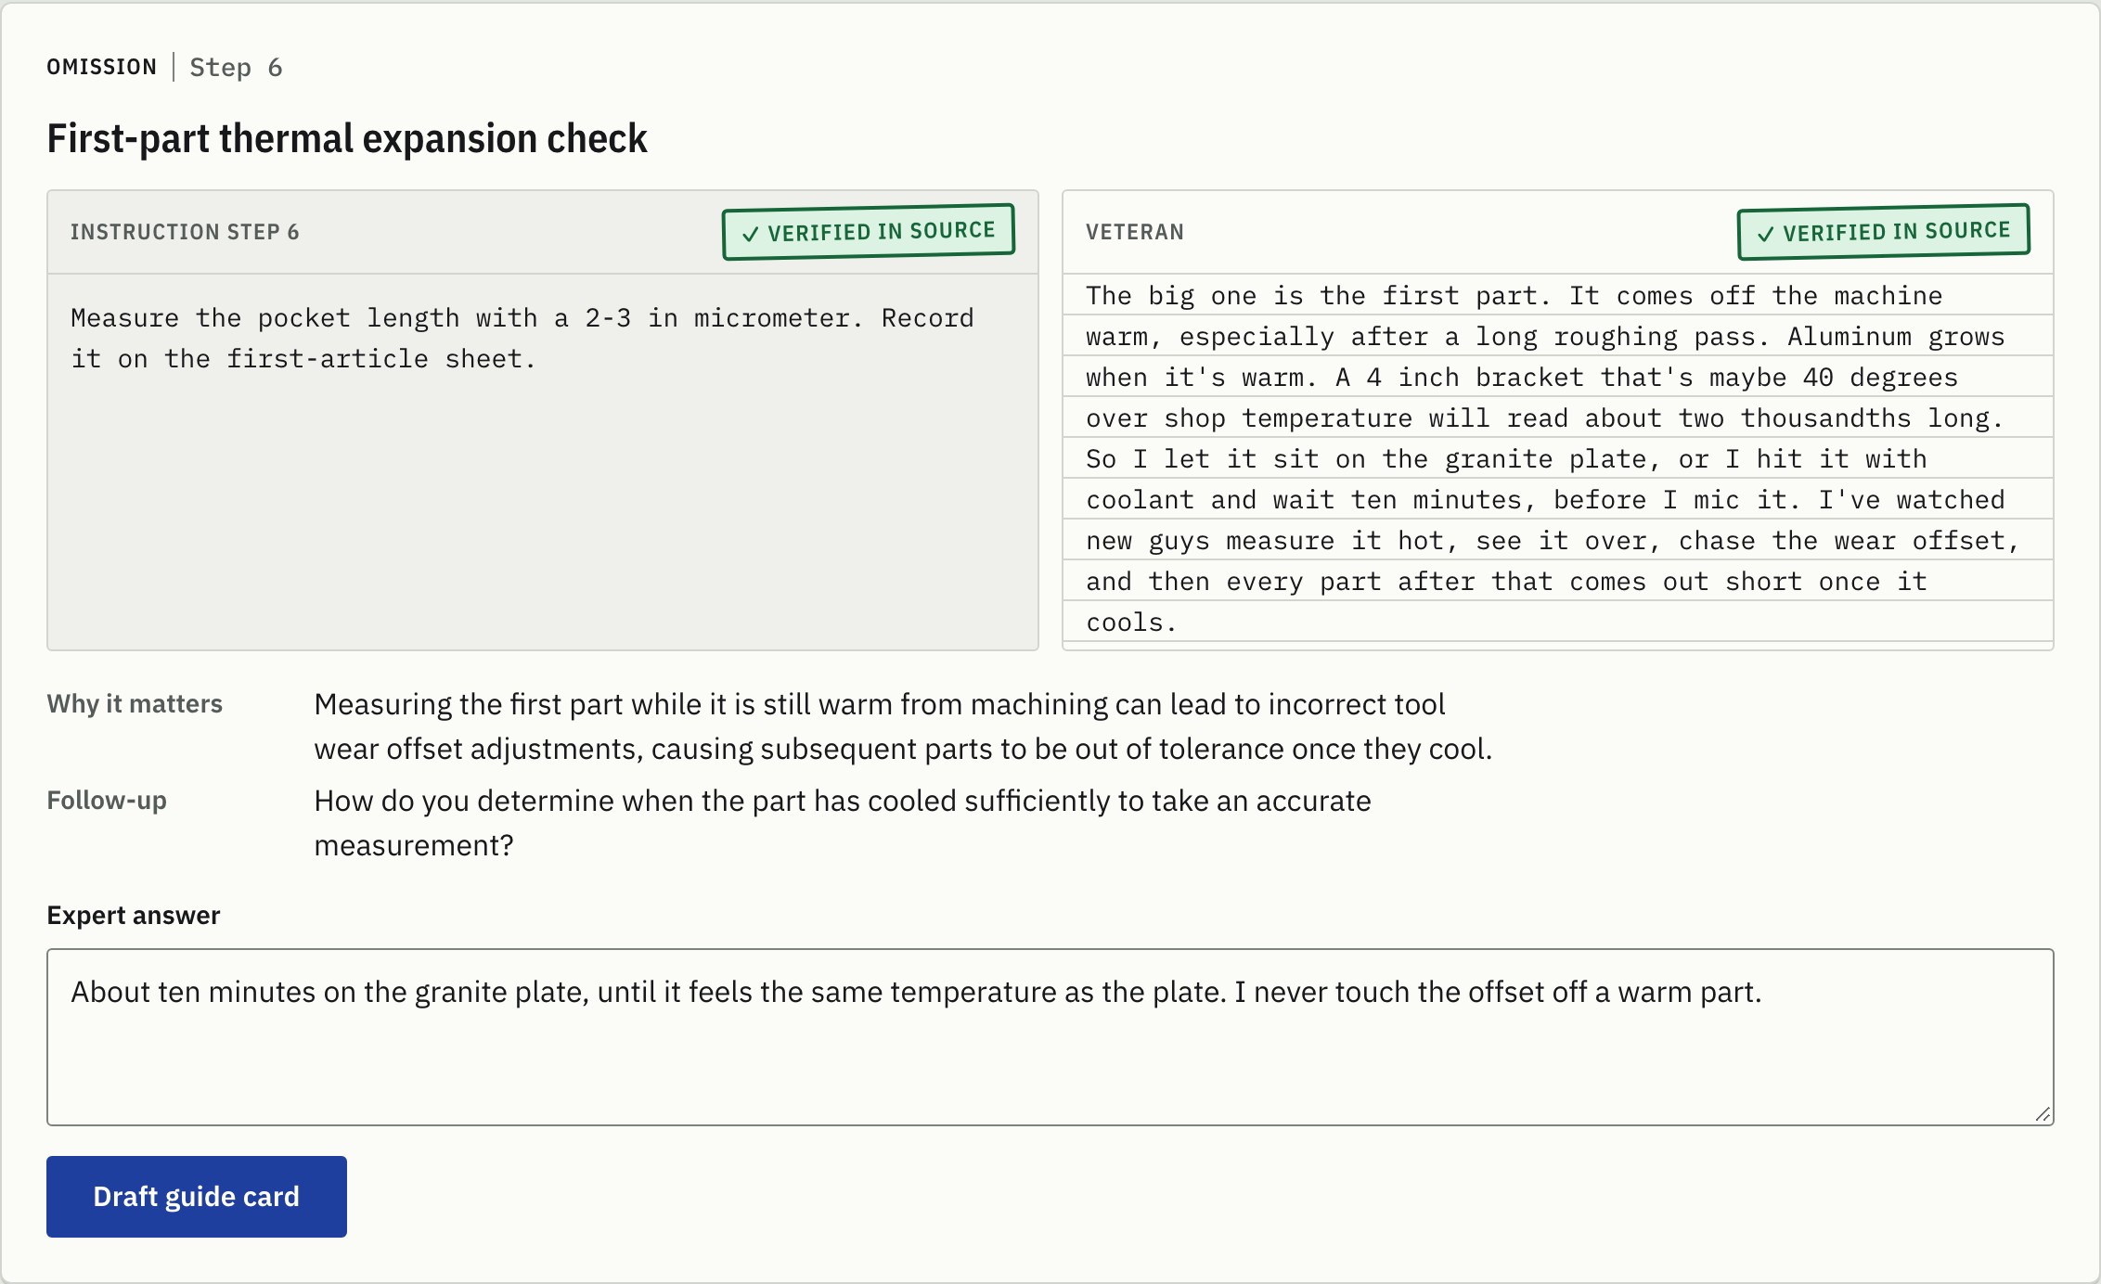
Compare: Granite flags what the instruction leaves out, and the app checks its quotes
WI-114 Rev C beside the veteran's notes, both labelled fictional
One finding per gap: omission, ambiguity or conflict
Quotes copied word for word, and the app checks them against the sources
A follow-up the veteran can answer from experience
Live capture: Granite on watsonx.ai · ibm/granite-4-h-small. Fictional training fixture.
Notes:
0:55 to 1:25, Compare. The work instruction sits beside the veteran's notes. Click Find gaps. Granite flags the cooling gap at Step 6, quotes both sources, and the app stamps each quote verified in source. If a quote is not found in the source, the finding is marked and cannot become a card. Then Granite asks the veteran a follow-up, and the veteran types a plain answer.

Slide 6
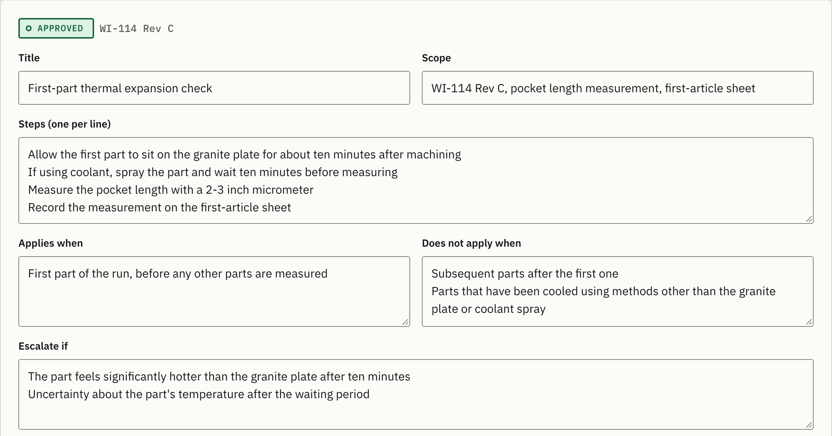
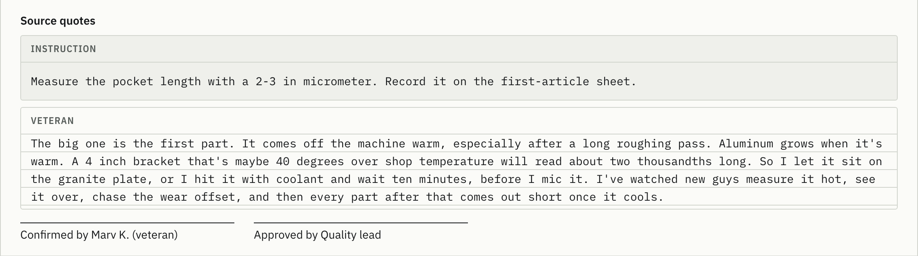
Review: the veteran confirms, quality approves, and the order can't be skipped
CANDIDATE
EXPERT CONFIRMED
APPROVED
Granite drafts the card from the veteran's answer
Any edit sends the card back to candidate
Skipping a step is rejected by the server
Live capture: Granite on watsonx.ai · ibm/granite-4-h-small. Fictional training fixture.
Notes:
1:25 to 1:50, Review. Granite drafts a guide card from the answer: scope, steps, when it applies, when it doesn't, when to escalate. The veteran confirms the account is accurate. Switch role to Quality lead and approve it for training. Status goes candidate, expert confirmed, approved, one step at a time, and any edit sends it back to the start. The server rejects a skipped step. The work instruction itself never changes.

Slide 7
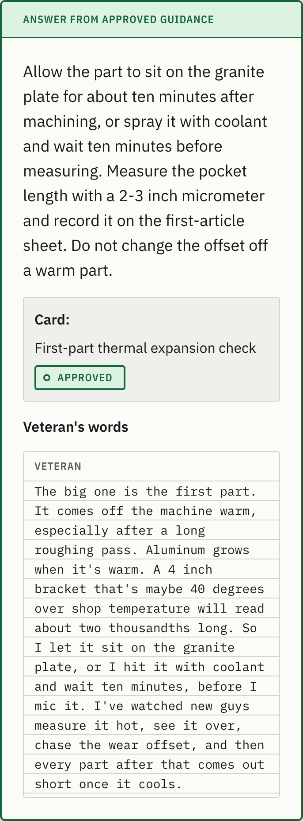
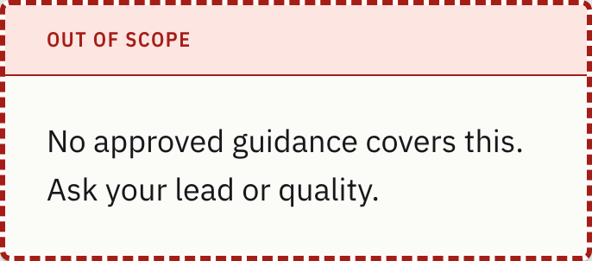
Ask: the apprentice gets an answer from approved cards only, or a refusal
APPROVED GUIDANCE
OUT OF SCOPE
The apprentice asks in their own words, on a phone at the machine
The answer uses only approved cards for WI-114 Rev C and cites the veteran's words
Nothing approved covers it? The app says so and sends them to a lead.
No approved card, no model call
Live captures at 375 px wide. Granite on watsonx.ai.
Notes:
1:50 to 2:15, Ask. Back at the machine, the apprentice asks: my first bracket measured 0.002 over, should I bump the wear offset? The answer comes only from the approved card: let it cool, measure again, then follow the work instruction. It cites the veteran's own words. Then the spindle-speed question: no approved card covers it, so the app says so and sends them to a lead. The answer shows the approved card it cites, so the apprentice can check it. Whether a part is good stays quality's call.

Slide 8
Granite proposes. App code decides.
Sources
Granite proposes
App code checks
People decide
Work instruction and veteran notes, as text
Finds gaps, asks follow-ups, drafts cards, answers
Quotes, status order, scope, citations
Veteran confirms. Quality lead approves.
IBM Granite ibm/granite-4-h-small on watsonx.ai · Next.js and TypeScript · model JSON validated with zod
TRUST RULES, ENFORCED IN APP CODE, NOT IN THE PROMPT
The veteran's quote, and the instruction quote when a step is named, are checked against the sources. If one isn't found, the finding can't become a card.
Cards move one way: candidate, expert confirmed, approved. The server rejects a skipped step.
1
2
Ask uses only approved cards for WI-114 Rev C. When none exist, the model isn't called at all.
Citations are filtered on the server, and the app writes the refusal itself, never the model.
3
4
Notes:
2:15 to 2:45, how it works. Next.js and TypeScript, with IBM Granite on watsonx.ai, ibm/granite-4-h-small. Granite reads and drafts. The app decides what counts: it checks the quotes against the sources, it only lets a card move forward, it only answers from approved cards for the right revision, and it filters citations on the server. If nothing is approved, Granite isn't even called. On a shop floor a confident wrong answer is worse than no answer, so those rules live in code, not in the prompt.

Slide 9
Limits today, and what comes next
LIMITS TODAY
NEXT
Demo roles, not real sign-in. The review order is enforced in code; who clicks is a demo switch.
One procedure, one revision: WI-114 Rev C, a fictional fixture.
Text in, no audio capture yet.
Checks pass by hand. Scripted acceptance tests are in progress.
Voice capture, so a veteran can talk through a job at the machine
Ingest real manuals and work instructions with Docling
Block reuse when a procedure revision changes
Ask already runs through watsonx Orchestrate. Next, the veteran-to-quality hand-off
watsonx.governance for audit trails
Notes:
2:45 to 3:00, limits and next. Be straight about what it doesn't do yet: demo roles, one revision, text only, scripted tests still in progress. Next is voice capture so the veteran talks instead of types, real manuals through Docling, blocking reuse when a revision changes, and moving the veteran-to-quality hand-off onto watsonx Orchestrate. Ask already runs through Orchestrate: the shiftproof_apprentice agent calls the app's Ask route, so the same trust rules apply.

Slide 10
What the veteran knows, reviewed, at the machine.
SHIFTPROOF · BUILT ON IBM GRANITE ON WATSONX.AI
github.com/critesjosh/mi-devfest
Josh · Daniel · Alex · Jason
AI tools used are listed in the repo README. All demo documents are fictional training fixtures.
Notes:
Hold this slide for questions. The repo has the code, the fixtures, the design system and the AI-tool disclosure.

