Slide 1

OSCORE
End-to-end secure communication for CoAP
Marco Tiloca
Ph.D., Senior Researcher
Cybersecurity Unit – RISE

Slide 2
Just a quick look at …
CoAP
OSCORE
Related activities

Slide 3
CoAP

Slide 4
CoAP
Constrained Application Protocol – RFC 7252
Web-transfer protocol, at the application layer
Think of it as a “lightweight alternative to HTTP” for the Internet of Things
Supported transports
Most used is UDP over IP
TCP or WebSockets (RFC8323)
SMS, CIoT, Bluetooth, LoRaWAN, IEEE 802.15.4, …
RESTful protocol
What matters is the resource status on the server and its transfer
Supported methods: GET, POST, PUT, DELETE
More recent ones: FETCH and PATCH (RFC 8132)

Slide 5

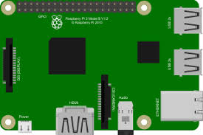
CoAP
Message exchange based on the Client-Server model
Request-Response exchanges
Some more message types for possible reliability
Token (variable length): set by the client sending a request
A Response has the same Token value of the Request
I.e., a response matches a request by Token
Request
Response
Server
Client

Slide 6
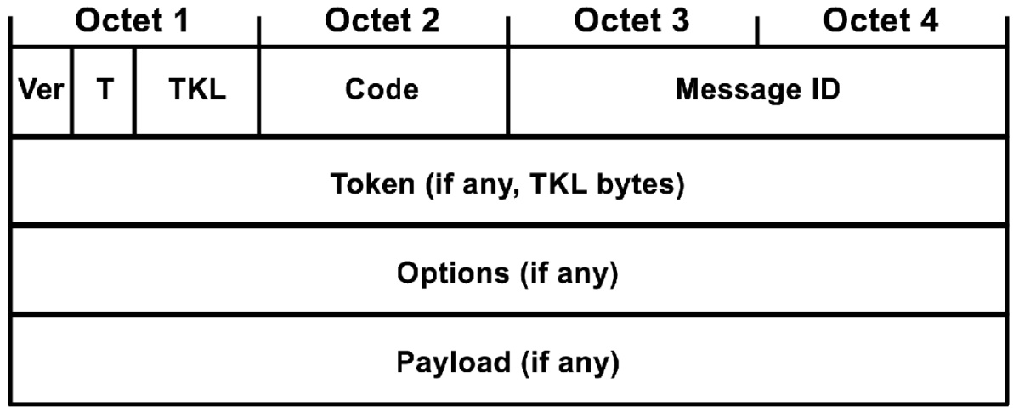
CoAP message format
Very compact size
Options (variable length)
Signaling extra protocol/message features
Encoding: Number/Length/Data
Payload (variable length)
If present, it starts with a 0xFF byte as marker
The payload ends when the datagram ends

Slide 7
Notable extensions
Observe (RFC 7641)
The client sends a Request and registers as an Observer
The server sends a Response with the current resource representation
When the resource content changes, the server sends a Notification response
The client can unregister or just silently forget about an observation
Blockwise (RFC 7959)
A whole content to deliver (body) can be too big to transfer
A sender can split the body into chunks (blocks), each sent in one CoAP message
The recipient will re-build the whole body when received all the blocks

Slide 8
Proxies
Intermediary nodes between client and server
Forward-proxy or reverse-proxy
HTTP-to-CoAP or CoAP-to-HTTP cross-proxy
Forward proxy
The client sends a request to the proxy, indicating the origin server to target
The proxy forwards the request to the origin server
The server sends a response to the proxy, thinking of it as a client
The proxy forwards the response to the client
Performance benefit
The proxy can cache responses to GET/FETCH requests
After the first client, next clients will get the response from the proxy
Server
Proxy
Client

Slide 9




Some more features
Support for one-to-many communication
Over UDP and IP multicast
Over any transport supporting one-to-many delivery
Message security
Nothing natively
Original suggestion for DTLS 1.2 (RFC 6347)
Security at the transport layer
Hop-by-hop – i.e. not end-to-end
With DTLS 1.2
Security terminates at a proxy, that starts a second secure session with the server
No support for CoAP over multicast
Server
DTLS
Channel
DTLS
Channel
Client
Proxy

Slide 10
OSCORE

Slide 11
OSCORE
Object Security for Constrained RESTful Environments – RFC 8613
End-to-end security at the application layer
Encryption, integrity and replay protection
Selective protection of CoAP messages
Use COSE (CBOR Object Signing and Encryption) – RFC 8152
Faithful to CoAP
Works wherever CoAP works (UDP, TCP, SMS, CIoT, IEEE 802.15.4, …)
Supports options and proxy forwarding (RFC 7252)
Supports Observe (RFC 7641) and Blockwise (RFC7959)
Supports PATCH & FETCH (RFC 8132) and CoAP over TCP (RFC 8323)
Can be used with HTTP and when translating between CoAP and HTTP

Slide 12
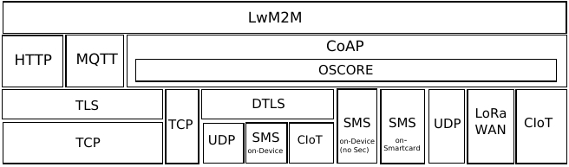
OSCORE
Included in OMA LwM2M as application-layer security solution

Slide 13
OSCORE – End-to-End message protection
Security
Context
Security
Context
Client
Proxy
Proxy
Server
HTTP
CoAP
CoAP
End-to-end security

Slide 14
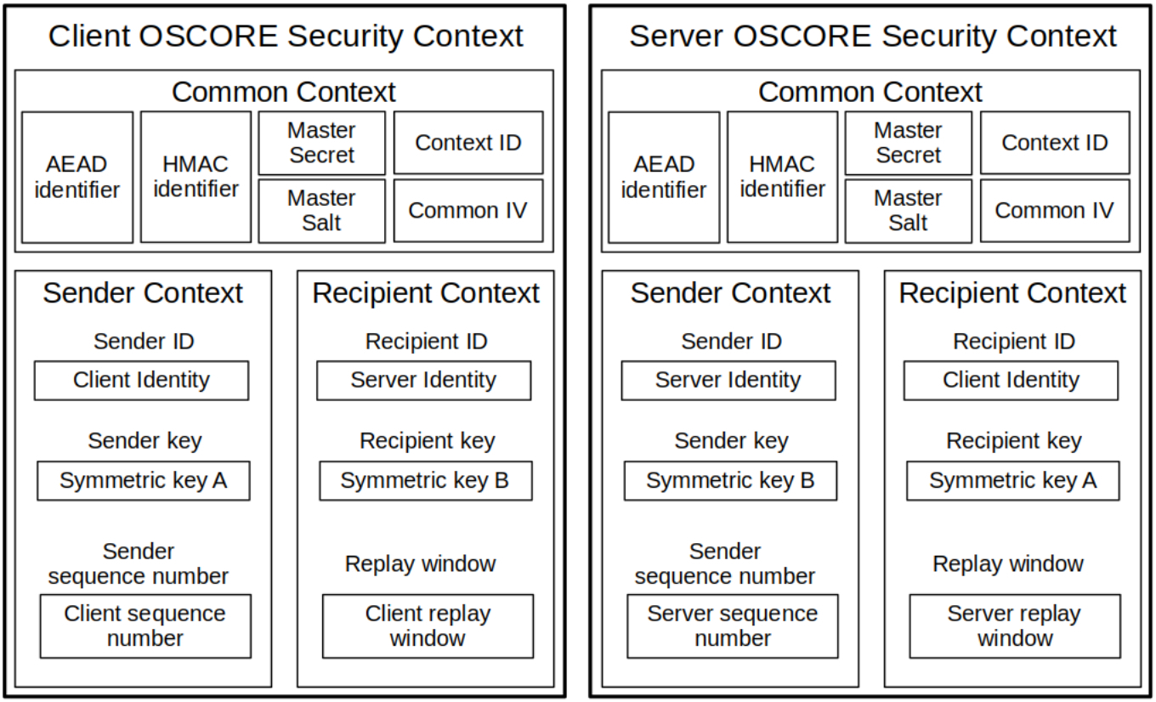
OSCORE – Security context
Security
Context
ID Context
Security
Context
ID Context
Client
Server

Slide 15

OSCORE – The mechanics
How it works
OSCORE Security Context shared between the two peers
Use signaled through the “OSCORE” CoAP option
It wraps a CoAP message into a COSE object
It delivers the result as a secured CoAP message
Selective encryption/authentication of CoAP fields
Class E: encrypted via the AEAD algorithm, hidden inside the OSCORE payload
Class I: integrity protected and visible from the outside (outer options)
Class U: unprotected and visible from the outside (outer options)
What is protected?
Encrypted and authenticated: original payload; original REST code; class E options
Authenticated only: class I options; other info as Additional Authenticated Data (AAD)

Slide 16
OSCORE – The mechanics
OSCORE Security Context – Common, Sender and Recipient parts
Contexts derived from a few input parameters, to be pre-established
Common
Common
Security Context
Sender Sender ID = 0
Supported change of roles, but Sender and
Recipient Context must remain unchanged
Sender Sender ID = 1
Security Context
Recipient Recipient ID = 1
Recipient Recipient ID = 0
1. Protect request with Sender Context
4. Verify response
with Recipient Context
2. Verify request with Recipient Context
3. Protect response with Sender Context
Client
Server

Slide 17
Related activities

Slide 18

Related activites (1/2)
Methods to establish OSCORE keys
OSCORE profile – Use the ACE Framework for Authentication and Authorization
Optimized execution of the EDHOC key establishment protocol
Lightweight method to update OSCORE keys (KUDOS)
Compact, with minimal message exchanges
Able to preserve high-level security properties
Robust against node rebooting
Advanced use for proxies
Caching of OSCORE-protected responses
Using of OSCORE also at proxies
Server
Client 1
Proxy
Client 2

Slide 19



Related activites (2/2)
Group OSCORE
End-to-end security for CoAP group communication
Adapted structures, constructs and mechanisms from OSCORE
The same security requirements of OSCORE are fulfilled
Source authentication is ensured
Secure binding between request and responses is ensured
Key provisioning for Group OSCORE
Coordinated by a Group Manager
Contextual with the authorized joining of a group
Authorization to join enforced by using the ACE framework

Slide 20

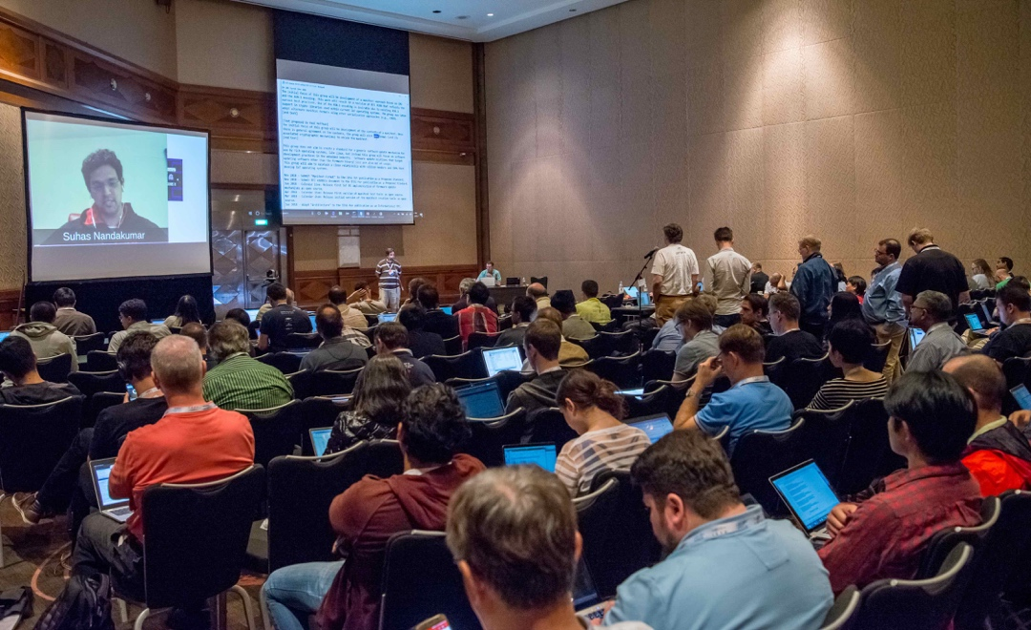
IETF standardization
Open standards through an open process
The mission of the IETF is to make the Internet work better by producing high quality, relevant technical documents that influence the way people design, use, and manage the Internet. [RFC 3935]
Several IoT-related Working Groups
CoRE, ACE, LAKE, …
Join and participate!

Slide 21
Thanks!
marco.tiloca@ri.se

