Slide 1
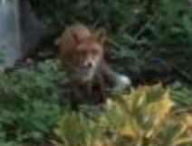
Foxie Sensor API for your Raspberry Pi
Raspberry Pi - IoT and Cognitive Platform with Python Flask, Firebase, Requests, Django and Bokeh
Lin Zhang, Mihai Criveti, Shailesh Wadhwa, Zhenbang Xiao, Ruiqi Li

Slide 2
Features
Python Library to retrieve sensor data from Raspberry Pi, Sensehat, etc
Corrected temperature readings (correlated with CPU temperature)
Python Camera: check your surroundings!
Graph reading data and predict what to wear (hat? Umbrella?)

Slide 3
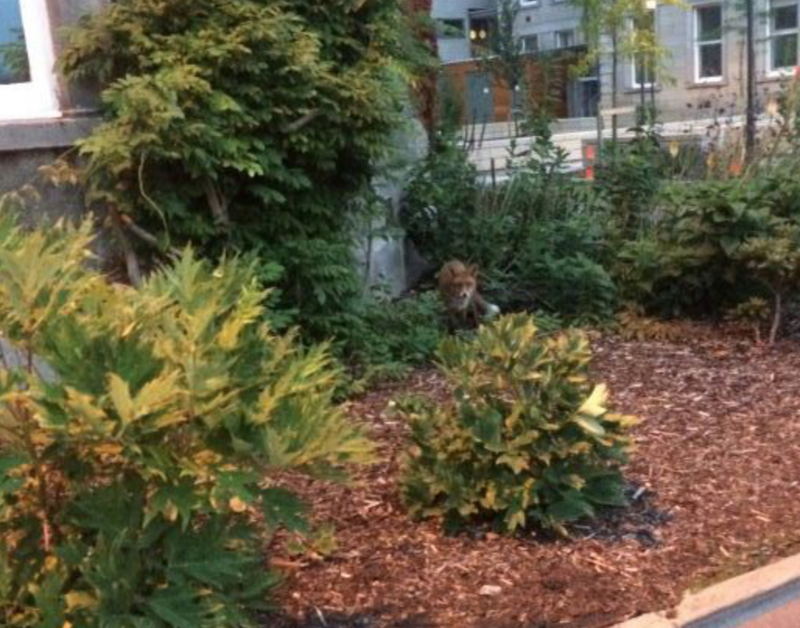
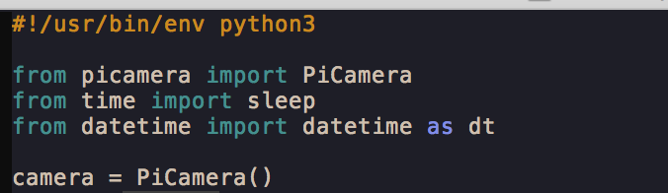
PyCamera
Capture Camera to Bytestream and Display (REST API and library)

Slide 4
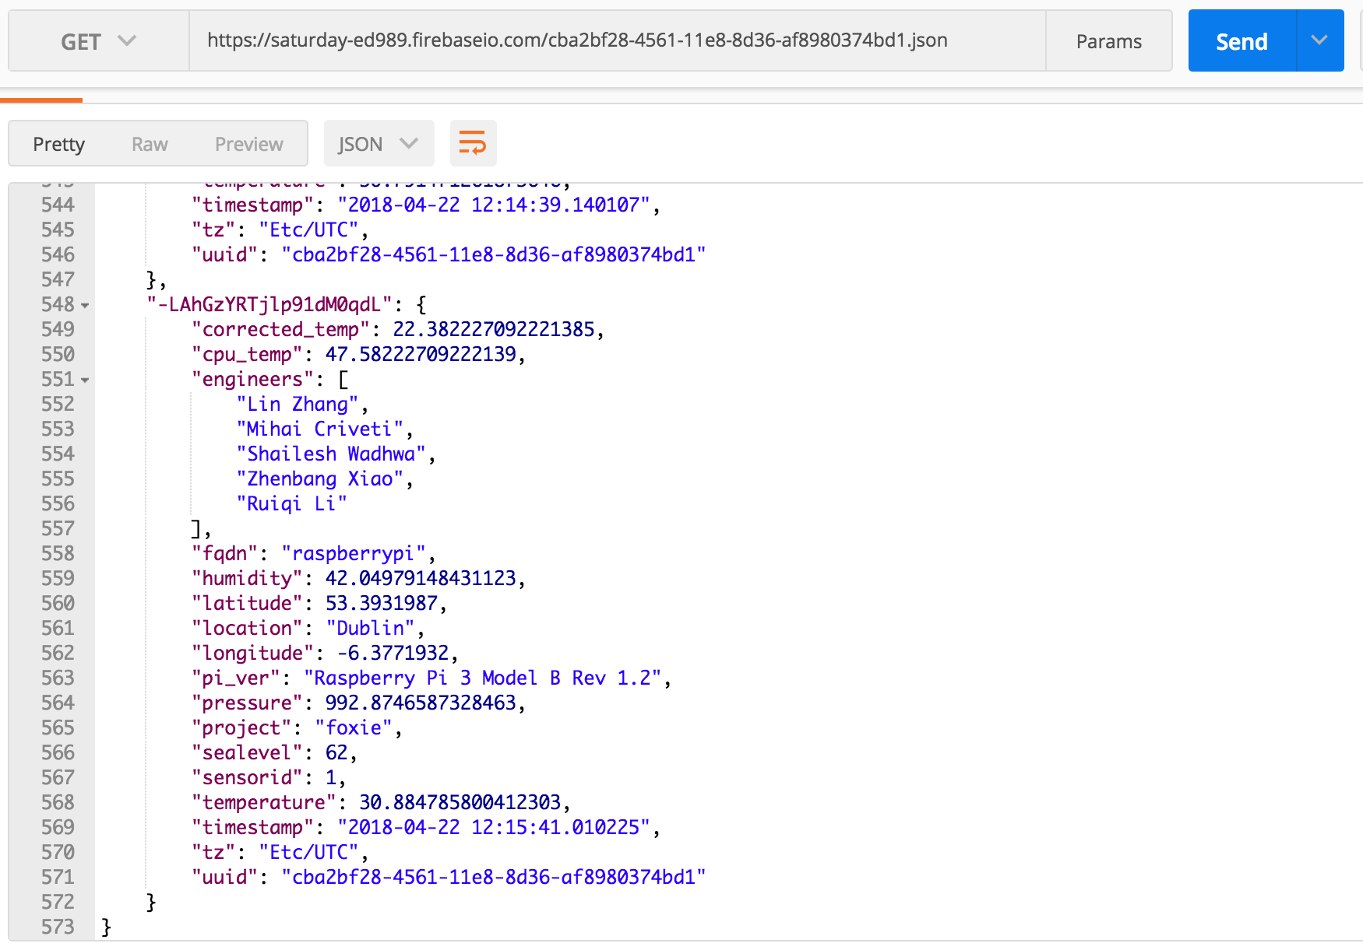
JSON API and NoSQL Database for IOT

Slide 5
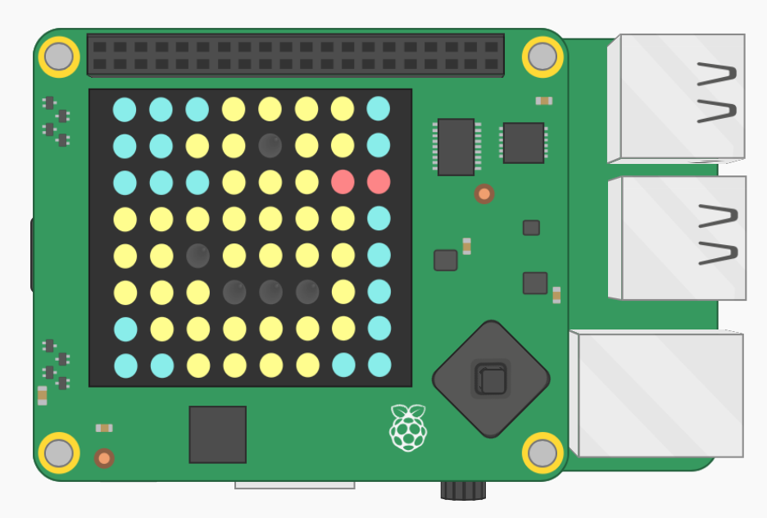
Rubber Duck (It’s about to rain!)

Slide 6
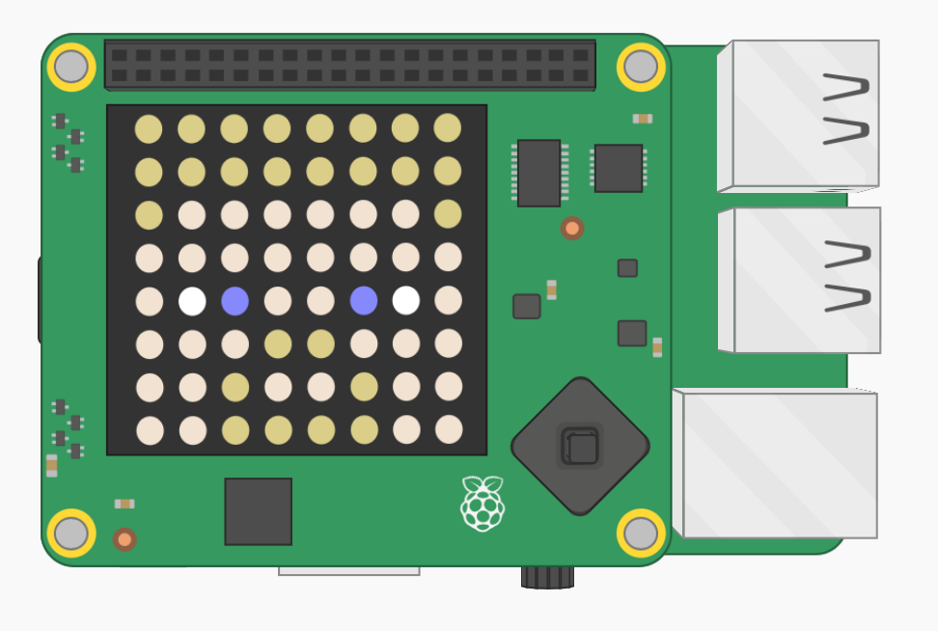
Steve (It’s cold, wear a hat)

Slide 7
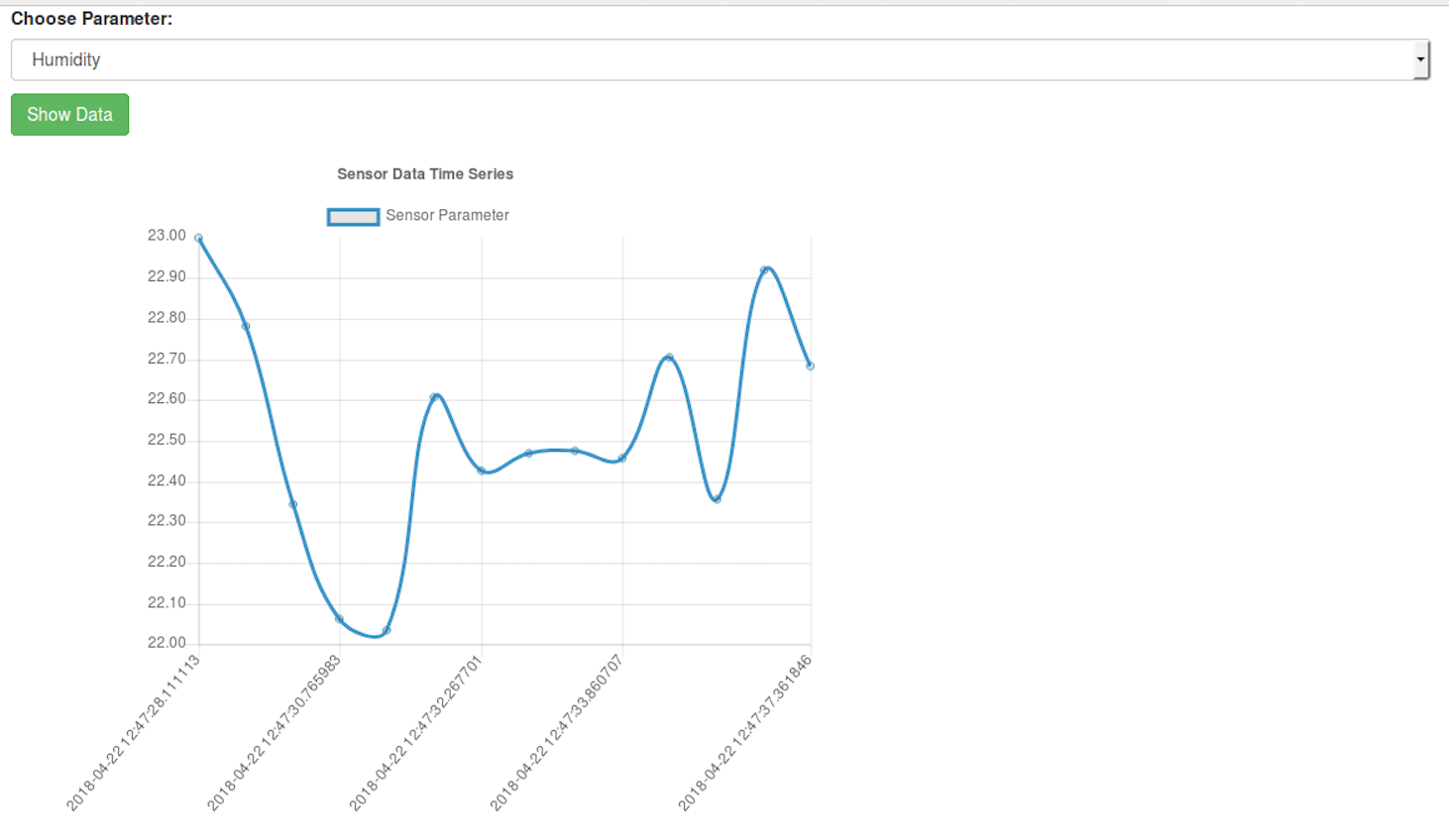
Graphing

Slide 8
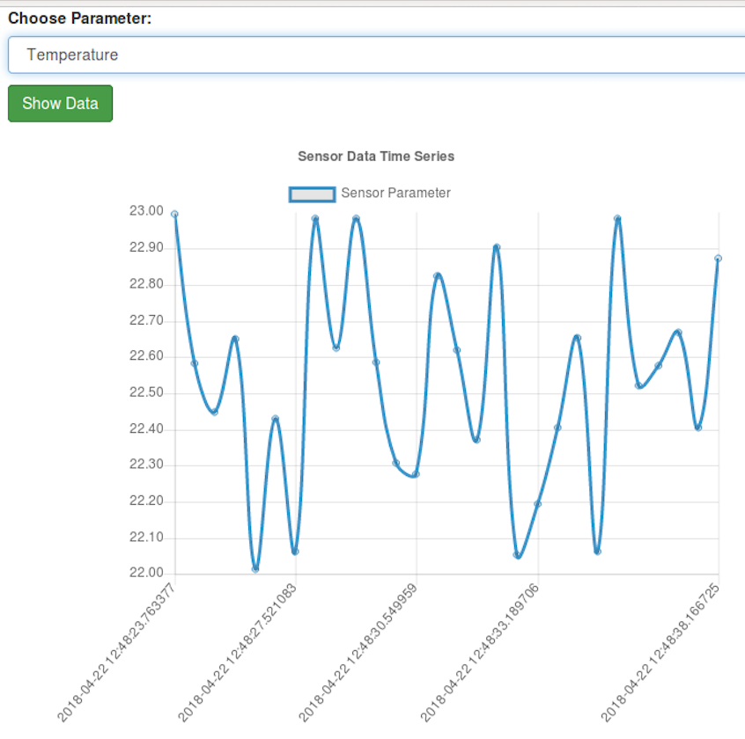
Graphing

Slide 9
Graphing

