Slide 1
docker in action

Slide 2
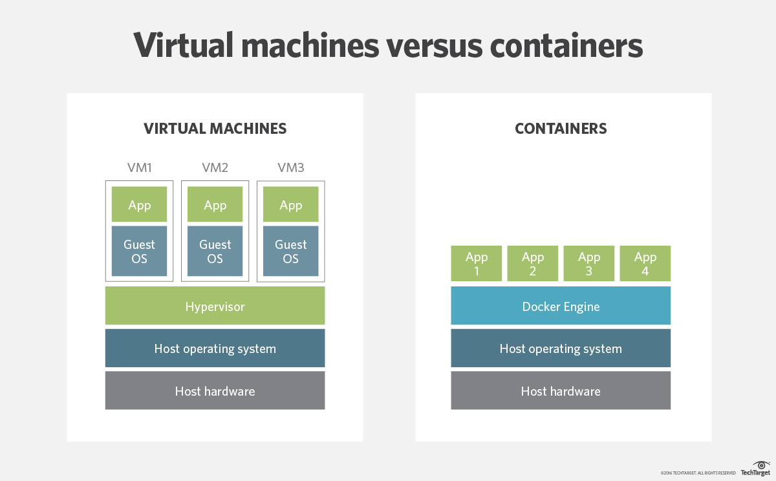
VMs vs containers
Containers and VMs are similar in their goals: to isolate an application and its dependencies into a self-contained unit that can run anywhere.

Slide 3
container vs docker
(OCI)

Slide 4
vs
linux
containers
windows
containers

Slide 5

https://12factor.net/

Slide 6
docker architecture
Docker Images | A recipe or template for creating Docker containers. It includes the steps for installing and running the necessary software.
Docker Container | Like a tiny virtual machine that is created from the instructions found within the Docker image originated
Docker Client | Command-line utility or other tool that takes advantage of the Docker API to communicate with a Docker daemon
Docker Host | physical or virtual machine that is running a Docker daemon and contains cached images as well as runnable containers created from images
Docker Registry | A repository of Docker images that can be used to create Docker containers. Docker Hub is the most popular social example of a Docker repository.
Docker Machine | A utility for managing multiple Docker hosts, which can run locally in VirtualBox or remotely in a cloud hosting service such as Amazon Web Services, Microsoft Azure, or Digital Ocean

Slide 7
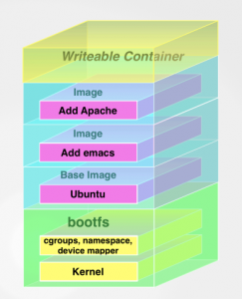
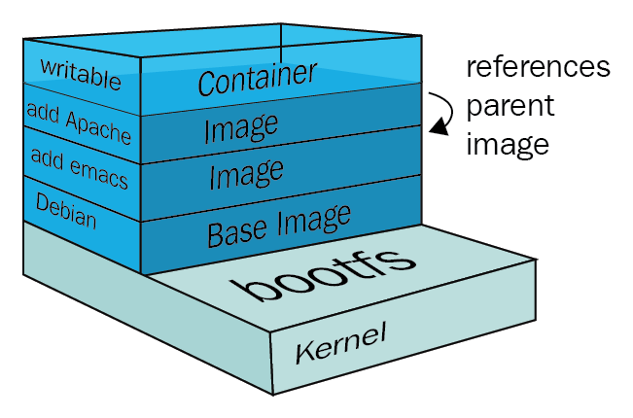
docker layered file system
https://collabnix.com/understanding-docker-container-image/
https://medium.com/docker-captain/docker-basics-f1a06fde18fb

Slide 8
docker workflow

Slide 9
docker usages
Provisioning backing services during development phase
Development environment for application code
Run tests
DevOps application
Create full local and testing environments
Deployment/Packaging solution

Slide 10
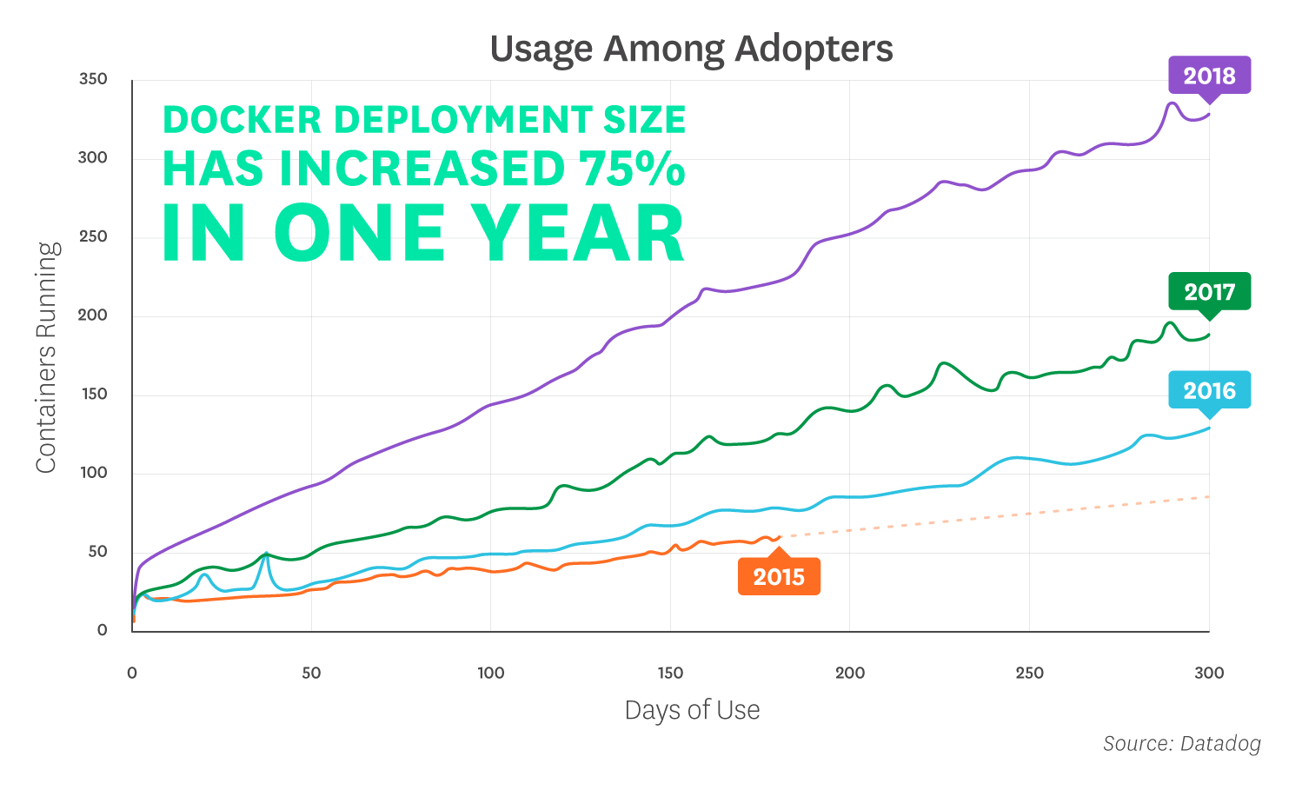
DOCKER ADOPTION TREND
https://www.datadoghq.com/docker-adoption/

Slide 11
Software List request from E&L
Current way
- VS 2017
- VS Code
- git 2.20.1
- mongo 3.4.19
- mongo 2.6.12
- mongo 1.8.0
- rabbitmq 3.7.10
- SQL Server 2017
- node v10.15.0
- node v9.4.0
- node v8.2.0
- node v7.2.0
- node v5.1.1
- node v4.4.4
...TO BE CONTINUE...
Docker way
- VS 2017
- VS Code
- git 2.20.1
- Docker Desktop

Slide 12

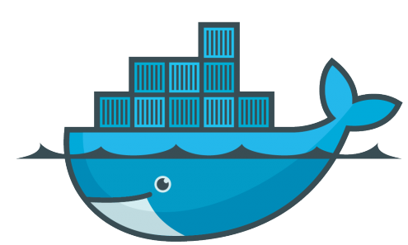


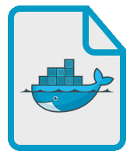
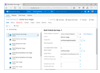

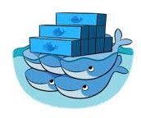







CI/CD
Docker Engine
TFS Source Control
TFS Build
TFS Release
Docker Swarm
C#
Dockerfile
Docker Image
Azure Container
Registry

Slide 13
demo

Slide 14
WOA
2003
2007
2013
2017
Windows
cassini
.net framework 1.1
WebForms
access
Mac OS
VirtualBox
Windows
cassini
.net framework 1.1
WebForms
access
Mac OS
xsp4
mono
WebForms
sqlite
Mac OS
docker engine
docker container
kestrel
.netcore2.0
WebApi
sqlite
VisualStudio
Manual Deployment
VisualStudio
Manual Deployment
VisualStudio
Manual Deployment
VisualStudio
Github
Travis
Canister
Heroku
docker-compose
.bat file
browser bookmark
.bat file
browser bookmark
.command file
browser bookmark
browser bookmark

