Slide 1
Data Profiling and Data Cleansing – Assignment 4 Duplicate Detection
Group 1:
Christoph Oehlke christoph.oehlke@student.hpi.uni-potsdam.de
Markus Hinsche markus.hinsche@student.hpi.uni-potsdam.de

Slide 2
Our approach: Machine Learning
partitions 10%
partitions 100%
learn
similarity model
classify
non-
duplicates
duplicates

Slide 3
Our approach: Machine Learning
partitions 10%
partitions 100%
learn
similarity model
classify
non-
duplicates
duplicates

Slide 4
Learning input: Gold standard + features
id1 | id2 | jaro_avg | jaro[address_1] | jaro[address_2] | ... | is_duplicate?
1 | 3 | 0.832 | 0.721 | 1 |  | 1
2 | 5 | 0.978 | 0.820 | 0.655 |  | 1
4 | 6 | 0.947 | 1 | 0.778 |  | 1
... | ... | ... | ... | ... | ... | ...
1 | 2 | 0.431 | 0.316 | 0.517 |  | 0
1 | 4 | 0.573 | 0.516 | 0 |  | 0
1 | 5 | 0.732 | 1 | 0.121 |  | 0
1 | 6 | 0.264 | 0.217 | 0.313 |  | 0
2 | 3 | 0.489 | 0 | 0.162 |  | 0
... | ... | ... | ... | ... | ... | ...

Slide 5
Learning output: Similarity model
if (jaro_avg >= 0.83) and (damerau_levenshtein_avg >= 0.73)
or
(jaro_avg >= 0.82) and (jaro[address_1] >= 0.84)
or
(jaro_avg >= 0.83) and (jaro[phone_number] >= 0.92)
or
(jaro_suburb >= 0.87) and (jaro_avg >= 0.80) and (levenshtein_avg >= 0.64):
then: duplicate ☺
else: non_duplicate ☹

Slide 6
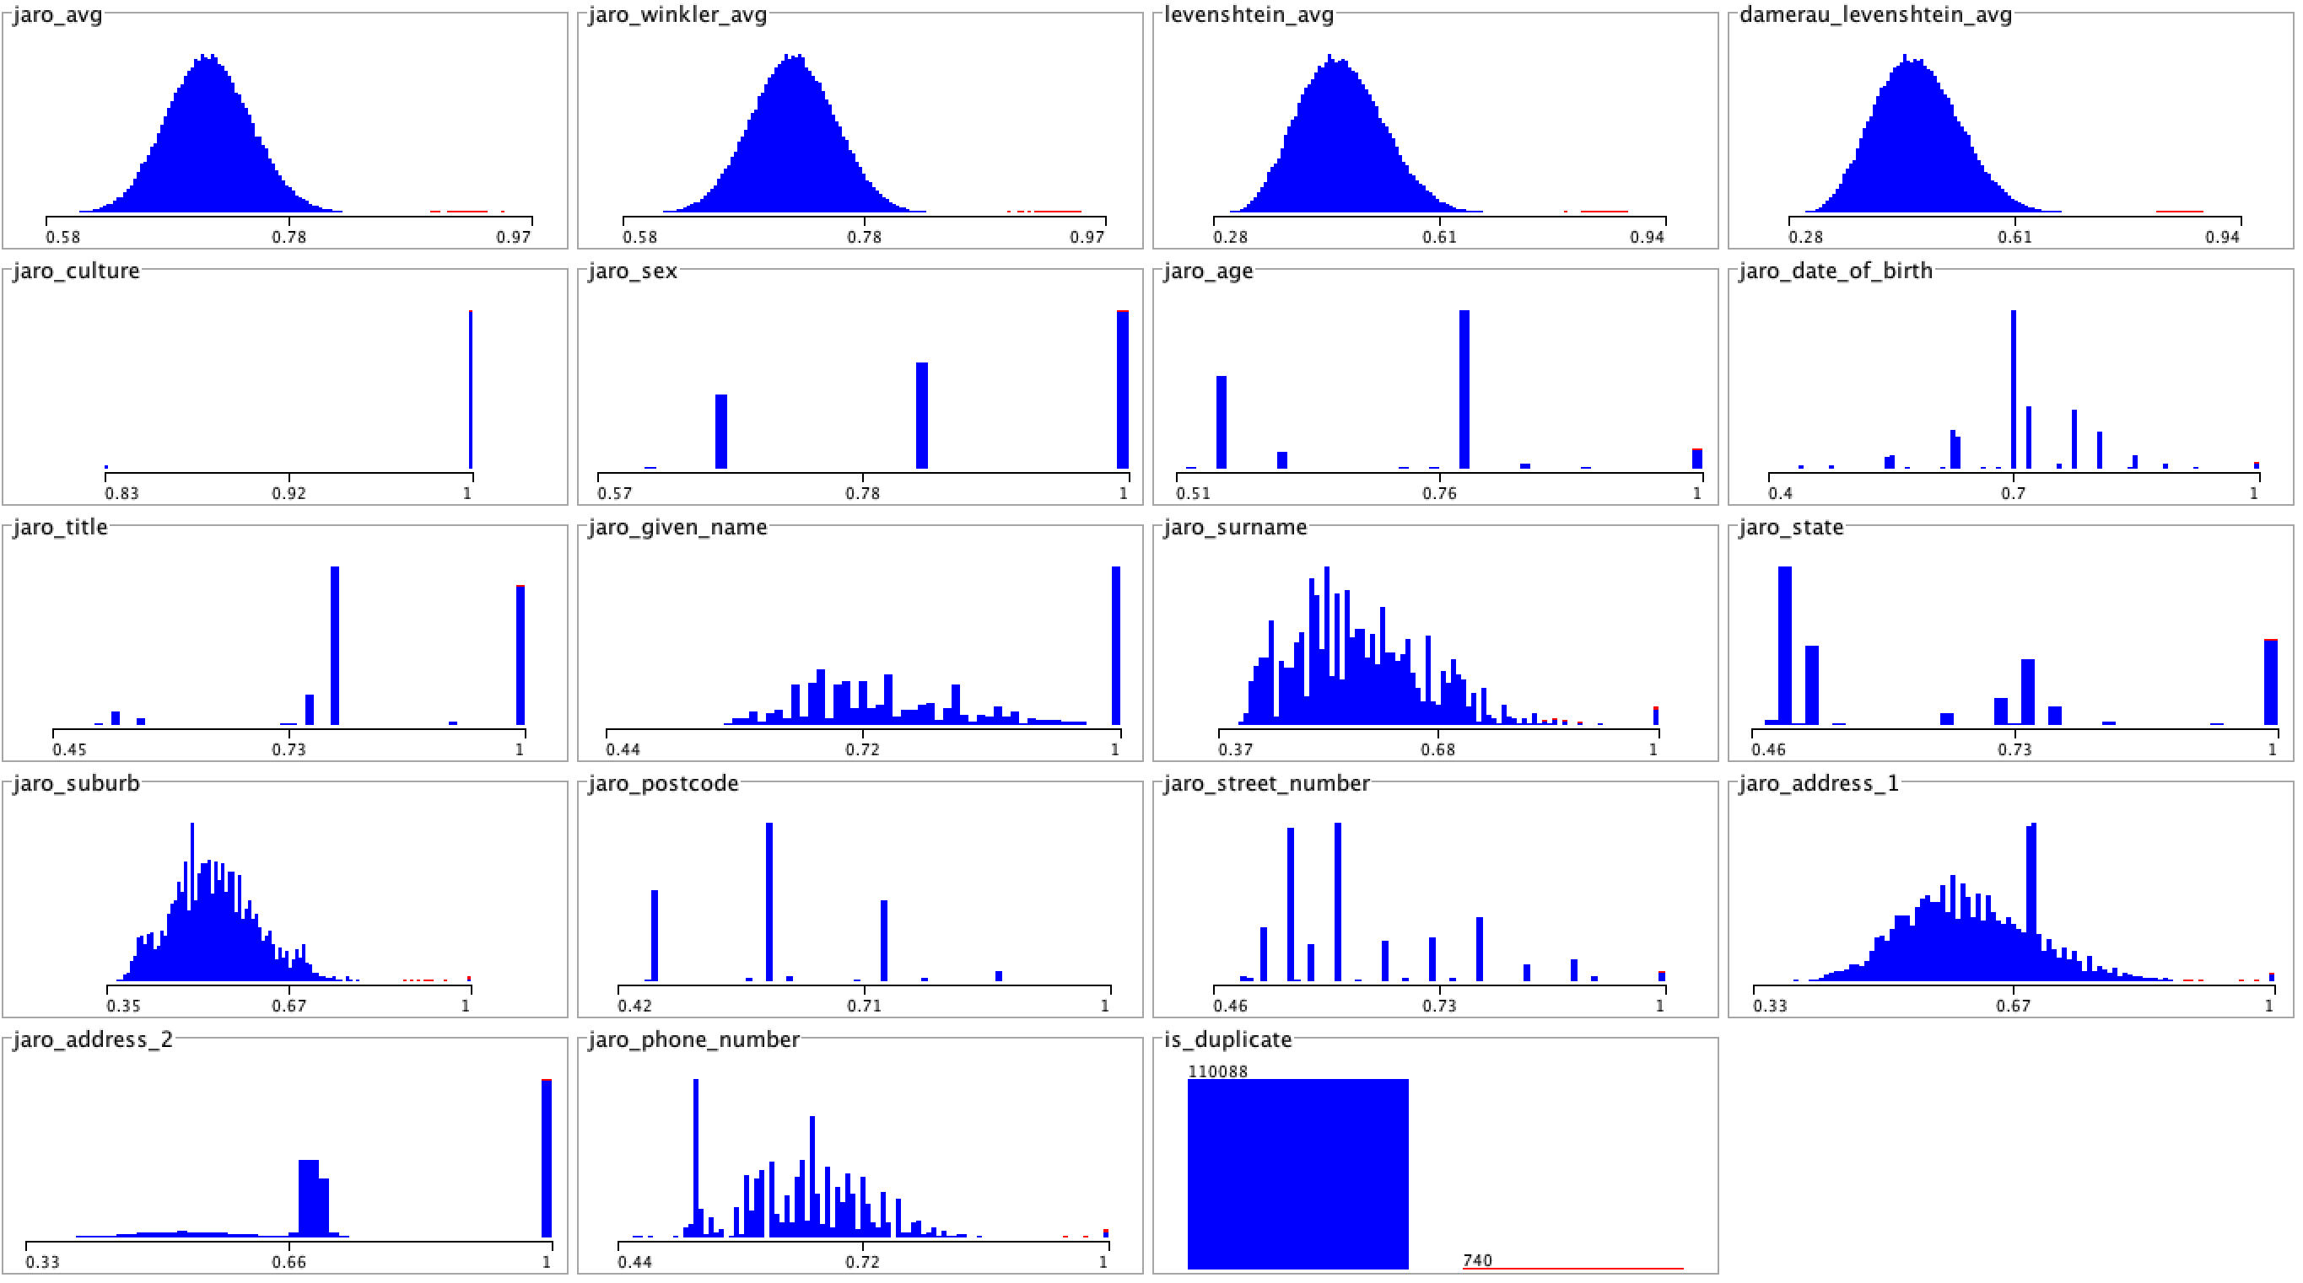

Slide 7
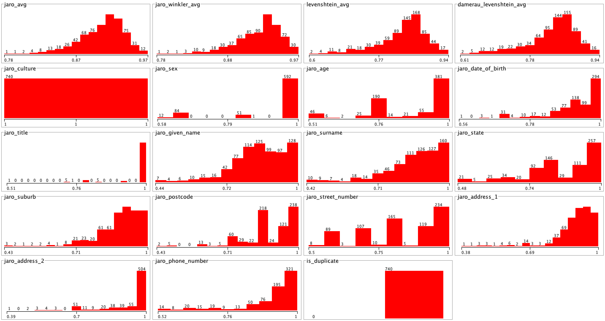

Slide 8
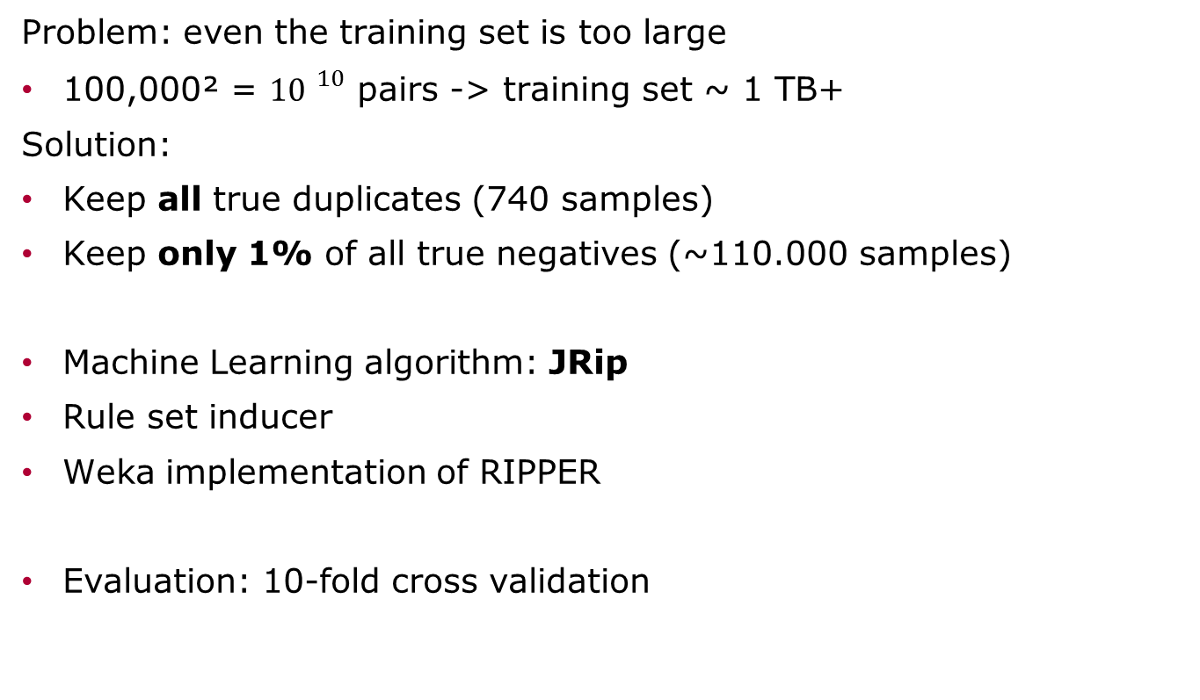
Design decisions for learning process
Problem: even the training set is too large
100,000² = ${10 }^{10}$ pairs -> training set ~ 1 TB+
Solution:
Keep all true duplicates (740 samples)
Keep only 1% of all true negatives (~110.000 samples)
Machine Learning algorithm: JRip
Rule set inducer
Weka implementation of RIPPER
Evaluation: 10-fold cross validation

Slide 9
Results & Discussion
Found 41086 duplicate groups
Trade-off between representative training set and presence of duplicates
In real scenarios, there may not exist a training set
We don‘t need to find out which features determine the class best
Machine learning does that for us ☺

