Slide 1
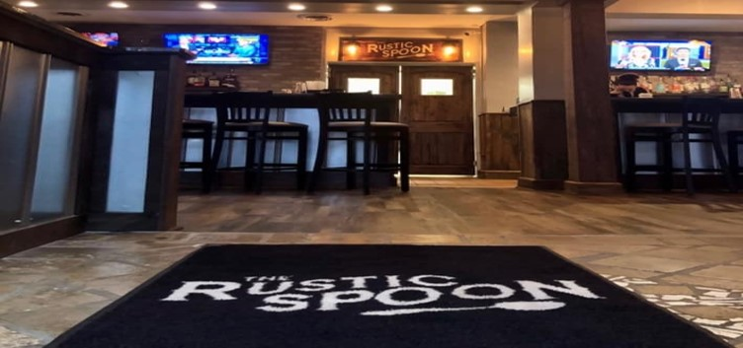
Home Page (desktop)
Navigation
Logo
Heading 1
Heading 3
Footer
Notes:
For the home page of The Rustic Spoon, the header would be a dark grey color background and the logo would be on the top left corner inside of the navigation. The navigation bar will include home, about, contact, etc. All of them will be linked together and it’ll take you to that page. The position for the navigation bar will be fixed. The heading 1 will say Welcome to The Rustic Spoon and heading 3 will say “we are a simple, honest, and local restaurant”. The background will be picture of what the restaurant would look like. The footer will be anchored to the bottom. The header, navigation, and footer will be the same on all pages.

Slide 2

Home Page (mobile)
Logo
Heading 1
Heading 3
Footer
Notes:
For the home page of The Rustic Spoon, the header would be a dark grey color background and the logo would be on the top left corner inside of the navigation. The navigation bar will include home, about, contact, etc. All of them will be linked together and it’ll take you to that page. The position for the navigation bar will be fixed. The heading 1 will say Welcome to The Rustic Spoon and heading 3 will say “we are a simple, honest, and local restaurant”. The background will be picture of what the restaurant would look like. The footer will be anchored to the bottom. The header, navigation, and footer will be the same on all pages.

Slide 3
Contact Page (desktop)
Navigation
Logo
Heading 1
<Bold paragraph>
Paragraph
<Bold paragraph>
Paragraph
Footer
Notes:
For the contact page of The Rustic Spoon, it involves their location, hours, fax and phone number. For the heading 1, it’ll say Contact and maybe a picture as a background or just leave it plain. The background will be white. (The header, navigation, and footer will be the same on all pages.)

Slide 4
Contact Page (mobile)
Logo
Heading 1
<Bold paragraph>
Paragraph
<Bold paragraph>
Paragraph
Footer
Notes:
For the contact page of The Rustic Spoon, it involves their location, hours, fax and phone number. For the heading 1, it’ll say Contact and maybe a picture as a background or just leave it plain. The background will be white. (The header, navigation, and footer will be the same on all pages.)

Slide 5
About Page (desktop)
Navigation
Logo
Heading 1
Description about the restaurant
Footer
Notes:
For the about page of The Rustic Spoon, it’s going to have a paragraph or two description about the restaurant with a white background. (The header, navigation, and footer will be the same on all pages.)

Slide 6
About Page (mobile)
Logo
Heading 1
Description about the restaurant
Footer
Notes:
For the about page of The Rustic Spoon, it’s going to have a paragraph or two description about the restaurant with a white background. (The header, navigation, and footer will be the same on all pages.)

Slide 7
Menu Page (desktop)
Navigation
Logo
Heading 1
Sentence about their menu
Embedded menu link
Footer
Notes:
For the menu page of The Rustic Spoon, the heading, it’ll say Menu. The image will be an embedded menu link. Also a sentence about their menu. (breakfast, brunch, and lunch)
(The header, navigation, and footer will be the same on all pages.)

Slide 8
Menu Page (mobile)
Logo
Heading 1
Sentence about their menu
Embedded menu link
Footer
Notes:
For the menu page of The Rustic Spoon, the heading, it’ll say Menu. The image will be an embedded menu link. Also a sentence about their menu. (breakfast, brunch, and lunch)
(The header, navigation, and footer will be the same on all pages.)

Slide 9
Gallery Page (desktop)
Navigation
Logo
Heading 1
Carousel with a few images
Footer
Notes:
For the gallery page of The Rustic Spoon, the heading, it’ll say Gallery and maybe a picture as a background or just leave it plain. The background will be white. There will be a carousel with a few pictures of their food and restaurant. (The header, navigation, and footer will be the same on all pages.)

Slide 10
Gallery Page (mobile)
Logo
Heading 1
Carousel with a few images
Footer
Notes:
For the gallery page of The Rustic Spoon, the heading, it’ll say Gallery and maybe a picture as a background or just leave it plain. The background will be white. There will be a carousel with a few pictures of their food and restaurant. (The header, navigation, and footer will be the same on all pages.)

