Slide 1
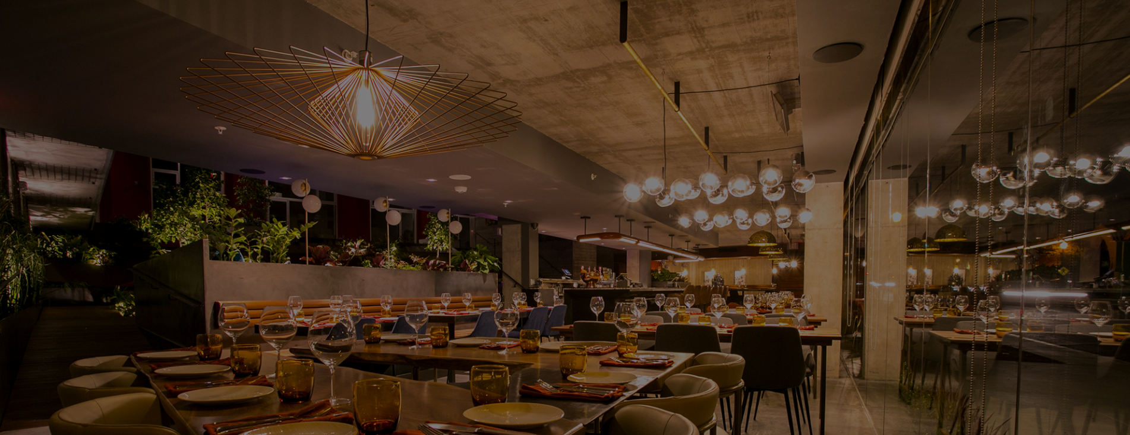
Home Page (desktop)
Navigation
Logo
Heading 1
Heading 3
Footer
Notes:
For the home page of The Rustic Spoon, the header would be a dark grey color background and the logo would be on the top left corner inside of the navigation. The navigation bar will include home, about, contact, etc. All of them will be linked together and it’ll take you to that page. The position for the navigation bar will be fixed. The heading 1 will say Welcome to The Rustic Spoon and heading 3 will say “we are a simple, honest, and local restaurant”. The background will be picture of what the restaurant would look like. The footer will be anchored to the bottom. The header, navigation, and footer will be the same on all pages.

Slide 2

Home Page (mobile)
Logo
Heading 1
Heading 3
Footer
Notes:
For the home page of The Rustic Spoon, the header would be a dark grey color background and the logo would be on the top left corner inside of the navigation. The navigation bar will include home, about, contact, etc. All of them will be linked together and it’ll take you to that page. The position for the navigation bar will be fixed. The heading 1 will say Welcome to The Rustic Spoon and heading 3 will say “we are a simple, honest, and local restaurant”. The background will be picture of what the restaurant would look like. The footer will be anchored to the bottom. The header, navigation, and footer will be the same on all pages.

Slide 3
Contact Page (desktop)
Navigation
Logo
Heading 1
<Bold paragraph>
Paragraph
<Bold paragraph>
Paragraph
Footer
Notes:
For the contact page of The Rustic Spoon, it involves their location, hours, fax and phone number. For the heading 1, it’ll say Contact and maybe a picture as a background or just leave it plain. The background will be white. (The header, navigation, and footer will be the same on all pages.)

Slide 4
Contact Page (mobile)
Logo
Heading 1
<Bold paragraph>
Paragraph
<Bold paragraph>
Paragraph
Footer
Notes:
For the contact page of The Rustic Spoon, it involves their location, hours, fax and phone number. For the heading 1, it’ll say Contact and maybe a picture as a background or just leave it plain. The background will be white. (The header, navigation, and footer will be the same on all pages.)

Slide 5
About Page (desktop)
Navigation
Logo
Heading 1
Image
Description about the restaurant
Footer
Notes:
For the about page of The Rustic Spoon, it’s going to have a paragraph or two description about the restaurant. For the heading, it’ll say About and maybe a picture as a background or just leave it plain. The background will be white. The image will be a picture of The Rustic Spoon logo or photos of their food. (The header, navigation, and footer will be the same on all pages.)

Slide 6
About Page (mobile)
Logo
Heading 1
Image
Description about the restaurant
Footer
Notes:
For the about page of The Rustic Spoon, it’s going to have a paragraph or two description about the restaurant. For the heading, it’ll say About and maybe a picture as a background or just leave it plain. The background will be white. The image will be a picture of The Rustic Spoon logo or photos of their food.

Slide 7
Menu Page (desktop)
Navigation
Logo
Heading 1
Embedded menu picture
Footer
Notes:
For the menu page of The Rustic Spoon, the heading, it’ll say Menu and maybe a picture as a background or just leave it plain. The background will be light gray depending what the menu looks like. The image will be an embedded menu picture. (The header, navigation, and footer will be the same on all pages.)

Slide 8
Menu Page (mobile)
Logo
Heading 1
Embedded menu picture
Footer
Notes:
For the menu page of The Rustic Spoon, the heading, it’ll say Menu and maybe a picture as a background or just leave it plain. The background will be light gray depending what the menu looks like. The image will be an embedded menu picture. (The header, navigation, and footer will be the same on all pages.)

Slide 9
Reservation Page (desktop)
Navigation
Logo
Heading 1
Heading 3
Paragraph
OpenTable reservations
Footer
Notes:
For the reservation page of The Rustic Spoon, it’ll have the OpenTable reservations which includes the date, time, and how many people. For the heading, it’ll say Reservation and maybe a picture as a background or just leave it plain. The background will be white. Heading 3 will say “Want to reserve a table? Just let us know the date, time and how many people.” There’s going to be an OpenTable reservation box in the center. (The header, navigation, and footer will be the same on all pages.)

Slide 10
Reservation Page (mobile)
Logo
Heading 1
Heading 3
Paragraph
OpenTable reservations
Footer
Notes:
For the reservation page of The Rustic Spoon, it’ll have the OpenTable reservations which includes the date, time, and how many people. For the heading, it’ll say Reservation and maybe a picture as a background or just leave it plain. The background will be white. Heading 3 will say “Want to reserve a table? Just let us know the date, time and how many people.” There’s going to be an OpenTable reservation box in the center. (The header, navigation, and footer will be the same on all pages.)

Slide 11
Gallery Page (desktop)
Navigation
Logo
Heading 1
Carousel with a few images
Footer
Notes:
For the gallery page of The Rustic Spoon, the heading, it’ll say Gallery and maybe a picture as a background or just leave it plain. The background will be white. There will be a carousel with a few pictures of their food and restaurant. (The header, navigation, and footer will be the same on all pages.)

Slide 12
Gallery Page (mobile)
Logo
Heading 1
Carousel with a few images
Footer
Notes:
For the gallery page of The Rustic Spoon, the heading, it’ll say Gallery and maybe a picture as a background or just leave it plain. The background will be white. There will be a carousel with a few pictures of their food and restaurant. (The header, navigation, and footer will be the same on all pages.)

