Slide 1
Impact of Inhibitory Gamma Background on Cell Nonlinearity

Slide 2
PARAMETERS
Inhibitory Gamma Parameters
Number of synapses = 30 (located on the soma)
Firing rate: 50 Hz
Distribution: 3 ms
Adjusted Current
All current injected has no noise (used to bring cell up to threshold)
Stimulus Synapses
Total synapses: 40 synapses
AMPA: 0.0015 µS
NMDA: 0.0039 µS
Firing rate: 50 Hz
Start Time: 0 ms
Noise: 0 ms
Location: 50% of the dendrite (on top of eachother, firing at the same time)

Slide 3
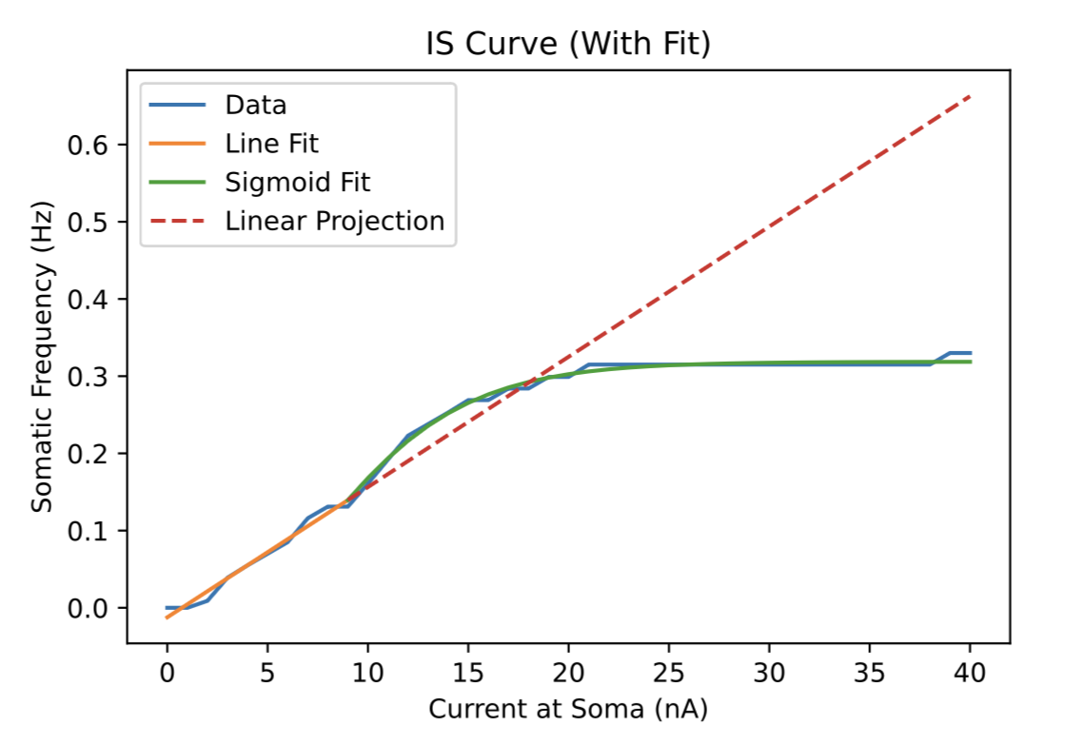
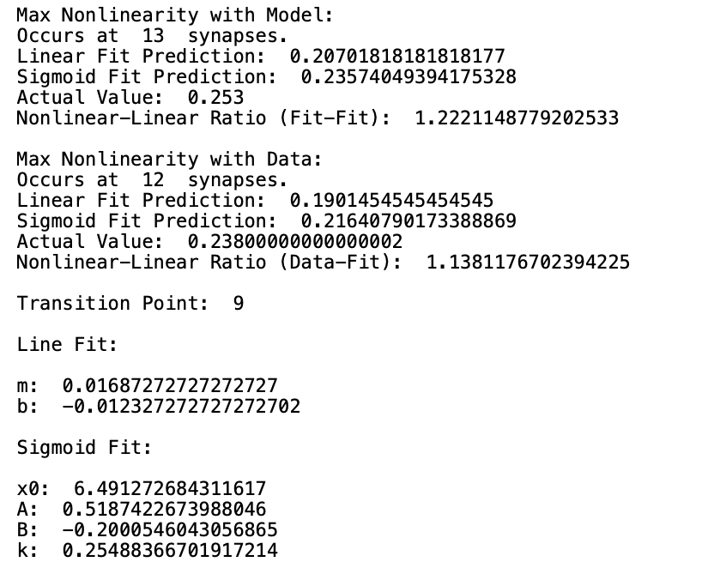
CASE #1
Inhib Gamma
Conductance: 0 µS
Adjusted Current
Amplitude: 1.09 nA

Slide 4
CASE #2
Inhib Gamma
Conductance: 0.0025 µS
Adjusted Current
Amplitude: 1.45 nA

Slide 5
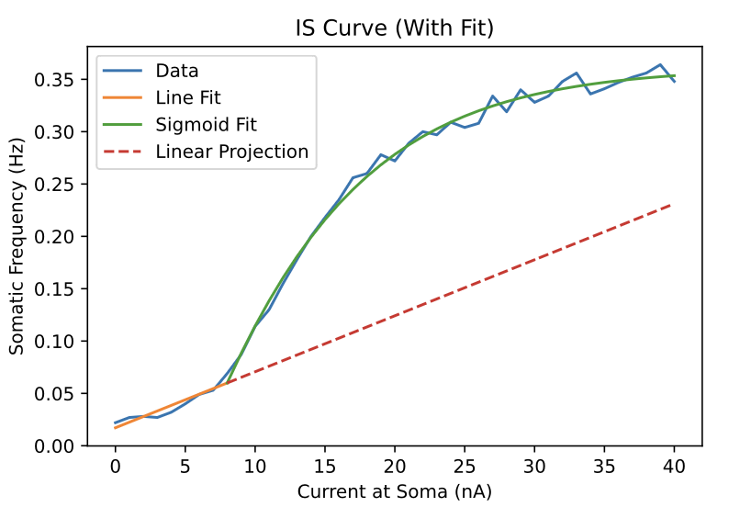
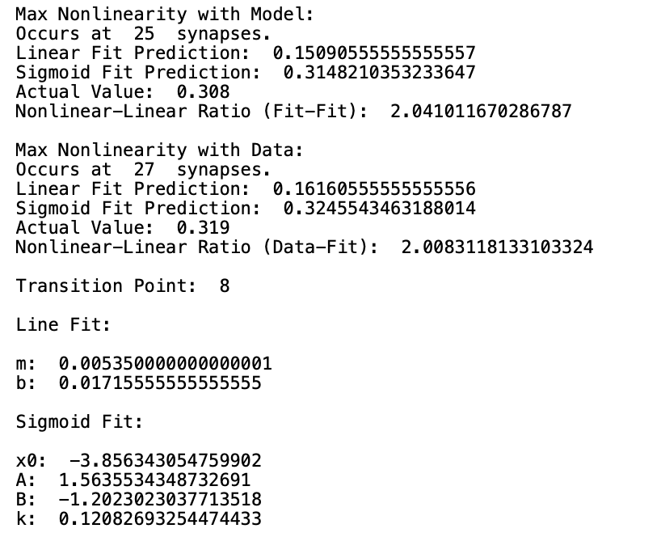
CASE #3
Inhib Gamma
Conductance: 0.005 µS
Adjusted Current
Amplitude: 1.775 nA

Slide 6
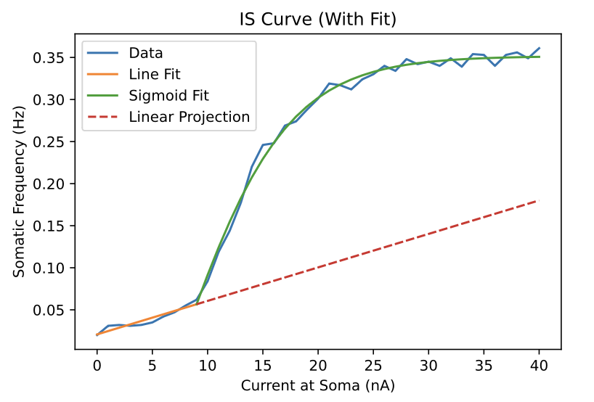
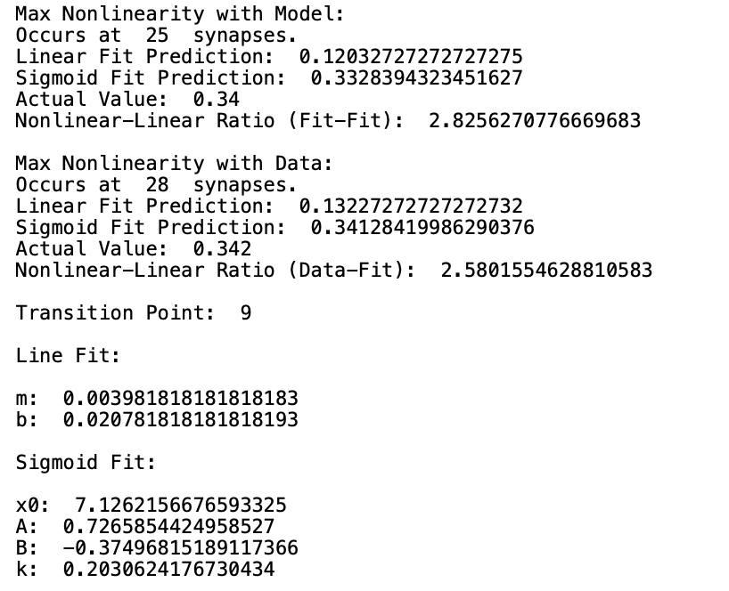
CASE #4
Inhib Gamma
Conductance: 0.01 µS
Adjusted Current
Amplitude: 2.2 nA

Slide 7
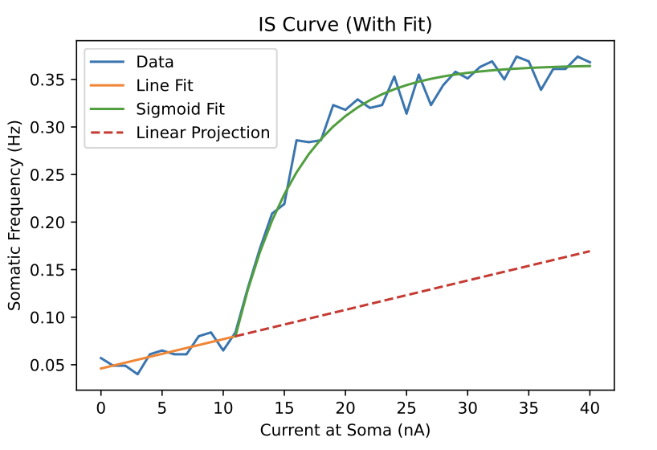
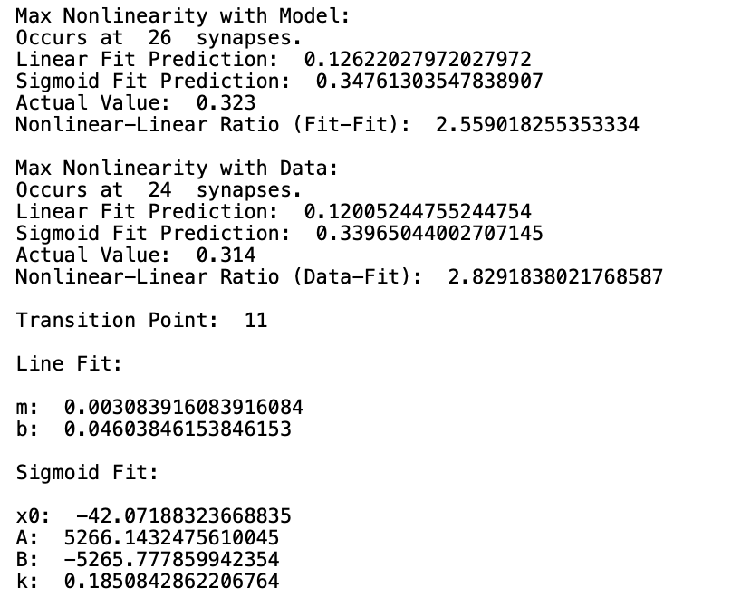
CASE #5
Inhib Gamma
Conductance: 0.02 µS
Adjusted Current
Amplitude: 2.8 nA

Slide 8
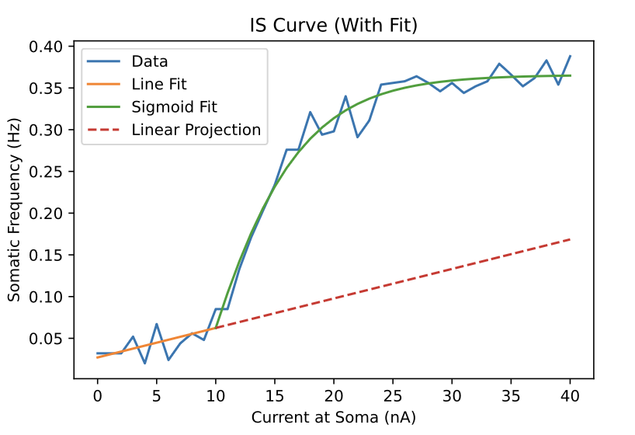
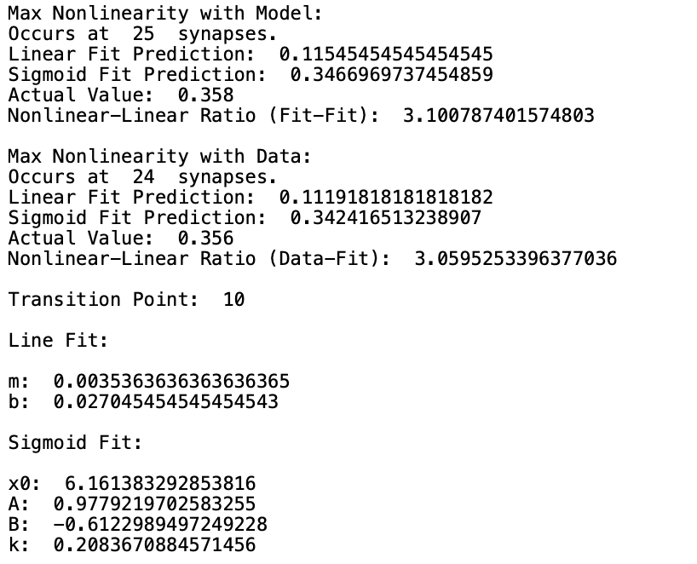
CASE #6
Inhib Gamma
Conductance: 0.03 µS
Adjusted Current
Amplitude: 3.35 nA

Slide 9
CASE #7
Inhib Gamma
Conductance: 0.04 µS
Adjusted Current
Amplitude: 3.6 nA

