Slide 1
Presentation Title
Subtitle
Achraf Ben-Hamadou
Assistant Professor
Digital Research Centre of Sfax
achraf.benhamadou@crns.rnrt.tn

Slide 2
Plan
Section 1
Section 2
Elements

Slide 3
Section 1

Slide 4
Slide's title

Slide 5
Slide's title
Slide's subtitle
Use the CRNS Content with Subtitle layout to show a subtitle under the frame title, as Beamer does with \begin{frame}{Title}{Subtitle}.

Slide 6
Section 2

Slide 7
1. Section 1
2. Section 2
Sub-section 2.1
3. Elements

Slide 8
Elements

Slide 9
Typography
The theme provides sensible defaults to emphasize text, accent parts or show bold results.

Slide 10
Font feature test
Regular
Italic
Small Caps
Bold
Bold Italic
Bold Small Caps
Monospace
Monospace Italic
Monospace Bold
Monospace Bold Italic

Slide 11
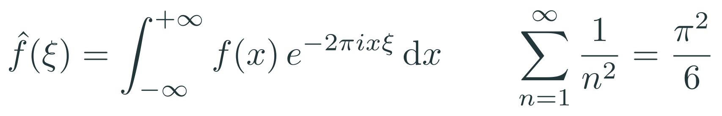
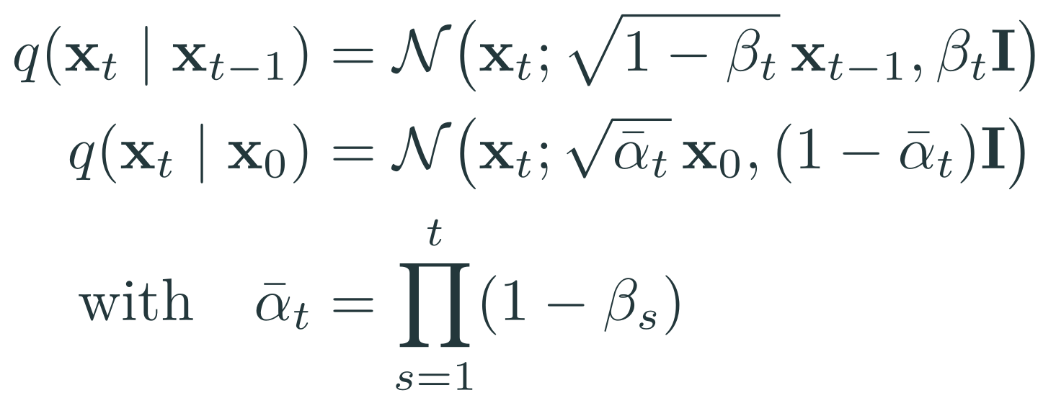
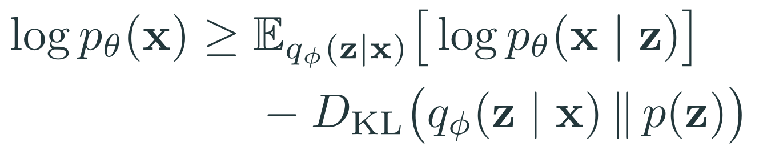
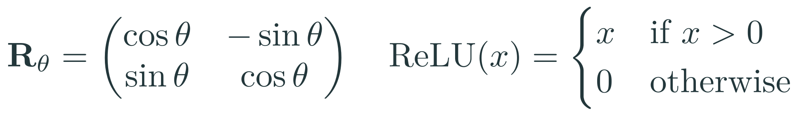
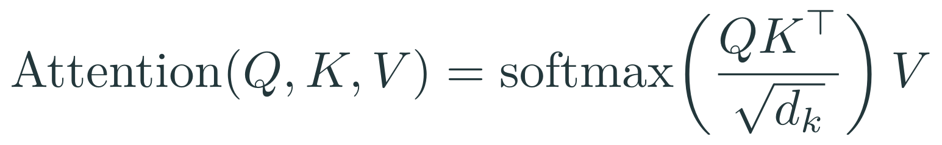
Mathematics
Fourier transform and Basel problem
Diffusion forward process
Variational lower bound
Matrices and cases
Scaled dot-product attention
Alphabets
Notes:
Equations are images rendered with LaTeX (Latin Modern) from pptx/equations.tex. To write new ones, use Insert > Equation, or render them the same way.

Slide 12
Lists
Items
Enumerations
Descriptions
Milk
Eggs
Potatoes
First,
Second and
Last.
PowerPoint Meeh.
Beamer Yeeeha.

Slide 13
Animation
This is really important
Now this
And now this
Notes:
In Beamer this list is revealed item by item. In PowerPoint, select the list and add Animations > Appear, with Effect Options > By Paragraph.

Slide 14
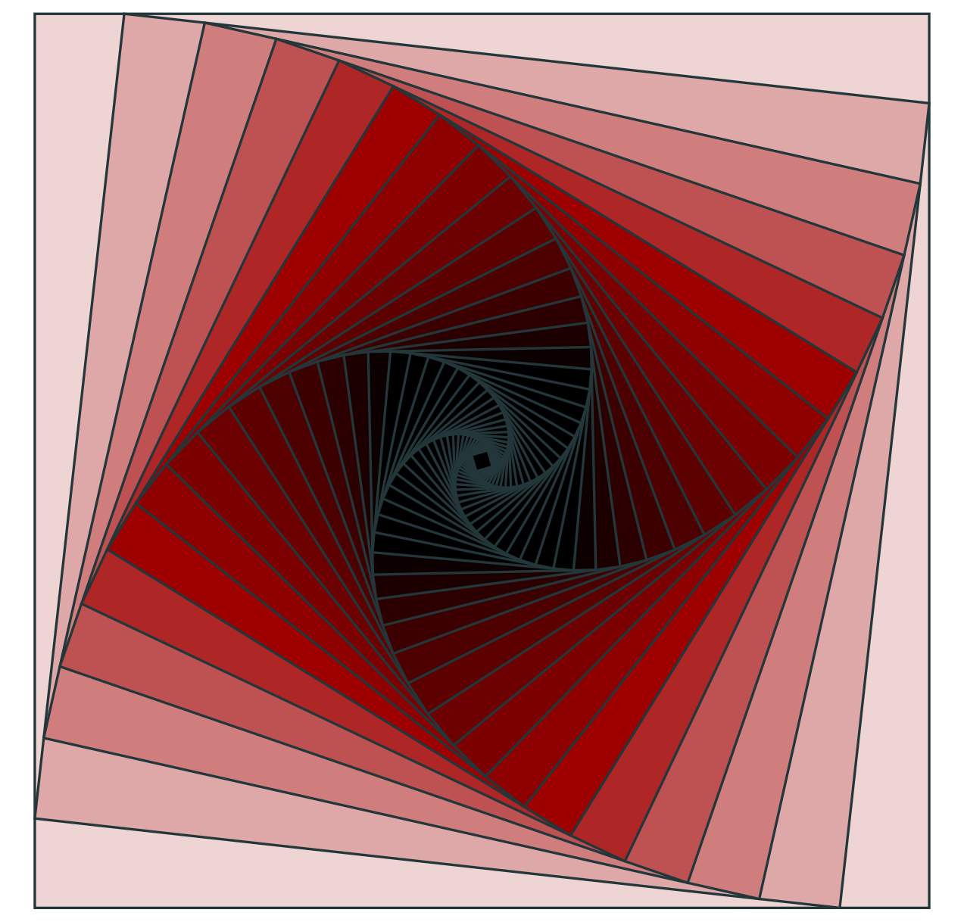
Figures
Figure 1: Rotated square from texample.net.

Slide 15
Tables
Table 1: Largest cities in the world (source: Wikipedia)
City | Population
Mexico City | 20,116,842
Shanghai | 19,210,000
Peking | 15,796,450
Istanbul | 14,160,467

Slide 16
Blocks
Three different block styles are pre-defined, with or without a background.
Default
Default
Block content.
Block content.
Alert
Block content.
Alert
Block content.
Example
Block content.
Example
Block content.

Slide 17
Thanks for your attention

