Slide 1
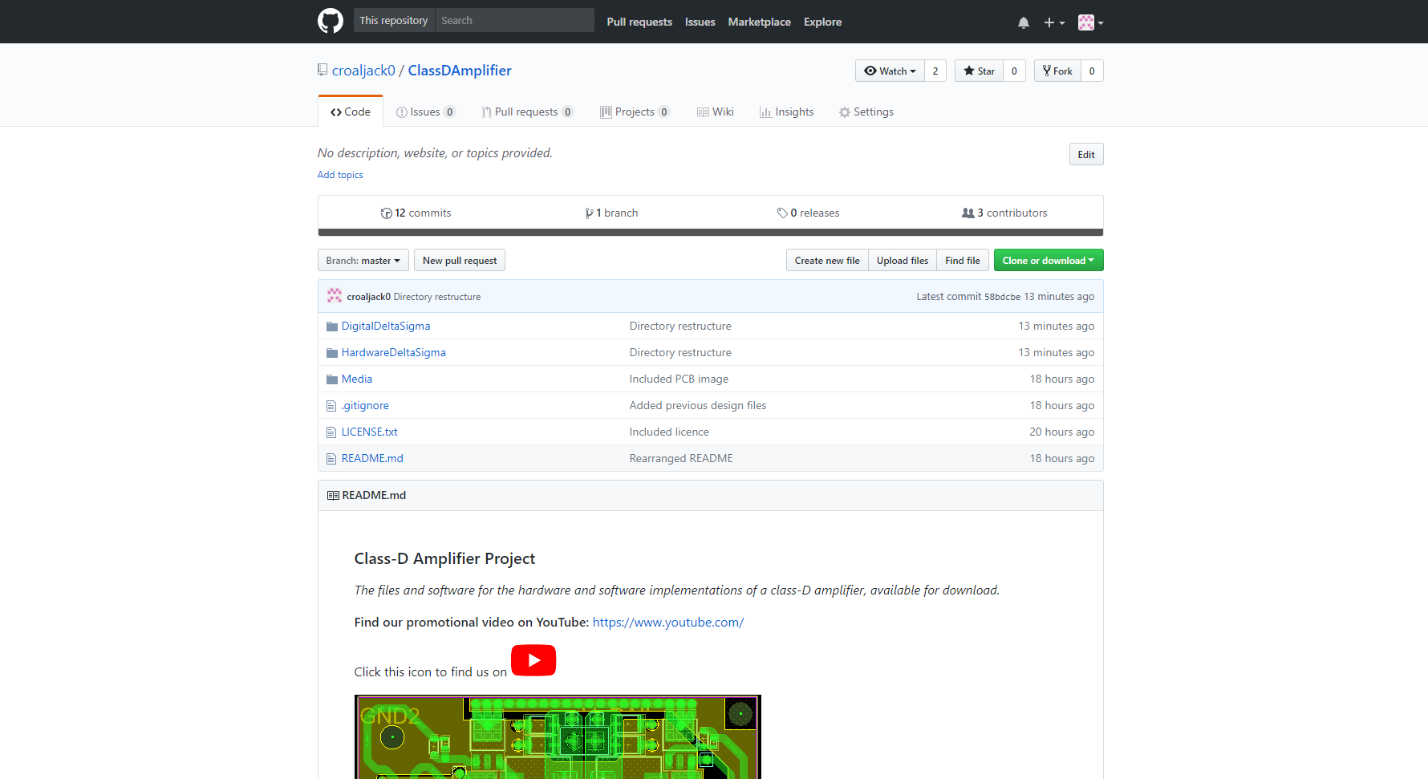
For more information, view our GitHub at: https://github.com/croaljack0/ClassDAmplifier

