Slide 1
Project 1: Group 12
Project Team:
Caleb Meinke, Luisa Murillo,
Gavin Bozan, and Charles Arnold

Slide 2
Project: Dataset | Introduction & Inspiration
Dataset:
Financial Transactions Dataset: Analytics
https://www.kaggle.com/datasets/computingvictor/transactions-fraud-datasets/code
Introduction:
The “Financial Transactions Dataset: Analytics,” contains financial payment card and card holder demographic information from 2010 through 2019.
Notes:
Talking points: - Dataset is comprised of multiple CSVs: One containing individual customer attributes and another containing payment transaction attributes
These files required merging on the client ID of each individual customer
Data cleansing – removing dollar signs from monetary values
Reverse geocoding for state extract
Added columns for DTI, State, state lat/long
The dataframe contained approximately 1,700 individual client IDs after merging and outlier elimination
The dataset is fictious, which limits its real-world use; however, inspiration for our effort came from multiple resources:
Post-pandemic focus on consumer spending, inflation, and debt are top of mind
Similar studies conducted by other organizations including
Center for Economic and Policy Research study, “Before and After the Pandemic: Income Volatility, Health Care Affordability, and Debt”
Financial Health Network’s study, “Financial Health Pulse 2023 U.S. Trends”

Slide 3
Objectives
Explore financial health on how it varies with:
Select demographics
Individual financial attributes
Geographic regions
Analyze the correlations between the above characteristics and established measurement of financial health, know as the total debt-to-income (DTI) ratio
Notes:
Talking Points:
Various forms of the debt-to-income ratio are used in the financial industry
The DTI is used to measure general financial health, creditworthiness, and financial stress
This is a known consideration in lending, credit scoring, and risk assessment.
This ratio provides a glance at individual debt payment obligations compared against income to determine financial health
Our analysis sought to use the DTI to test the following hypotheses:
Alternative: Customer demographics including age, gender, and income influence individual financial health (as measured by the DTI)
Null: Customer demographics including age, gender, and income have no impact on individual financial health (as measured by the DTI)
Alternative: Individual financial attributes including total debt, total card count, and credit score influence individual financial health (as measured by the DTI)
Null: Individual financial attributes including total debt, total card count, and credit score have no impact on individual financial health (as measured by the DTI)
Alternative: Customer geographic information including state, region, and per-capita-income influence individual financial health (as measured by the DTI)
Null: Customer geographic information including state, region, and per-capita-income have no impact on individual financial health (as measured by the DTI)

Slide 4
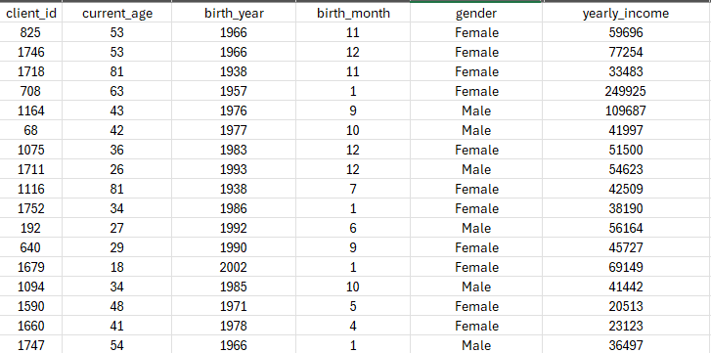
Customer Demographics
QUESTION 1: How do customer demographics (e.g., age, gender, income) correlate with customer financial health?

Slide 5
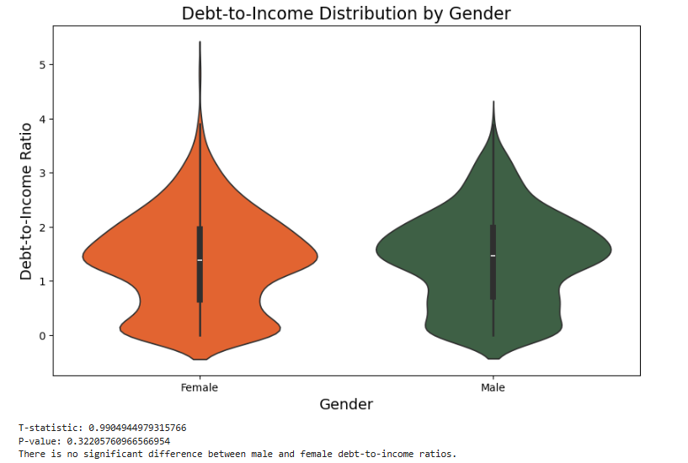
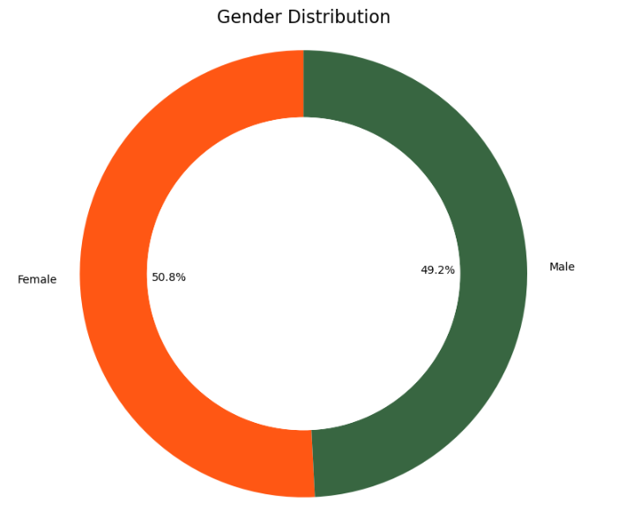
Notes:
- The goal of this analysis is to explore the distribution of debt-to-income ratios across genders and identify any significant differences between women and men
- The dataset includes debt-to-income ratios for a sample of men and women, with the following gender distribution: Women 50.8% and Men 49.2%.
A violin plot was used to visualize the distribution of debt-to-income ratios for both men and women. The shape of the violin plot provides insight into the density and spread of the data, with the wider parts of the plot indicating higher concentrations of data points.
Difference in tails, we wanted to do a T-test; look similar but wanted to confirm
- In summary, our analysis of the debt-to-income ratios across genders revealed no significant difference between men and women. This suggests that gender alone may not be a key determinant in the distribution of debt-to-income ratios in this sample.

Slide 6
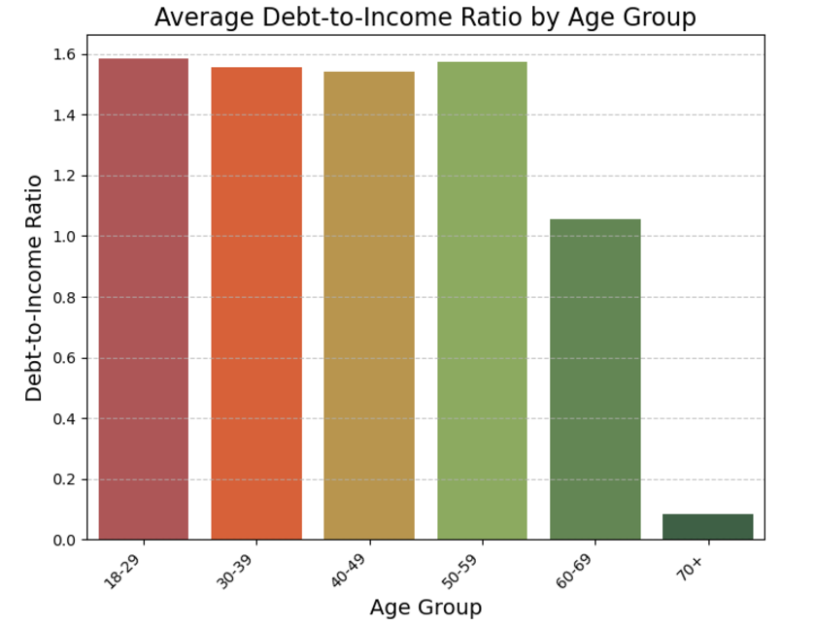
Notes:
-This analysis explores how the debt-to-income ratio varies across different age groups to understand if age plays a role in shaping financial behavior, particularly in relation to debt levels.
- We divided the dataset into six age bins: 18-29, 30-39, 40-49, 50-59, 60-69, and 70+, and computed the average debt-to-income ratio for each group.
- From the chart, we observe that the average debt-to-income ratio is higher for younger age groups (18-29) and tends to decrease with age, starting in the 60’s with a major drop specially in the 70+ category, which may reflect lower debt levels as people approach retirement.
- We noticed that the trend was dipping and started back to rise in the age bin of 50-59, our thoughts for the reason for this is that this age group children are starting college and this could be a factor of the uprise in the debt-to-income ratio
- In summary, debt-to-income ratios tend to decrease with age, reflecting financial stability as individuals progress through their life, careers and approach retirement.

Slide 7
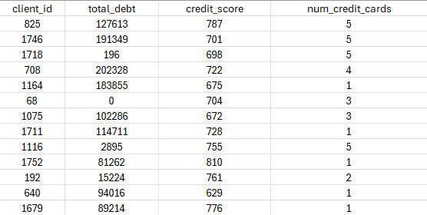
Financial Attributes
QUESTION 2: How do financial attributes (e.g., card count, credit score, total debt) correlate with customer financial health?
Notes:
Speaking notes:
we’re looking at how financial factors like credit scores, total debt, and the number of credit cards relate to customer financial health. By financial health, I mean how well people manage debt and credit.

Slide 8
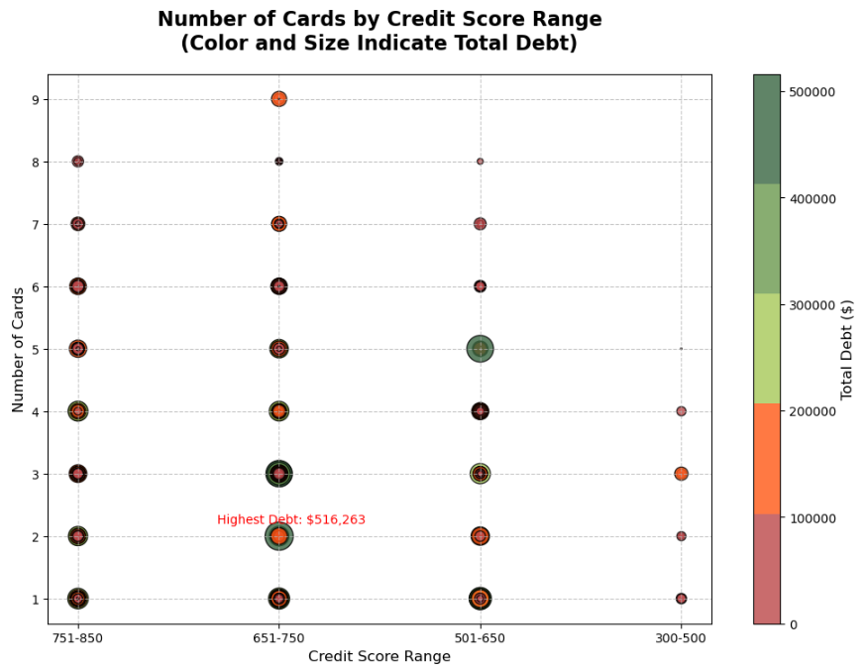
Notes:
Speaking notes:
This chart shows how many credit cards people have, broken down by credit score ranges, with color and size showing total debt.
A key point: People in the 651–750 range have the highest debt, even if they don’t always have the most cards.
One interesting outlier is here—a debt of over $500,000! The question is, does having more cards mean higher debt? Not always. It’s likely tied to income, credit limits, or spending habits."

Slide 9
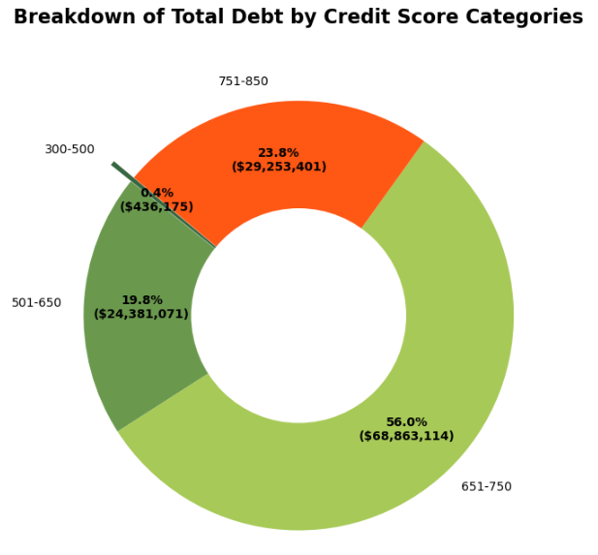
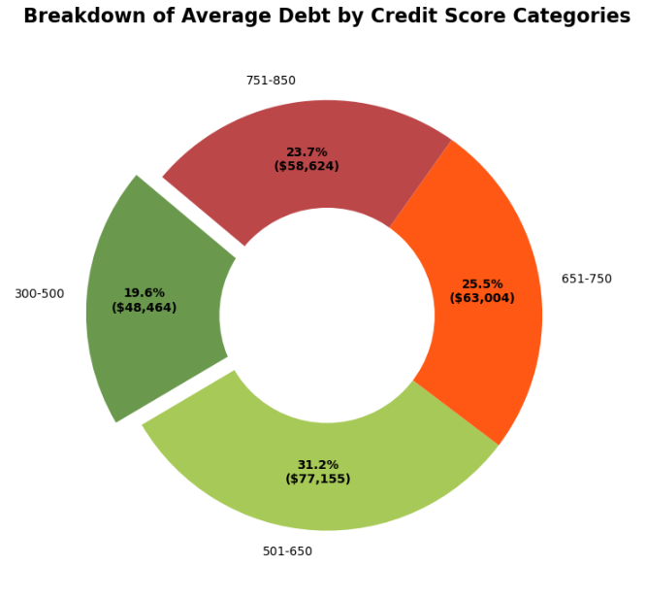
Notes:
Speaking notes:
Here’s how total debt is distributed. Over half of all debt is held by the 651–750 group, which lenders often see as reliable. On the other hand, the 300–500 group holds less than 1% of the total debt. This is likely due to credit restrictions rather than better financial health.“
average debt for each credit score range. The 501–650 group has the highest average debt at over $77,000. This suggests they might be borrowing more but facing higher costs, like interest rates.
Meanwhile, the 300–500 range has the lowest average debt, likely because they have limited access to credit Key Takeaways - Mid-range credit scores often come with high debt but might not always mean financial trouble—it could depend on income or spending. - More cards don’t automatically mean more debt, though it can show reliance on credit. - Lower credit scores often mean limited access to credit, which can make managing finances harder." - We focused more on credit score because we assumed that higher credit scores mean lower debt to income but luisa talks about that later.

Slide 10
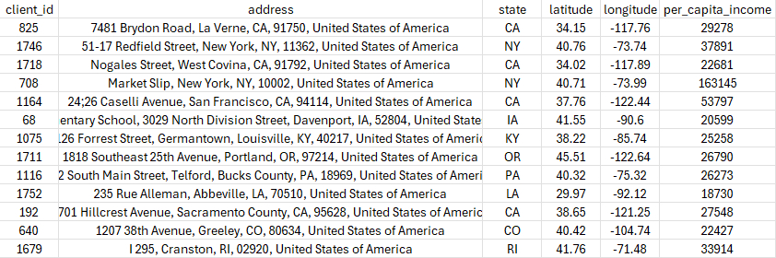
Geographic Information
QUESTION 3: How does customer geographic information (e.g. state, city, per capita income) correlate with customer financial health?

Slide 11
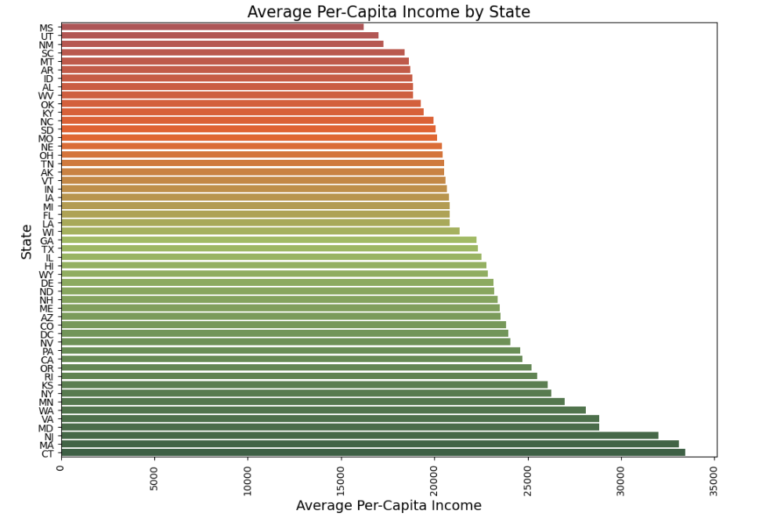
Notes:
Speaking points: Looking at average per-capita income by state shows a clear geographical difference in incomes.
This is a known factor from other studies that look at regional income and cost of living (used in wage assignments, benefit allocations, and other financial assessments
The team’s assumption was that states and regions with lower per-capita income may rely on debt spending more than regions with notably higher per-capita-income, which would result in a higher DTI.

Slide 12
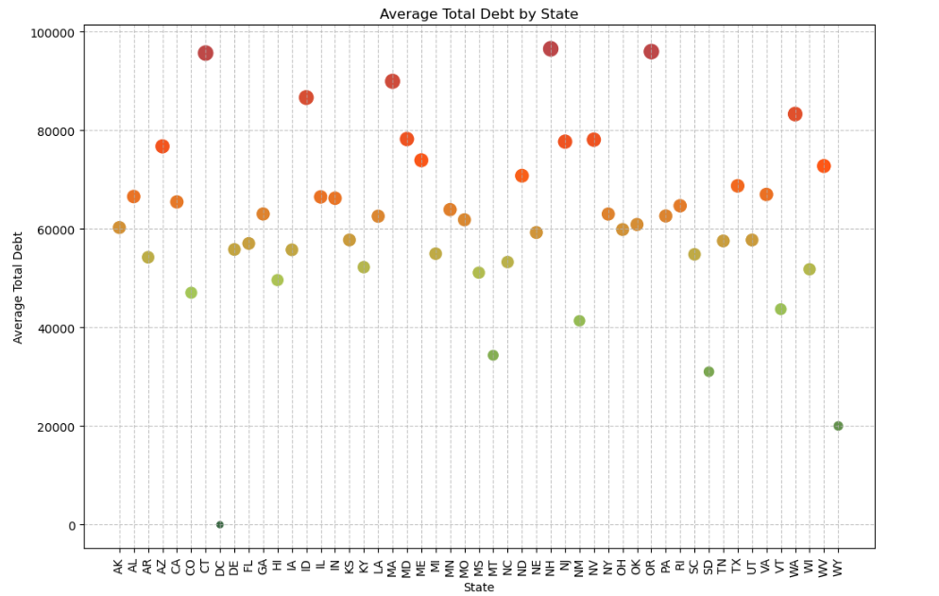
Notes:
Speaking notes: Initial assessment looked at debt by state, using the dataframe population with debt and income outliers removed to smooth the data.
- The gradient shows highest total debt (red) to lowest total debt (green) across the scatterplot across

Slide 13
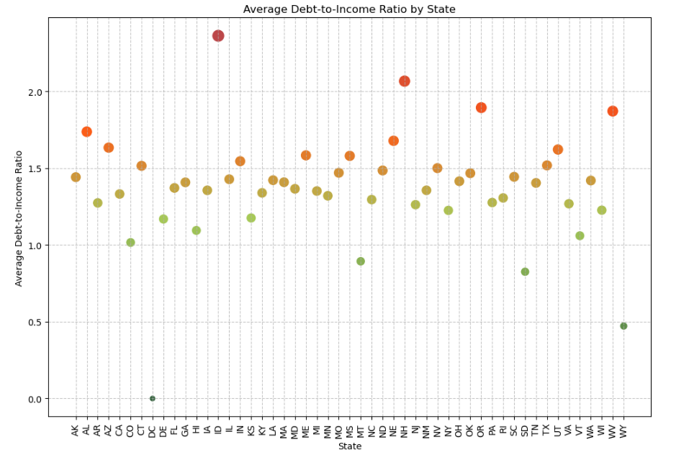
Notes:
Speaking notes: Secondary assessment looked at DTI by state, using the dataframe population with debt and income outliers removed to smooth the data.
The gradient shows highest DTI (red) to lowest DTI (green) across the scatterplot across
The DTI view tightened the variance between the population of states, and served as our geographic plot

Slide 14

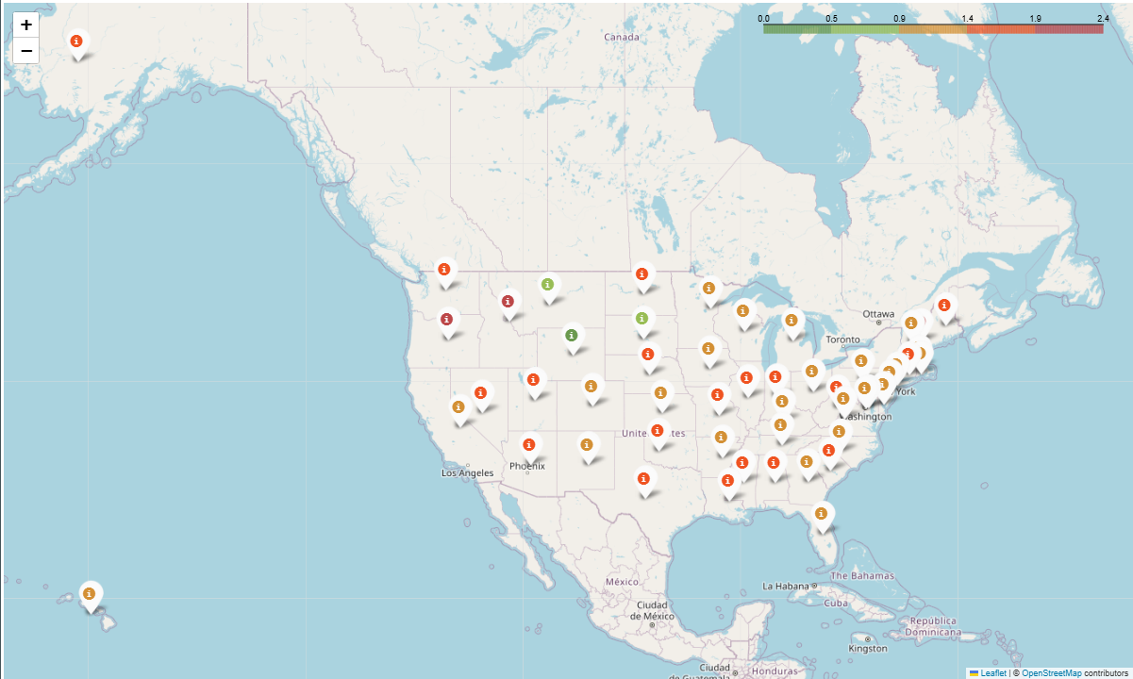

Average Debt-to-Income (DTI) by State
Notes:
Speaking notes:
Plotting DTI by state geographically did not show any apparent geographical relationship to DTI.
There was relatively even distribution of high and low DTI across the map
The only exceptions observed were in the northern plains region (MT, WY, SD) and the East Coast Metro region (PA, NY, NJ, and surrounding states)
The northern plains region showed a grouping of low DTI states. This may be a result of small sample sizes for these states, however.
The East coast metro region showed DTI more consistently around the median of DTI by state
Both would require further investigation to prove out, however.

Slide 15
Bias and Limitations
Limitations:
Fictitious data – Use for exercise
Some states had very small sample size
Bias:
Distribution of Male(49.2%)to Female (50.8%)
Wasn’t a 50/50 split but is Reflective of US Population
# of outliers impacted ‘gold standard of measurement’ (e.g. Age, State, DTI Ratio)
Removed outliers in total debt and yearly income to ensure that the DTI was smoothed out
May have unintentionally created bias by being selective of the outliers we removed
Notes:
Speaking notes:
Limitations:
- First, the data we used is fictitious and meant only for exercise purposes, so it’s not based on real-world statistics."
- Second, some states had very small sample sizes, which may not accurately represent broader trends." But you know you gotta work with what you got
Bias:
- In terms of gender distribution, the data shows 49.2% male and 50.8% female. While this isn’t a perfect 50/50 split, it does reflect the overall U.S. population.
- We also adjusted for outliers in total debt and yearly income to smooth out the Debt-to-Income ratio, or DTI. However, by being selective with these outliers, we may have unintentionally introduced bias.

Slide 16
Regression Analysis

Slide 17
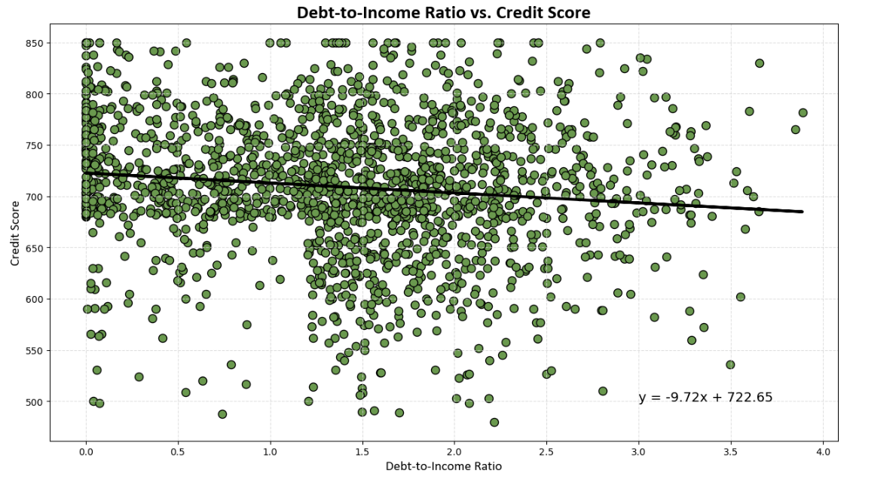
Notes:
Speaking notes:
Credit score doesn't have any impact in DTI because there are lots more factors that do impact person financial profile. Credit score does factor in things like total debt and total income, but that other factors like payment delinquencies, frequency of credit applications, total assets, and others also factor into the score. This shows that DTI is not a primary determinate in the calculation of credit scores.

Slide 18
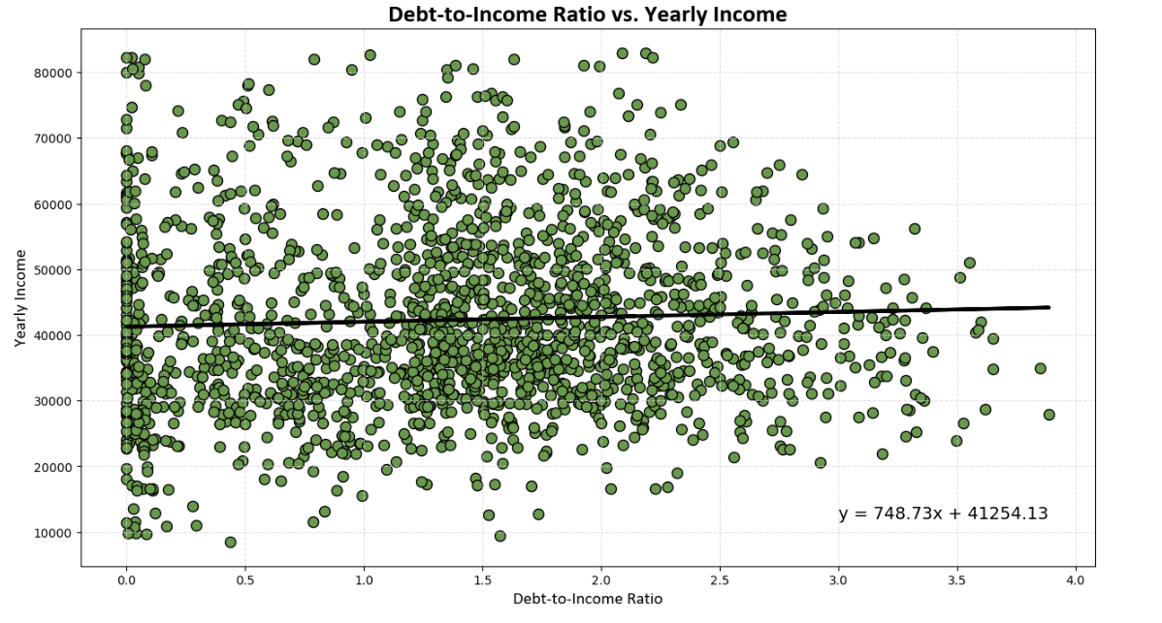
Notes:
Speaking notes:
yearly income: No correlation, a decrease or increase in yearly income doesn't necessary increase or decrease DTI

Slide 19
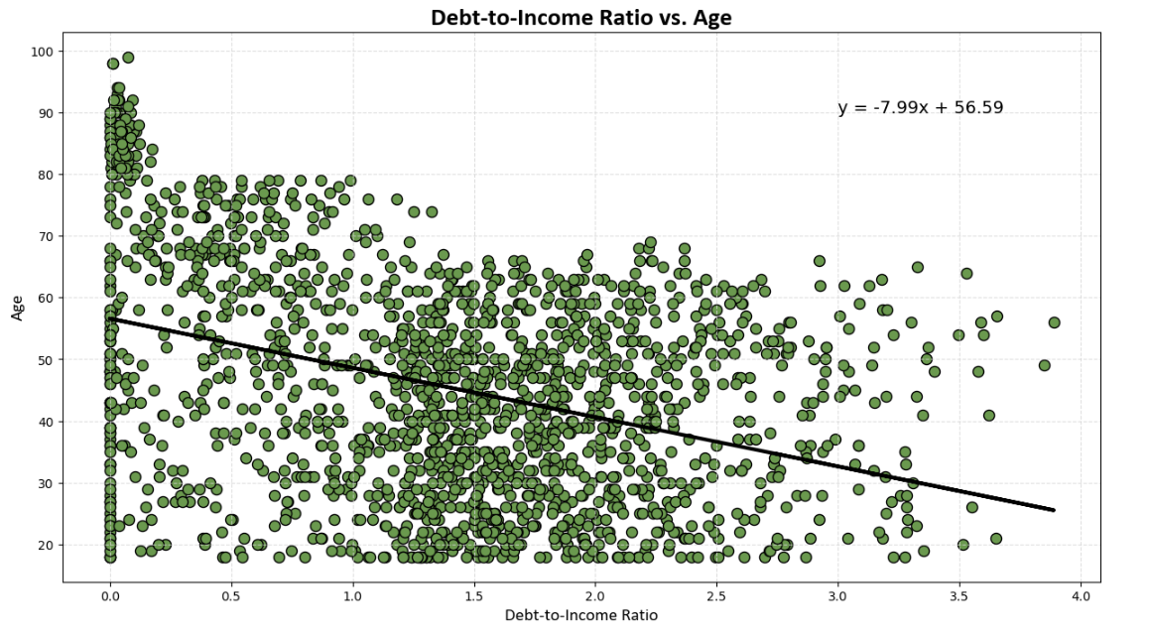
Notes:
Speaking notes:
Age definitely has a correlation as people get older DTI decrease. This is a moderate negative correlation between DTI and Age. there is a relationship, but it isn't a strong one according to this dataset.

Slide 20
Conclusion|Final Thoughts
Debt-to-Income (DTI) ratio impact:
Credit Score
Yearly Income
Age
The only correlation that exists is between DTI and Age
As you mature in life your debt-to-income ratio lower, doesn’t matter income, credit score
Expected to see that the lower the income the higher the debt-to-ratio

Slide 21
Thank You!

Slide 22
Works Cited
Financial Transactions Dataset: Analytics
https://www.kaggle.com/datasets/computingvictor/transactions-fraud-datasets/code
Kaggle: Introduction to Folium
https://www.kaggle.com/code/imdevskp/folium
ChatGPT – Python AI Assistance
https://chatgpt.com/

