Slide 1
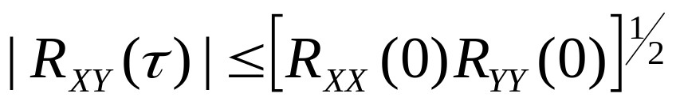
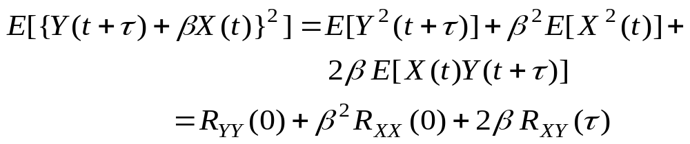


Example 4: Prove Property 6 of two WSS processes X(t)
and Y(t), i.e.
Solution:
Start with the linear combination Y(t+τ )+β X(t), where β is any
number, and find its MS value (positive)
To assure that this quadratic is non-negative
or
Department of Electrical & Computer Engineering

Slide 2
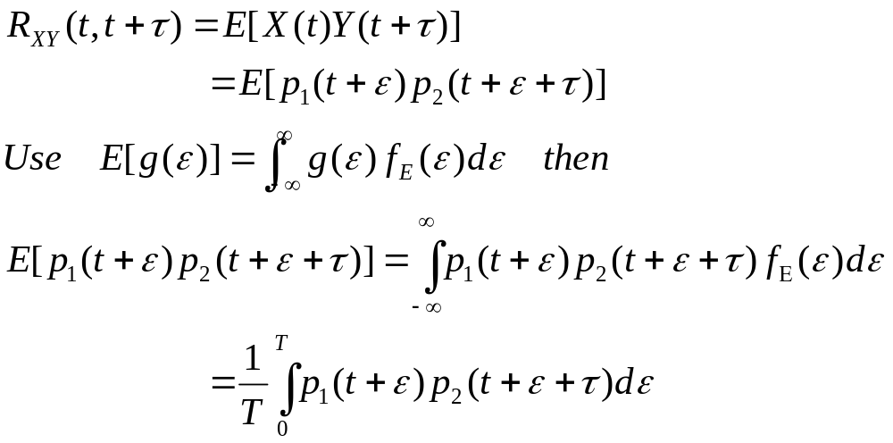
Example 5: Define two r.p.’s by X(t) = p₁(t + ε) and
Y(t) = p₂(t + ε), when p₁(t) and p₂(t) are both periodic waveforms
with period T and ε is a r.v. uniformly distributed on the
interval (0,T). Find an expression for the cross-correlation
function E[X(t)Y(t + τ)]. Are these r.p.’s jointly WSS?
Solution:
Let η = t + ε ⇒ dη = dε and
Department of Electrical & Computer Engineering

Slide 3
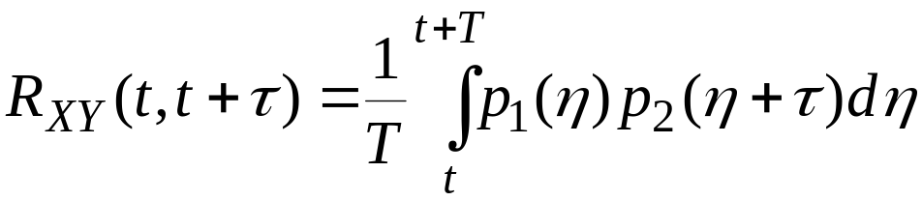
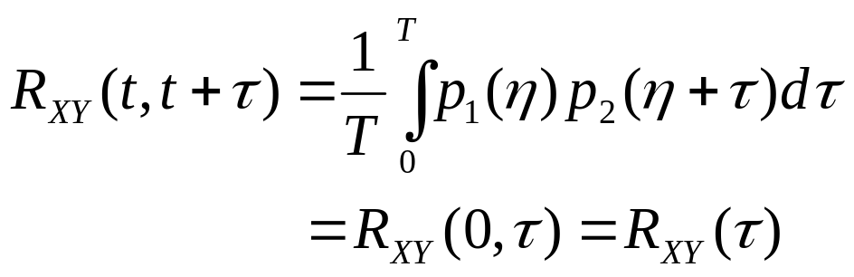


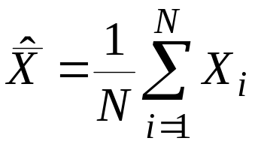
Since p₁(η) and p₂(η) are periodic with period T, we can write,
i.e. jointly WSS.
Example 6: An ensemble member of a stationary r.p. X(t) is
sampled at N times t_{i}, i = 1, 2, … N. By treating the samples
as r.v.’s X_{i} = X(t_{i}), an estimate or measurement of mean
value = E[X(t)] of the process is normally formed by
time averaging the samples:
Department of Electrical & Computer Engineering

Slide 4

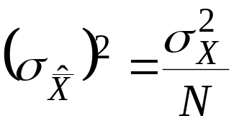
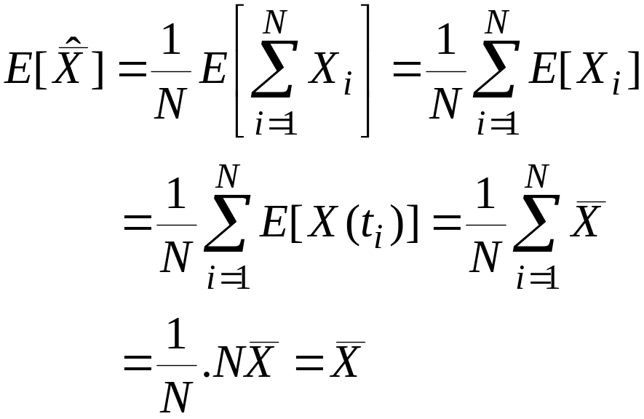
(a) Show that
(b) If the samples are separated far enough in time so
that the r.v.’s X_{i} can be considered statistically independent,
show that the variance of the estimate of the process mean is
Solution:
(a)
i.e. unbiased in mean
Department of Electrical & Computer Engineering

Slide 5
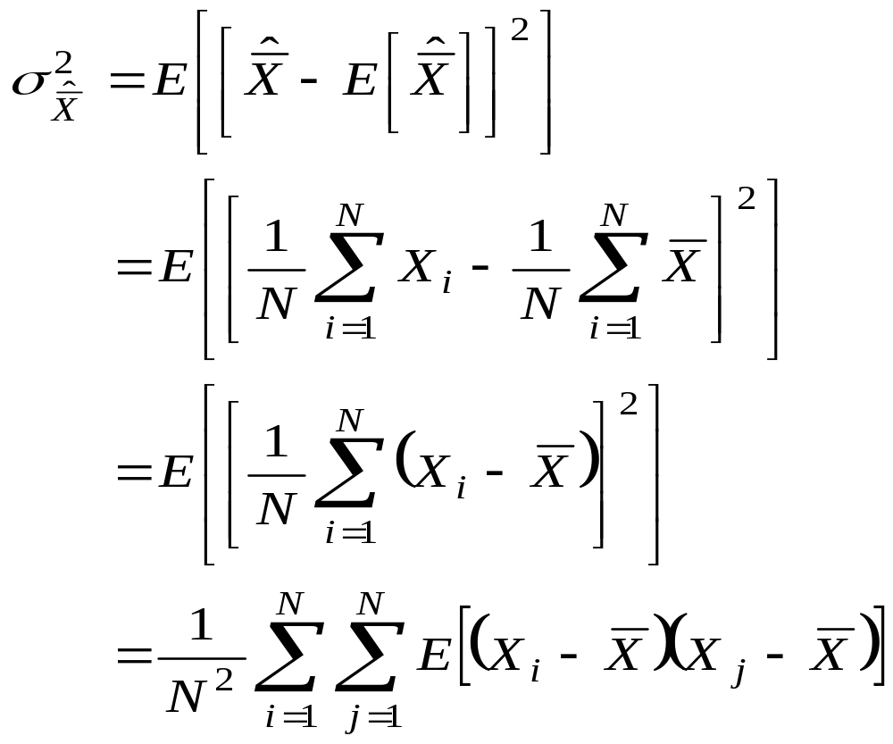
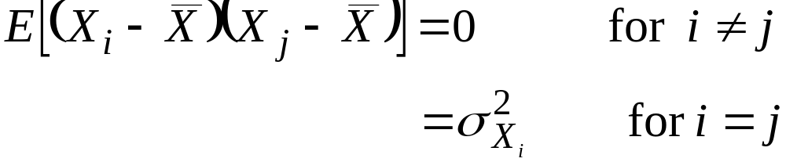
(b)
But,
Department of Electrical & Computer Engineering

Slide 6
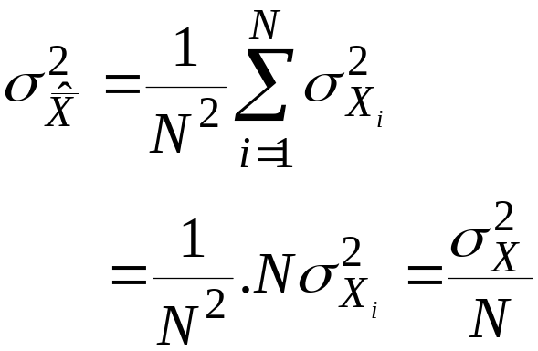
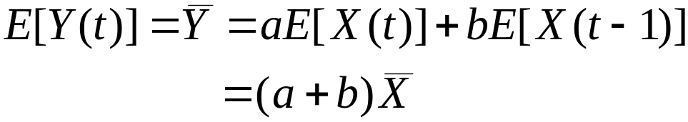
Thus,
Example 7: If X(t) is WSS with mean and ACF R_{XX}(τ).
Find the expression for mean, ACF and R_{XY}(τ) of
Y(t) = a X(t) + b X(t – 1)
Solution:
(a)
Department of Electrical & Computer Engineering

Slide 7
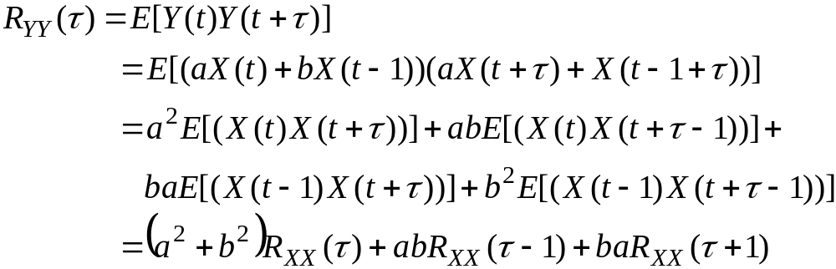
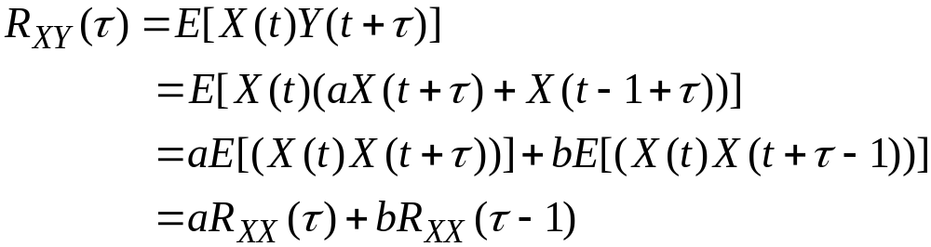
(b)
(c)
Department of Electrical & Computer Engineering

Slide 8


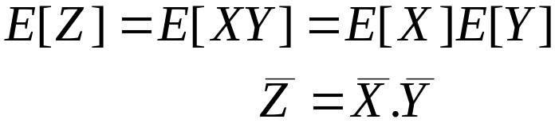
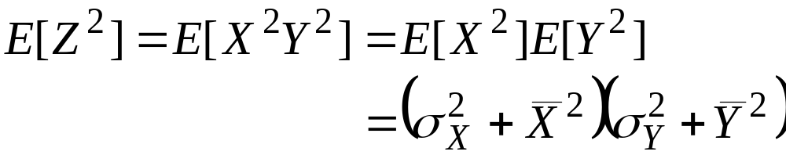
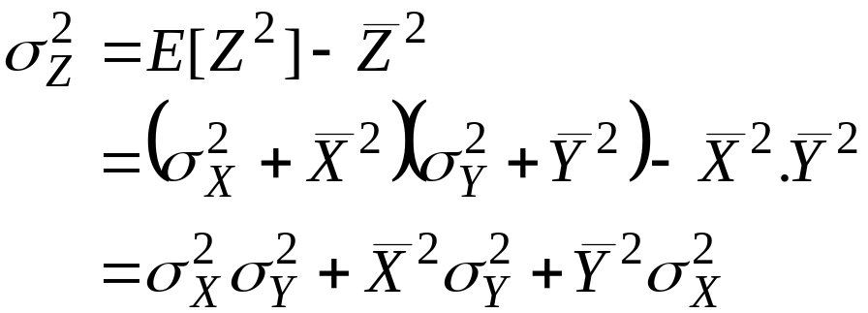
Example 8: Consider Z = XY, where X and Y are
Independent Gaussian r.v.’s with X ~ N( , σ_{X}²) and
Y ~ N( , σ_{Y}²). Find and σ_{Z}² in terms of statistics of X and Y.
Solution:
(a)
(b)
Now,
Department of Electrical & Computer Engineering

Slide 9
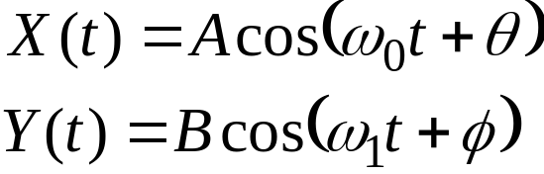
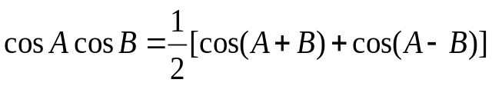
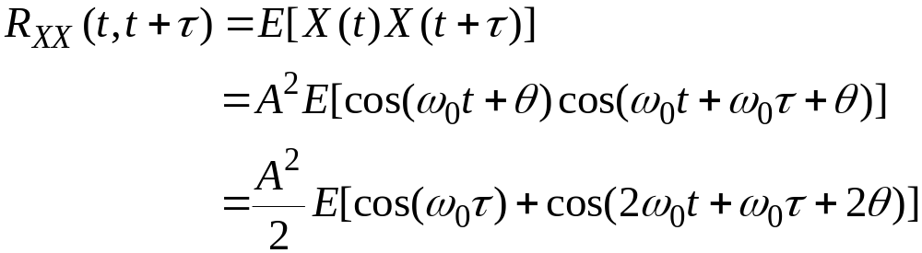
Example 9: Given
A, B, ω₀, ω₁: Constants
θ, φ : Independent r.v.’s uniformly distributed over (0, 2π).
Show that X(t), Y(t) are not jointly WSS.
If θ = φ , show that X(t), Y(t) are not jointly WSS unless
ω₀= ω₁.
Solution:
Use:
Department of Electrical & Computer Engineering

Slide 10
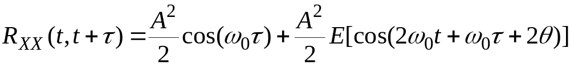
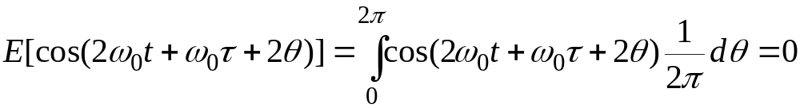
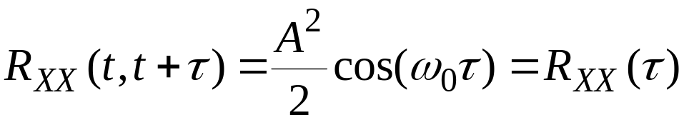
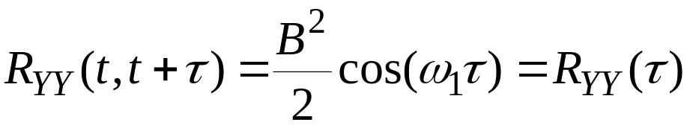
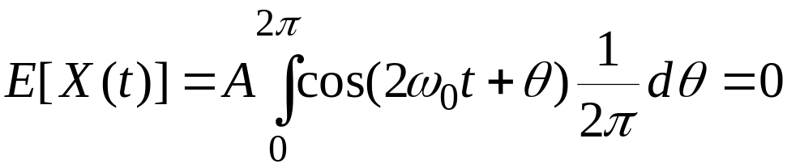
Now,
Thus,
and
Also E[X(t)] = E[Y(t)] = 0, since
Department of Electrical & Computer Engineering

Slide 11
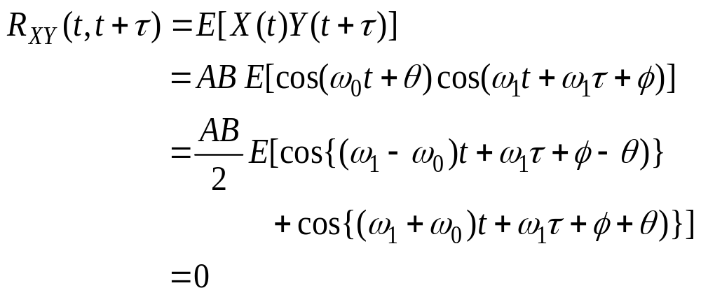
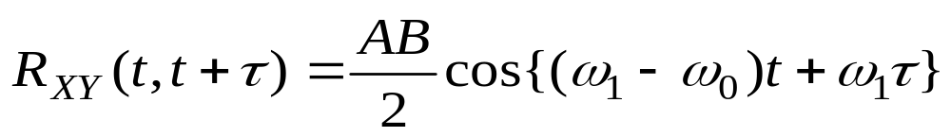
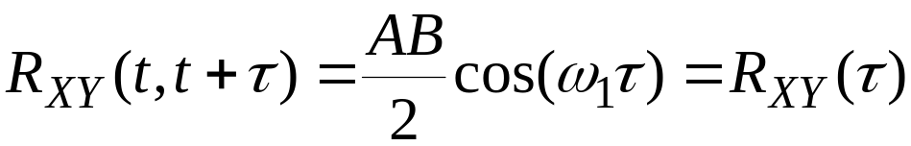
i.e., X(t) and Y(t) are individually WSS. But now,
which is not a function of τ, so X(t), Y(t) are not jointly WSS.
(b)
If θ = φ ⇒
which is again function of t. When ω₀ = ω₁,
Department of Electrical & Computer Engineering

Slide 12
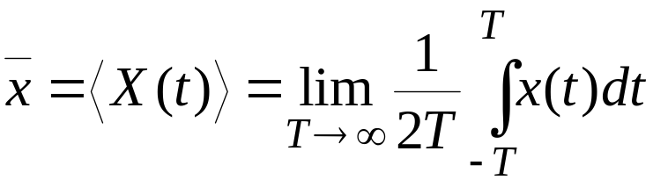
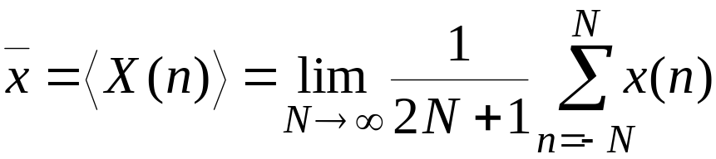
Time Averages and Ergodicity:
In practice, we would like to deal with only a single sample
function rather than the ensemble of functions. For example,
we may wish to infer the probability law or certain averages
of the r.p. from the measurements on a single member of the
ensemble set.
The time average for the ensemble set is defined as,
→ Continuous time case
→ Random sequence case
Department of Electrical & Computer Engineering

Slide 13
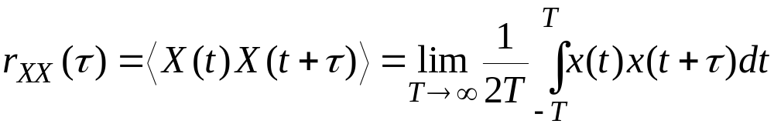
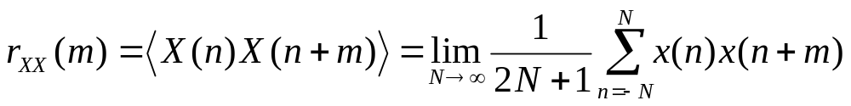



Then, the time average autocorrelation function will be,
If these time averages are computed for each sample function
within the ensemble set, these values, i.e., , r_{XX}(τ) or
r_{XX}(m) form r.v.’s themselves. Now, it is obvious (due to WSS)
that taking E[.] (ensemble average) of these r.v.’s yields,
and
Department of Electrical & Computer Engineering

Slide 14


Now if we assume that the deviations of these averages
are zero from one sample to another, then
In other words, the time averages obtained from one signal
(time series) are equal to the ensemble averages.
Ergodic r.p.’s:
A r.p. is said to be “ergodic” if the time averages computed
for a sample function can be used as an approximation to the
corresponding ensemble averages of the r.p. This is a very
restrictive form of stationarity (presupposes stationarity).
Department of Electrical & Computer Engineering

Slide 15
This assumption (even though not very practical) simplifies
the inference of the statistics greatly as it allows all the
statistics to be measured from only one sample function.
Example 10: Given an ergodic r.p. with ACF as shown
R_{XX}(τ)
50
20
τ
Find (a) E[X(t)], (b) E[X²(t)], (c) σ_{X}².
Department of Electrical & Computer Engineering

Slide 16
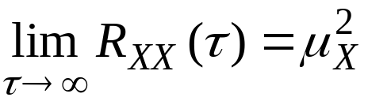


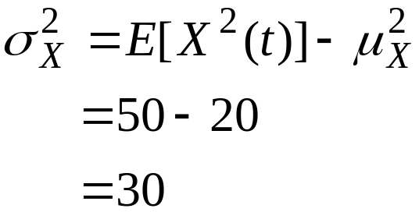
Solution:
(a) From the properties of ergodic r.p.,
Thus,
(b)
(c)
Reading Assignment For Week 12: Sections
6.3-6.4 (Peebles)
Department of Electrical & Computer Engineering

Slide 17
A Brief Review on Digital Filters (Computer Assign 3):
Why Digital vs. Analog?
Advantages:
Less (no) sensitivity to temperature variations / aging.
Better reliability.
Can be made adaptive.
More compact and light weight.
Less cost, etc.
Disadvantage:
Quantization effects due to rounding /truncation.
Department of Electrical & Computer Engineering

Slide 18
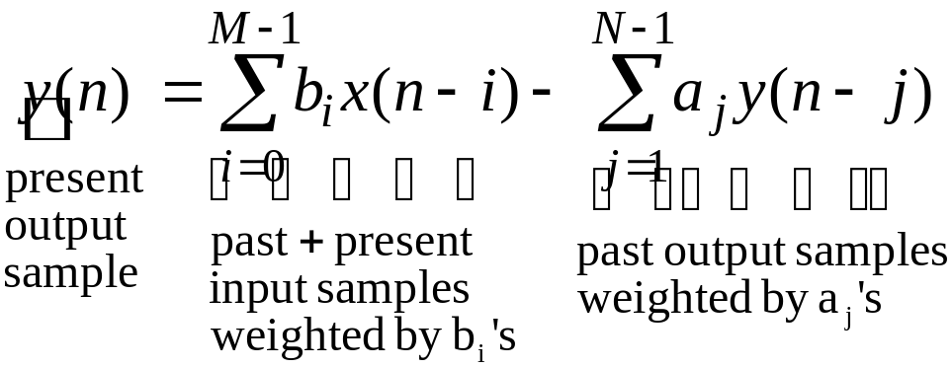
Two Types:
(1) Recursive or Infinite Impulse Response (IIR):
Input/output difference equation is
where x(n) : Input
y(n) : Output
a_{i}, b_{i}’s : Filter coefficients
N : Order
Above equation is called an ARMA (Auto-Regressive Moving
Average) process.
Department of Electrical & Computer Engineering

Slide 19
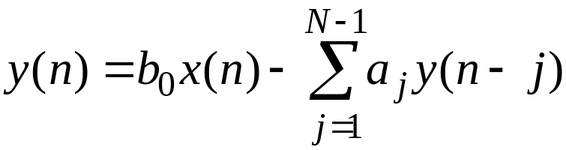
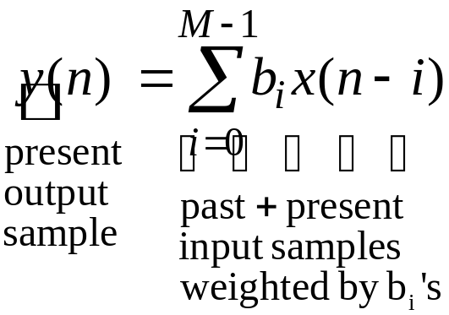
Special Case:
If b_{i} = 0, ∀i ≠ 0, then
This system is referred to as AR (Auto Regressive) process.
(2) Non-Recursive or Finite Impulse Response (FIR):
This is Moving Average
(MA) filter.
Thus, this filter can be viewed as a special case of IIR when
a_{j} = 0, ∀ j.
Department of Electrical & Computer Engineering

Slide 20
MATLAB Filter Command:
Y = filter (b, a, X)
where X = Input signal (vector)
Y = Output signal (vector)
a = [a₀, a₁, …, a_{N-1}]
b = [b₀, b₁, …, b_{M-1}]
Thus, for an FIR filter,
a = [a₀, 0, …, 0] and a₀ = 1 usually.
b = [b_{opt}] or b = [1/6, 1/6, …, 1/6] for a simple averaging filter
of the same order M=6.
Department of Electrical & Computer Engineering

Slide 21
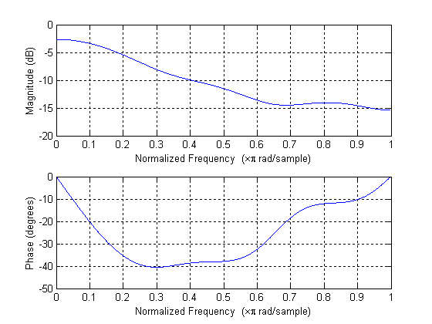
Magnitude and Phase Responses of the Optimal Filter:
Department of Electrical & Computer Engineering

