Slide 1
Chapter 6: Random Processes
In engineering and science, we often encounter problems, which
involve random signals that vary with time, e.g., bit stream in a
binary communication system (random message), noise, etc.
So far, we have investigated random events and r.v.’s (numerical
functions of events). Now consider assigning time functions to
the outcome of random events.
Definition:
Let s be a possible outcome of an experiment, assign (according
to some rule) a time function, x(t,s) to each outcome. Then,
x(t,s): Sample Function
Department of Electrical & Computer Engineering

Slide 2
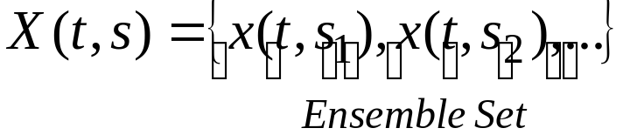
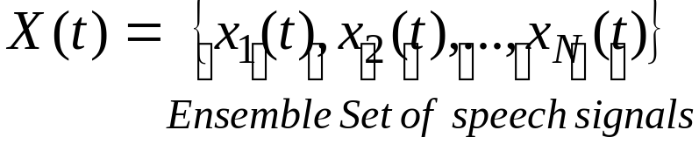
The family of such functions, X(t,s), is called random
process (or r.p.), i.e., X(t,s) can take on one of many possible
time functions x(t,s_{i})’s. Thus X(t,s) is a family or an ensemble
of time functions x(t,s_{i})’s.
Suppressing the ‘s’ index, x(t) is a sample function of r.p. X(t).
For example, assume that we have repeated the experiment of
collecting a speech signal N times and every time, due to
presence of random noise, we get a new signal x_{i}(t), then
Department of Electrical & Computer Engineering

Slide 3
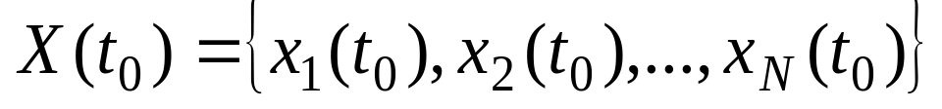
If ‘t’ is fixed, X becomes a r.v. i.e. randomness wrt the
ensemble set.
Question: How can we describe some statistical measures on X(t)? We could look at a particular time, t_{0,} then
is a r.v., which can be described by either PDF or CDF.
t₀
X(t₀)
x₁(t)
x₂(t)
x_{N}(t)
Department of Electrical & Computer Engineering

Slide 4

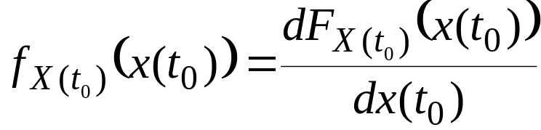
Thus, we can define its CDF and PDF, i.e.,
and
The r.p. is said to be statistically defined if the CDF is known
for all t_{j}’s. In most cases, this is a lot of information to ask for.
Thus, some assumptions need to be made to facilitate the
representation of r.p. in practical cases.
Department of Electrical & Computer Engineering

Slide 5
Definitions:
Continuous vs. Discrete r.p.:
(1) X(t) is said to be a continuous r.p., if both X and t take
Continuous range of values. e.g., Thermal noise in circuits
(2) X(t) is said to be a discrete r.p., if X takes only a finite
number of values while t changes continuously.
Continuous vs. Discrete random sequence:
X(n) is said to be a continuous random sequence if X takes
continuous range of values while n is discrete.
(2) X(n) is said to be a discrete random sequence, where both
time and amplitude take discrete values (sampled & quantized).
In what follows, we primarily confine our discussions to the 1st case
though the results can also be extended to other cases.
Department of Electrical & Computer Engineering

Slide 6

Deterministic (Pseudo-Random) vs. Non-deterministic
(True Random):
Deterministic: The function that represents each sample
function is known. e.g.,
where A, ω are fixed but φ is a r.v. with a specified PDF.
For every new value of φ, a r.p. in the ensemble set is
generated, i.e., randomness is over the ensemble set not
with respect to time. Similarly, the randomness could be due to
A or ω.
Non-deterministic: A totally random signal i.e. nothing is
predictable about the r.p.
Department of Electrical & Computer Engineering

Slide 7
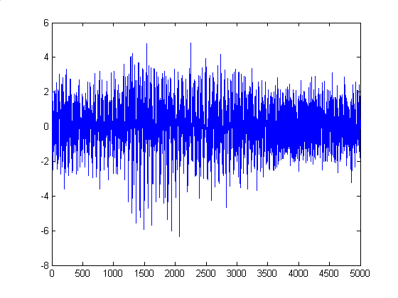
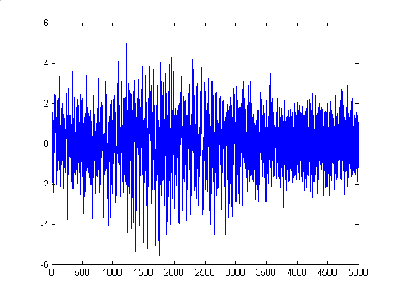
Two Noisy Measurements of a Speech Signal (‘Hello’)
Noisy Signal 1
Noisy Signal 2
A slice through time
Department of Electrical & Computer Engineering

Slide 8
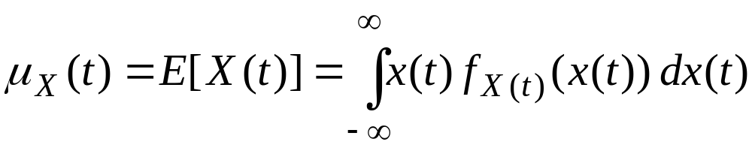
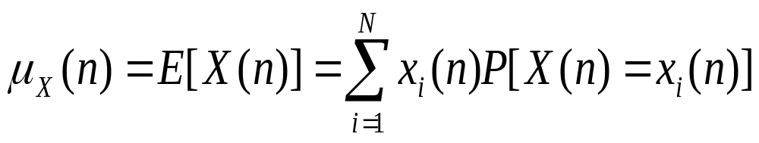
Measures on r.p.’s and Averages:
Since a r.p. is an indexed set of r.v.’s, we may likewise
characterize the process by statistical averages of the random
variables comprising of random process, such averages are
called “Ensemble Averages”.
(1) Ensemble Mean:
Note t is assumed to be fixed.
For discrete case,
x_{i}(n) = i^{th} sample function
Department of Electrical & Computer Engineering

Slide 9
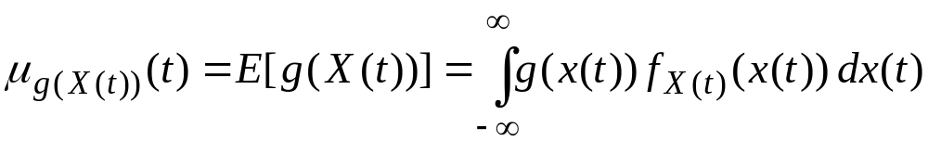
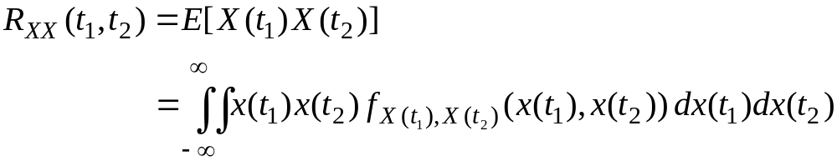
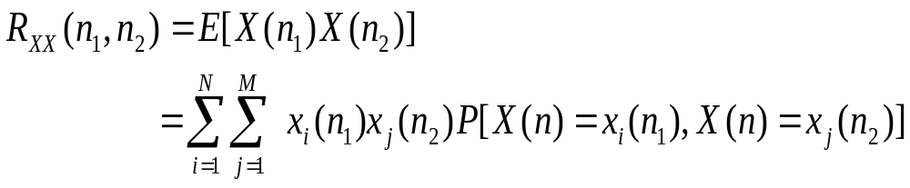
In general,
(2) Ensemble Auto-Correlation:
Measure of how much X(t) varies in time on the average.
Let t₁ and t₂ be two instances in time, then the autocorrelation
is defined by,
For discrete case,
Department of Electrical & Computer Engineering

Slide 10
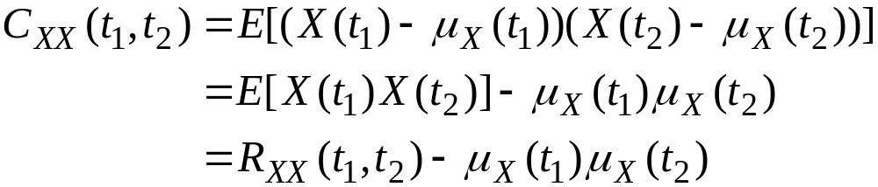
t₁
t₂
X(t₁)
X(t₂)
x₁(t)
x₂(t)
x_{N}(t)
(3) Ensemble Auto-Covariance:
Measure of spread from the mean.
Department of Electrical & Computer Engineering

Slide 11


Measures on two (or more) r.p.’s:
Let X(t) and Y(t) be r.p.’s with ACF’s R_{XX}(t₁,t₂) and R_{YY}(t₁,t₂),
respectively. The cross-correlation between X(t) and Y(t),
which gives a measure of dependence between these r.p.’s is,
Note that:
If X(t₁) and Y(t₂), independent,
for all t₁ and t₂
If X(t₁) and Y(t₂) are orthogonal,
for all t₁ and t₂
Department of Electrical & Computer Engineering

Slide 12
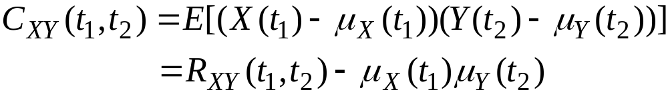

The cross-covariance function is
For independent processes,
for all t₁ and t₂
Example 1:
The process X(t) = a cos(ωt) + b sin(ωt) (pseudo r.p.)
where a, b are two independent Gaussian (normal) r.v.’s with
E[a] = E[b] = 0, E[a²] = E[b²] = σ²
and ω is a constant. Find R_{XX}(t₁,t₂).
Department of Electrical & Computer Engineering

Slide 13
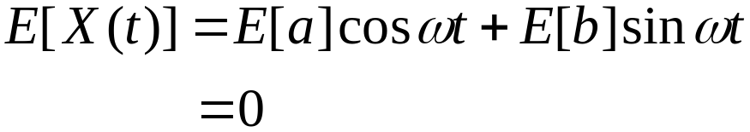
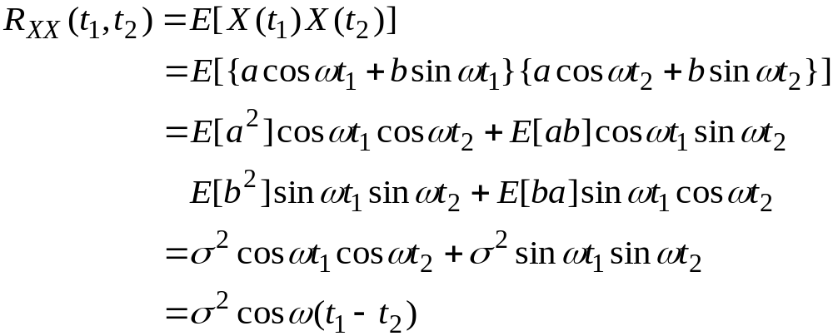
Solution:
Clearly, r.v.’s X(t_{i}) are linear combinations
of normal r.v.’s, a, b, thus they are jointly normal (why?) and to
determine their statistics, it suffices to find the mean and
autocorrelation of X(t).
0, since independent r.v.’s
0
Department of Electrical & Computer Engineering

Slide 14
Stationary Processes:
(1) Strictly Stationary:
A r.p. is strictly stationary if X(t) and X(t + τ) have the
same statistics (of all orders) for all τ.
t
t + τ
X(t)
X(t + τ)
x₁(t)
x₂(t)
x_{N}(t)
τ
Department of Electrical & Computer Engineering

Slide 15
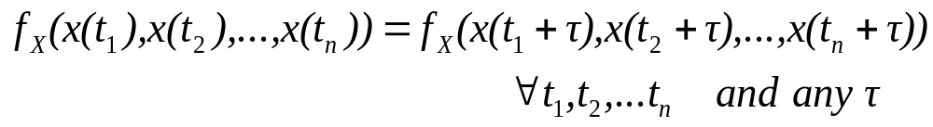

(2) Stationary of order n:
For stationary process of order n, the joint PDF and CDF must
be invariant under any finite time shift, i.e.
and similarly for the joint CDF.
The r.p. is strict-sense stationary if this is true for all orders n.
(3) Wide-Sense Stationary (WSS):
A r.p. is stationary of order n=2 or wide-sense stationary if
and
Department of Electrical & Computer Engineering

Slide 16
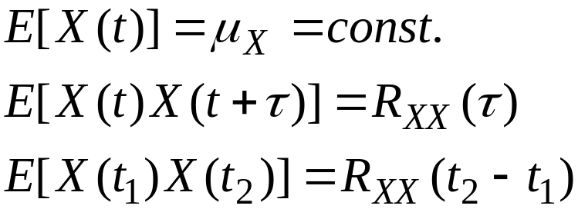
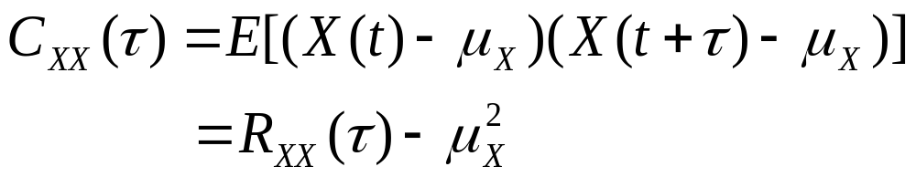

It can easily be shown that these conditions reduce to
… Only dependent on
shift, τ and not t.
or
i.e., the 1st and 2nd order moments are not time dependent.
Also
Clearly,
Department of Electrical & Computer Engineering

Slide 17
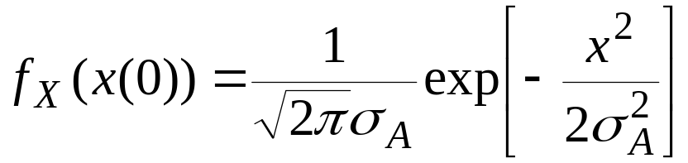
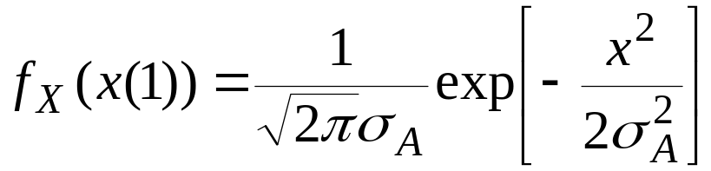
Example 2:
Given X(t) = A cos πt (pseudo r.p.)
where A is a Gaussian r.v. with E[A] = 0 and E[A²] = σ_{A}²
Find PDF’s of X(0) and X(1). Is X(t) stationary in any sense?
Solution:
For t = 0, X(0) = A ⇒ E[X(0)] = 0
E[X²(0)] = σ_{A}²
Thus,
For t = 1, X(1) = A cos π = -A ⇒ E[X(0)] = 0
E[X²(0)] = σ_{A}²
Thus again,
Department of Electrical & Computer Engineering

Slide 18


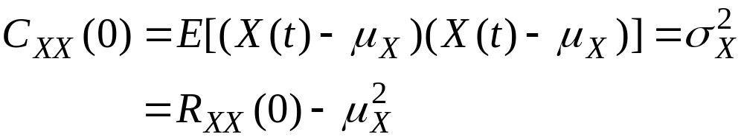
E[X(t)] = E[A] cos πt = 0 = fixed.
E[X²(t)] = E[A²] cos πt
Since E[X²(t)] is time dependent, r.p. X(t) is NOT wide–sense stationary.
Properties of WSS Processes (Important):
(1) Recall that
… Mean squared value.
Department of Electrical & Computer Engineering

Slide 19




(2)
… even symmetry.
Since,
(3)
i.e., ACF is decreasing function of
τ and bounded by R_{XX}(0).
(4) If X(t) and Y(t) are WSS and jointly WSS, i.e.,
then,
For WSS and independent r.p.’s,
Department of Electrical & Computer Engineering

Slide 20

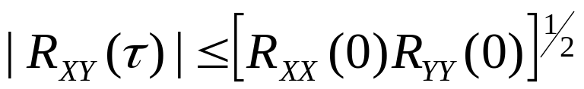
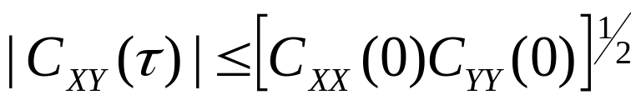
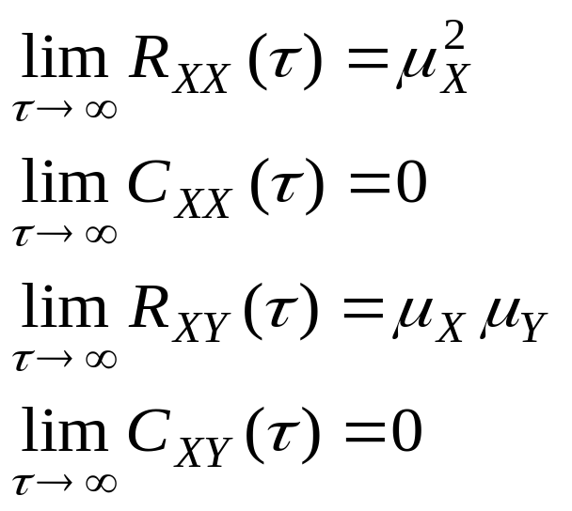
(5)
(6)
For many r.p.’s, they become less correlated as they
become more separated in time. Thus
More correlated
Slow varying
C_{XX}(τ)
τ
Less correlated
Fast varying
Department of Electrical & Computer Engineering

Slide 21
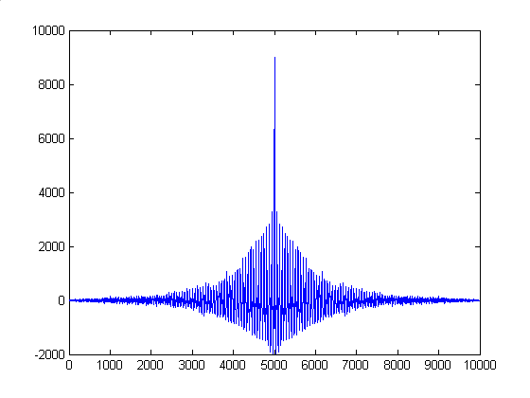
Plot of Auto-Correlation as a Function of lag (τ)
ACF of the
Noisy Signal 1
The large spike at τ =0 is due to white additive noise.
The exponentially decreasing behavior of this ACF is clearly noticeable.
Department of Electrical & Computer Engineering

Slide 22
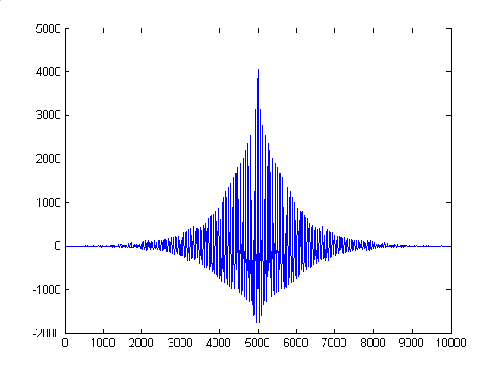
Plot of Auto-Correlation as a Function of lag (τ)
ACF of the
Actual Signal-
Ensemble average
The spike at τ =0 (due to white additive noise) does not exist anymore.
Department of Electrical & Computer Engineering

Slide 23

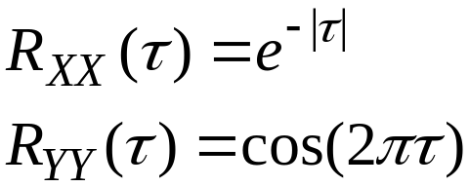
Remark:
C_{XX}(τ)
The r.p. X(t) is said to be “white” if
σ_{X}²
τ
This is in analogy with white light, in which all the frequencies are present.
Example 3:
Given statistically independent, zero mean r.p.’s X(t) and Y(t)
with ACF’s
Find R_{W1W1}(τ) of W₁(t) = X(t) + Y(t)
Find R_{W2W2}(τ) of W₂(t) = X(t) - Y(t)
Find R_{W1W2}(τ).
Department of Electrical & Computer Engineering

Slide 24
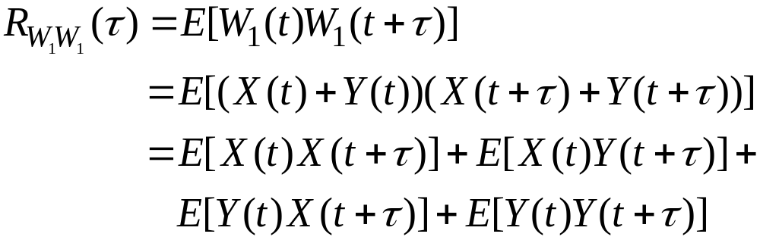
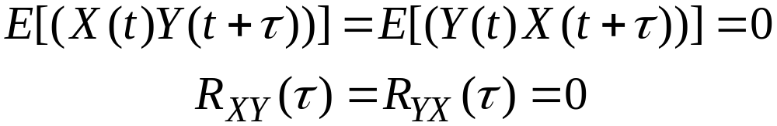
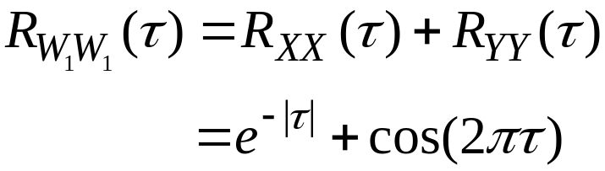
Solution:
(a)
Since statistically independent and zero mean,
Thus,
Department of Electrical & Computer Engineering

Slide 25
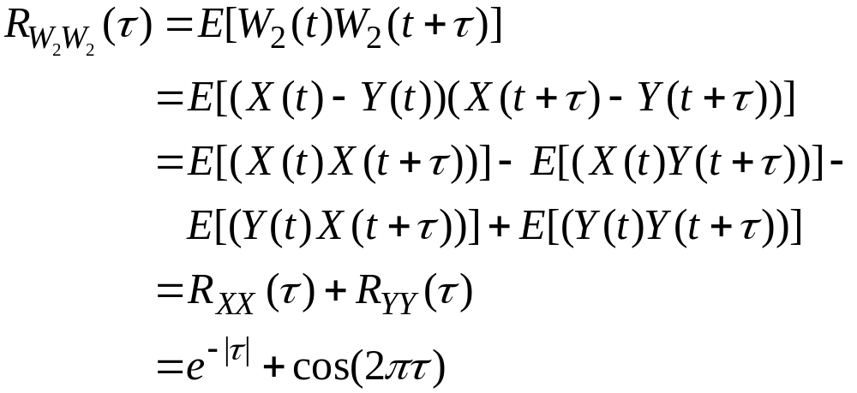
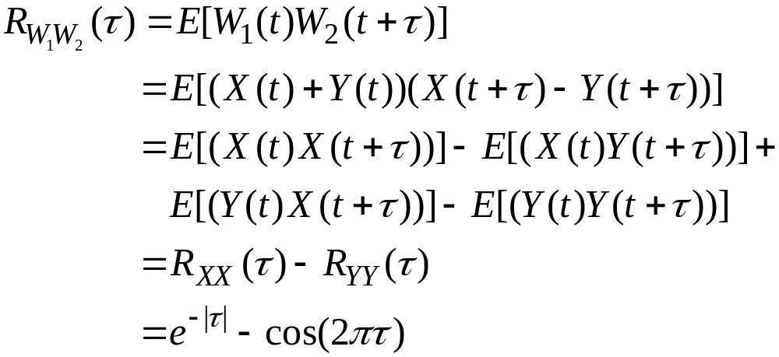
(b)
(c)
Reading Assignment For Week 11: Sections
6.1-6.3 (Peebles)
Department of Electrical & Computer Engineering

Slide 26
Quiz 1 (6 minutes- 2%)
1. Give clear definitions of pseudo and true r.p’s and provide an
example of each (different than those discussed in class). Can the
sample functions in an ensemble set correspond to different
‘phenomenon’? Why?
2. Describe the practical importance of auto- and cross-correlation
functions and give real-life examples.
Department of Electrical & Computer Engineering

