Slide 1
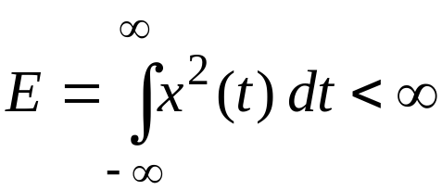
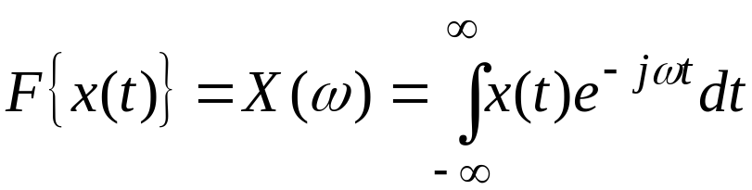
Chapter 7: Spectral Density
Although Fourier transform does not exist for r.p.’s (infinite
energy), the auto-correlation and cross-correlation functions
are non-periodic and energy signals. Thus, for these functions,
Fourier transform does exist.
Review on Fourier Transform:
Definition: A deterministic non-periodic signal x(t) is said to
be “energy-signal” if and only if,
Fourier transform of a non-periodic energy signal x(t) is
Department of Electrical & Computer Engineering

Slide 2
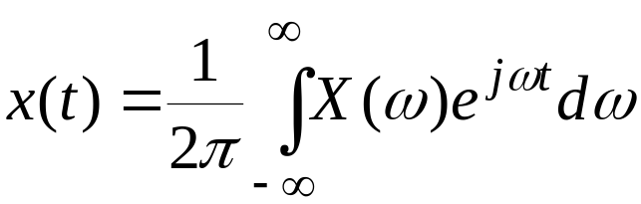
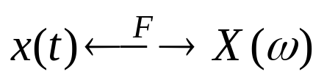
where X(ω) : Fourier Transform (FT) of x(t) or frequency
spectrum of x(t).
ω : Continuous variable representing frequency in
rad / sec, where ω = 2πf … (f in Hz.)
e^{-j ωt} : Basis function for FT representation.
x(t) can be recovered uniquely from its FT via the inverse
FT, i.e.,
Thus, there is a one-to-one correspondence,
Time
domain
Frequency
domain
Department of Electrical & Computer Engineering

Slide 3

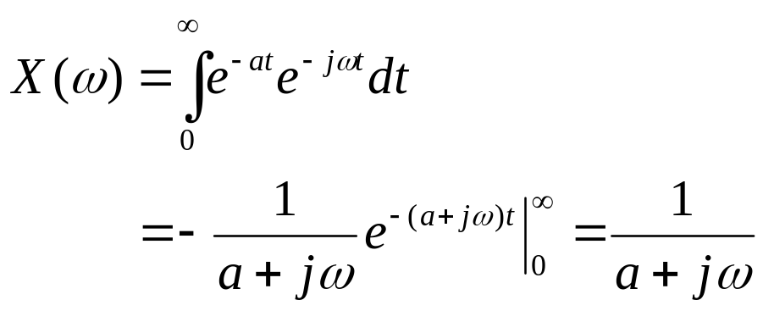


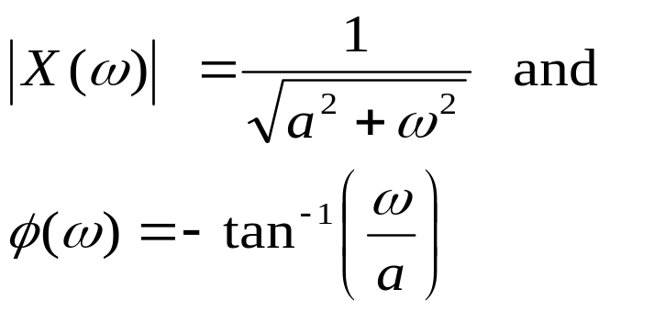


Remarks and Properties:
FT, X(ω) is a complex function in ω having amplitude
and phase, i.e.,
where |X(ω)| : Amplitude spectrum
φ(ω) : Phase spectrum
Example 1: Let x(t) = e^{-at} u(t), then
|X(ω)|
ω
a
φ(ω)
a
ω
Department of Electrical & Computer Engineering

Slide 4
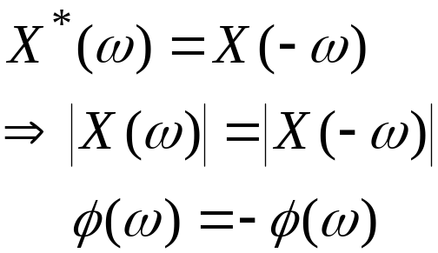
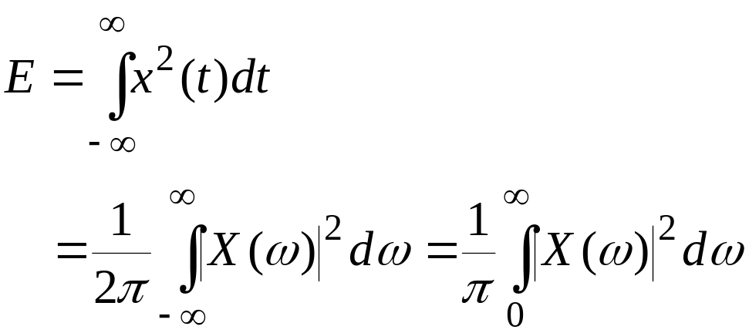
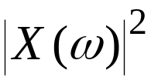
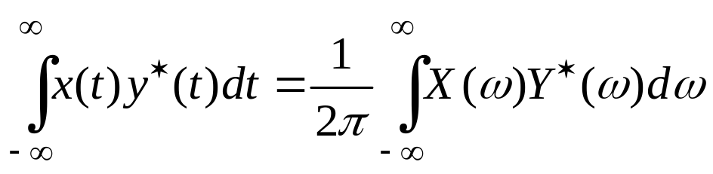
(2) X(ω) has conjugate symmetry, i.e.,
… Symmetrical w.r.t. vertical axis
… Anti-symmetric
(3) Parseval’s Theorem : Energy is preserved under FT operation.
Energy in time domain
Energy in frequency
domain
: Energy spectrum
More general case:
Inner Product in time/Freq
Department of Electrical & Computer Engineering

Slide 5

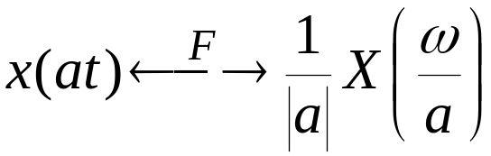
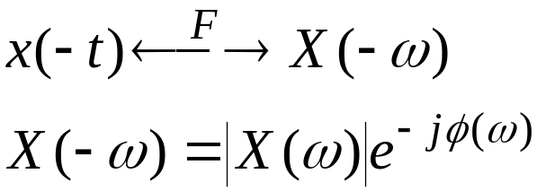
(4) Linearity:
(5) Scaling:
|a| > 1 → Compression in Time (more rapid)
Expansion in Frequency (more high frequencies)
|a| < 1 → Expansion in Time (slow varying)
Compression in Frequency (more low frequencies)
This property is used in data transmission to reduce the required BW of the receiver.
For a = – 1 → Time reflection
i.e., only phase is affected (-).
Department of Electrical & Computer Engineering

Slide 6
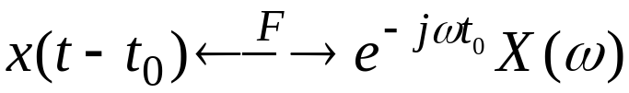
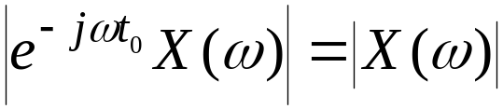

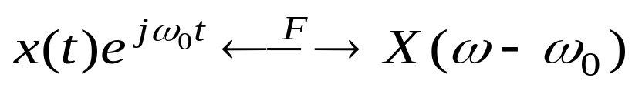
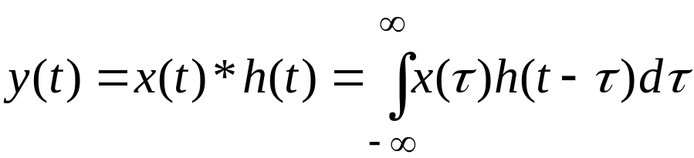
(6) Time shift:
No change in amplitude as
But,
(7) Frequency shift:
This is used in Amplitude Modulation (AM).
(8) Convolution in Time:
Department of Electrical & Computer Engineering

Slide 7


Then,
Function H(ω) = Y(ω) / X(ω), is the “transfer function” of
the system with input x(t) and output y(t).
x(t)
LTI System
h(t) / H(ω)
y(t)
H(ω) is also called frequency response of the LTI system.
where |H(ω)| : Magnitude response
θ(ω) : Phase response
These give the behavior of the system at any particular frequency.
Department of Electrical & Computer Engineering

Slide 8
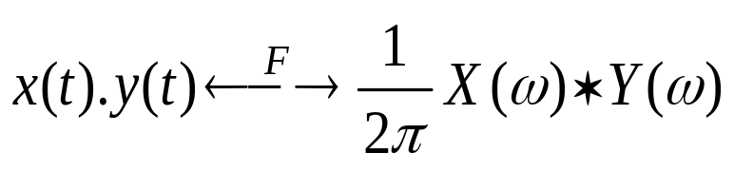
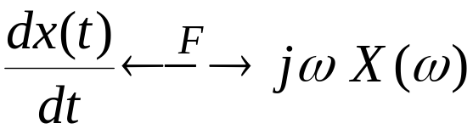
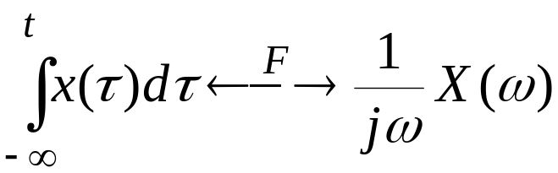
(9) Convolution in Frequency:
This is used in sampling in time.
(10) Differentiation in time:
(11) Integration in time:
provided X(ω) / ω has a bounded limit at ω = 0
See Appendices D & E for properties and Fourier transforms
of some typical signals.
Department of Electrical & Computer Engineering

Slide 9
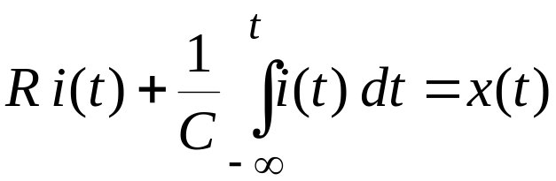
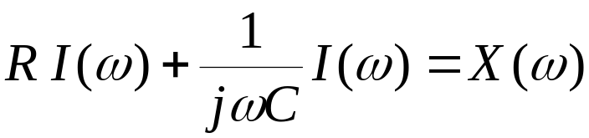
Example 2: Consider an RC circuit as shown. Find h(t)
for this circuit.
R
+
+
x(t)
i(t)
C
y(t)
-
-
Write KVL,
Take FT of both the sides,
Department of Electrical & Computer Engineering

Slide 10
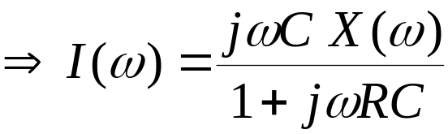
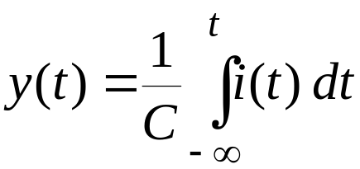
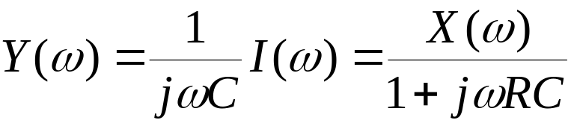
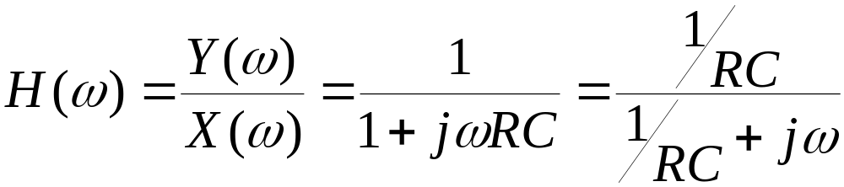
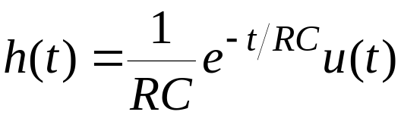
Also,
or
Thus,
Using the FT table,
RC = τ = Time constant
of RC circuit
Department of Electrical & Computer Engineering

Slide 11
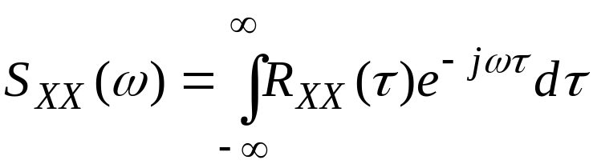
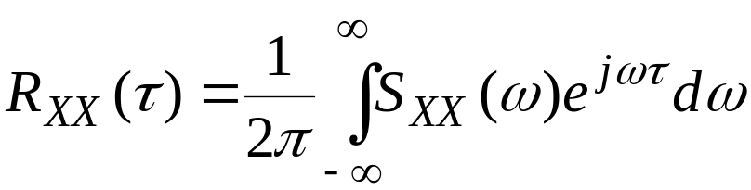

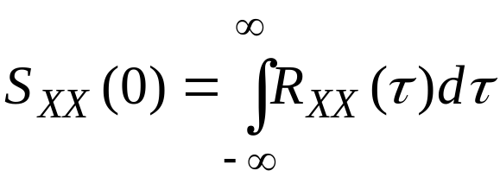
Power Spectrum or Spectral Density Function (SDF):
Let X(t) be a WSS r.p. with ACF R_{XX}(τ) , then SDF is
and
Thus,
Wiener-Khintchine Relations
Properties:
(1) S_{XX}(ω) is real, and S_{XX}(0) ≥ 0
(2) Since R_{XX}(τ) is real, S_{XX}(-ω) = S_{XX}(ω), i.e., symmetrical.
(3)
Department of Electrical & Computer Engineering

Slide 12
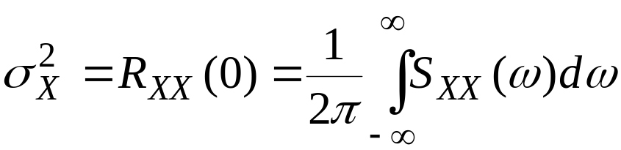

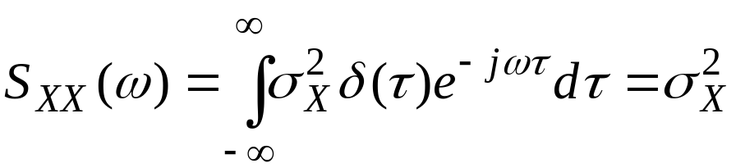

(4)
Remark:
For a “white” noise process,
Thus,
S_{XX}(ω)
R_{XX}(τ)
σ_{X}²
σ_{X}²δ(τ)
τ
ω
i.e. contains all the frequencies with equal contribution.
Department of Electrical & Computer Engineering

Slide 13

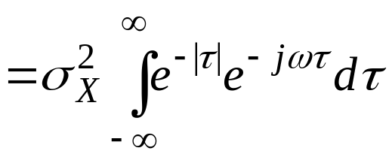
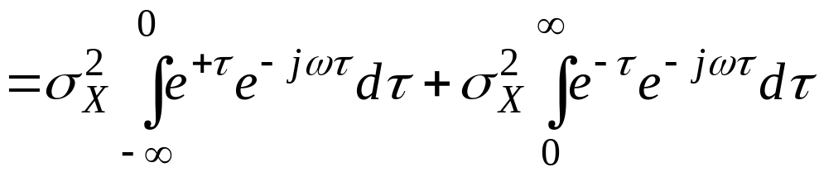
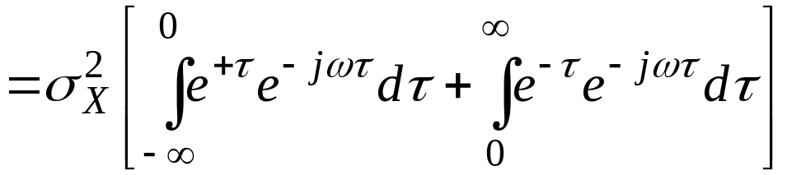
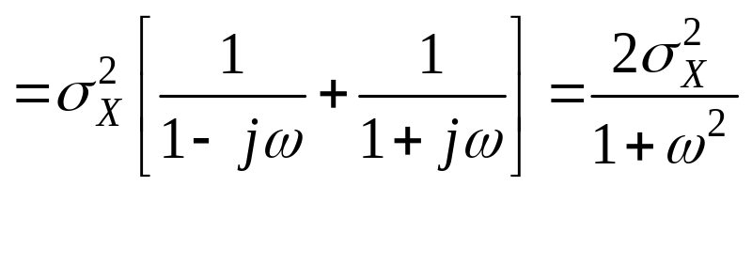
Example 3: Random process X(t), which is WSS has an ACF given by,
R_{XX}(τ)
σ_{X}²
Find SDF.
Solution:
0
τ
Department of Electrical & Computer Engineering

Slide 14
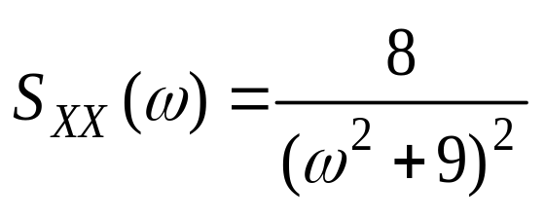
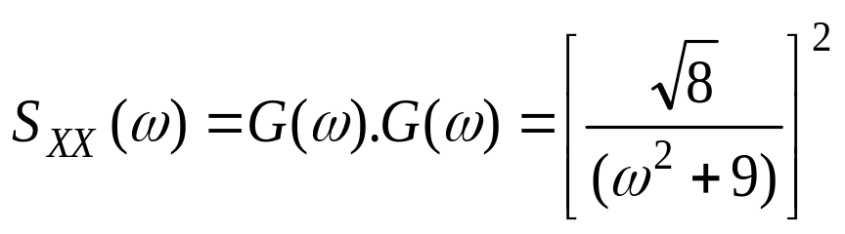
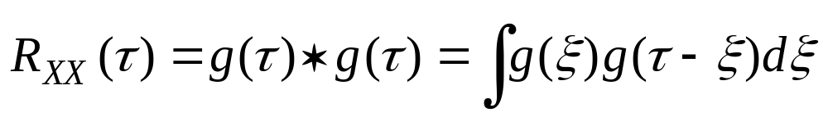
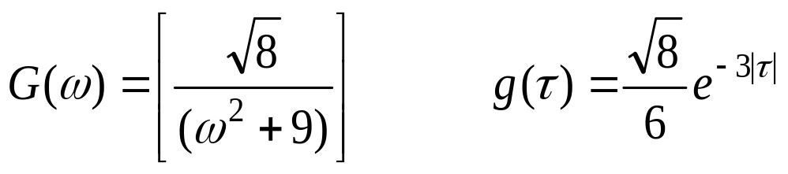
Example 4: A WSS r.p. X(t) has an SDF given by,
Find its ACF.
Solution: Let us rewrite S_{XY}(ω) as
Now, using the convolution property, we have
But, from Table E.1. (page 434), we have
F⁻¹
Department of Electrical & Computer Engineering

Slide 15
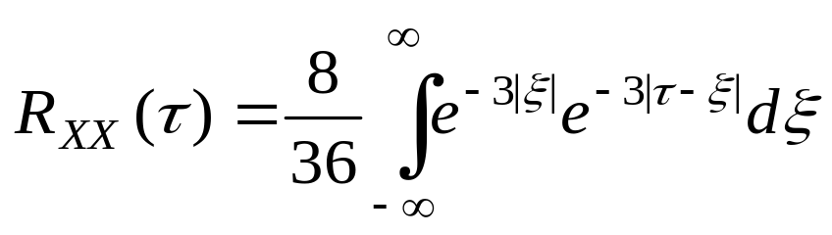
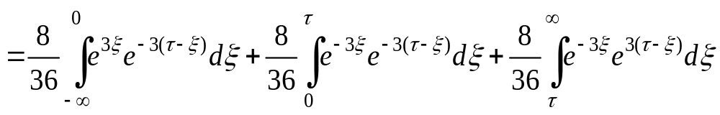
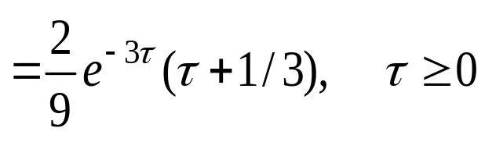
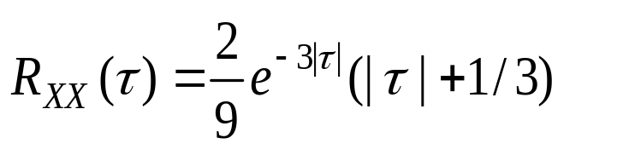
Thus,
Since R_{XX}(-τ) = R_{XX}(τ), then
Department of Electrical & Computer Engineering

Slide 16
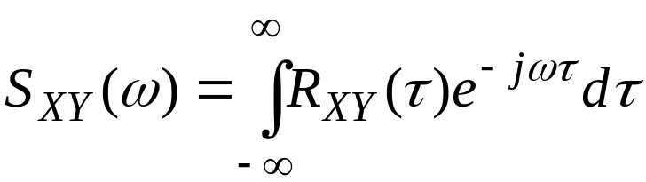

Cross Power Spectrum:
Consider two r.p.’s X(t) and Y(t) with cross-correlation
function R_{XY}(τ). We assume that X(t), Y(t) are individually and
jointly WSS. Then, cross power spectrum is defined by,
and
Properties:
(1) S_{XY}(ω)= S_{YX}(-ω)= S*_{YX}(ω).
(2) The real part of S_{XY}(ω) or S_{YX}(ω) has even symmetry while the
imaginary part has odd symmetry.
Department of Electrical & Computer Engineering

Slide 17
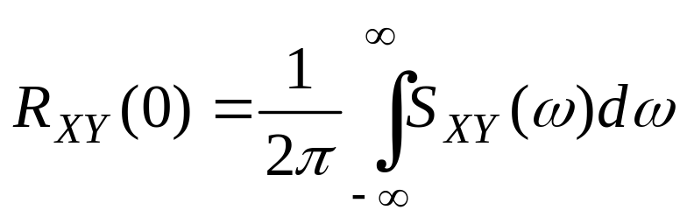
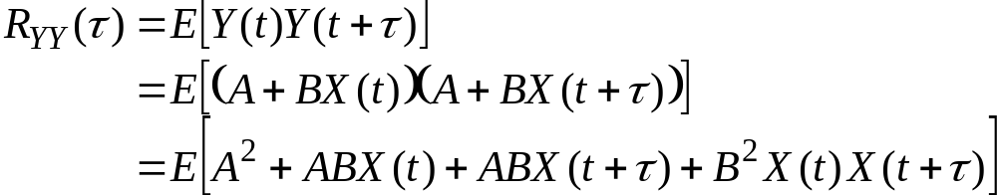
and
(3) If X(t) and Y(t) are orthogonal, then S_{XY}(ω)= S_{YX}(ω)=0.
(4)
Example 5: If X(t) is stationary and
Y(t) = A + B X(t)
with A, B real constants. Find R_{YY} , R_{XY} , S_{YY} and S_{XY}.
Solution:
Department of Electrical & Computer Engineering

Slide 18

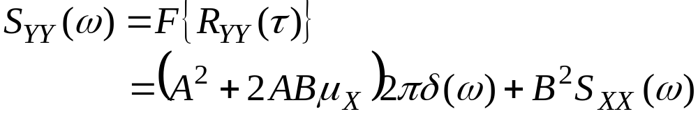
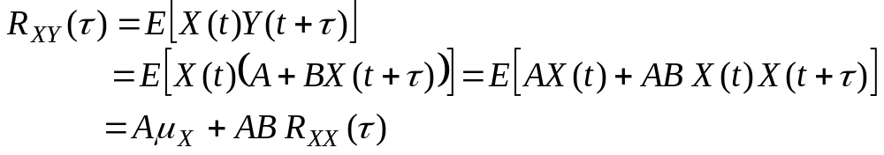
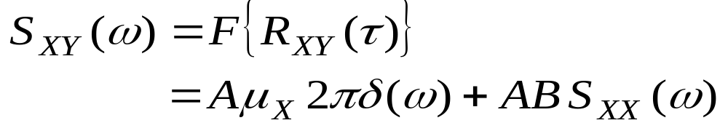
Department of Electrical & Computer Engineering

Slide 19
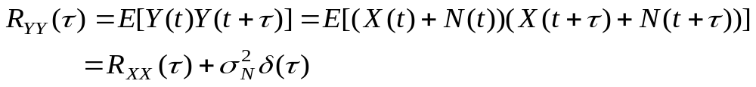



Example 6: Let Y(t) = X(t) + N(t) be a r.p. representing an observed
signal and X(t) be a WSS signal, while N(t) is a zero mean white
Gaussian noise process with variance σ_{N}² independent of signal.
Find expression for S_{YY} and S_{XY} .
Solution:
Thus,
Also,
Reading Assignment For Week 13: Sections
7.1-7.3 (Peebles)
Department of Electrical & Computer Engineering

