Slide 1
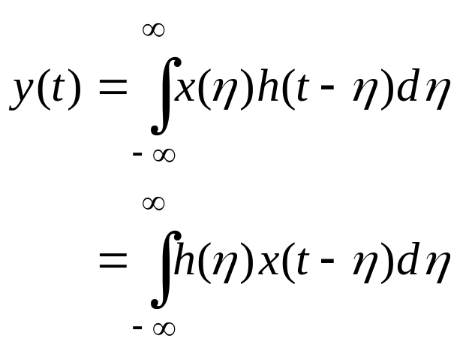




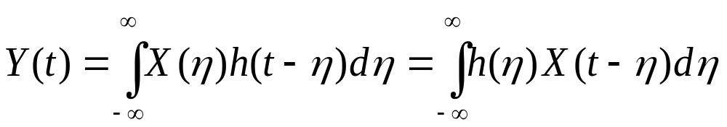


Chapter 8: Linear Systems with Random Inputs
Consider a causal stable LTI system with impulse response h(t) and let x(t) be a real input signal i.e. a sample function of a WSS random process X(t). Then, we have
LTI System
or
The same convolution equation holds for the entire ensemble sets X(t) and Y(t) i.e.
Now, given the mean and autocorrelation function, and of X(t), the statistics of Y(t) can be determined as follows.
Department of Electrical & Computer Engineering

Slide 2
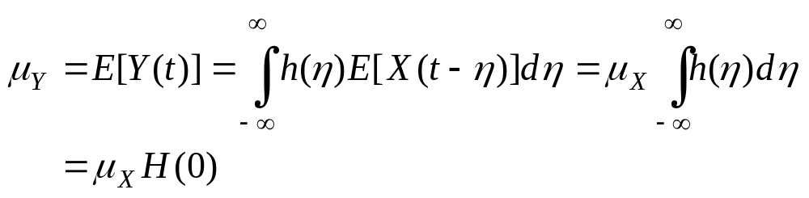
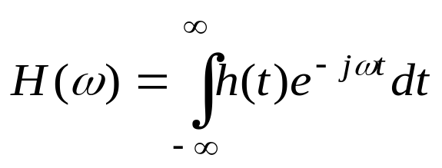
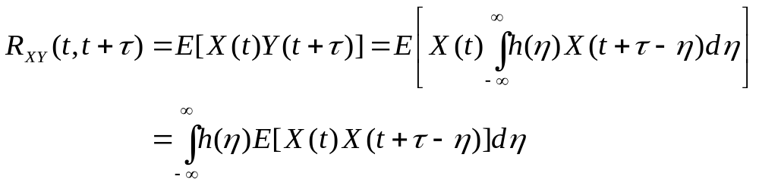
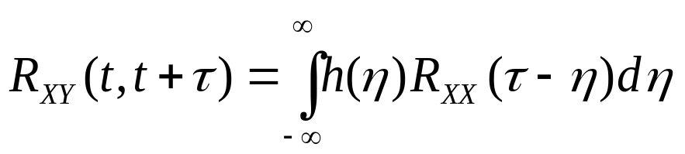
Mean
i.e. mean of Y(t) is constant
is the Frequency Response of the LTI System
where
Cross-Correlation and Cross Power Spectrum
or

Slide 3



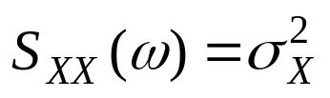
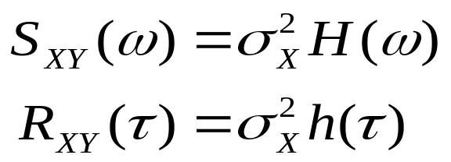
If X(t) is WSS, then
The cross-power spectrum is then given by
Remark
For a white process
and
Thus,
i.e. for a white-noise input, the cross-correlation between input and output of a linear system is proportional to the impulse response of the system (or the cross-power spectrum is proportional to the frequency response).

Slide 4
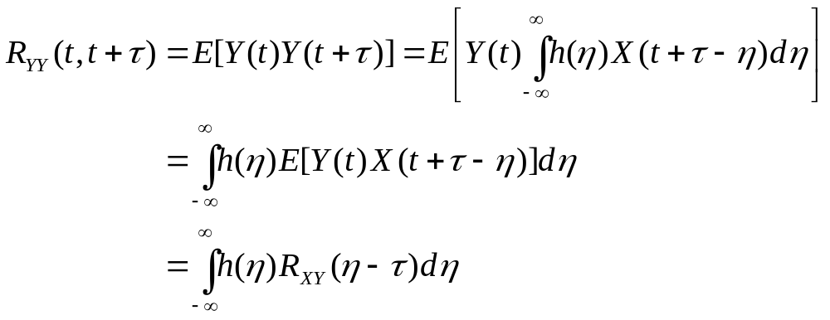

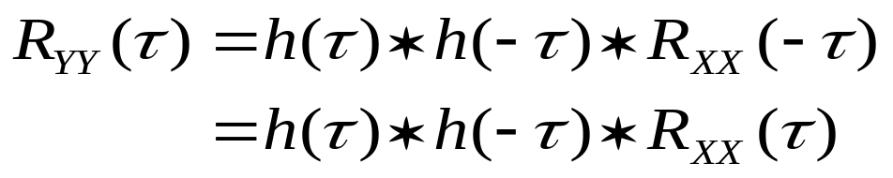
Auto-Correlation and Power Spectrum
If X(t) is WSS, then
On the other hand,
Thus,

Slide 5
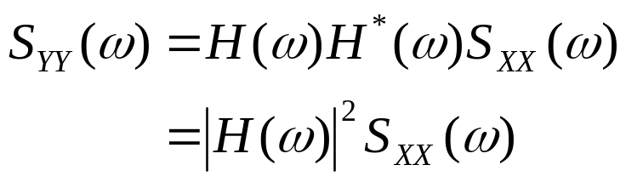


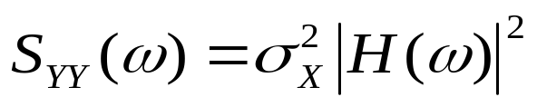

The power spectrum is
Spectral Factorization
Important Remarks
1. For a white process
and
Thus,
i.e. the output signal is NOT white and is correlated (colored noise) since the power spectrum is dependent on frequency.
2. Since mean of Y(t) is constant and its auto-correlation and cross-correlation functions are only dependent on , the output r.p. is also individually and jointly WSS with the input X(t).

Slide 6
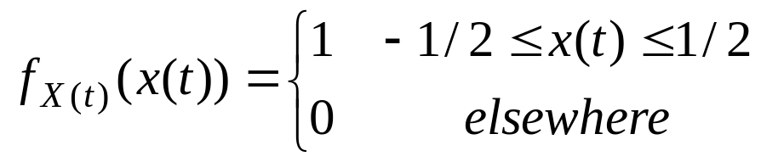







Example 1:
A white WSS random process X(t) with uniform PDF
is applied to the input of a system with structure shown below. Find the output power spectral density.
+
-
Solution
We first find and then .

Slide 7
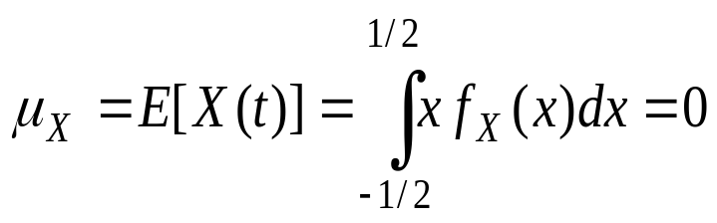
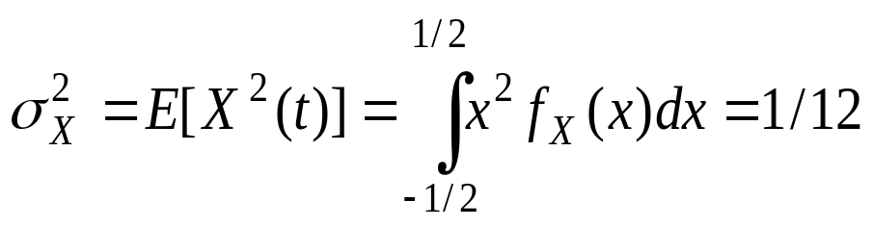
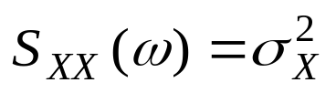

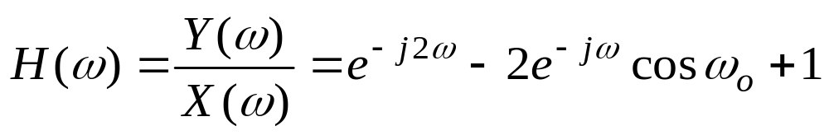
Since WSS
and
Since the input is a stationary white process
Thus, the power spectral density of the input is
From the system structure,
Thus,

Slide 8
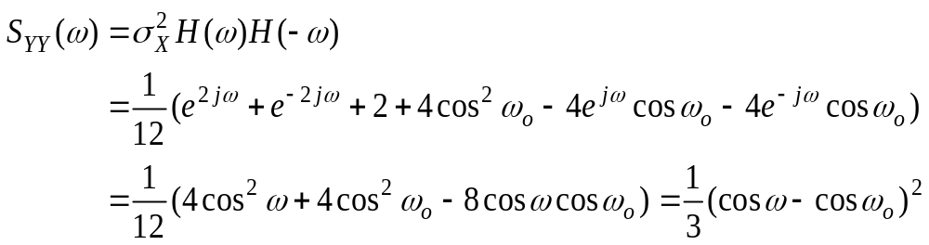
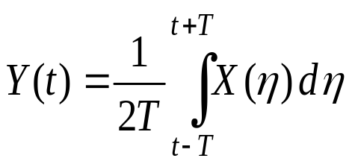
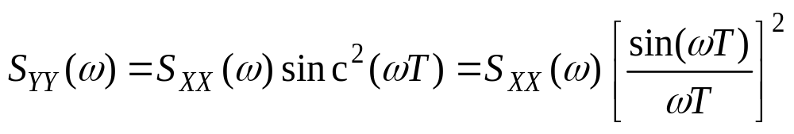
Example 2:
Consider a r.p. Y(t) defined as
where X(t) is a WSS r.p. Show that

Slide 9
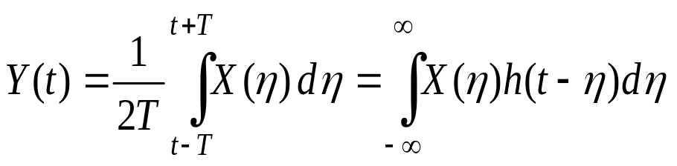
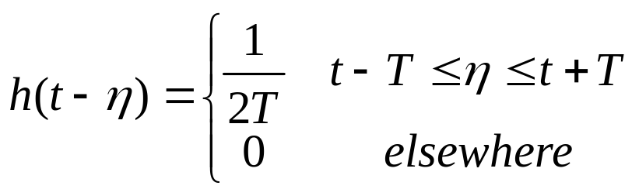
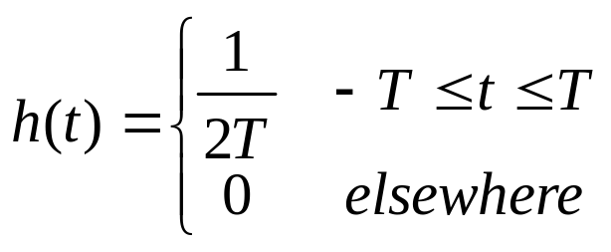

Solution
Rewrite the expression for Y(t) as a convolution integral i.e.
where
That is, Y(t) is the output of a LTI system with symmetric impulse response h(t) given by
and hence
Thus, using the power spectrum equation for Y(t), we get

Slide 10


Example 3-Another Version of Example 1:
A white WSS random process X(t) with uniform PDF
is applied to the input of a filter with realization shown below. Find the output power spectral.
+
-
Solution
Use
We first find and then .

Slide 11
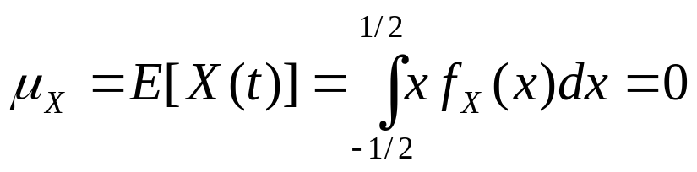
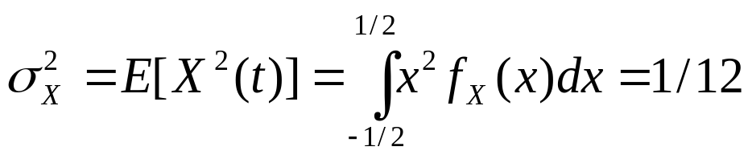

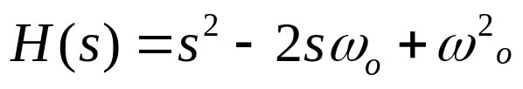
Since the process is white
Thus, the power spectral density of the input is
From the realization
Thus,

