Slide 1

Analysis of Greenhouse Gases in our Neighborhood! (Ochsenkopf, Germany)

Slide 2
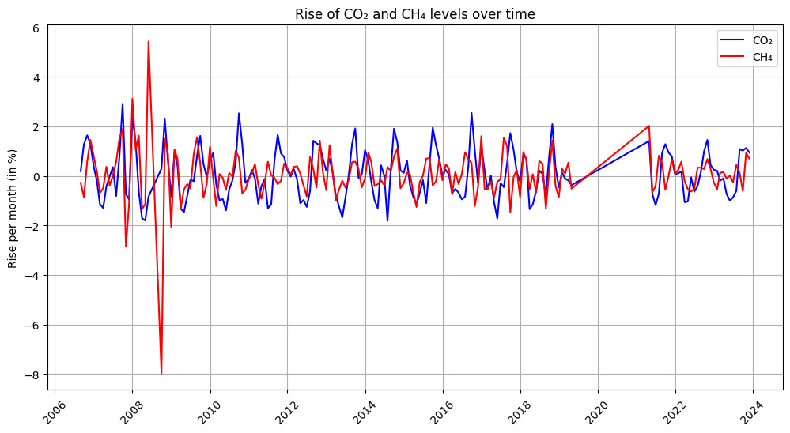
Our project
We created a Jupyter Notebook and analyzed the atmospheric carbon dioxide and methane concentrations from NOAA Global Monitoring Laboratory for Ochsenkopf, Germany
While on the first view the percentual rise doesn‘t look that concerning, the following slides show the full story

Slide 3
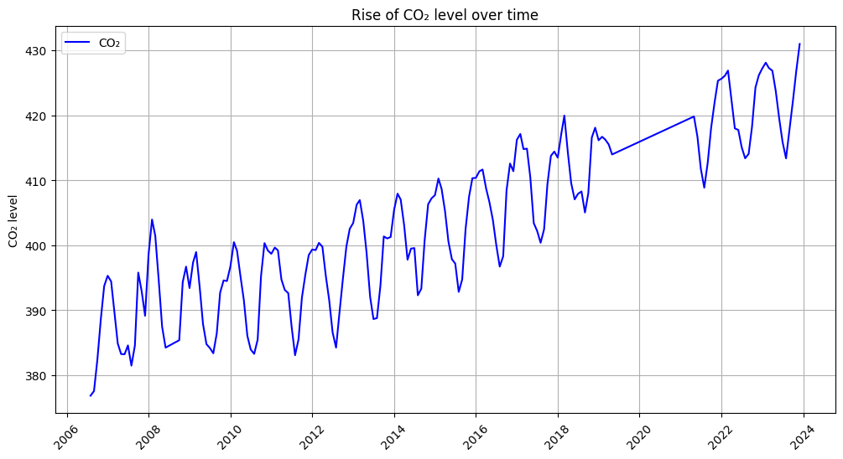
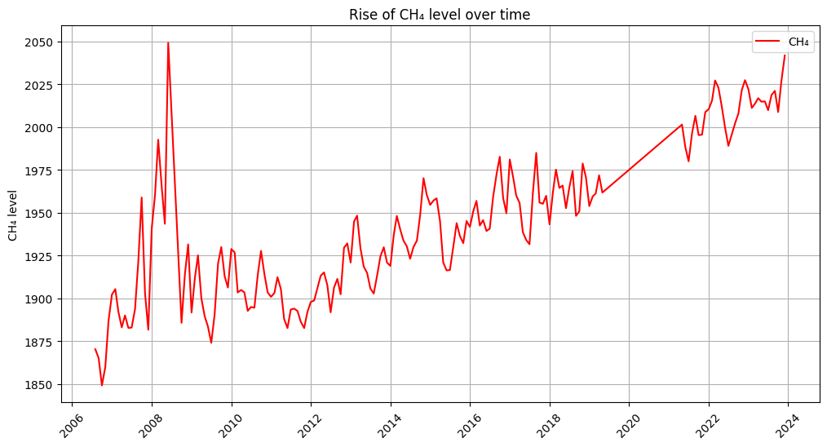
Rise of Co2 and Ch4 levels over time
Total rise of the CO₂ level over time [last - first value]: 12.56 % in 183 months → On average 0.82 % per year
Total rise of the CH₄ level over time [last - first value]: 8.4 % in 183 months → On average 0.55 % per year

Slide 4
Average rise of Co2 and Ch4 levels per month
Another interesting finding is that the rise of the Co2 level reaches it‘s yearly peak in October (on average), while the Ch4 level fluctuares more
Possible reasons for that on the next few slides

Slide 5
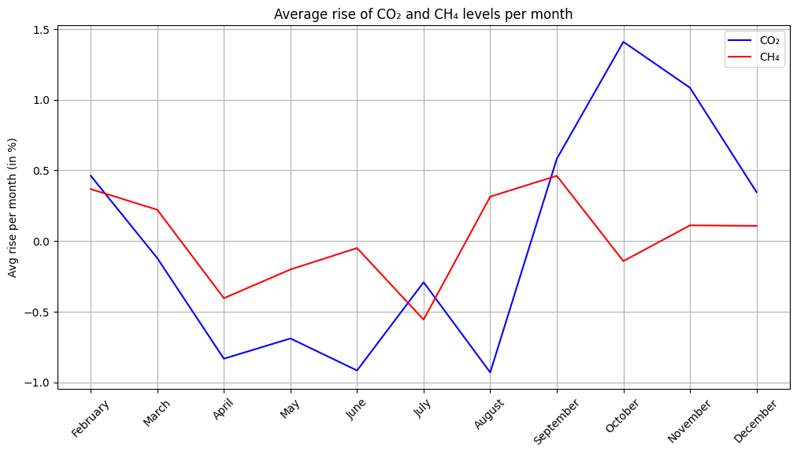

Slide 6
Possible reasons why Co2 Emissions rise in Ochsenkopf, Germany in October
Increased Heating
Colder weather → Higher energy demand for heating.
Agricultural Activity
Harvest season → More machinery & fuel usage.
More Transportation
Crop logistics & holiday travel → More vehicles on roads.
Reduced CO2 Absorption
Trees enter dormancy → Less CO2 absorbed by nature.
Regional Events
Festivals & gatherings → Temporary energy and travel spikes.

Slide 7
Possible reasons why Ch4 Emissions rise in Ochsenkopf, Germany in October
Agricultural Activity
Harvest season → Livestock farming increases methane from manure & digestion.
Organic Waste Decomposition
Crop waste and organic matter decompose, releasing methane.
Soil Disturbance
Tilling and harvesting → Disturbed soil releases stored methane.
Landfills and Waste
Increased organic waste from harvests → Landfills emit more methane.
Seasonal Animal Feeding
Livestock confined and fed → Increased methane from animal digestion (enteric fermentation).

