Slide 1



FIFA Match Prediction
Cristian Groza
Yifei Gu
Andrew Doyle

Slide 2
Introduction
Hypothesis:
Random variable outcome Y can be predicted using input variables X
Input features X :
# home games
# home goals
# away games
# away goals
home goals/game
away goals/game

Slide 3
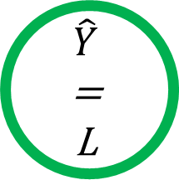
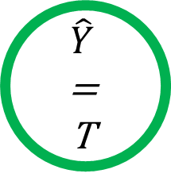
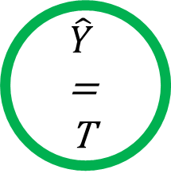

Methods
X₁
>
X₃
false
true
Random forests
Based on decision trees
X₃
> 1.3
X₅
<
X₆
false
true
false
true
=
L
=
T
=
T
=
W

Slide 4
Methods
Each tree trained with random subset of training data
Each node tests random features

Slide 5
Data
83 teams
852 games
Features goals and outcome of games
Most features are difficult to leverage without outside data (team names have predictive power with outside data)

Slide 6
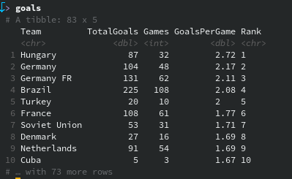
Feature extraction
The total goals in history
The total games in history
Average goals per game
Rank
Data reshaped with dplyr from tidyverse

Slide 7
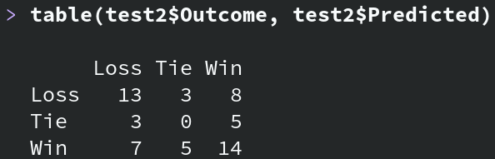
Predictions
Performance similar to training
50% testing accuracy

Slide 8
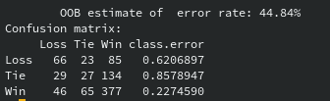
Model fit
Fairly good at classifying wins
Pretty bad at predicting ties

Slide 9
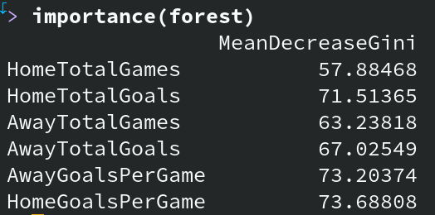
Feature importance
Larger Gini decrease is better

Slide 10
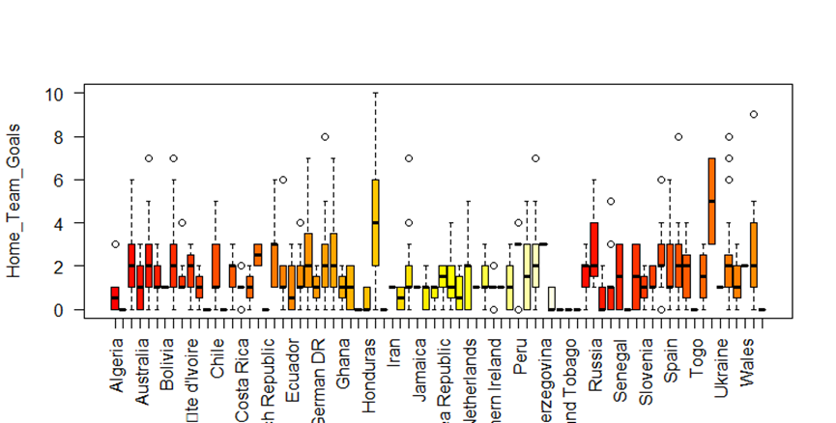

Slide 11
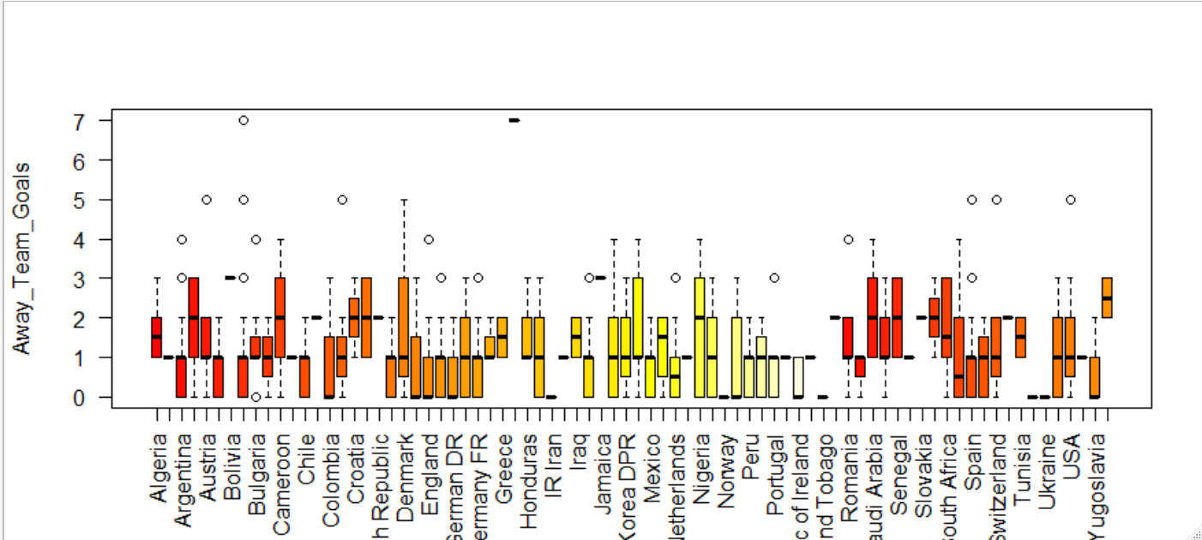

Slide 12
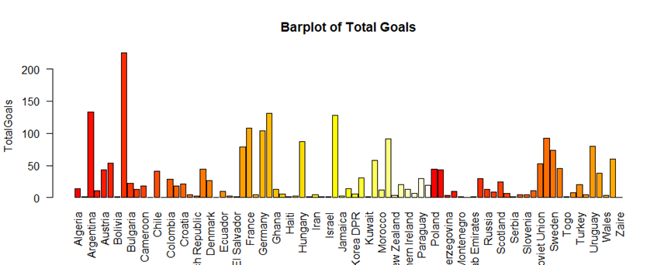

Slide 13
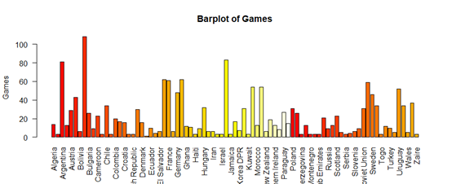

Slide 14
