Slide 1



FIFA Match Prediction
Cristian Groza
Yifei Gu
Andrew Doyle

Slide 2
Introduction
Hypothesis:
Random variable outcome Y can be predicted using input variables X
Input features X :
# home games
# home goals
# away games
# away goals
home goals/game
away goals/game

Slide 3
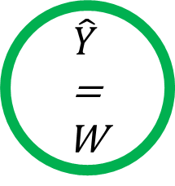
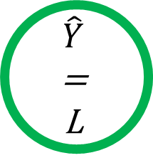
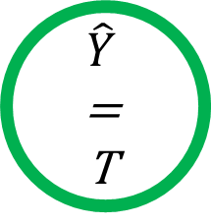

Methods
X₁
>
X₃
false
true
Random forests
Based on decision trees
X₃
> 1.3
X₅
<
X₆
false
true
false
true
$$\hat{Y}$$
=
L
$$\hat{Y}$$
=
T
$$\hat{Y}$$
=
T
$$\hat{Y}$$
=
W

Slide 4
Methods
Each tree trained with random subset of training data
Each node tests random features

