Slide 1
ICD-10 Code Prediction from MIMIC-IV Discharge Summaries
NLP Final Project · Spring 2025
Presented by
Devasai Sunder Tangella · [Partner Name]
(Edit names in PowerPoint)

Slide 2
Agenda
1
Problem Statement & Motivation
6
Approach 1: Chunk-BERT + Label Attention
2
Prior Work
7
Approach 2: BiLSTM-LAAT
3
Dataset & Base Model (TF-IDF)
8
Experimental Results
4
Individual Contributions
9
Discussion & Challenges
5
Proposed Approaches — Overview
10
Future Work
ICD-10 Code Prediction · NLP Final Project
2

Slide 3
Problem Statement & Motivation
PROBLEM
Given a clinical discharge summary (~1,500 words), predict the set of
ICD-10 diagnosis codes assigned to that hospital encounter.
This is a multi-label classification task with 7,940 possible codes.
WHY IS THIS HARD?
• Massive label space: 7,940 unique ICD-10 codes after frequency filtering
• Extreme class imbalance: rare codes appear in <0.1% of admissions
• Long documents: avg ~1,500 words exceeds BERT's 512-token limit
• Semantic complexity: same diagnosis expressed with different phrasing
CLINICAL IMPACT
• Manual coding costs US hospitals ~$25B/yr
• Automated prediction reduces errors
• Accurate codes drive reimbursement, epidemiology, and quality-of-care metrics
ICD-10 Code Prediction · NLP Final Project
3

Slide 4
Prior Work
CAML / DR-CAML (Mullenbach et al., 2018)
CNN + per-label attention over clinical text. Established that label-aware attention is critical for ICD coding.
PLM-ICD (Huang et al., 2022)
Overlapping chunks + per-label attention over pretrained LM. Achieves SOTA on MIMIC-III with full-document coverage.
LAAT (Vu et al., 2020)
BiLSTM encoder + label attention. Showed RNN-based models with label attention rival transformer approaches.
ClinicalBERT (Alsentzer et al., 2019)
Pre-trained on MIMIC clinical notes; captures contextual semantics but truncates at 512 tokens.
ICD-10 Code Prediction · NLP Final Project
4

Slide 5
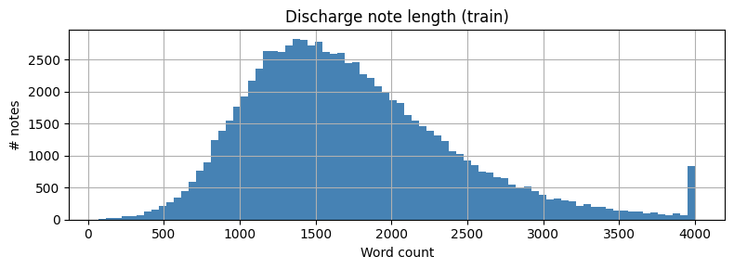
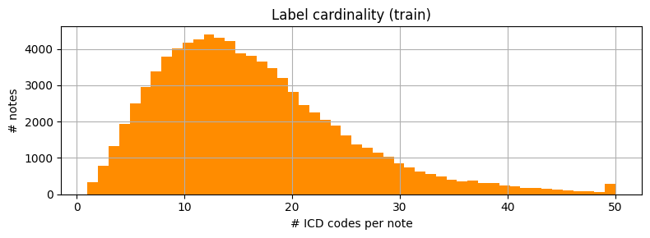
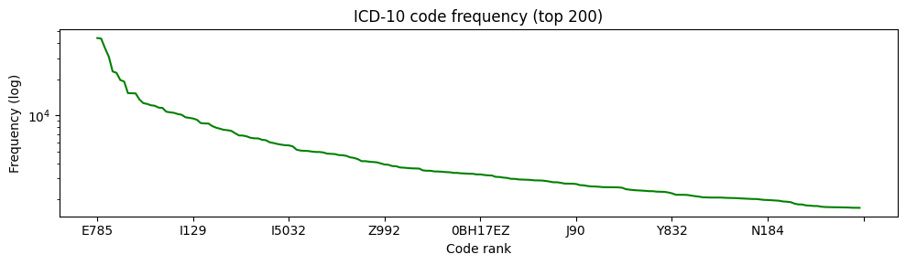
Dataset & Base Model (TF-IDF)
MIMIC-IV CLINICAL DATABASE
• 331,793 discharge notes from Beth Israel Deaconess
• 122,304 admissions with notes + ICD-10 codes
• 7,940 codes (freq ≥ 10); Top-50 for experiments
• Patient-level split (no leakage): Train 85,081 (70%), Val 18,371 (15%), Test 18,852 (15%)
BASE MODEL: TF-IDF + SGD (SHARED)
• 50K-dim TF-IDF vectors (unigrams + bigrams, sublinear TF)
• OneVsRest SGDClassifier (log loss, L2 penalty, balanced class weights)
• Threshold tuning on validation → t = 0.53
• Micro-F1: 0.60 | Macro-F1: 0.57 | AUROC: 0.93
• Serves as the baseline both approaches aim to improve upon
ICD-10 Code Prediction · NLP Final Project
5

Slide 6
Individual Contributions — Teammate 1
[Teammate 1 — edit name]
APPROACH 1: CHUNK-BERT + LABEL ATTENTION (PLM-ICD INSPIRED)
• Designed chunking strategy: sliding window (6 × 512 tokens, stride 256) for full-document coverage
• Implemented per-label attention — 50 learnable query vectors attend across all chunk embeddings
• Bio_ClinicalBERT encoder with two-phase training (frozen → fine-tune last 2 layers)
TRAINING & OPTIMIZATION
• Sigmoid focal loss (gamma=2.0, alpha=0.25) to handle severe class imbalance
• Mixed-precision (fp16) + gradient accumulation (batch 4 × 8 = effective 32) on GCP L4 GPU
• ~8 hours training; validation F1 improved from 0.41 → 0.47 across training phases
ADDITIONAL CONTRIBUTIONS
• MIMIC-IV data extraction pipeline & cohort construction (122K admissions)
• Text preprocessing: de-id stripping, normalization, TF-IDF feature engineering
• Built shared evaluation framework (threshold tuning, head/torso/tail analysis)
ICD-10 Code Prediction · NLP Final Project
6

Slide 7
Individual Contributions — Teammate 2
[Teammate 2 — edit name]
APPROACH 2: BiLSTM-LAAT (LABEL ATTENTION OVER BiLSTM)
• Implemented LAAT architecture: BiLSTM encoder + structured label attention mechanism
• Word-level tokenization with 50K vocabulary — processes up to 4,000 tokens natively
• Per-label attention with learned projection: Z = tanh(W·H^T), A = softmax(U·Z)
TRAINING & CALIBRATION
• 10 epochs with focal loss, AdamW (lr=1e-3), batch size 32 on GCP L4 GPU
• Temperature calibration post-training — reduced ECE from 0.07 to 0.02
• Achieved best individual Micro-F1: 0.72 — significantly outperforms base model (+12 F1 pts)
ADDITIONAL CONTRIBUTIONS
• Comparative evaluation across all models (per-label scatter analysis, bar charts)
• Production packaging: src/ Python module, FastAPI API, Docker containerization
• Pytest test suite covering data processing, model shapes, and API schemas
ICD-10 Code Prediction · NLP Final Project
7

Slide 8
Proposed Approaches — Overview
Two approaches for Top-50 ICD-10 prediction, both addressing full-document processing:
Approach 1
Approach 2
Chunk-BERT + Label Attention
BiLSTM-LAAT
• PLM-ICD inspired architecture
• 6 overlapping 512-token chunks → Bio_ClinicalBERT
• Concatenate all token embeddings across chunks
• Per-label attention: 50 learnable query vectors
• Two-phase training: frozen → fine-tune BERT
• LAAT (Vu et al., 2020) inspired architecture
• Word embeddings → Bidirectional LSTM encoder
• Structured label attention: W·H^T → tanh → softmax
• Processes up to 4,000 tokens natively (no chunking)
• Lightweight: 10 epochs, trains in ~30 min on L4
Both approaches use per-label attention and process full documents — key advantages over truncation-based BERT.
ICD-10 Code Prediction · NLP Final Project
8

Slide 9
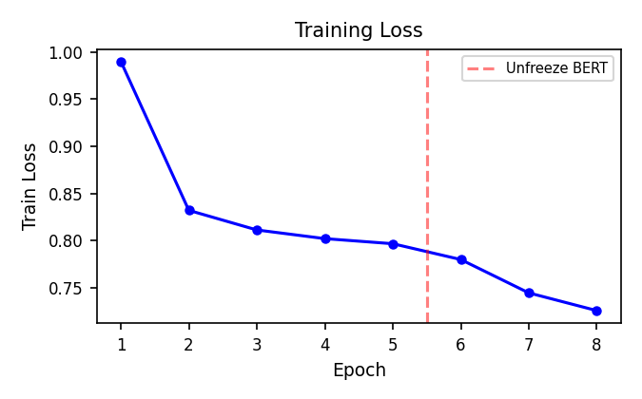
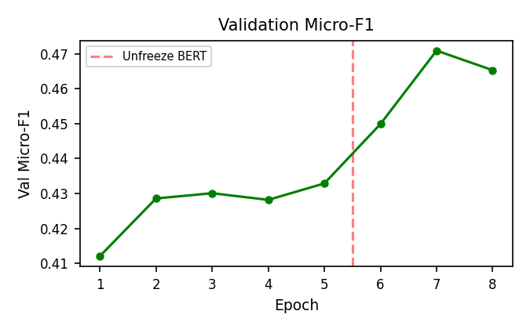
Approach 1 — Chunk-BERT + Label Attention
CHUNKING + ENCODING
1. Tokenize full note → sliding window (512 tokens, stride 256)
2. Pad/truncate to max 6 chunks; mask padding during attention
3. Bio_ClinicalBERT encodes each chunk → concat all embeddings
LABEL ATTENTION
• 50 learnable query vectors (R^768), Xavier-initialized
• Scores = H @ Q^T → softmax → weighted sum per label
• Per-label linear projection for final logits
TWO-PHASE TRAINING
Phase 1: 5 ep, lr=1e-3 — trains attention + classifier (BERT frozen)
Phase 2: 3 ep, lr=2e-5 — unfreezes last 2 BERT layers
Focal loss (gamma=2.0) · fp16 · batch 4×8 on GCP L4
ICD-10 Code Prediction · NLP Final Project
9

Slide 10
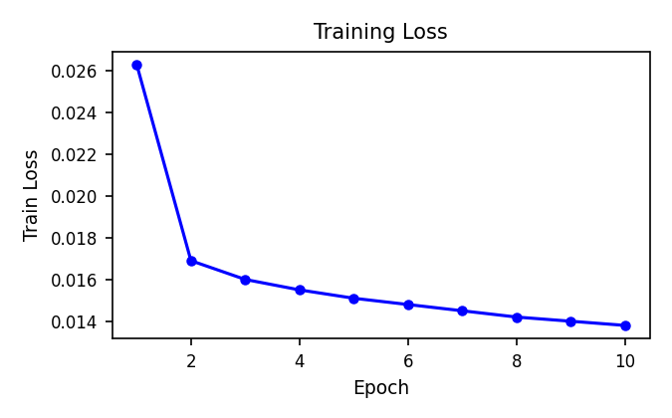
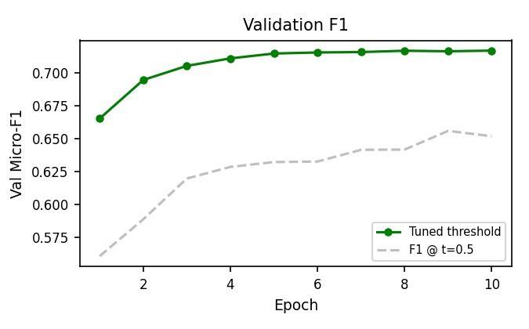
Approach 2 — BiLSTM-LAAT
ARCHITECTURE (LAAT — Vu et al., 2020)
1. Word embedding layer (dim=200, vocab=50K) → BiLSTM (hidden=256)
2. Label attention: Z = tanh(W·H^T), A = softmax(U·Z)
3. Per-label FFN classifier → 50 sigmoid outputs
KEY DESIGN CHOICES
• Processes up to 4,000 word tokens — full document, no chunking
• Lightweight: ~11M parameters (vs 108M for BERT-based approach)
• Focal loss + temperature calibration (ECE: 0.07 → 0.02)
TRAINING
10 epochs, AdamW lr=1e-3, batch 32 on GCP L4 GPU
Val F1 improved steadily: 0.67 → 0.72 (tuned threshold)
Early stopping patience = 3; best at epoch 8
ICD-10 Code Prediction · NLP Final Project
10

Slide 11
Results — Test Set (Top-50 Codes)
Metric | Base Model (TF-IDF+SGD) | Approach 1 (Chunk+Attn) | Approach 2 (BiLSTM-LAAT)
Micro-F1 | 0.60 | 0.53 | 0.72
Macro-F1 | 0.57 | 0.50 | 0.66
Micro-Precision | 0.49 | 0.42 | 0.72
Micro-Recall | 0.75 | 0.72 | 0.72
Macro-AUPRC | 0.57 | 0.52 | 0.68
Micro-AUROC | 0.93 | 0.89 | 0.95
Threshold | 0.53 | 0.63 | 0.30
BiLSTM-LAAT achieves best results: +12 F1 pts over base model, with balanced precision (0.72) and recall (0.72).
Approach 1 matches base model recall but needs more training epochs — BERT layers unfrozen only for 3 epochs.
ICD-10 Code Prediction · NLP Final Project
11

Slide 12
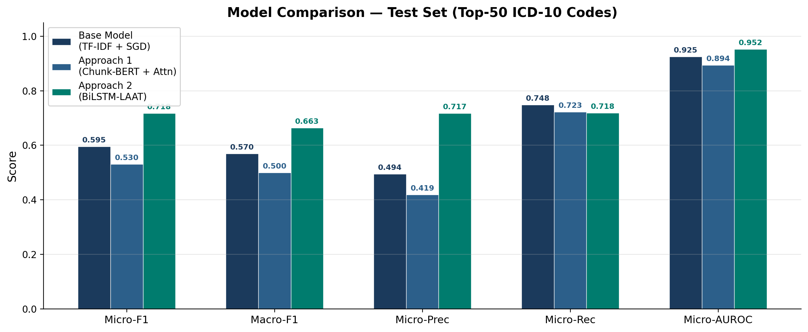
Results — Model Comparison
ICD-10 Code Prediction · NLP Final Project
12

Slide 13
Key Takeaways
1
BiLSTM-LAAT outperforms both BERT-based and TF-IDF approaches
With only ~11M parameters, the BiLSTM achieves 0.72 F1 — processing 4K tokens natively without chunking overhead.
2
Full-document processing is critical for ICD coding
Both proposed approaches process the complete note. Truncated ClinicalBERT (512 tokens) scored only 0.52 F1.
3
Label attention is the key architectural component
Both approaches use per-label attention — each ICD code learns to attend to its most relevant tokens in the document.
4
Lightweight models can outperform large transformers
BiLSTM-LAAT trains in ~30 min vs ~8 hrs for Chunk-BERT. Smaller models can be more practical for clinical deployment.
ICD-10 Code Prediction · NLP Final Project
13

Slide 14
Discussion — Analysis & Insights
WHY DOES BiLSTM-LAAT OUTPERFORM CHUNK-BERT?
BiLSTM processes 4,000 tokens in a single pass — no chunking artifacts or cross-chunk boundary issues.
Word-level tokenization preserves medical terminology directly; BERT's subword tokenizer fragments clinical terms.
WHY DOES TF-IDF REMAIN COMPETITIVE?
ICD codes are defined by precise medical terms — "acute kidney failure" maps directly to N17.9.
TF-IDF bigrams capture these domain-specific phrases without needing contextual understanding.
CALIBRATION MATTERS FOR CLINICAL USE
Temperature scaling on BiLSTM-LAAT reduced ECE from 0.07 to 0.02 — clinically reliable confidence scores.
The gap between AUROC (0.95) and F1 (0.72) shows strong ranking ability — per-label threshold tuning could push F1 higher.
ICD-10 Code Prediction · NLP Final Project
14

Slide 15
Discussion — Challenges & Solutions
Label-Space Scalability
Full 7,940-label training was infeasible (100+ GPU-hrs). Focused on Top-50 codes covering 32.5% of labels.
Long-Document Processing
BERT's 512-token limit loses 40-60% of each note. Solved with chunking (Approach 1) and BiLSTM (Approach 2).
Severe Class Imbalance
Rare codes appear in <0.1% of admissions. Addressed with focal loss (gamma=2.0) in both approaches.
Probability Calibration
Raw model outputs were overconfident. Temperature scaling (T=0.63 for BiLSTM) reduced ECE to 0.02.
ICD-10 Code Prediction · NLP Final Project
15

Slide 16
Future Work & Next Steps
ENSEMBLE — IMMEDIATE NEXT STEP
• Weighted probability blend of TF-IDF + BiLSTM-LAAT with tuned threshold
• The models make different types of errors — lexical vs. sequential-contextual
• Preliminary analysis suggests 3-5% F1 improvement is achievable over best individual model
INTERACTIVE DEMO (STREAMLIT + FastAPI)
• Streamlit web UI: paste a discharge summary → predicted ICD-10 codes with confidence scores
• FastAPI backend with attention-based evidence highlighting per predicted code
• Docker-containerized for reproducible deployment
FURTHER EXTENSIONS
• Scale to Top-500 codes — more realistic clinical deployment scenario
• Per-label threshold tuning — global threshold is suboptimal for rare codes
• Clinical-Longformer (4,096 tokens) to combine transformer power with full-document coverage
ICD-10 Code Prediction · NLP Final Project
16

Slide 17
Thank You!
Questions?
ICD-10 Code Prediction · NLP Final Project · Spring 2025
Devasai Sunder Tangella · [Partner Name]

