Slide 1

Efrén Jiménez Delgado ejimenez@go-labs.net @gigo_

Slide 2

Agenda
What is?
How I can participate?
What happens if I become famous

Slide 3

What is?
Repositories that we can to share with the community.
“Cache” like company.
Tell the world how good we are.

Slide 4
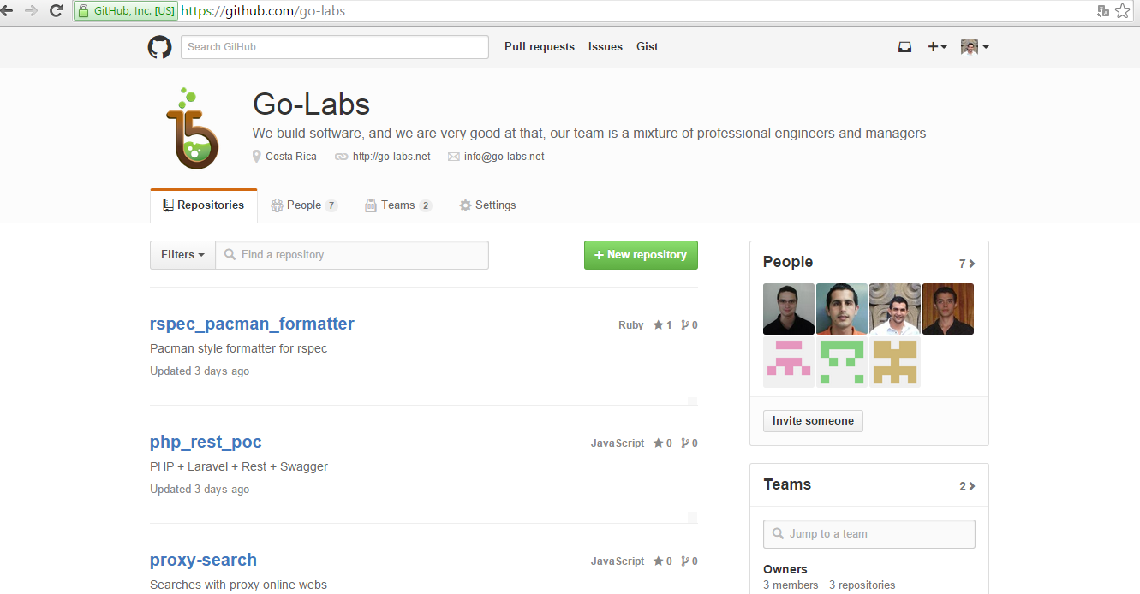
How I can participate?

Slide 5
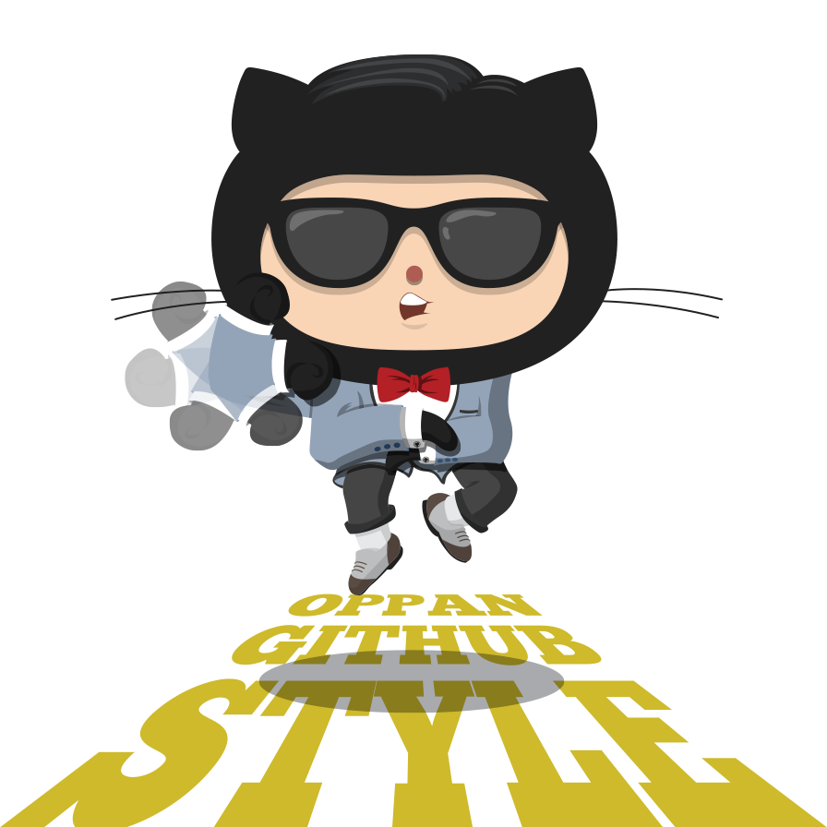
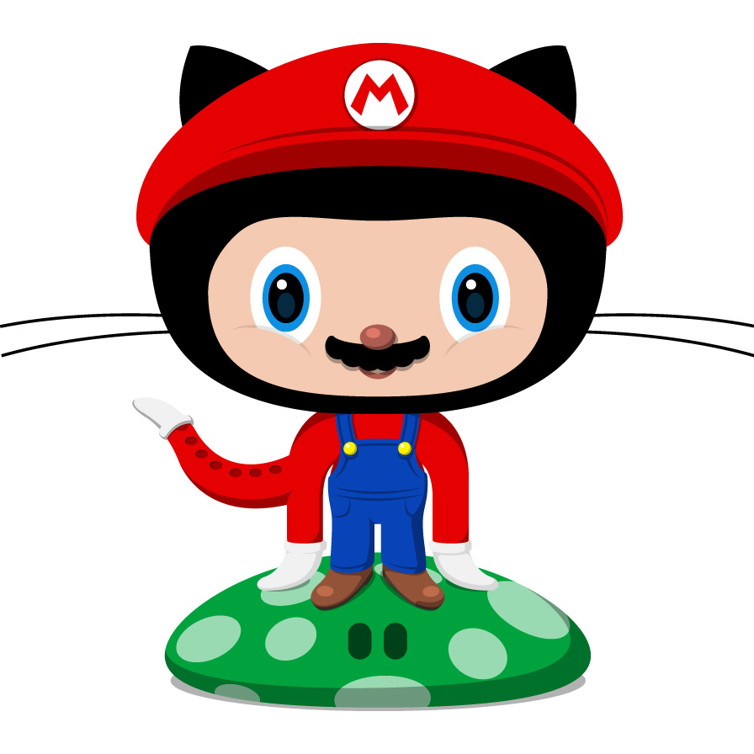
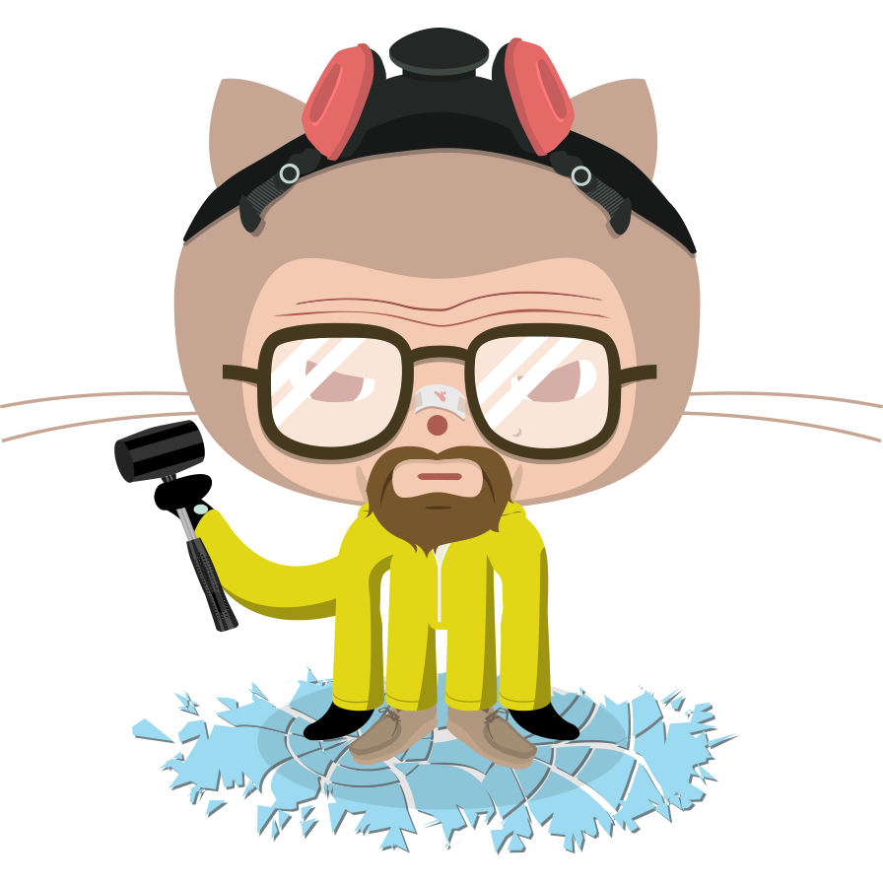
What happens if I become famous

