Slide 1


By :

Slide 2
Efrén Jiménez Delgado ejimenez@go-labs.net @gigo_

Slide 3

Agenda
What’s it?
Why node.js?
Features
How works?
How used?
When to use it?
Examples
Interview questions

Slide 4
What´s Node.js
Is a platform built on Chrome's JavaScript runtime for easily building fast, scalable network applications. Node.js uses an event-driven, non-blocking I/O model that makes it lightweight and efficient, perfect for data-intensive real-time applications that run across distributed devices.
From: https://nodejs.org/

Slide 5
Why node.js
“Node's goal is to provide an easy way to build scalable network programs”

Slide 6
Why node.js
Asynchronous i/o framework.
Core in c++ on top of v8.
Rest of it in JavaScript.
Swiss army knife for network.
Related stuffs.

Slide 7
Features
Can handle thousands of concurrent connections with minimal overhead (cpu/memory) on a single process.
Great documentations.
The most important modules package (http://www.modulecounts.com/)
Is It is the most widely used programming language in the world. (http://www.sitepoint.com/whats-best-programming-language-learn-2015/)

Slide 8
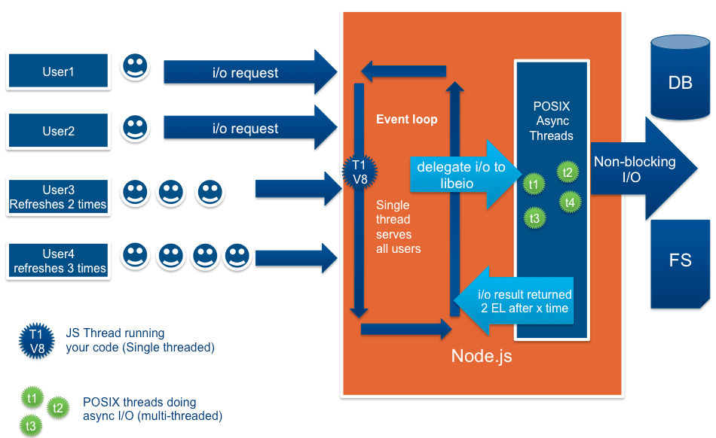
How works

Slide 9

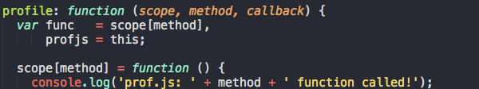
How works

Slide 10
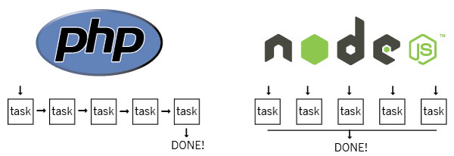
How works

Slide 11
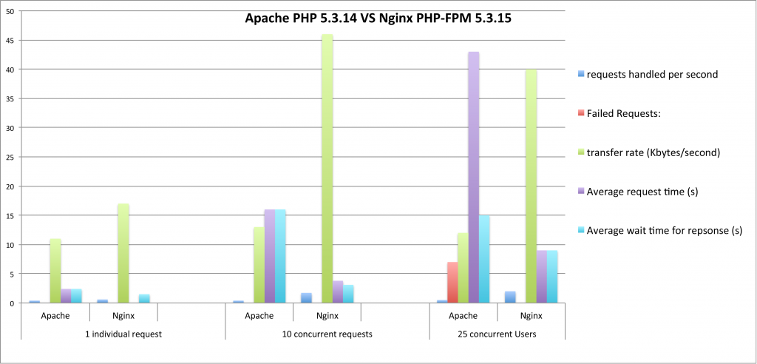
How works

Slide 12
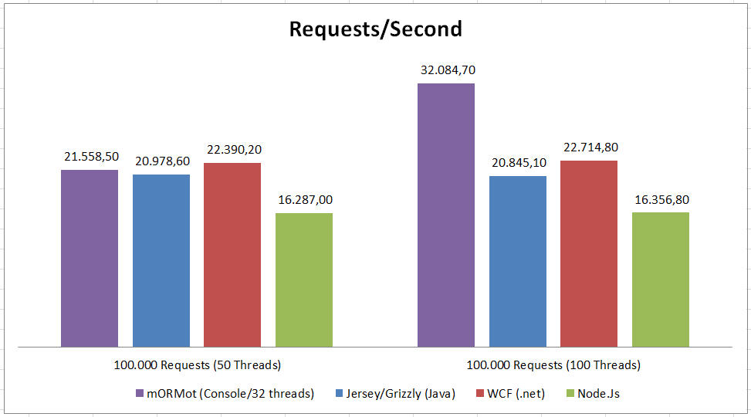
How works

Slide 13
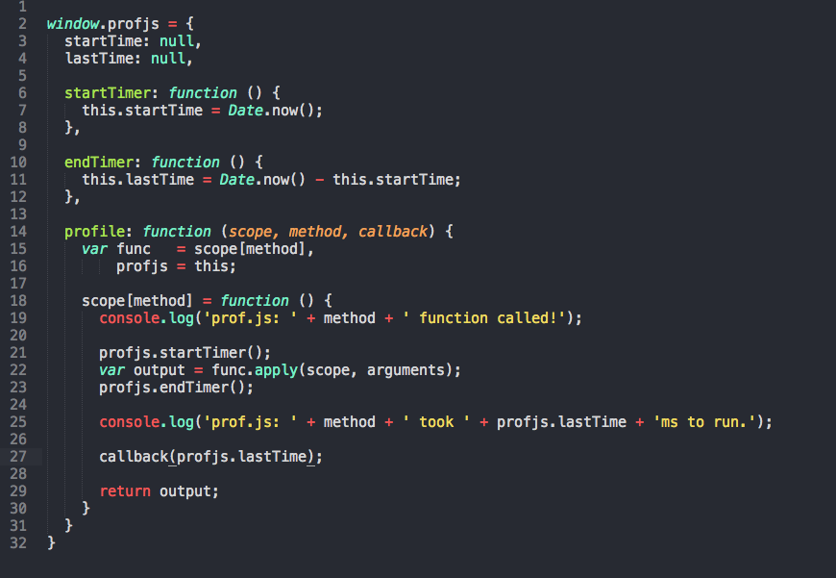
How used

Slide 14
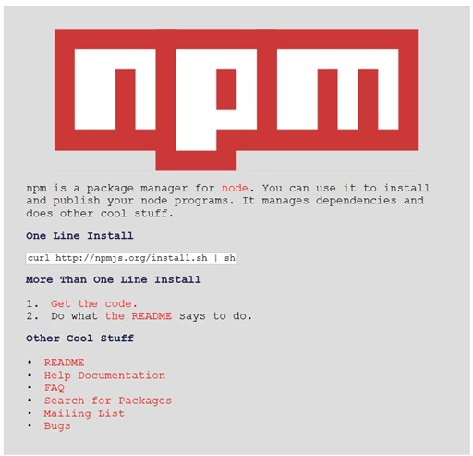
How used

Slide 15
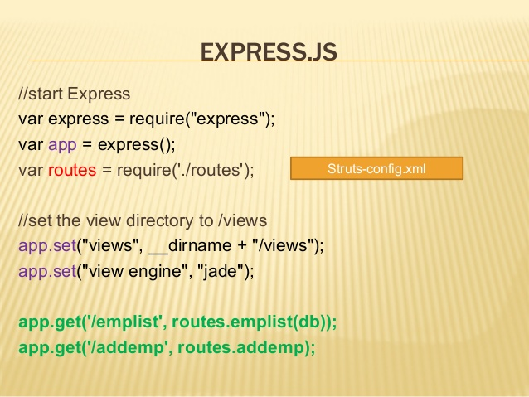
How used

Slide 16
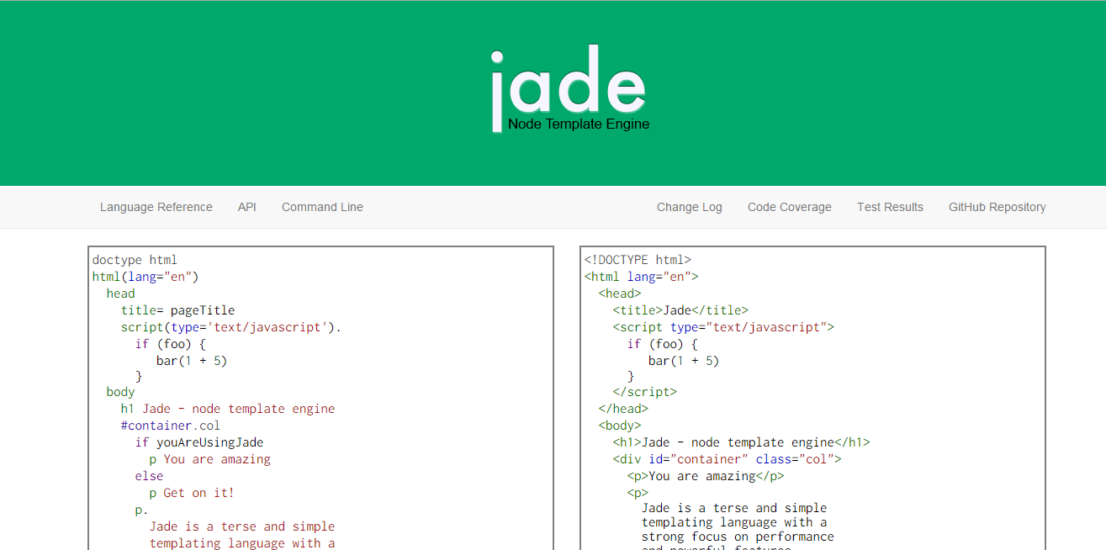
How used

Slide 17
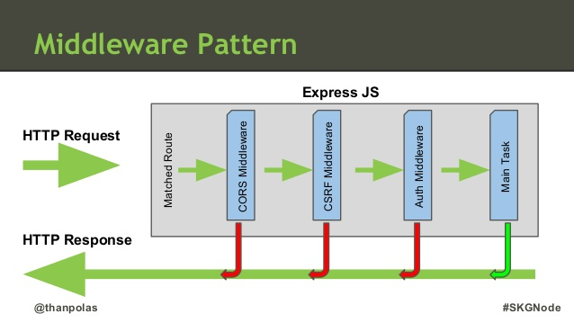
How used

Slide 18
When to use it?
Chat/messaging
Real-time applications
Intelligent proxies
High concurrency applications
Communication hubs
Coordinators

Slide 19
Examples
http://drawwithme.herokuapp.com/
http://weplay.io/
https://talky.io

Slide 20
Interview questions
POM
Can you programming a asynchronous function?
Do you know what is a callback?
Do you know what is a module?

Slide 21
