Slide 1
Handwritten Text Recognition Using Image-Captioning Models With Attention Francesco Bonanni, 1604119 University of Rome, ‘‘La Sapienza

Slide 2
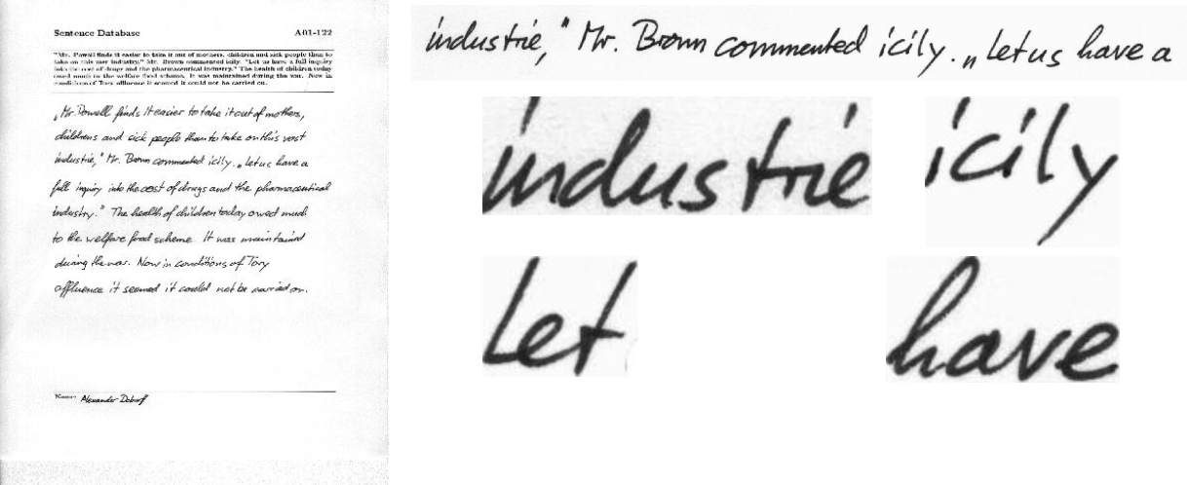
Problem definition and Dataset
The task is to build a model that can receive an image with handwritten text and produce the corresponding text as output.
The dataset used is the IAM Handwriting dataset, which contains forms of handwritten English text as PNG images with 256 gray levels.
*
* https://fki.tic.heia-fr.ch/databases/iam-handwriting-database

Slide 3
Resources
The model architecture used is inspired by Show, Attend and Tell: Neural Image Caption Generation with Visual Attention [arXiv:1502.03044].
Other resources used are:
https://www.tensorflow.org/tutorials/text/image_captioning
https://github.com/sgrvinod/a-PyTorch-Tutorial-to-Image-Captioning
*
* Kelvin Xu, Jimmy Ba, Ryan Kiros, Kyunghyun Cho, Aaron Courville, Ruslan Salakhutdinov, Richard
Zemel, Yoshua Bengio, in : Machine Learning (cs.LG); Computer Vision and Pattern Recognition (cs.CV)

Slide 4
Model
The model is composed by an Encoder and a Decoder.
As Encoder we used a 101 layered ResNet pretrained on the ImageNet classification task and we fine-tuned it on the IAM dataset.
The Decoder is an LSTM with an Attention module. In this way each time the LSTM produce a token it can focus on different parts of the input sentence image.

Slide 5
Training
For semplicity we trained the model on the sentence level. This means that the input image is just one sentence of handwritten text.
We processed the target sentence we used a RobertaTokenizer from HuggingFace.
The loss used is the CrossEntropy and the metric is the top-5 accuracy computed on tokens.
We did not perform hyperparameter tuning. We used the same hyperparameter configuration as in https://github.com/sgrvinod/a-PyTorch-Tutorial-to-Image-Captioning. The only parameter we tuned is the input image size.

Slide 6
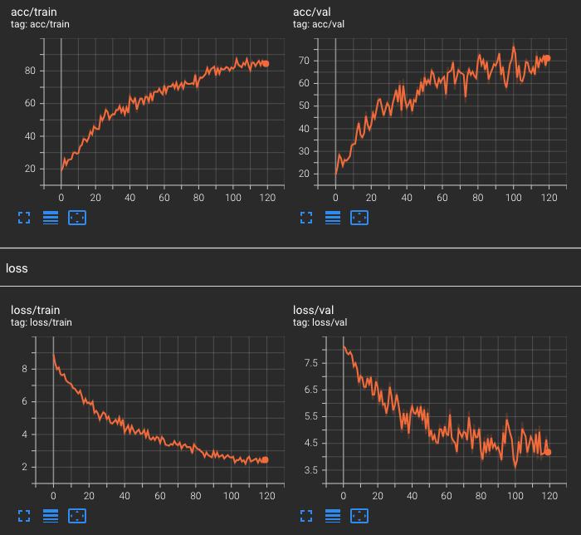
Train and Valid Losses
The best model was obtained with an input size of (80, 900). We reached 0.85 on train, 0.70 on validation and 0.68 on test set as top-5 accuracy.

Slide 7
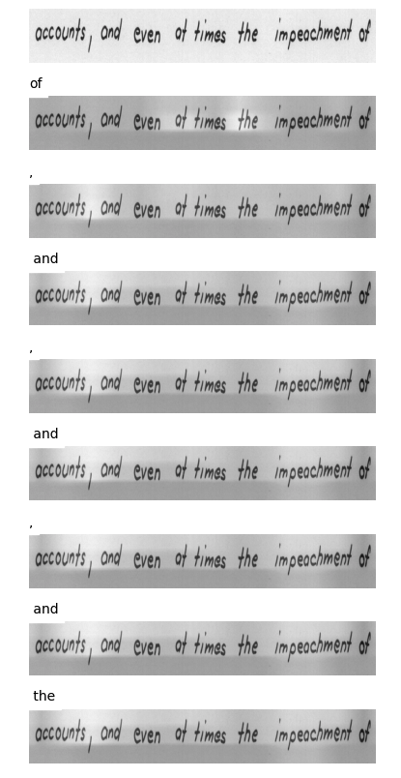
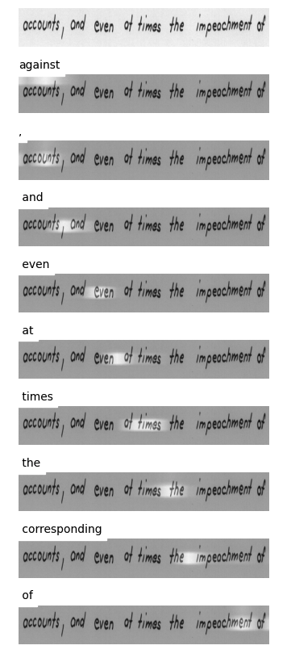
Some qualitative results
SENTENCE FROM THE TRAINING SET
This is the output of the model after 5 epochs (left) and after 115 epochs (right). It is clear from the attention plot that the model learnt to ‘read’ from left to right. Even though is far from the SOTA, it learns to recognize most of the words.

Slide 8
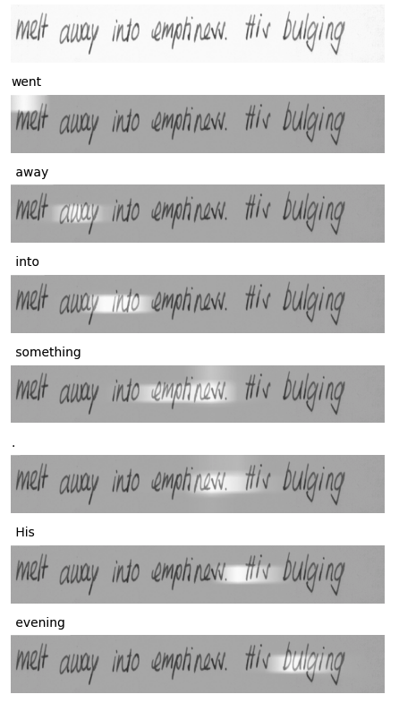
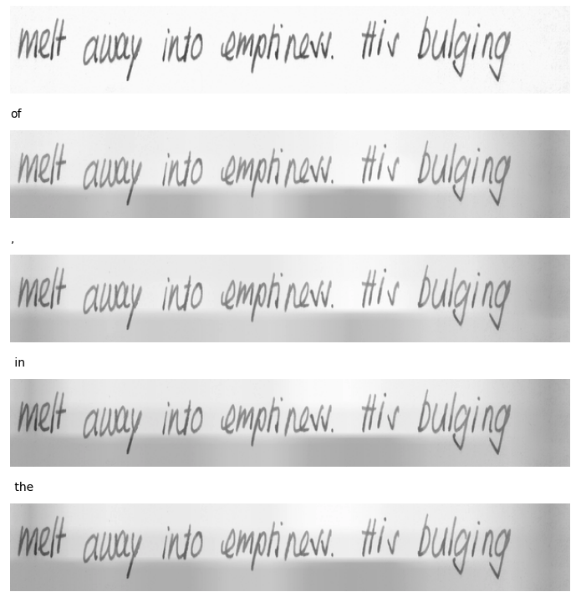
Some qualitative results
SENTENCE FROM THE VALIDATION SET
This is the output of the model after 5 epochs (left) and after 115 epochs (right). It is clear from the attention plot that the model learnt to ‘read’ from left to right. Even though is far from the SOTA, it learns to recognize most of the words.

Slide 9
Code details and structure
Pyspark is not used for training but only to preprocess the dataset inside the pyspark.ipynb. In order to run the code, after running ‘’pip install –r requirements.txt’’ you need to download the IAM dataset and move the files in a directory called ’’datasets/’’:
datasets/
lines.txt
formsA-D.tgz
formsE-H.tgz
formsI-Z.tgz
Then you need to run ‘’python create_input_files.py’’ to extract and split the data into train/ val/ and test/ folders. Now you can run ’’python train.py’’. To load the pretrained weights and test the model on a sentence, move the image sentence inside the folder ‘’test-imgs’’ and open the notebook ‘’caption.ipynb’’.

