Slide 1
Handwritten Text Recognition Using Image-Captioning Models With Attention Francesco Bonanni University of Rome, La Sapienza

Slide 2
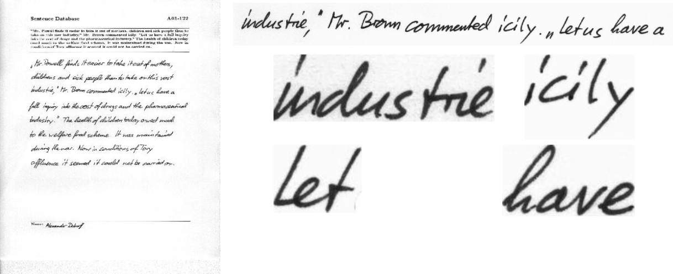
Problem definition and Dataset
The task is to build a model that can receive an image with handwritten text and produce the corresponding text as output.
The dataset used is the IAM Handwriting dataset, which contains forms of handwritten english text as PNG images with 256 gray levels.
*
657 writers contributed samples of their handwriting
1539 pages of scanned text
5685 isolated and labeled sentences
13353 isolated and labeled text lines
115320 isolated and labeled words
* https://fki.tic.heia-fr.ch/databases/iam-handwriting-database

Slide 3
Model
The model is composed by an Encoder and a Decoder.
As Encoder we used a 101 layered ResNet pretrained on the ImageNet classification task and we fine-tuned it on the IAM dataset.
The Decoder is an LSTM with an Attention module. In this way each time the LSTM produce a token it can focus on different parts of the input sentence image.

Slide 4
Resources
The model architecture used is inspired by Show, Attend and Tell: Neural Image Caption Generation with Visual Attention [arXiv:1502.03044].
Other resources/tutorials used are:
https://www.tensorflow.org/tutorials/text/image_captioning
https://github.com/sgrvinod/a-PyTorch-Tutorial-to-Image-Captioning
*
* Kelvin Xu, Jimmy Ba, Ryan Kiros, Kyunghyun Cho, Aaron Courville, Ruslan Salakhutdinov, Richard
Zemel, Yoshua Bengio, in : Machine Learning (cs.LG); Computer Vision and Pattern Recognition (cs.CV)

Slide 5
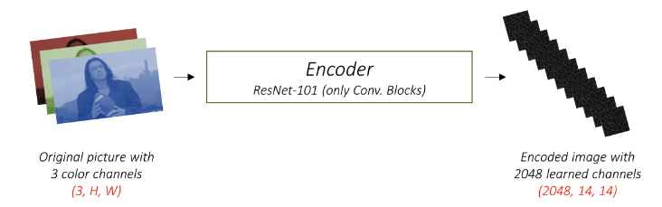
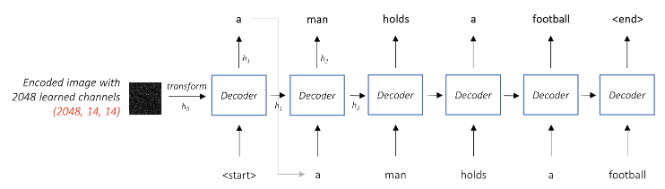
Image Captioning Without Attention
the first hidden state h₀ is obtained by averaging the encoded image across all pixels

Slide 6
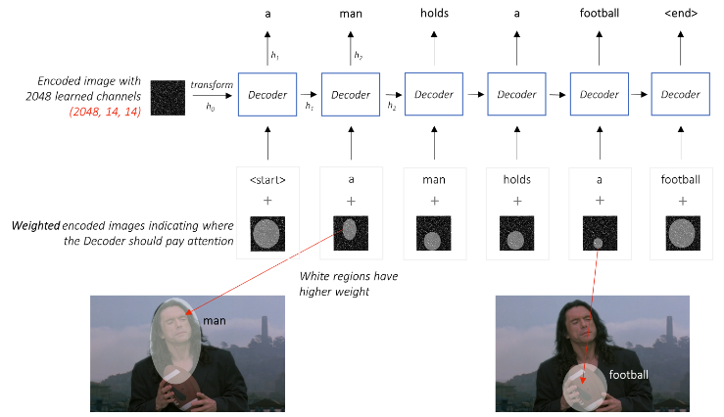
Image Captioning With Attention
we want the decoder to be able to look at different parts of the image at different points in the sequence
source: https://github.com/sgrvinod/a-PyTorch-Tutorial-to-Image-Captioning

Slide 7
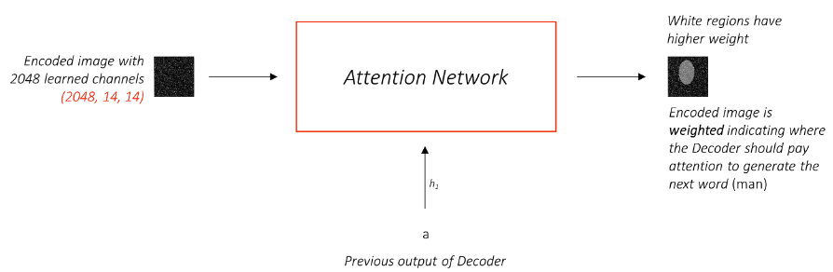
Image Captioning With Attention
previous hidden state

Slide 8
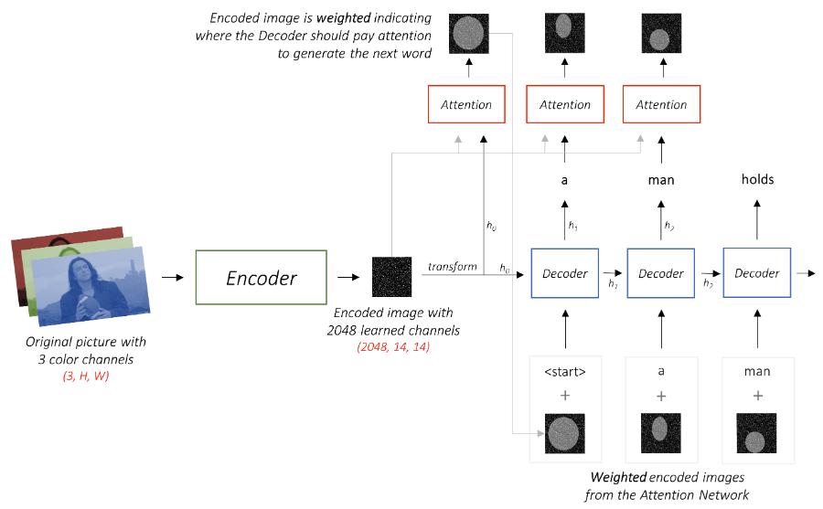
Image Captioning With Attention
source: https://github.com/sgrvinod/a-PyTorch-Tutorial-to-Image-Captioning

Slide 9
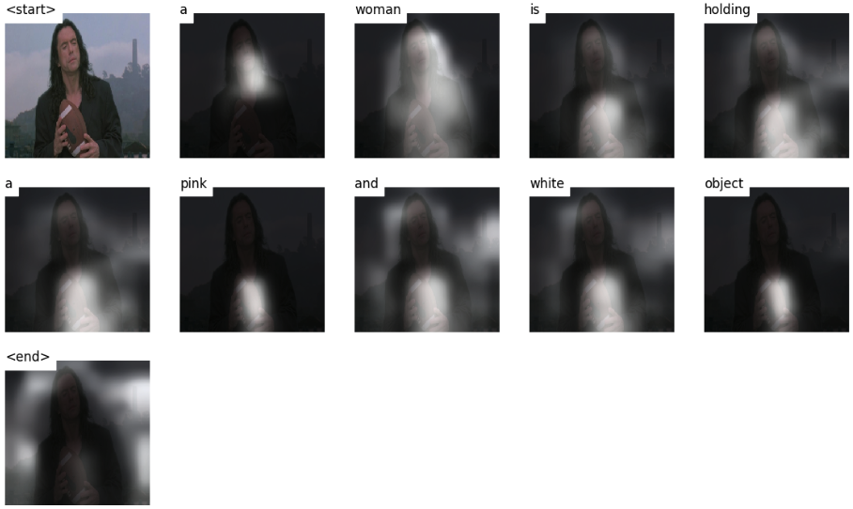
source: https://github.com/sgrvinod/a-PyTorch-Tutorial-to-Image-Captioning

Slide 10
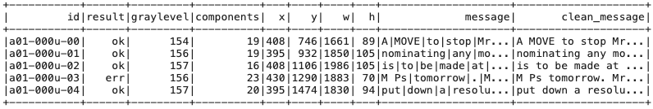
Data Processing
The input is scaled in [0, 1], normalized using training mean and std of training set and resized to a fixed size.
The target is cleaned using regex expressions.

Slide 11
Training
For simplicity we trained the model on the sentence level (13353 sentences). This means that the input image is just one sentence of handwritten text.
To process the target sentence we used a RobertaTokenizer from HuggingFace.
The loss used is the CrossEntropy and the metric is the top-5 accuracy.

Slide 12
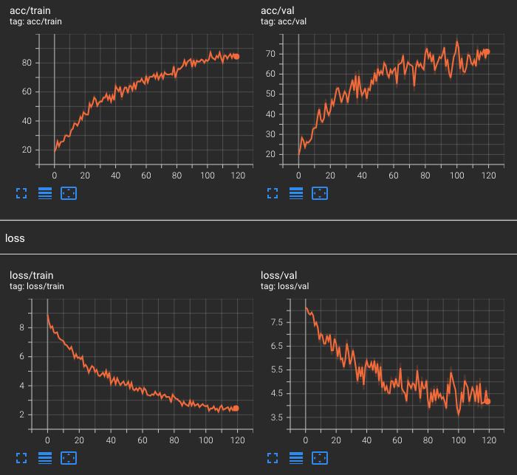
Learning Curves
The best model was obtained with an input size of (80, 900).
We reached 0.85 on train, 0.70 on validation and 0.68 on test set as top-5 accuracy.

Slide 13
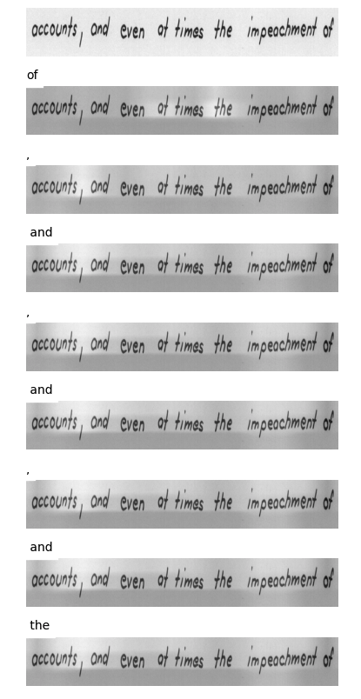
Some results
input sentence: «accounts, and even at times of the impeachment of»
after 3 training epochs
of
,
and
,
and
,
and
the
decoded sentence: "of, and, and, and the"

Slide 14
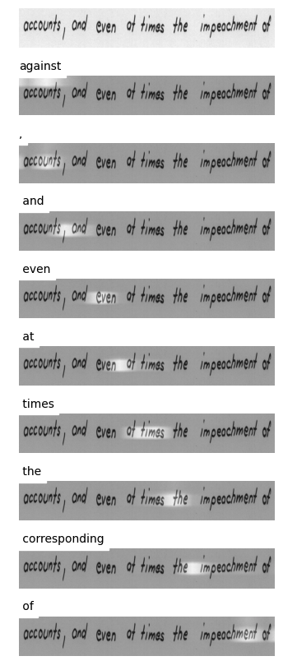
Some results
after 150 training epochs
input sentence: «accounts, and even at times of the impeachment of»
after 3 training epochs
against
of
,
,
and
and
even
,
at
and
times
,
the
and
corresponding
of
the
decoded sentence: "of, and, and, and the"
decoded sentence: "against, and even at time the corresponding of"

Slide 15
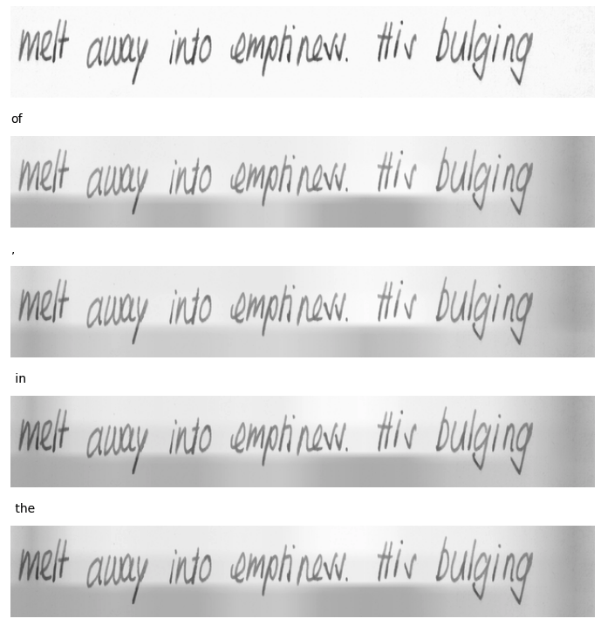
Some results
input sentence: «melt away into emptiness. His bulging»
after 3 epochs training
of
.
in
the
decoded sentence: "of. in the"

Slide 16
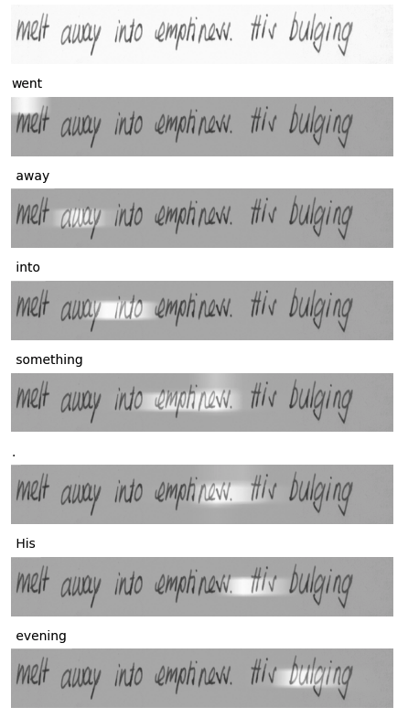
Some results
after 150 epochs training
input sentence: «melt away into emptiness. His bulging»
went
after 3 epochs training
away
of
into
.
something
in
.
the
His
decoded sentence: "of. in the"
evening
decoded sentence: "went away into something. His evening"

Slide 17
Future Work
hyperparameter tuning (e.g. try different size for the encoded image)
load pretrained embedding vectors
better data processing and data augmentation
add a language model on top to proofread and correct decoding errors
The ultimate goal would be to feed a full text image (multiple sentences) as input instead of a single row sentence.

Slide 18
Code details and structure
Pyspark is not used for training but only to preprocess the dataset inside the pyspark.ipynb. In order to run the code, after running ‘’pip install –r requirements.txt’’ you need to download the IAM dataset and move the files in a directory called ’’datasets/’’:
datasets/
lines.txt
formsA-D.tgz
formsE-H.tgz
formsI-Z.tgz
Then you need to run ‘’python create_input_files.py’’ to extract and split the data into train/ val/ and test/ folders. Now you can run ’’python train.py’’. To load the pretrained weights and test the model on a sentence, move the image sentence inside the folder ‘’test-imgs’’ and open the notebook ‘’caption.ipynb’’.

