Slide 2
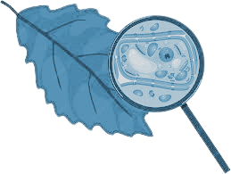
FLAURALYSIS
Plant Disease Detection System
Submitted to:
Department of Computer Science and Engineering

Slide 3
Supervised by: Prof. Akshay Dubey
Prof. Shraddha Sharma
Team Members
1. Jayant Neema(0827CS201107)
2. Leena Ghatiya(0827CS201125)
3. Manas Dhaketa(0827CS201130)
4. Mandvee Vatsa(0827CS201132)

Slide 4
Project Presentation Outline
Abstract
Introduction
Problem Statement
Survey of Existing Systems
Project Objectives
Requirement Analysis
Solution Proposed
The Outcome Discussion
Conclusions

Slide 5
Abstract
Diseases are a natural catastrophe affecting plant growth and lifespan.
The most outrageous problem faced by farmers is plant diseases, which needs to get solved immediately.
This deep Learning based model Flauralysis, detects and predicts most of the plant diseases which may be caused due to many-sidedness.
This application will suggest useful tips on the basis of farmers query and will display the possible diseases that may affect crops in the long run and give preventive advice as “Prevention is always better than cure”.
Beneficial for farmers and researchers to quickly detect and respond to outbreaks, potentially preventing crop losses and improving yields.

Slide 6
Introduction
Diseases in plants is the main ground for degradation in peculiarity of plants and deprivation in production and economics of agricultural products.
Nowadays plant diseases detection has received increasing attention in monitoring large fields of crops. Farmers experience great difficulties in switching from one disease control policy to another.
The advancement in traditional approach of naked eye observation of experts for detection and identification of plant diseases was highly required.
Early information on crop health can facilitate the control of diseases through proper management strategies.
This technique improves productivity of crops through several steps which are image acquisition, image pre-processing, features extraction and neural network based classification.

Slide 7
Problem Statement
Plant disease identification and prediction using machine learning using algorithms and models to analyze images of plants and identify any signs of disease or damage.
Propose a solution to help farmers and researchers quickly detect and respond to outbreaks, potentially preventing crop losses and improving yields.

Slide 8
Survey of Existing Systems
1. Plantix:
Advantages:
User-friendly mobile application with a large user base.
Provides personalized recommendations and information for crop management.
Offers a wide range of plant disease detection capabilities.
Supports multiple languages and is accessible to farmers worldwide.
Disadvantages:
Relies heavily on user-submitted images, which may vary in quality and consistency.
Limited to plant disease detection and nutrient deficiency analysis.
Accuracy may vary depending on the quality of images and database coverage.
Gaps Identified:
Scaling the database and continuously updating it with new diseases and regions.
Ensuring accuracy and reliability across different crop types and growing conditions.
Addressing potential biases in the user-submitted images.
2. PlantVillage:
Advantages:
Online platform with a large community of experts and users.
Provides disease identification and management advice.
Allows users to interact and seek guidance from experts.
Supports knowledge sharing and collaboration among users.
Disadvantages:
Relies on user-submitted images, which may have variations in quality and lighting conditions.
Limited to plant disease identification and lacks real-time monitoring features.
Accuracy can be affected by the expertise and knowledge of the community.
Gaps Identified:
Ensuring the timely response and accuracy of disease identification from experts.
Handling a large volume of user submissions and maintaining an up-to-date database.

Slide 9
Survey of Existing Systems
3. Agrio:
Advantages:
AI-based platform offering real-time disease detection and monitoring services.
Provides actionable insights and recommendations for farmers.
Supports proactive management of crop health.
Integrates computer vision technology with data analytics.
Disadvantages:
Requires access to an internet connection and compatible devices.
Cost and affordability may be a barrier for small-scale farmers.
Localization and adaptation to specific crop varieties and regions may be limited.
Gaps Identified:
Ensuring the accuracy and reliability of disease detection algorithms in diverse environments.
Addressing the digital divide and ensuring accessibility to farmers in remote areas.
Managing and analyzing large volumes of real-time data for accurate disease monitoring
4.Image-Based Plant Disease Detection Systems:
Advantages:
Advancement in computer vision made it possible to detect plant diseases through images.
Allows early detection of diseases without physically damaging the plants.
Highly scalable, covering vast agricultural areas.
Disadvantages:
Limited accuracy as relies on the quality of the images and the algorithms used.
Limited disease coverage as it may not detect diseases those not having distinctive visual symptoms or those that require laboratory analysis.
Lack of real-time monitoring.
Gaps identified:
Standardized protocols for image capture, including lighting conditions, angles, to improve accuracy and comparability across different systems.
Integration with disease databases can enhance accuracy by comparing captured images with known disease symptoms.
Automation and real-time analysis by developing algorithms.

Slide 10
Survey of Existing Systems
5 Molecular-Based Plant Disease Detection Systems:
Advantages:
High sensitivity and specificity for precise identification of pathogens.
Early detection enables early intervention and prevention of disease spread.
Wide range of disease detection like spectrum of pathogens, bacteria, viruses.
Disadvantages:
Infrastructure and expertise requirement for sample collection, DNA/RNA extraction, and analysis.
Time-consuming,results in hindering rapid decision-making for disease management.
The equipment, expertise needed are costly, making them less accessible to resource-limited farmers.
Gaps Identified:
Point-of-care devices can be used directly in the field without extensive laboratory infrastructure.
Enhancing the range of pathogens that can be detected by molecular techniques, including emerging or less-studied pathogens.
Reducing the time required for sample processing and analysis through improved protocols and automation.

Slide 11
Objectives
The identification of plant diseases is a key concern in today’s world with new pathogens growing up everywhere. It is to be done via technique that takes plant photos and determines if they contain diseases using machine vision equipment. These detection tools have partially replaced the old fashioned naked eye identification techniques.
In this project people can easily detect the disease that is affecting the life of plant in some simple steps .It identifies the plant diseases using image processing ,after identification of the disease, suggests the name of pesticide to be used. It also identifies the insects and pests responsible for the epidemic.
Along with the disease detection, users can get the suggestion of preventive measures to treat the disease . Additionally , disease prevention ideas and care tips will be provided for the different plants and crops .

Slide 12
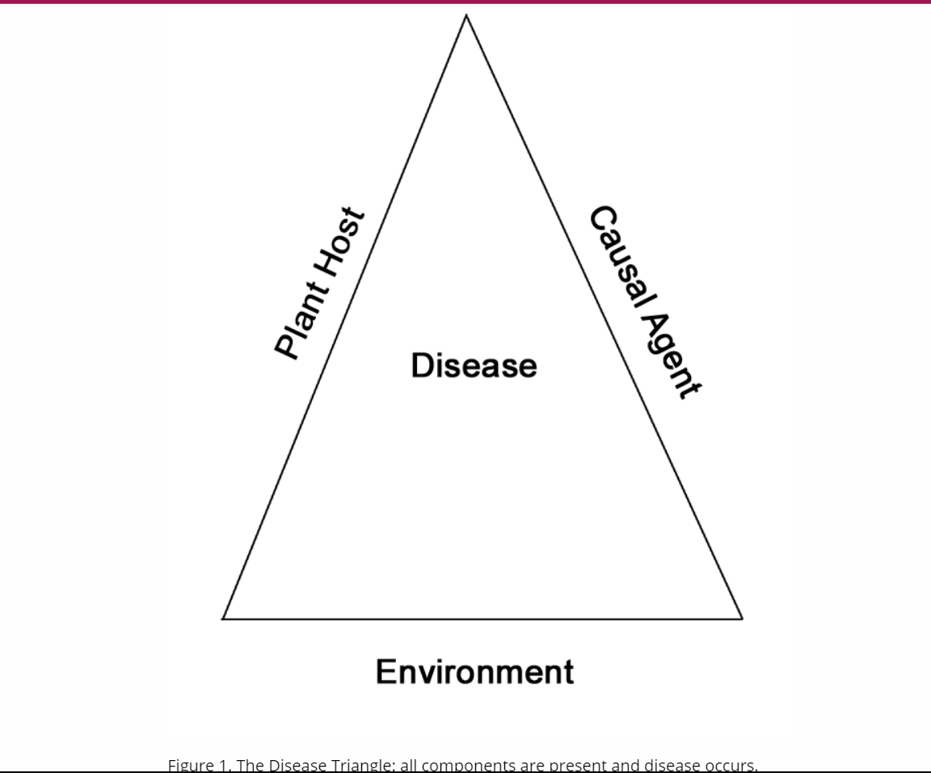
Requirement Analysis
Plants are subject to a variety of problems that
threaten their health affecting not only
aesthetics but posing more serious
consequences like plant death.
Regardless of the plant host or particular
type of disease that is encountered, the
concepts of disease prevention and
management are fundamentally the same.

Slide 13
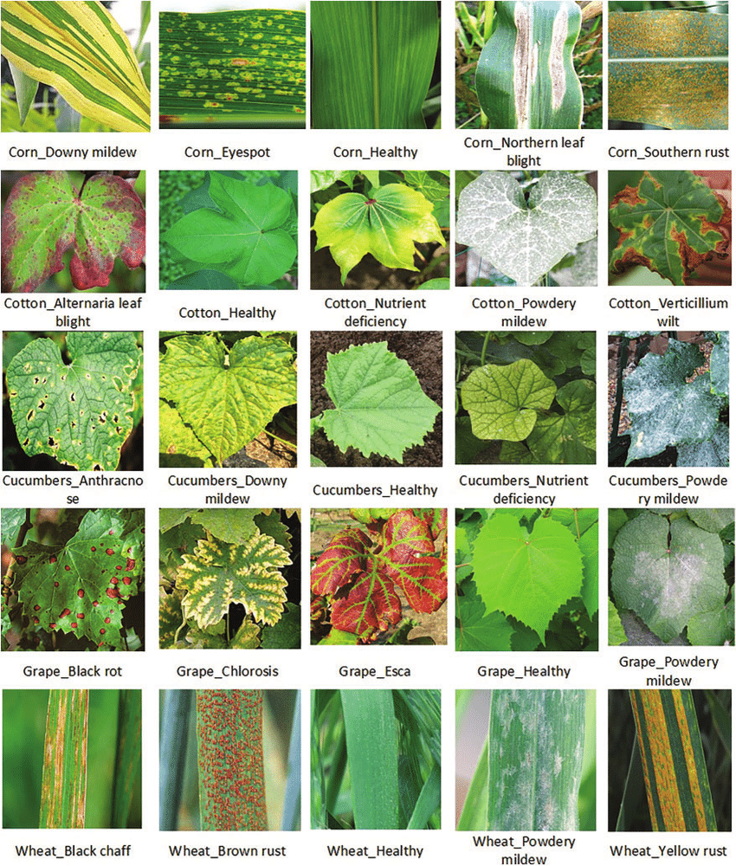
Requirement Analysis
Management of plant diseases involves a two-step process :
1. Disease Diagnosis : Leaf spot, Blight, Chlorosis, Necrosis, Wilt, Distortion etc are symptoms shown by leaves which needs to be analysed in detail as they have least differentiating parameter.
2. Management Options : Implementing strategies to minimize the impact of the disease.

Slide 14
Requirement Analysis
FUNCTIONAL REQUIREMENTS
User Interface
Disease Detection & Classification
Preventive Measures
Predictive Causes
Suggestive Tips
Notification
Image Acquisition & Preprocessing
Dataset Maintenance
NON-FUNCTIONAL REQUIREMENTS
Accuracy(at Least 80% ) & Performance
Security & Privacy
Speed
Reliability
Transparency
Portability
Fault Tolerance
Scalability
Maintainability

Slide 15
Solution Proposed
The implementation of the system involves the following stages:
Data Collection
Data Pre-processing
Building the CNN Model
Inference Function
Displaying Inference Data -Backend Fast API TensorFlow -Website (React JS)
The CNN Model is built in following steps:
Resizing and Normalisation Layer
Data Augmentation
Model Architecture
Compiling the Model
Training the Model
Testing the Model

Slide 16
Solution Proposed
The procedure that system follows for prediction is :
The input test image is acquired and preprocessed in the next stage and then it is converted into array form for comparison.
The selected database is properly segregated and preprocessed and then renamed into proper folders.
The model is properly trained using CNN and then classification takes place.
The comparison of the test image and the trained model take place followed by the display of the result.
If there is a defect or disease in the plant the software displays the disease along with the remedy.

Slide 17
Expected Outcome
Automated Disease Diagnostic
Early Disease Detection
Accurate Disease Detection
Improved Crop Production and Sustainability
Treatment for the disease
Disease prevention measures for different plants

Slide 18
Conclusion
The proposed system is being developed, taking in mind the benefits of the farmers and agricultural sector.
This system detect diseases in plants and also provide the remedy for it so as to identify and diagnose various diseases that affect plants, thereby aiding in timely interventions and preventing crop losses.
It will be based on python and will be targeting for an accuracy of around 70% to 80%.
By contributing to sustainable farming practices, this project has the potential to make a substantial positive impact on food security and global agricultural sustainability.

Slide 19
Q&A

Slide 20
THANKS

