Slide 1

Retail Product Descriptor Generator
Automating generation of product description
Notes:
AI-generated content may be incorrect. ---

Slide 2
Automating generation of product description
Team
Dipanjan Ghosh
Vineet Singh
Sayan Samanta
Urbi Sengupta
Suham Chatterjee
Notes:
AI Hackathon 2026: Innovate, Automate, Accelerate, Why an AI Hackathon Matters Today

Slide 3

Problem Statement
Purposeful Innovation
Retailers Struggle to create engaging and consistent
Automating Processes
Participants use AI to automate repetitive tasks, enhancing efficiency and decision-making in business environments.
Accelerating Outcomes
The hackathon accelerates productivity and insight generation by fostering rapid prototyping and collaboration using modern AI tools.
Learning and Growth
Participants gain hands-on experience with cutting-edge AI technologies, cloud platforms, and collaborative teamwork.
Notes:
The AI Hackathon 2026 is designed as a future-focused innovation platform that brings together creative minds, technologists, and problem solvers to build intelligent solutions for real-world challenges. This hackathon emphasizes not just coding, but purposeful innovation—where artificial intelligence is applied to automate processes, enhance decision-making, and accelerate business outcomes. The central vision is to create a collaborative environment that encourages experimentation, rapid prototyping, and bold thinking using modern AI technologies such as machine learning, generative AI, and intelligent automation. Participants are challenged to move beyond theoretical ideas and instead build practical, scalable solutions that can be demonstrated, evaluated, and potentially adopted in real business environments. The theme “Innovate, Automate, Accelerate” reflects three core objectives: fostering innovation through creative problem-solving, leveraging AI to automate manual or repetitive tasks, and accelerating productivity, efficiency, and insight generation. This hackathon also serves as a learning and growth opportunity, allowing participants to gain hands-on experience with cutting-edge tools, cloud platforms, and AI frameworks while collaborating across domains. By encouraging cross-functional teamwork and time-bound execution, the event mirrors real-world innovation cycles, preparing participants for future AI-driven workplaces. Ultimately, the AI Hackathon 2026 aims to act as a launchpad for transformative ideas that demonstrate how AI can responsibly and effectively shape the future of work, technology, and business.

Slide 4

Technology approach
Frontend – HTML & CSS for review status and report display
AI Layer – Dipseek to perform language understanding and summarization
Backend – Json
Model Used -
Notes:
In today’s rapidly evolving digital landscape, organizations are under constant pressure to innovate faster while managing increasing complexity and data volumes. An AI hackathon provides a focused and impactful way to address these challenges by encouraging teams to think creatively and apply artificial intelligence to meaningful problems. Many industries still rely on manual processes, fragmented systems, and underutilized data, which leads to inefficiencies, delays, and missed opportunities. An AI hackathon directly targets these pain points by creating solutions that demonstrate how automation, predictive analytics, and intelligent decision systems can drive measurable improvements. Additionally, hackathons foster a culture of innovation by empowering individuals to experiment without the fear of failure, promoting learning through hands-on development. They also help bridge the gap between business needs and technical capabilities, as participants must align their solutions with real use cases and outcomes. From a strategic perspective, AI hackathons act as incubators for future-ready ideas, enabling organizations to identify high-potential concepts and talent. They also accelerate digital transformation by showcasing what is possible with modern AI tools in a short time frame. In essence, an AI hackathon is not just a competition; it is a catalyst for innovation, skill development, and long-term value creation in an AI-driven world.

Slide 5
Proposed Solution
Notes:
Identifying the Core Problem Statement, Opportunity for AI-Driven Transformation

Slide 6
Input
Add product details (Single / Batch)
Input
Add product details (Single / Batch)
Input
Add product details (Single / Batch)
Input
Add product details (Single / Batch)
Notes:
The core problem addressed in this AI hackathon centers around inefficiencies caused by manual processes, delayed decision-making, and the underutilization of available data. In many operational environments, critical tasks still depend on human intervention for data entry, validation, analysis, and approval, leading to longer turnaround times and higher error rates. Additionally, while organizations collect vast amounts of data, much of it remains siloed or unused, limiting its potential value. Decision-makers often rely on historical reports rather than real-time insights, making it difficult to respond proactively to changing conditions. Scalability is another major concern, as traditional systems struggle to handle increasing workloads without proportional increases in cost or effort. These challenges create an opportunity for AI-driven solutions that can automate workflows, analyze data intelligently, and provide actionable insights at scale. By clearly defining this problem statement, the hackathon sets a focused direction for participants, ensuring that solutions are relevant, impactful, and aligned with real business needs rather than abstract experimentation.

Slide 7
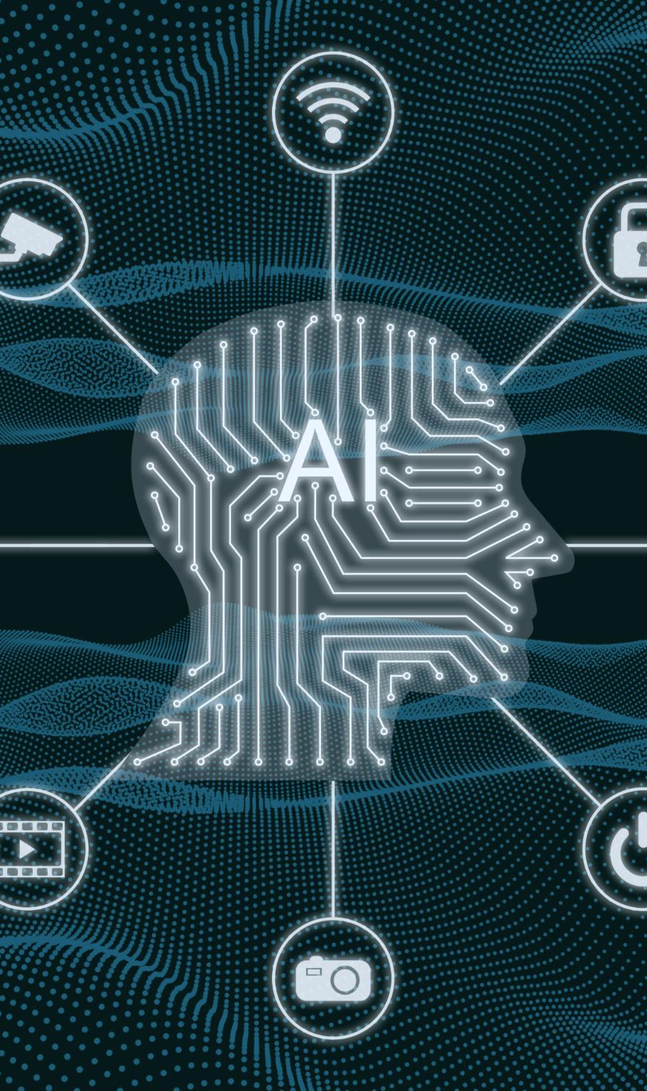
Opportunity for AI-Driven Transformation
Automation of Routine Tasks
AI automates repetitive manual work, freeing employees to focus on higher-value activities and increasing efficiency.
Data-Driven Decision Making
Real-time analytics and machine learning enable faster, more accurate, and informed organizational decisions.
Generative AI Assistance
Generative AI supports content creation, summarization, and knowledge retrieval, enhancing user experience.
Practical AI Exploration
Hackathons provide an environment to build proof-of-concept AI solutions that demonstrate tangible benefits.
Notes:
Artificial intelligence presents a powerful opportunity to transform how organizations operate, make decisions, and deliver value. By applying machine learning models, natural language processing, and predictive analytics, routine tasks can be automated, and complex patterns in data can be uncovered with speed and accuracy. AI systems can learn from historical data to predict outcomes, recommend actions, and continuously improve over time. This creates opportunities to reduce operational costs, improve accuracy, and enhance user experiences. For example, intelligent automation can replace repetitive manual work, freeing employees to focus on higher-value activities. Real-time analytics can support faster and more informed decision-making, while generative AI can assist in content creation, summarization, and knowledge retrieval. The hackathon environment allows teams to explore these opportunities in a practical way, building proof-of-concept solutions that demonstrate tangible benefits. This focus on opportunity ensures that AI is positioned not as a buzzword, but as a strategic enabler of sustainable and scalable transformation.

Slide 8
Solution and Technology
Notes:
Proposed AI Solution Overview, Technology Stack and Tools

Slide 9
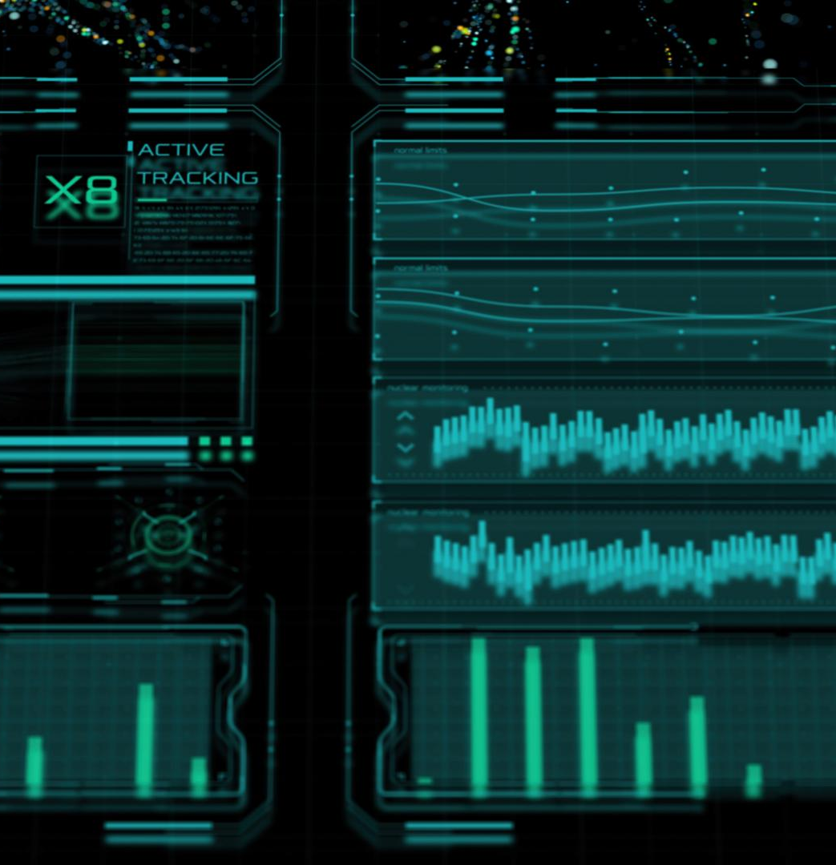
Proposed AI Solution Overview
Intelligent Modular System
The AI solution is modular and intelligent, designed for automation, prediction, and generating insights from data.
Data Processing and Model Inference
Handles data ingestion, preprocessing, and machine learning model inference for pattern recognition and recommendations.
Integration and Automation
Integrates AI decision logic into workflows reducing manual tasks while improving speed and accuracy.
Scalability and Usability
Designed to scale with growing data and users, featuring intuitive dashboards for easy insight interpretation.
Notes:
The proposed AI solution is designed as an intelligent, modular system that addresses the identified problem through automation, prediction, and insight generation. At its core, the solution leverages machine learning models to analyze incoming data, identify patterns, and generate recommendations or automated actions. The system is built to handle data ingestion, preprocessing, model inference, and output delivery in a seamless flow. By integrating AI-driven decision logic into existing workflows, the solution reduces manual intervention while improving speed and accuracy. A key design principle is scalability, ensuring that the solution can grow with increasing data volumes and user demands. The solution also emphasizes usability, presenting insights through intuitive dashboards or interfaces that enable users to understand and act on AI outputs effectively. This end-to-end approach demonstrates how AI can be embedded into real business processes to deliver measurable value rather than operating as an isolated technical component.

Slide 10
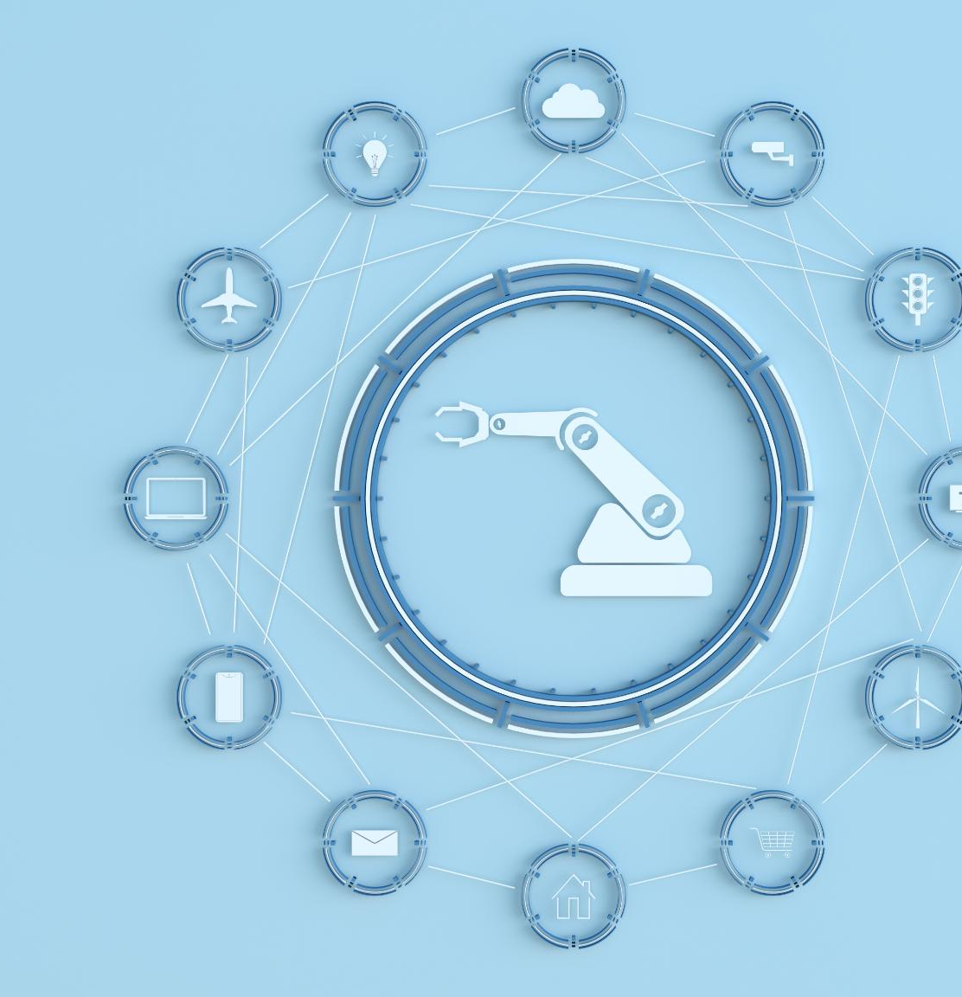
Technology Stack and Tools
Programming Language
Python is the primary language chosen for its extensive data science and machine learning ecosystem.
Cloud Platforms
Cloud services such as Azure and AWS provide scalable hosting and compute resource management.
Machine Learning and AI
Machine learning frameworks and generative AI models enable prediction, classification, and intelligent automation.
Integration and Automation
APIs integrate system components while automation tools manage workflows and deployments efficiently.
Notes:
The technology stack for this AI hackathon solution is built using modern, cloud-native, and open-source tools to ensure flexibility and performance. Python serves as the primary programming language due to its strong ecosystem for data science and machine learning. Cloud platforms such as Azure or AWS are used to host services, manage compute resources, and enable scalability. Machine learning frameworks and generative AI models power prediction, classification, and intelligent automation capabilities. APIs are used to integrate different system components and enable seamless data exchange. Automation tools and cloud services support workflow orchestration, monitoring, and deployment. This carefully selected technology stack allows rapid development during the hackathon while also being robust enough for future enhancement and enterprise adoption.

Slide 11
Architecture and Impact
Notes:
High-Level Architecture Design, Business Impact and Value Creation

Slide 12

High-Level Architecture Design
Layered Modular Architecture
The AI system employs a layered modular design for clarity, scalability, and ease of maintenance.
Data Layer Functions
The data layer manages ingestion from diverse sources and preprocesses data to ensure quality.
AI Layer Capabilities
Responsible for model training, inference, and continuous learning for system improvement.
Business Logic and Presentation
Integrates AI outputs into workflows and provides user interfaces for visualization and interaction.
Notes:
The architecture of the AI solution is designed with a layered and modular approach to ensure clarity, scalability, and maintainability. The data layer handles ingestion from multiple sources and performs preprocessing to ensure quality and consistency. The AI layer is responsible for model training, inference, and continuous learning, enabling the system to improve over time. The business logic layer integrates AI outputs into workflows, rules, and decision engines. Finally, the presentation layer provides dashboards, visualizations, or user interfaces for interaction and insight consumption. This separation of concerns allows teams to update or enhance individual components without disrupting the entire system. The architecture demonstrates best practices in modern AI system design, balancing performance, flexibility, and reliability.

Slide 13
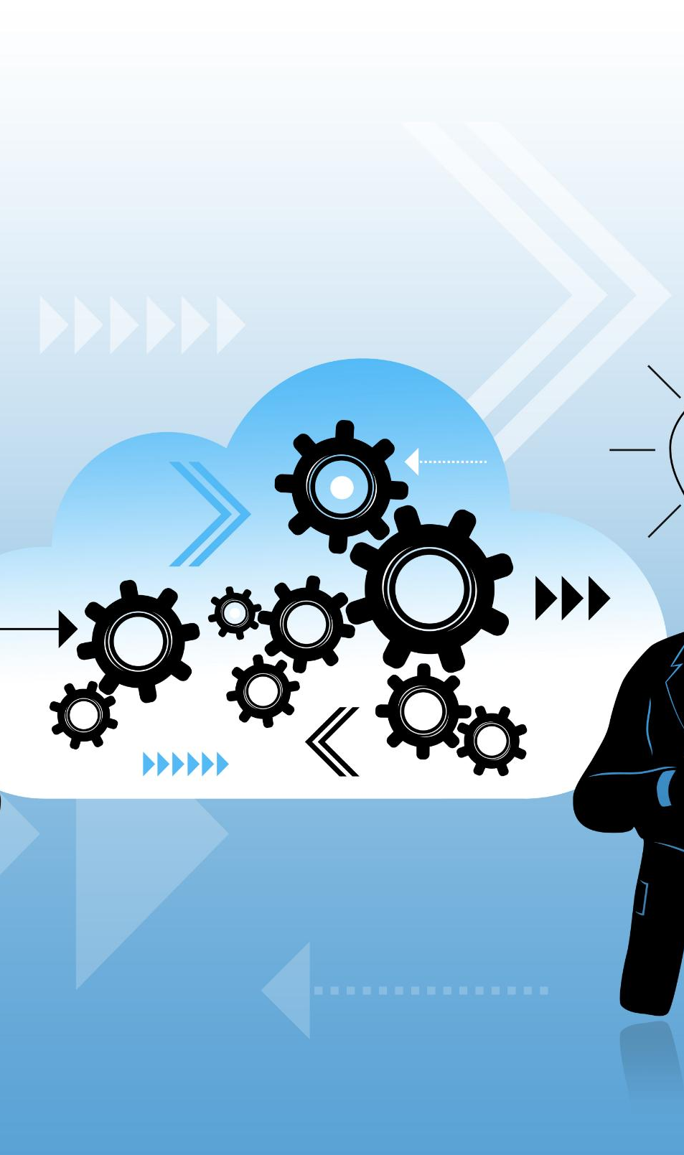
Business Impact and Value Creation
Automation and Efficiency
Automation reduces turnaround time, enabling faster service delivery and improved operational efficiency.
Data-Driven Decision Making
AI provides data-backed recommendations that enhance decision accuracy beyond intuition-based judgments.
Scalability and Cost Optimization
Scalable AI solutions handle growing workloads without proportional cost increases, optimizing expenses.
Productivity and Competitive Advantage
Productivity gains allow focus on strategic tasks, boosting customer satisfaction and competitive edge.
Notes:
The AI solution delivers significant business impact by addressing efficiency, accuracy, and scalability challenges. Automation reduces turnaround time for key processes, enabling faster service delivery and response. AI-driven insights improve decision quality by providing data-backed recommendations rather than intuition-based judgments. Scalability ensures that the solution can handle growing workloads without proportional increases in cost. Additionally, productivity gains allow employees to focus on strategic and creative tasks instead of repetitive work. These benefits collectively contribute to cost optimization, improved customer or user satisfaction, and stronger competitive advantage. The hackathon solution clearly demonstrates how AI can translate technical innovation into tangible business value.

Slide 14
Demonstration and Future
Notes:
Demo Highlights and Key Features, Future Roadmap and Conclusion

Slide 15
Future Roadmap and Conclusion
Roadmap for AI Enhancement
Focus on advanced AI models, broader data integration, and scaling for enterprise-wide deployment.
Planned Improvements
Continuous learning, better accuracy, and expanded automation capabilities are key goals.
Impactful AI Solutions
Collaboration and innovation deliver AI that drives meaningful change today and in the future.
Notes:
The future roadmap focuses on enhancing the solution with advanced AI models, broader data integration, and enterprise-wide deployment. Planned improvements include continuous learning, improved accuracy, and expanded automation capabilities. With proper governance and scaling, the solution can evolve into a production-ready platform. In conclusion, this AI hackathon presentation demonstrates how focused innovation, modern technology, and collaborative effort can produce impactful AI solutions. It reinforces the idea that AI is not just the future, but a powerful tool that can be applied today to drive meaningful change.

