Slide 1
Enrollment System
Nicko Laygo – BSCS-2A

Slide 2
System Functions:
Administrator
Enroll Students
View Enrolled Students Info.
Approve of Enrollment Request
Update & Delete Students Info.
Update Tuition Cost
User
Enroll
View Enrollment Status

Slide 3
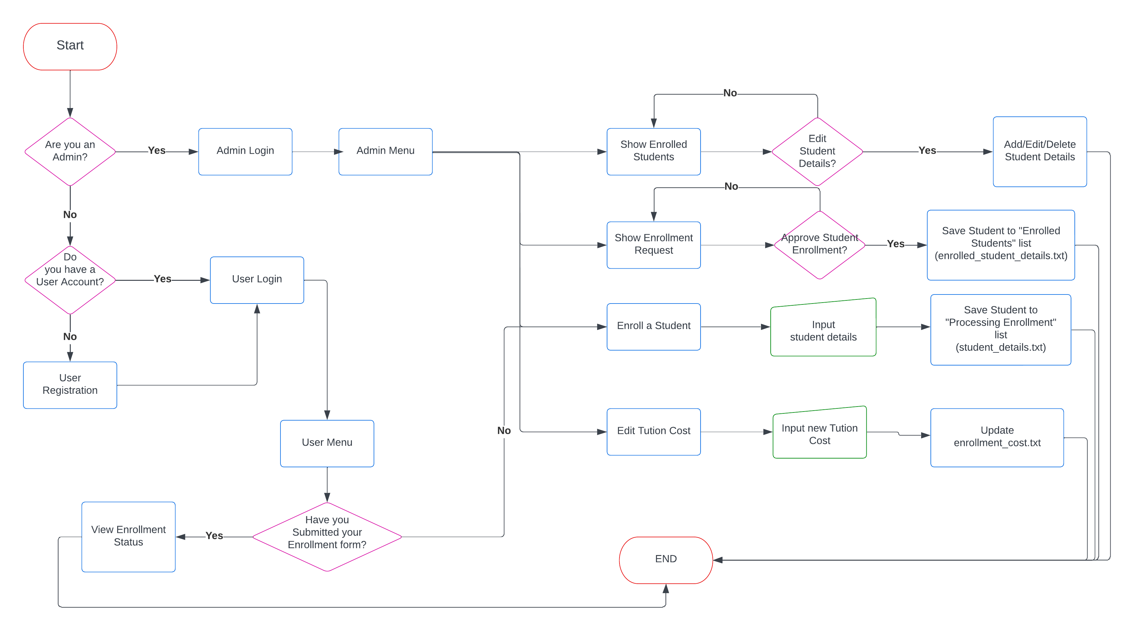
Enrollment System Flowchart

Slide 4
Onto the Program!

