Slide 1
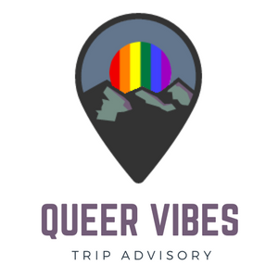

Slide 2
Creative Direction & Inspiration
LGBT+ Community
Destination Weddings & Honeymoons
Vacation & Nightlife
Creative Direction:
Colours: Purple as Main Accent
Content: History & Travel
Homepage:
Rainbow Colours
Slideshow

Slide 3
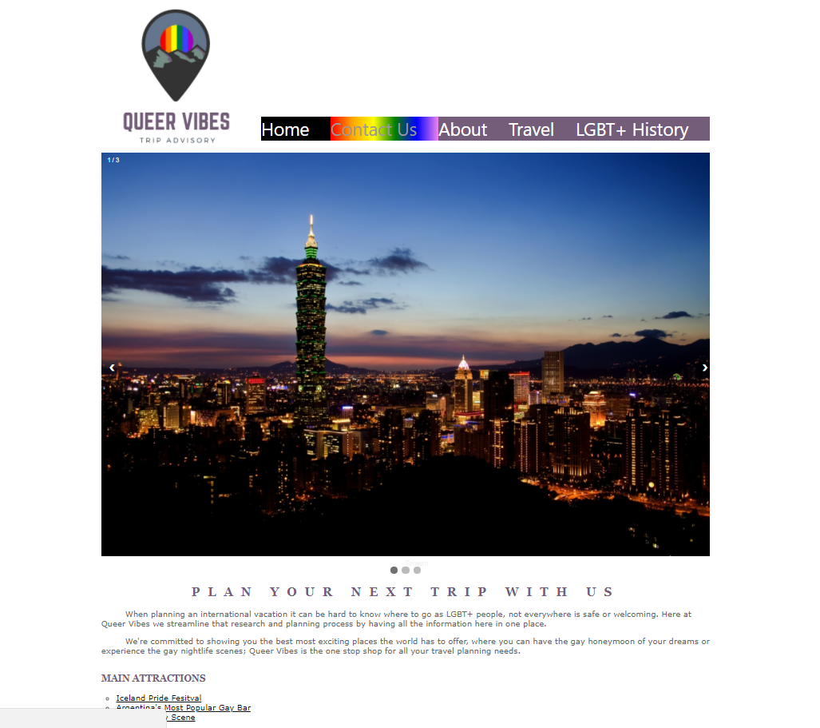

Slide 4
