Slide 1
Extensiones Modelo RBC
Macroeconomía II

Slide 2
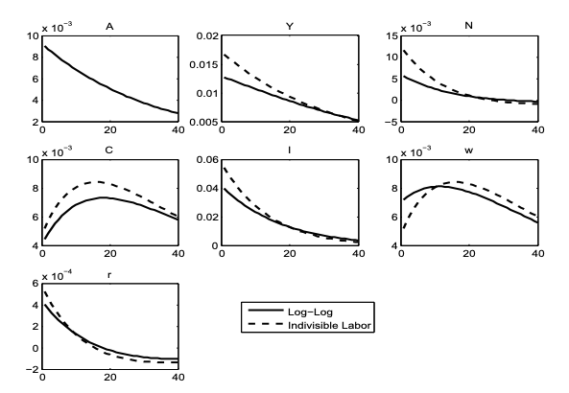
Indivisible Labor

Slide 3
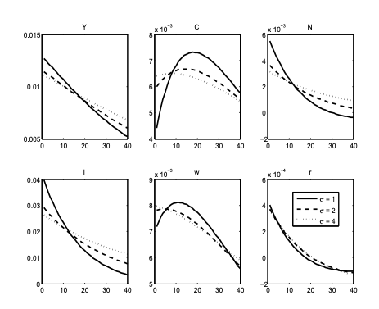
Intratemporal Non-Separability: King, Plosser, and Rebelo (1988) and Greenwood, Hercowitz, and Hoffman (1988)

Slide 4
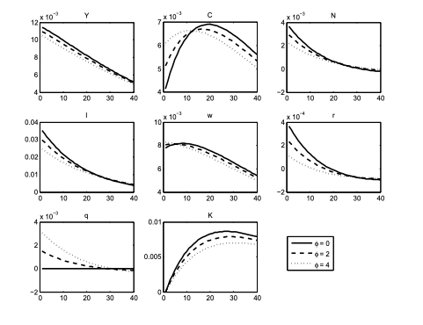
Capital and Investment Adjustment Costs

Slide 5
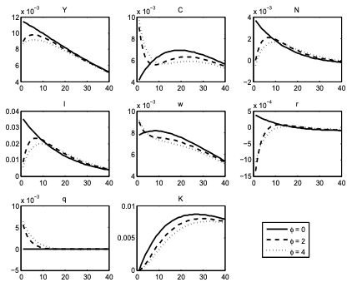
Capital and Investment Adjustment Costs II

