Slide 1
Extensiones Modelo RBC
Macroeconomía II

Slide 2
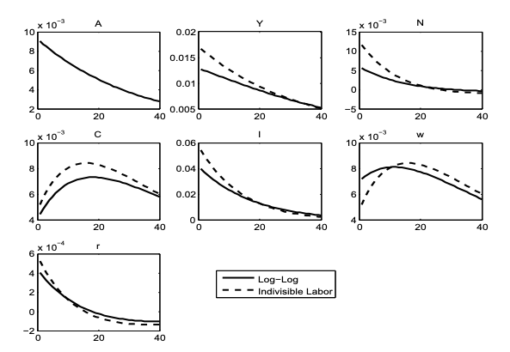
Indivisible Labor

Slide 3
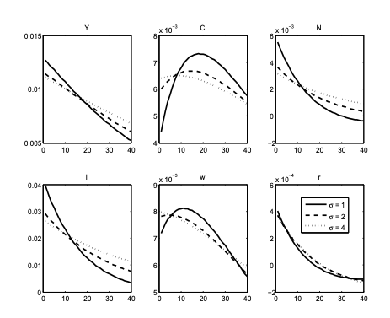
Intratemporal Non-Separability: King, Plosser, and Rebelo (1988)

Slide 4
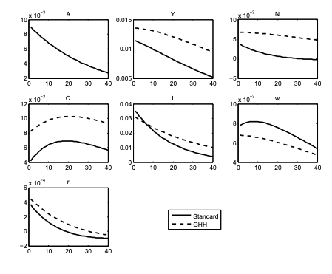
Intratemporal Non-Separability: Greenwood, Hercowitz, and Hoffman (1988)

Slide 5
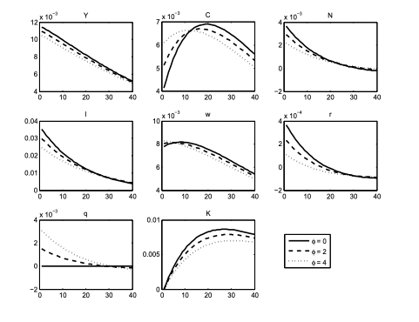
Capital and Investment Adjustment Costs

Slide 6
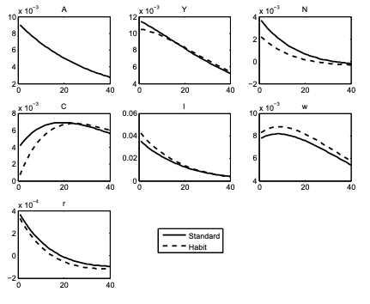
Habit Formation

Slide 7
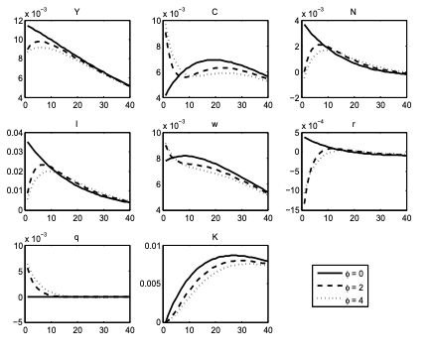
Capital and Investment Adjustment Costs II

