Slide 1
Fiscal Policy

Slide 2

Parameterization
$α=\frac{1}{3}$
$β=1$
$χ=1$
$δ=0.025$
$θ=4$
$ω=0.2$
$ρ_{A}=0.97$
$ρ_{G}=0.95$
$σ_{A}=σ_{G}=0.01$

Slide 3
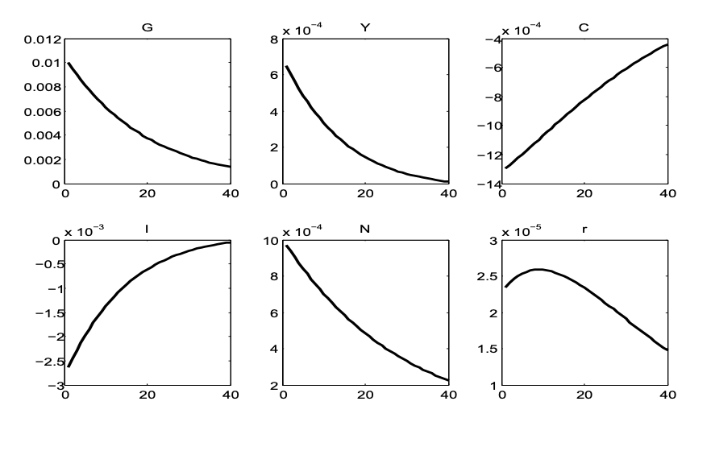
Lump-Sum Taxes

Slide 4
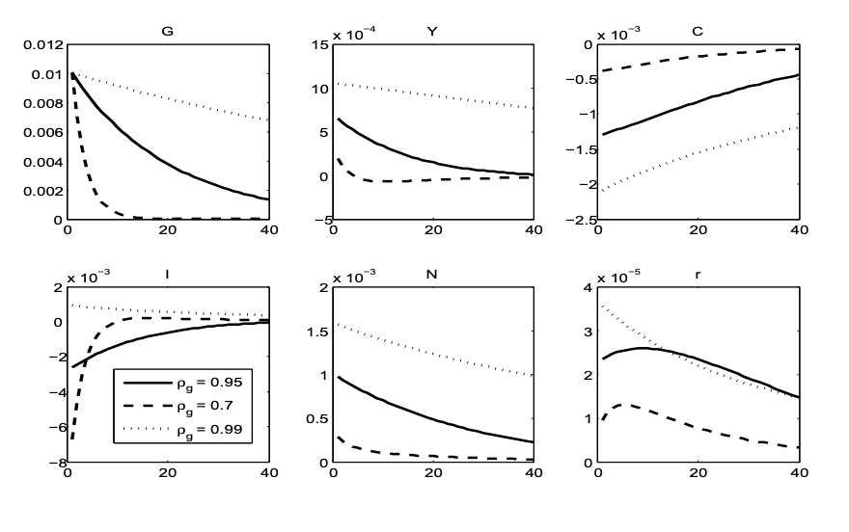
Lump-Sum Taxes

Slide 5

Parameterization
$ρ_{n}=ρ_{k}=0.90$
$σ_{n}=σ_{k}=0.01$
$τ_{k}=0.1$
$τ_{n}=0.2$

Slide 6
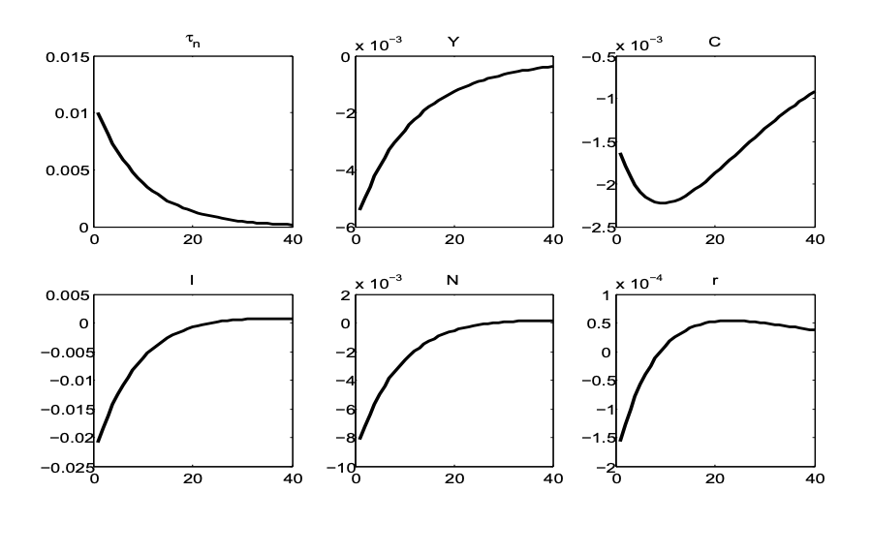
Distortionary Taxes: Labor

Slide 7
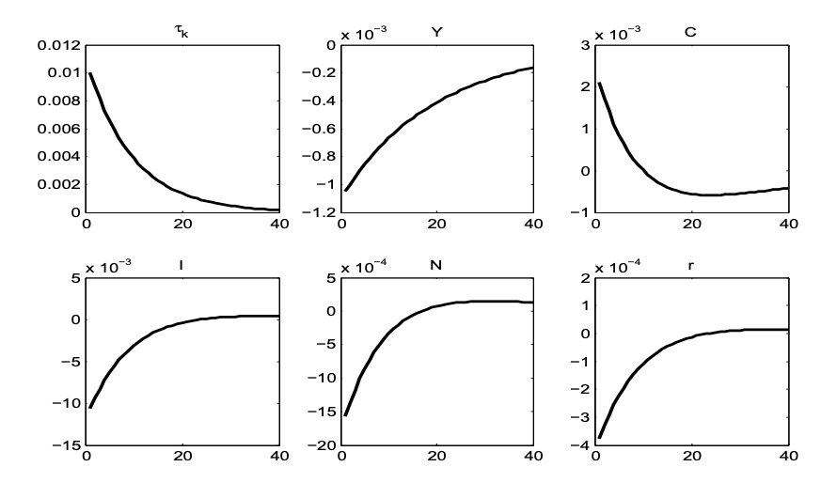
Distortionary Taxes: Capital

Slide 8
No Lump Sum Taxes

Slide 9
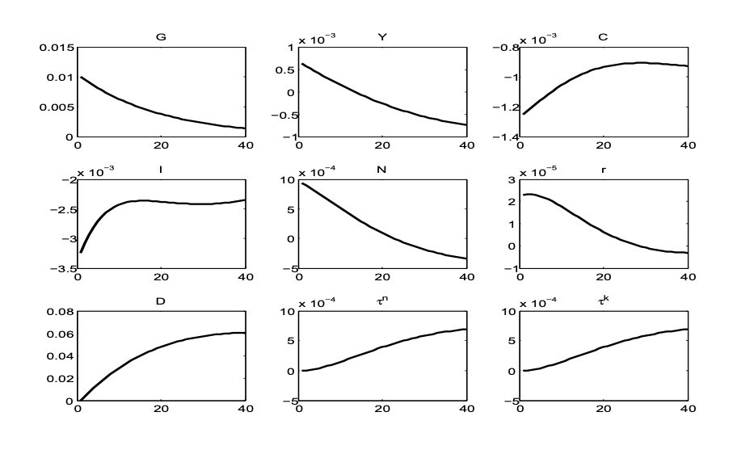
Government Spending Shock

Slide 10
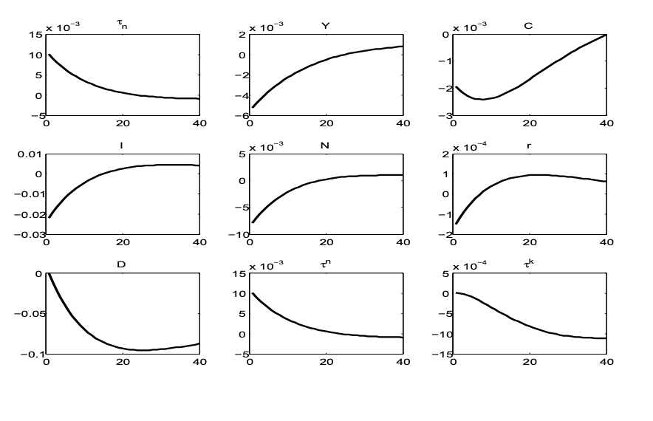
Labor Taxes Shock

Slide 11
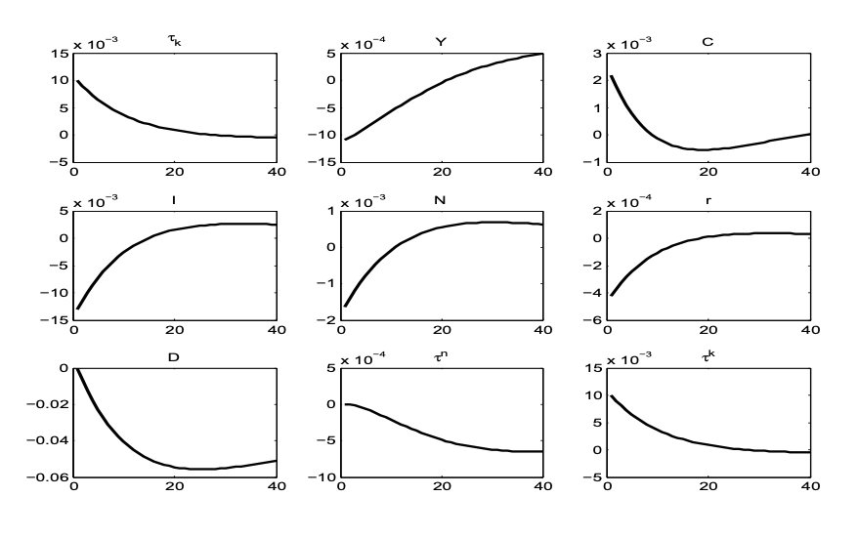
Capital Taxes Shock

