Slide 1



GRAND FINALE
AZADI KA AMRIT MOHATSAV HACKTHON 2022
TEAM ID: TM000059
PROBLEM STATEMENT: A STATE WEB PORTAL FOR WOMEN SEXUAL HARRASMENT AT WORKPLACE

Slide 2
INTRODUCTION
This a state web portal for women sexual harassment at workplaces.
Common portal design for Police officer and the Nodal Officer for the tracking of FIR.
In which Police Officer updates the status for the FIR and which can be reviewed by Nodal Officer.
Nodal Officer can review the work for Police Officer and according to it suggestion can be given.

Slide 3
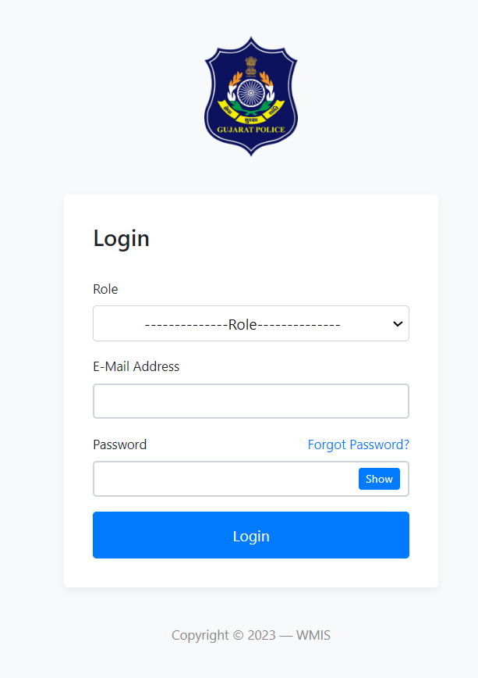
WORKING
This a Login Page for 3 three users of the platform:
Complainant
Police Officer
Nodal Officer

Slide 4
Complainant
The complainant who had faced Sexual Harassment at Workplace.
Would be able to lodge complaint online through the portal.
Information Collected from Complainant:
Victim Details
Name
Mobile No
Email
Aadhar Card No
Date of Birth
District
Respondent Details
1)Name
2)District
3)Pin Code
4)Organization Name
5)Organization Address
6)Gender

Slide 5
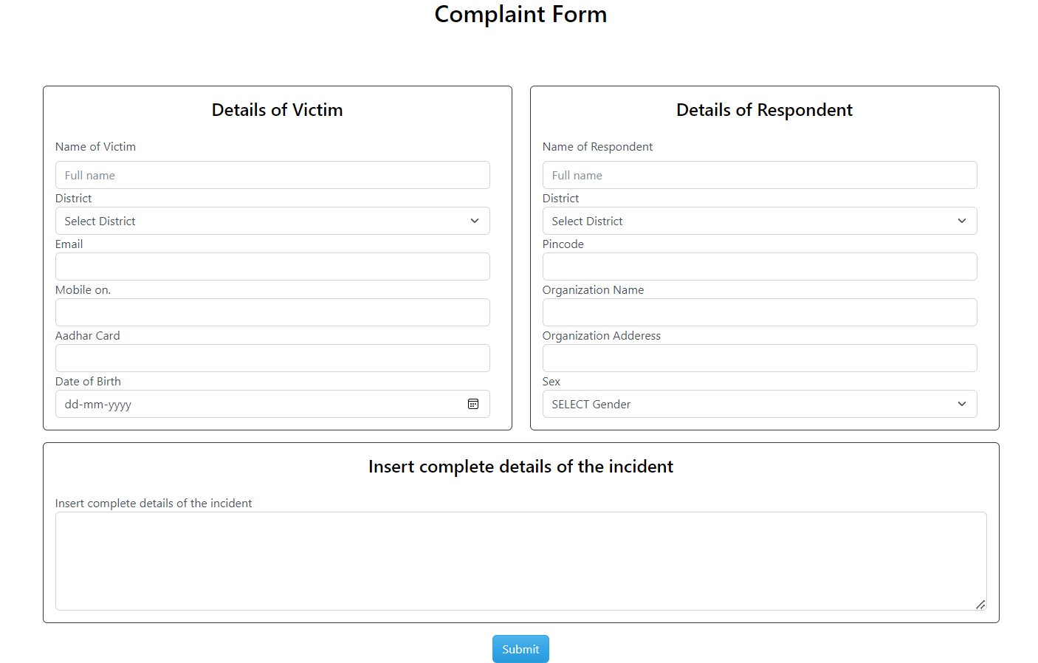
Complaint Form

Slide 6
Police Officer
The Role of Police Officer is regular update the status of FIR on regular basis.
Proper documentation need to uploaded on the portal.
For Proper tracking of FIR 4 Stages has been made for making the process easy.
If any suggestion given by Nodal Officer need to be taken care by him/her.

Slide 7
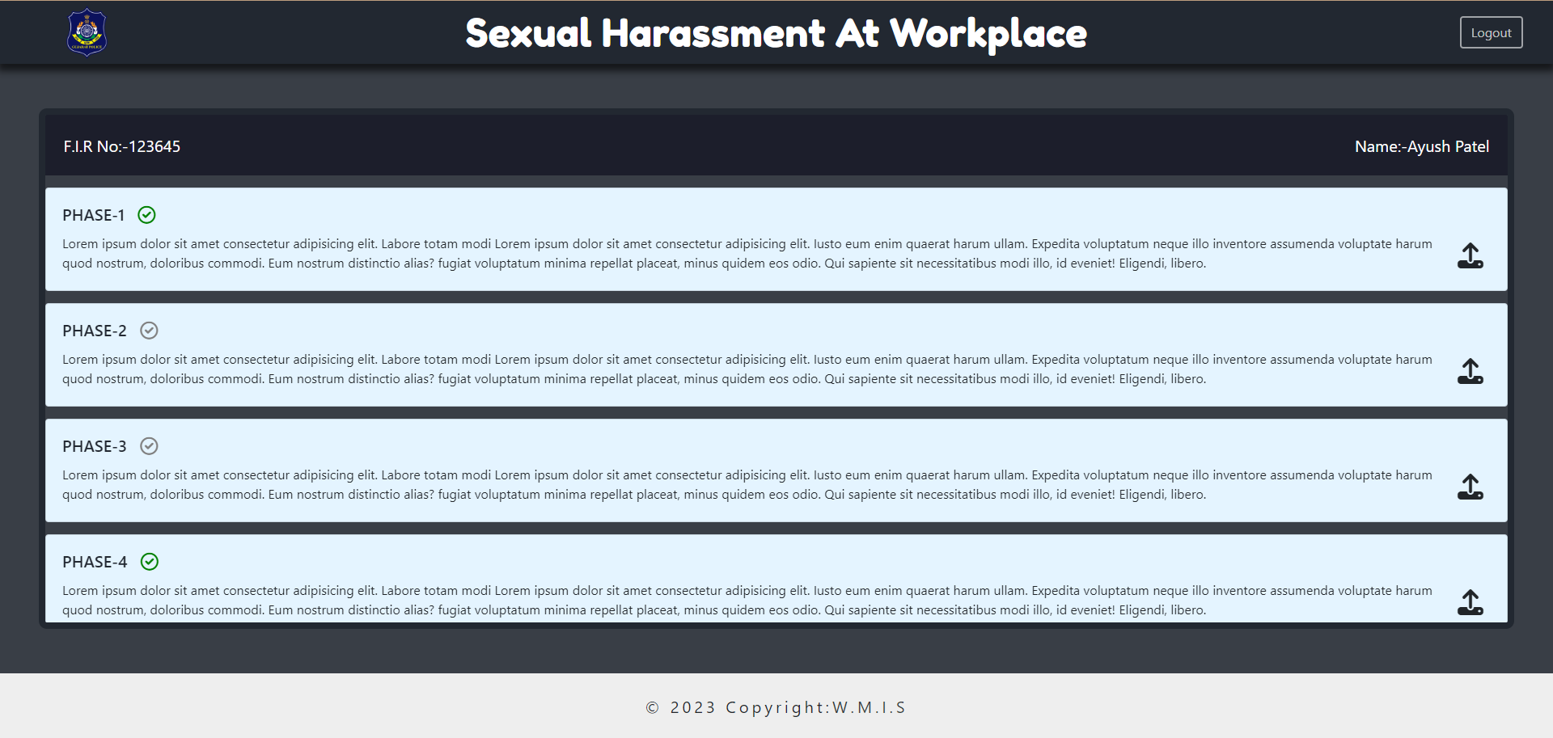
Police Officer’s View

Slide 8
Nodal Officer
The Primary Work of Nodal Officer is coordinate and supervise such statistical activities in the central government or state government.
As a case my he/She, in which he designated, and shall exercise such powers and perform such other duties.
In Our Case:
The Role of Nodal Officer is to keep track on FIR what had been done.
The Officer can give the suggestion to the Investigation Officer of the Case.

Slide 9
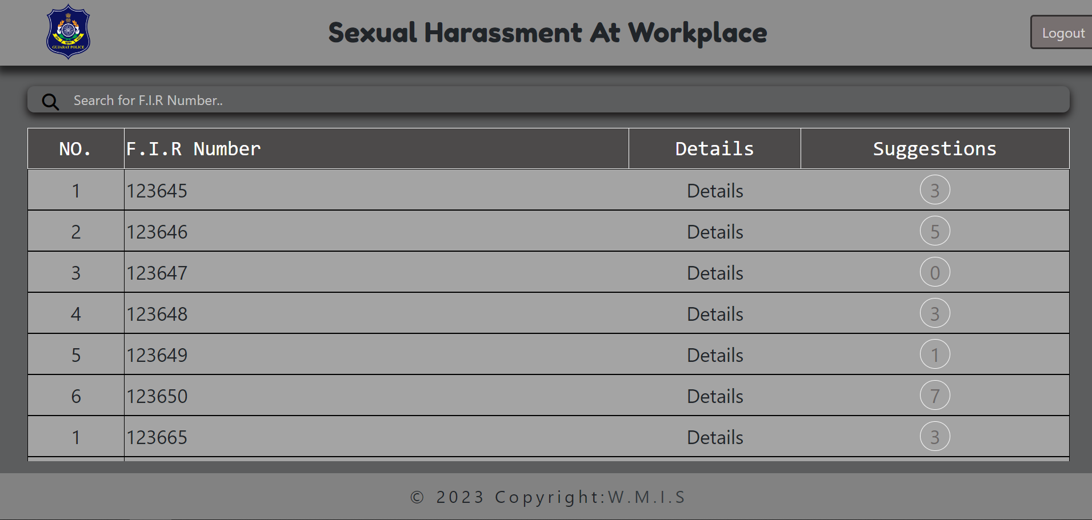
Nodal Officer’s View

Slide 10
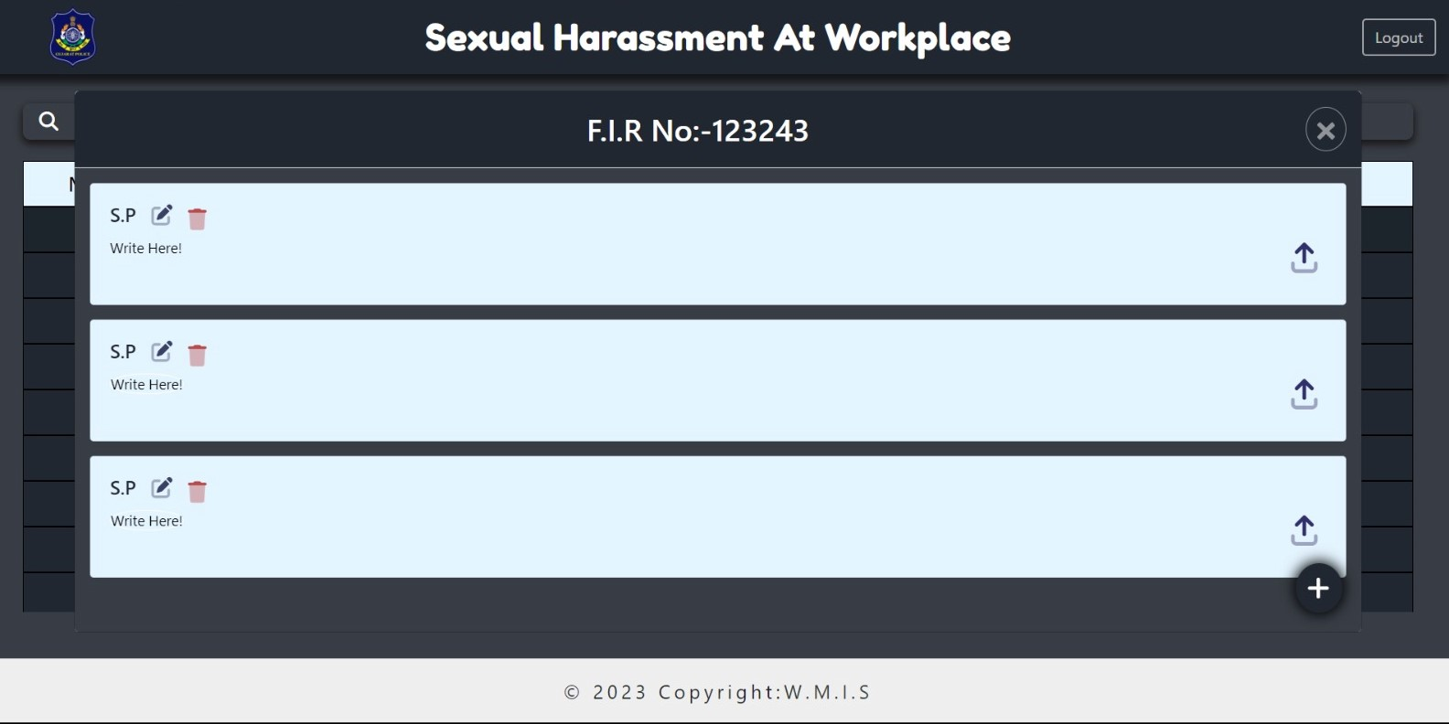
Sample Images

