Slide 1
Course 1 Neural Networks and Deep Learning
Htoo Hlaing Win 洪台吕

Slide 2
Week 1 - Introduction to Deep Learning
What is Neural Network?
Supervised Learning with Neural Networks
Why is Deep Learning taking off?

Slide 3
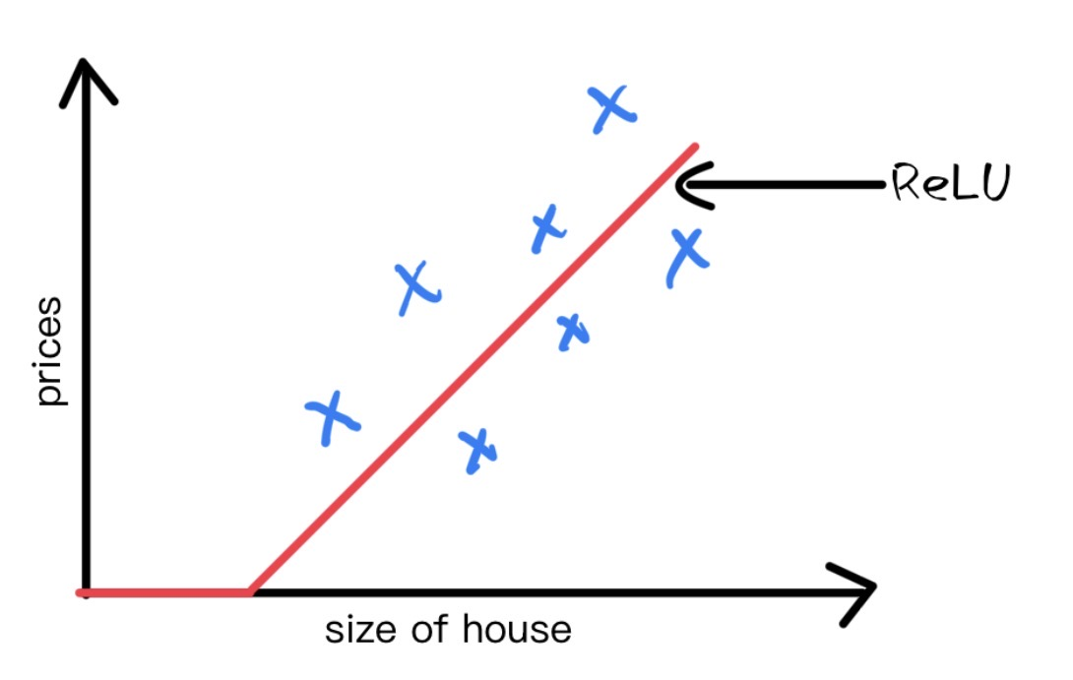
What is Neural Network?
Neuron
Size
x
Price
y
The input is the size of the house (x).
The output is the price of the house (y).
The Neuron implements ReLU function, which is the red line in the graph.

Slide 4
What is Neural Network?
Size
x1
#bedrooms
x2
Price
y
zip code
x3
wealth
wealth
x4
Hidden Unit
Input Layer
Multiple Neural Network
The price of the house can be affected not only by
Size of the house, number of bedrooms, place and wealth
The role of the neural network is to predict the price and it will automatically
generate the hidden units. We only need to provide the input x and the output y.

Slide 5
Supervised Learning of Neural Network
Input(x) | Output(y) | Application
Home features | Price | Real Estate
Ad, user info | Click on ad?(0/1) | Online Advertising
Image | Object(1...1000) | Photo tagging
Audio | Text Transcript | Speech Recognition
English | Chinese | Machine Translation
Image, Radar info | Position of the cars | Autonomous Driving
Standard NN
Convolutional NN
Rectified NN
Hybrid(CNN and others)
Supervised Learning :
Regression : predict results with Continuous output
Classification: predict results with discrete output

Slide 6


Supervised Learning of Neural Network
Structured Data
Unstructured Data
Size | #bedrooms | ... | Price (1000$)
2104 | 3 |  | 400
1600 | 3 |  | 330
2400 | 3 |  | 369
⁞ | ⁞ |  | ⁞
3000 | 4 |  | 540
Audio
Image
User Age | Ad Id | ... | Click
41 | 93242 |  | 1
80 | 93287 |  | 0
18 | 87312 |  | 1
⁞ | ⁞ |  | ⁞
27 | 71244 |  | 1
Hello NJUST Students...
Text

Slide 7
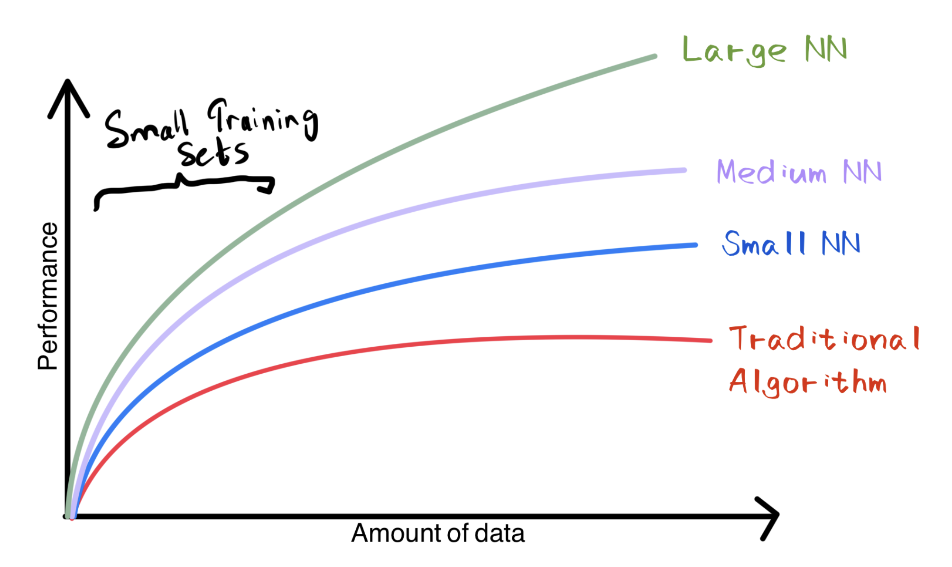
Why is deep learning taking off?
To get the high level performance:
Being able to train a big enough neural network
Huge amount of labeled data

Slide 8
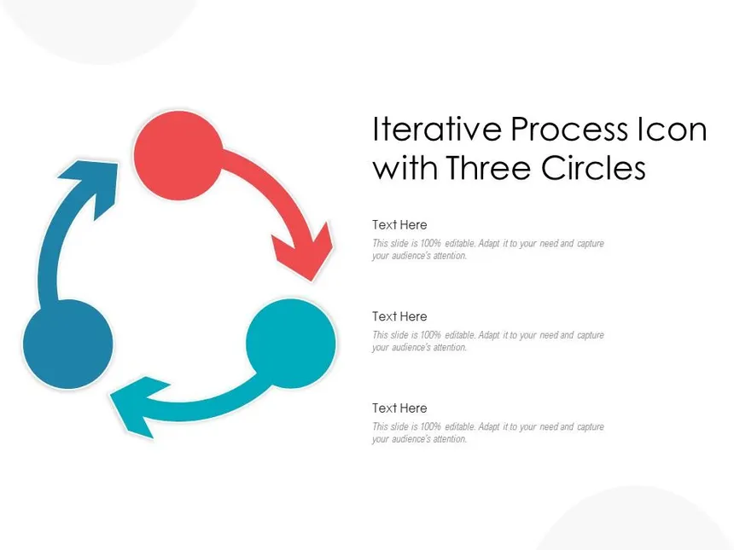
Why is deep learning taking off?
Idea
Experiment
Code
It take a good amount of time to train a neural network,
Affects my productivity. Faster computation helps to iterate
And improve new Algorithm.

Slide 9
Week 2 Neural Network Basics
Binary Classification
Logistic Regression: Cost Function
Gradient Descent
Python and Vectorization

Slide 10


Binary Classification
Binary Classification is an act of classifying the things using 1 or 0
1 means true and 0 means false.
To check image whether is it a cat or not, is binary classification.
The most basic Neural Network is binary classification.
Is to train that input x is an image and predicts whether the corresponding
Label y is 1 or 0.
1 This is a cat.
0 This is not a cat.

Slide 11
Logistic Regression
w is the weight, b is the bias and x^{(i)} is the i^{th} example represented as a column vector
Given
We want

Slide 12
Logistic Regression
Cost Function is the average of the loss function of the entire set.
And then we are going to find the parameters w and b that minimize the overall
Cost function.

Slide 13
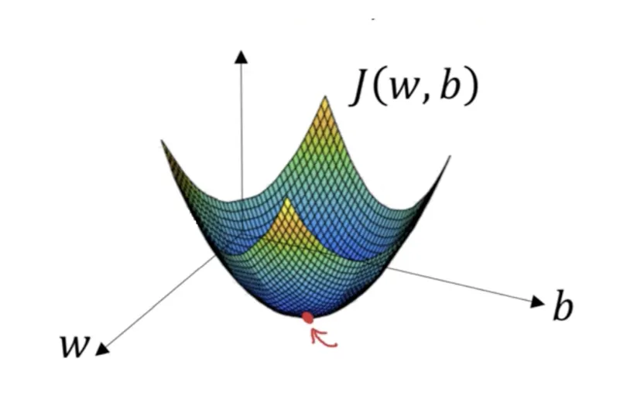
Gradient Descent
In order to find w, b that minimize J(w, b), We have to use backward propagation.
Which is using derivative.
dZ = A – Y
α is the learning rate

Slide 14
Python and Vectorization
In Neural Network, we should avoid explicit use of for loop which makes your
Algorithm slower. In order to solve this we can vectorize input x and weight and
Bias. There is numpy function we can use, which is np.dot. This is the dot product
Of two vectors and we must be careful of the shapes, this is the most common error
When we use vectorize version.

Slide 15
Week 3 Shallow Neural Network
What is Neural Network?
Neural Network representation
Vectorization across multiple examples
Activation Functions
Backward Propagation
Random Initialization

Slide 16
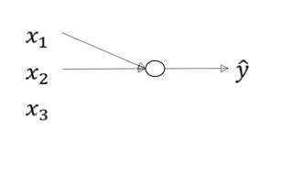
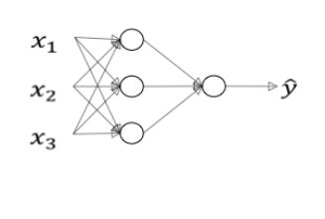

What is a Neural Network?

Slide 17
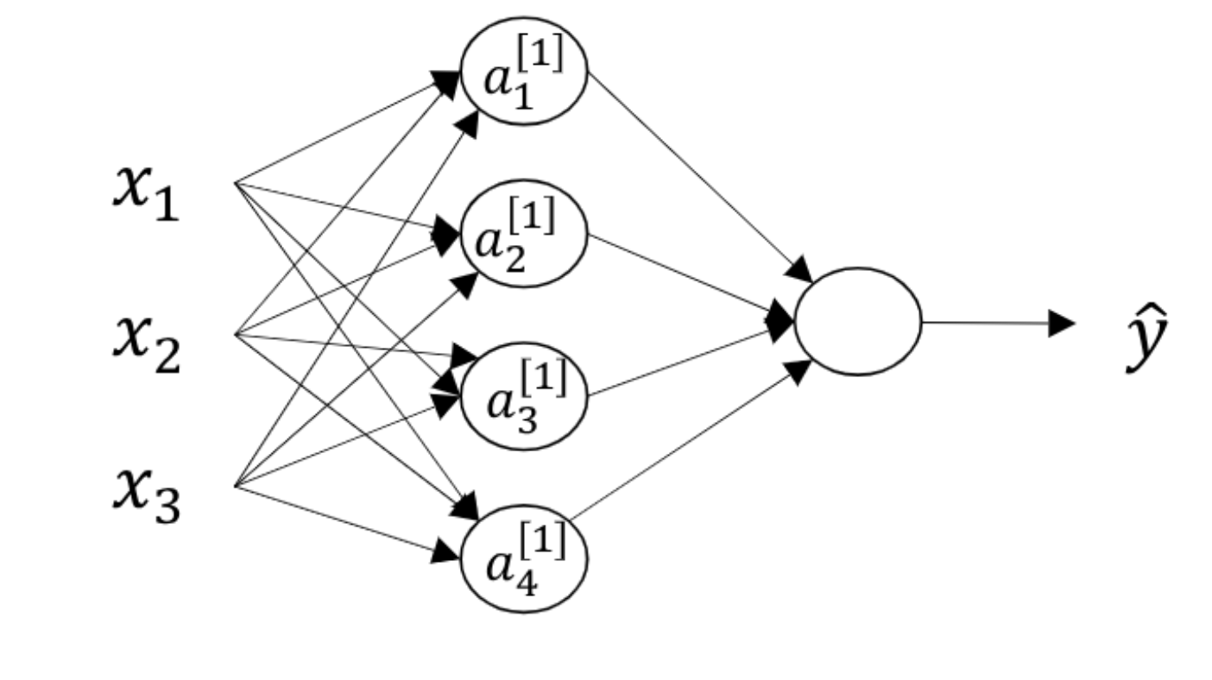
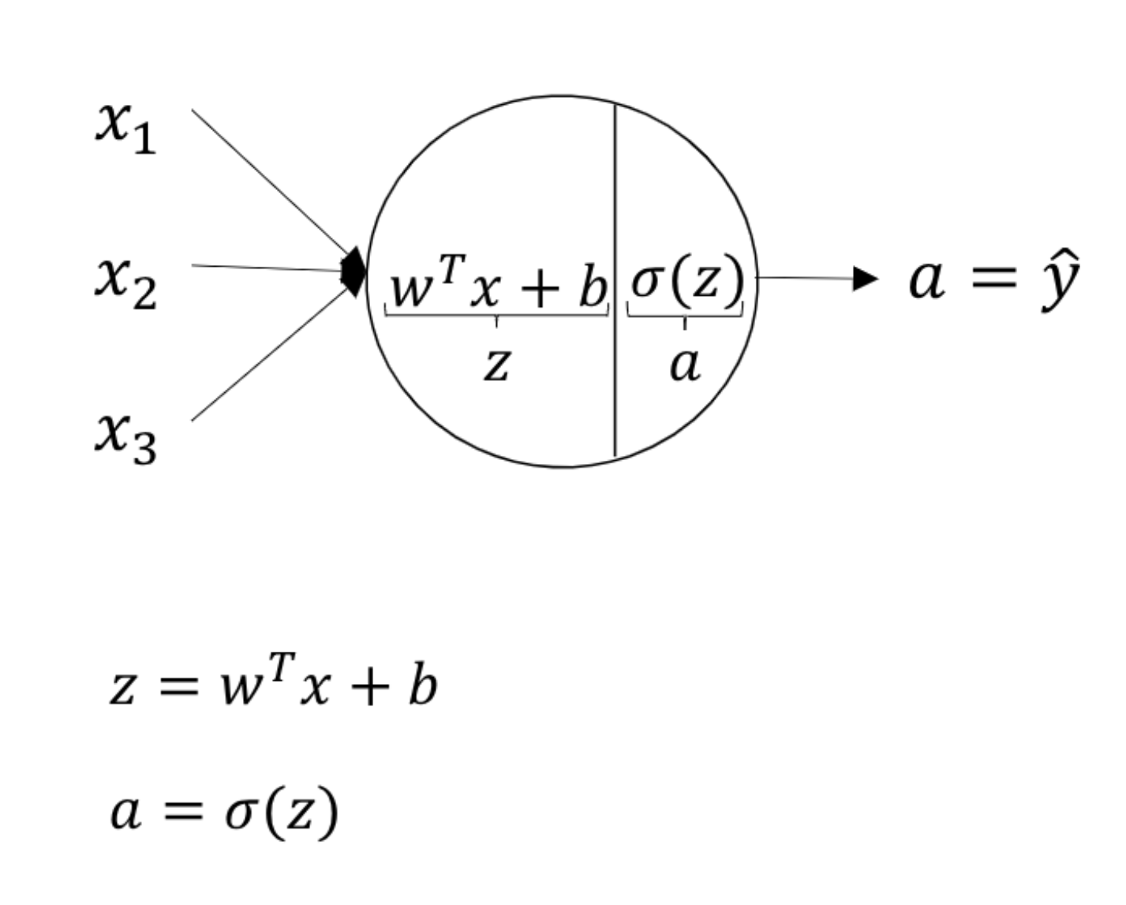
Neural Network Representation

Slide 18
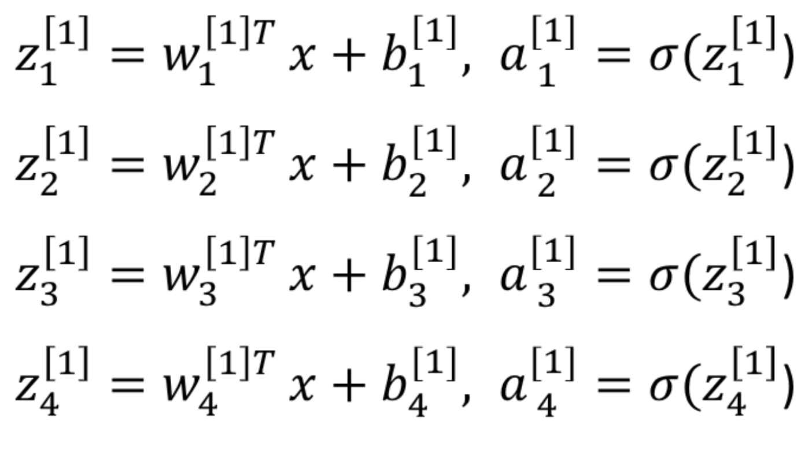
Neural Network Representation

Slide 19
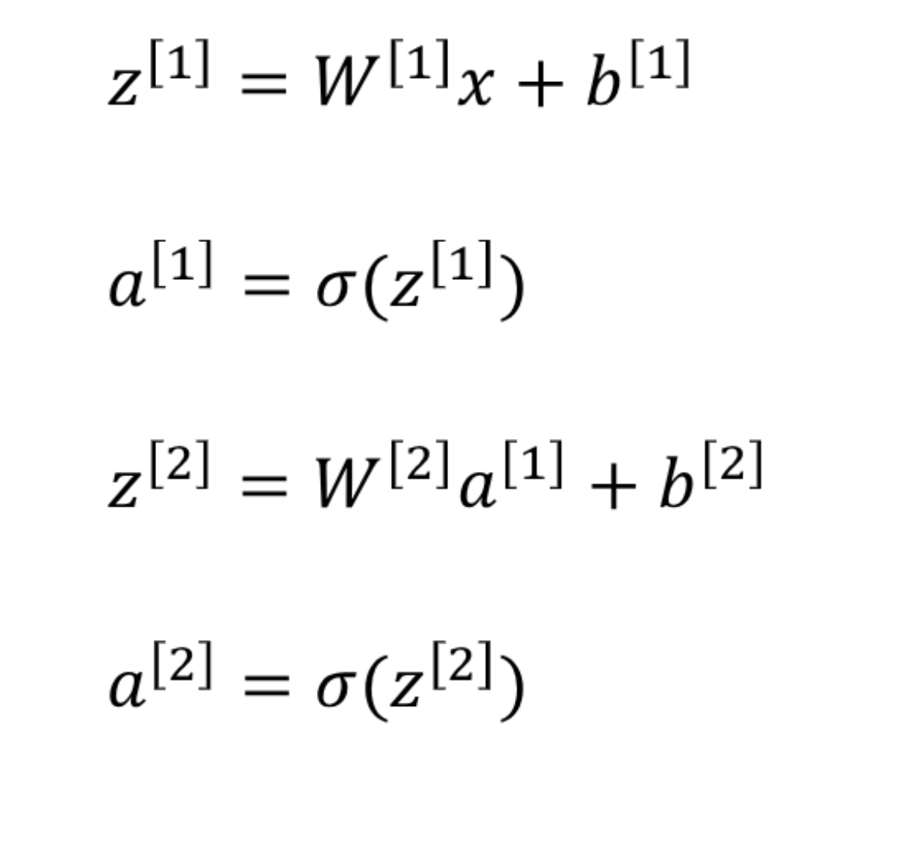
Neural Network Representation

Slide 20
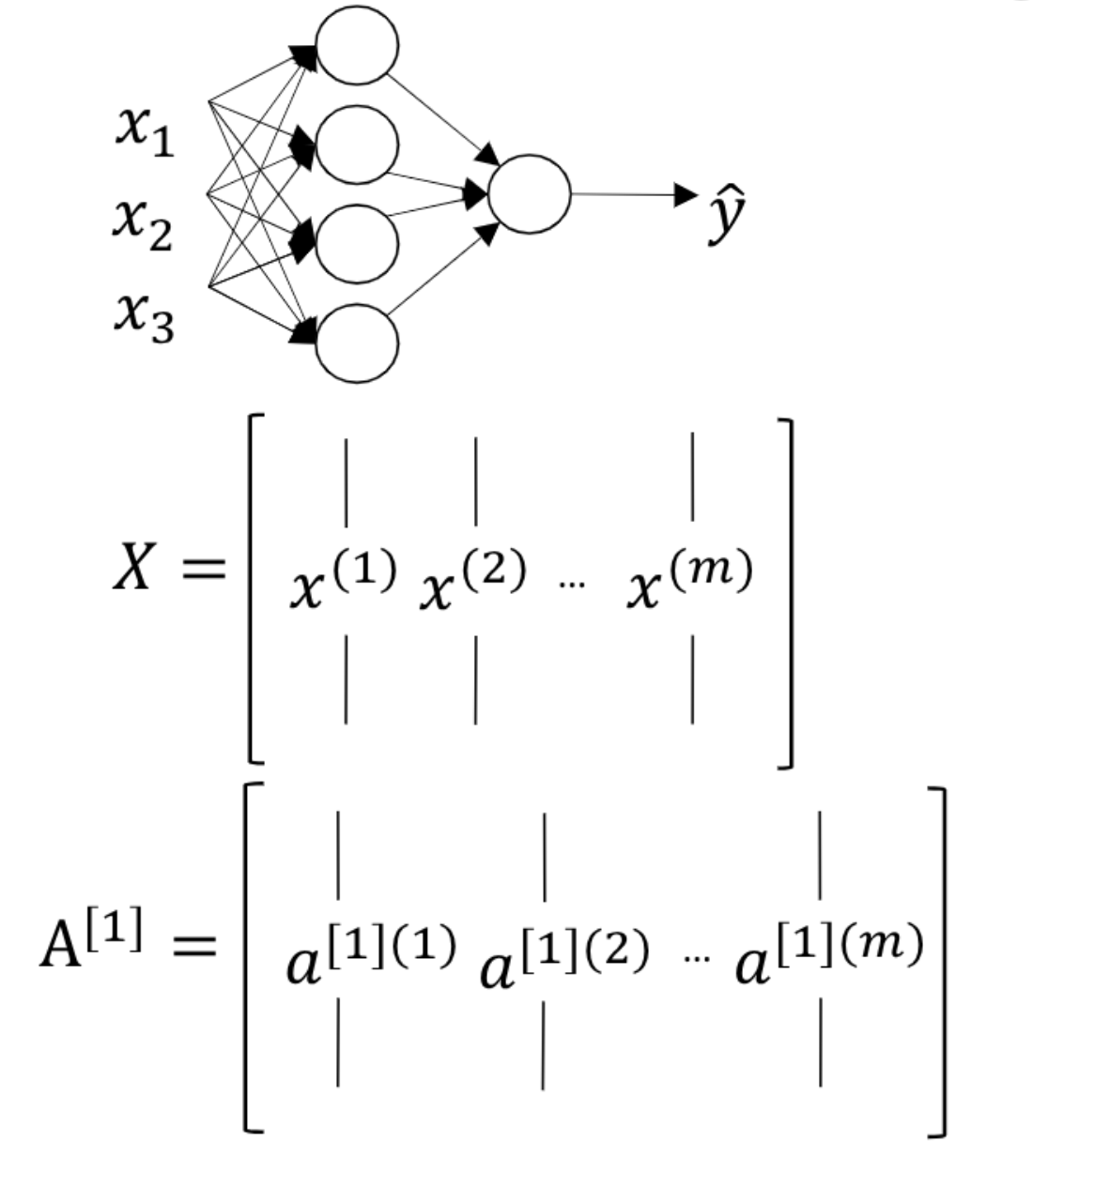
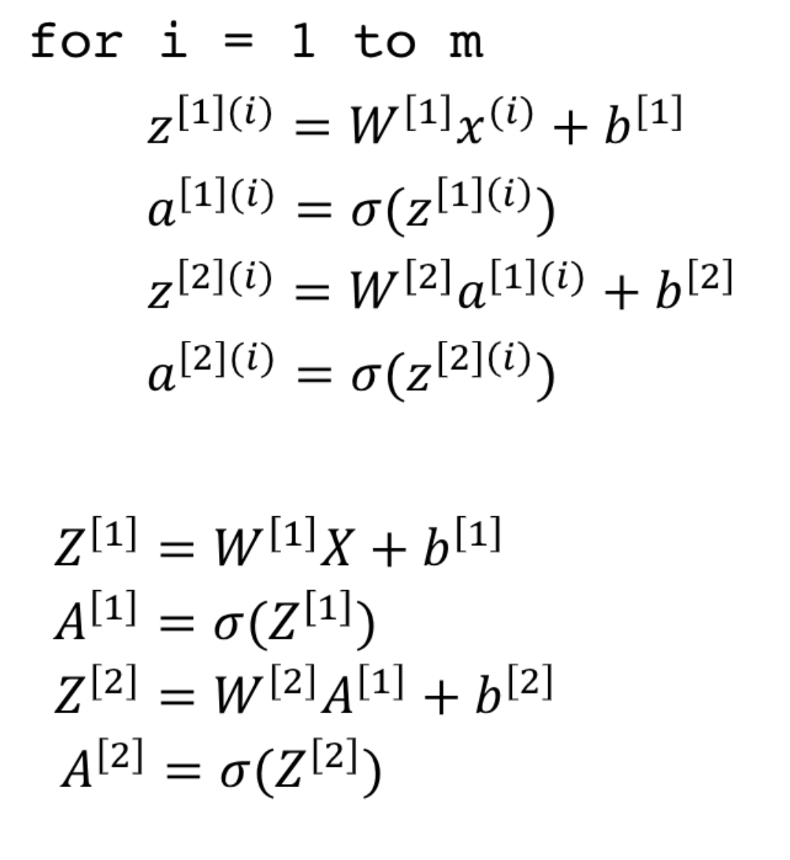
Vectorization across multiple examples

Slide 21
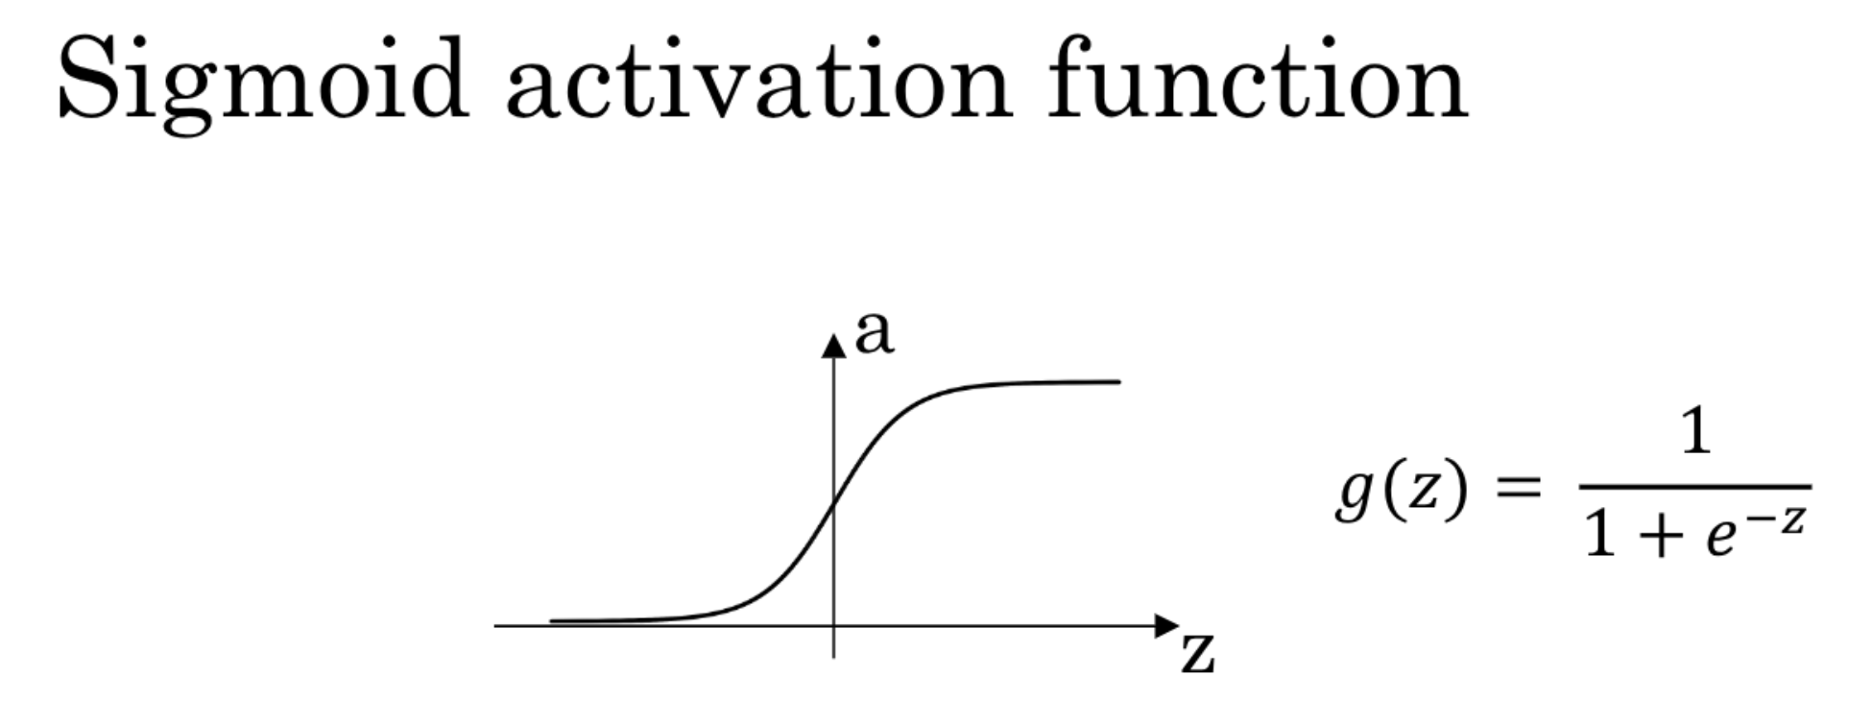
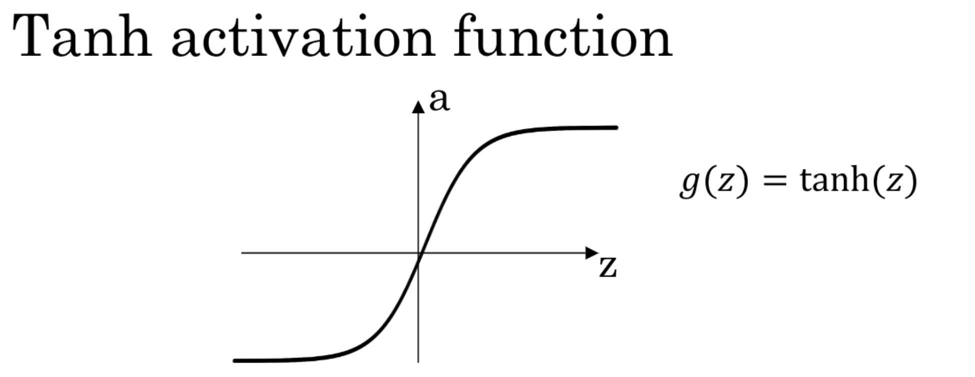
Activation Functions
Tanh Function is generally better than Sigmoid function
Cause tanh center at 0, so average output is around 0, not 0.5
Like sigmoid. This means gradients for next layers now push different
Weights in different directions simultaneously, not zig-zaging. So training
Is smoother and faster.
But when binary classification we use output layer to be sigmoid,we do
That because we need between 0 and 1, and Hidden layers to tanh to train faster.

Slide 22
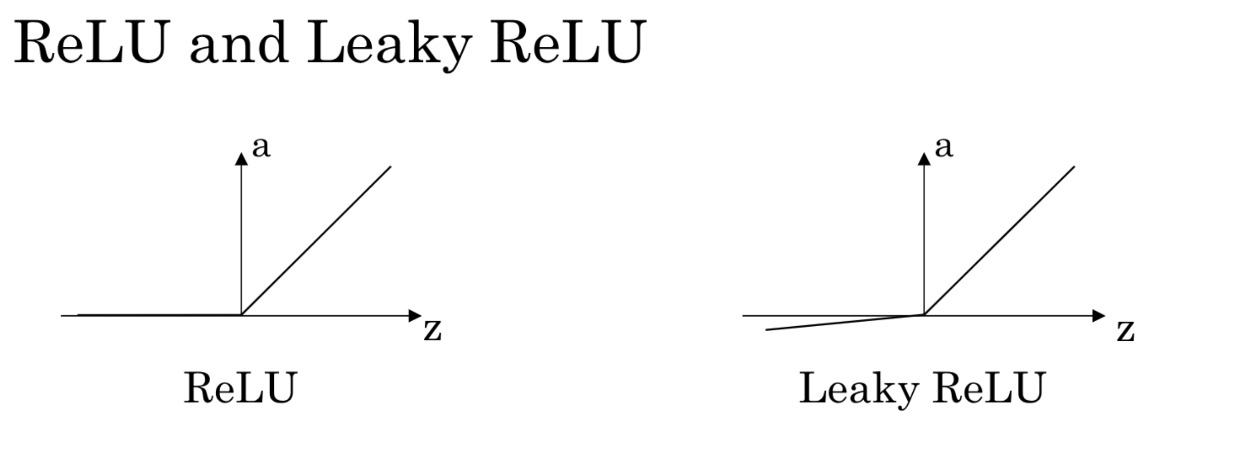
Activation Functions
Why ReLU is better than sigmoid and tanh is because its gradient is exactly 1, so
It never shrinks and that is why deep NN(50, 100+ layers) can be trainable but
Sigmoid and tanh impossible to train.
Downside of ReLU is when z < 0 its gradient is always 0 and never update
Parameters. So neurons are effectively dead and contributes nothing to the training.
Leaky ReLU solves this problem when z < 0 and its gradient is 0.01 so it still updates
Parameters and neurons become useable.

Slide 23
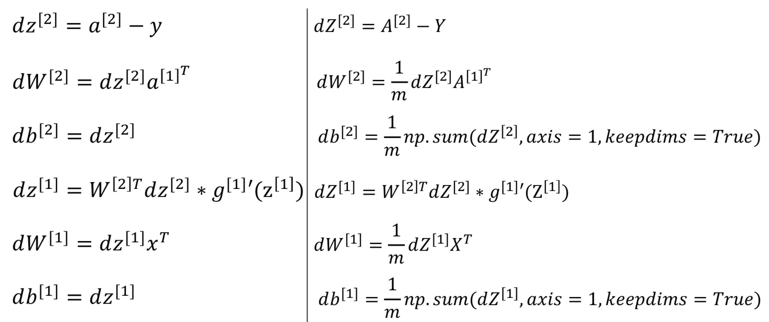
Backward Propagation

Slide 24
Random Initialization
Why need to initialize w to be random?
If we initialize it to 0, z becomes 0 and A becomes zero too. So each layer and
Each neurons output the same value. This basically means training with 1 layer
And 1 neuron and other layers and neurons becomes useless. Another thing is
When we calculate grdient, we got the identical gradient too.
If we randomize, we get different weight so we train different edges and cases
And each neuron starts learning differently.
Why multiply by 0.01(very small values)?
In sigmoid and tanh functions when z becomes relatively large or relatively small
The gradient becomes very small. So it trains slower. That’s why need to start
With very small values and it updates parameters quickly and get to the minimum
Loss fastly.

Slide 25
Week 4 Deep Neural Network
What is Deep Neural Network?
Forward Propagation
Why Deep Neural Network?
Building blocks and Backward Propagation
Hyperparameters and Parameters

Slide 26
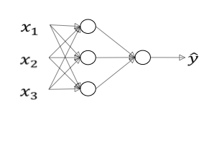
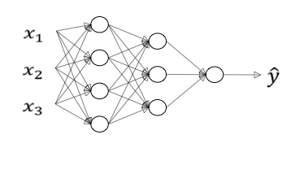
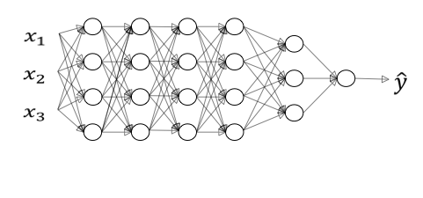
What is Deep Neural Network?
logistic regression
1 hidden layer
2 hidden layers
5 hidden layers

Slide 27
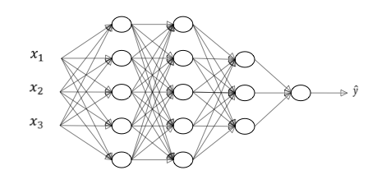
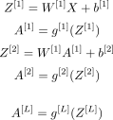
Forward Propagation
…

Slide 28


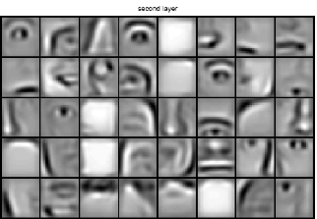
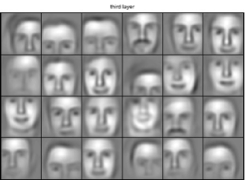
Why Deep Neural Network?

Slide 29
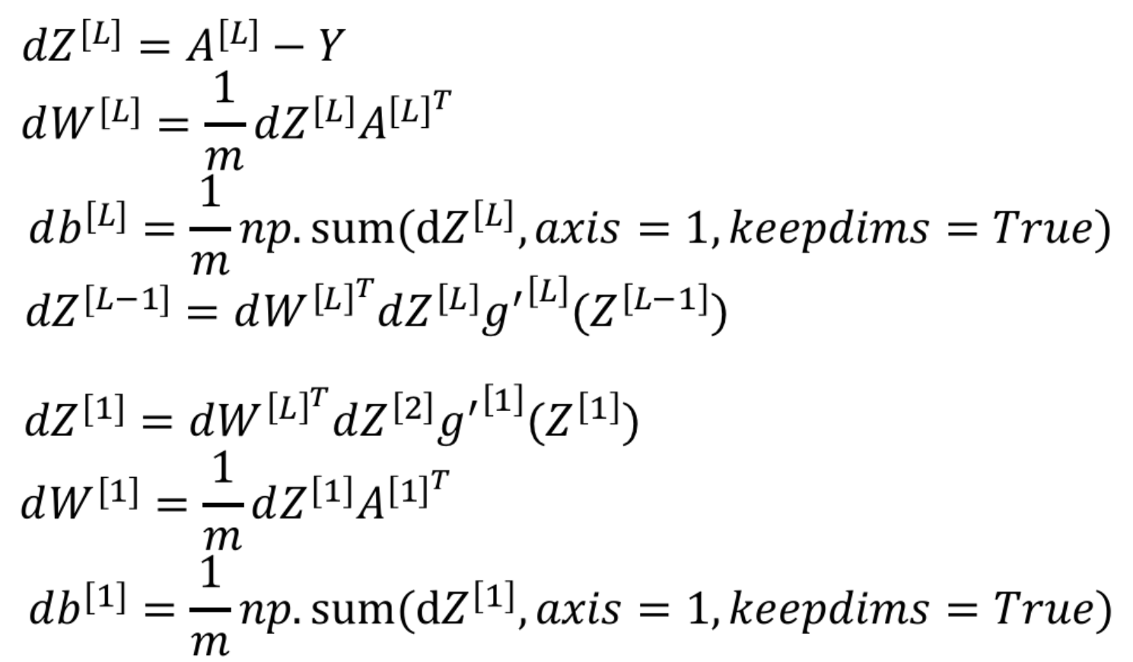
Building blocks and Backward Propagation
At each layer of forward propagation ,We will save Z to cache to use it later
In backward propagation. And After each backward propagation, we save
dW and db to grad cache too to later to update parameters.

Slide 30
Hyperparameters and Parameters
Parameters are W[1] and b[1] - they are learned directly from the data during training. Hyperparameters are the settings that control how training happens: the learning rate a, number of iterations, number of layers L, number of units n[1] in each layer, and the choice of activation function g[1] at each layer. Later hyperparameters include momentum, mini-batch size, and regularization. Hyperparameters ultimately determine what the learned parameters will be.

Slide 31
Thank You!!!

