Slide 1
Predicting the 2020 Happiest Countries using Linear Regression
Justyn Crook

Slide 2
Data
CSV files
Data
Country
Rank
Score
Economy
Family
Health
Freedom
Trust
Generosity
Dystopia Residual
Notes:
There are six CSV files, one for each year beginning with 2015 and ending with 2020.
Each csv files includes 153 countries and their ranks. They also include the dependent variable Happiness_Score and 7 independent variables: economy (the GDP per capita ranking), the social support, the healthy life expectancy, the people’s freedom to make life choices, perceptions of corruption, generosity of others in society, and the dystopia residual. Dystopia Residual is equal to Dystopia + the contribution of each individual’s country residual. The Dystopia value is a hypothetical country that has values equal to the world’s lowest national averages for each of the six factors. The residual for each country is the contribution that country would give to the dystopia to make life evaluations, meaning how much better that individual country would make the dystopia.

Slide 3
Data Description
 | Happiness Rank | Happiness Score | Economy | Family | Health | Freedom | Trust | Generosity | Dystopia Residual
count | 935 | 935 | 935 | 935 | 935 | 935 | 935 | 935 | 935
mean | 78.420321 | 5.394436 | 0.908311 | 1.091028 | 0.625581 | 0.41968 | 0.126166 | 0.213797 | 2.009179
std | 45.021905 | 1.124935 | 0.402023 | 0.324069 | 0.2509 | 0.152199 | 0.107021 | 0.119452 | 0.557145
min | 1 | 2.5669 | 0 | 0 | 0 | 0 | 0 | 0 | 0.183
25% | 39.5 | 4.54 | 0.600264 | 0.879945 | 0.449596 | 0.317835 | 0.054357 | 0.12703 | 1.674143
50% | 78 | 5.3535 | 0.97438 | 1.143945 | 0.667465 | 0.436 | 0.09261 | 0.199358 | 2.02518
75% | 117 | 6.1985 | 1.228785 | 1.347408 | 0.81471 | 0.539885 | 0.15773 | 0.271398 | 2.366195
max | 158 | 7.8087 | 2.096 | 1.644 | 1.141 | 0.724 | 0.55191 | 0.838075 | 3.83772
Notes:
This table shows the number of rows of data, the mean of each variable along with their standard deviations, mins, maxes, and percentiles. There was a lot of data between all the csv files and that really helped when using Linear Regression to predict the happiness scores.

Slide 4
Data Cont.
Country | Rank | Score | Economy | Family | Health | Freedom | Trust | Generosity | Dystopia Residual
FI | 1 | 7.808 | 1.285190 | 1.499 | 0.9612 | 0.662317 | 0.477 | 0.159670 | 2.762835
DK | 2 | 7.645 | 1.326949 | 1.503 | 0.9793 | 0.665040 | 0.495 | 0.242793 | 2.432741
CH | 3 | 7.559 | 1.390774 | 1.472 | 1.0405 | 0.628954 | 0.407 | 0.269056 | 2.350267
IS | 4 | 7.504 | 1.326502 | 1.548 | 1.0008 | 0.661981 | 0.144 | 0.362330 | 2.460688
NO | 5 | 7.488 | 1.424207 | 1.495 | 1.0080 | 0.670201 | 0.434 | 0.287985 | 2.168266
NL | 6 | 7.448 | 1.338946 | 1.464 | 0.9756 | 0.613626 | 0.368 | 0.336318 | 2.352117
SE | 7 | 7.353 | 1.322235 | 1.433 | 0.9864 | 0.650298 | 0.442 | 0.272828 | 2.246299
NZ | 8 | 7.299 | 1.242318 | 1.487 | 1.0081 | 0.646790 | 0.461 | 0.325726 | 2.128108
AT | 9 | 7.294 | 1.317286 | 1.437 | 1.0009 | 0.603369 | 0.281 | 0.255510 | 2.398446
LU | 10 | 7.237 | 1.536676 | 1.387 | 0.9864 | 0.610137 | 0.367 | 0.195954 | 2.153700
Notes:
As you can see here, the economy, family, health, freedom, trust, generosity, and dystopia residual are used to compute the score, and the score is what makes the rank.

Slide 5
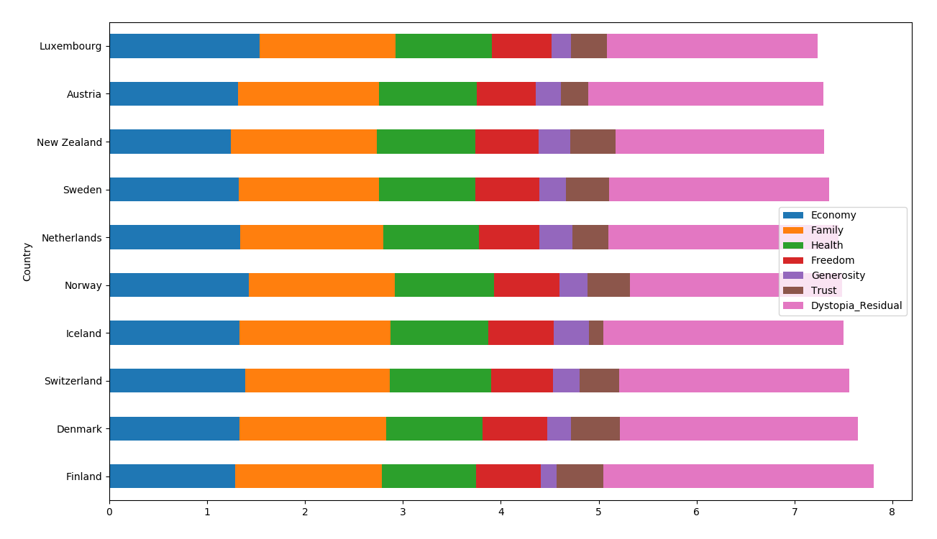
Notes:
Here I have made a bar graph of each variable and it’s contribution to the overall happiness score of the top 10 countries of 2020. We can see that the dystopia residual has the most affect, followed by economy and family, health, freedom, then trust and generosity.

Slide 6
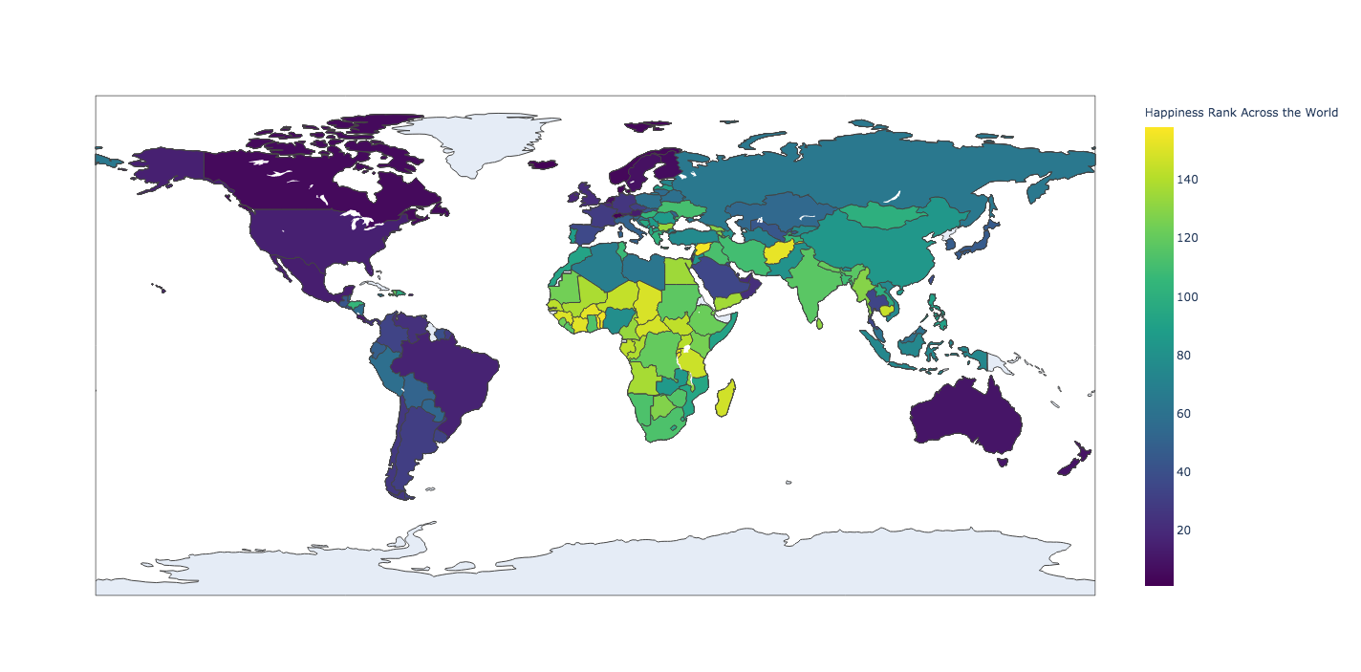
Notes:
I made a make_choropleth method with the plotly module to plot my data onto a choropleth to show the happiness rank across the world. The darker the blue, the higher the rank.

Slide 7
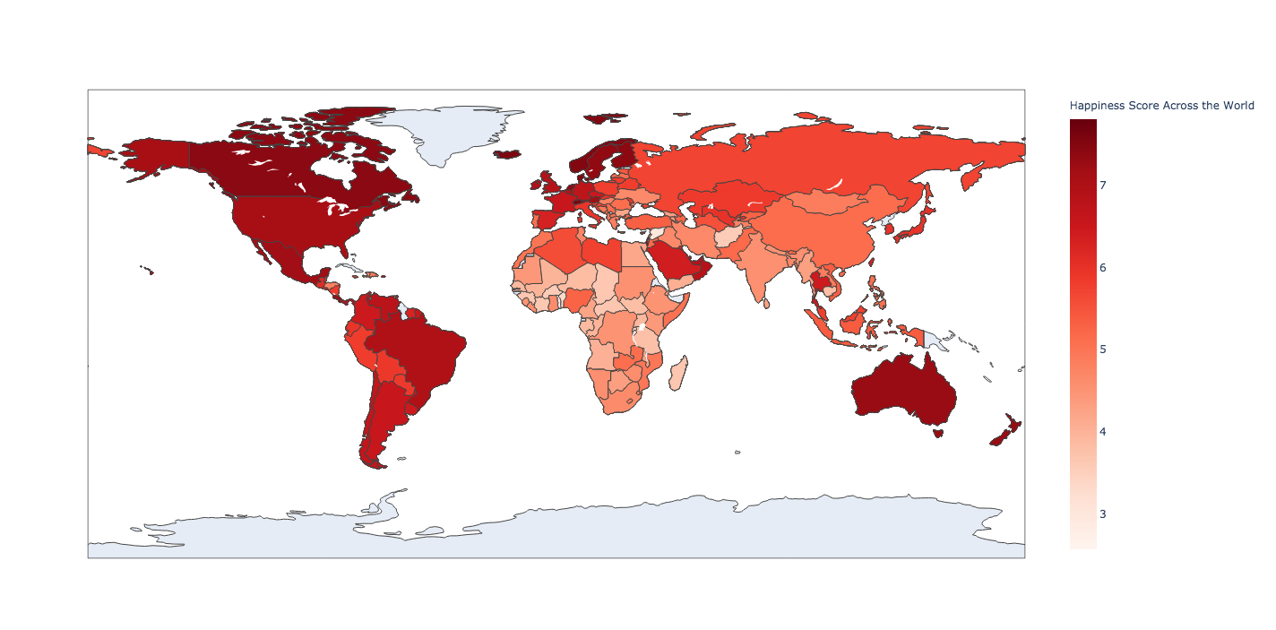
Notes:
This method also made this choropleth. Here, the darker the red, the higher the happiness score. The higher the score, the higher the rank.
Next show the pairplot

Slide 8
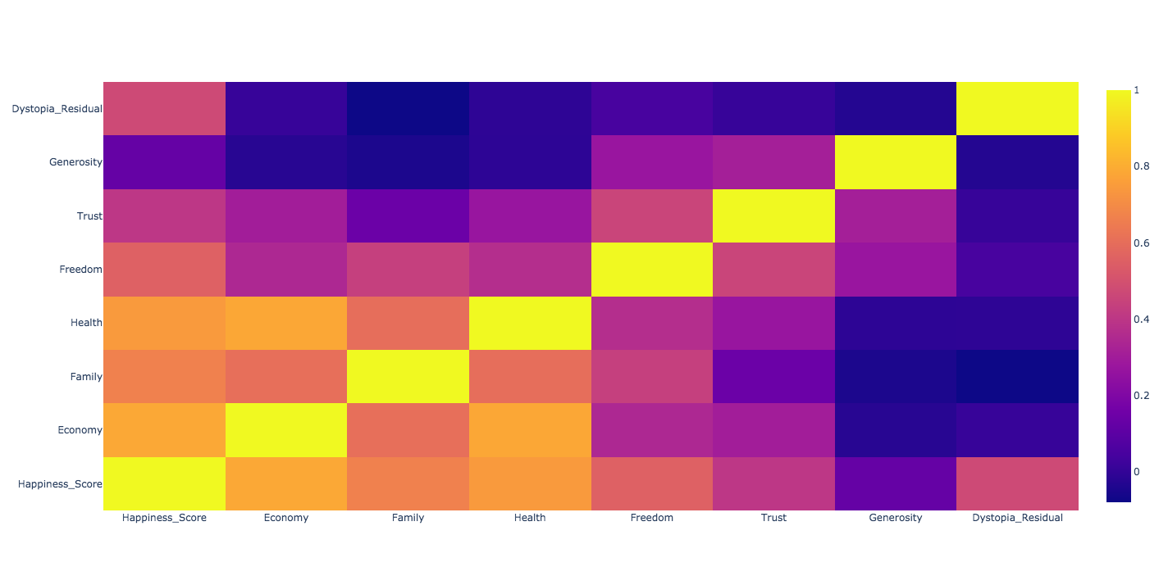
Notes:
I then used a heatmap to find out what variables affected the overall happiness score the most. Shown here, we can see that economy and health have the largest effect, followed by family and the dystopia residual. Freedom, trust, and generosity have some effect on the happiness score, but not much. So, when predicting the 2020 happiness score using the past 6 years of data, I also predicted the scores without freedom, trust, and generosity individually. I then also predicted the scores without all three. The results will be shown later.

Slide 9
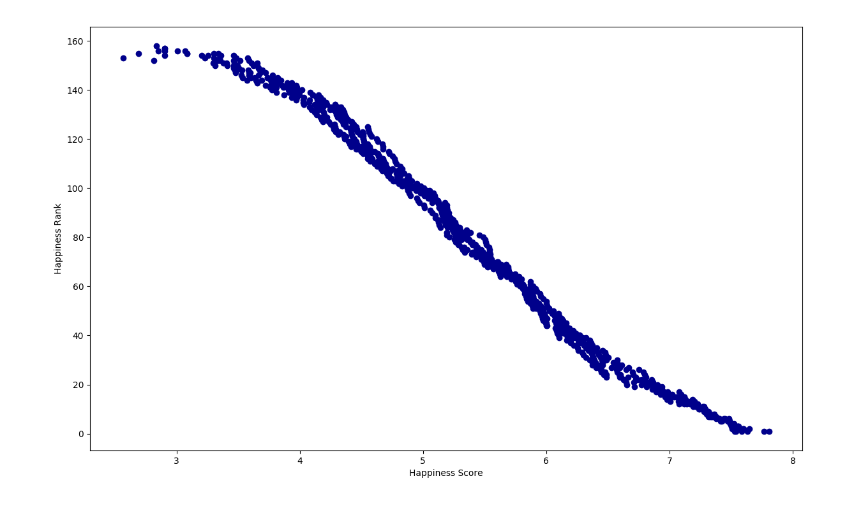
Notes:
I then made a score_v_rank method that shows the negative (but really positive) correlation between the happiness score and happiness rank. The higher the score, the better the rank, which makes sense.

Slide 10
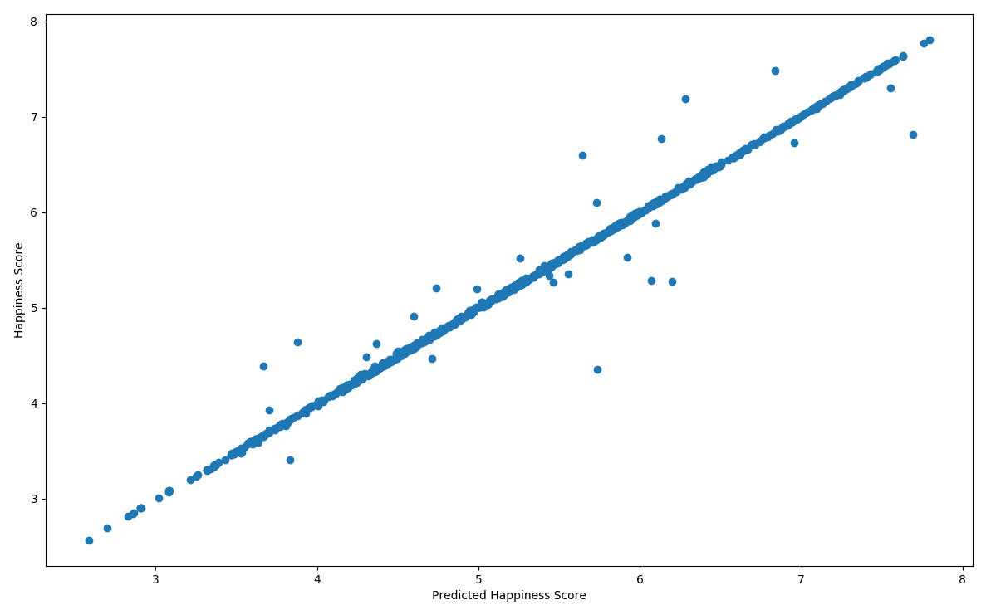
Linear Regression Prediction
Notes:
I then made a predict_happiness method that uses linear regression to predict the happiness score. I first dropped the country, and happiness rank from the dataframe, then did this again along with dropping the happiness score. On the new dataframe that did not have the country, rank and score, I used the Linear Regression fit and predict methods to predict the happiness score. I then compared that data to the actual data to show this graph. Besides a few outlier, we can see that linear regression does a great job at predicting the happiness score.

Slide 11
Coefficients
After using linear regression to predict the score, we found the coefficients of each variable.
Economy: 1.015487
Family: 0.980562
Health: 0.993835
Freedom: 1.010251
Trust: 0.988958
Generosity: 0.920629
Dystopia Residual: 0.983378
This means that the equation we can use to actually predict the happiness score is:
score = 1.015487(economy) + 0.980562(family) + 0.993835(health) + 1.010251(freedom) + 0.988958(trust) + 0.920629(generosity) + 0.983378(dystopia_residual)

Slide 12
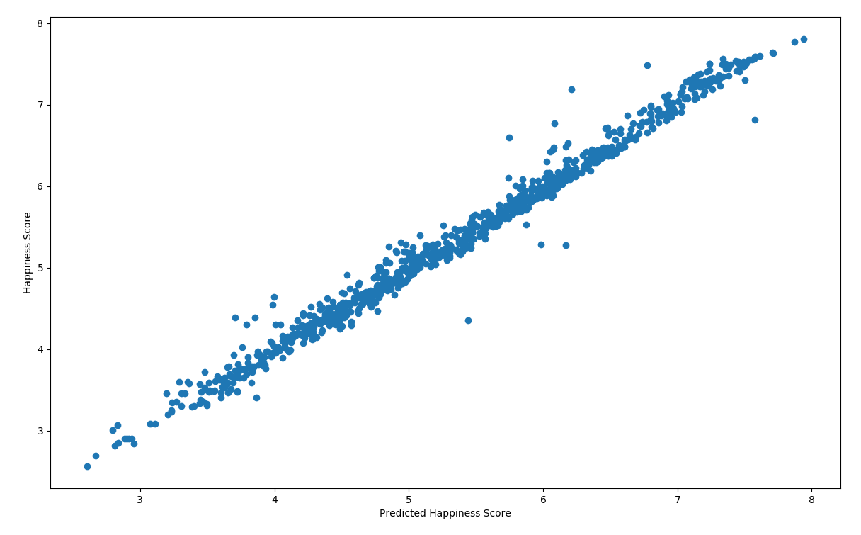
Linear Regression Prediction w/o Generosity

Slide 13
Coefficients
After using linear regression to predict the score without generosity, we found the coefficients of each variable.
Economy: 1.015487
Family: 0.980562
Health: 0.993835
Freedom: 1.010251
Trust: 0.988958
Dystopia Residual: 0.983378
This means that the equation we can use to actually predict the happiness score is:
score = 0.991881(economy) + 0.936516(family) + 0.981912(health) + 1.197229(freedom) + 1.239792(trust) + 0.972774(dystopia_residual)

Slide 14
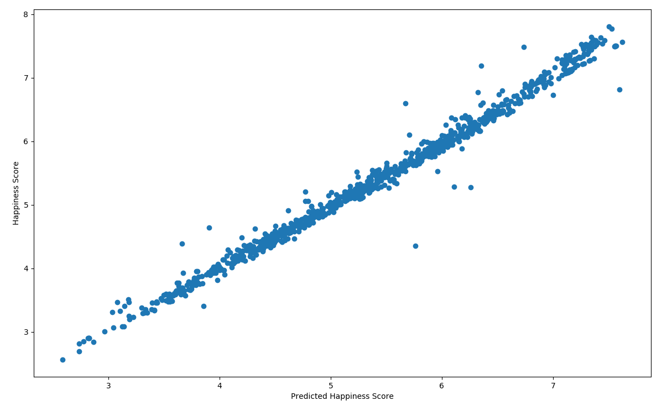
Linear Regression Prediction w/o Trust

Slide 15
Coefficients
After using linear regression to predict the score without trust, we found the coefficients of each variable.
Economy: 1.085873
Family: 0.913794
Health: 1.013045
Freedom: 1.273222
Generosity: 1.100439
Dystopia Residual: 0.979467
This means that the equation we can use to actually predict the happiness score is:
score = 1.085873(economy) + 0.913794(family) + 1.013045(health) + 1.273222(freedom) + 1.100439(generosity) + 0.979467(dystopia_residual)

Slide 16
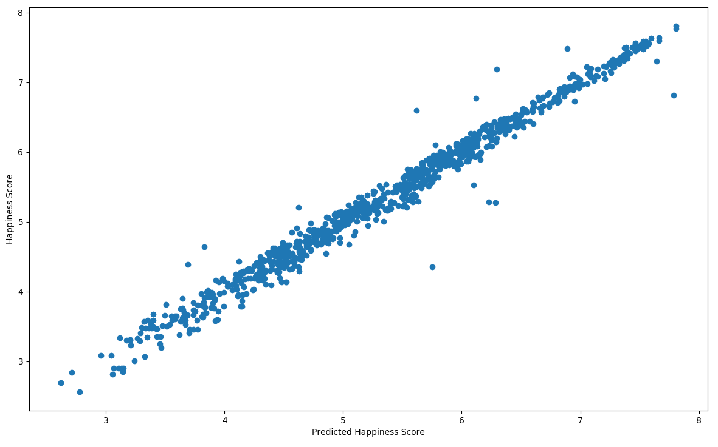
Linear Regression Prediction w/o Freedom

Slide 17
Coefficients
After using linear regression to predict the score without freedom, we found the coefficients of each variable.
Economy: 0.990562
Family: 1.160842
Health: 1.057406
Trust: 1.464886
Generosity: 1.163208
Dystopia Residual: 1.005416
This means that the equation we can use to actually predict the happiness score is:
score = 0.990562(economy) + 1.160842(family) + 1.057406(health) + 1.464886(trust) + 1.163208(generosity) + 1.005416(dystopia_residual)

Slide 18
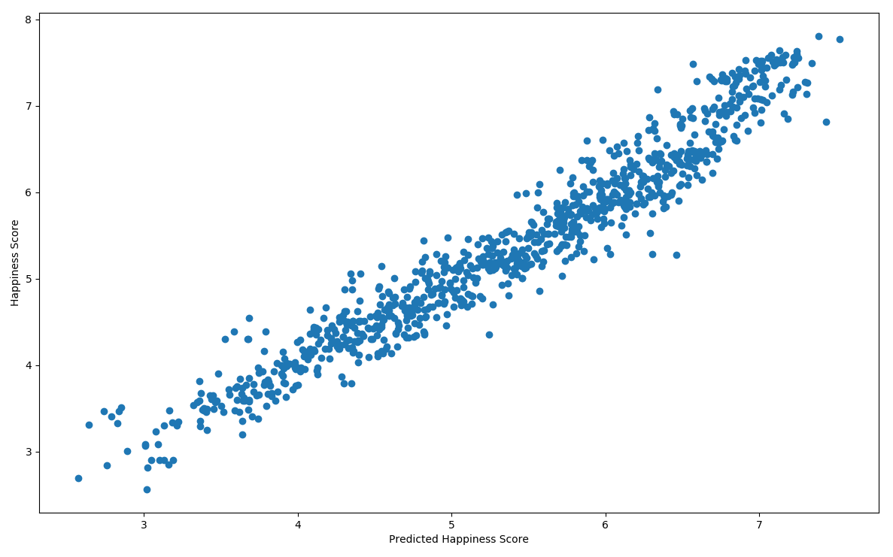
Linear Regression Prediction w/o Three

Slide 19
Coefficients
After using linear regression to predict the score without generosity, trust, and freedom, we found the coefficients of each variable.
Economy: 1.092340
Family: 1.090017
Health: 1.145901
Dystopia Residual: 0.996784
This means that the equation we can use to actually predict the happiness score is:
score = 1.092340(economy) + 1.090017(family) + 1.145901(health) + 0.996784(dystopia_residual)

Slide 20
Conclusion
In conclusion, linear regression is very useful in predicting the happiness score for countries. Though all the independent variables are useful, there are several that could technically be excluded and still have results that aren’t skewed or changed.

