Slide 1
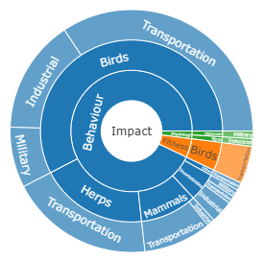

Slide 2
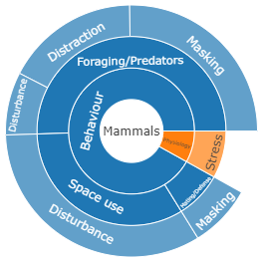

Slide 3
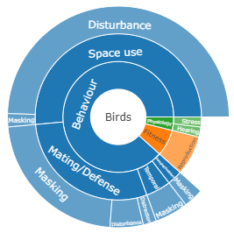

Slide 4
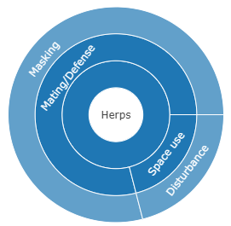

Slide 5
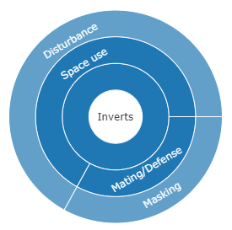

Slide 6
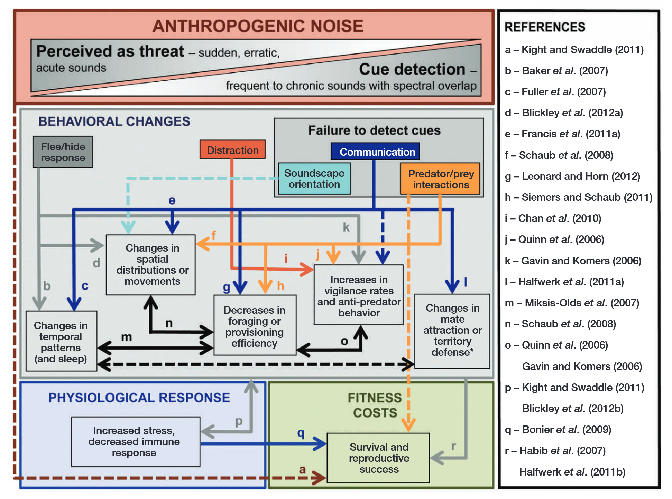

Slide 7
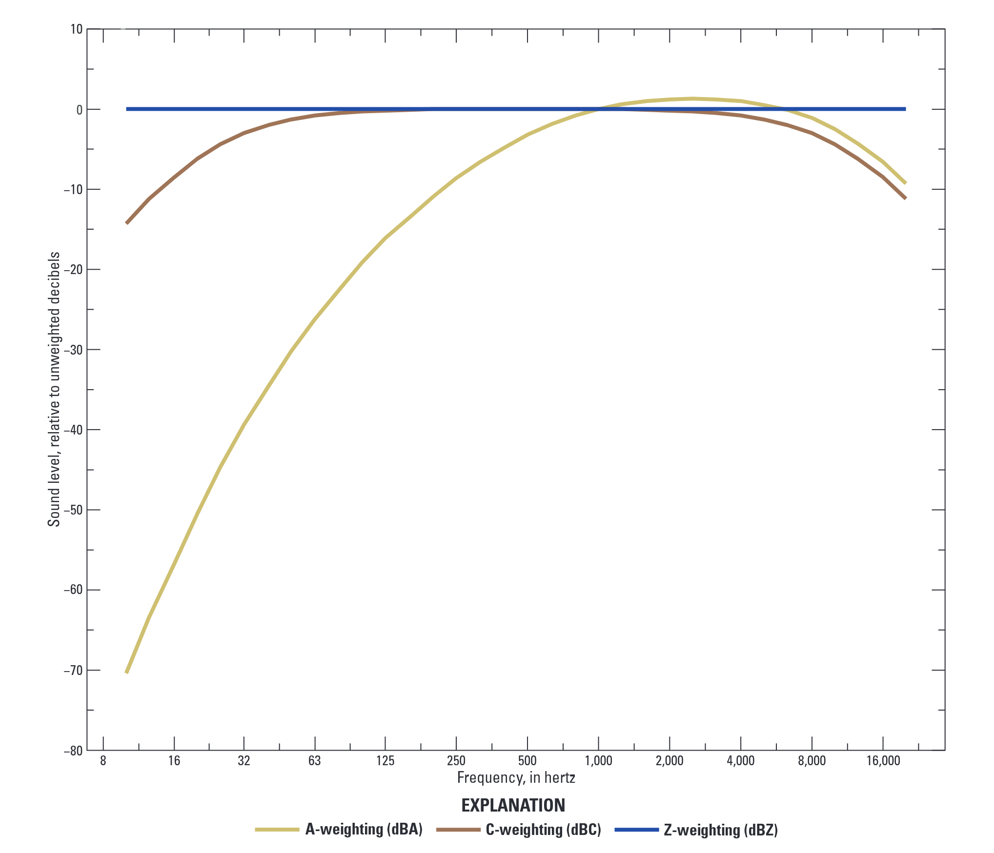

Slide 8
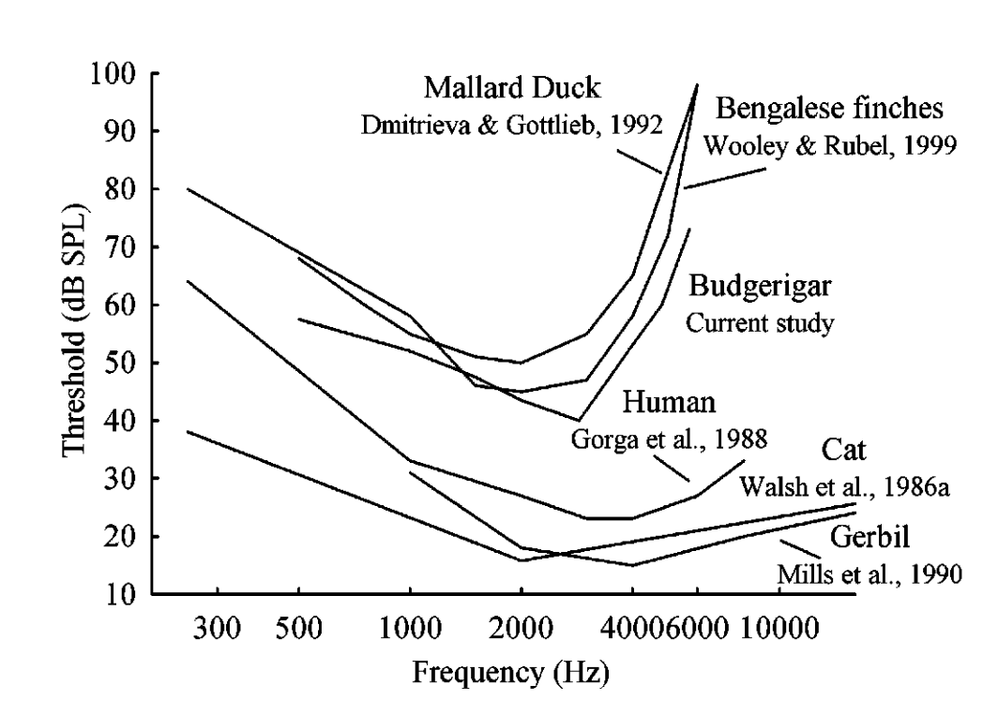

Slide 9
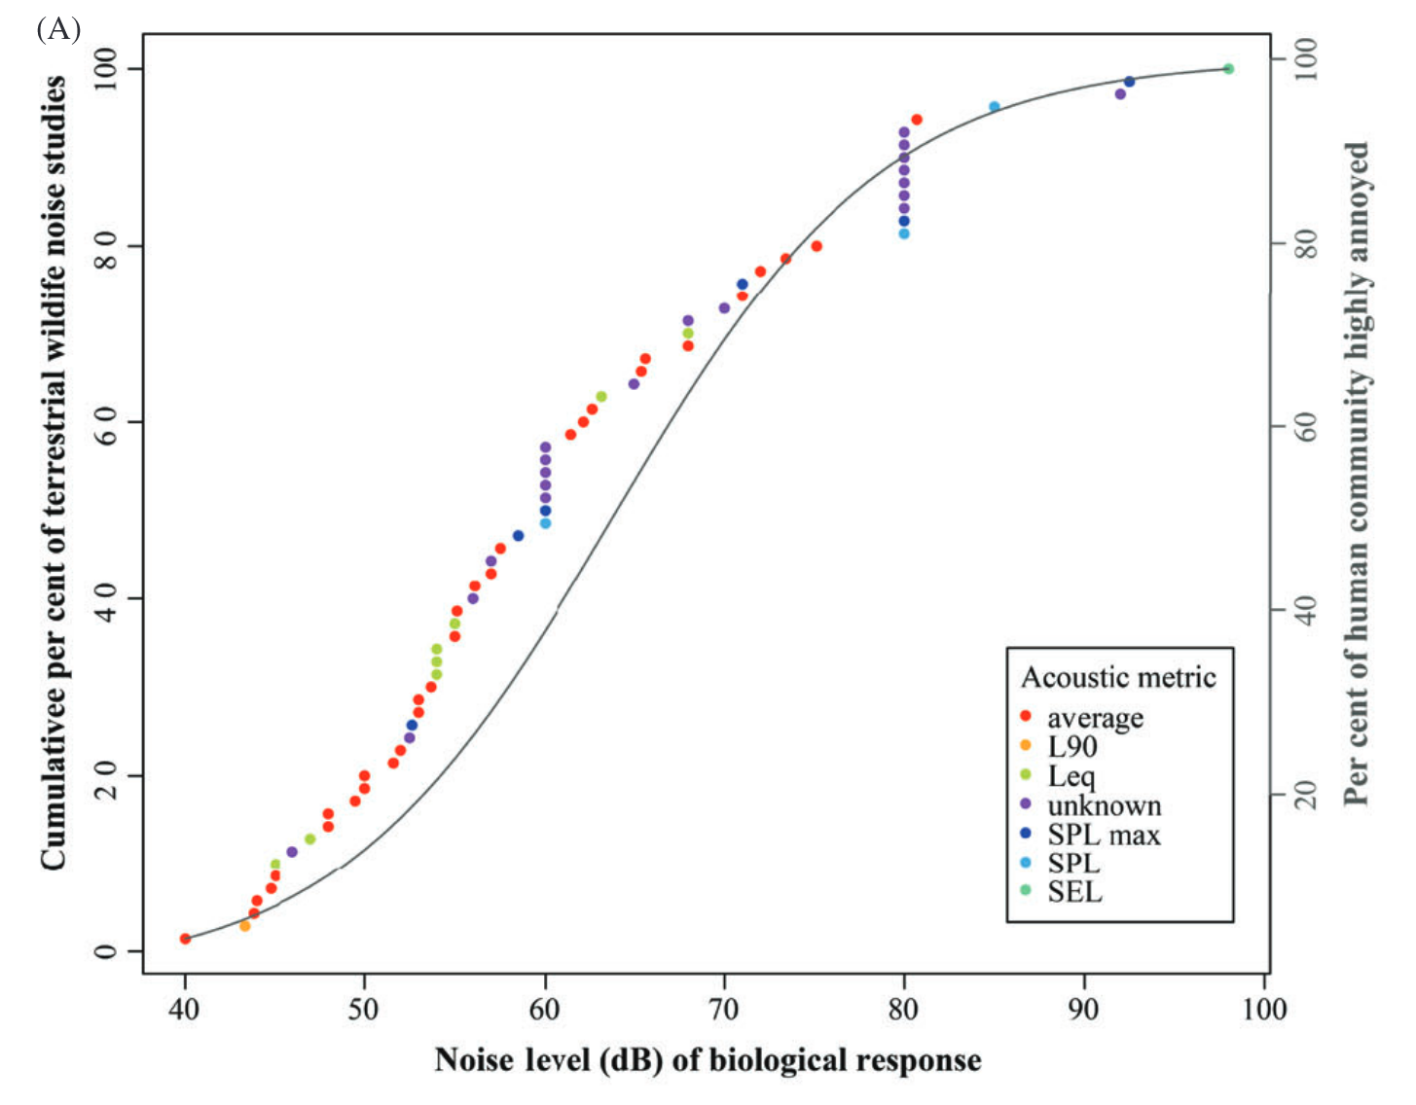

Slide 10
Exposure
Proximity to roads or industrial sites
Sensitivity
Startle response to sudden, loud noise
Masking of acoustic signals
Impact
Reduced foraging time
Failure to find potential mates
Adaptive capacity
Change in timing of foraging activities
Change in pitch or volume of mating call
Vulnerability
Poor body condition leads lower survival rate
Lower mating success leads to lower reproductive rate

Slide 11
