Slide 1


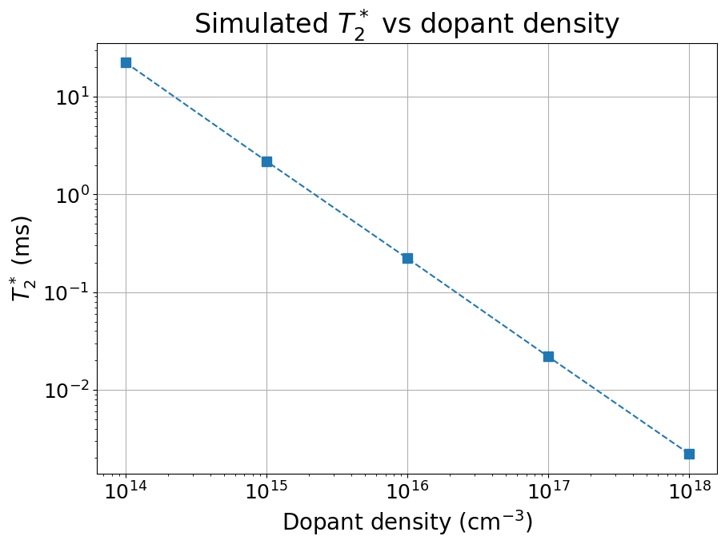
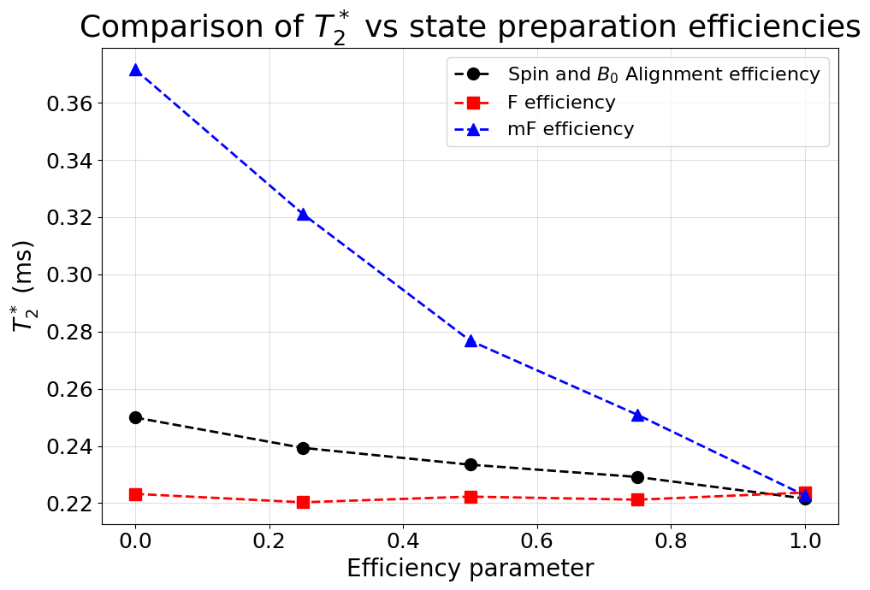
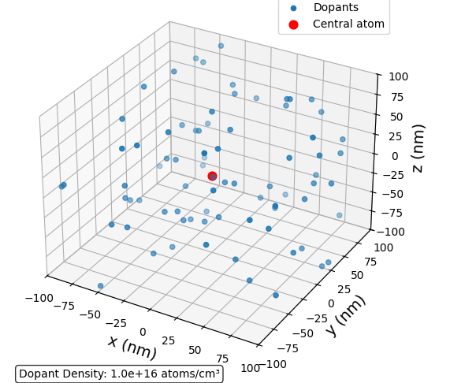
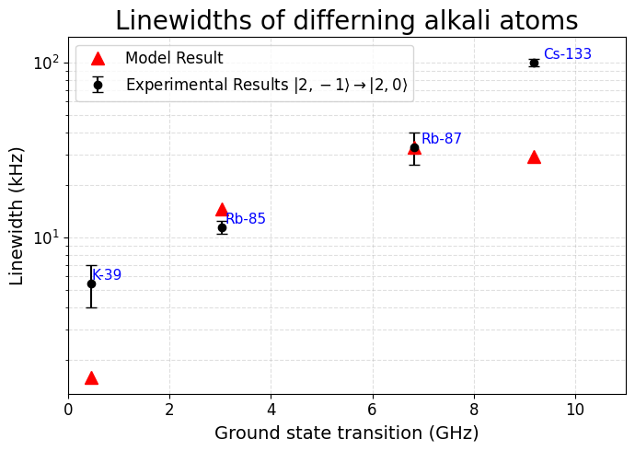
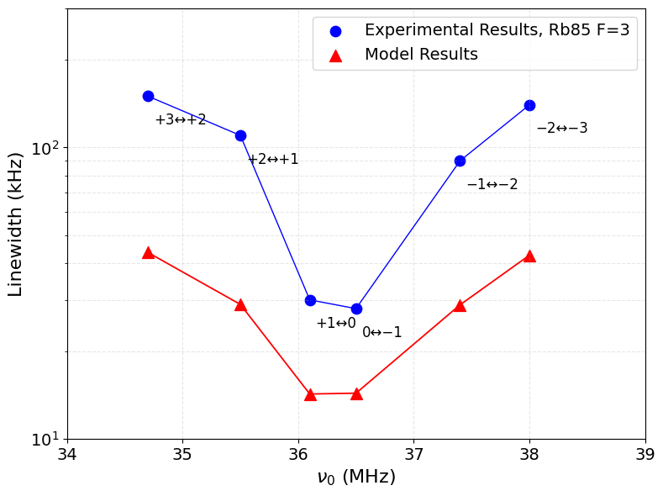
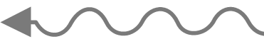
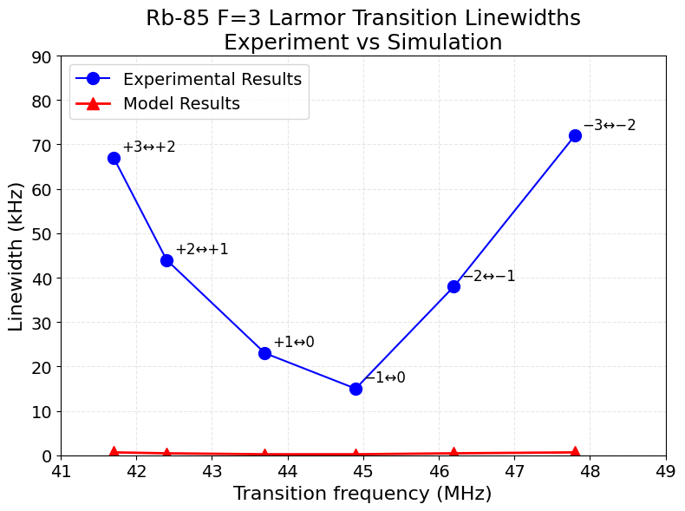
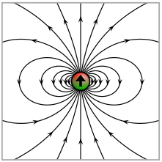
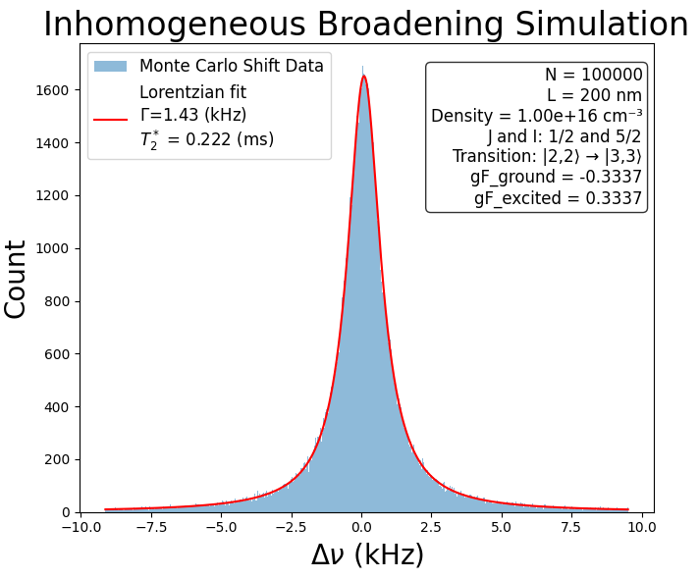
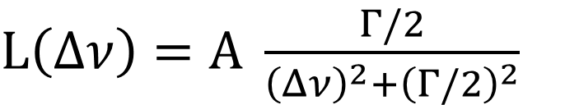
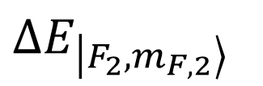


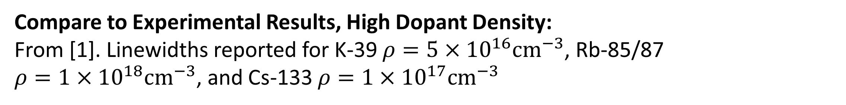
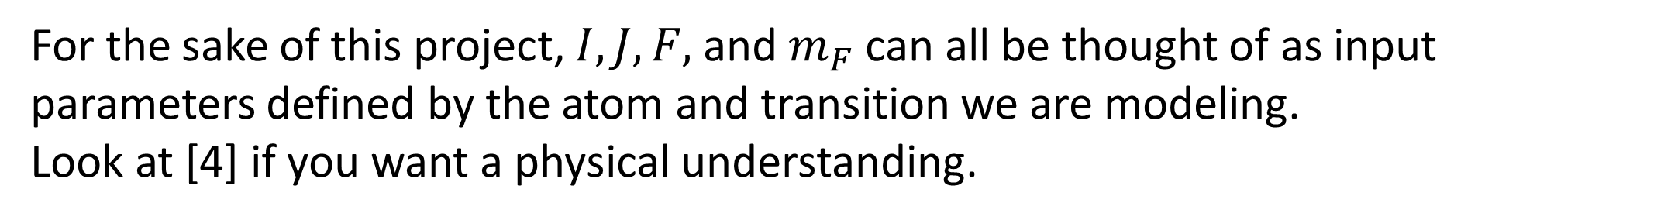
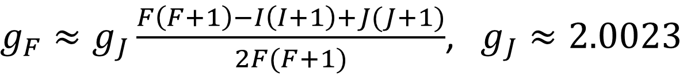

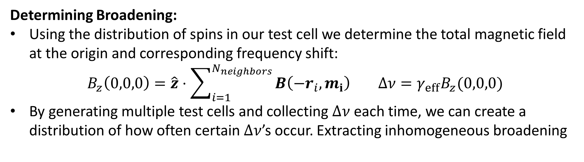
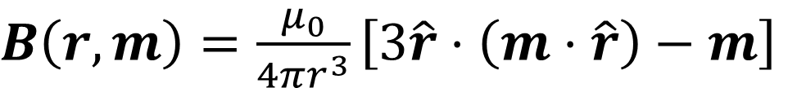
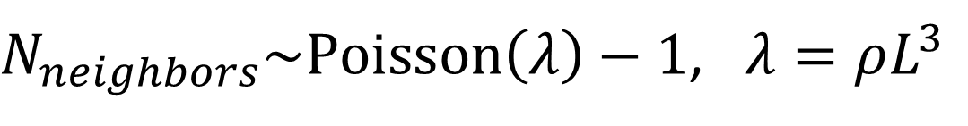

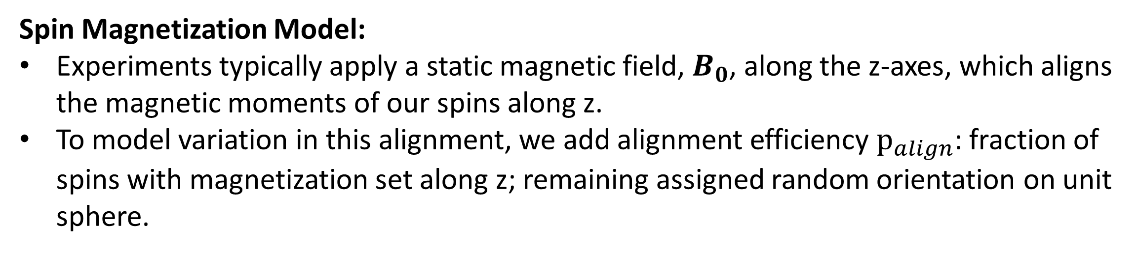
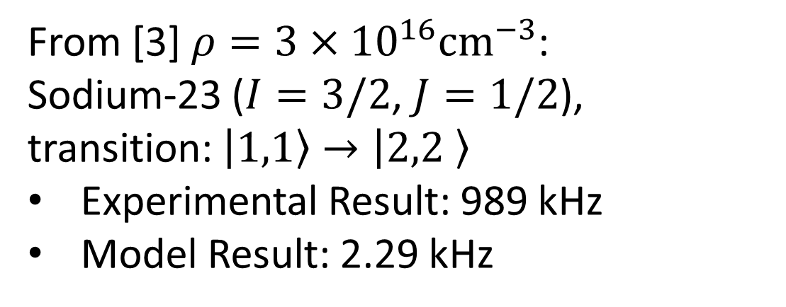

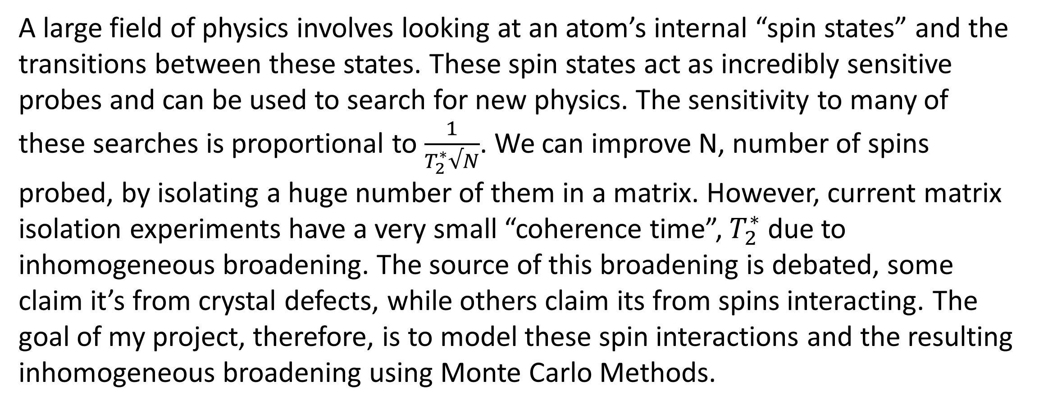
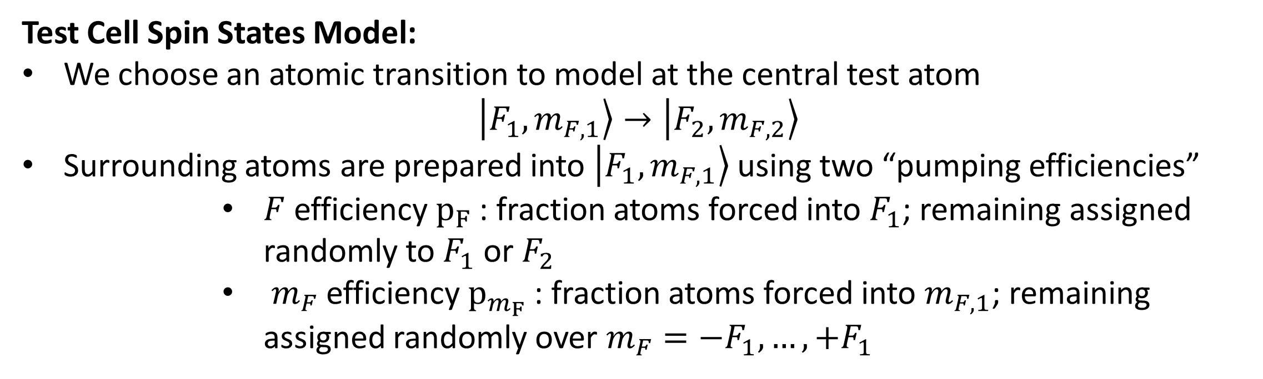
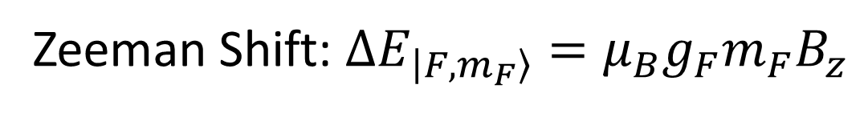
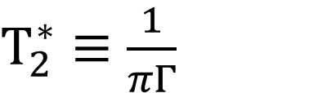
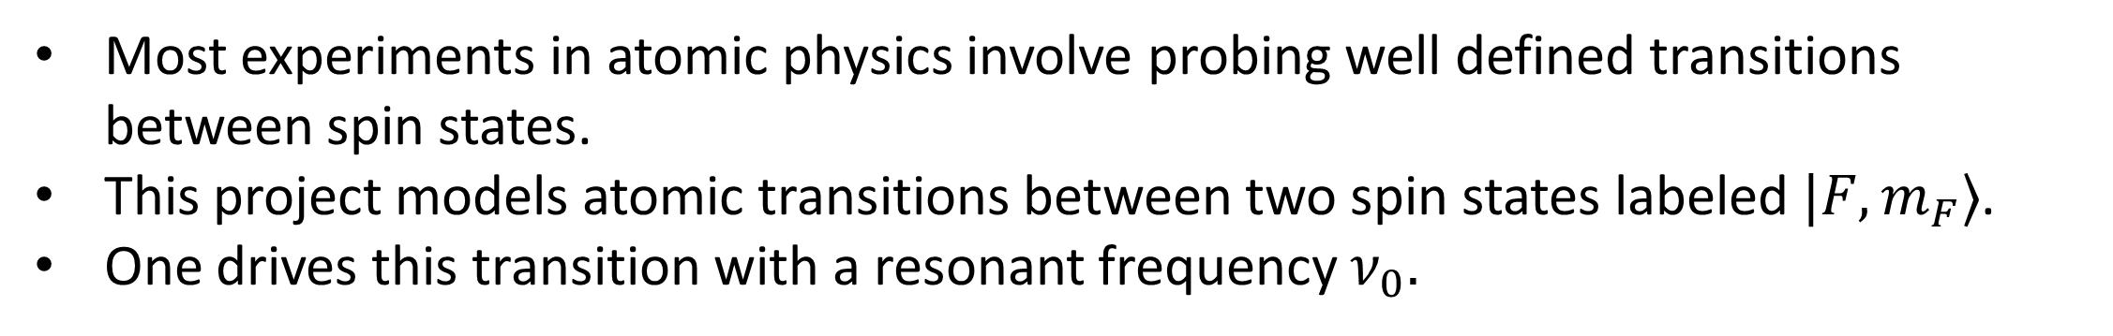
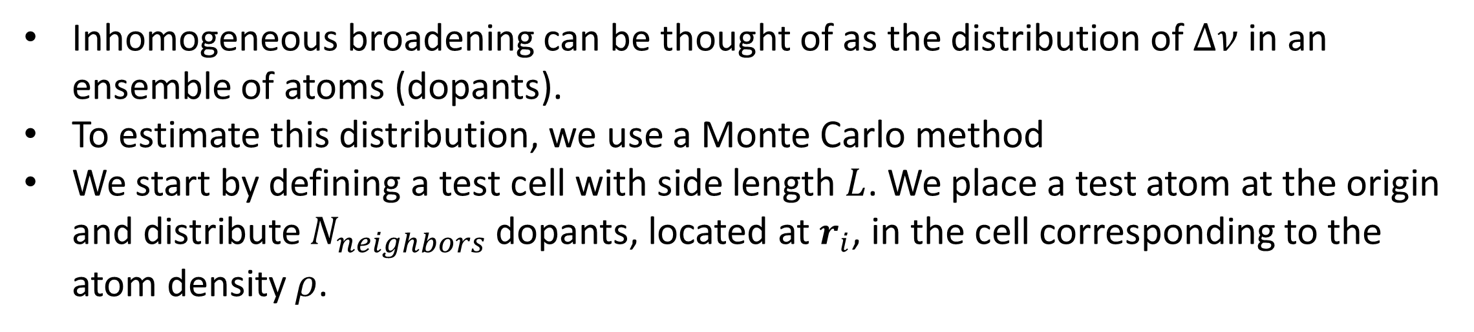
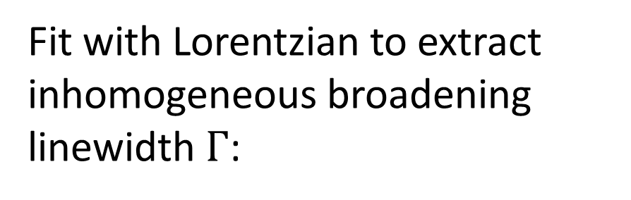
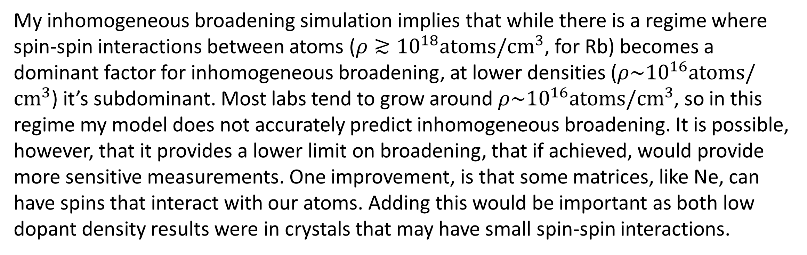

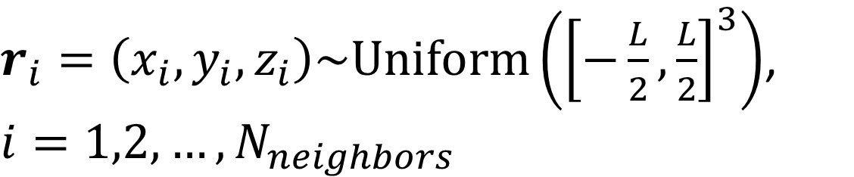

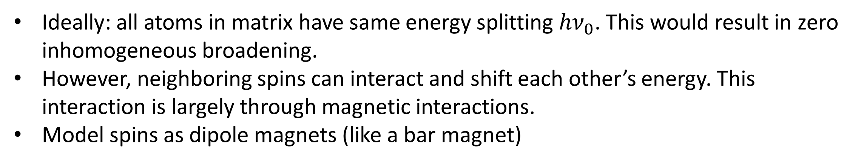
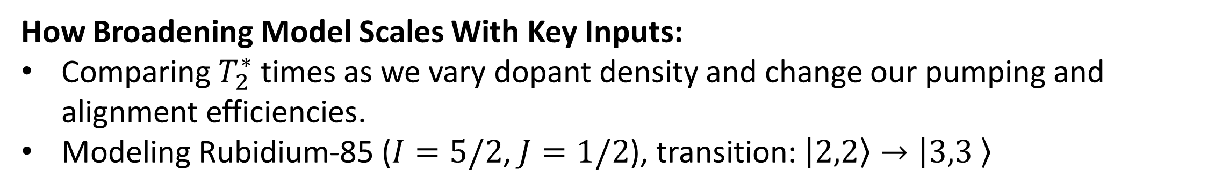

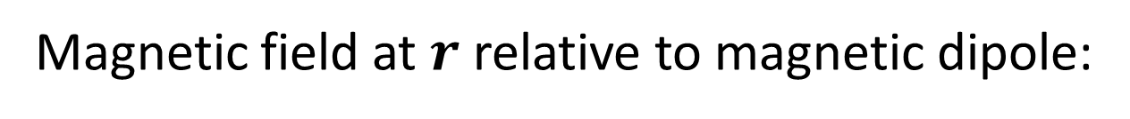
POSTER TITLE
Author List
Department of Biomedical Engineering, Northwestern University, Evanston, IL, USA
Modeling Inhomogeneous Broadening through Spin-Spin Interactions
in Matrix Isolated Spin Ensembles
Isaac Cross
Northwestern University, Evanston, IL
Introduction
Broadening Model
Results
A large field of physics involves looking at an atom’s internal “spin states” and the transitions between these states. These spin states act as incredibly sensitive probes and can be used to search for new physics. The sensitivity to many of these searches is proportional to $\frac{1}{T_{2}^{∗}√N}$. We can improve N, number of spins probed, by isolating a huge number of them in a matrix. However, current matrix isolation experiments have a very small “coherence time”, $T_{2}^{∗}$ due to inhomogeneous broadening. The source of this broadening is debated, some claim it’s from crystal defects, while others claim its from spins interacting. The goal of my project, therefore, is to model these spin interactions and the resulting inhomogeneous broadening using Monte Carlo Methods.
Inhomogeneous broadening can be thought of as the distribution of $Δν$ in an ensemble of atoms (dopants).
To estimate this distribution, we use a Monte Carlo method
We start by defining a test cell with side length $L$. We place a test atom at the origin and distribute $N_{neighbors}$dopants, located at $r_{i}$, in the cell corresponding to the atom density $ρ$.
How Broadening Model Scales With Key Inputs:
Comparing $T_{2}^{∗}$ times as we vary dopant density and change our pumping and alignment efficiencies.
Modeling Rubidium-85 ($I=5/2$, $J=1/2$), transition: $\left|2,2\right\rangle →\left|3,3 \right\rangle$
$N_{neighbors}\sim Poisson\left(λ\right)−1$, $λ=ρL^{3}$
Spin-Spin Interaction Model
$r_{i}=\left(x_{i},y_{i},z_{i}\right)\sim Uniform\left({\left[−\frac{L}{2},\frac{L}{2}\right]}^{3}\right)$, $i=1,2,…,N_{neighbors}$
Compare to Experimental Results, High Dopant Density:
From [1]. Linewidths reported for K-39 $ρ=5×{10}^{16}cm^{−3}$, Rb-85/87
$ρ=1×{10}^{18}cm^{−3}$, and Cs-133 $ρ=1×{10}^{17}cm^{−3}$
Most experiments in atomic physics involve probing well defined transitions between spin states.
This project models atomic transitions between two spin states labeled $|F,m_{F}⟩$.
One drives this transition with a resonant frequency $ν_{0}.$
$$|F_{2},m_{F,2}⟩$$
Test Cell Spin States Model:
We choose an atomic transition to model at the central test atom
$$\left|F_{1},m_{F,1}\right\rangle →\left|F_{2},m_{F,2}\right\rangle$$
Surrounding atoms are prepared into $\left|F_{1},m_{F,1}\right\rangle$ using two “pumping efficiencies”
  $F$ efficiency $p_{F}$: fraction atoms forced into $F_{1}$; remaining assigned randomly to $F_{1}$ or $F_{2}$
  $m_{F}$ efficiency $p_{m_{F}}$: fraction atoms forced into $m_{F,1}$; remaining assigned randomly over $m_{F}=−F_{1},…,+F_{1}$
Energy
$hν_{0}$
$$|F_{1},m_{F,1}⟩$$
Ideally: all atoms in matrix have same energy splitting $hν_{0}$. This would result in zero inhomogeneous broadening.
However, neighboring spins can interact and shift each other’s energy. This interaction is largely through magnetic interactions.
Model spins as dipole magnets (like a bar magnet)
Spin Magnetization Model:
Experiments typically apply a static magnetic field, $B_{0}$, along the z-axes, which aligns the magnetic moments of our spins along z.
To model variation in this alignment, we add alignment efficiency $p_{align}$: fraction of spins with magnetization set along z; remaining assigned random orientation on unit sphere.
Compare to Experimental Results, Low Dopant Density:
From [2]. Rb-85 F=3, $ρ=1.5×{10}^{16}cm^{−3}$
Magnetic field at $r$ relative to magnetic dipole:
$$m$$
From [3] $ρ=3×{10}^{16}cm^{−3}$:
Sodium-23 ($I=3/2$, $J=1/2$), transition: $\left|1,1\right\rangle →\left|2,2 \right\rangle$
Experimental Result: 989 kHz
Model Result: 2.29 kHz
$B\left(r,m\right)=\frac{μ_{0}}{4πr^{3}}\left[3\hat{r}⋅\left(m⋅\hat{r}\right)−m\right]$
N
Dipole “magnetic moment”:
Determining Broadening:
Using the distribution of spins in our test cell we determine the total magnetic field at the origin and corresponding frequency shift:
$$B_{z}\left(0,0,0\right)=\hat{z}⋅\sum_{i=1}^{N_{neighbors}}{B\left({−r}_{i},m_{i}\right)} Δν=γ_{eff}B_{z}(0,0,0)$$
By generating multiple test cells and collecting $Δν$ each time, we can create a distribution of how often certain $Δν$’s occur. Extracting inhomogeneous broadening
${m= g}_{F}m_{F}μ_{B}\hat{m}$
S
Hyperfine Landé g-factor:
$g_{F}≈g_{J}\frac{F\left(F+1\right)−I\left(I+1\right)+J(J+1)}{2F(F+1)}$, $g_{J}≈2.0023$
Modified from [5]
Conclusion
For the sake of this project, $I,J,F,$ and $m_{F}$ can all be thought of as input parameters defined by the atom and transition we are modeling.
Look at [4] if you want a physical understanding.
My inhomogeneous broadening simulation implies that while there is a regime where spin-spin interactions between atoms ($ρ≳{10}^{18}atoms/cm^{3}$, for Rb) becomes a dominant factor for inhomogeneous broadening, at lower densities ($ρ\sim {10}^{16}atoms/cm^{3}$) it’s subdominant. Most labs tend to grow around $ρ\sim {10}^{16}atoms/cm^{3}$, so in this regime my model does not accurately predict inhomogeneous broadening. It is possible, however, that it provides a lower limit on broadening, that if achieved, would provide more sensitive measurements. One improvement, is that some matrices, like Ne, can have spins that interact with our atoms. Adding this would be important as both low dopant density results were in crystals that may have small spin-spin interactions.
Spin states experience “Zeeman shifts” in magnetic fields
Fit with Lorentzian to extract inhomogeneous broadening linewidth $Γ$:
Zeeman Shift: $ΔE_{\left|F,m_{F}\right\rangle }=μ_{B}g_{F}m_{F}B_{z}$
$L\left(Δν\right)=A \frac{Γ/2}{{\left(Δν\right)}^{2}+{\left(Γ/2\right)}^{2}}$
$$|F_{2},m_{F,2}⟩$$
$ΔE_{\left|F_{2},m_{F,2}\right\rangle }$
Coherence time:
Energy
$T_{2}^{∗}≡\frac{1}{πΓ}$
References & Acknowledgements
$$|F_{1},m_{F,1}⟩$$
$h{(ν}_{0}+Δν)$
[1] S. Upadhyay, U. Dargyte, V. D. Dergachev, R. P. Prater, S. A. Varganov, T. V. Tscherbul, D. Patterson, and J. D. Weinstein, Spin coherence and optical properties of alkali-metal atoms in solid parahydrogen, Phys. Rev. A 100, 063419 (2019).
[2] U. Dargyte, D. M. Lancaster, and J. D. Weinstein, Optical and spin-coherence properties of rubidium atoms trapped in solid neon, Phys. Rev. A 104, 032611 (2021).
[3] A. N. Kanagin, N. de Zordo, A. Angerer, W. Kersten, N. Lagos, J. Schmiedmayer, and E. S. Redchenko, Impurities in cryogenic solids: a new platform for hybrid quantum systems, arXiv:2508.21651 (2025).
[4] D. A. Steck, Rubidium 85 D Line Data, available online at http://steck.us/alkalidata (revision 2.1.6, 20 September 2013).
[5] I. S. Grant and W. R. Phillips, Electromagnetism, 2nd ed., Manchester Physics Series (John Wiley & Sons, Chichester, 2008).
$Δν=\frac{ΔE_{\left|F_{2},m_{F,2}\right\rangle } −ΔE_{\left|F_{1},m_{F,1}\right\rangle }}{h}=γ_{eff}B_{z}$, $γ_{eff}=\frac{μ_{B}}{h}(g_{F_{2}}m_{F,2}−g_{F_{1}}m_{F,1})$

