Slide 1



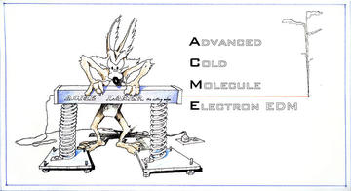

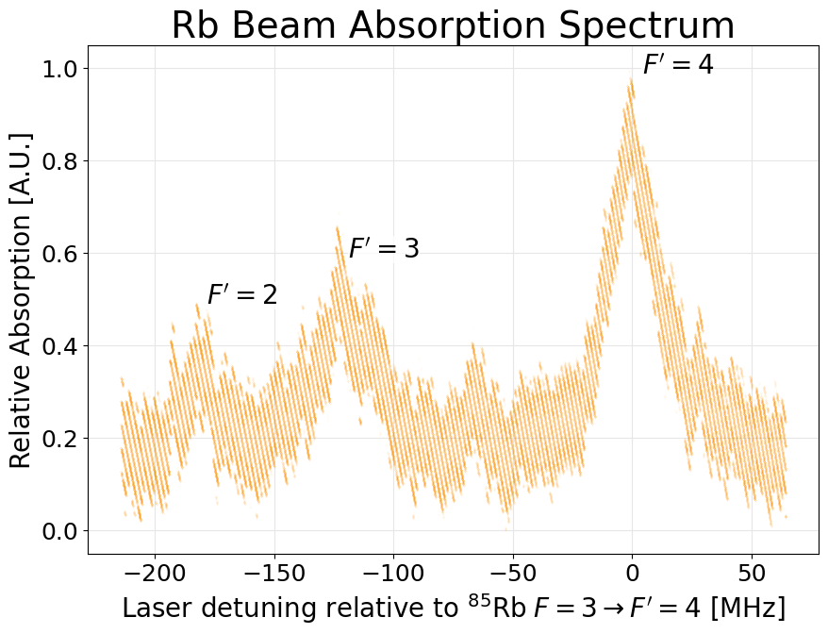
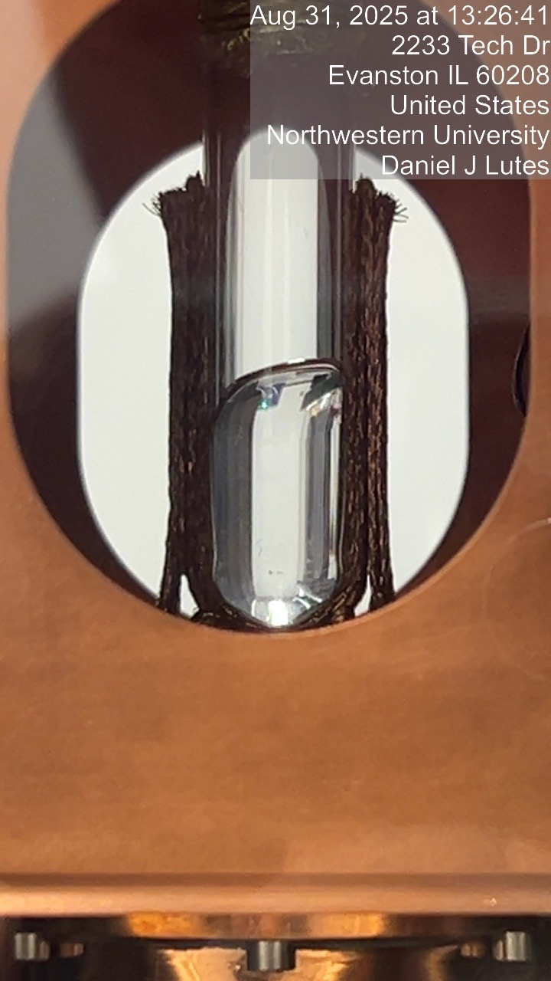

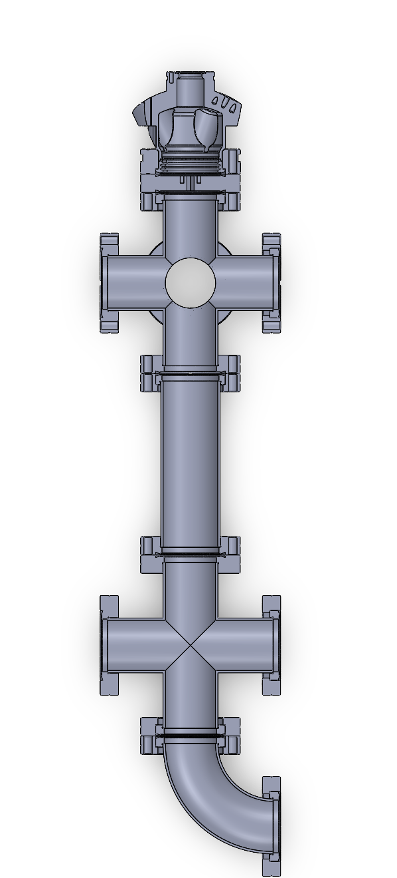
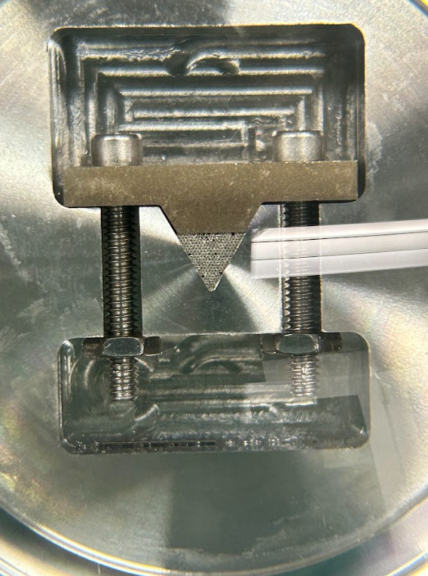
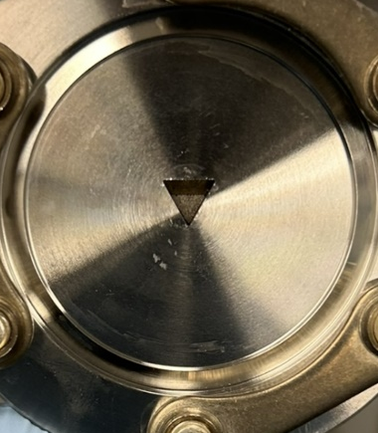
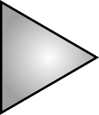
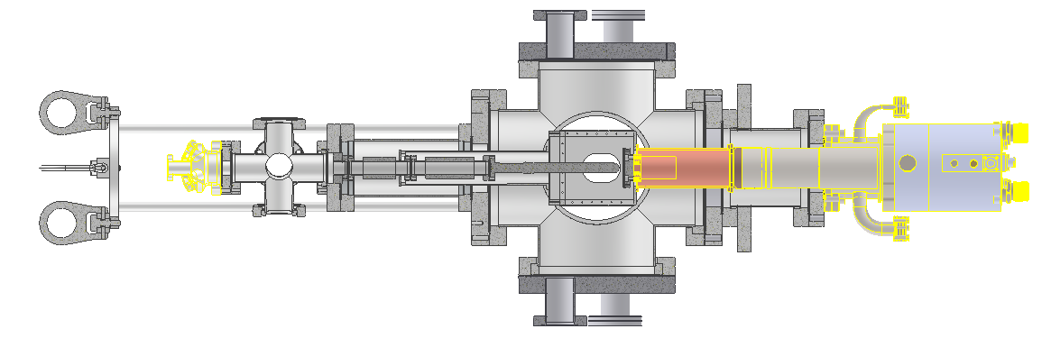

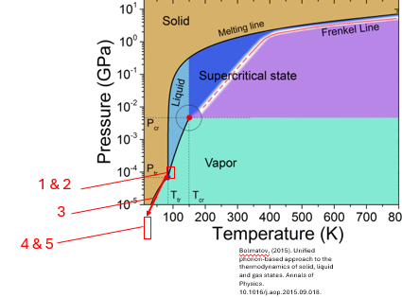






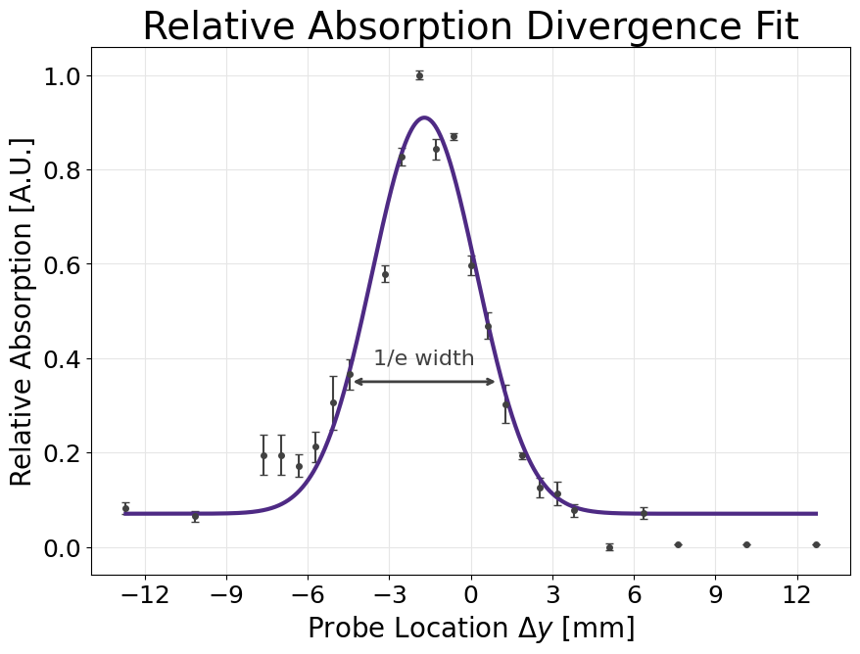
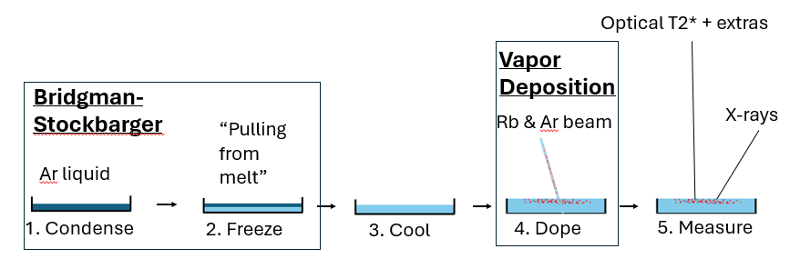
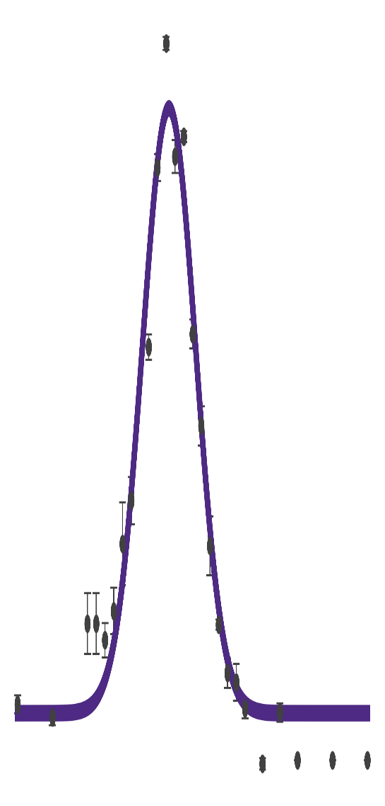
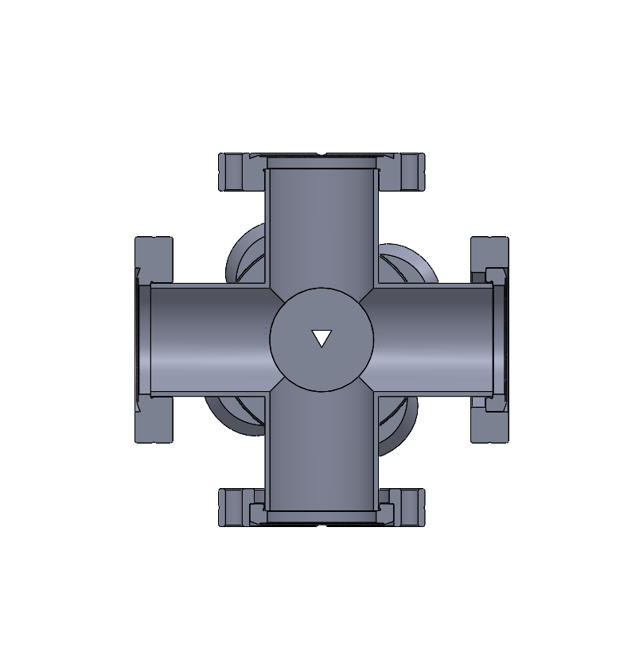
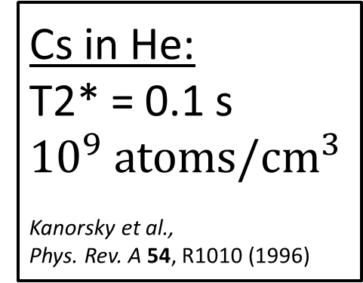
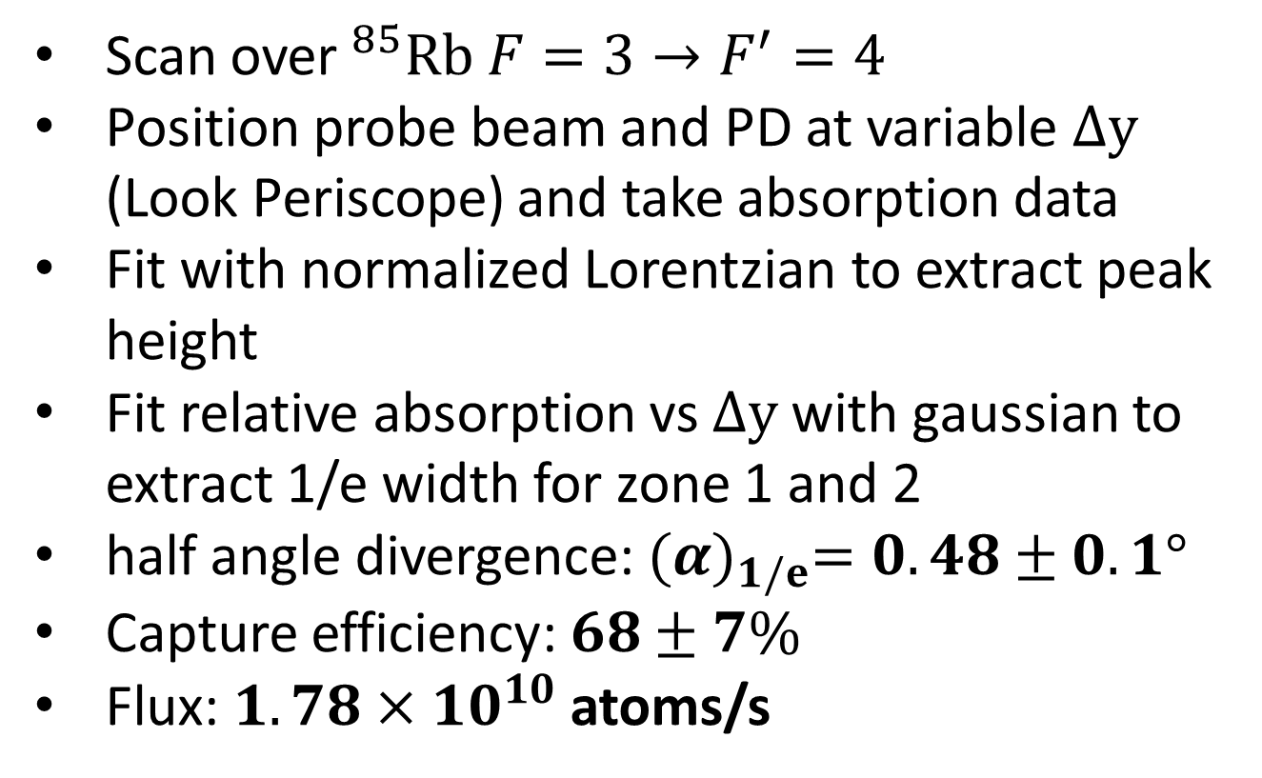
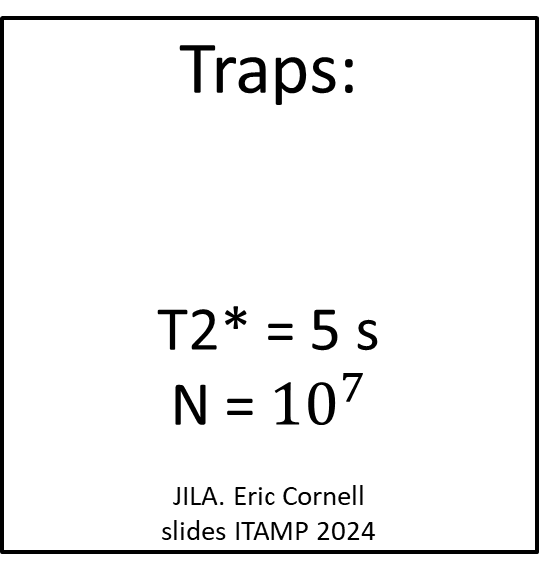

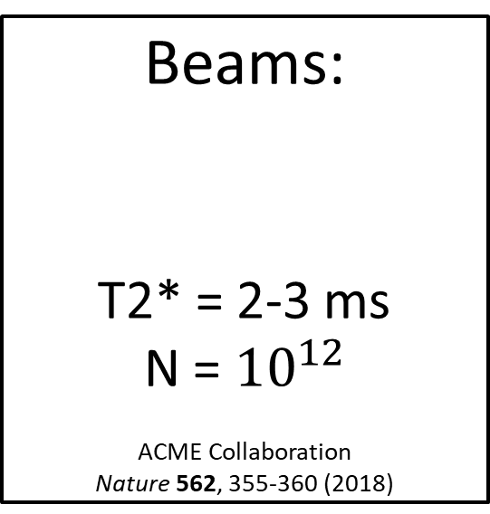

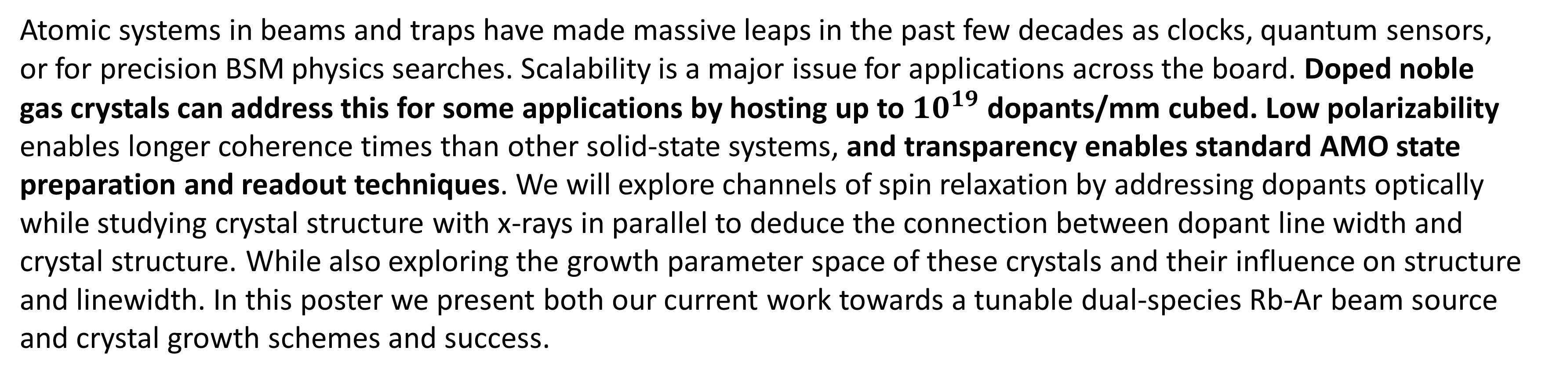

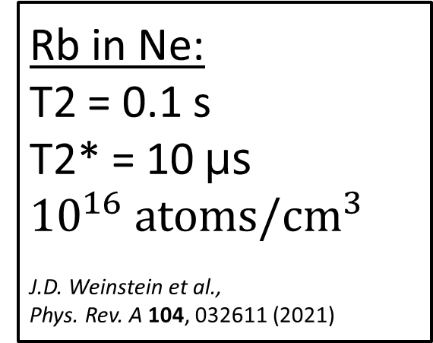
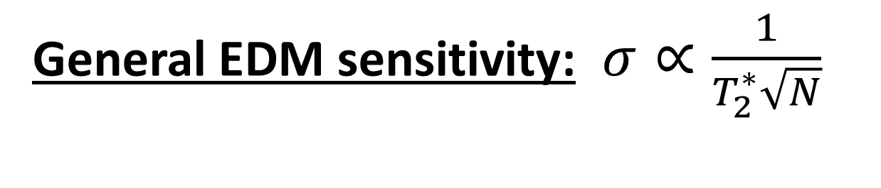
Towards Doped Cryogenic Rare Gas Crystals for Precision Measurement
Isaac Cross¹, Daniel Lutes¹, Joel Adhiambo¹, Brian Odom¹
1. Department of Physics and Astronomy, Northwestern University, Evanston, IL, USA
Center for
Fundamental Physics
Motivation
Comparison to Existing Platforms
Atomic systems in beams and traps have made massive leaps in the past few decades as clocks, quantum sensors, or for precision BSM physics searches. Scalability is a major issue for applications across the board. Doped noble gas crystals can address this for some applications by hosting up to ${10}^{19}$ dopants/mm cubed. Low polarizability enables longer coherence times than other solid-state systems, and transparency enables standard AMO state preparation and readout techniques. We will explore channels of spin relaxation by addressing dopants optically while studying crystal structure with x-rays in parallel to deduce the connection between dopant line width and crystal structure. While also exploring the growth parameter space of these crystals and their influence on structure and linewidth. In this poster we present both our current work towards a tunable dual-species Rb-Ar beam source and crystal growth schemes and success.
Existing Platforms
Doped Noble Gas Crystals
Beams:
T2* = 2-3 ms
N = ${10}^{12}$
ACME Collaboration
Nature 562, 355-360 (2018)
Traps:
T2* = 5 s
N = ${10}^{7}$
JILA. Eric Cornell
slides ITAMP 2024
Cs in He:
T2* = 0.1 s
$${10}^{9} {atoms/cm}^{3}$$
Kanorsky et al.,
Phys. Rev. A 54, R1010 (1996)
Rb in Ne:
T2 = 0.1 s
T2* = 10 µs
$${10}^{16} {atoms/cm}^{3}$$
J.D. Weinstein et al.,
Phys. Rev. A 104, 032611 (2021)
Many dopants
Large discrepancy between T2 and T2* due to inhomogeneous broadening, thought to be from grain boundaries
General EDM sensitivity: $σ∝\frac{1}{T_{2}^{∗}\sqrt{N}}$
Demonstrates one can achieve long coherence times in a cryogenic crystal
Not enough dopants due to high helium pressure required for growth
Will address this by growing single crystal seeds and then performing epitaxy
Beam Source
Crystal Growth
Overview
Characterization Procedure
Pictures of Cm scale transparent argon crystals
Our beam source is designed to transport a collimated dual-species beam of Rb and Ar to our growth substrate. Our beam sets key parameters such as dopant density and growth rate. Characterization of a Rb beam has been done shown in this section we are currently introducing Ar.
Hoist Rings
Beam Characterization Setup
Beam source
Scope
Microcapillaries large aspect ratio allows tight collimation
Array of capillaries allows relatively large flux
To Argon handling system and pumps for inner vacuum system
Beam pipe
Left: thorcam Right: iphone photo
Nozzle of 231 100µm ID microcapillaries
Original nozzle design modified from:
R. Senaratne et al., Rev. Sci. Instrum. 86, 023105 (2015).
Handles heat load between beam source and growth volume
Characterization
Mode + Zone Selector
Periscope
½ mm, ≈1µW
Power Reduction
and Control
Scan over$^{85}Rb F=3→F^{′}=4$
Position probe beam and PD at variable $∆y$ (Look Periscope) and take absorption data
Fit with normalized Lorentzian to extract peak height
Fit relative absorption vs $∆y$ with gaussian to extract 1/e width for zone 1 and 2
half angle divergence: ${(α)}_{1/e}=0.48±0.1°$
Capture efficiency: $68±7\%$
Flux: $1.78×{10}^{10}$ atoms/s
Copper heat shield
Overview
$$\hat{y}$$
$$\hat{x}$$
λ/2
Optically transparent cm scale argon crystals have been grown using the Bridgeman-Stockbarger method at cryogenic temperatures
Portable cryostat supports optical access and is compatible with APS 28ID Beamline
Beam source and cryostat Integration is on the horizon
Will use to study inhomogeneous broadening in dopant ensemble
To Other Systems
Borosilicate glass tube for
crystal growth
Interrogation Zone 1
$$\hat{z}$$
λ/2
λ/2
To pumps for outer vacuum
Isolation,
Mode Shaping,
and Collimation
Mounting Plate
Collimated Rb or Rb-Ar Beam
Reference Cell
Compatible with APS 28-ID diffractometer
Balanced PD
Frequency Modulated
TOPTICA DL Pro
Scope
Custom compact ARS cryocooler
Periscope
∆y
To He compressor
Interrogation Zone 2
Periscope
References
Acknowledgements
Translation stages move PD and top periscope mirror, allowing vertical absorption scans of Rb beam
R. Senaratne, S. V. Rajagopal, Z. A. Geiger, K. M. Fujiwara, V. Lebedev, and D. M. Weld, Effusive atomic oven nozzle design using an aligned microcapillary array, Rev. Sci. Instrum. 86, 023105 (2015).
ACME Collaboration. Improved limit on the electric dipole moment of the electron, Nature 562, 355–360 (2018).
S. I. Kanorsky, A. Weis, J. Wurster, and T. W. Hänsch, Millihertz magnetic resonance spectroscopy of Cs atoms in body-centered-cubic ⁴He, Phys. Rev. A 54, R1010 (1996).
U. Dargyte, D. M. Lancaster, and J. D. Weinstein, Optical and spin-coherence properties of rubidium atoms trapped in solid neon, Phys. Rev. A 104, 032611 (2021).
The study resulting in this presentation was assisted by a grant from the Undergraduate Research Grant Program which is administered by Northwestern University's Office of Undergraduate Research. However, the conclusions, opinions, and other statements in this presentation are the author's and not necessarily those of the sponsoring institution.

