Slide 1

Chad Ross
Kyle Shepard

Slide 2
About the Game
Top-down 2D adventure game
Everything made completely from scratch
Engine
Assets: level layouts and textures
Gamepad support (from Java library 'jamepad')

Slide 3
Mechanics
Free movement and rotation with precise input from controller analog sticks
Map is 2D array of Room objects, with transitions happening when character starts to leave screen
Rooms are created from a text file with different characters representing different tiles
(Incomplete) combat using collision detection
(Incomplete) multiple 16:9 resolutions

Slide 4
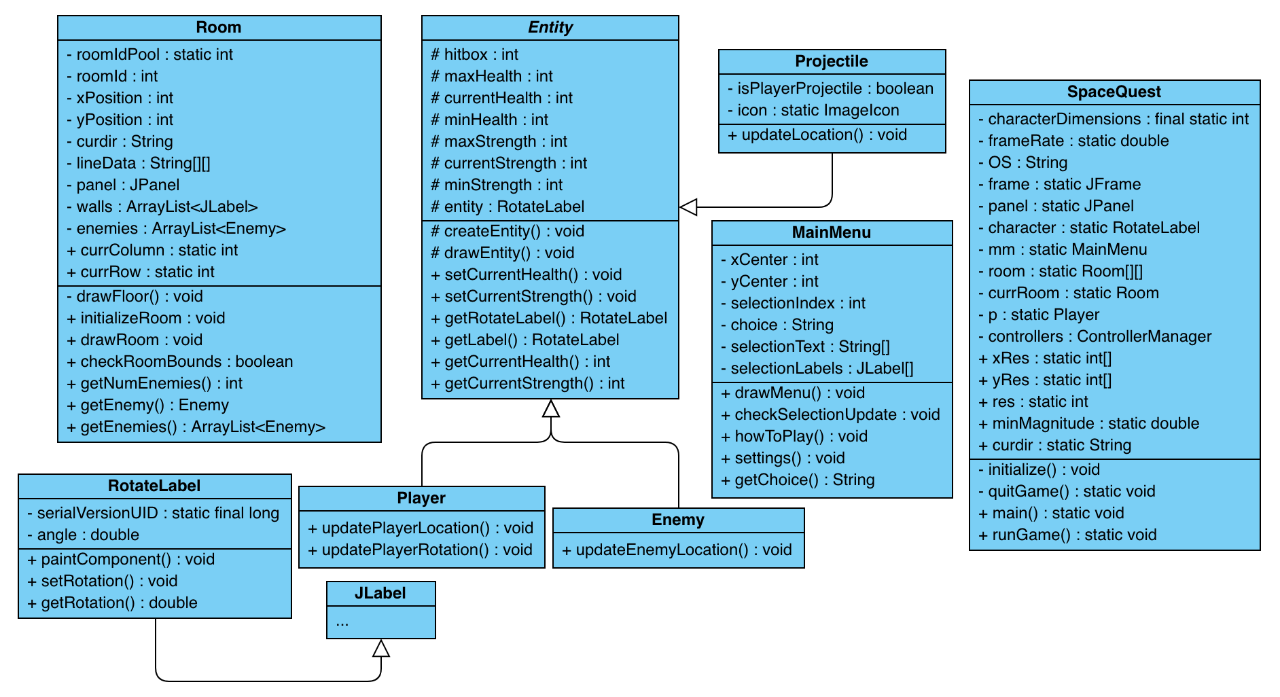
Project Hierarchy

Slide 5
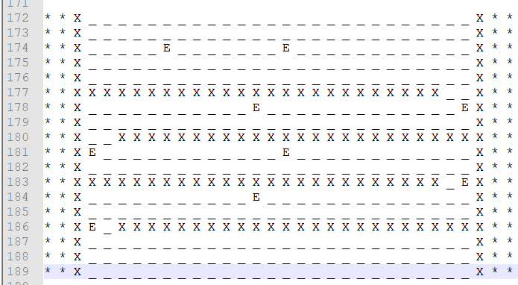
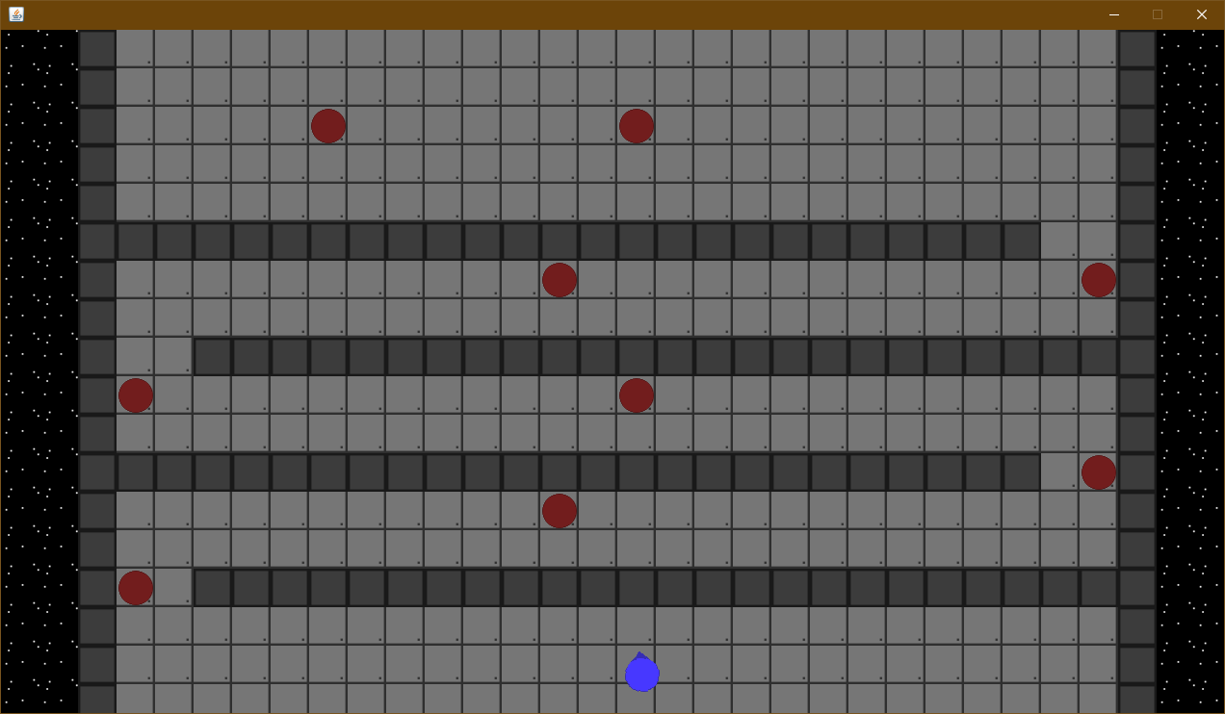





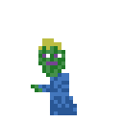
Assets

Slide 6
Demo!

Slide 7
What We Would Do Differently
Spend more time on getting combat to work (enemies, projectiles, etc.)
Custom frame rate and resolution
Probably not use Swing
Better transitions between rooms

Slide 8
Questions?

