Slide 1
WORKFORCE
App Introduction Guide
Page-by-page walkthrough of Workforce Control (SaaS + Company + Office),
the Employee app, Lobby Display, and Task Operations.

Slide 2
START HERE
Who uses which app
Six surfaces. One company identity. Clear roles.

Slide 3
Product map
1. Platform (SaaS)
SUPER_ADMIN — create companies & company admins
2. Company admin
ORG_ADMIN — setup offices, schedules, staff, ops
3. Office admin
OFFICE_ADMIN — day-to-day ops for assigned offices
4. Employee app
Check-in/out, leave, chat, meetings, performance
5. Lobby display
Tablet board: who’s in + meeting rooms
6. Task Operations
Projects & Kanban using the same people

Slide 4
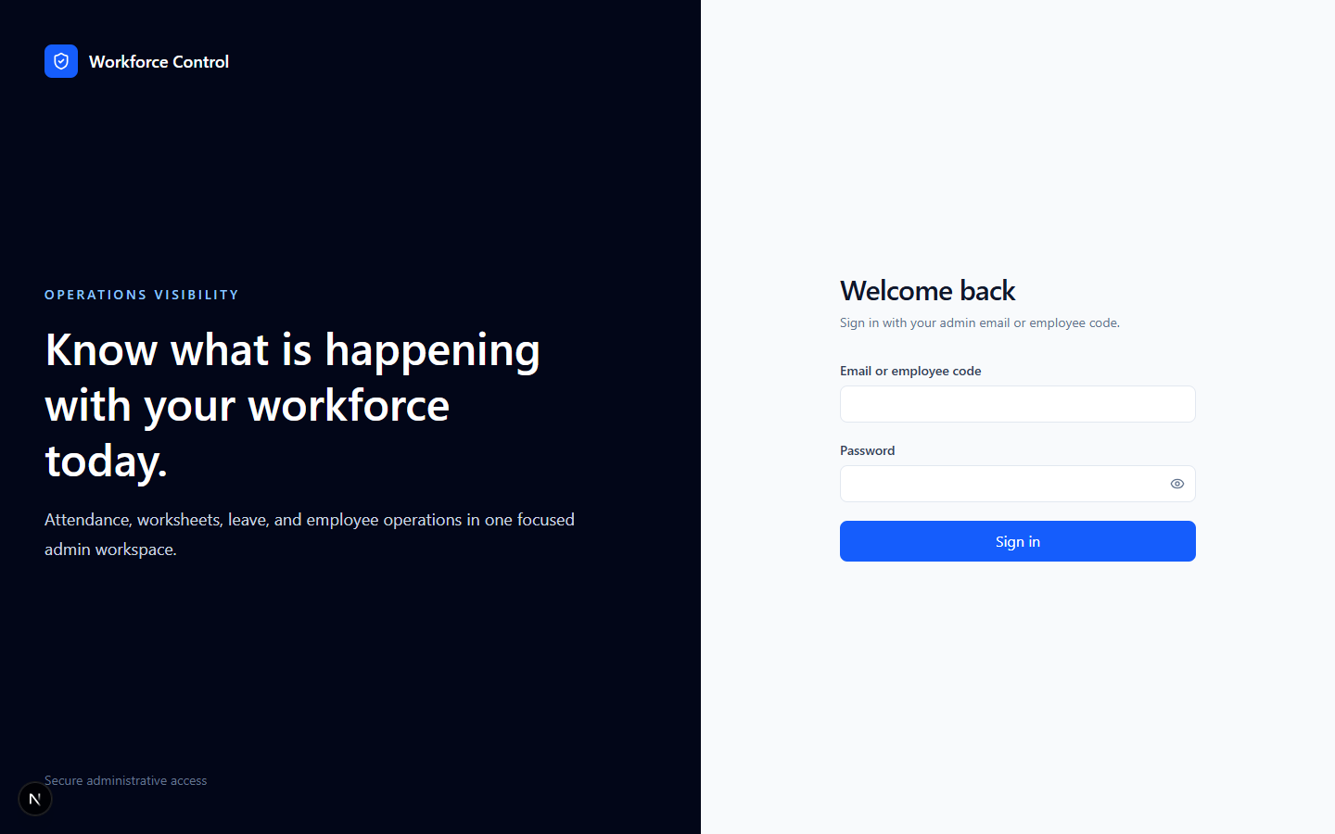
ENTRY
Admin sign-in — Workforce Control
/login
Real screenshot of the live admin portal login. Platform, company, and office admins all enter here; role decides the sidebar after sign-in.
• Use admin email
• Forced password change may appear first
• Multi-role accounts get a context picker

Slide 5
SECTION A
Platform (SaaS) side
Create tenants and company admins — the start of every customer.

Slide 6
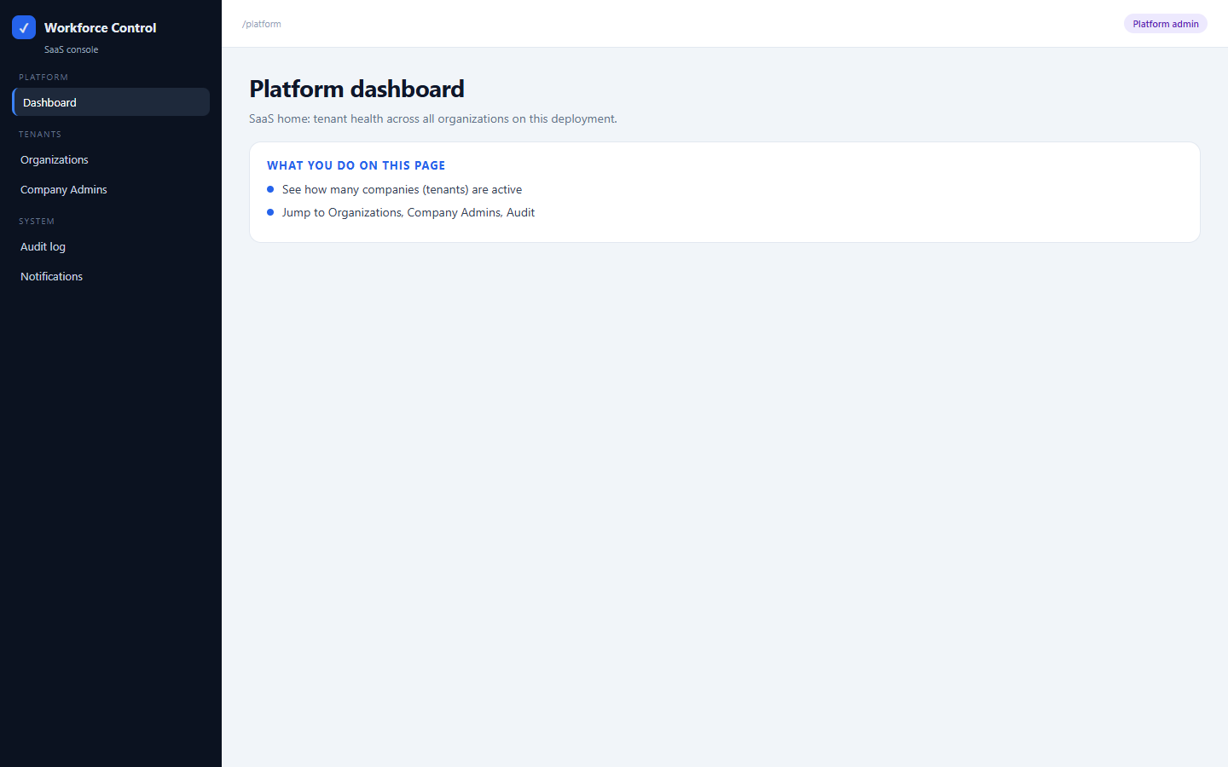
PLATFORM / SaaS
Platform dashboard
/platform
SaaS home: tenant health across all organizations on this deployment.
• See how many companies (tenants) are active
• Jump to Organizations, Company Admins, Audit

Slide 7
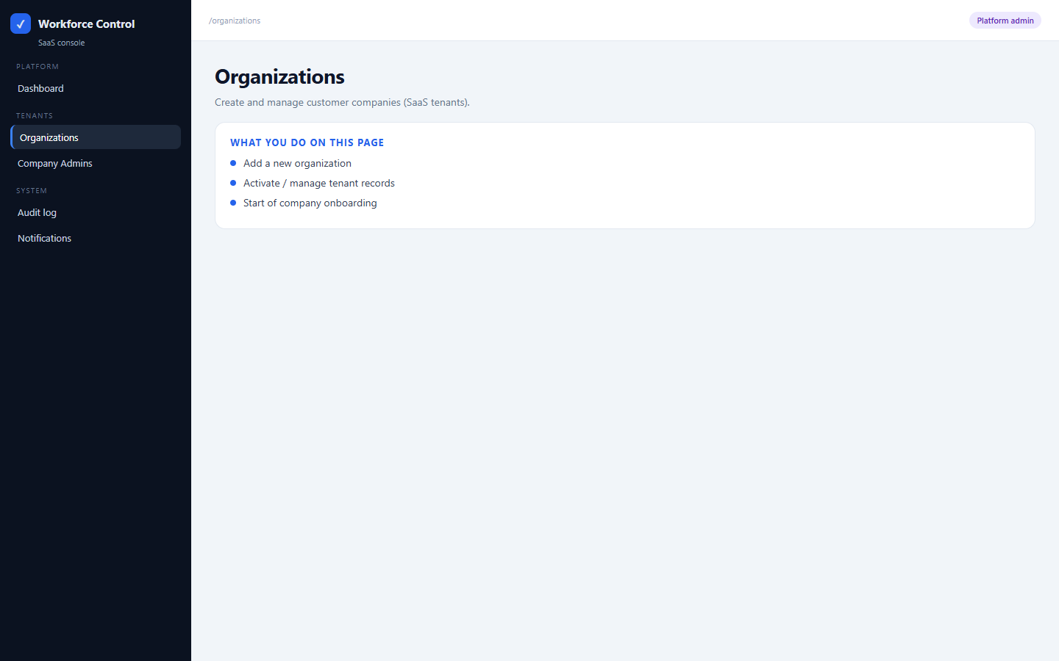
PLATFORM / SaaS
Organizations
/organizations
Create and manage customer companies (SaaS tenants).
• Add a new organization
• Activate / manage tenant records
• Start of company onboarding

Slide 8
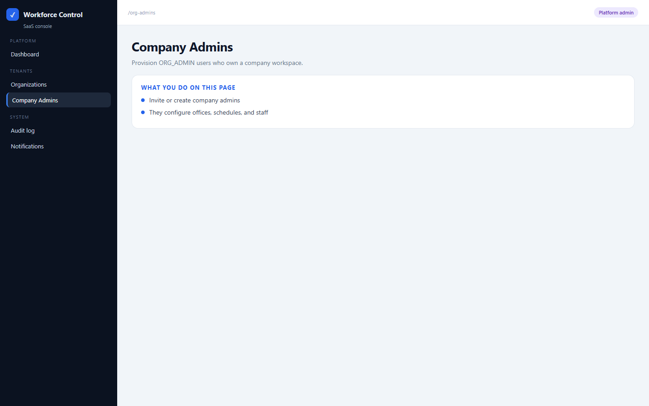
PLATFORM / SaaS
Company Admins
/org-admins
Provision ORG_ADMIN users who own a company workspace.
• Invite or create company admins
• They configure offices, schedules, and staff

Slide 9
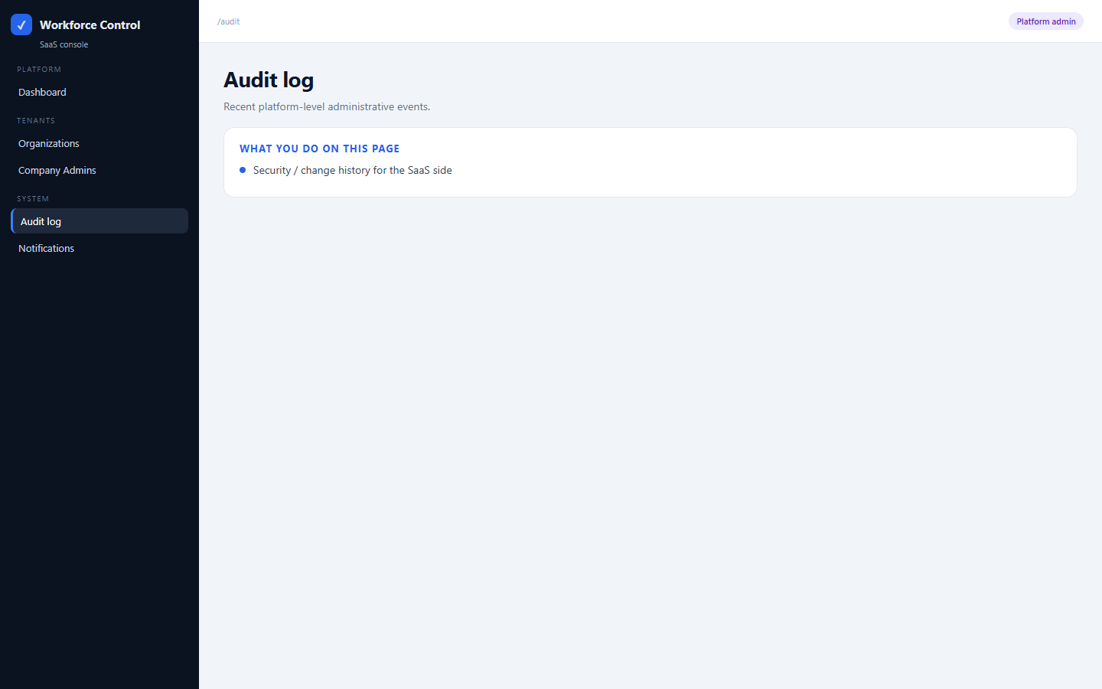
PLATFORM / SaaS
Audit log
/audit
Recent platform-level administrative events.
• Security / change history for the SaaS side

Slide 10
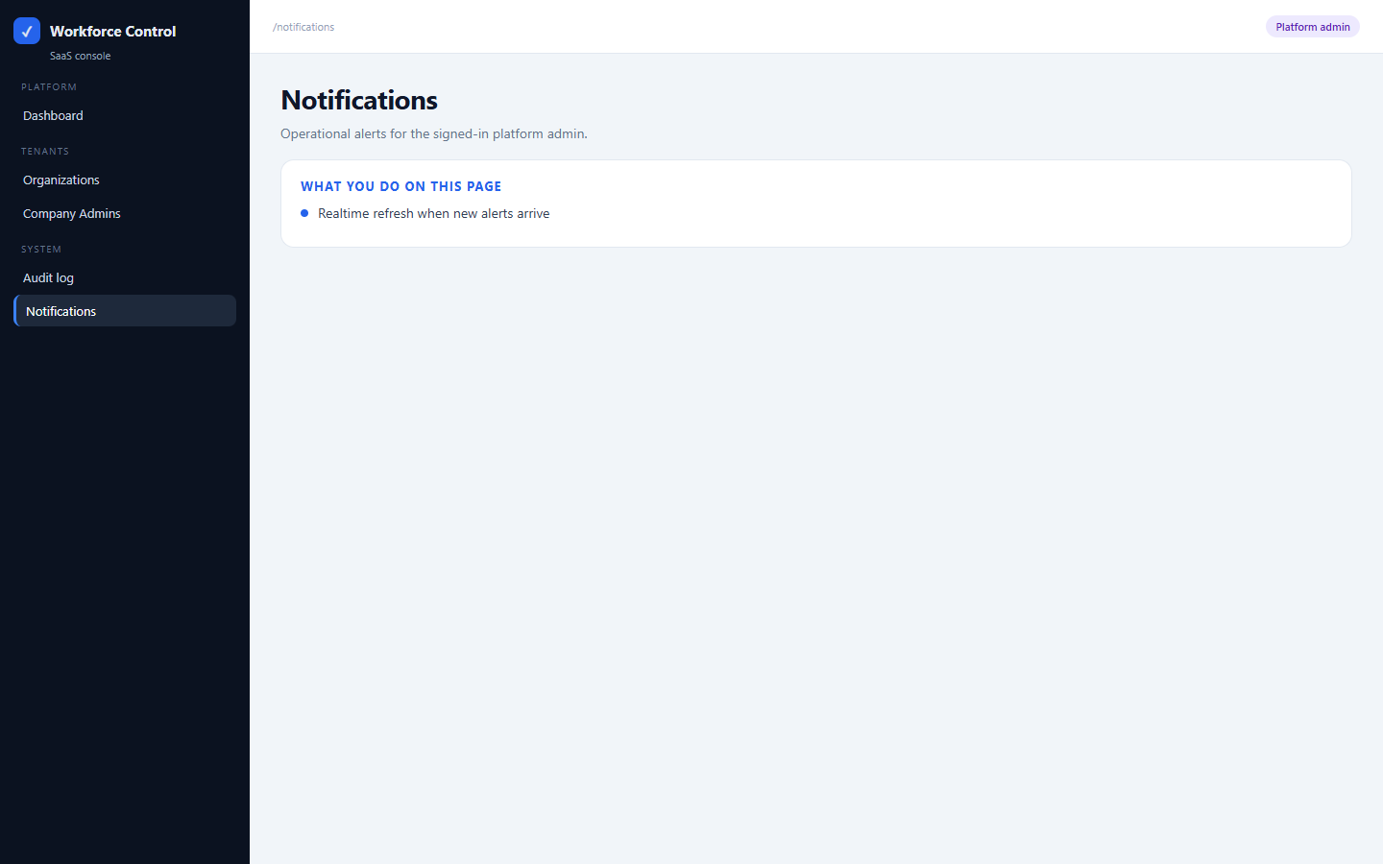
PLATFORM / SaaS
Notifications
/notifications
Operational alerts for the signed-in platform admin.
• Realtime refresh when new alerts arrive

Slide 11
SECTION B
Company admin — setup
Map offices, set hours, add people. This is the foundation.

Slide 12
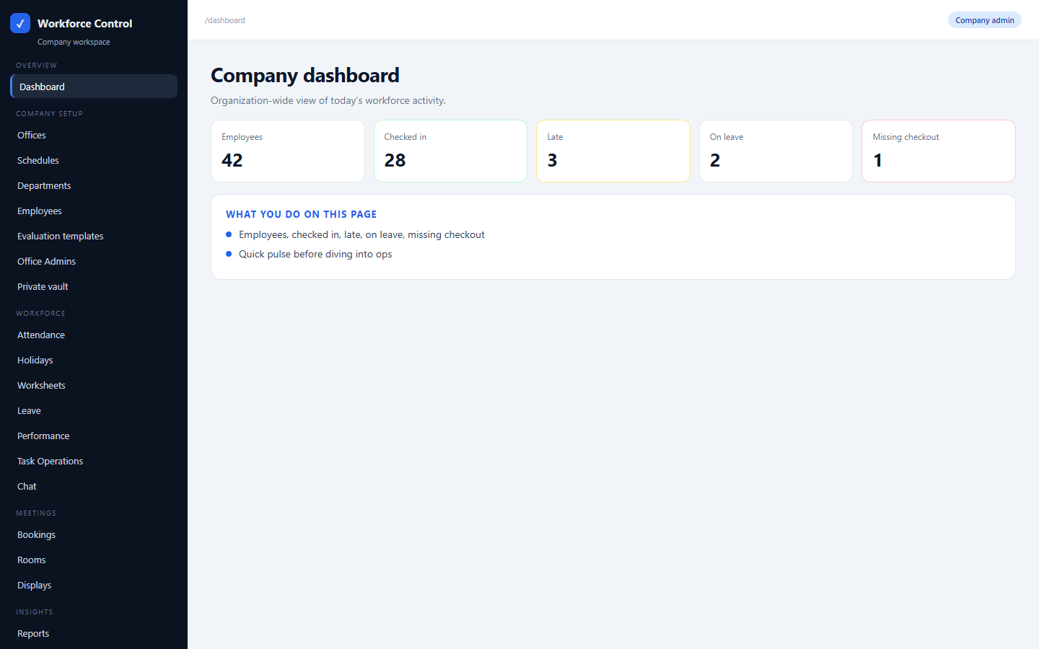
COMPANY SETUP
Company dashboard
/dashboard
Organization-wide view of today’s workforce activity.
• Employees, checked in, late, on leave, missing checkout
• Quick pulse before diving into ops

Slide 13
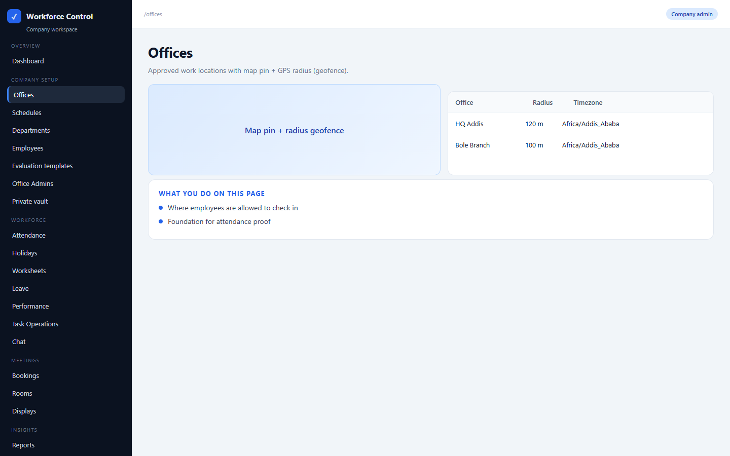
COMPANY SETUP
Offices
/offices
Approved work locations with map pin + GPS radius (geofence).
• Where employees are allowed to check in
• Foundation for attendance proof

Slide 14
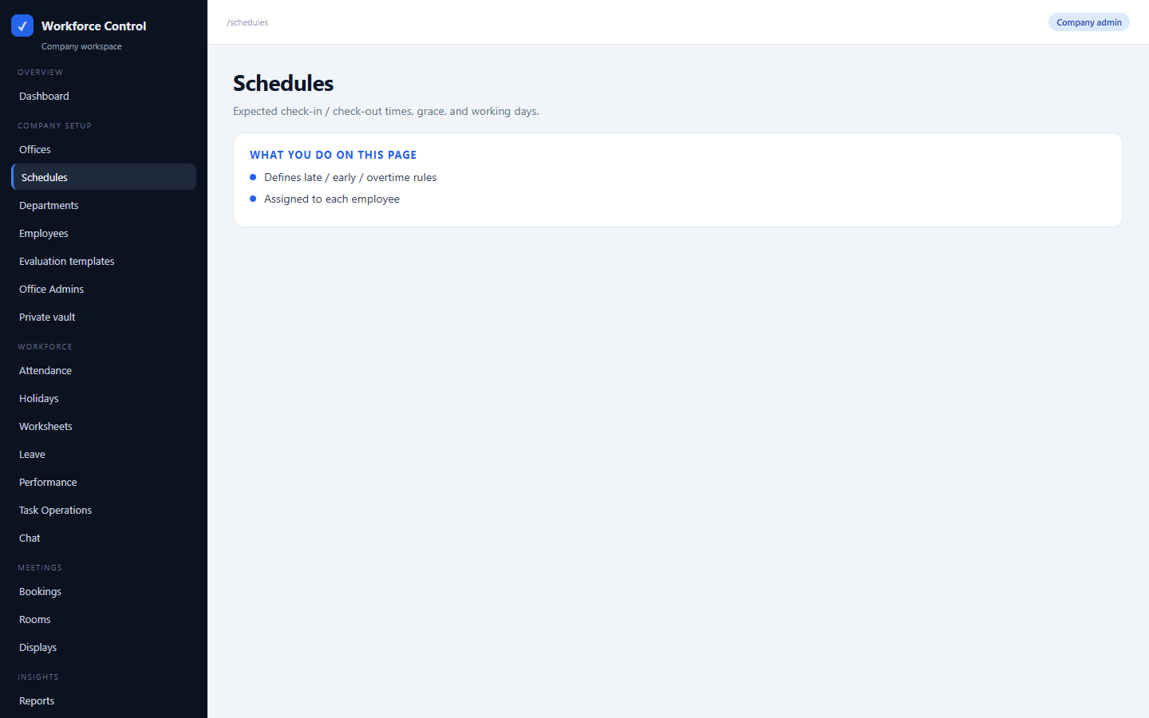
COMPANY SETUP
Schedules
/schedules
Expected check-in / check-out times, grace, and working days.
• Defines late / early / overtime rules
• Assigned to each employee

Slide 15
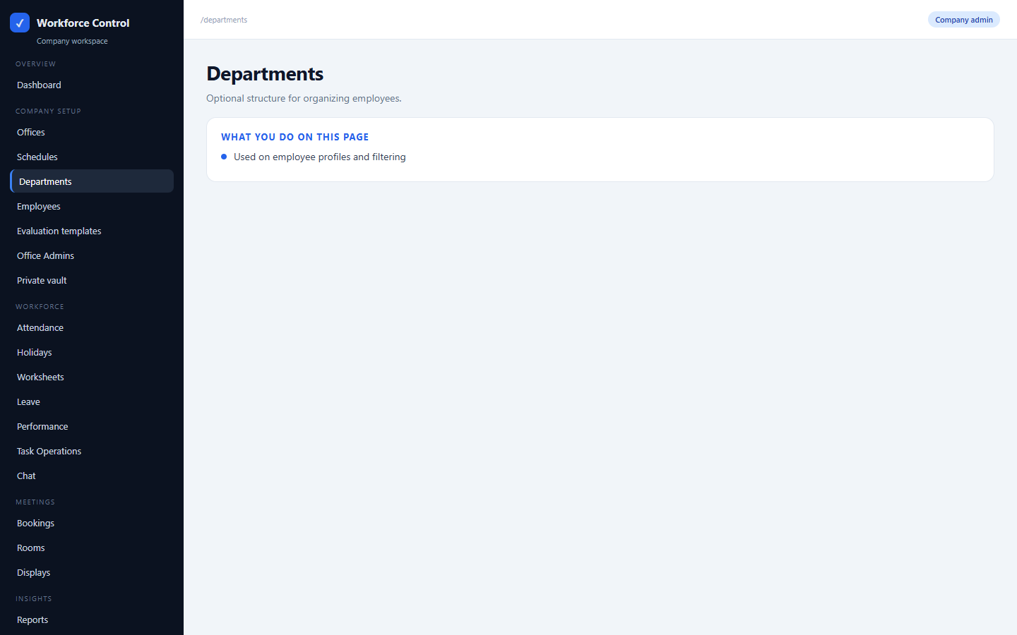
COMPANY SETUP
Departments
/departments
Optional structure for organizing employees.
• Used on employee profiles and filtering

Slide 16
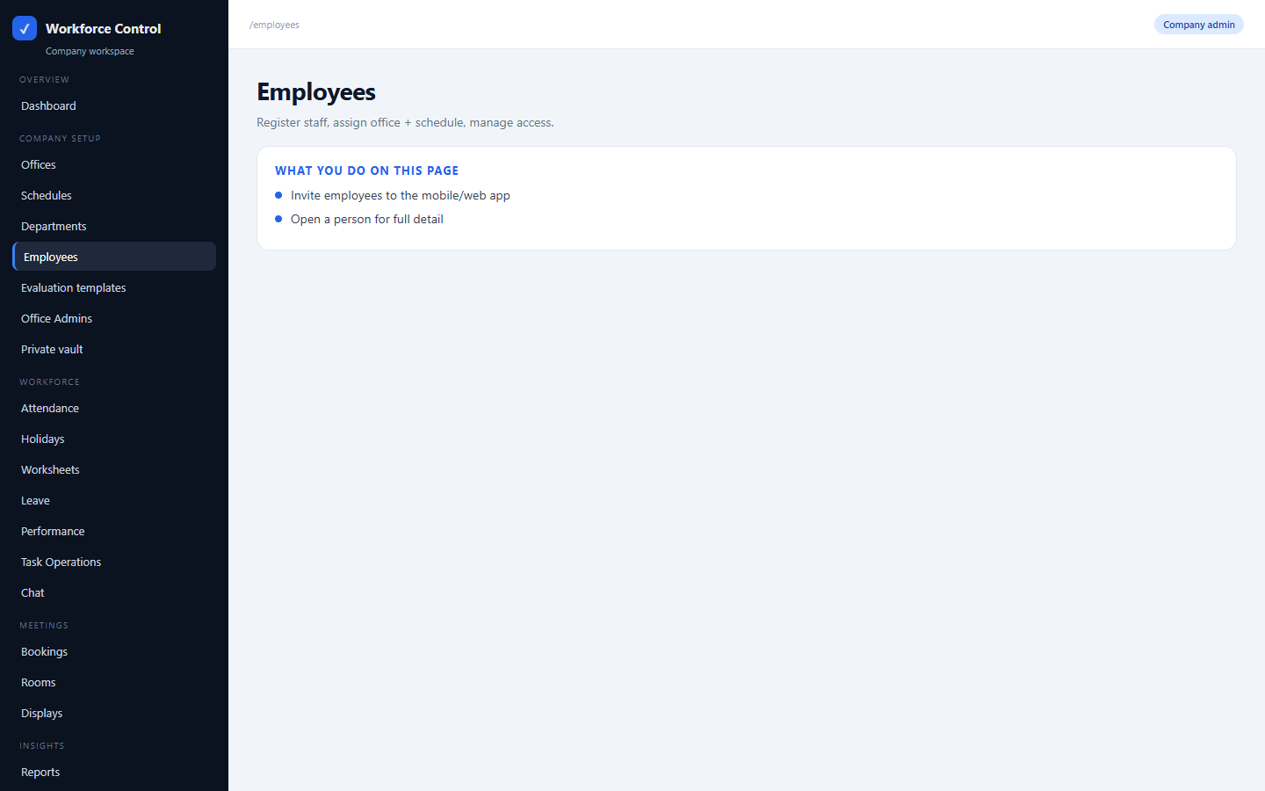
COMPANY SETUP
Employees
/employees
Register staff, assign office + schedule, manage access.
• Invite employees to the mobile/web app
• Open a person for full detail

Slide 17
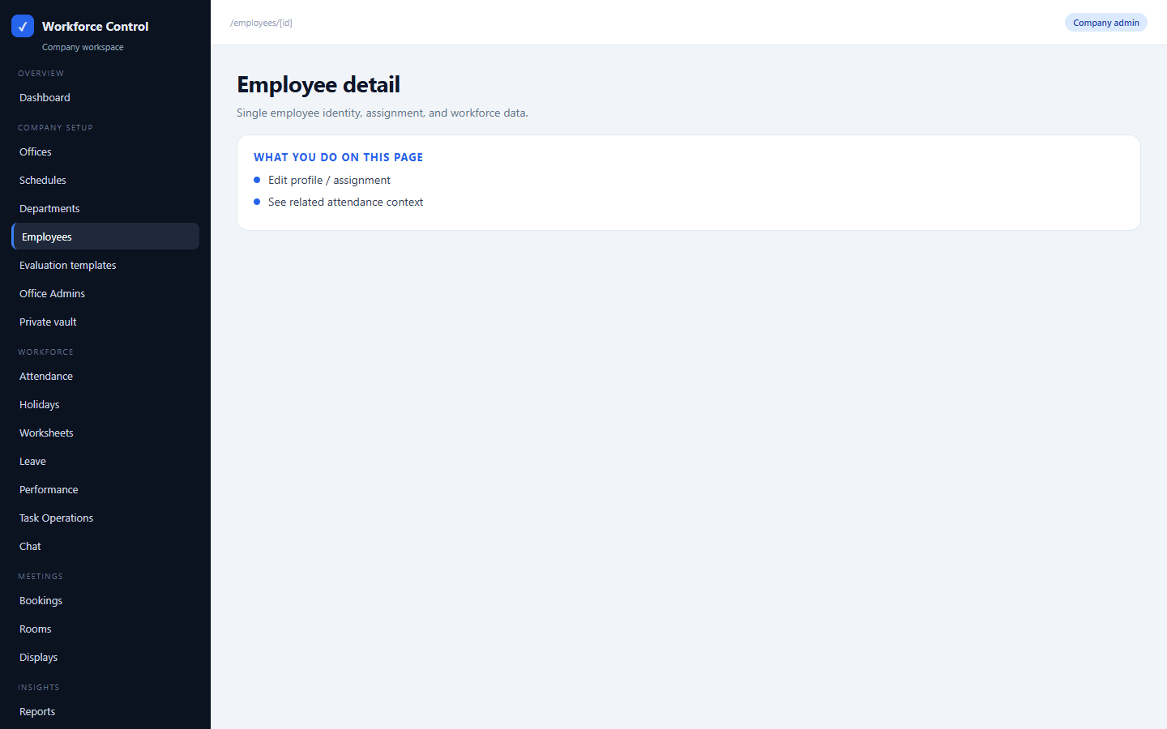
COMPANY SETUP
Employee detail
/employees/[id]
Single employee identity, assignment, and workforce data.
• Edit profile / assignment
• See related attendance context

Slide 18
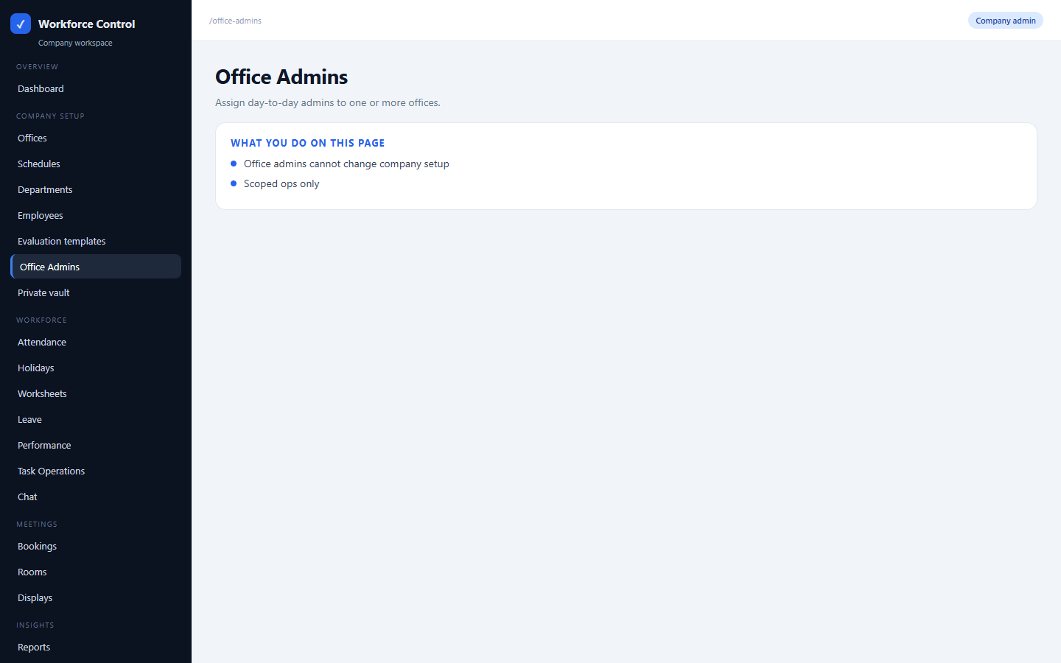
COMPANY SETUP
Office Admins
/office-admins
Assign day-to-day admins to one or more offices.
• Office admins cannot change company setup
• Scoped ops only

Slide 19
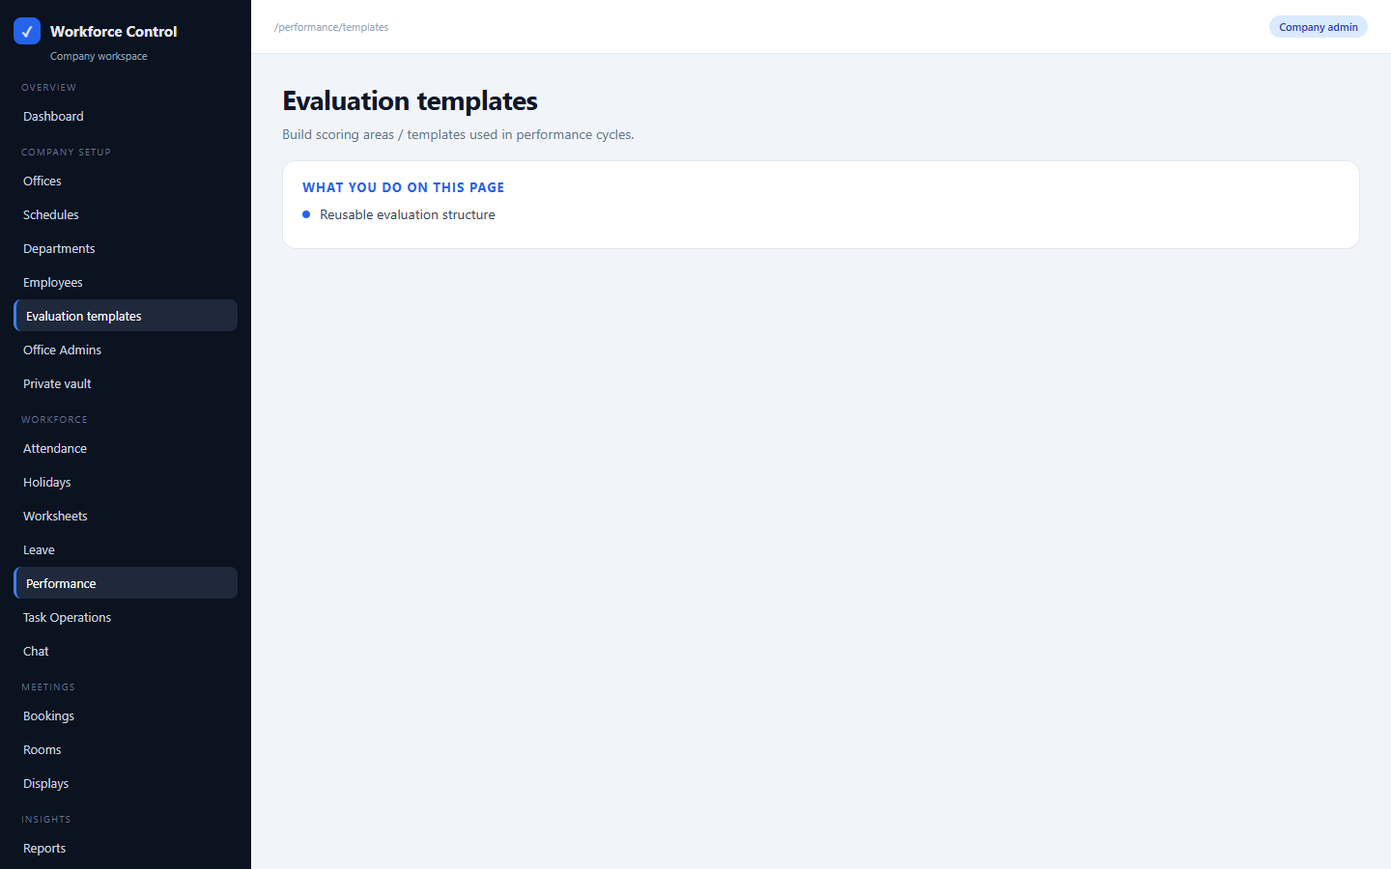
COMPANY SETUP
Evaluation templates
/performance/templates
Build scoring areas / templates used in performance cycles.
• Reusable evaluation structure

Slide 20
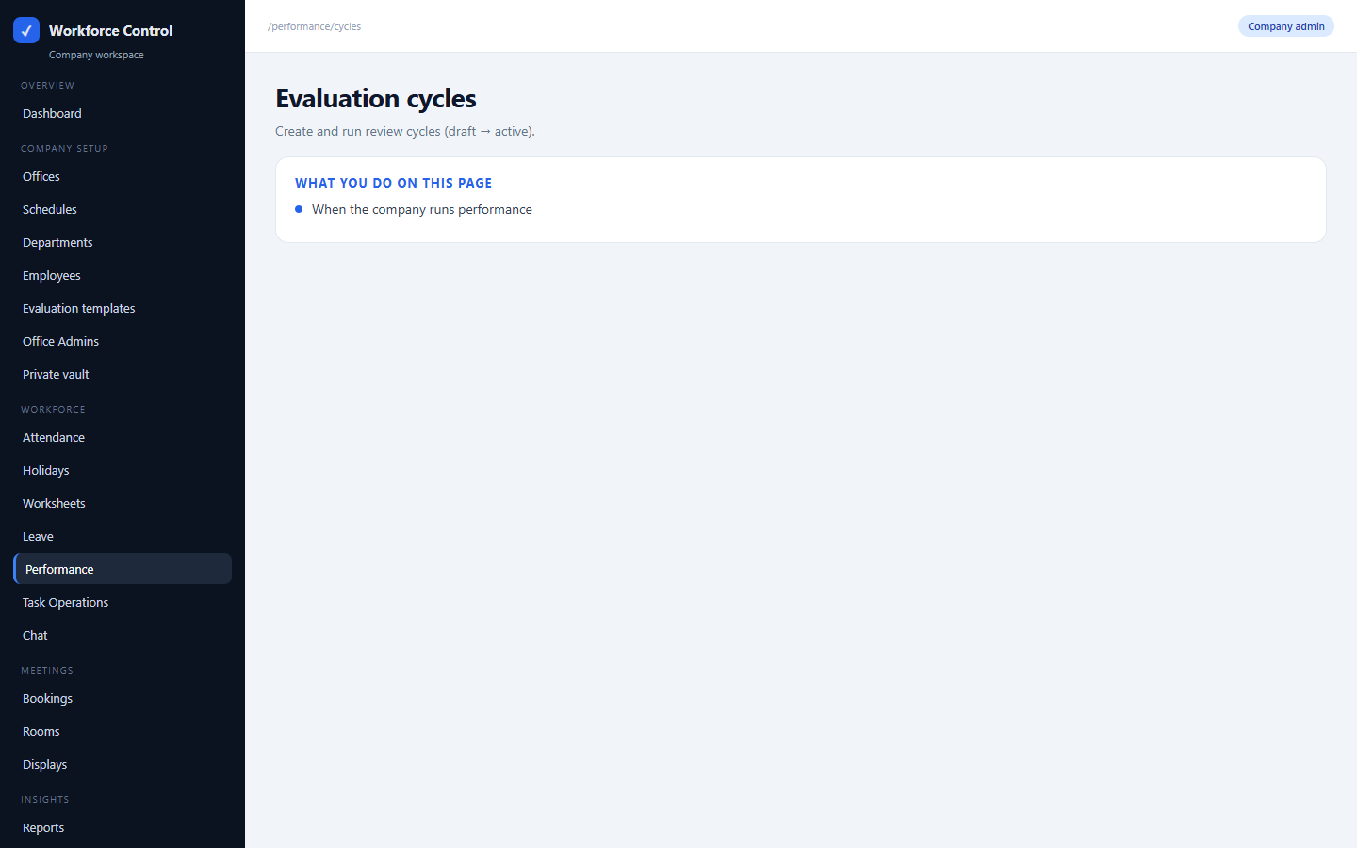
COMPANY SETUP
Evaluation cycles
/performance/cycles
Create and run review cycles (draft → active).
• When the company runs performance

Slide 21
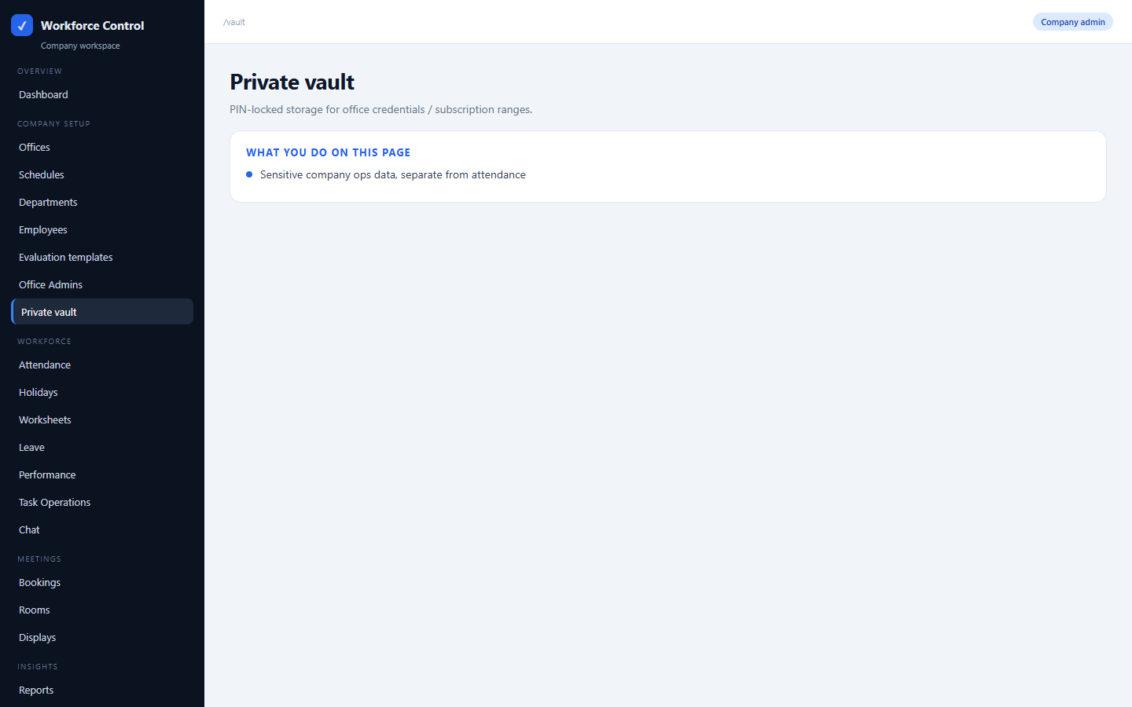
COMPANY SETUP
Private vault
/vault
PIN-locked storage for office credentials / subscription ranges.
• Sensitive company ops data, separate from attendance

Slide 22
SECTION B
Company admin — daily operations
Attendance, leave, chat, meetings, tasks, performance, reports.

Slide 23
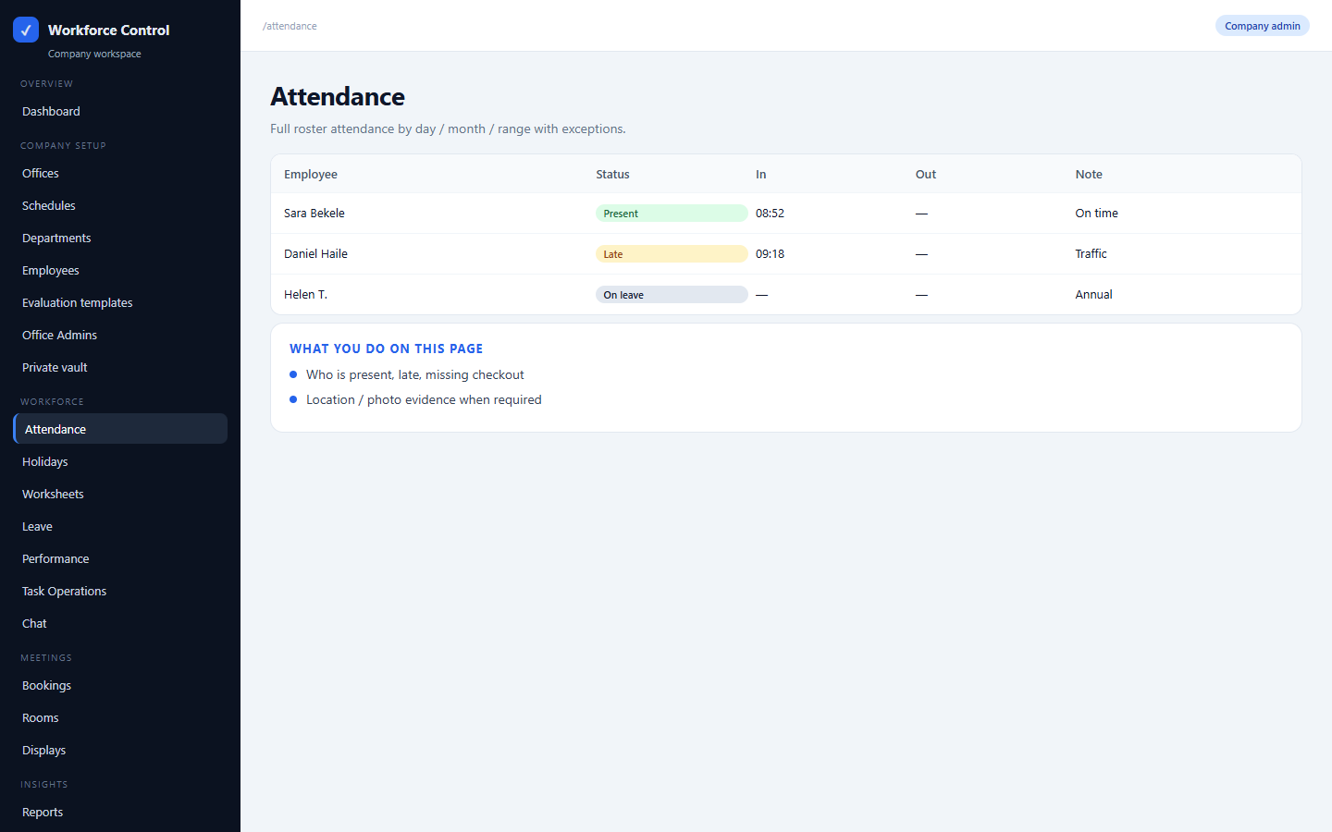
COMPANY OPS
Attendance
/attendance
Full roster attendance by day / month / range with exceptions.
• Who is present, late, missing checkout
• Location / photo evidence when required

Slide 24
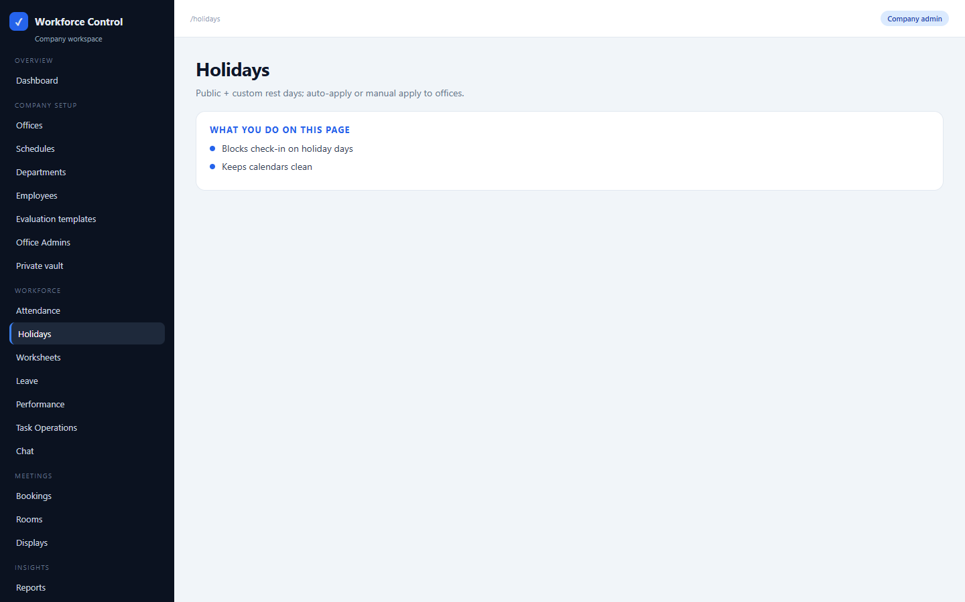
COMPANY OPS
Holidays
/holidays
Public + custom rest days; auto-apply or manual apply to offices.
• Blocks check-in on holiday days
• Keeps calendars clean

Slide 25
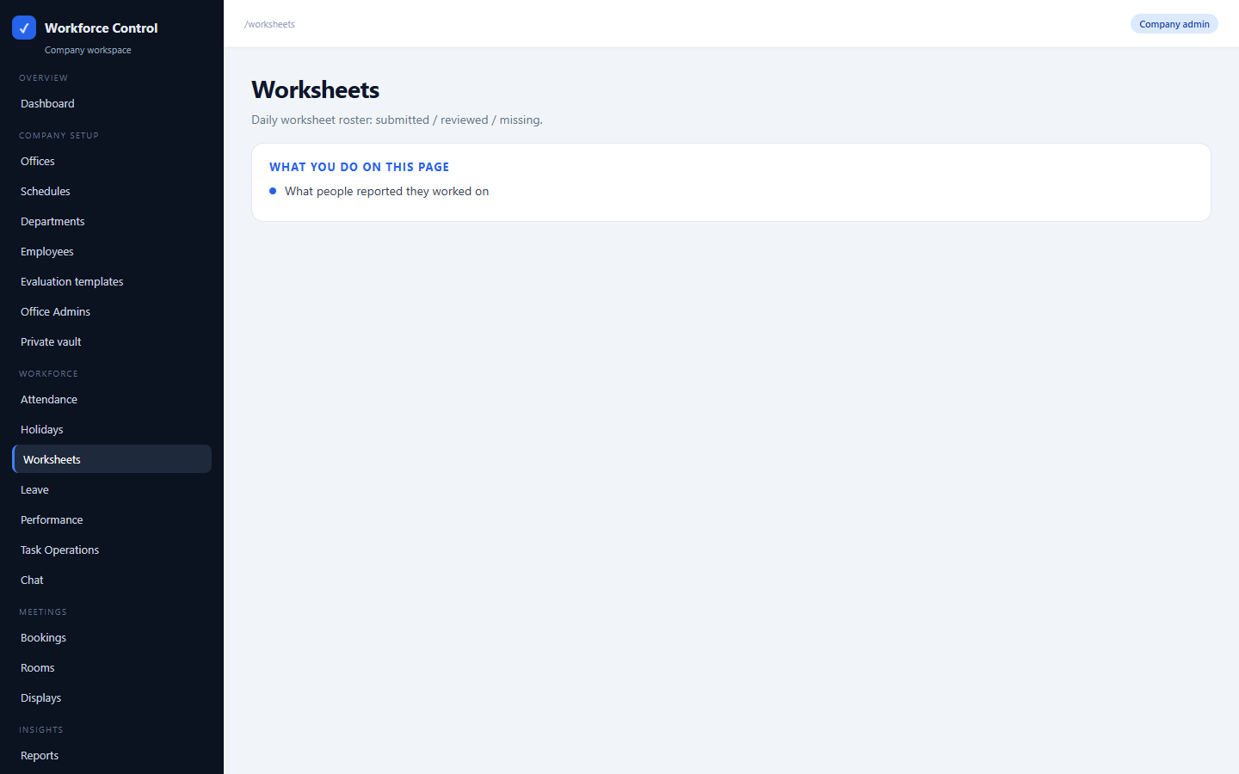
COMPANY OPS
Worksheets
/worksheets
Daily worksheet roster: submitted / reviewed / missing.
• What people reported they worked on

Slide 26
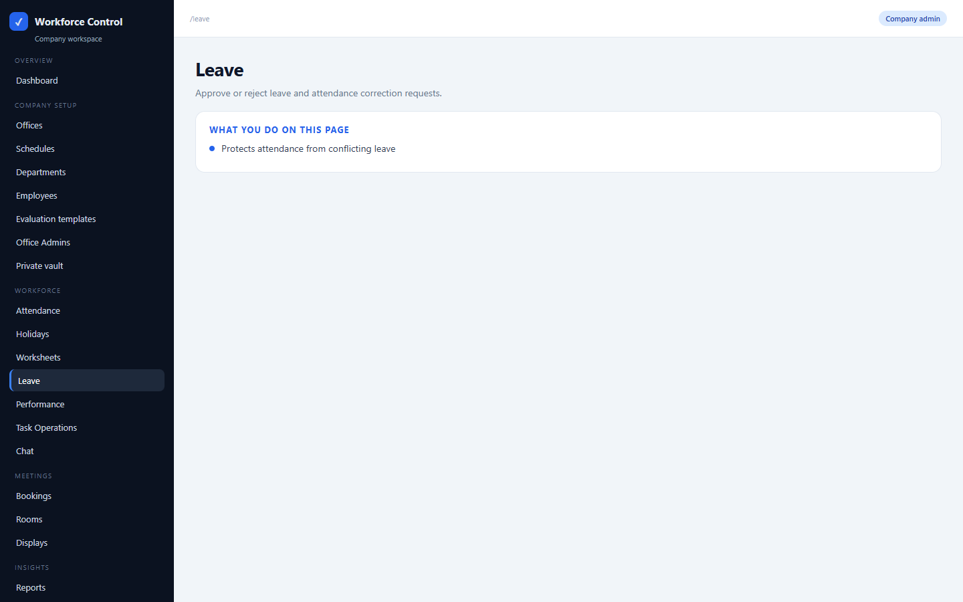
COMPANY OPS
Leave
/leave
Approve or reject leave and attendance correction requests.
• Protects attendance from conflicting leave

Slide 27
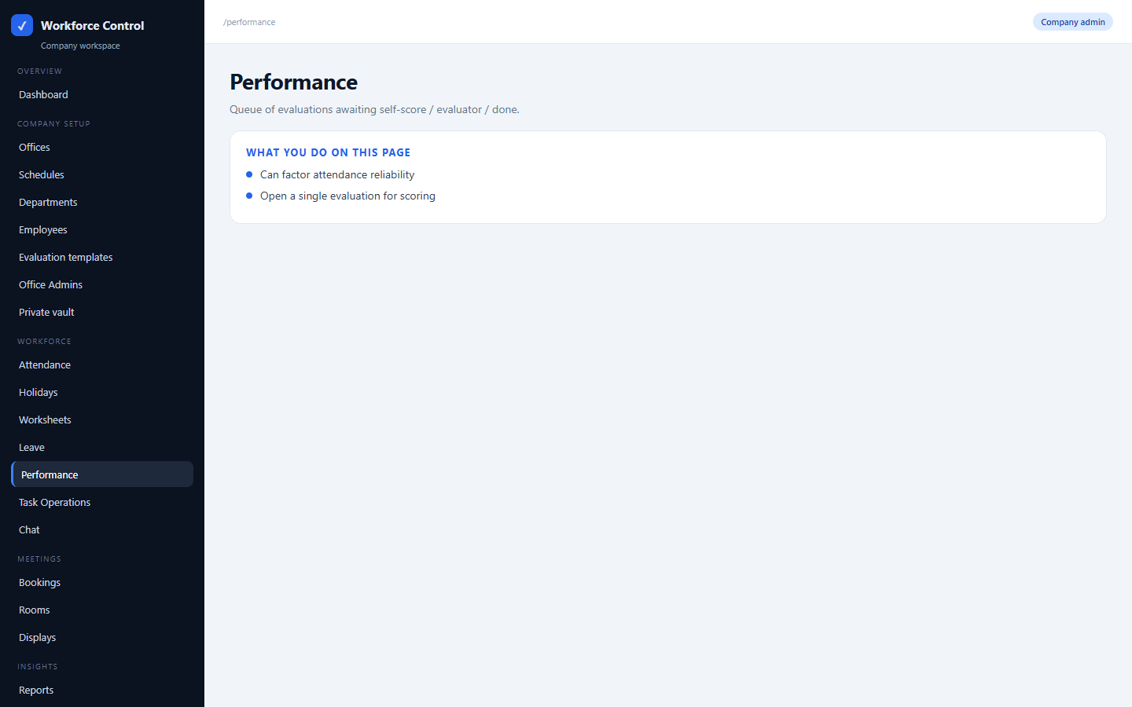
COMPANY OPS
Performance
/performance
Queue of evaluations awaiting self-score / evaluator / done.
• Can factor attendance reliability
• Open a single evaluation for scoring

Slide 28
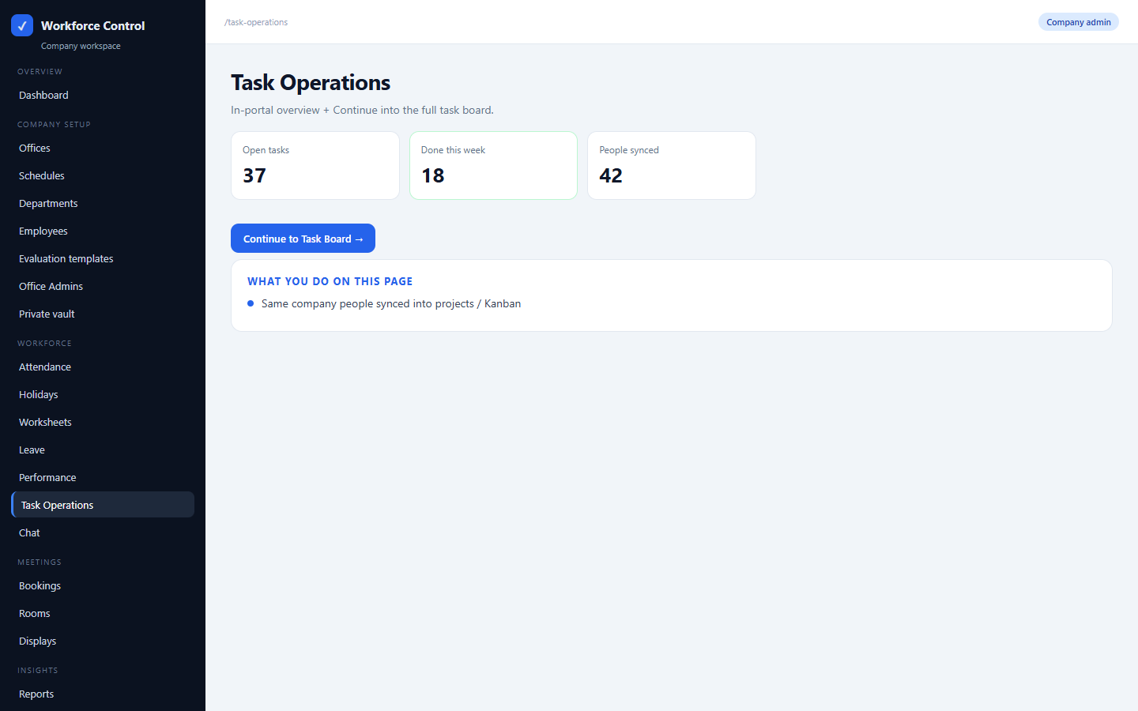
COMPANY OPS
Task Operations
/task-operations
In-portal overview + Continue into the full task board.
• Same company people synced into projects / Kanban

Slide 29
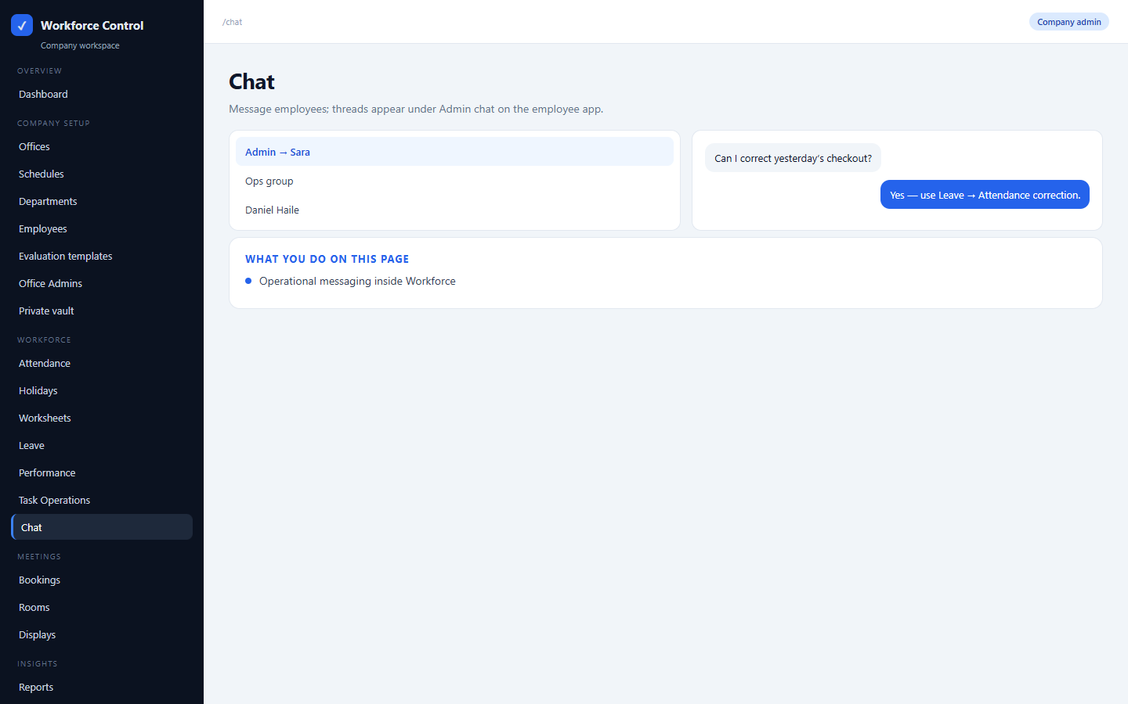
COMPANY OPS
Chat
/chat
Message employees; threads appear under Admin chat on the employee app.
• Operational messaging inside Workforce

Slide 30
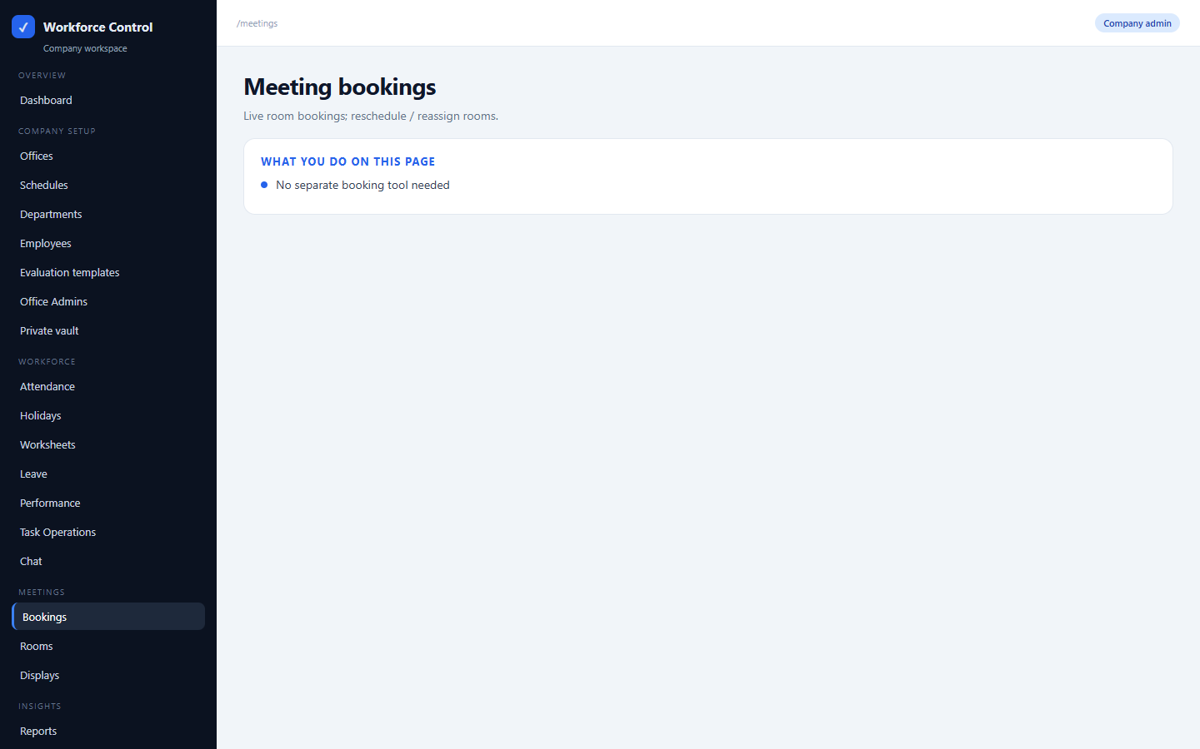
COMPANY OPS
Meeting bookings
/meetings
Live room bookings; reschedule / reassign rooms.
• No separate booking tool needed

Slide 31
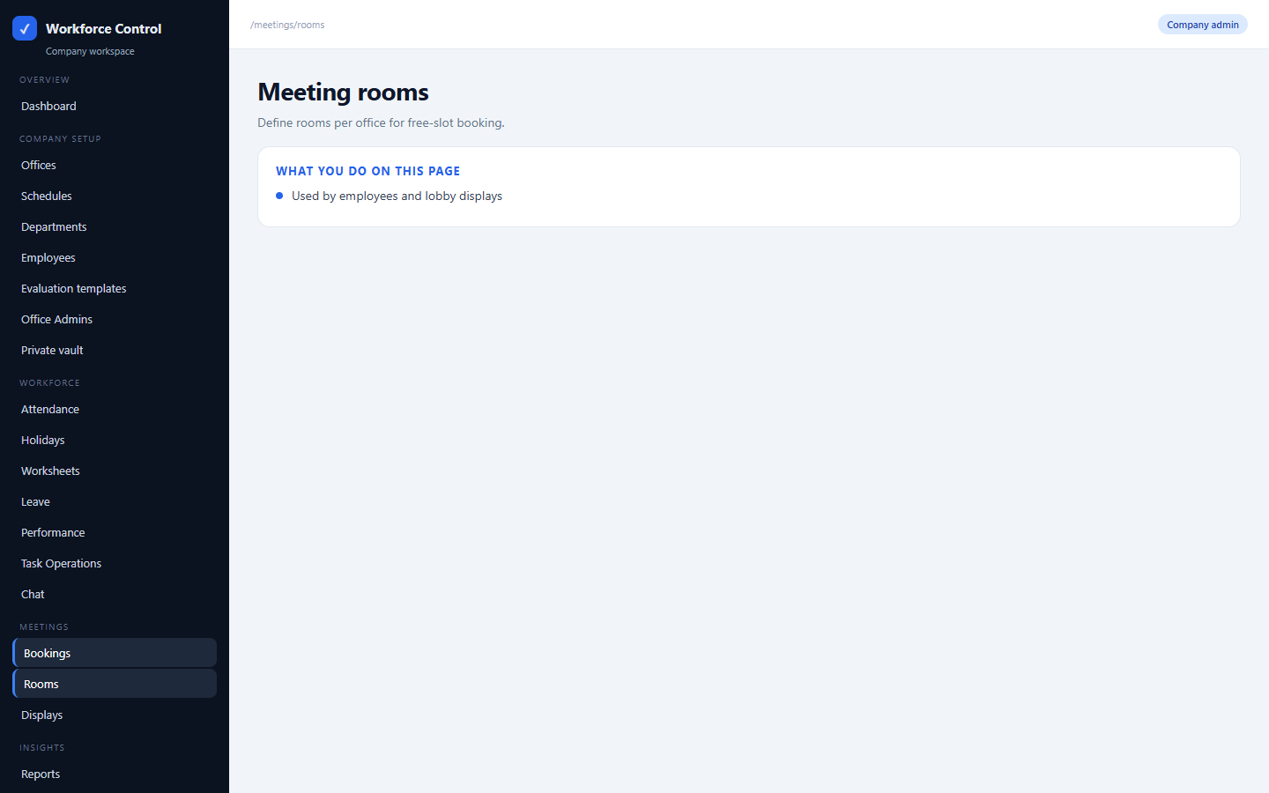
COMPANY OPS
Meeting rooms
/meetings/rooms
Define rooms per office for free-slot booking.
• Used by employees and lobby displays

Slide 32
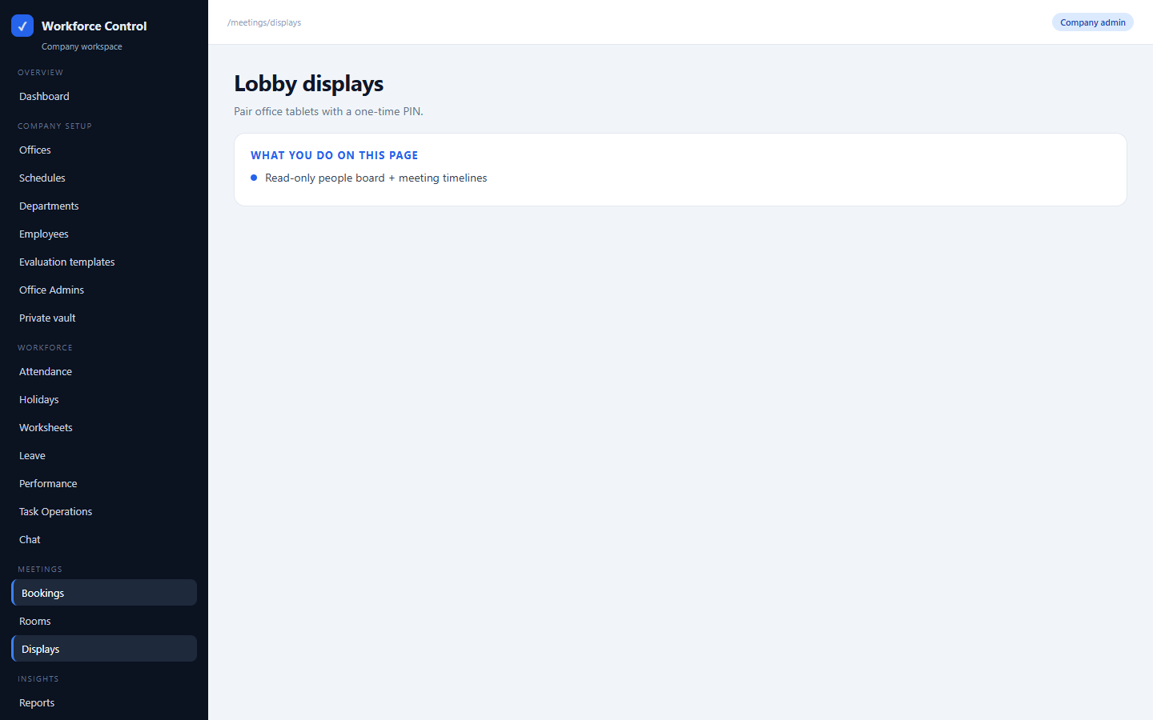
COMPANY OPS
Lobby displays
/meetings/displays
Pair office tablets with a one-time PIN.
• Read-only people board + meeting timelines

Slide 33
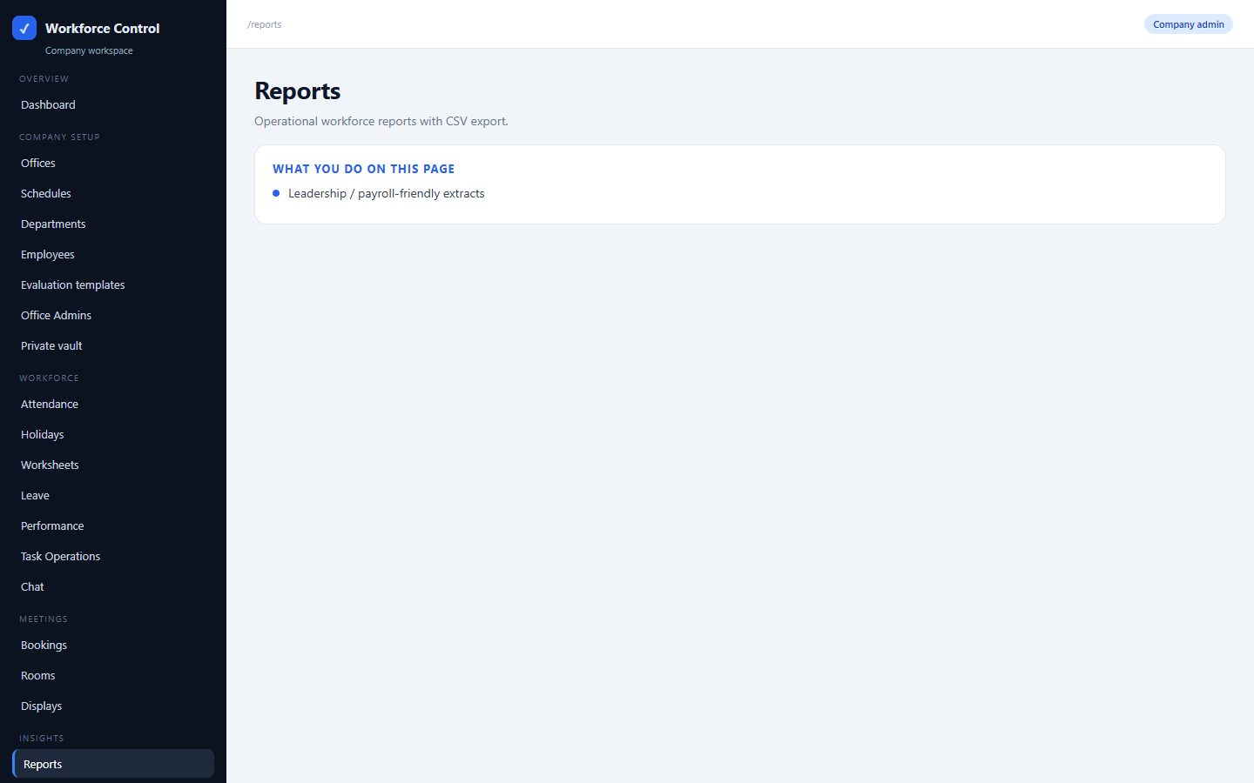
COMPANY OPS
Reports
/reports
Operational workforce reports with CSV export.
• Leadership / payroll-friendly extracts

Slide 34
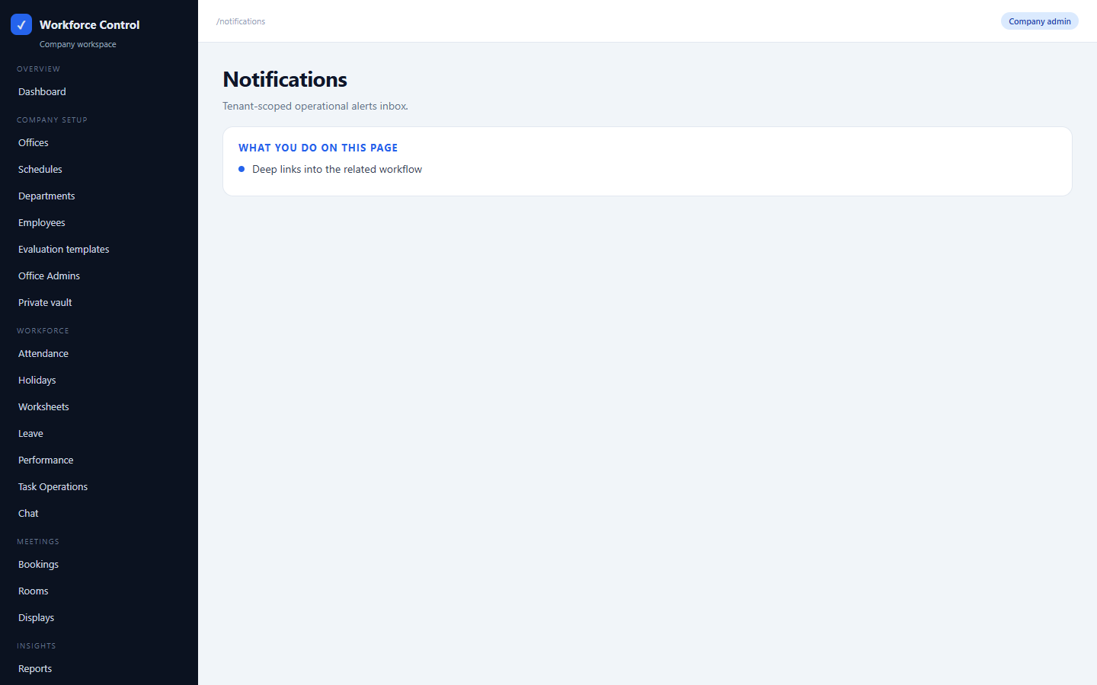
COMPANY OPS
Notifications
/notifications
Tenant-scoped operational alerts inbox.
• Deep links into the related workflow

Slide 35
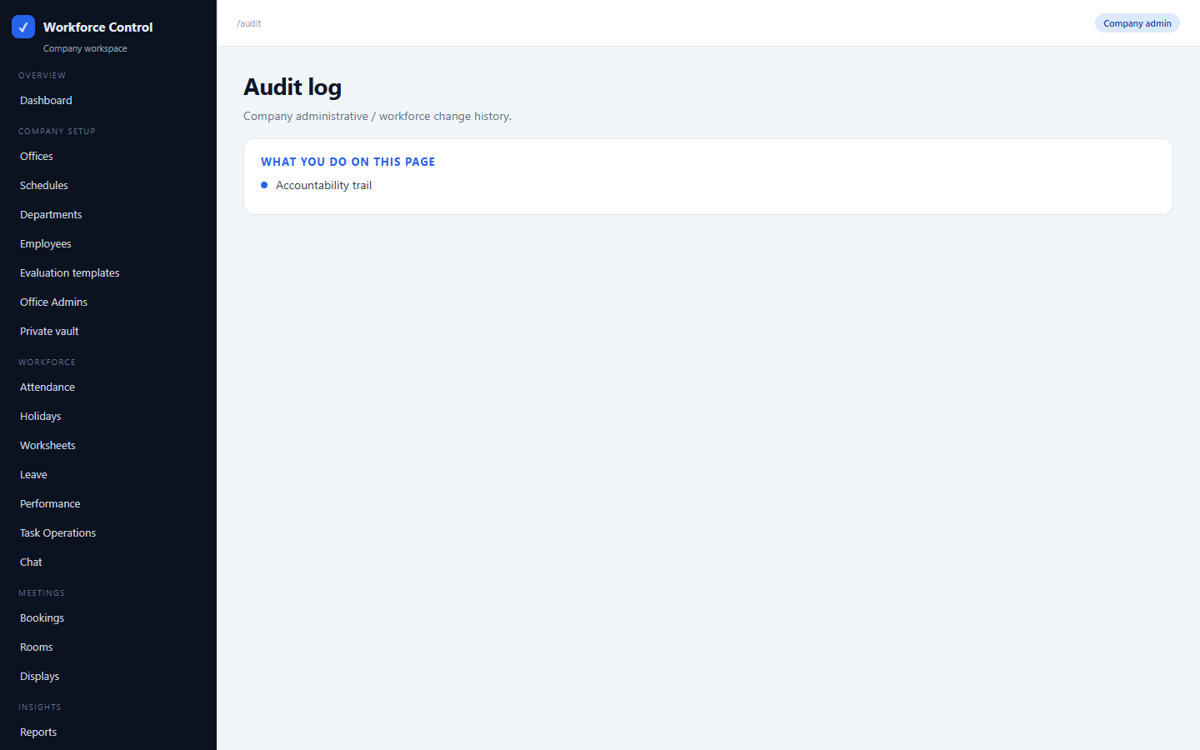
COMPANY OPS
Audit log
/audit
Company administrative / workforce change history.
• Accountability trail

Slide 36
SECTION C
Office admin side
Office Admin sees the same day-to-day ops pages, scoped to assigned office(s). They do NOT get company setup: Offices, Schedules, Departments, Office Admins, Performance templates/cycles, Meetings stack, or Vault.

Slide 37
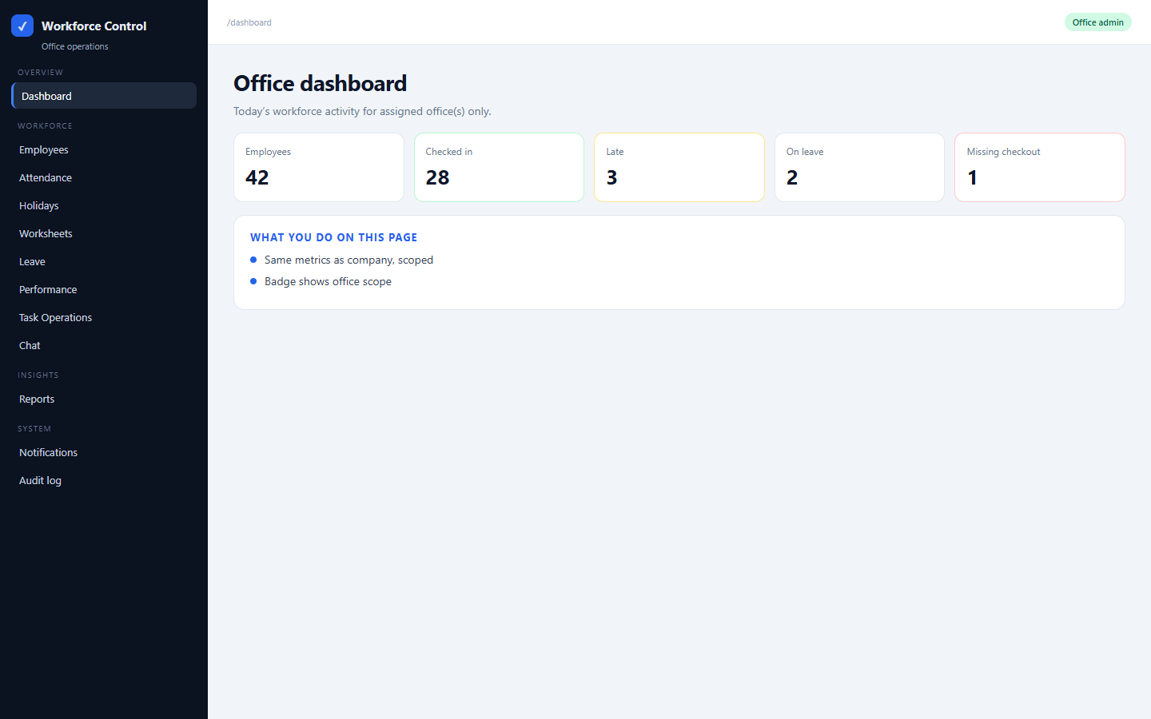
OFFICE ADMIN
Office dashboard
/dashboard
Today’s workforce activity for assigned office(s) only.
• Same metrics as company, scoped
• Badge shows office scope

Slide 38
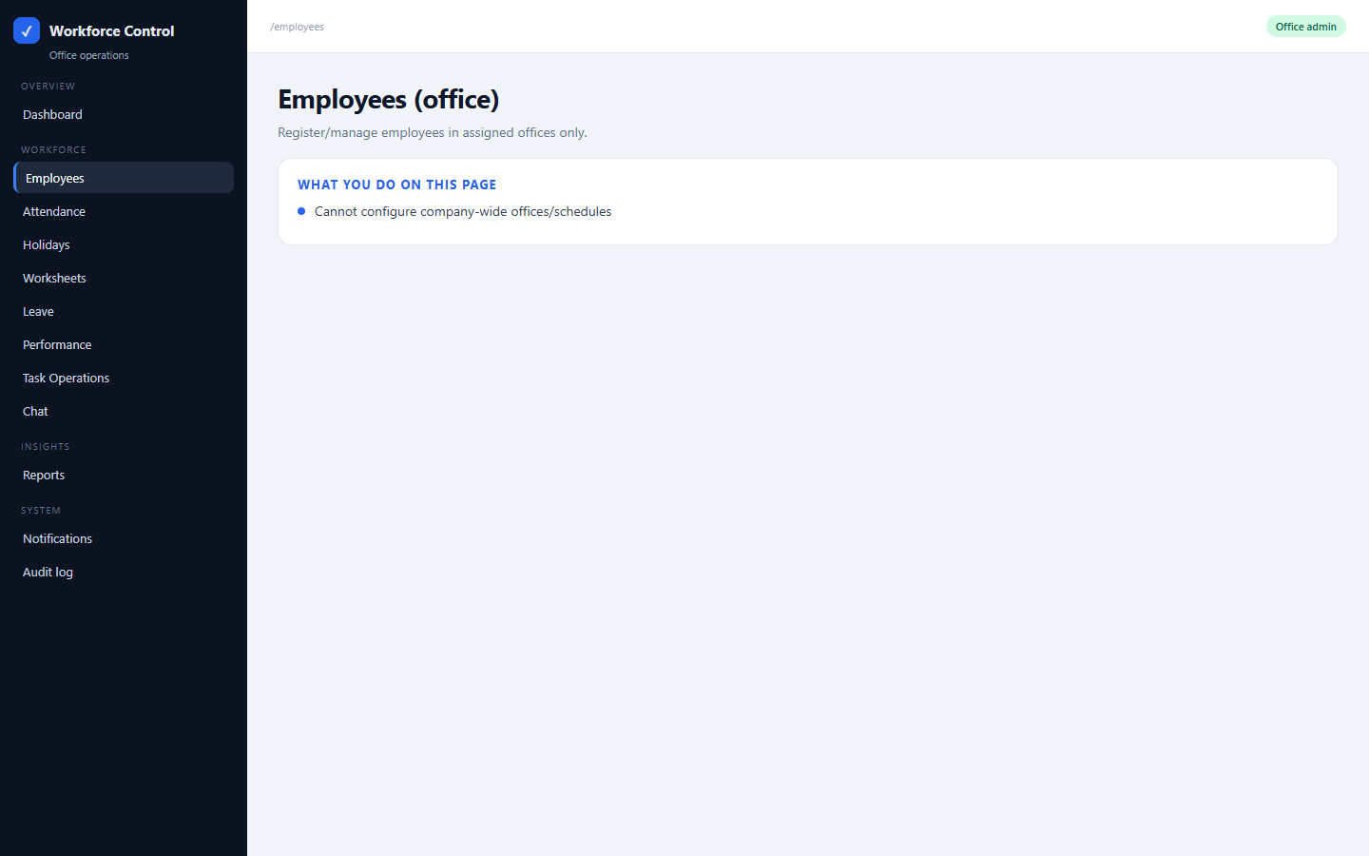
OFFICE ADMIN
Employees (office)
/employees
Register/manage employees in assigned offices only.
• Cannot configure company-wide offices/schedules

Slide 39
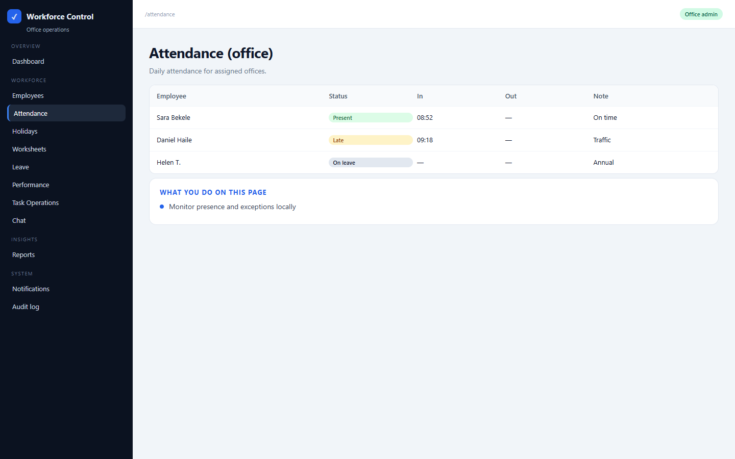
OFFICE ADMIN
Attendance (office)
/attendance
Daily attendance for assigned offices.
• Monitor presence and exceptions locally

Slide 40
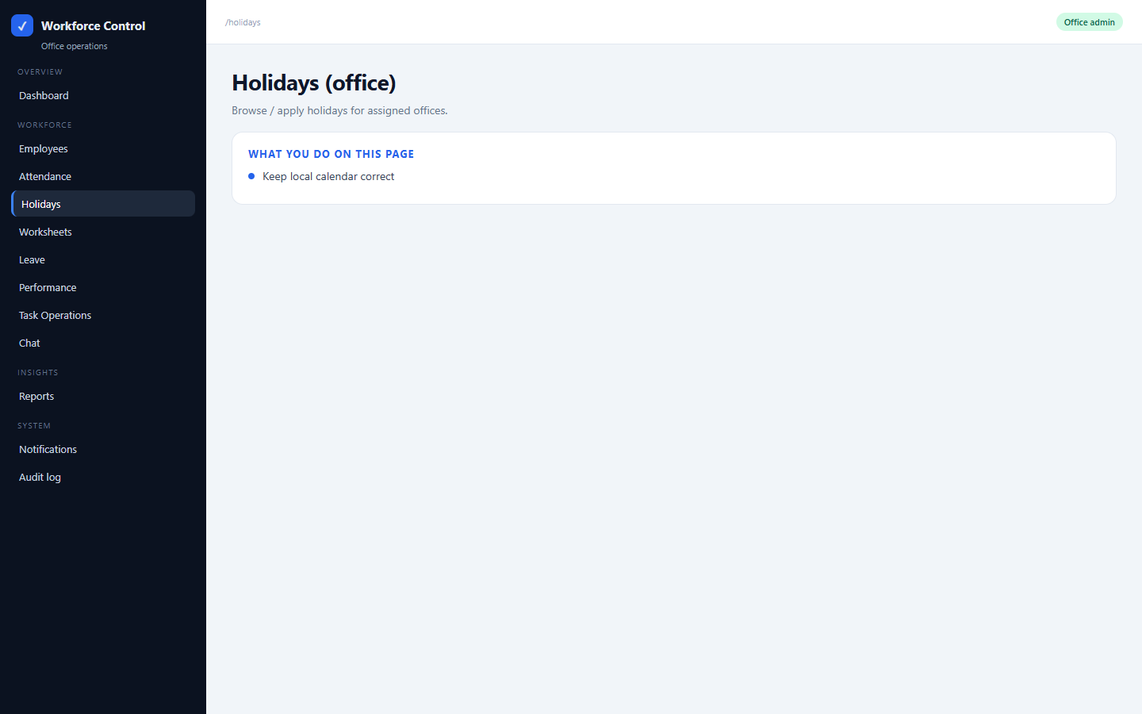
OFFICE ADMIN
Holidays (office)
/holidays
Browse / apply holidays for assigned offices.
• Keep local calendar correct

Slide 41

OFFICE ADMIN
Worksheets (office)
/worksheets
Worksheet submissions for assigned offices.
• Review what was submitted today

Slide 42
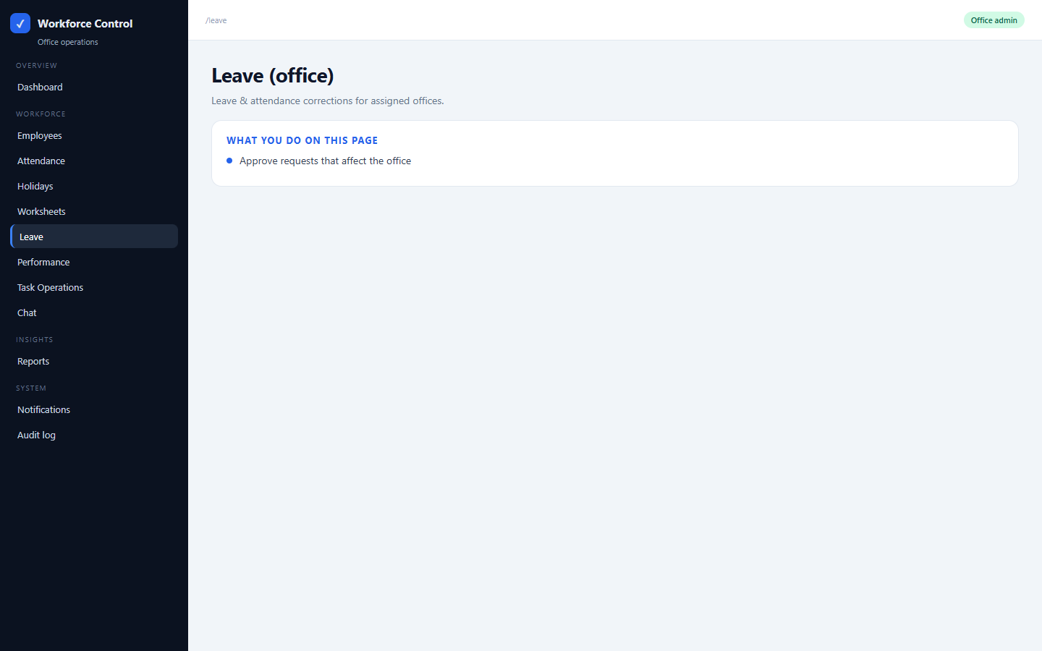
OFFICE ADMIN
Leave (office)
/leave
Leave & attendance corrections for assigned offices.
• Approve requests that affect the office

Slide 43
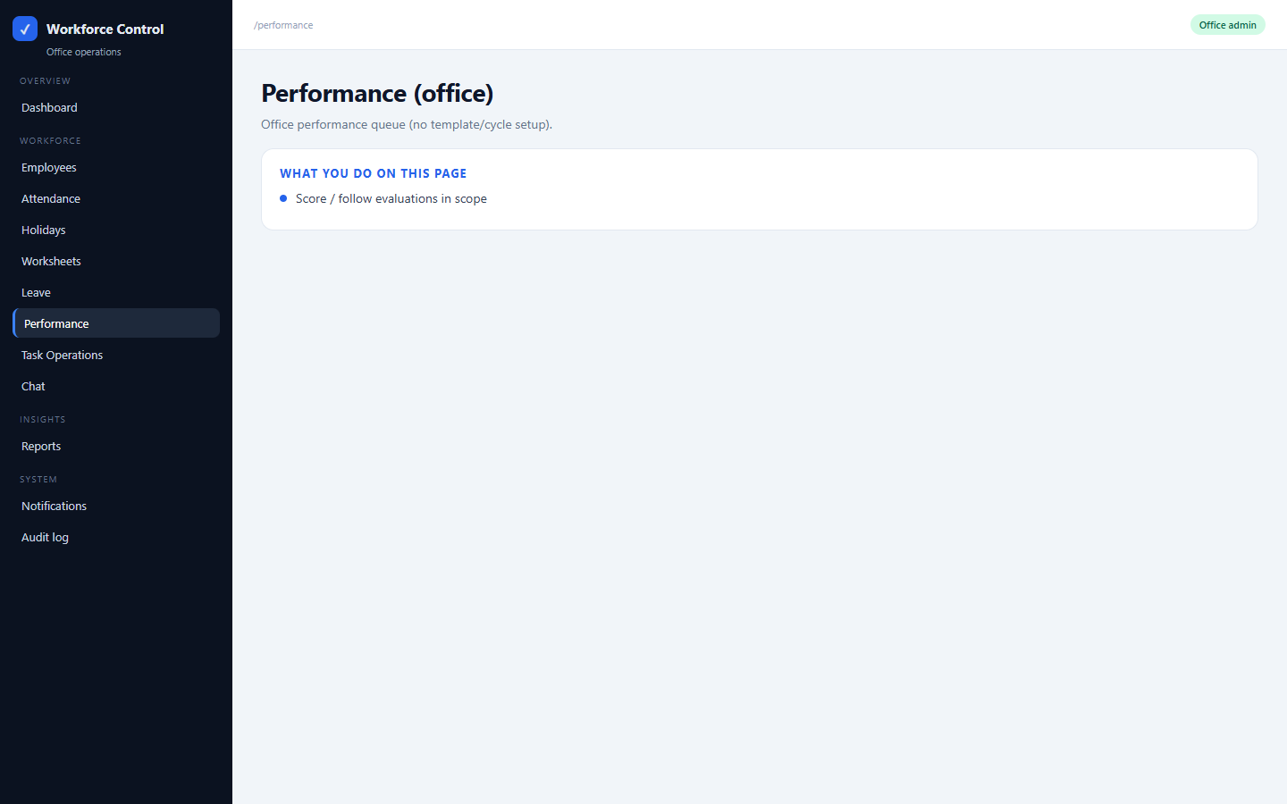
OFFICE ADMIN
Performance (office)
/performance
Office performance queue (no template/cycle setup).
• Score / follow evaluations in scope

Slide 44
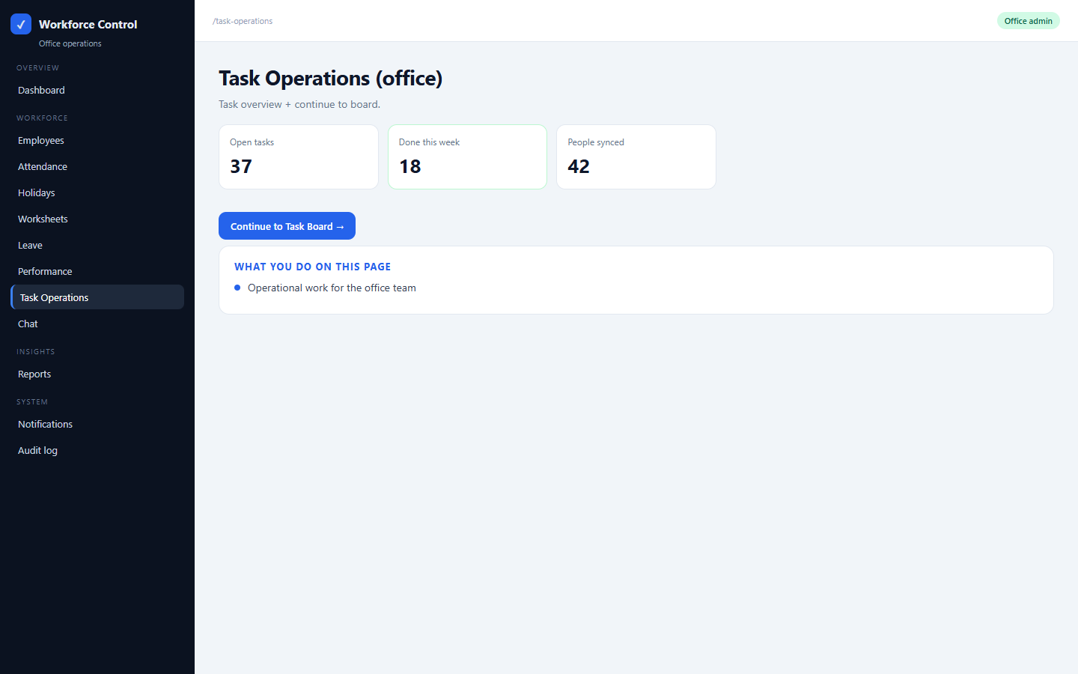
OFFICE ADMIN
Task Operations (office)
/task-operations
Task overview + continue to board.
• Operational work for the office team

Slide 45
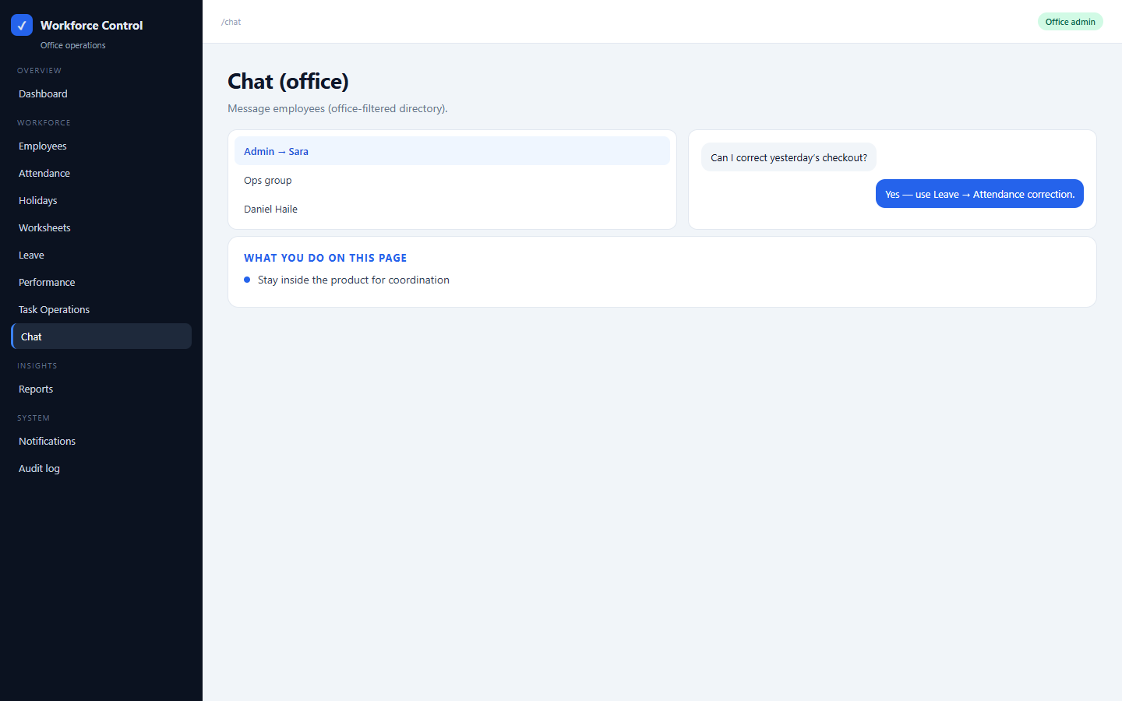
OFFICE ADMIN
Chat (office)
/chat
Message employees (office-filtered directory).
• Stay inside the product for coordination

Slide 46
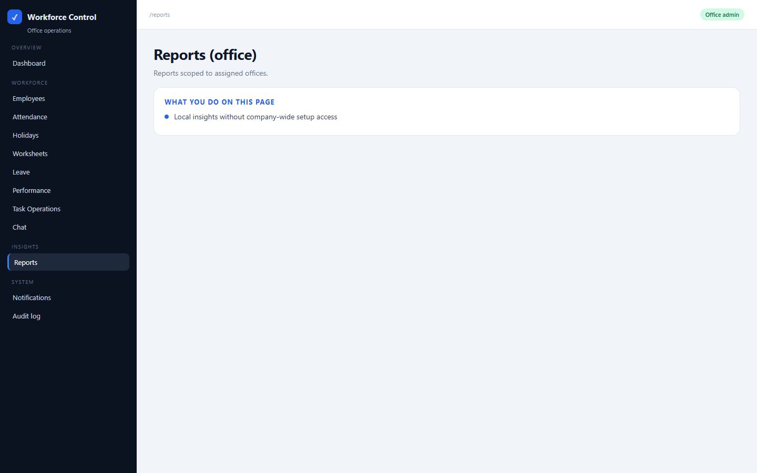
OFFICE ADMIN
Reports (office)
/reports
Reports scoped to assigned offices.
• Local insights without company-wide setup access

Slide 47
SECTION D
Employee-facing app
Time clock, leave, chat, meetings, and self-evaluations on mobile/web.

Slide 48
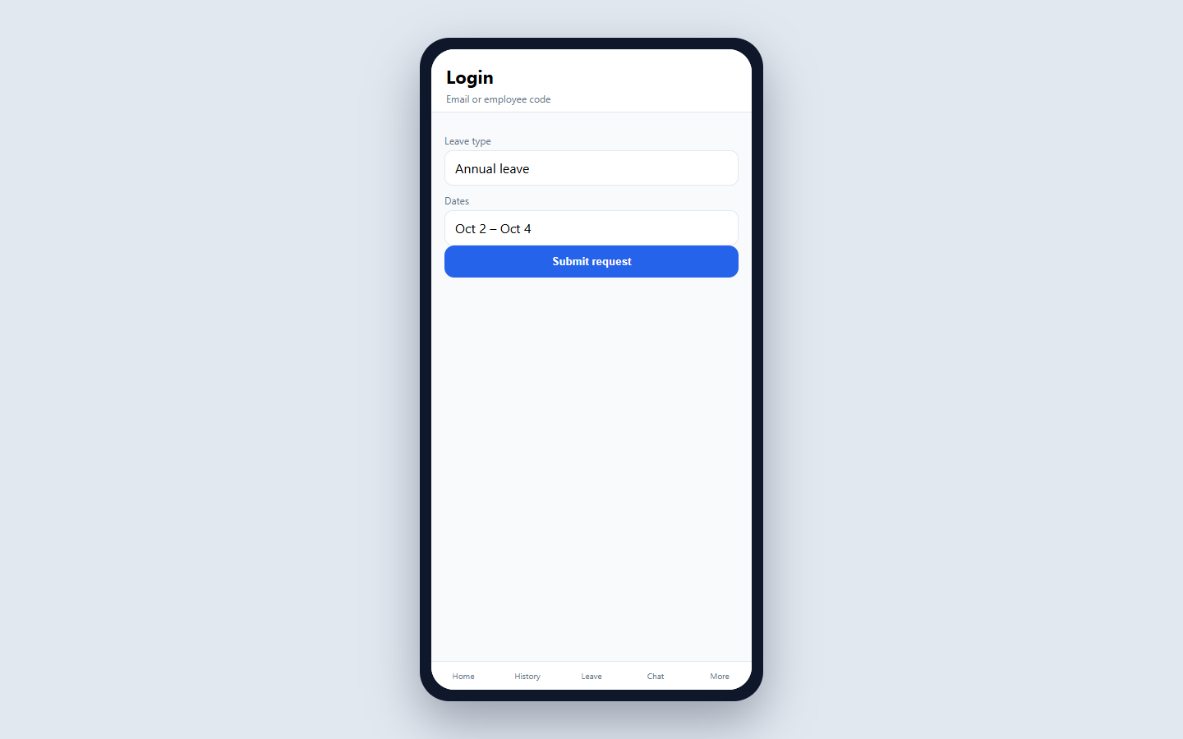
EMPLOYEE APP
Login
/login
Sign in with email or employee code (org slug when needed).
• Primary employee surface
• Same org identity as admin portal

Slide 49
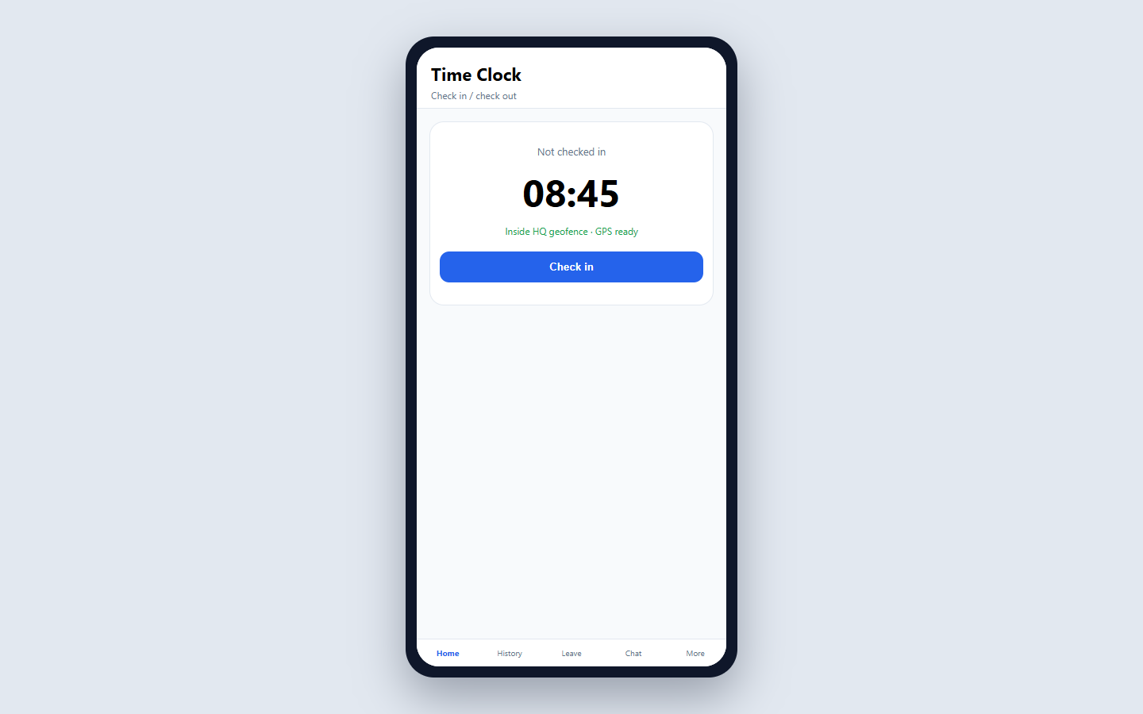
EMPLOYEE APP
Time Clock
/home
Check in / out with GPS (and photo when company requires it). Late reason when late.
• Primary employee surface
• Same org identity as admin portal

Slide 50
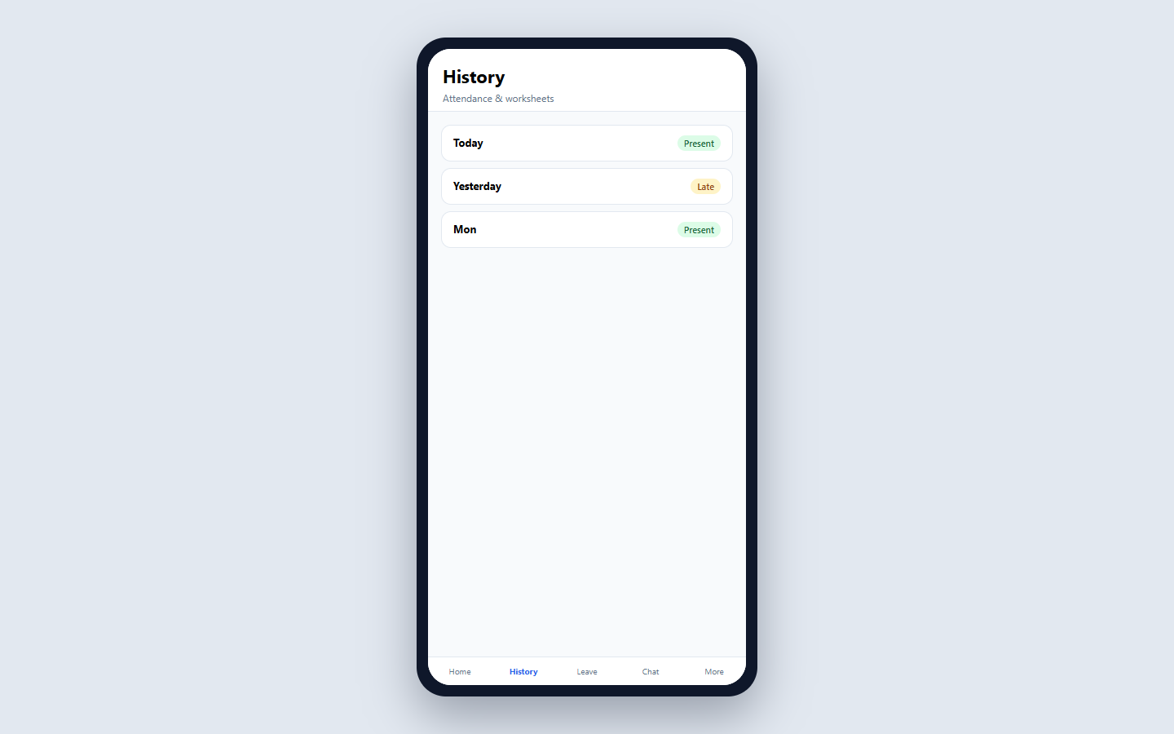
EMPLOYEE APP
History
/history
Past attendance days, holidays, worksheets, multi-day corrections.
• Primary employee surface
• Same org identity as admin portal

Slide 51

EMPLOYEE APP
Leave
/leave
Request leave, see balances/history, submit attendance corrections.
• Primary employee surface
• Same org identity as admin portal

Slide 52
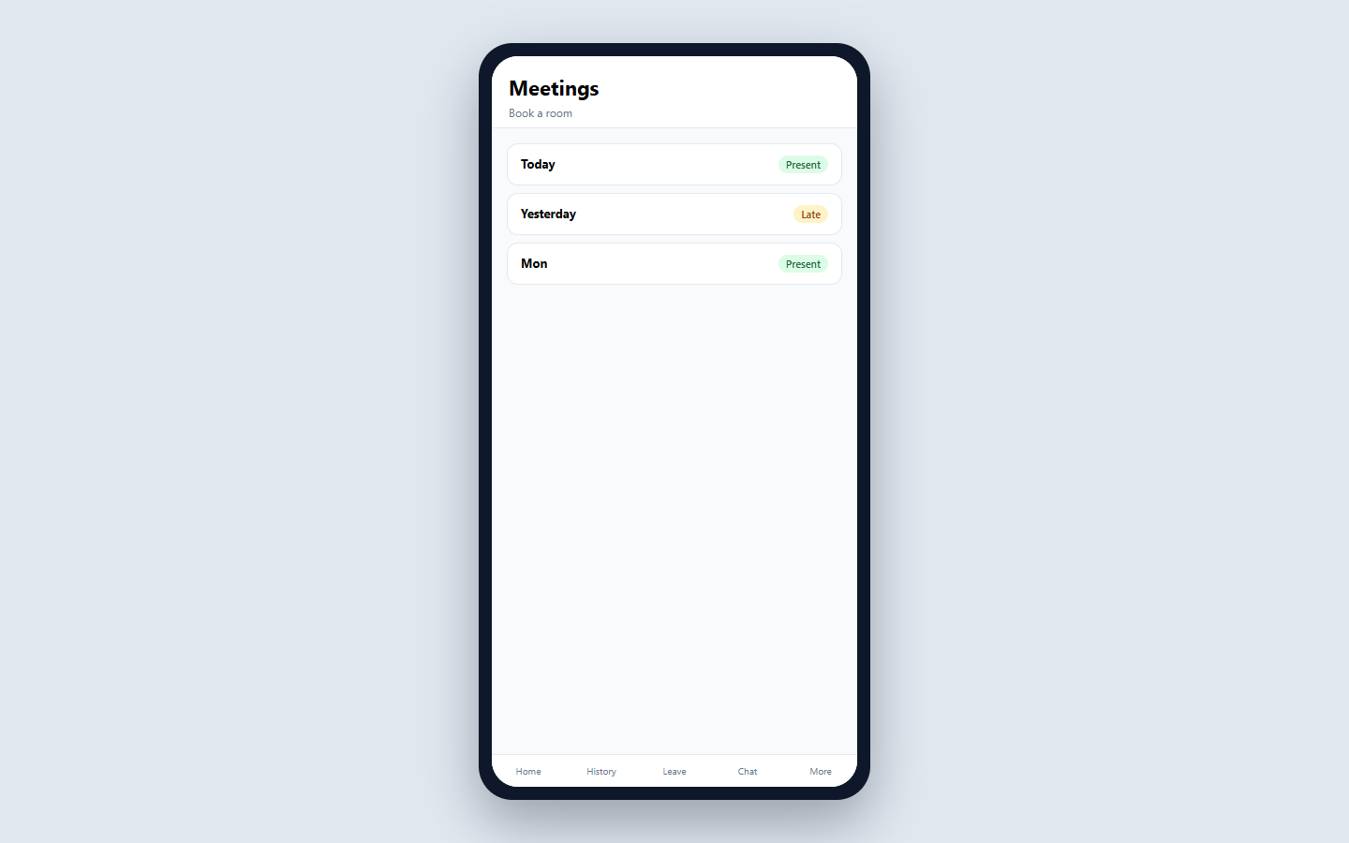
EMPLOYEE APP
Meetings
/meetings
Book meeting rooms and view upcoming bookings.
• Primary employee surface
• Same org identity as admin portal

Slide 53
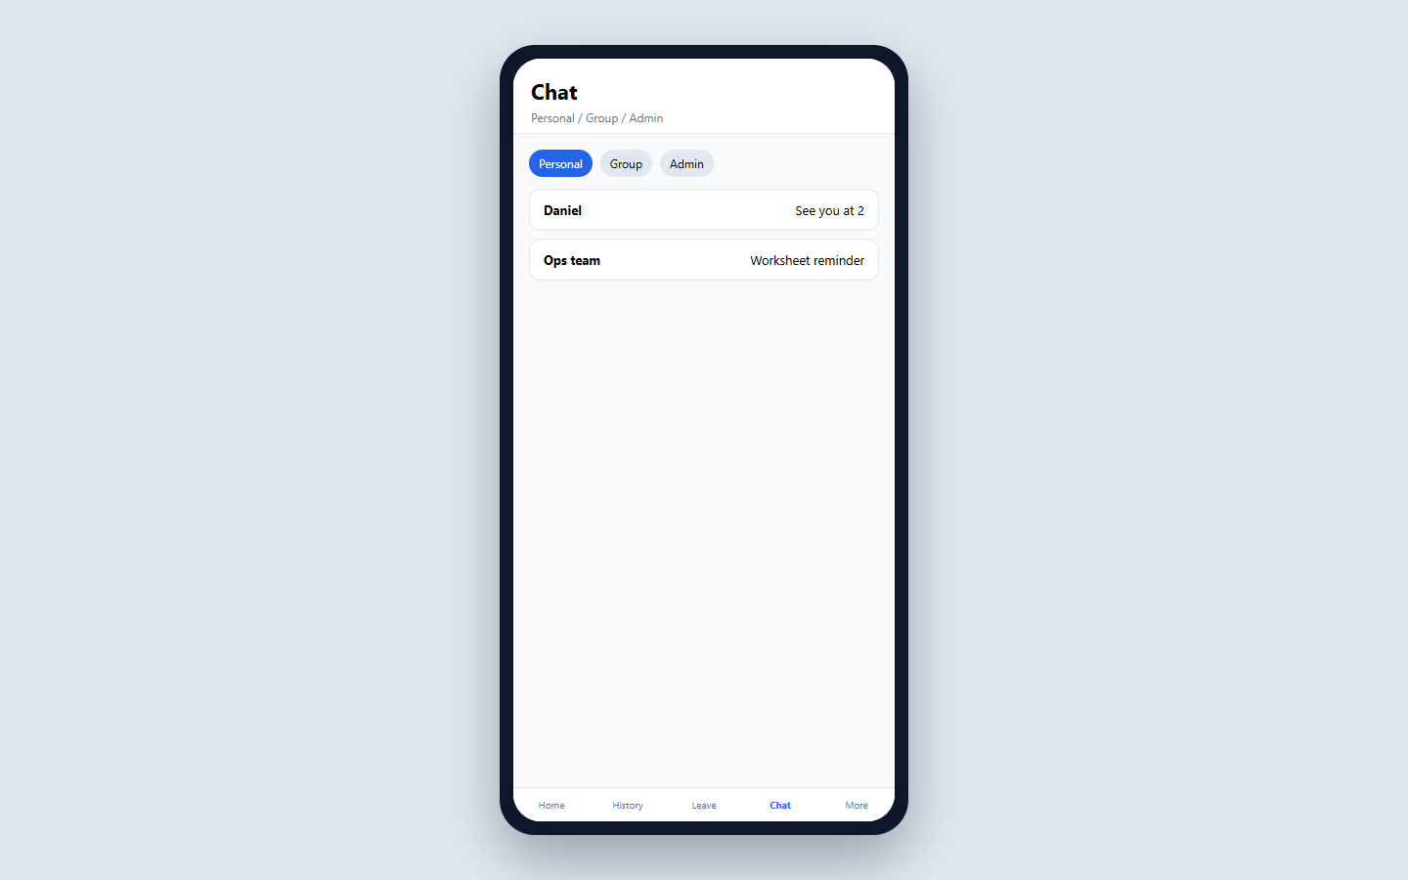
EMPLOYEE APP
Chat
/chat
Personal / Group / Admin tabs — message colleagues and admins.
• Primary employee surface
• Same org identity as admin portal

Slide 54
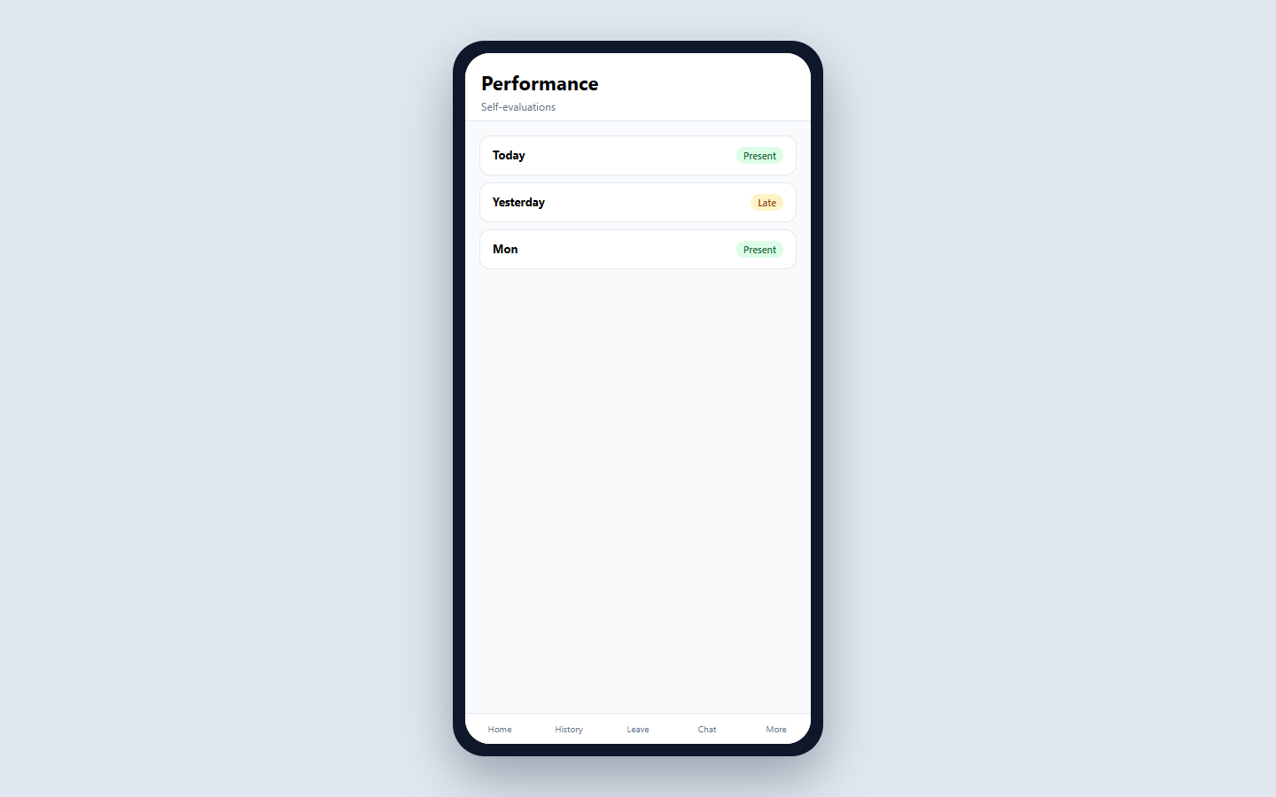
EMPLOYEE APP
Performance
/evaluations
Open and complete self-evaluations when a cycle is active.
• Primary employee surface
• Same org identity as admin portal

Slide 55
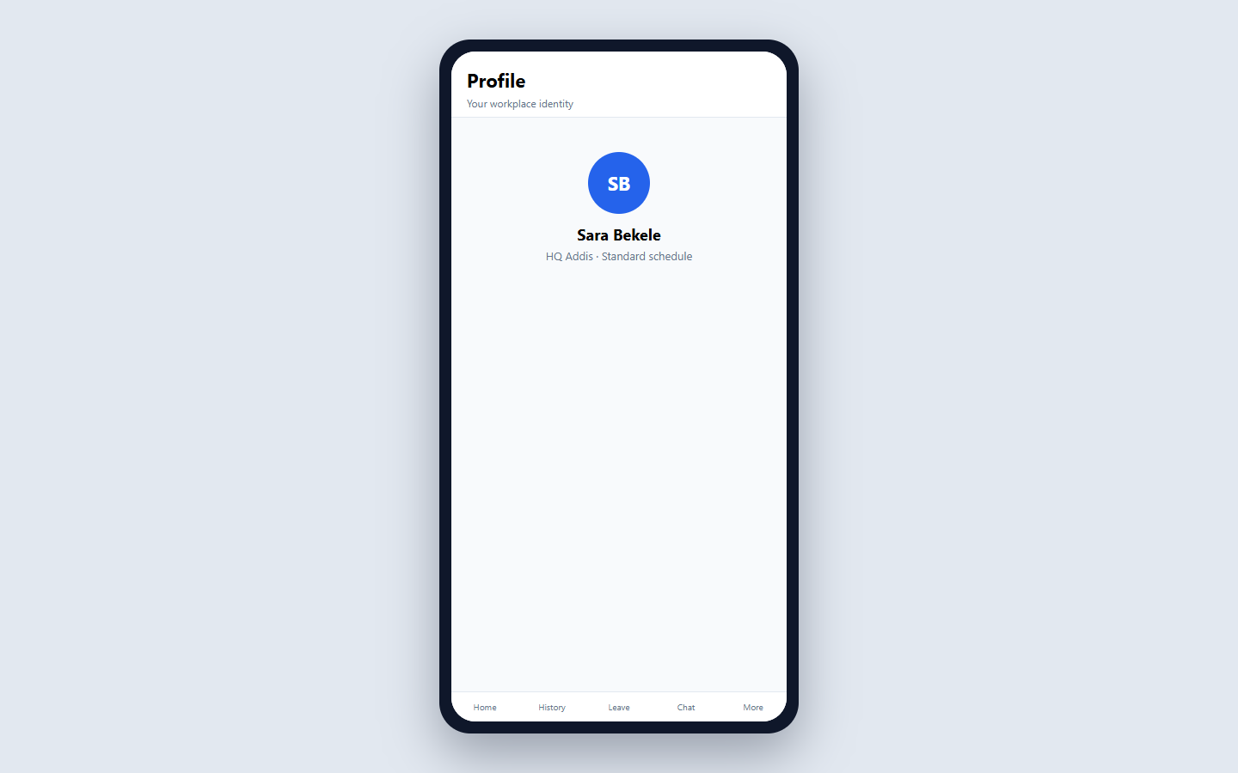
EMPLOYEE APP
Profile
/profile
Identity, job title, office, and schedule.
• Primary employee surface
• Same org identity as admin portal

Slide 56
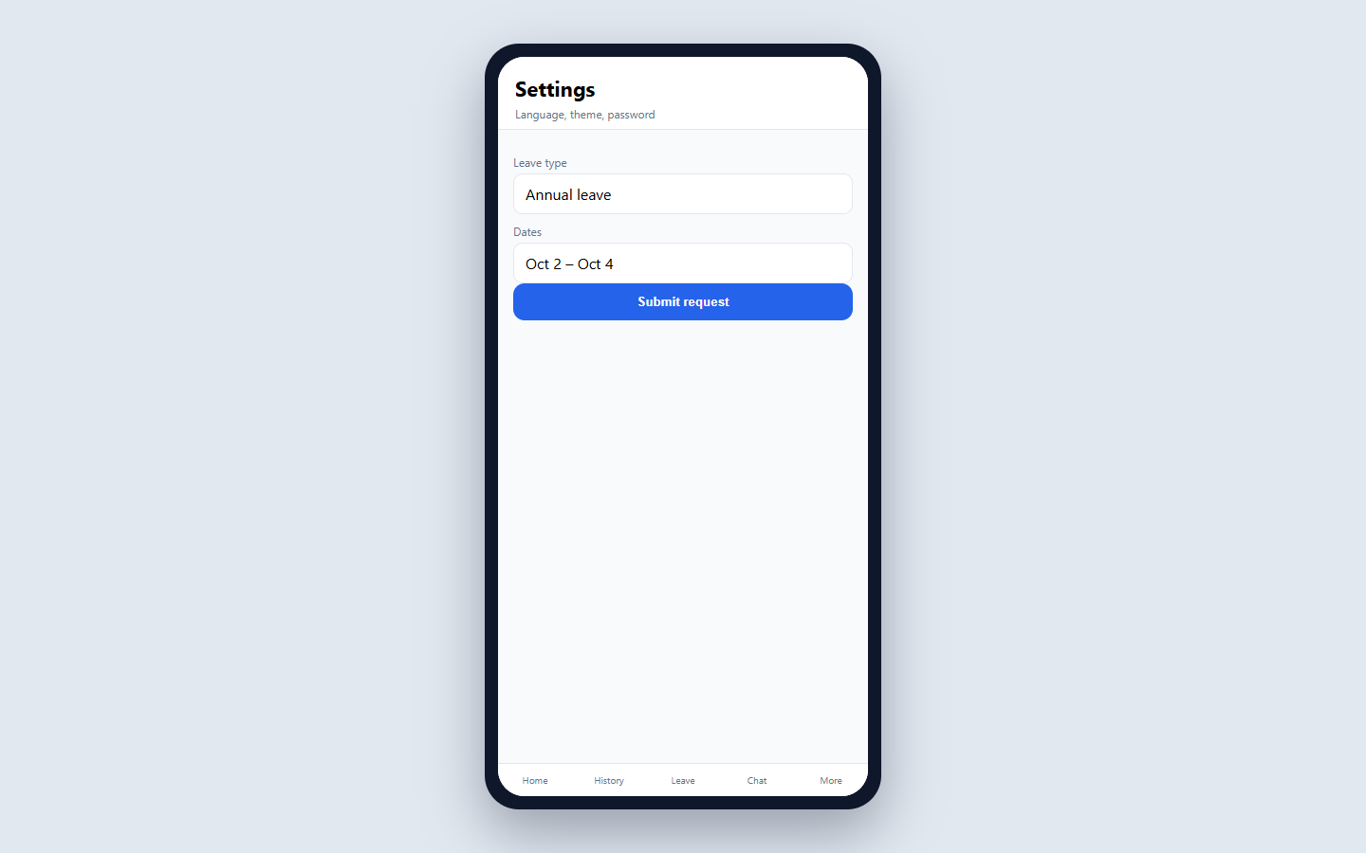
EMPLOYEE APP
Settings
/settings
Language, theme, password change, sign out.
• Primary employee surface
• Same org identity as admin portal

Slide 57

EMPLOYEE APP
Notifications
/notifications
In-app alerts with deep links into leave, attendance, chat, etc.
• Primary employee surface
• Same org identity as admin portal

Slide 58
SECTION E
Lobby Display
Pair a tablet once — then it shows presence and meetings.

Slide 59
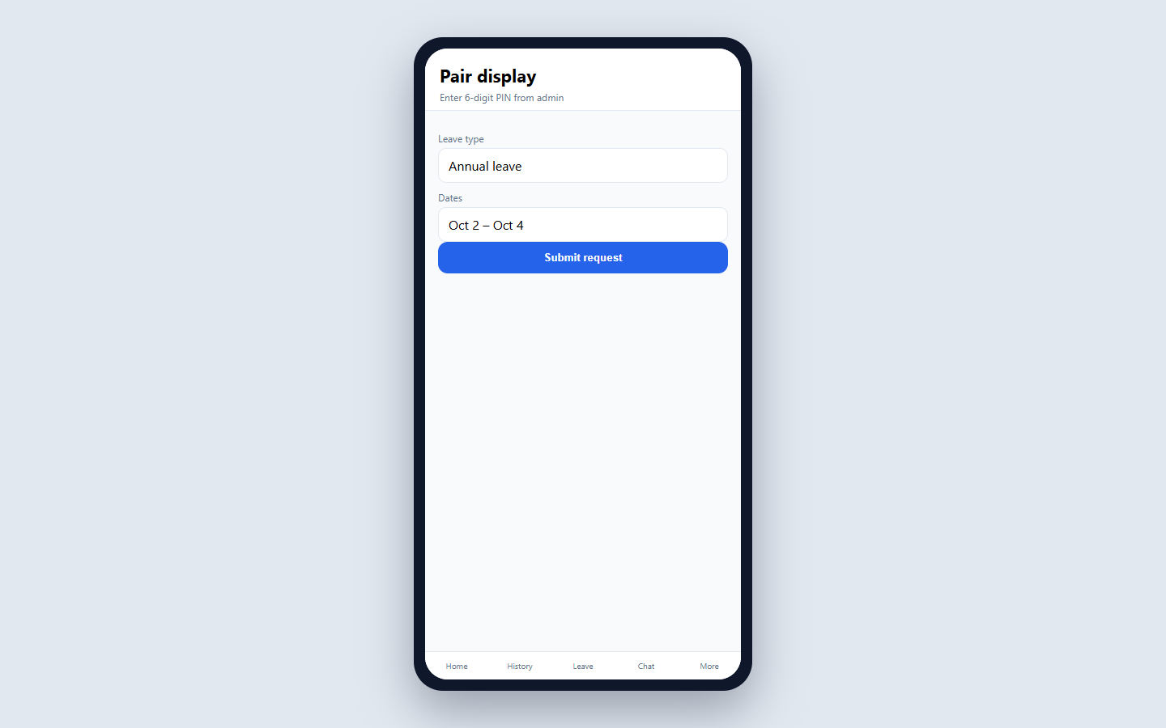
DISPLAY
Pair display
disp_pair
Enter the 6-digit PIN from Admin → Lobby displays to bind the tablet to an office.
• Read-only kiosk
• Bound to one office

Slide 60
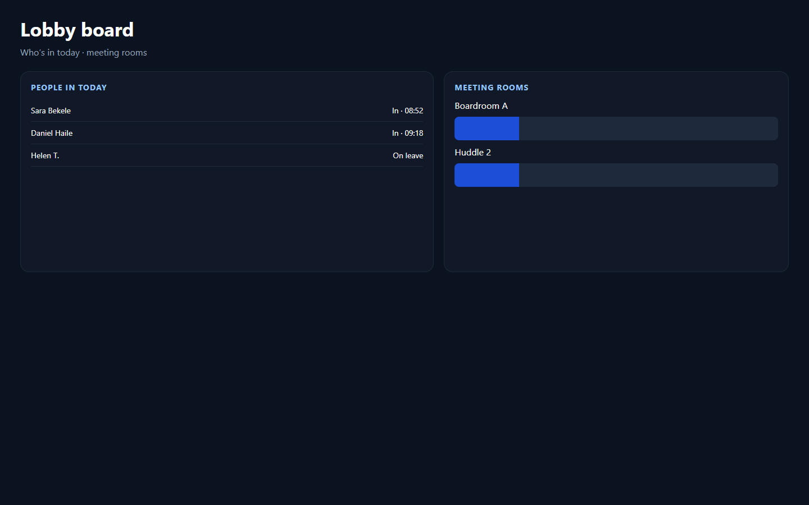
DISPLAY
Lobby board
disp_board
Landscape kiosk: who’s in today and/or meeting-room timelines (rooms / people / both).
• Read-only kiosk
• Bound to one office

Slide 61
SECTION F
Task Operations
Projects and boards for the same company people.

Slide 62
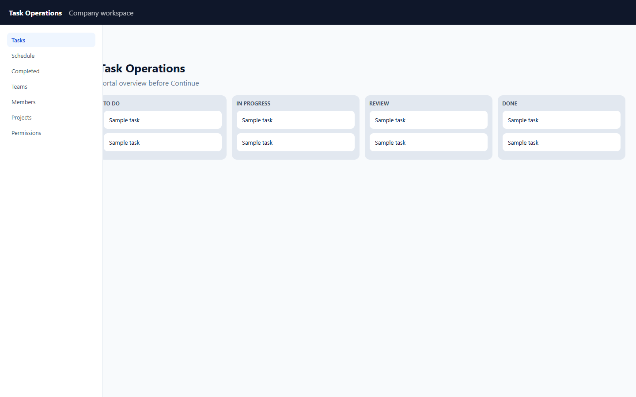
TASK OPERATIONS
Portal overview
tt_overview
Admin Task Operations page: counts, people, recent tasks, Continue button.
• SSO continue from admin
• Own permission matrix

Slide 63
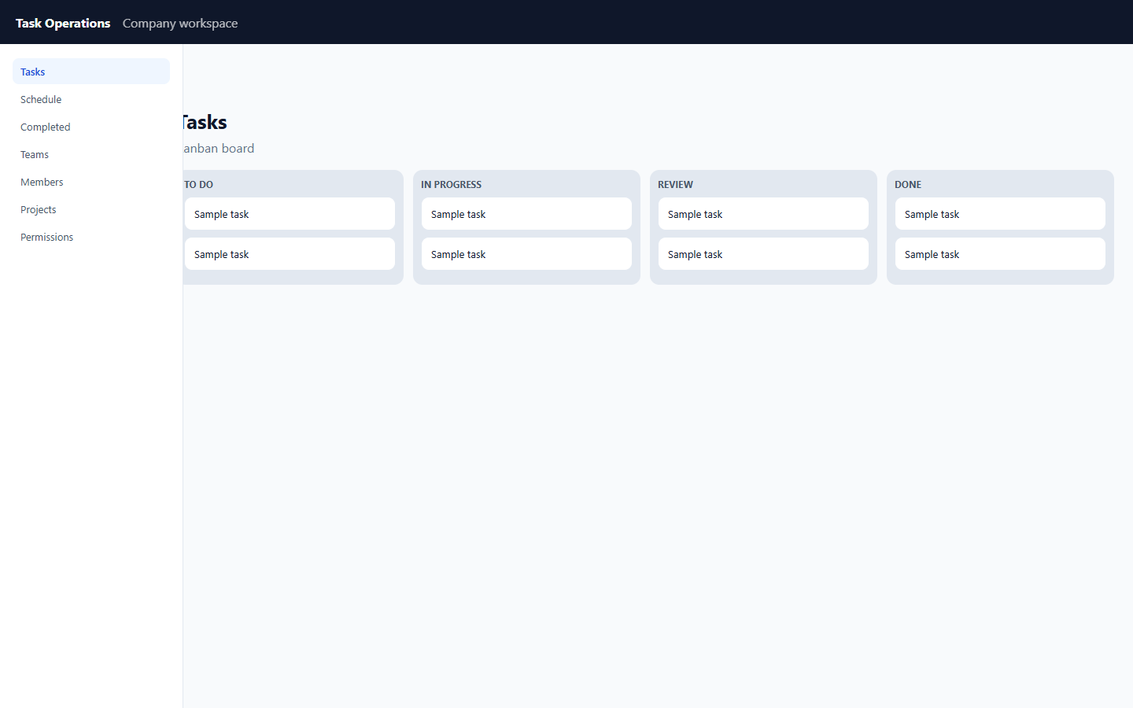
TASK OPERATIONS
Tasks board
tt_tasks
Kanban board filtered by project / team / member.
• SSO continue from admin
• Own permission matrix

Slide 64

TASK OPERATIONS
Schedule
tt_schedule
Week calendar of schedule events with guests and projects.
• SSO continue from admin
• Own permission matrix

Slide 65

TASK OPERATIONS
Completed
tt_completed
Archive of finished tasks.
• SSO continue from admin
• Own permission matrix

Slide 66

TASK OPERATIONS
Teams
tt_teams
Organize people into teams.
• SSO continue from admin
• Own permission matrix

Slide 67

TASK OPERATIONS
Team members
tt_members
Workforce-synced people + Task Ops permission roles.
• SSO continue from admin
• Own permission matrix

Slide 68

TASK OPERATIONS
Projects
tt_projects
Create and manage projects.
• SSO continue from admin
• Own permission matrix

Slide 69

TASK OPERATIONS
Permissions
tt_permissions
Role permission matrix for Task Operations.
• SSO continue from admin
• Own permission matrix

Slide 70
How to present this
1) Start with product map → who signs into which surface
2) Platform: create org + company admin
3) Company: Offices → Schedules → Employees → daily ops
4) Contrast Office Admin (scoped, no company setup)
5) Employee Time Clock → Leave → Chat → Performance
6) Display pairing + Task Operations Continue

