Slide 1
Prepare Your Environment
Please check
https://news.crosscompute.com
for updated instructions.
Today's exercises are online.
https://github.com/invisibleroads/crosscompute-tutorials

Slide 2
Cross-disciplinary Analytics with Python
Roy Hyunjin Han
CrossCompute

Slide 3
Raise Your Hand If You Have Used Python

Slide 4
Sit Next to Someone with More Experience

Slide 5
The Most Important Part of an Analysis

Slide 6
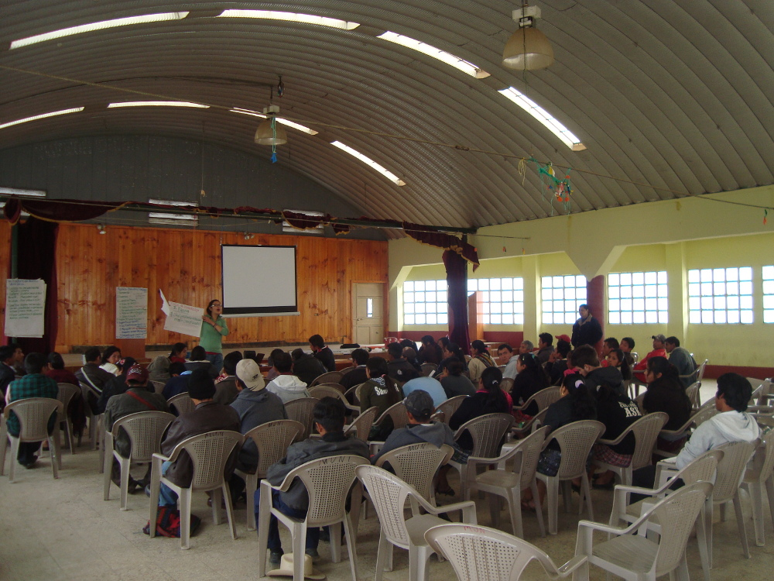
The Most Important Part of an Analysis

Slide 7
Introduce Yourself to Two People

Slide 8
Roy Hyunjin Han
Building systems in Python since 2006
https://github.com/invisibleroads
Emerging Markets
Electricity Infrastructure
Municipal Government
Technology Transfer
Airline Reservation Systems
Retail
Neural Genetics

Slide 9
CrossCompute
Making computational science accessible
Custom browser-based analytics platforms for your business
Hands-on training in large-scale data analysis

Slide 10
Python
http://pyvideo.org/video/976/keynote-raymond-hettinger

Slide 11
000 Set goals for cross-disciplinary analytics hands-on workshop
Prepare environment
Use environment
Prepare datasets
Explore datasets
Analyze datasets

Slide 12
Preview
9:10 0. Basic
9:20 1. Numerical
9:30 2. Temporal
10:10 3. Spatial
10:30 Break

Slide 13
Preview
11:00 4. Computational
11:20 5. Operational
11:30 6. Integrative
12:10 7. Predictive
12:30 End

Slide 14
0. Basic

Slide 15
Prepare Your Environment
Please check
https://news.crosscompute.com
for updated instructions.
Today's exercises are online.
https://github.com/invisibleroads/crosscompute-tutorials

Slide 16
010 Count the number of links on a webpage
Please open notebook #010

Slide 17
011 Explore interactively with IPython

Slide 18
050 Find the fastest path from Brooklyn Bridge to 96th and Broadway

Slide 19
051 Analyze network relationships with NetworkX

Slide 20
Python Package Index (PyPI)
# Pronounce it
http://pypi.python.org/pypi
# Install package in virtual environment
v
pip install --upgrade pyramid

Slide 21
090 Explore the NYC MTA
Subway System
Google PageRank Algorithm

Slide 22
1. Numerical

Slide 23

100 Animate a heatmap

Slide 24
111 Work with Matrices in NumPy
Boolean Mask

Slide 25
121 Apply optimized algorithms from SciPy
# Optimize rations

Slide 26
131 Visualize with Matplotlib
http://matplotlib.org/1.2.0/examples/pylab_examples/streamplot_demo.html

Slide 27
2. Temporal

Slide 28
200 Find Regions with Recent Earthquakes
Merge
Group By
Apply
Resample

Slide 29
211 Model Time Series with Pandas
Boolean Mask
Column Selection

Slide 30
210 Explore 311 Service Request Distributions

Slide 31
251 Compute statistics with StatsModels

Slide 32
3. Spatial

Slide 33

Spatial Reference Gives Meaning to (47, 62)
http://etsy.me/T50629

Slide 34

Spatial Reference Gives Meaning to (47, 62)

Slide 35
300 Count Graffiti Sightings within 100 Feet of a Subway Entrance
Spatial Reference Transformation
KDTree
RTree

Slide 36
321 Analyze spatial relationships with GeometryIO, Shapely, PySAL
Query by distance
Spatio-temporal correlations

Slide 37
Break

Slide 38
Preview
11:00 4. Computational
11:30 5. Operational
11:40 6. Integrative
12:20 7. Predictive
12:30 End

Slide 39
4. Computational

Slide 40
401 Harness Machine Learning with Scikit-Learn
http://scikit-learn.org/dev
Model Selection
Pipeline
Grid Search
History of the Kalman Filter

Slide 41
5. Operational

Slide 42
501 Discuss practical considerations in real-world applications
Chunk large CSV files
Use h5py
Use numpy.memmap
Limit columns in DataFrames
Use lru_cache or dogpile.cache

Slide 43
6. Integrative
Rank the influence of alcohol and chocolate on marriage age
Estimate Big Mac prices from World Bank contracts

Slide 44
600 Rank the Influence of Alcohol and Chocolate on Marriage Age

Slide 45
620 Estimate Big Mac Prices from World Bank Contracts

Slide 46
7. Predictive

Slide 47
Packages
Numerical NumPy, SciPy, Matplotlib, PyTables, h5py
Temporal Pandas
Spatial GDAL, GEOS, PROJ.4, Shapely, GeometryIO, PySAL, HPGL
Textual NIMFA, NLTK, Pattern
Computational Scikit-Learn, StatsModels, NetworkX, Theano
Python Package Index (PyPI)

Slide 48
Resources
Conferences PyCon, PyData
Videos PyVideo
Texts The Python Tutorial by the Python Software Foundation
Python for Data Analysis by Wes McKinney
Think Python by Allen B. Downey
Programming Python by Mark Lutz
Websites SingPath by Sandra Boesch and Chris Boesch

Slide 49
Acknowledgments
Python Software Foundation
IPython: Fernando Perez, Brian E. Granger, Benjamin Ragan-Kelley, Thomas Kluyver, Bradley M. Froehle
Pandas: Wes McKinney, Chang She
Scikit-Learn: David Cournapeau, Gael Varoquaux, Olivier Grisel, Jake VanderPlas, Alexandre Gramfort
NYC Mayor's Office: Michael Flowers, Nick O'Brien, Benjamin Dean, Catherine Kwan, Lauren Talbot
O'Reilly Media: Sophia DeMartini
Republic Polytechnnic: Beng Keat Liew
Modi Research Group: Alex Dorey, Freeza Huang, Chris Natali
Cathaleen Kaiyoorawongs, Chunghee Han, Jake Maslow

Slide 50
Thank you!
CrossCompute is a team of experts specializing in building browser-based analytics platforms for startups, businesses and organizations. We work with clients to understand their needs, integrate tools from researchers to meet those needs and boost local capacity through written tutorials and hands-on training in large-scale data analysis.
Office Hour
Wednesday, October 24
1:40pm, Rhinelander North (Table C)
support@crosscompute.com

