Slide 1
CROSSFUZE / SALES ENABLEMENT
INTERNAL ONLY · DO NOT PRESENT
Meeting breakdown & sales process
From an executive AI readiness conversation to an evidence-led, paid delivery engagement.
01
MEETING 1
02
ASSESSMENT
03
MEETING 2
04
AI RUNSTATE
Executive discovery · 30–45 min
Evidence-led workshop · 90 min
Working session · 45–60 min
Paid delivery · 12 months
Create the case for readiness
Establish the first decision
Turn findings into a delivery plan
Plan. Prioritise. Ship.
›
›
›
Connect AI ambition to the ServiceNow AI Readiness Gap. Establish business priorities, risks and a potential first outcome.
Review seven readiness dimensions, controls and indicative consumption. Capture uncertainties, owners and a candidate use case.
Walk the dependencies, Permission to Automate, Assist assumptions and first 90-day priorities. Agree measures and decision owners.
AI Action Plan, up to four backlog cycles and Extend capacity (80 hours a month for nine months). Release and measure governed outcomes.
ADVANCE WHEN
OUTPUT
ADVANCE WHEN
RESULT
90-minute assessment agreed
AI Readiness Decision Brief
Sponsor and scope agreed for quote
Continuous, measurable delivery
QUOTE / APPROVAL
After Meeting 2: issue a scoped 12-month AI RunState proposal and quote (priority outcomes, first 90-day plan, investment). Customer approves scope, price and terms before paid delivery starts.
INTERNAL ONLY • HIDDEN IN SLIDE SHOW • PRESENT FROM SLIDE 2 • EXAMPLE SCORES AND TIMINGS REMAIN PROVISIONAL
Notes:
INTERNAL FACILITATOR PAGE — DO NOT PRESENT. This slide is intentionally hidden.
Sales process: (1) Meeting 1 is the original 30-slide executive AI Readiness narrative. Aim to secure consent for the 90-minute assessment, not to close RunState in the first conversation. (2) The assessment is evidence-led; the free self-serve tools can be used before it. Record evidence, limitations, owners, risks, possible first outcome, and indicative Assist consumption in the AI Readiness Decision Brief. (3) Meeting 2 is this separate technical/commercial follow-up. Confirm the use case, technical dependencies, Permission to Automate, measures, workload and first 90 days. Invite CIO/platform owner, process owner and governance/commercial decision makers as appropriate. (4) AI RunState is a paid 12-month advisory, backlog and Extend delivery engagement: 2 advisory reviews, up to 4 backlog cycles, and Extend 80 hours per month for 9 months.
Commercial stage gates are suggested sales guidance, not agreed customer commitments. Keep results provisional until verified. Do not share this hidden internal overview page with customers. Begin Meeting 1 on slide 2; use the separate 14-slide Meeting 2 presentation after the assessment.

Slide 2


EDITION 2026
THE CROSSFUZE GUIDE TO AUTONOMOUS IT
The Road
to Zero.
How ready are you to let AI act?
Part of Preparing for the Autonomous Enterprise
Crossfuze · ServiceNow Elite Partner
Notes:
OPENING | Buyer situation, not technology catalogue. 'You've invested in ServiceNow and AI. Where are results proving difficult? Today we'll focus on which operating outcome matters first, what might be stopping safe execution and whether a 90-minute assessment would help.' Keep the cover's approved Road to Zero framing.
--- EXISTING FACILITATOR NOTES ---

Slide 3
AI leadership priorities
MANAGING TECHNOLOGY IN 2026
Risk
Know which agents are running, what they may do, and how to stop them.
Innovation
Move high-value use cases from experiments into governed production.
Strategy
Unify disconnected AI initiatives around accountable, measurable business outcomes.
Notes:
BUYER PRIORITIES | Ask which of strategy, risk or innovation is currently most visible to their leadership. Let the buyer rank the pressures. Do not assume all three are equally urgent.
--- EXISTING FACILITATOR NOTES ---

Slide 4



Turn AI ambition
into business value
?
?
?
?
?
AI in
production
Trusted
data
Governed
agents
Assist
consumption
Measurable
outcomes
Prioritize impact
© 2026 Crossfuze. All Rights Reserved.
Notes:
BUYER SCORECARD | Invite current baselines: pilots reaching production, safe data coverage, owned knowledge, known agents, consumption estimates and measurable value. All question marks are prompts, not claims.
--- EXISTING FACILITATOR NOTES ---
THE AI SCORECARD
Ask the audience what is on their current AI scorecard. How many pilots reach production? How much of the data can the agents safely trust? Can they identify and govern their agents? Do they know the likely Assist consumption and tier fit? Can they show measurable outcomes?
The challenge is not a shortage of potential use cases; it is knowing which use cases can be run safely and economically. The five placeholders are questions, not invented measurements.

Slide 5





We've invested in AI.
Where are the results?
!
!
!
!
!
CIO
Platform Owner
AI / Knowledge Lead
CISO
Finance / Procurement
Pilots never
reach production
Unreliable data
limits AI decisions
Knowledge and agents
lack clear owners
Unapproved agents
expand risk
Consumption and value
remain uncertain
© 2026 Crossfuze. All Rights Reserved.
Notes:
BUYER-FIRST OPEN | Ask: 'We've invested in AI. Where are the results?' Invite the CIO to describe the business pressure behind AI investment: incidents and requests still arriving, pilots not in governed production, unclear outcome evidence and Assist economics. Use the five role cards as conversation prompts, never as facts about this customer. Do not imply the customer's teams are the problem.
--- EXISTING FACILITATOR NOTES ---
AI LEADERSHIP IS STRUGGLING
These are the practical symptoms we hear: three promising pilots but none in production; CMDB and service data cannot be relied on; knowledge is unowned or outdated; leaders cannot account for every agent; and Finance cannot explain the projected consumption or value.
These are common diagnostic prompts, not a claim that every customer experiences all five. The customer is the hero in this story; avoid implying their teams are the problem. The underlying readiness of the estate determines how safely they can deploy AI.

Slide 6







Autonomous IT is the promise.
Readiness makes it real.
✓
✓
✓
✓
✓
CIO
Platform Owner
AI / Knowledge Lead
CISO
Finance / Procurement
A clear first
AI use case
Dependable data
for action
Owned knowledge
and agents
Permission to act
within limits
Modeled usage
and business value
Evidence creates permission to act.
© 2026 Crossfuze. All Rights Reserved.
AI Platform
Notes:
BUYER VALUE | Map each operational problem to a prerequisite the customer would recognise: a first target use case, dependable data, owned knowledge, Permission to Automate and consumption/value modelling. The green checks show capabilities to validate, not evidence of readiness.
--- EXISTING FACILITATOR NOTES ---
AI IS THE PROMISE. READINESS MAKES IT REAL.
Each problem has an achievable next step: pick one valuable use case; prove that the data is dependable; put ownership around knowledge and agents; define Permission to Automate; and model Assist consumption alongside the outcome.
This is evidence-led progression, not a claim of zero risk or automatic production readiness. The green checks mean prerequisites to investigate and satisfy. Crossfuze measures readiness and identifies the limiting foundation.

Slide 7



Autonomy Is Earned.
The Five Zeros Of Autonomous IT.
Head of Service Desk
Head of Tech Operations
Head of Asset Mgmt.
CISO
Head of Strategy & Planning
0
0
0
0
0
Touch
Support
Service
Outages
Asset
Issues
Severe
Breaches
Misaligned
Investments
For Autonomous IT, the Five Zeros describe the destination. Readiness determines where you begin.
* Projected outcomes shown are illustrative, not guaranteed.
© 2026 Crossfuze. All Rights Reserved.
Notes:
FIVE ZEROS | Invite the customer to select the operating pain they would reduce first. ServiceNow's Five Zeros are directional outcomes, not a promise of literal zero. Preserve the approved Five Zero names and 'Autonomy Is Earned'.
--- EXISTING FACILITATOR NOTES ---
AUTONOMY IS EARNED — FIVE ZEROS TO PURSUE
Preserve ServiceNow's Five Zeros: Zero-Touch Support; Zero Service Outages; Zero Asset Issues; Zero Severe Breaches; Zero Misaligned Investments. These are directional north stars, not guaranteed results. Every step towards Zero returns capacity to a team.
The sensible first Zero is not necessarily the most dramatic. Start where business value is high and the readiness gap is smaller. Crossfuze's readiness approach also serves Business Re-Invention across functions such as HR, Finance and Procurement, without renaming the IT-specific Five Zeros.

Slide 8







Autonomous Workforce
Head of Service Desk
Head of Tech Operations
Head of Asset Mgmt.
CISO
Head of Strategy & Planning
Service Desk
AI specialists
IT Operations
AI specialists
Asset
AI specialists
Security
AI specialists
Strategy & Planning
AI specialists
Autonomous
Triage, assess,
& resolve P3,
P4 issues
Triage incoming events, engage team & agents
to resolve issues
Proactively manage asset estate &
inbound requests
Triage, organize & distribute incoming security incidents
Align, automate, &
recommend planning
& resourcing
Head of Service Desk
Head of Tech Operations
Head of Asset Mgmt.
CISO
Head of Strategy & Planning
Self-service
resolution for
top call drivers
Remediation
playbooks with observability solution
Optimize and automate asset lifecycle events
Orchestrated remediation for prioritized exposures
Automate
planning
Automate
Business Value
Self-service advice
for top call drivers
Clarify
events &
blast radius
Understand
& query about
asset estate
Identify, prioritize, & remediate security events quickly
Empower teams to prioritize portfolios and planning
Insight
Service
Operations
Asset
Security/Risk
Portfolio
Technology Workflow Products
AI Platform
Workflows
Autonomous, Scalable, Self-healing
AI
AI Control Tower, AI Agent Orchestration, Now Assist
Data
Knowledge Graph, Raptor DB, Workflow Data Fabric
Notes:
Confidence Monitor:
• Walk bottom-up — Insight → Automate → Autonomous
• Most customers live in the bottom two rows today
• Business value grows as you move up
• We can layer AI as fast — or measured — as they want
• End state: self-healing, self-learning, self-defending
Practice Script:
Five columns, one per persona. Let’s walk this from the bottom-up.
Most organizations are somewhere between Insight and Automate today. The Autonomous row is the destination — AI Specialists handling work end-to-end, the system learning and improving with every resolution.
The good news: you don't have to get there all at once. We have ways to layer in AI capability that match your pace — whether you want to start focused and expand, or move aggressively toward full autonomy from the start. How fast you want to move and how much value you want to realize sooner rather than later is a conversation worth having.
That's what self-healing, self-learning, and self-defending looks like in practice.
[CLICK]

Slide 9



Think beyond pilots.
Aim for transformation.
AI that completes work — grounded in trusted data, guided by workflows, and bounded by clear controls.
CIO
© 2026 Crossfuze. All Rights Reserved.
Notes:
THINK BEYOND PILOTS. AIM FOR TRANSFORMATION.
The real shift is from agents that demonstrate capability to AI that completes work under known rules. That requires trusted data and knowledge, dependable workflows, and policies that make clear what AI may act on, when it must ask for approval, how it hands over, and how to stop or reverse actions.
TRANSITION TO ACT TWO: ServiceNow brings the AI capability. Crossfuze helps the enterprise decide what it can safely do, then turns that decision into an ongoing delivery plan through AI RunState.

Slide 10

4000+
500+
ServiceNow
implementations
ServiceNow
certifications
Who can help turn AI ambition into outcomes?
1m+
11
Consulting hours delivered
CMA and CTA architecture programmes gradudates
© 2026 Crossfuze. All Rights Reserved.
Notes:
BUYER-FIRST POSITION | This is a credibility bridge, not the reason the buyer is here. Start with their first outcome and the barriers to delivering it. Crossfuze experience provides supporting evidence, not a customer-specific guarantee. Confirm the current approved proof points before external publication.
--- EXISTING FACILITATOR NOTES ---
ACT 2 — SERVICE NOW BUILT FOR THIS MOMENT
ServiceNow's published figures establish the scale of its platform: 85%+ of the Fortune 500, 100K+ enterprise AI apps in production, 95B+ workflows powered annually, and a 97%+ renewal rate over 20+ quarters. These are ServiceNow's published claims, not Crossfuze results. Verify the latest ServiceNow proof and approved use before external distribution.
THE CROSSFUZE BRIDGE
Scale proves the platform opportunity. It does not prove the maturity of any customer's individual implementation. The difference between what the AI Platform can do and what an enterprise can responsibly permit AI to do is the starting point for Crossfuze AI Readiness.
Transition: If the platform has the capacity, what kind of work is the Autonomous Workforce able to take on?

Slide 11
Meet your
Autonomous Workforce
AI Specialists
Agentic Workflows
AI Agents
Do jobs end-to-end
Scoped to a specific process
Do specific, singular tasks
Can be deployed in a few clicks
Use tools (GenAI skills, Flows, etc.)
Encompass multiple tasks
Are modular
Coordinate many AI agents and tools
Involve multiple AI agents
Require some configuration
Require orchestration
Have assigned roles, skills, and rules
Can be orchestrated to complete an individual workflow
Initiated by a prompt or trigger
Learn and improve over time
2024
2025
2026
© 2026 Crossfuze. All Rights Reserved.
Notes:
BUYER SITUATION | Before showing ServiceNow Autonomous Workforce, ask which tasks remain high-volume, expensive or risky. Present platform capabilities as possible answers, subject to estate readiness and contracted rights.
--- EXISTING FACILITATOR NOTES ---
MEET YOUR AUTONOMOUS WORKFORCE
Preserve the ServiceNow hierarchy as shown: AI Agents (2024), Agentic Workflows (2025) and AI Specialists (2026). The source slide describes AI specialists as agents that do jobs end-to-end, coordinate AI agents and tools, have assigned roles and rules, and learn over time. Present these as platform capabilities rather than guaranteed outcomes of any customer installation.
Crossfuze implication: an agent's technical capability is not the same as permission to act in a particular business. The customer's data, knowledge, workflows, controls and operating ownership set the current ceiling.
Transition: A specialist can do more than suggest — it can complete work. What makes that compelling?

Slide 12


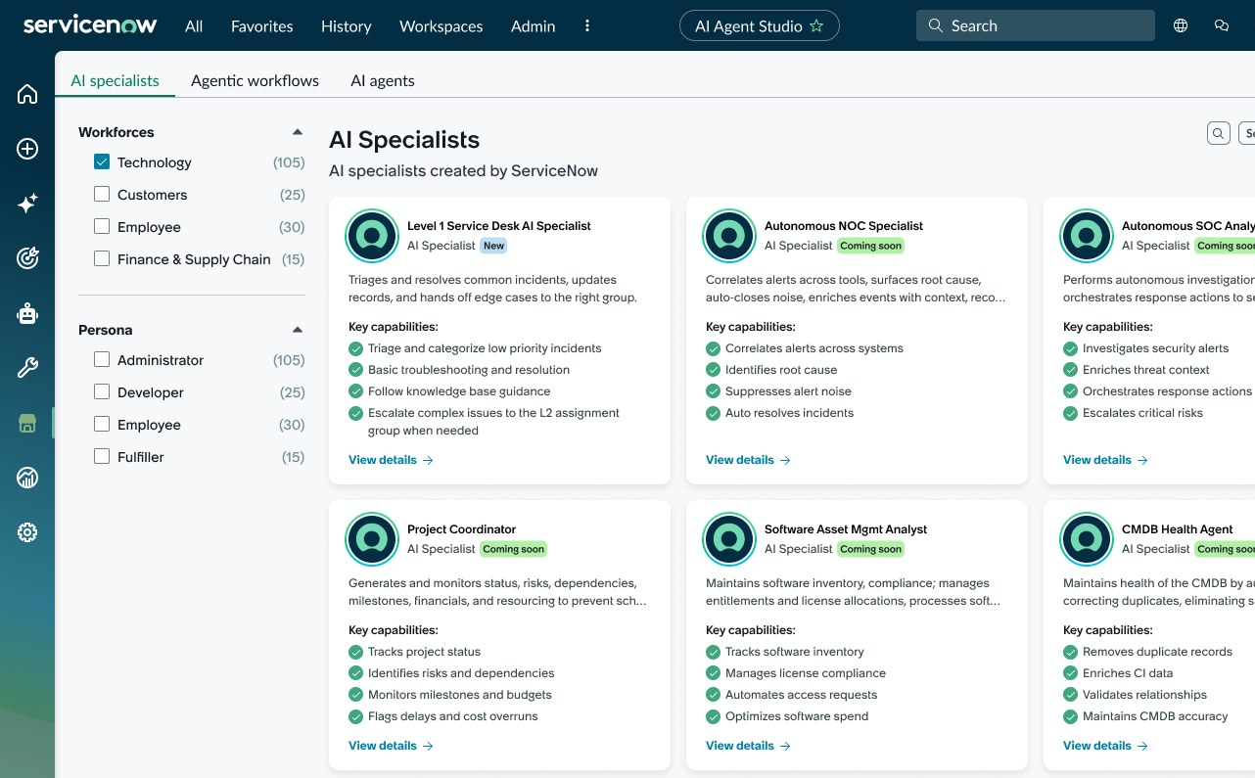
ServiceNow Autonomous Workforce
Introducing domain-specific AI specialists that do jobs, not just tasks
Where could AI free up capacity?
Realize compounding value as
AI specialists learn and improve
Easily deploy AI specialists with built-in context and security
© 2026 Crossfuze. All Rights Reserved.
Notes:
BUYER-FIRST FRAME | Ask which repetitive or constrained work is absorbing capacity in the customer's IT operation. The autonomous workforce is a possible capability, but the buyer's desired result, ownership and constraints come first. Do not imply instantaneous capacity or deployment.
--- EXISTING FACILITATOR NOTES ---
SCALE YOUR TEAM WITH INSTANT CAPACITY
ServiceNow's product story is compelling: domain-specific AI specialists can perform jobs rather than simply make task suggestions, learn and improve with use, and be deployed with existing security and context.
For Crossfuze, the buyer's practical questions are: which use cases do we permit first; what data may the specialist access; whose approval is needed before a sensitive action; how do we trace and stop it; and who is accountable when exceptions occur?
Avoid implying that out-of-the-box availability means a customer's estate has been assessed, configured, governed or licensed for every workload.

Slide 13


AI specialists
IT Team
Status update requests
Do the work
that matters most
Improve service quality
L1 triage
Password resets
Reduce response times
Access provisioning
Manage growing complexity
Ticket routing
Software deployment
Address staffing shortages
Vulnerability scanning
Which workflows are ready
to run safely?
Reduce cybersecurity risks
Remediation tracking
AI Platform
© 2026 Crossfuze. All Rights Reserved.
Notes:
BUYER EXAMPLES | Use these use cases as prompts. Ask which one is relevant to the customer's operational backlog; do not assume feasibility, entitlement or delivery timing.
--- EXISTING FACILITATOR NOTES ---
DO THE WORK THAT MATTERS MOST
The source contrasts tasks an AI specialist can perform — updates, triage, password resets, routing, provisioning, vulnerability scanning — with what the IT team gets back: service quality, faster responses, less complexity, fewer staffing constraints, better cybersecurity outcomes.
ASK: Which of these workflows would be the most useful in your organisation? Then ask the harder question: can you show enough evidence to allow AI to execute this workflow safely?
Crossfuze identifies the first use case at the intersection of business value and readiness, rather than declaring all the workflows ready because ServiceNow can technically support them.
The same decision logic also applies outside IT, but these examples intentionally preserve the original ServiceNow Autonomous IT frame.

Slide 14







AI pacesetters turned AI into real business value
90%
210K
87%
reduction in event incident tickets
tickets resolved
automatically
each month
increase in overall
self-service rate
33%
3,400
15–25
reduction in mean
time to resolve
hours of IT staff productivity savings
per month
minutes saved
per major incident
18%
576
22%
reduction in incidents escalated to an expert
days saved through
automated request processing
increase in
developer
productivity
© 2026 Crossfuze. All Rights Reserved.
Other company and product names may be trademarks of the respective companies with which they are associated.
Notes:
PROOF HANDLING | External company success examples illustrate market possibility, not guaranteed Crossfuze or customer results. Attribute any case-study numbers and distinguish observed results from projected outcomes.
--- EXISTING FACILITATOR NOTES ---
SERVICE NOW AI PACESETTER EVIDENCE
The original ServiceNow presentation contains a nine-tile grid of customer outcome examples, including reductions in event tickets and mean time to resolve, automated ticket handling, savings in staff hours, self-service gains and employee productivity. The figures and logos are retained from the supplied source. These are ServiceNow/customer proof points, not Crossfuze results.
Important: proof of potential does not mean a different customer's instance will deliver the same results. Verify approved attribution, definitions and source dates before external sales use. Do not combine metrics from different customers into one guaranteed outcome.
TRANSITION: Enterprise AI value is measurable. Which outcome should the customer's readiness investment target first?

Slide 15
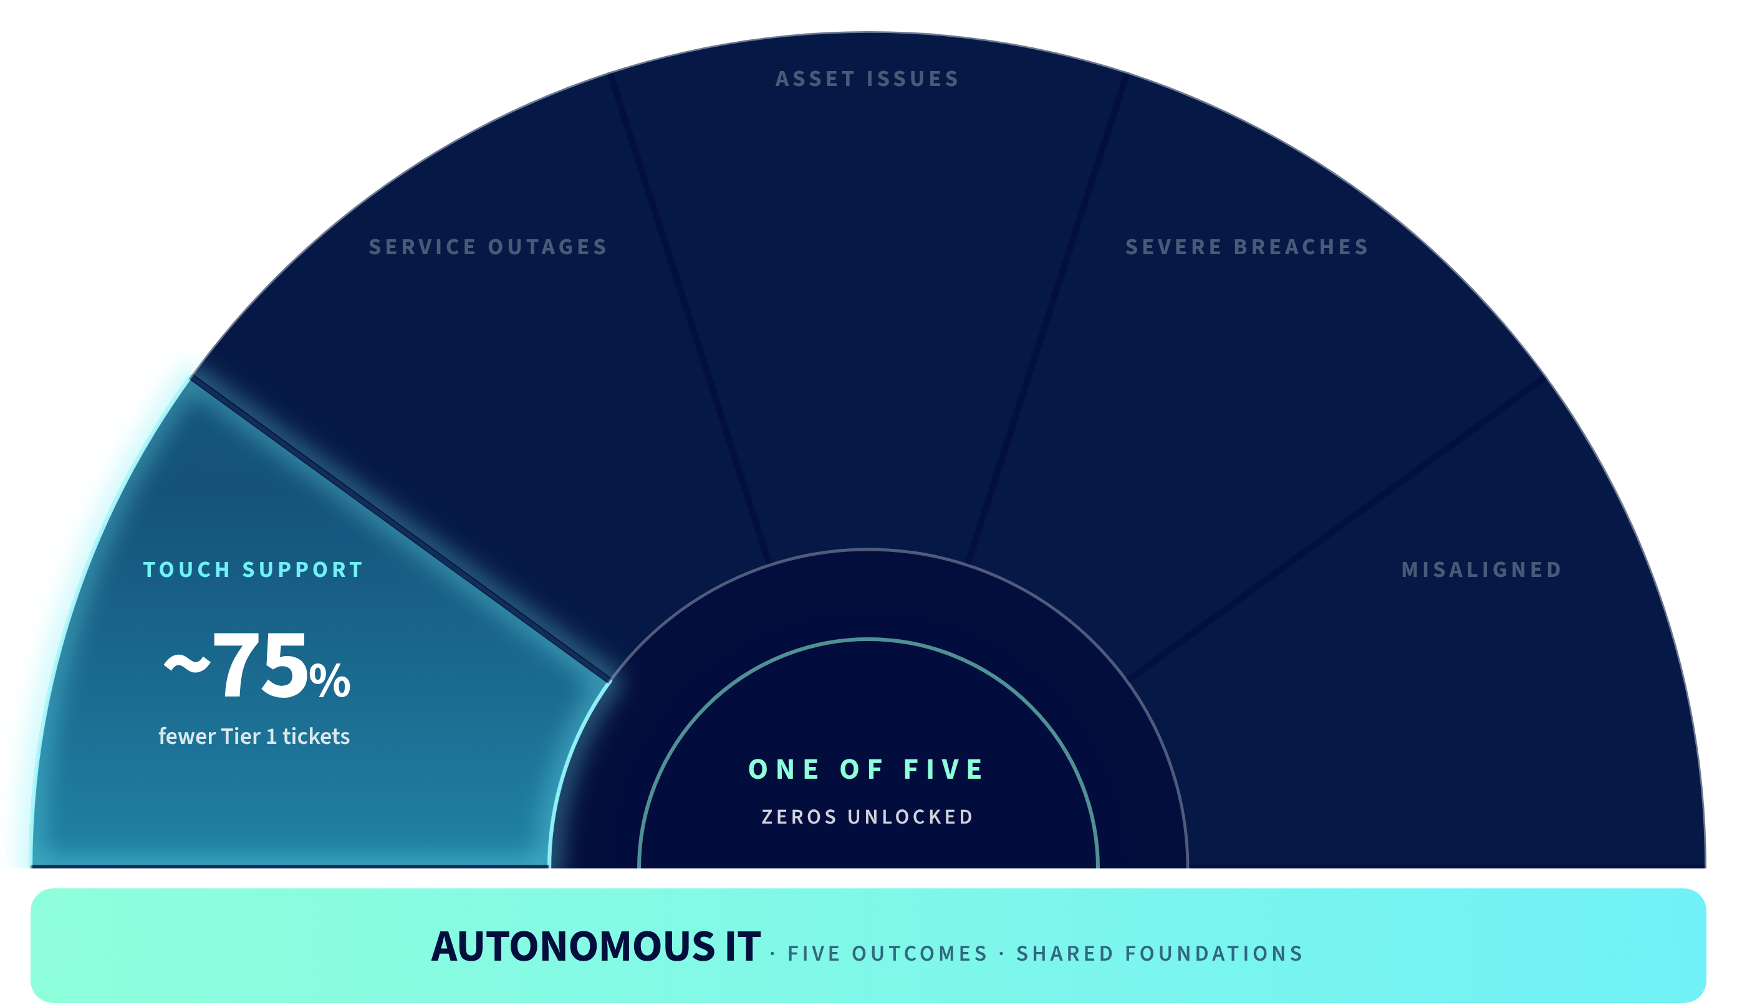



Autonomous IT: Building exponential value
© 2026 Crossfuze. All Rights Reserved.
Notes:
SERVICE MANAGEMENT — THE STARTING SCORECARD
Source slide shows ~30% potential reduction in Tier 1 tickets in Service Management. It is a directional ServiceNow benchmark. It is not a Crossfuze delivery forecast and should not be presented as automatic.
This is the first step of a useful visual contrast. Later slides build from service-management automation to broader Autonomous IT outcomes.
For the customer, start with current incident volumes, ticket mix, deflection eligibility, workflow complexity, quality of knowledge, staffing baseline and Assist entitlement. Even a promising ROI estimate is not credible without those facts.
Crossfuze connects that readiness evidence to a realistic priority and implementation backlog.

Slide 16
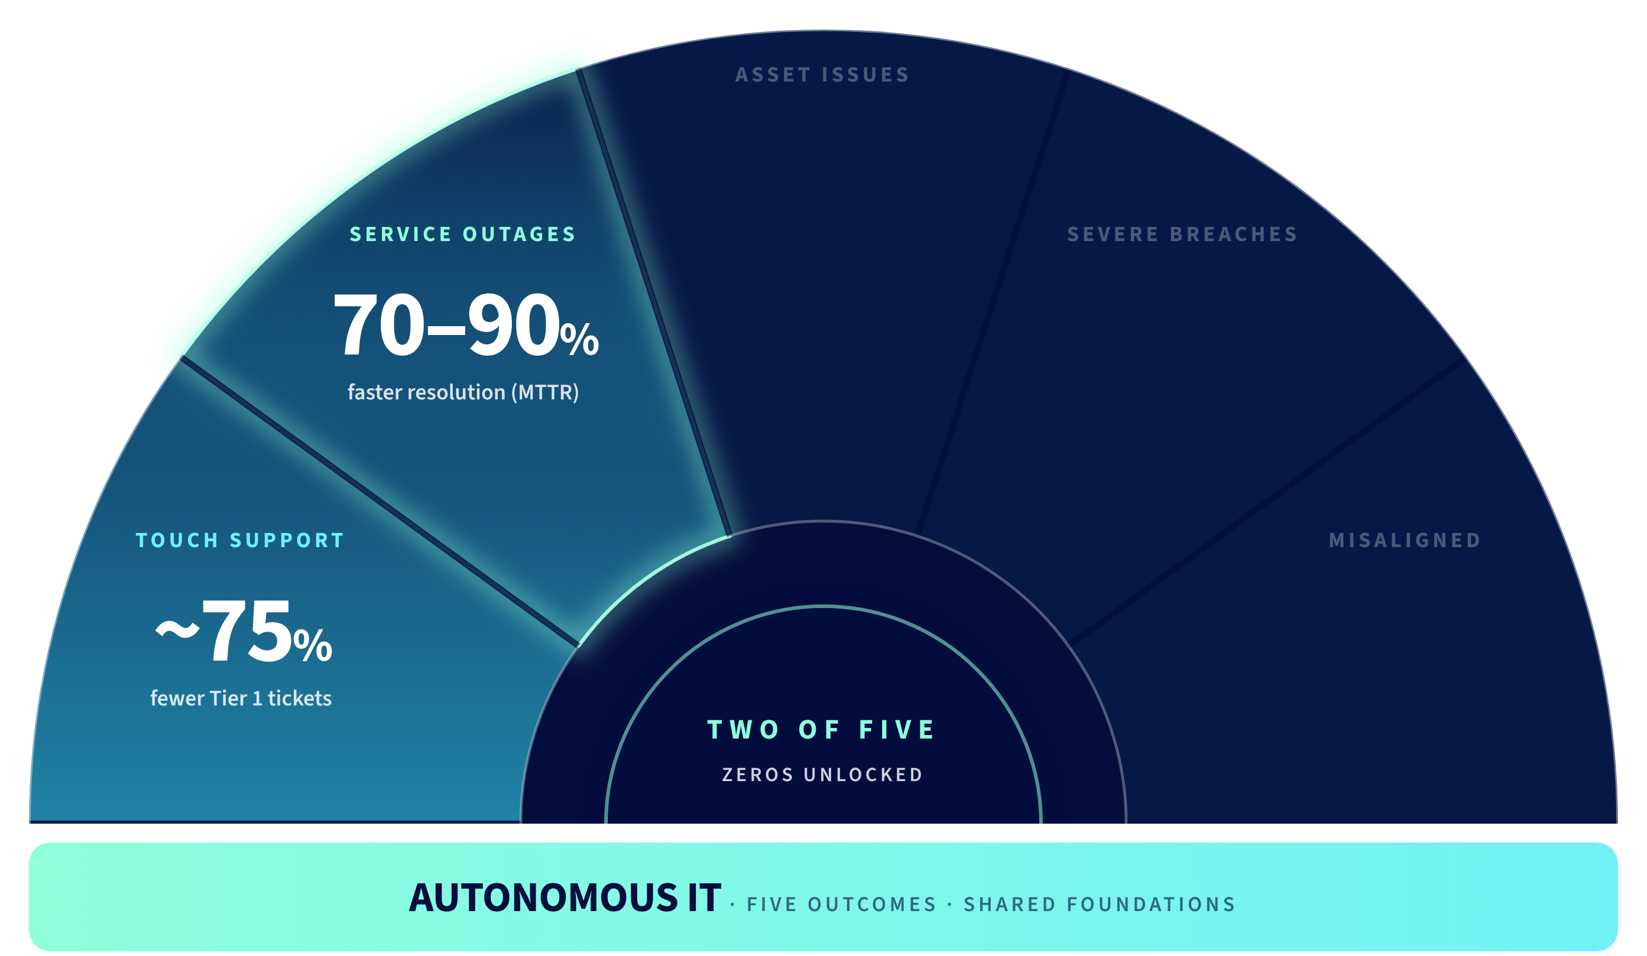
Autonomous IT: Building exponential value
© 2026 Crossfuze. All Rights Reserved.
Notes:
SERVICE MANAGEMENT — THE STARTING SCORECARD
Source slide shows ~30% potential reduction in Tier 1 tickets in Service Management. It is a directional ServiceNow benchmark. It is not a Crossfuze delivery forecast and should not be presented as automatic.
This is the first step of a useful visual contrast. Later slides build from service-management automation to broader Autonomous IT outcomes.
For the customer, start with current incident volumes, ticket mix, deflection eligibility, workflow complexity, quality of knowledge, staffing baseline and Assist entitlement. Even a promising ROI estimate is not credible without those facts.
Crossfuze connects that readiness evidence to a realistic priority and implementation backlog.

Slide 17
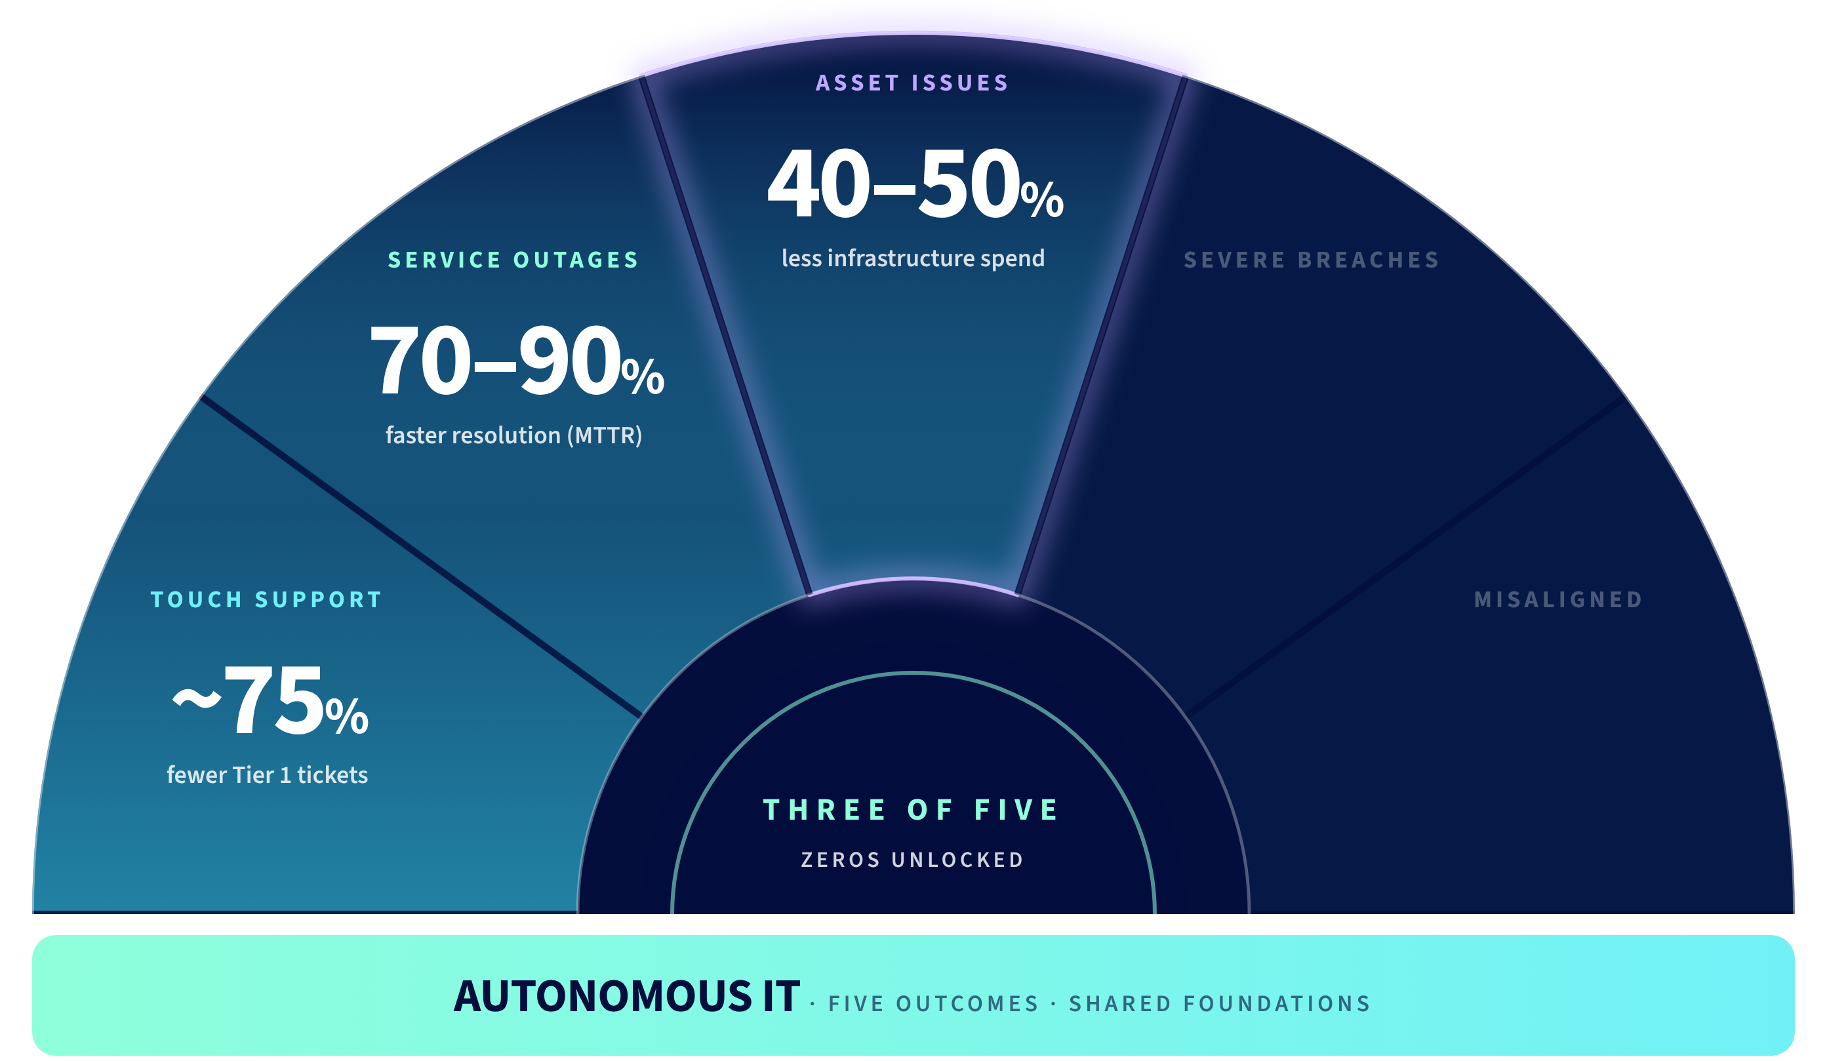
Autonomous IT: Building exponential value
© 2026 Crossfuze. All Rights Reserved.
Notes:
SERVICE MANAGEMENT — THE STARTING SCORECARD
Source slide shows ~30% potential reduction in Tier 1 tickets in Service Management. It is a directional ServiceNow benchmark. It is not a Crossfuze delivery forecast and should not be presented as automatic.
This is the first step of a useful visual contrast. Later slides build from service-management automation to broader Autonomous IT outcomes.
For the customer, start with current incident volumes, ticket mix, deflection eligibility, workflow complexity, quality of knowledge, staffing baseline and Assist entitlement. Even a promising ROI estimate is not credible without those facts.
Crossfuze connects that readiness evidence to a realistic priority and implementation backlog.

Slide 18
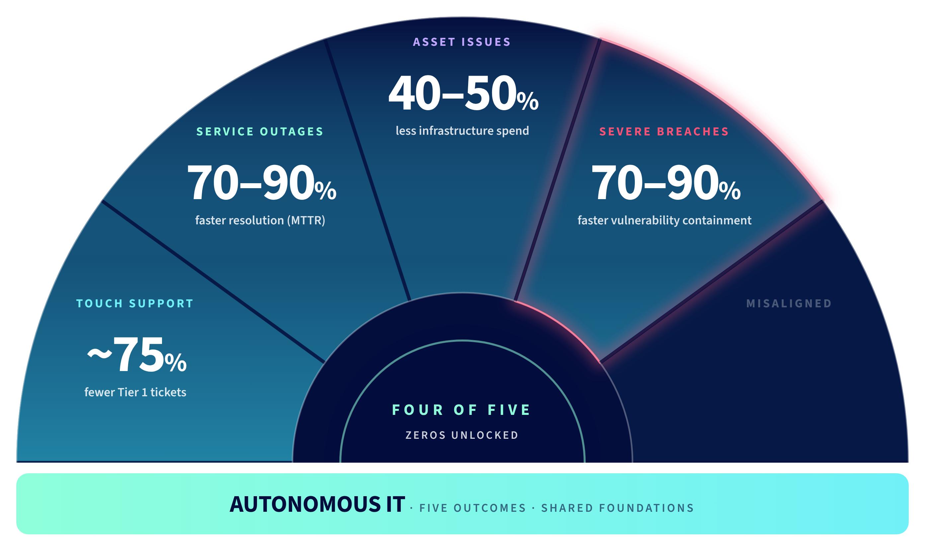
Autonomous IT: Building exponential value
© 2026 Crossfuze. All Rights Reserved.
Notes:
SERVICE MANAGEMENT — THE STARTING SCORECARD
Source slide shows ~30% potential reduction in Tier 1 tickets in Service Management. It is a directional ServiceNow benchmark. It is not a Crossfuze delivery forecast and should not be presented as automatic.
This is the first step of a useful visual contrast. Later slides build from service-management automation to broader Autonomous IT outcomes.
For the customer, start with current incident volumes, ticket mix, deflection eligibility, workflow complexity, quality of knowledge, staffing baseline and Assist entitlement. Even a promising ROI estimate is not credible without those facts.
Crossfuze connects that readiness evidence to a realistic priority and implementation backlog.

Slide 19
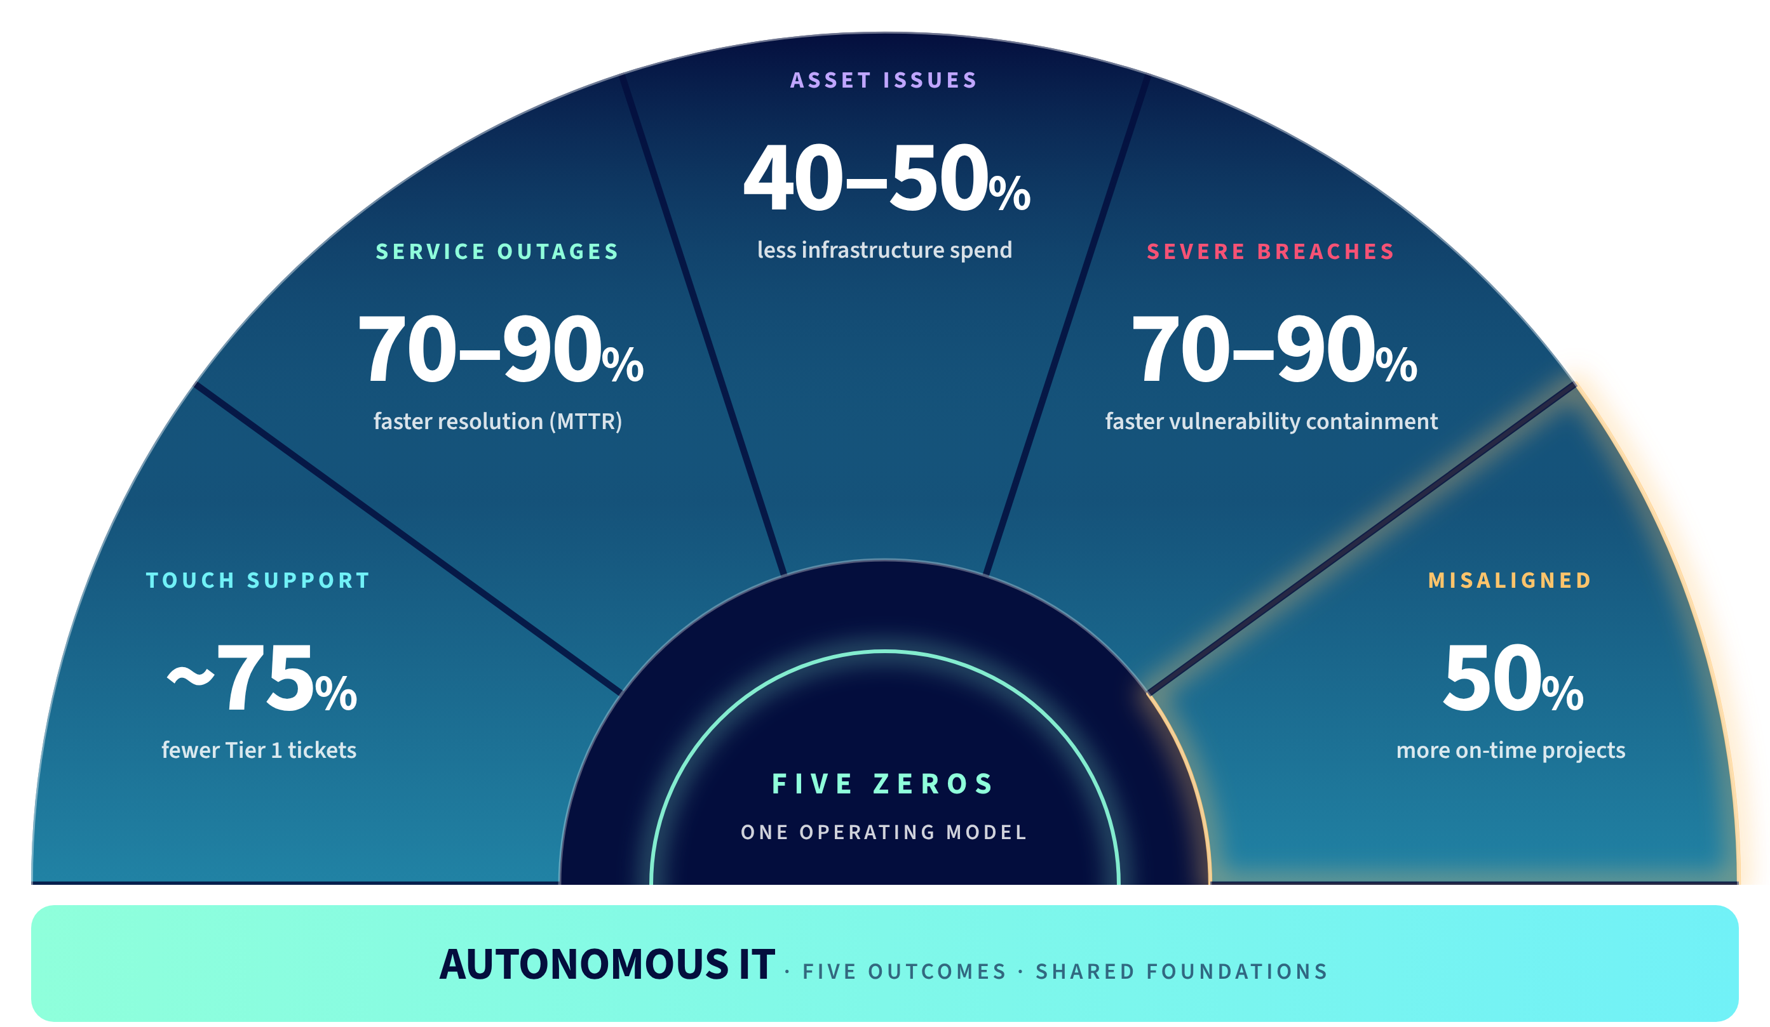
Autonomous IT: Building exponential value
© 2026 Crossfuze. All Rights Reserved.
Notes:
SERVICE MANAGEMENT — THE STARTING SCORECARD
Source slide shows ~30% potential reduction in Tier 1 tickets in Service Management. It is a directional ServiceNow benchmark. It is not a Crossfuze delivery forecast and should not be presented as automatic.
This is the first step of a useful visual contrast. Later slides build from service-management automation to broader Autonomous IT outcomes.
For the customer, start with current incident volumes, ticket mix, deflection eligibility, workflow complexity, quality of knowledge, staffing baseline and Assist entitlement. Even a promising ROI estimate is not credible without those facts.
Crossfuze connects that readiness evidence to a realistic priority and implementation backlog.

Slide 20
Now on Now sets the bar for AI business value
90%+
85%
7x
IT interactions resolved via
AI-powered self-service
IT support agents redeployed
to strategic work
faster closing
risk & security incidents
5600:1
$500M
98%
employee to support personnel
annualized value
from agentic automation
reduction from
events to alerts
$89M+
26%
70%
hard savings & cost avoidance via AI-powered IT cost management
total reduced IT asset spend year over year
70% efficiency gain for Product
Managers in development story writing
© 2026 Crossfuze. All Rights Reserved.
Other company and product names may be trademarks of the respective companies with which they are associated.
Notes:
PLATFORM PROOF | Now on Now demonstrates a vendor example, not the customer's future result. Ask whether the same process, data and control conditions are present before translating benchmarks.
--- EXISTING FACILITATOR NOTES ---
NOW ON NOW — SERVICE NOW'S OWN OPERATING EVIDENCE
This slide shows ServiceNow's own published Now on Now figures. Its nine tiles illustrate operational throughput, self-service, staffing leverage, incident closure and estimated agentic value. These are vendor-specific figures and are not a proxy for customer or Crossfuze results. Some values and dates may have evolved since the source was produced; verify before external presentation.
The business point is not that every organisation will replicate this scale. It is that the platform has demonstrated the potential for AI to carry real work, subject to suitable foundations.
Segue to the Crossfuze proposition: ServiceNow has established the capability and possible value. What is the current customer's evidence — and where can it safely begin?

Slide 21

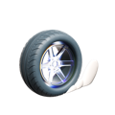


























The ServiceNow AI control tower for business reinvention
Voice
Enterprise Search
Video
AI Experience
Chat
Web
Apps
ANY
Industry
ANY
IT
CRM
Security & Risk
Autonomous Workflows
Employee Experience
App Development
Sense
Decide
Act
Data
AI Model
Workflow
ANY
ANY
ANY
Workflow Data Fabric
Workflow Data Network
RaptorDB
MCP & A2A
Process Mining
CMDB
AI Skills
Knowledge Base
Knowledge Center
Analytics & BI
Context Engine
Knowledge Studio
Modular Agentic
Architecture
AI Specialists
Action Fabric
App Engine
Build Agent
Agent Orchestrator
Agentic Playbooks
AI Agent Studio
Identity & Discovery
Risk
Value
Secure
Vault
Guardian
AI Control Tower
System, Identity, Asset
Platform Security
ANY
Cloud
System of Record
ANY
ANY
© 2026 Crossfuze. All Rights Reserved.
Notes:
PLATFORM FIT | Translate Control Tower and other governance capabilities into the buyer's question: Who can authorise an autonomous action, see why it ran and stop or reverse it? Validate product entitlements and actual configuration.
--- EXISTING FACILITATOR NOTES ---
SLIDE 20 — SENSE → DECIDE → ACT → SECURE
Keep the full ServiceNow platform flow shown in the source diagram. Sense consumes trustworthy enterprise data; Decide grounds and reasons using approved knowledge and governed AI; Act executes through enterprise workflows; Secure limits and monitors activity across each step.
Crossfuze uses the architecture as a readiness check: do the foundations actually support the proposed transaction safely, in the target customer estate? This is not a new competing product architecture.
For every proposed autonomous use case, specify what the agent can read, what decision is allowed, what action it can perform and who can intervene.

Slide 22
EXHIBIT 01 · THE EXECUTION GAP
Platform AI capability
YOUR SERVICENOW AI READINESS GAP
What's stopping us from
letting AI do the work?
CAPABILITY →
The ServiceNow AI Readiness Gap
THIS IS THE WORK
Can we trust the data, rely on the workflow, control the action and justify the consumption?
Organisational readiness
Calculate your readiness →
2024
2026 AND BEYOND
WHAT THE PLATFORM CAN DO
WHAT YOUR OPERATION CAN SAFELY USE
ILLUSTRATIVE TRAJECTORY. READINESS VARIES BY ESTATE
Notes:
BUYER-FIRST READINESS GAP | Ask the customer which high-value action they still would not let AI execute. Probe the real constraint: record/data quality, approved knowledge, workflow determinism, authority / Permission to Automate, accountability or Assist economics. The ServiceNow AI Readiness Gap is an explanatory framework, not evidence of this customer's maturity. The trajectory is illustrative.
--- EXISTING FACILITATOR NOTES ---
SLIDE 17 — THE SERVICENOW AI READINESS GAP
ServiceNow AI is ready. The question is whether your organisation is. The ServiceNow AI Readiness Gap is the distance between what ServiceNow AI can do and what your organisation can safely let it do. The distance is determined by data, AI and agents, workflows and governance. More product capability alone does not close it.
ASK: What is the one action you would like AI to take today but are not yet comfortable permitting?
Crossfuze assesses the evidence, names the limiting foundation and recommends the first responsible outcome.
Source: The Crossfuze AI Readiness Assessment, October 2026, p.06.

Slide 23
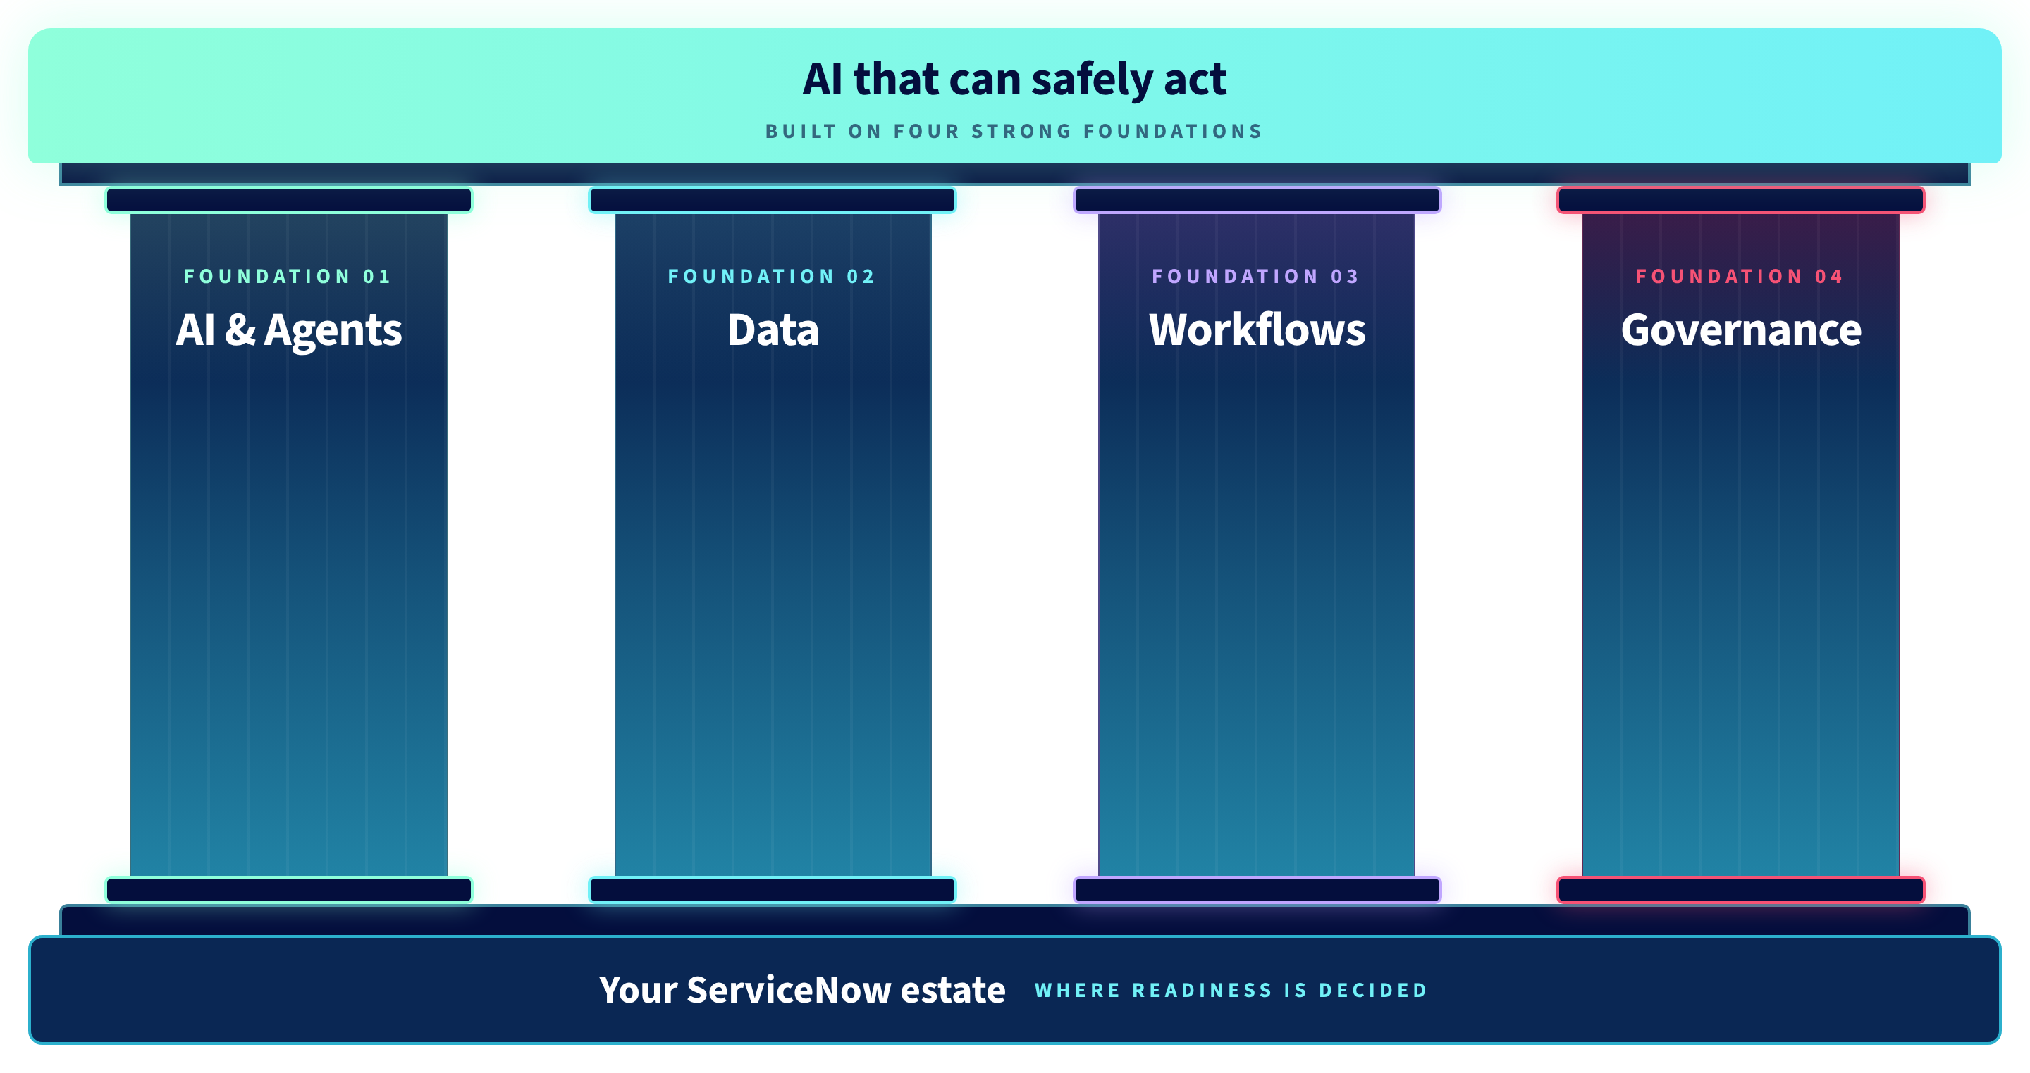
AI needs
four strong foundations.
© 2026 Crossfuze. All Rights Reserved.
© 2026 Crossfuze. All Rights Reserved.
Notes:
READINESS FOUNDATION | Four foundations are a diagnostic lens. Ask which is the first blocker to the buyer's desired workflow, rather than treating every foundation as equally important.
--- EXISTING FACILITATOR NOTES ---
SLIDE 19 — EVIDENCE BEFORE AUTONOMY
The guide sets group shares: Data 20%; AI and agents 15%; Workflows 30%; Governance 25%. These are aggregations of the seven weighted dimensions. A further 10% is Platform and Entitlement, evaluated per Zero and with Assist allocation fit.
Examples of “ready” include CMDB alignment to CSDM, review-owned knowledge, standard request/change paths with rollback, and explicit actions/approval boundaries with tested stops.
Do not label a foundation ready from an interview alone; evidence must be observed, calculated, inferred or assumed, and statuses remain visible. Source: Crossfuze guide pp.07–09.

Slide 24

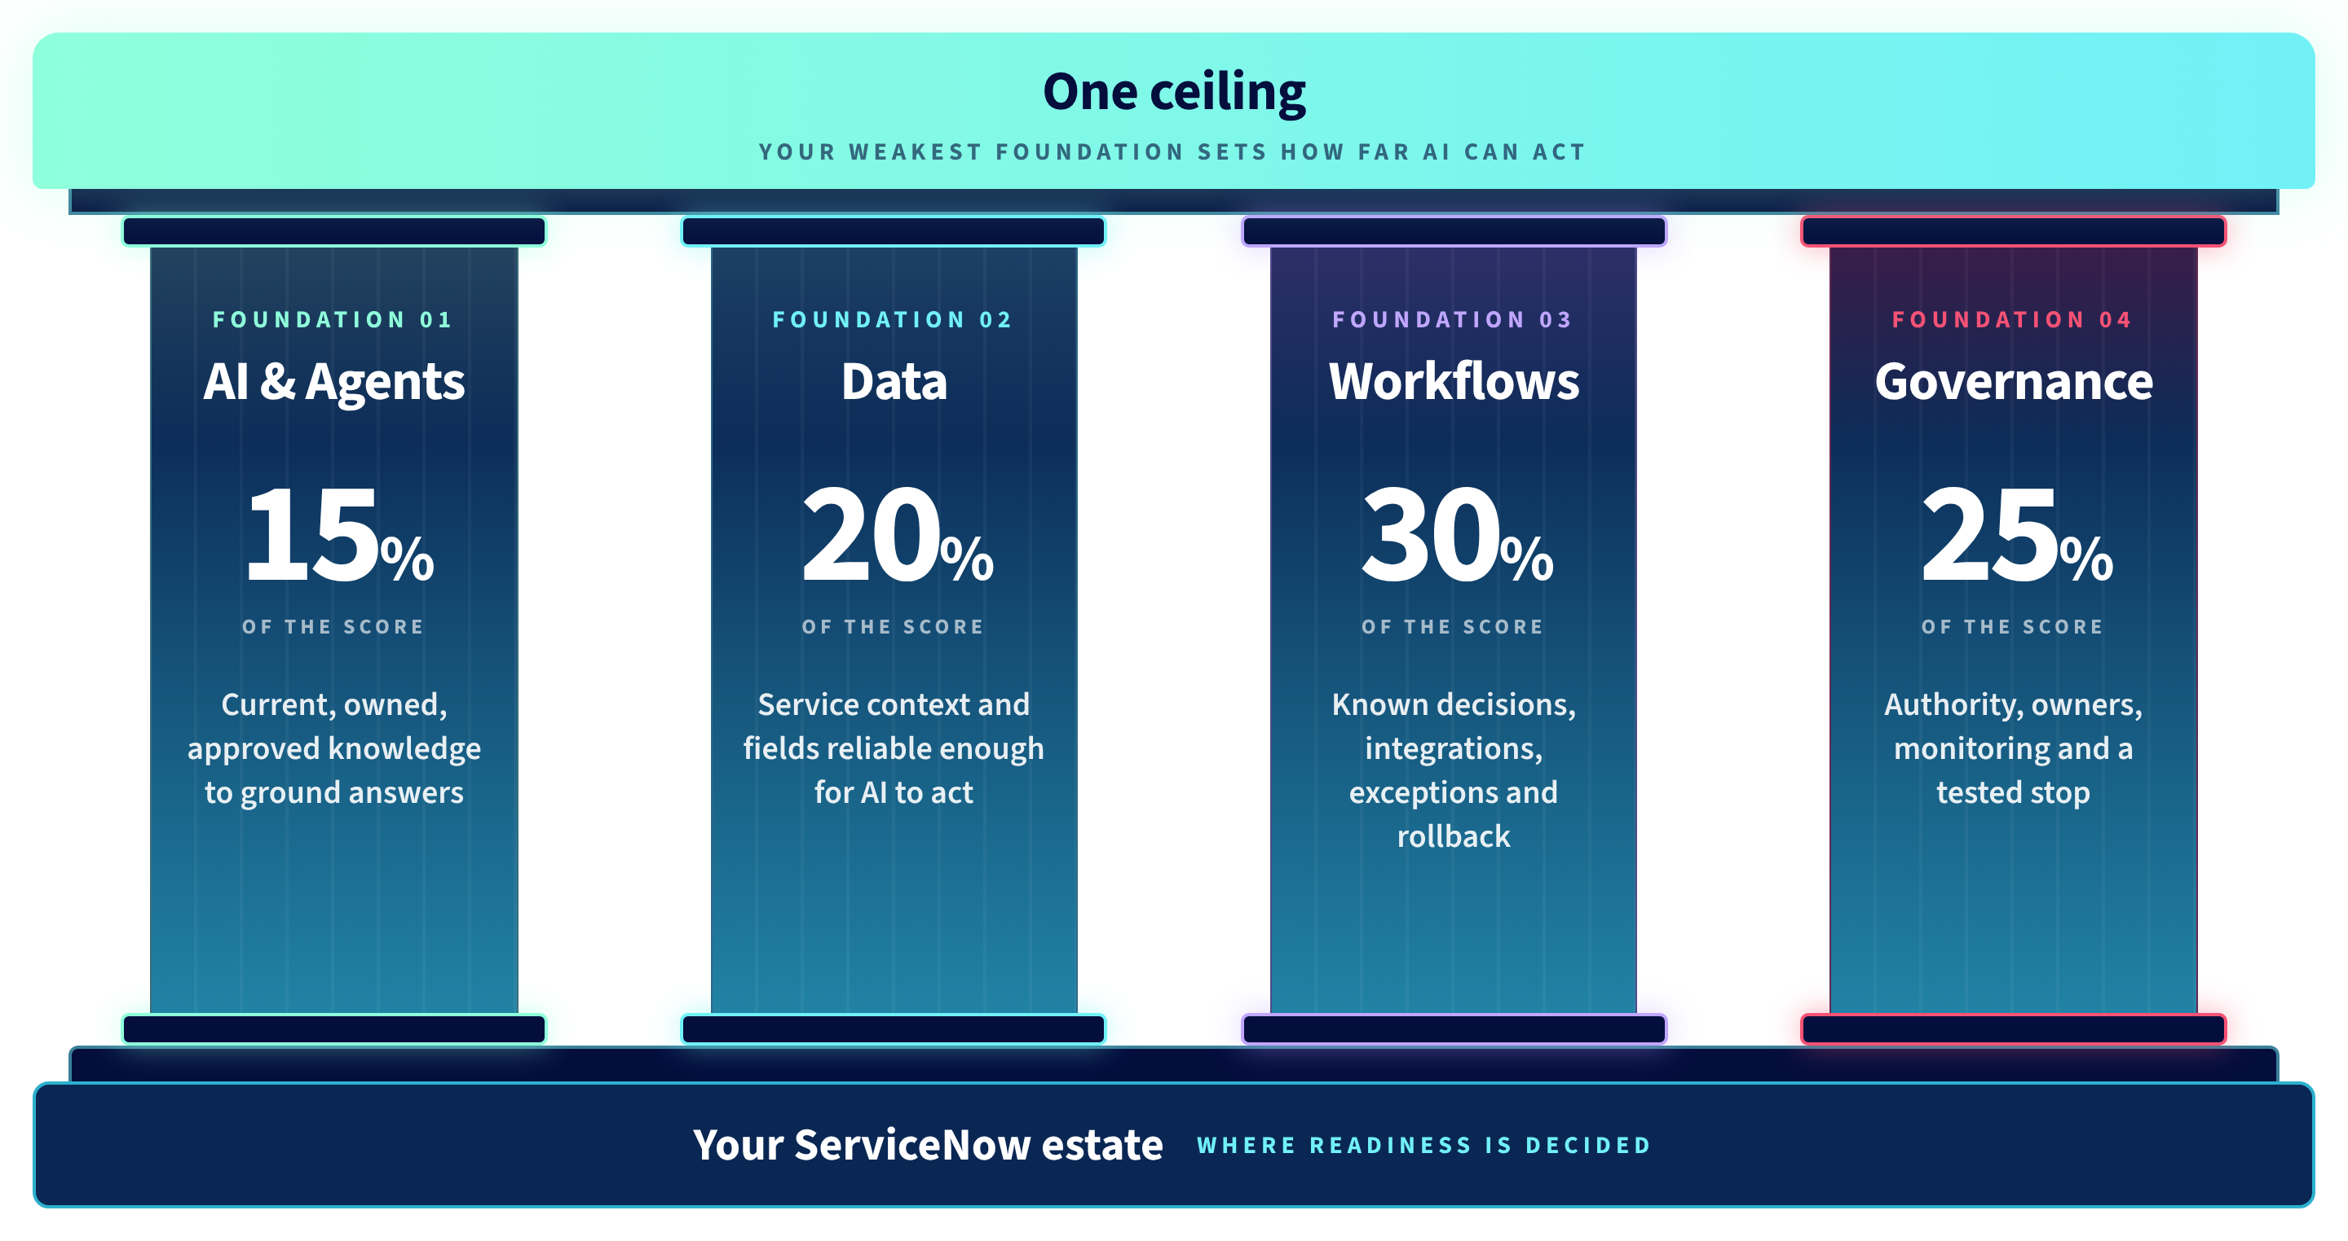
Four foundations.
one ceiling.
© 2026 Crossfuze. All Rights Reserved.
© 2026 Crossfuze. All Rights Reserved.
Notes:
READINESS CEILING | Explain the limiting foundation in practical terms: if the required knowledge, data, workflow or control isn't dependable, AI should not act autonomously. This is a workflow-specific decision, not a score of the customer without assessment evidence.
--- EXISTING FACILITATOR NOTES ---
SLIDE 19 — EVIDENCE BEFORE AUTONOMY
The guide sets group shares: Data 20%; AI and agents 15%; Workflows 30%; Governance 25%. These are aggregations of the seven weighted dimensions. A further 10% is Platform and Entitlement, evaluated per Zero and with Assist allocation fit.
Examples of “ready” include CMDB alignment to CSDM, review-owned knowledge, standard request/change paths with rollback, and explicit actions/approval boundaries with tested stops.
Do not label a foundation ready from an interview alone; evidence must be observed, calculated, inferred or assumed, and statuses remain visible. Source: Crossfuze guide pp.07–09.

Slide 25


Autonomy Is Earned.
Greater autonomy requires stronger evidence and controls.
0
0
0
0
0
Touch
support
Service
outages
Asset
issues
Severe
breaches
Misaligned
Investments
Which Zero can your evidence support first?
* Five Zeros are directional ambitions, not guaranteed results.
© 2026 Crossfuze. All Rights Reserved.
Notes:
OUTCOME OPTIONS | Invite the buyer to compare potential operational benefit and prerequisite readiness. These are possible first-Zero destinations, not guaranteed projects.
--- EXISTING FACILITATOR NOTES ---
SLIDE 23 — AUTONOMY IS EARNED
The Five Zeros remain the ServiceNow Autonomous IT destination: Zero-Touch Support, Zero Service Outages, Zero Asset Issues, Zero Severe Breaches and Zero Misaligned Investments. The word Zero describes the North Star, not an unconditional promise.
Here is the contrast: without trusted data, defined workflows, owners and governance, an AI action is a risk. With these foundations and control evidence, the organisation can permit an appropriate, bounded action and earn greater autonomy.
Permission must expand in line with observed outcomes and safe controls, not just because another AI feature has been purchased.
Crossfuze works backwards from a measurable desired outcome to a readiness decision and a first delivery backlog.

Slide 26
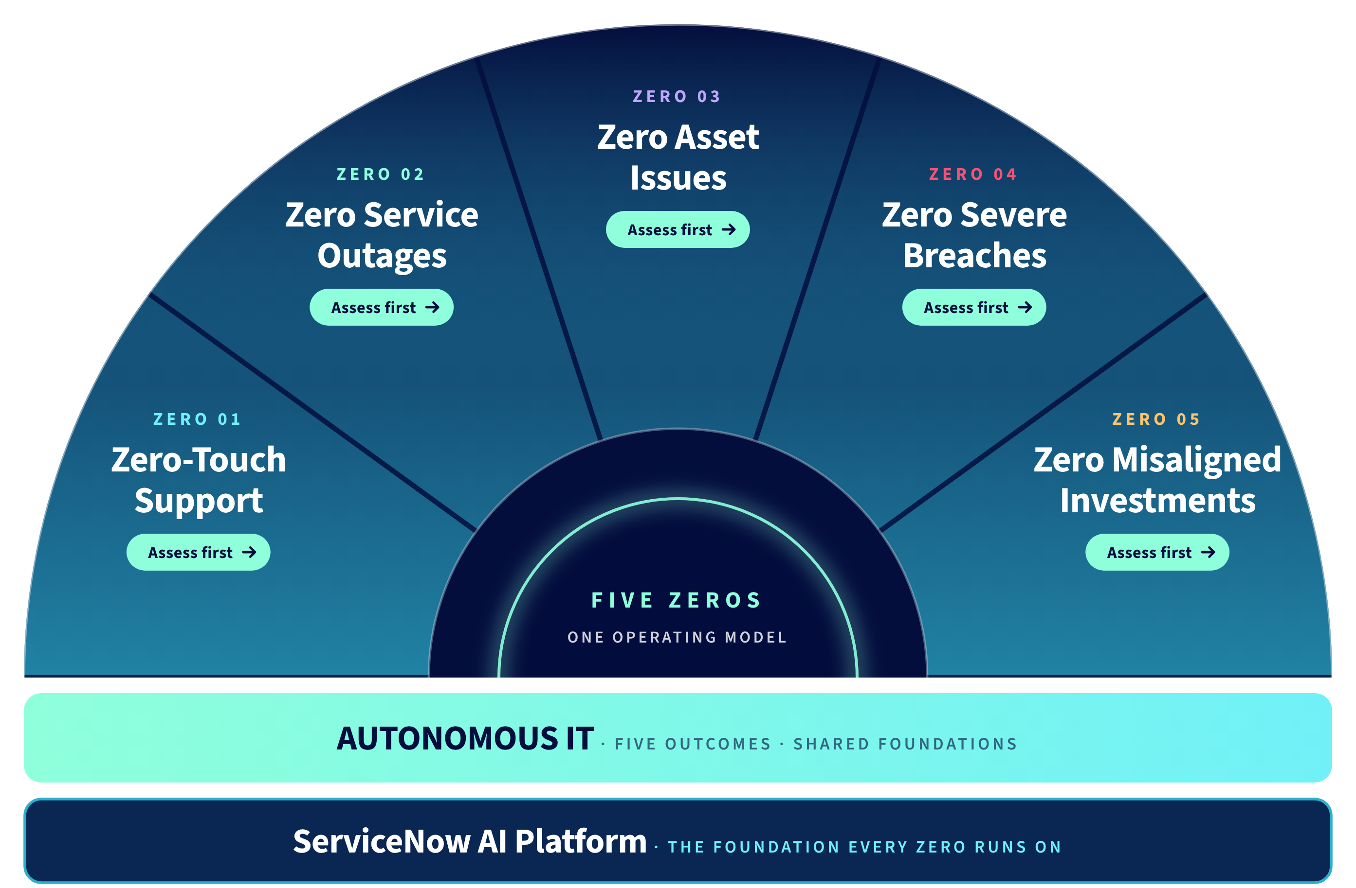
Which Zero should we tackle first?
Business value × Readiness × Assist consumption
Notes:
BUYER DECISION | 'Where could we remove the most operational friction, without taking on risk or Assist consumption we do not understand?' Compare business value, readiness evidence, Permission to Automate and expected usage. This is a candidate starting point; the 90-minute assessment provides the next layer of evidence, not a guaranteed outcome.
--- EXISTING FACILITATOR NOTES ---
SLIDE 24 — PICK YOUR STARTING POINT
Use ServiceNow’s five Zero options. But instead of the largest promised ROI, choose the FIRST outcome based on (1) meaningful measurable business value, (2) smallest critical readiness gaps, (3) governance/permission for the proposed actions, and (4) the likely Assist consumption and package/entitlement fit.
Outcome choices: Zero-Touch Support, Zero Service Outages, Zero Asset Issues, Zero Severe Breaches, Zero Misaligned Investments. All source outcome figures are directional, not guaranteed. The same readiness and value/consumption logic may be applied to business workflows in HR, Finance, Procurement and other ServiceNow processes, without renaming the IT-specific Five Zeros.
ASK: What would be the most useful first demonstrably safe production outcome?
BRIDGE TO ACT 4: The free tools and the 90-minute Crossfuze Readiness Assessment produce an initial AI Readiness Decision Brief. AI RunState is then the 12-month mechanism to plan, prioritise and ship approved outcomes through the AI Action Plan, backlog cycles and Extend Services.

Slide 27
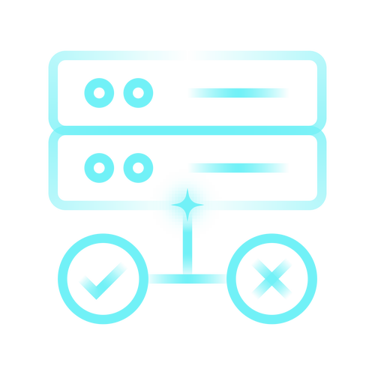


Know where to start. Know what it takes. Keep moving.
The first two steps are free.
01
02
03
Self-serve tools
Readiness Assessment
AI RunState
FREE · ABOUT 10 MINUTES
FREE · 90 MINUTES
12-MONTH ENGAGEMENT
THE QUESTION
THE QUESTION
THE QUESTION
Are we ready?
Where should we start?
How do we keep delivering?
WHAT YOU GET
WHAT YOU GET
WHAT YOU GET
AI Readiness Benchmark score, Assist estimate and tier map.
Decision Brief: your autonomy ceiling, first outcome and 90-day priorities.
AI Action Plan, quarterly backlog cycles and monthly Extend delivery capacity.
Book your 90-minute session →
© 2026 Crossfuze. All Rights Reserved.
Notes:
BUYER JOURNEY | The buyer needs three decisions, not three product pitches: (1) Is there a readiness signal? Optional free self-serve Benchmark/Estimator are directional. (2) Where should we begin? The free 90-minute assessment creates an initial AI Readiness Decision Brief with assumptions and limitations. (3) How can it be delivered? If justified, a separately scoped paid AI RunState engagement provides advisory, backlog and Extend delivery capacity. Do not imply that paid AI RunState is automatically agreed or that production is guaranteed in 90 days.
--- EXISTING FACILITATOR NOTES ---
SLIDE 27 — THREE STEPS. THE FIRST TWO ARE FREE
01 SELF-SERVE TOOLS: free AI Readiness Benchmark and Assist Estimator + Tier Map. Approximately ten minutes if used before the call. They are optional, not required prework.
02 90-MINUTE AI READINESS ASSESSMENT: a free, facilitated session with the Crossfuze AI practice. Based on available evidence, it produces an initial AI Readiness Decision Brief. It is not a full platform configuration inspection or technical validation and provisional findings remain visible.
03 CROSSFUZE AI RUNSTATE: the paid, 12-month engagement turning selected outcomes into delivery: AI Action Plan, backlog cycles and Extend Services. User controls priorities and acceptance.
Keep these as three distinct products/steps. The self-serve online benchmark is not the same as the facilitated assessment.
Source: Crossfuze guide pp.04,16–19,20.

Slide 28
ILLUSTRATIVE READOUT
How ready are we?
Autonomous Workforce
SEVEN WEIGHTED DIMENSIONS
Data quality
20%
5/10
WEIGHTED SCORE
5.2/10
Process determinism
15%
8/10
Knowledge and content
15%
3/10
PROVISIONAL
Workflow and integration
15%
5/10
AUTONOMY CEILING
Governance and security
15%
3/10
Knowledge
Platform and entitlement
10%
8/10
Weakest required foundation
Ownership and adoption
10%
5/10
Missing evidence is not scored as zero. This example is not a customer assessment.
© 2026 Crossfuze. All Rights Reserved.
Notes:
Illustrative score only: This is NOT the customer’s readiness assessment. Explain that the initial assessment evaluates seven weighted dimensions, identifies the limiting prerequisite and records evidence confidence. The 5.2/10 example and knowledge ceiling must not be presented as customer facts.

Slide 29


AUTONOMOUS IT / VALUE & AI CONSUMPTION
What will AI cost us as it scales?
Estimate what each outcome uses, then check the value and the entitlement fit.
01 MODEL THE WORK
02 SIZE THE USAGE
03 SELECT THE TIER
Illustrative agentic run sizes
Example annual mix
Capability × entitlement coverage
NARROW
0–4 tools
25
Assists
30,000 narrow × 25
FOUNDATION
Assisted
5,000 wide × 150
MEDIUM
5–8 tools
50
Assists
ADVANCED
Agentic
1.5M
150
PRIME
Autonomous
WIDE
9–20 tools
Assists
ANNUAL ASSISTS
GATE 1 Required functions and controls
Run volumes × complexity = annual usage
Illustrative baseline; P90 to be modelled
GATE 2 P90 demand vs. real allocation
THE DECISION
Choose a tier only when both capability fit and expected usage are covered.
Planning model only. Actual Assist rates, entitlement and product access depend on contract and configuration.
© 2026 Crossfuze.
Notes:
Buyer economic question: What will usage cost, and will the outcome justify it? The 25/50/150 Assist examples and 1.5M total are planning illustrations only, not contracted rates or customer forecasts. Tier choice also depends on capability, entitlements, P90 usage and the actual ServiceNow agreement. Confirm separately with ServiceNow.

Slide 30

What will 90 minutes help us answer?
YOUR AI READINESS DECISION BRIEF • PROVISIONAL FINDINGS
01
Foundation scores
02
Autonomy ceiling
03
Control gaps
Four foundations.
Seven weighted dimensions.
The weakest required
foundation.
Observed, provisional
or requiring validation.
04
First outcome
05
Tier and usage
06
Initial priorities
Value × readiness
starting priority.
Indicative Assist scenario
and entitlement fit.
Actions, owners and
dependencies.
Provisional findings remain visible. Technical validation follows where needed.
© 2026 Crossfuze. All Rights Reserved.
Notes:
Free 90-minute assessment output: a provisional AI Readiness Decision Brief identifying where the evidence points, limitations, indicative Assist/tier findings, a candidate first outcome and initial 90-day priorities. Do not represent this as a completed technical audit, production validation or the detailed 90-day roadmap produced under the paid Action Plan.

Slide 31

CROSSFUZE / AI RUNSTATE / WHAT IT IS
From an AI decision to
work that gets done.
A readiness assessment identifies where to start. AI RunState is Crossfuze’s 12-month
ServiceNow AI delivery engagement that helps turn agreed priorities into approved work.
THE DECISION
THE ENGAGEMENT
First Zero identified
→
AI RunState
Readiness gaps · owner ·
90-day priorities
Advisory direction · Delivery-ready backlog · Extend capacity
The customer keeps control of priorities, approvals and production release.
ONE 12-MONTH ENGAGEMENT
Notes:
Introduce AI RunState after the Decision Brief. This is not the assessment and is not a licence. The SOW describes an annual service of three connected components: AI Action Plan to decide what matters and in what order; Backlog Prioritization to turn agreed outcomes and demand into delivery-ready stories; Extend to deliver accepted stories within contracted monthly capacity. Customer owns prioritization, UAT and production approval. This is a proposed paid engagement after Meeting 2 and agreement of scope and commercial terms. Avoid promises of production outcomes or delivery speed.

Slide 32
EDITION 2026
THE CROSSFUZE GUIDE TO AUTONOMOUS IT
AI RunState.
From Readiness to delivery.
Part of Preparing for the Autonomous Enterprise
Crossfuze · ServiceNow Elite Partner
Notes:
OPEN — HOW READY ARE YOU TO LET AI ACT?
ServiceNow has made powerful AI capabilities available. The hard question for an enterprise isn't just whether the technology can act. It's whether your data, workflows, knowledge and governance are ready to let it act safely. Today is about moving from AI potential to evidence-led decisions — and then continuing to deliver outcomes.
Core theme: Autonomy Is Earned. Part of Preparing for the Autonomous Enterprise.

Slide 33

AUTONOMOUS IT / ROAD TO ZERO / THE OFFERING
Turn AI priorities and existing
demand into delivered work.
AI RunState
Your priorities, supported by a plan, an approved backlog and capacity to deliver.
What is AI RunState?
A 12-month Crossfuze ServiceNow engagement that combines an AI action plan, prioritisation of existing and new work, and contracted technical delivery capacity.
01
Know what matters.
02
Make work ready.
03
Get approved work moving.
AI ACTION PLAN
BACKLOG PRIORITISATION
EXTEND SERVICES
Identify valuable AI use cases, dependencies and a practical 90-day roadmap.
Bring together new opportunities and existing requests; refine and sequence stories for approval.
Configure and test eligible ServiceNow enhancements, administration, defect fixes and support.
Two advisory reviews
Up to four backlog cycles
80 hours/month × 9 months
YOU STAY IN CONTROL
You set the priorities and approve the work. Crossfuze helps prepare, configure and test it.
START WITH THE FREE 90-MINUTE ASSESSMENT · AI RUNSTATE IS A SEPARATE PAID ENGAGEMENT
Notes:
SOW alignment: Crossfuze AI Run State is a 12-month paid service. Its AI Action Plan establishes a baseline, prioritises AI opportunities and produces a 90-day roadmap, with two advisory reviews over the term. Up to four Backlog Prioritization cycles reconcile demand from the Action Plan AND existing customer sources, refine stories, assess feasibility, estimate and sequence work, and prepare customer-approved delivery backlogs. Extend Services provides 80 contracted hours per month for nine months after onboarding, with no monthly rollover, to review/configure/test eligible approved backlog work including ServiceNow enhancements, platform administration, defects and support. It does not promise to clear the entire existing backlog or guarantee every proposed story or a fixed rate of deployment. New-module implementations, professional-services projects and any single item >40 hours are out of scope and need separate contract. Customer retains priorities, decisions, licensing, UAT and production approval. AI-specific oversight remains with customer. Meeting 1 goal is agreement to the free 90-minute AI Readiness Assessment, not the paid engagement.

Slide 34

CROSSFUZE / AI RUNSTATE
A 12-month delivery rhythm.
Advisory sets direction. Backlog Cycles prepare customer-approved work. Extend delivers within monthly capacity.
M1
M2
M3
M4
M5
M6
M7
M8
M9
M10
M11
M12
ADVISORY
PLAN
REFRESH
BACKLOG CYCLES
CYCLE 1
CYCLE 2
CYCLE 3
C4
ONBOARDING
M3
EXTEND DELIVERY
80 HOURS / MONTH · NINE MONTHS
MONTH 3 IS ONBOARDING — EXTEND SPRINTS START IN MONTH 4
Delivery depends on approved sprint-ready stories, access, technical acceptance and customer testing.
CROSSFUZE · AI RUNSTATE
10
Notes:
AI RUNSTATE | SOW-ALIGNED DELIVERY TIMELINE
Source: 2026_10 AI Run State_US_DRAFTv1.0 4a.docx, Timeline pages 6-7.
Months 1-2 AI Action Plan (initial advisory approximately 8 weeks). Month 3 onboarding and Backlog Cycle 1 (cycle spans months 3-4). Months 4-12 Extend delivery at 80 hours per month for nine months; unused monthly hours expire and never roll over. Further cycles months 6-7, 9-10 and 12. Second advisory review months 7-8.
This supersedes the earlier illustrative 90-day progression that implied delivery/production within 90 days of service commencement. Product owner approval and Crossfuze TL acceptance required. Fourth backlog cycle can prepare a subsequent quarter or potential renewal, but renewal is not automatic. Calendar depends on prerequisites. No specific customer use case is guaranteed to be shipped.

Slide 35

WHAT’S OUR NEXT STEP?
Start with 90 minutes.
Leave with a decision.
FREE AI READINESS ASSESSMENT / THE START OF YOUR ROAD TO ZERO
WHAT WE DO TOGETHER
YOU LEAVE WITH
01
Choose the first outcome
Your AI Readiness
Decision Brief
Prioritise where business value and readiness meet.
02
Review readiness and controls
Examine the seven dimensions, evidence and gaps.
Initial readiness and autonomy ceiling
First candidate outcome
03
Model likely AI consumption
Indicative Assist and tier assumptions
Estimate Assist demand and indicative tier fit.
90-day priorities, owners and dependencies
Autonomy Is Earned.
Book your 90-minute session
Notes:
Meeting 1 conversion objective: ask agreement to a FREE 90-minute AI Readiness Assessment. Explain the three elements of the working session: candidate first outcome, readiness/control evidence, and indicative Assist demand. Outcome is an initial Decision Brief, not a final quoted implementation plan.

Slide 36

STAGE 02 / THE AI READINESS ASSESSMENT
What did we learn from your assessment?
Four findings turn a 90-minute working session into a defensible first decision.
01
02
03
04
READINESS
OPPORTUNITY
CONSUMPTION
CONTROL
Where you stand
Where AI can help
What it may use
What must be true
[Readiness finding]
[Candidate first Zero]
[Assist / tier finding]
[Permission and owner]
Score status, limiting foundation and evidence confidence.
Priority workflow, business pressure and potential value.
Run volumes, complexity and entitlement assumptions.
Approval boundaries, exceptions and accountable ownership.
ASSESSMENT OUTPUT
AI Readiness Decision Brief → Proposed first outcome, with unknowns clearly identified.
CROSSFUZE / AUTONOMOUS IT · ROAD TO ZERO
03
Notes:
Stage 02 recap: populate each bracketed finding from the actual 90-minute AI Readiness Decision Brief. Quote whether the evidence is full/provisional/unavailable. Do not invent a score, tier fit, value forecast or customer agreement. Use the summary to introduce the proposed first Zero.

Slide 37

STAGE 02 / OUTCOME RECOMMENDATION
Which Zero should we pursue first?
Choose the first controlled workflow where business value, readiness and deliverability intersect.
BUSINESS VALUE
RECOMMENDED FIRST ZERO
01
[Why this outcome matters]
[Selected Zero]
Baseline, demand, cost or risk to improve.
READINESS FIT
FIRST WORKFLOW
02
[What the assessment supports]
[Selected service / workflow]
Evidence available; dependencies still to validate.
Provisional recommendation — confirm the evidence and agree the outcome with the customer.
FIRST PROOF
03
[How success will be measured]
Metric, accountable owner and review point.
DECISION REQUIRED
Confirm the first-Zero hypothesis, workflow, owner and proof measures.
CROSSFUZE / AUTONOMOUS IT · ROAD TO ZERO
04
Notes:
Present the recommended first Zero from the assessment, not as an assumed result. Replace selected Zero and workflow placeholders. Justify with three decision criteria: business value, actual readiness evidence, and first measurable proof. Obtain customer agreement or record the amendments required. Other Zeros remain destinations. Transition to existing evidence-validation slide: "Now let us test the dependencies for that workflow."

Slide 38

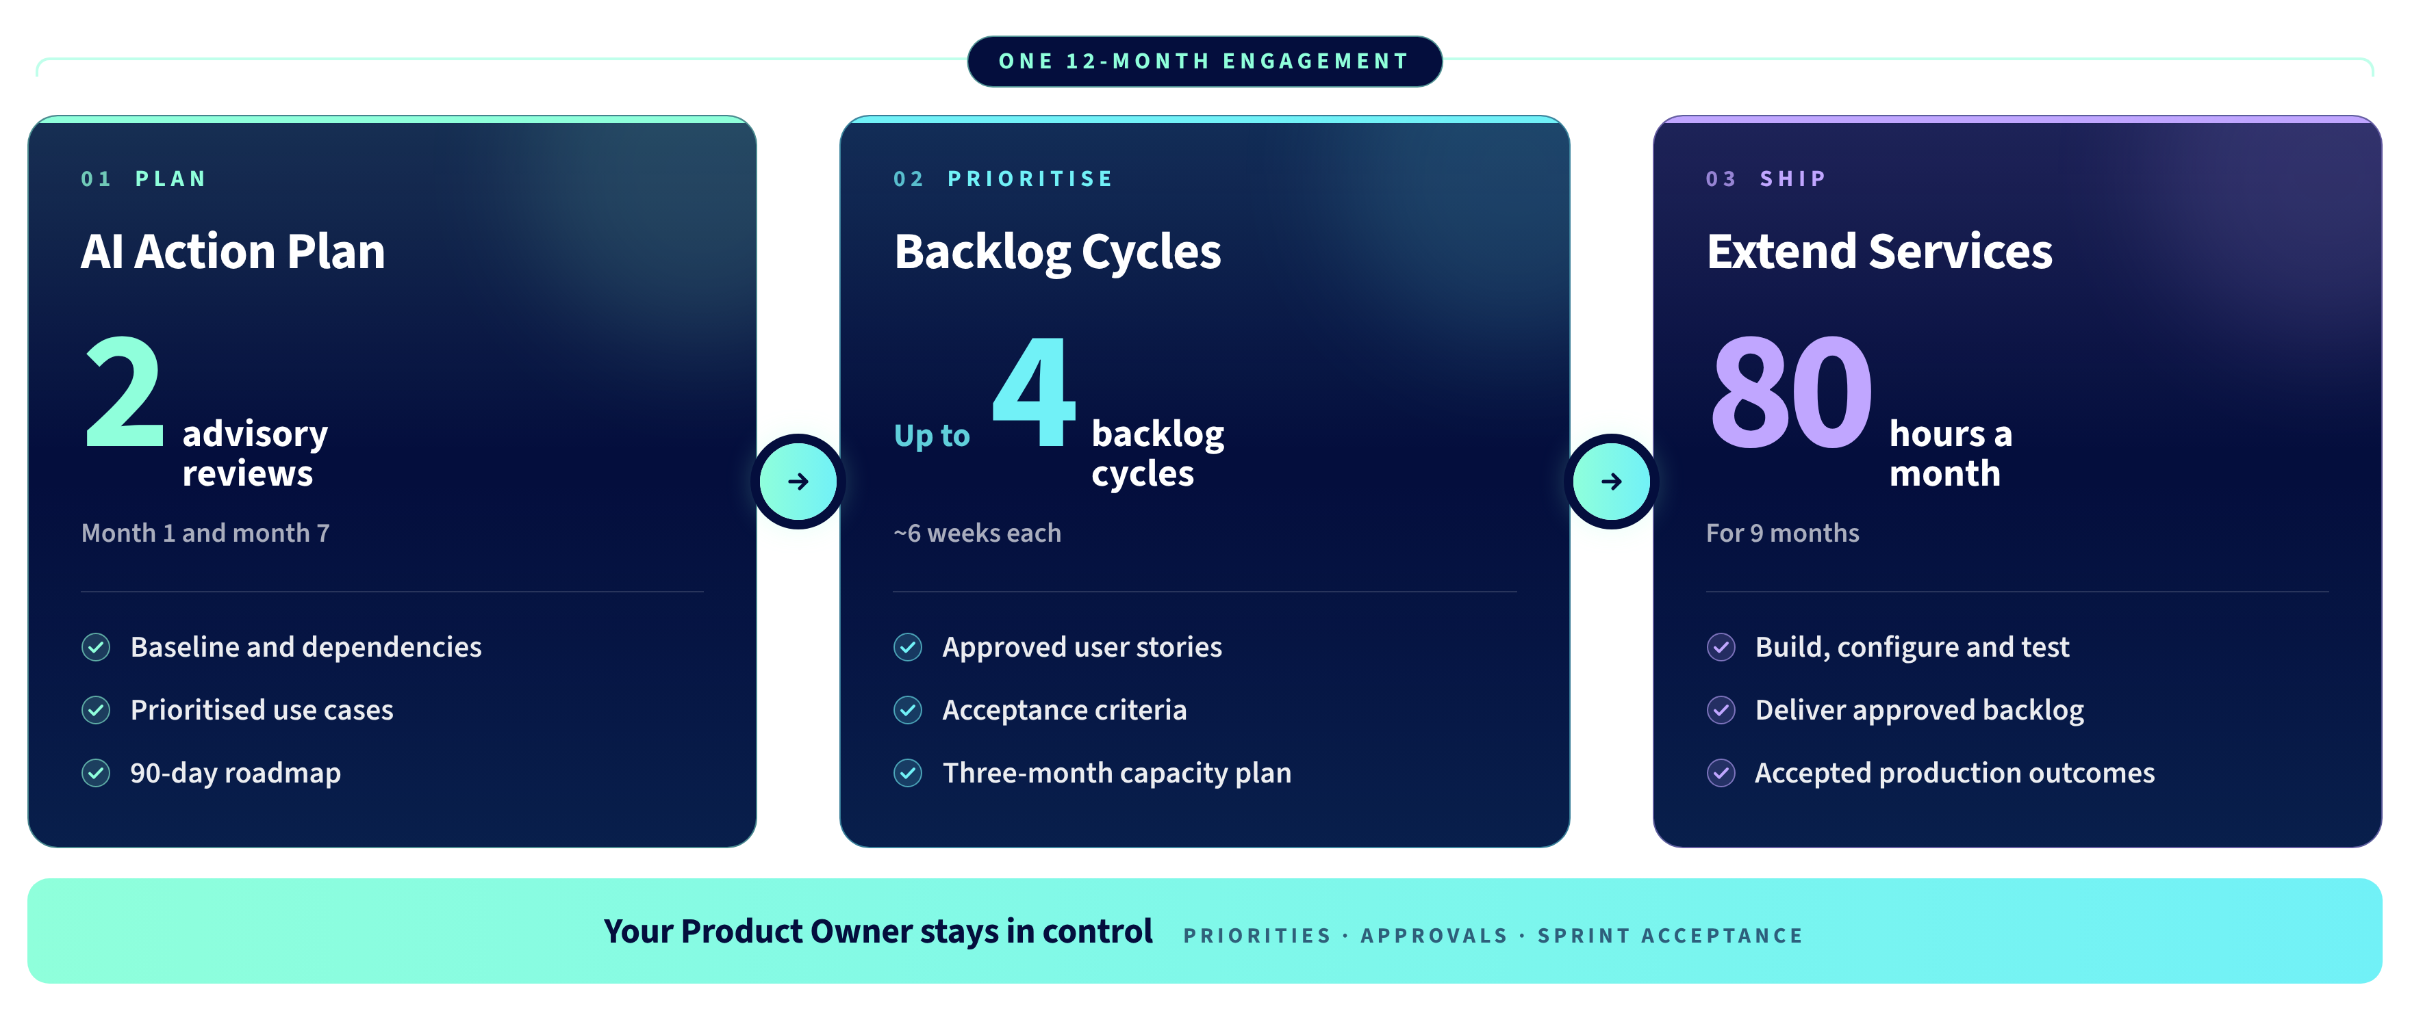
CROSSFUZE AI RUNSTATE (CARS)
Plan it. Prioritise it.
Ship it, every quarter.
© 2026 Crossfuze. All Rights Reserved.
Notes:
SLIDE 29 — AI RUNSTATE. PLAN IT. PRIORITISE IT. SHIP IT.
Crossfuze AI RunState is one 12-month engagement for ServiceNow AI across Autonomous IT and Business Re-Invention. The exact customer scope is confirmed by the SOW.
PLAN — AI ACTION PLAN: advisory at the start (Month 1, approximately eight weeks) and a second advisory review in Month 7. Facilitated workshop-led baseline, gaps and dependencies, prioritised use cases, current/future-state experience, draft user stories and an AI Action Plan with a first 90-day roadmap.
PRIORITISE — BACKLOG CYCLES: up to four planning cycles (approximately six weeks each) from Month 3 and quarterly afterward. They resolve requirements, acceptance criteria, dependencies, effort, sequencing and capacity; the customer Product Owner approves the backlog.
SHIP — EXTEND SERVICES: 80 hours per month for nine months. A named Technical Lead and Crossfuze capacity build, configure, test and remediate against approved user stories. The customer retains approval and acceptance. Scope/hours are SOW-dependent.
Do not equate 80 hours/month with the full 12 months; Extend is scheduled for 9 months in the source guide.
Source: Crossfuze AI Readiness Guide pp.18–19.

Slide 39
INTERNAL ONLY / HIDE DURING PRESENTATION
Commercial reference — US draft SOW.
Confirm regional pricing and executed terms before presenting a customer quotation.
$15,500
$186,000
USD per month · 12-month term
Total fees in US draft SOW
Pricing excludes taxes, travel and additional third-party licensing / Assist consumption. Contract is non-cancellable for convenience; changes and renewal require signed agreement.
INTERNAL REFERENCE ONLY · NOT AN APPROVED CUSTOMER QUOTE
CROSSFUZE · AI RUNSTATE
20
Notes:
INTERNAL US DRAFT COMMERCIAL REFERENCE - DO NOT PRESENT
Source draft SOW pages 7-8: $15,500 per month, 12 months, total $186,000 USD, excl applicable taxes. Paid monthly from service commencement. Valid for 30 days after delivery of formal SOW. Licences/AI Assist balances are customer-provided, expenses and change orders separate. Noncancellable for convenience. Renewal/change only by signed change order. This is a regional draft not universal commercial packaging. Verify before quoting. This slide is hidden in PowerPoint Show.

Slide 40
THE NEXT STEP
Start with 90 minutes.
Leave with a decision.
FREE AI READINESS ASSESSMENT / THE START OF YOUR ROAD TO ZERO
WHAT WE DO TOGETHER
YOU LEAVE WITH
01
Choose the first outcome
Your AI Readiness
Decision Brief
Prioritise where business value and readiness meet.
02
Review readiness and controls
Examine the seven dimensions, evidence and gaps.
Initial readiness and autonomy ceiling
First candidate outcome
03
Model likely AI consumption
Indicative Assist and tier assumptions
Estimate Assist demand and indicative tier fit.
90-day priorities, owners and dependencies
Autonomy Is Earned.
Book your 90-minute session
Notes:
MEETING 1 CLOSE | Ask for a specific 90-minute assessment date and the platform/process/ownership stakeholders needed. Explain the input and output briefly: candidate Zero, evidence, limiting foundation, Permission to Automate and indicative consumption; a documented initial Decision Brief with unknowns. Do not close the paid 12-month engagement at Meeting 1.
--- EXISTING FACILITATOR NOTES ---
Close on the free 90-minute AI Readiness Assessment — not a commitment to a paid AI RunState engagement. In the session, explore candidate outcomes, evidence across the seven readiness dimensions, permission and governance controls, and indicative Assist consumption and tier assumptions. The initial AI Readiness Decision Brief records limitations and further validation required, the first candidate outcome and first 90-day priorities. AI RunState is a separately scoped and quoted 12-month engagement discussed after Meeting 2.

Slide 41
The
Confidence
to Keep Evolving.
Autonomy Is Earned.
Start with evidence. Keep delivering through AI RunState.
Book your 90-minute AI Readiness Assessment →
Notes:
FINAL CTA | Preserve 'The Confidence to Keep Evolving' and 'Autonomy Is Earned'. Close on booking the free 90-minute assessment. The detailed AI RunState service is a later commercial decision, subject to scoping and approval.
--- EXISTING FACILITATOR NOTES ---
SLIDE 30 — THE CONFIDENCE TO KEEP EVOLVING
This is the approved Crossfuze promise, not a claim that safe autonomy can be guaranteed from a single session.
Closing script: ServiceNow provides the AI. The readiness of your data, agents, workflows and governance determines what that AI can safely do today. The Crossfuze AI Readiness Assessment gives you an evidence-led starting decision. Crossfuze AI RunState makes delivery continuous: an AI Action Plan, backlog planning that adapts and Extend capacity to ship the chosen outcomes.
Autonomy Is Earned. The Confidence to Keep Evolving.
Primary CTA: book the free 90-minute assessment. Secondary: use the AI Readiness Benchmark and Assist Estimator.
No customer proof is implied by this closing visual.

Slide 42
Appendix Working Slides/Draft
Notes:
SLIDE 30 — THE CONFIDENCE TO KEEP EVOLVING
This is the approved Crossfuze promise, not a claim that safe autonomy can be guaranteed from a single session.
Closing script: ServiceNow provides the AI. The readiness of your data, agents, workflows and governance determines what that AI can safely do today. The Crossfuze AI Readiness Assessment gives you an evidence-led starting decision. Crossfuze AI RunState makes delivery continuous: an AI Action Plan, backlog planning that adapts and Extend capacity to ship the chosen outcomes.
Autonomy Is Earned. The Confidence to Keep Evolving.
Primary CTA: book the free 90-minute assessment. Secondary: use the AI Readiness Benchmark and Assist Estimator.
No customer proof is implied by this closing visual.

Slide 43
Your AI readiness scorecard
Strategy Governance Data
CIO / AI Lead
Data Owner
AI Governance
Platform / Finance
Business Owner
?
?
?
?
?
AI in
production
Trusted
data
Governed
agents
Assist
consumption
Proven
outcomes
© 2026 Crossfuze. All Rights Reserved.
Readiness not yet assessed. Every answer should be supported by evidence.
Notes:
ACT 2 CLOSE — WHAT WOULD YOUR AI READINESS SCORECARD SHOW?
This slide is deliberately adapted from ServiceNow's Five Zeros scorecard. The question marks mean NOT YET ASSESSED; they are not zero scores or evidence of failure. The five prompts help begin a practical discovery: AI in production, trusted data, governed agents, Assist consumption, and measurable outcomes.
The formal Crossfuze Readiness Assessment goes deeper than these opening questions. The assessment evaluates weighted, evidence-backed readiness dimensions and identifies the limiting foundation (the autonomy ceiling), alongside technical constraints, governance gaps, a priority use case and indicative consumption.
ASK: Which of these five questions can you answer with evidence today? Which is still a guess?
HANDOFF TO ACT 3: ServiceNow AI is ready. The question is whether the enterprise foundations are ready to support safe action. That is the ServiceNow AI Readiness Gap and why the Crossfuze 90-minute Assessment is an appropriate first decision step. AI RunState is the ongoing delivery engagement after the decision.

Slide 44
Together, we turn readiness into momentum.
Start with evidence.
The Decision Brief shows where you stand, what limits safe action and what to do first.
90
days · an actionable
first roadmap
Plan around the outcome.
The AI Action Plan translates findings into the next 90 days of prioritised work.
12
Deliver and learn.
Backlog cycles adapt the priorities; Extend provides capacity to ship approved changes.
months · one engagement
to keep delivering
© 2026 Crossfuze. All Rights Reserved.
Notes:
SLIDE 26 — TOGETHER, WE TURN READINESS INTO MOMENTUM
This is an adaptation of the ServiceNow commitment-to-success slide. Do not retain the original 24% and 21% claims here: those metrics refer to ServiceNow Impact success plans, not Crossfuze AI RunState. The two figures now describe the Crossfuze engagement structure: a first 90-day roadmap, and a twelve-month AI RunState engagement.
This customer story connects assessment to delivery. The Decision Brief tells us where to start; advisory designs the AI Action Plan; backlog planning reacts to shifting priorities; Extend builds, configures and tests approved items.
In the Crossfuze guide, the first 90-minute assessment is free and the self-serve benchmark/estimator is free. AI RunState is a separately scoped delivery offer.
Source: Crossfuze Readiness Guide, October 2026, pp.16–19.

Slide 45
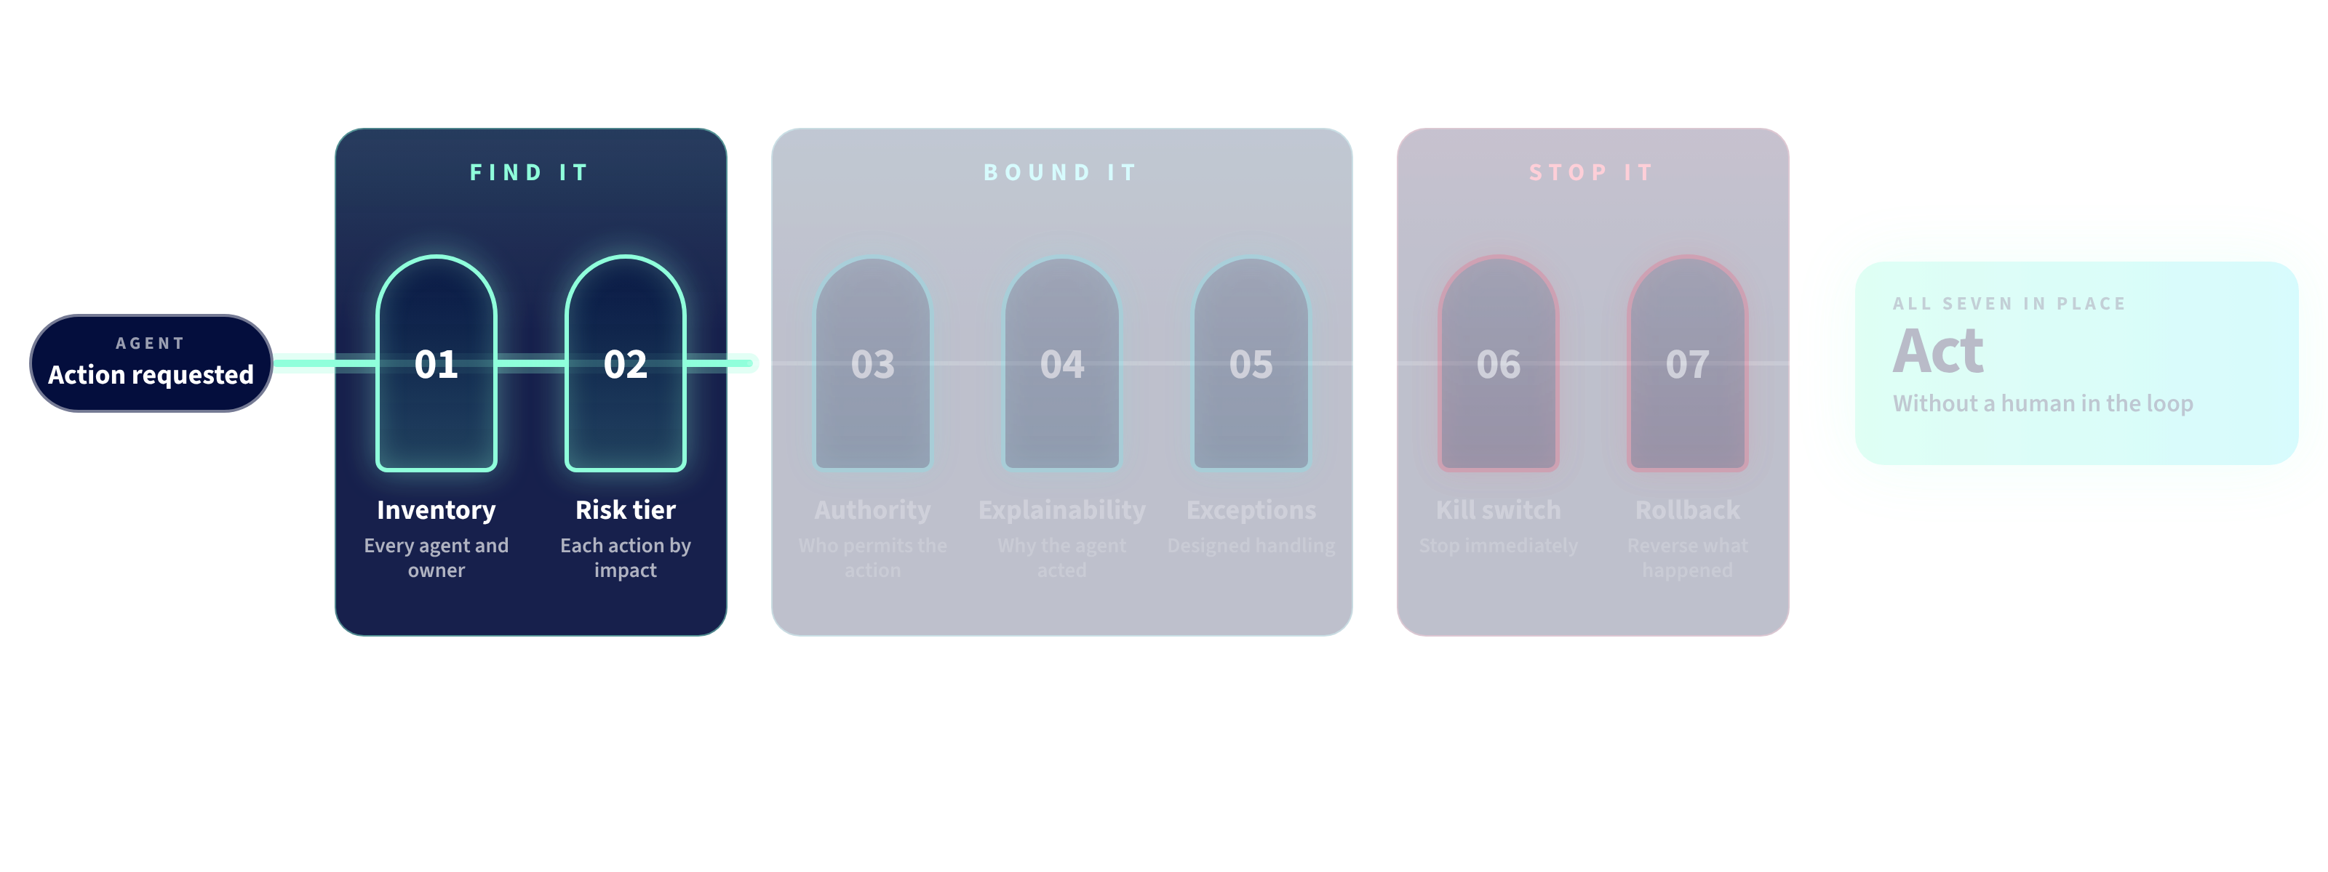
Permission to Automate.
Seven controls determine what an agent may do without a human in the loop.
© 2026 Crossfuze. All Rights Reserved.
Notes:
SLIDE 21 — PERMISSION TO AUTOMATE
Seven named controls must be checked before an agent executes actions without a human in the loop: (1) Inventory, (2) Risk tier, (3) Authority, (4) Explainability, (5) Exception handling, (6) Kill switch, (7) Rollback.
Find it: know what agents exist and classify risk. Bound it: specify explicit limits, log why actions happen and define escalation to a person. Stop it: test the stop and know who can reverse the action.
If a required control is missing, AI may recommend, but should not take the autonomous action. This is a boundary decision, not a broad prediction of success.
Source: Crossfuze Readiness Assessment, Permission to Automate, p.10.

Slide 46
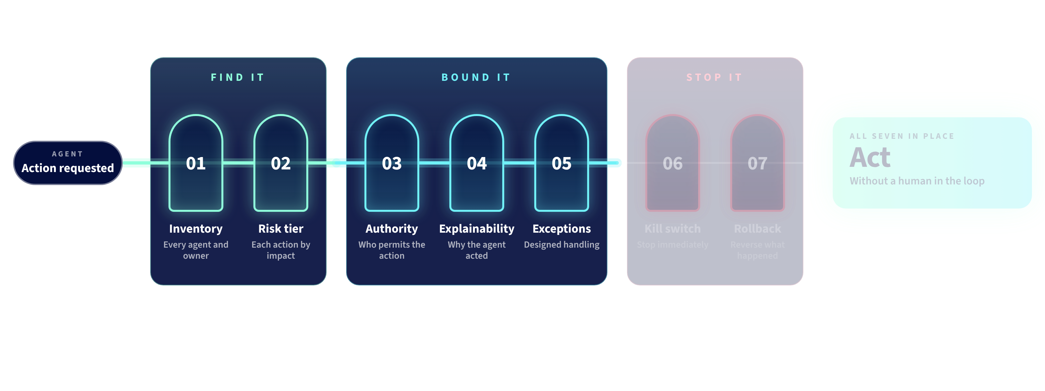
Permission to Automate.
Seven controls determine what an agent may do without a human in the loop.
© 2026 Crossfuze. All Rights Reserved.
Notes:
SLIDE 21 — PERMISSION TO AUTOMATE
Seven named controls must be checked before an agent executes actions without a human in the loop: (1) Inventory, (2) Risk tier, (3) Authority, (4) Explainability, (5) Exception handling, (6) Kill switch, (7) Rollback.
Find it: know what agents exist and classify risk. Bound it: specify explicit limits, log why actions happen and define escalation to a person. Stop it: test the stop and know who can reverse the action.
If a required control is missing, AI may recommend, but should not take the autonomous action. This is a boundary decision, not a broad prediction of success.
Source: Crossfuze Readiness Assessment, Permission to Automate, p.10.

Slide 47
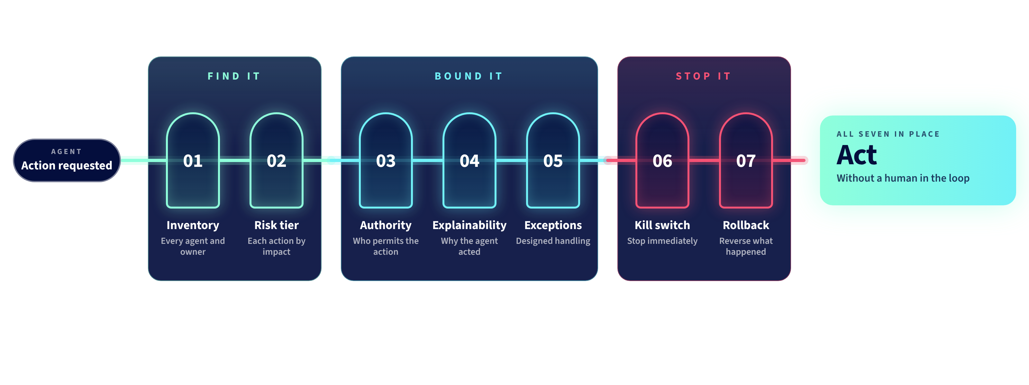
Permission to Automate.
Seven controls determine what an agent may do without a human in the loop.
© 2026 Crossfuze. All Rights Reserved.
Notes:
SLIDE 21 — PERMISSION TO AUTOMATE
Seven named controls must be checked before an agent executes actions without a human in the loop: (1) Inventory, (2) Risk tier, (3) Authority, (4) Explainability, (5) Exception handling, (6) Kill switch, (7) Rollback.
Find it: know what agents exist and classify risk. Bound it: specify explicit limits, log why actions happen and define escalation to a person. Stop it: test the stop and know who can reverse the action.
If a required control is missing, AI may recommend, but should not take the autonomous action. This is a boundary decision, not a broad prediction of success.
Source: Crossfuze Readiness Assessment, Permission to Automate, p.10.

Slide 48
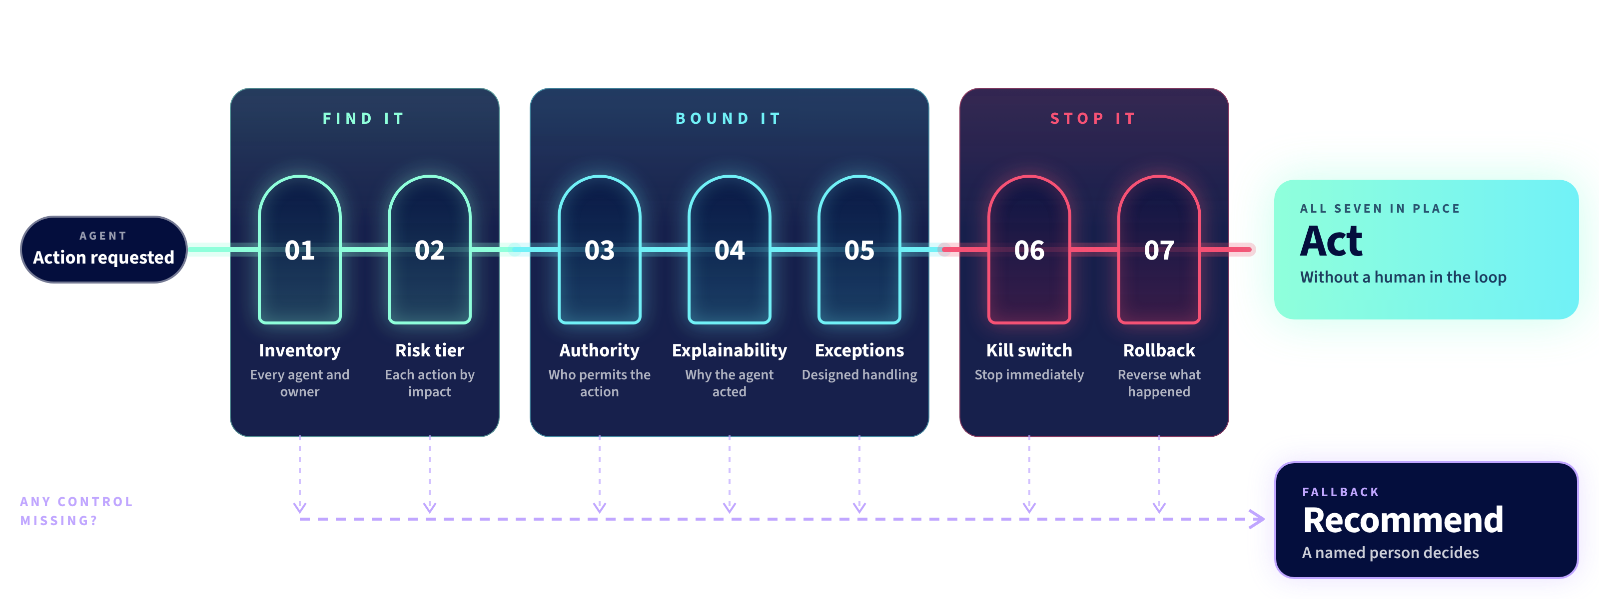
Permission to Automate.
Seven controls determine what an agent may do without a human in the loop.
© 2026 Crossfuze. All Rights Reserved.
Notes:
SLIDE 21 — PERMISSION TO AUTOMATE
Seven named controls must be checked before an agent executes actions without a human in the loop: (1) Inventory, (2) Risk tier, (3) Authority, (4) Explainability, (5) Exception handling, (6) Kill switch, (7) Rollback.
Find it: know what agents exist and classify risk. Bound it: specify explicit limits, log why actions happen and define escalation to a person. Stop it: test the stop and know who can reverse the action.
If a required control is missing, AI may recommend, but should not take the autonomous action. This is a boundary decision, not a broad prediction of success.
Source: Crossfuze Readiness Assessment, Permission to Automate, p.10.

Slide 49
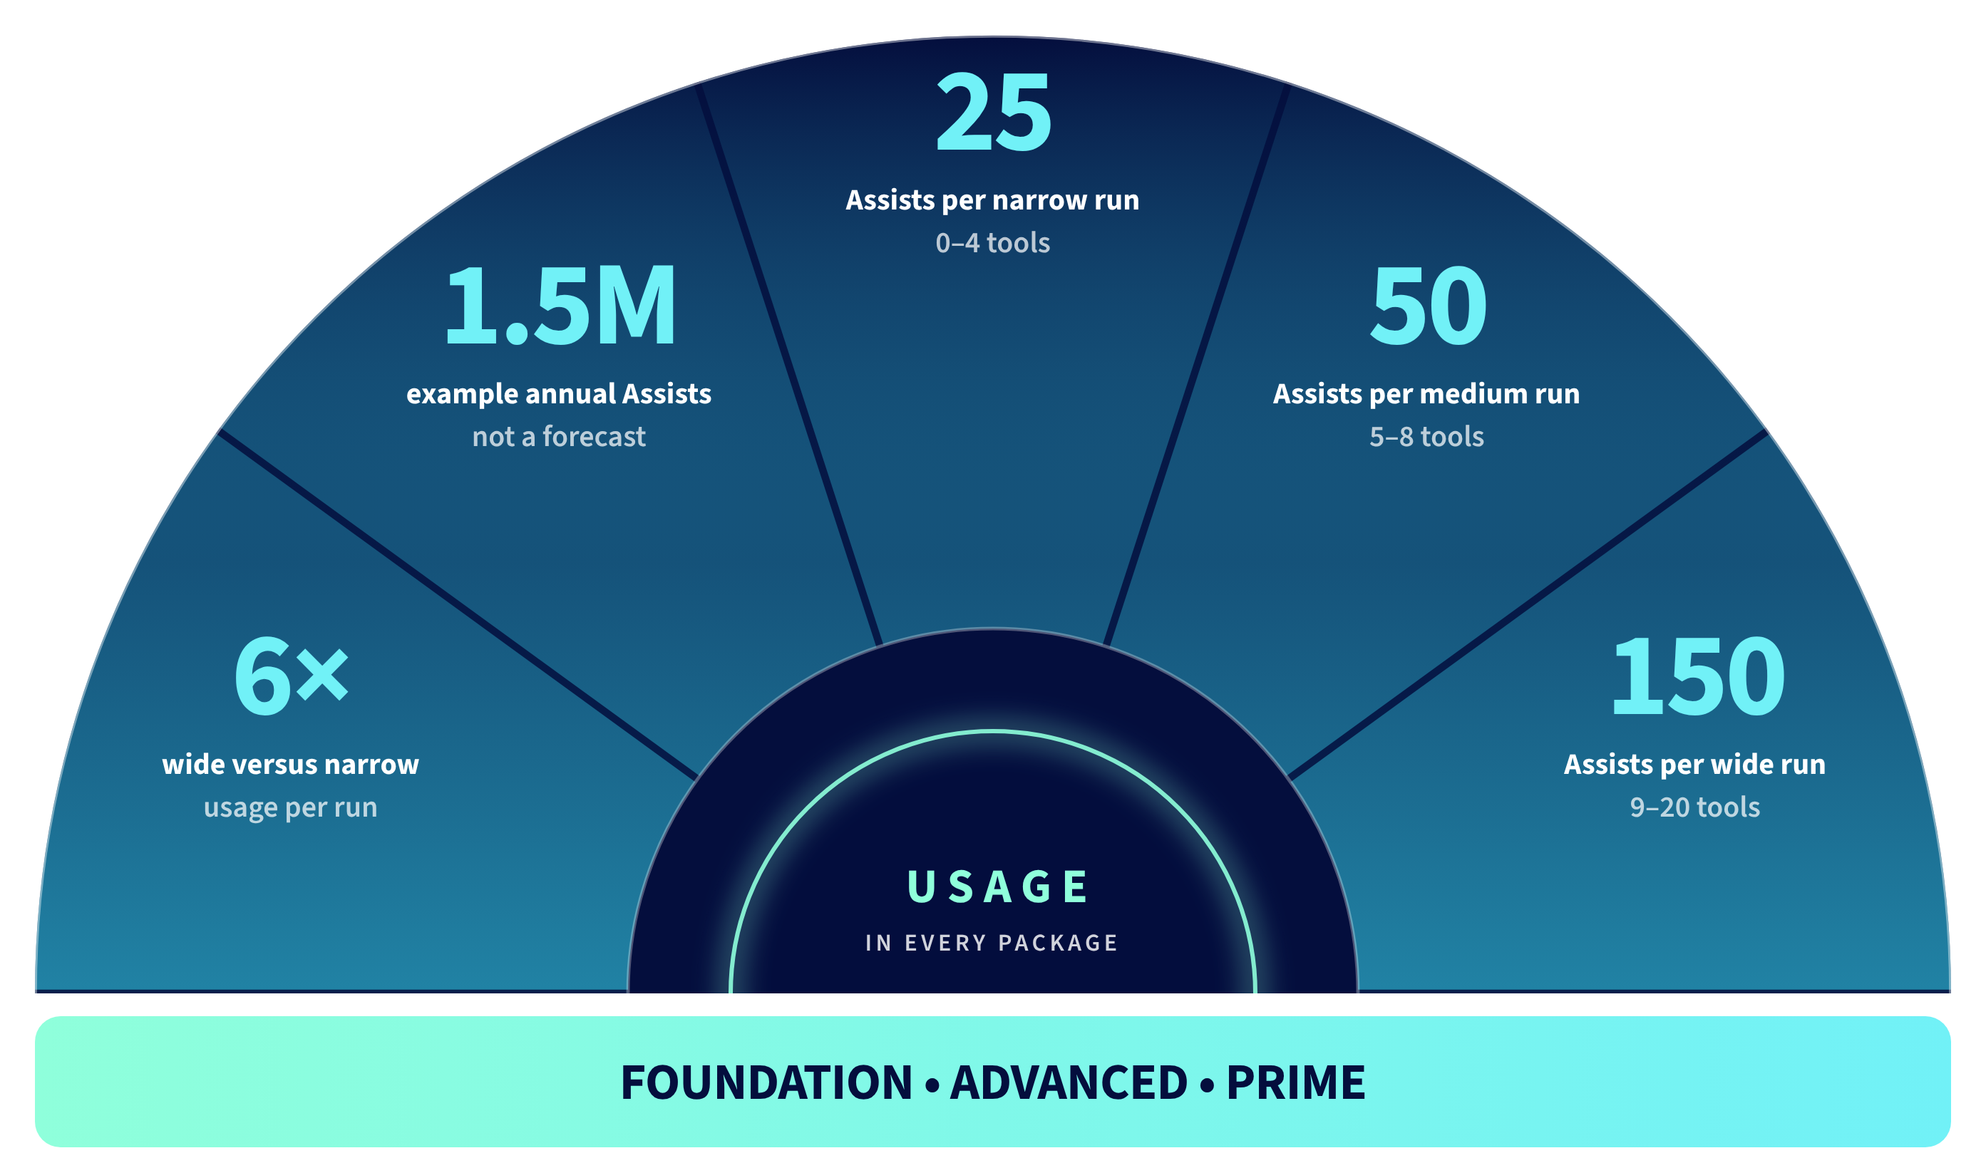
AI in every package. Usage that scales.
Notes:
SLIDE 25 — AI IN EVERY PACKAGE. USAGE THAT SCALES
The Crossfuze source guide describes Foundation (Assisted), Advanced (Agentic), and Prime (Autonomous) packages, while emphasizing that allocation and entitlement vary by product and package. Do not suggest that every function is included at every tier or that every customer has the same allocation.
Assist consumption is based on agentic run complexity: 25 Assists for a narrow run of 0–4 tools; 50 for a medium run with 5–8 tools; 150 for a wide run with 9–20 tools. A wide run consumes six times a narrow run. These are the planning run sizes in the source guide, not a universal bill.
ILLUSTRATIVE ONLY: 30,000 narrow × 25 + 5,000 wide × 150 = 1.5M Assists annually. This must be replaced by customer-specific run volumes, tool counts, configuration and allocation. Assist consumption and Data Fabric credits are separate meters.
Why readiness matters: clean data, owned knowledge and deterministic workflows help reduce waste and rework. Crossfuze models the value and consumption of the chosen Zero before renewal.
Source: Crossfuze Readiness Guide, October 2026, pp.13–14; ServiceNow commercial model referenced by guide.
TRANSITION: Estimation is important, but estimates alone do not put governed AI into production.

Slide 50
AI RunState. Plan it. Prioritise it. Ship it.
One 12-month engagement. Advisory sets direction, backlog adapts priorities, Extend delivers.
01
PLAN
02
PRIORITISE
03
SHIP
AI Action Plan
Backlog Cycles
Extend Services
2 advisory reviews
Up to 4 cycles
80 hours / month
Month 1 and month 7
~6 weeks each
9 months
Baseline and dependencies
Prioritised use cases
90-day roadmap
Approved user stories
Acceptance criteria
Three-month capacity plan
Build, configure and test
Deliver approved backlog
Accepted production outcomes
The customer Product Owner retains control of priorities, approvals and sprint acceptance.
© 2026 Crossfuze. All Rights Reserved.
Notes:
SLIDE 29 — AI RUNSTATE. PLAN IT. PRIORITISE IT. SHIP IT.
Crossfuze AI RunState is one 12-month engagement for ServiceNow AI across Autonomous IT and Business Re-Invention. The exact customer scope is confirmed by the SOW.
PLAN — AI ACTION PLAN: advisory at the start (Month 1, approximately eight weeks) and a second advisory review in Month 7. Facilitated workshop-led baseline, gaps and dependencies, prioritised use cases, current/future-state experience, draft user stories and an AI Action Plan with a first 90-day roadmap.
PRIORITISE — BACKLOG CYCLES: up to four planning cycles (approximately six weeks each) from Month 3 and quarterly afterward. They resolve requirements, acceptance criteria, dependencies, effort, sequencing and capacity; the customer Product Owner approves the backlog.
SHIP — EXTEND SERVICES: 80 hours per month for nine months. A named Technical Lead and Crossfuze capacity build, configure, test and remediate against approved user stories. The customer retains approval and acceptance. Scope/hours are SOW-dependent.
Do not equate 80 hours/month with the full 12 months; Extend is scheduled for 9 months in the source guide.
Source: Crossfuze AI Readiness Guide pp.18–19.

